Slide 1

Fan Speed PID Controller using Analog Components
Names: I.Ds:
Marwan sultan 21-101138
Tamer Ahmed 21-101103
Mohamed Ehab 21-101110
Ahmed Daib 21-101102
Porf.Nader Madkor

Slide 2
Introduction
PID controllers are fundamental in control systems.
Project aim: implement analog PID for fan control.
Three-stage methodology: digital, simulation, hardware.
Target: control fan speed using only analog components.

Slide 3
System Overview
Closed-loop PID control system for 12V DC fan.
Main blocks: Setpoint input, Tachometer Feedback, F-V Converter.
Instrumentation Amplifier, PID Controller, Output Stage.
Power: Dual ±24V supplies for op-amps.

Slide 4
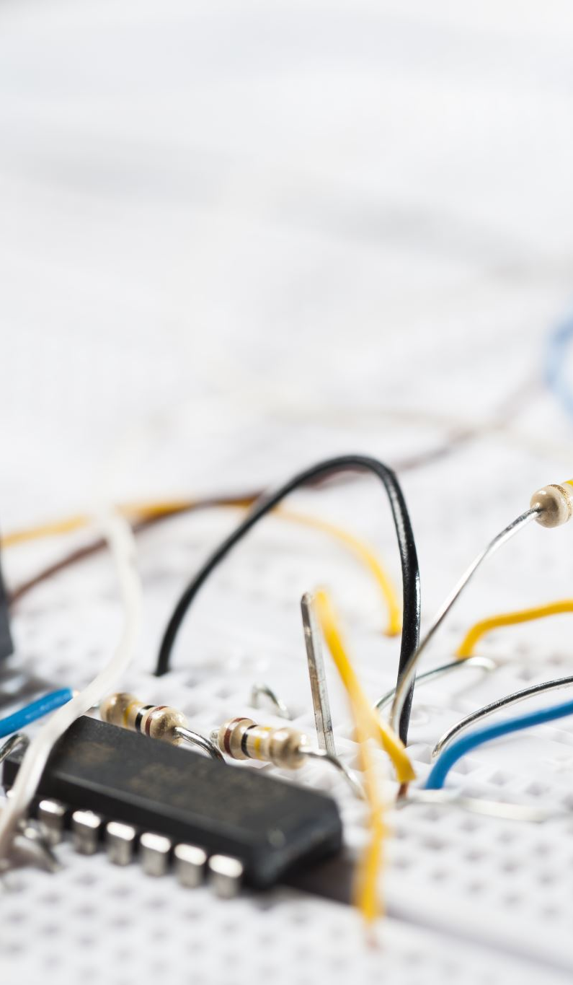
Phase I: Digital Prototyping
Used microcontroller to prototype control logic.
Tuned PID parameters via Ziegler–Nichols method.
PWM to analog via RC filter, amplified to 12V.
Built baseline understanding of system behavior.

Slide 5
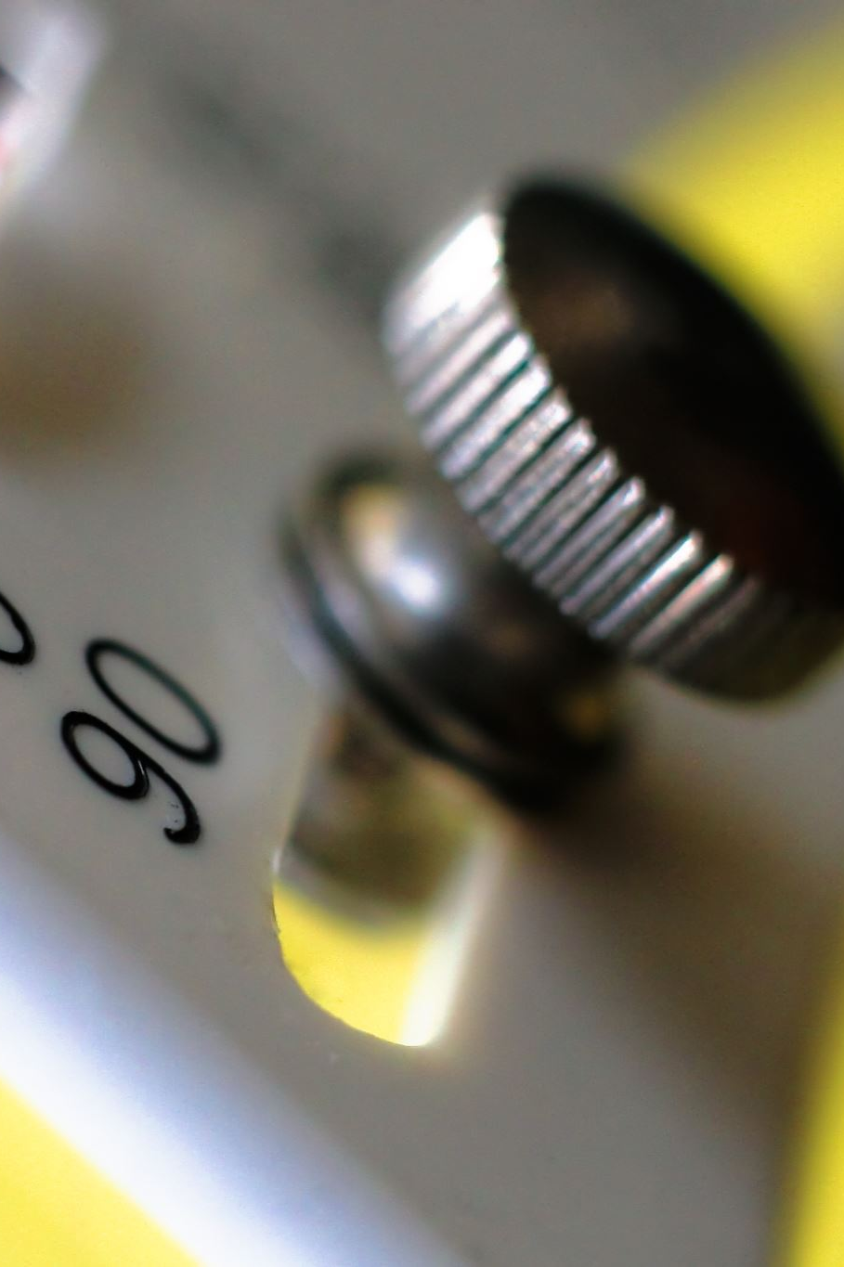
Phase II: Analog Simulation
Simulated analog PID in Multisim 14.3.
Built op-amp based integrator, differentiator, gain blocks.
F–V conversion using LM2907N IC.
Simulated real-world behavior of tachometer feedback.

Slide 6

Phase III: Hardware Implementation
Built full circuit using breadboard and op-amps.
Used potentiometers for tuning PID gains.
Overcame power supply challenges (dual ±24V).
Kick-start mechanism added for 0-RPM deadlock.

Slide 7
Experiments & Results
Digital phase: effective PWM control with PID tuning.
Simulation: convergence achieved, validated design.
Hardware: stable control, disturbance rejection.
Minor issues (e.g., zero feedback at rest) resolved.

Slide 8

Challenges & Fixes
Signal instability solved using pull-up resistors and diodes.
Power delivery improved via Darlington transistors.
Feedback loss at 0 RPM resolved with manual pulse.
Fine-tuning needed due to real-world non-idealities.

Slide 9
Future Work
Adaptive PID with real-time tuning.
Single-supply design using rail-to-rail op-amps.
Smaller F–V transducers or PLL-based feedback.
Hybrid analog-digital systems for monitoring.

Slide 10
Conclusion
Successfully implemented analog PID for fan speed control.
Phased approach ensured systematic learning.
Project bridged theoretical knowledge with hardware design.
Useful for educational and low-cost control applications.

Slide 11
Acknowledgments
Prof. Nader Mansour – project guidance and flexibility.
Dr. Mohammed Anwar – lab equipment support.
Team collaboration and iterative development were key.

Slide 12

Thank you.
Any questions.

