Slide 1
Smart Fire Fighting System
Suppression that doesn't wait on the network.
Graduation Project Defense · Modern Academy for Engineering & Technology · Supervisor: Dr. Maha Gaber

Slide 2
AGENDA
This defense, in four moves.
01
Architecture
Two tiers, one bus
02
AI & Vision
Confirm, see, alert
03
Reliability & Results
Proven, measured
04
Live Demonstration
Ground truth

Slide 3
SITUATION
Minutes
Heat release ∝ t²
A structure fire becomes unsurvivable in minutes — hazard accumulates as t², not linearly.

Slide 4
COMPLICATION
Conventional detectors are single-signal and blind; “smart” ones depend on the very network a fire takes down.
LEGACY POINT DETECTION
CLOUD-SMART SYSTEMS
— Single modality (smoke OR heat)
— AI lives in the cloud
— Building-wide, no zone resolution
— Round-trip latency in the loop
— No visual confirmation
— Fails when the network fails

Slide 5
QUESTION
So: how do you get AI-grade intelligence and a guaranteed local response?

Slide 6
ANSWER · THE GOVERNING THESIS
A fail-operational,
AI-confirmed,
room-level fire system
that suppresses in one control cycle —
without waiting on the network.

Slide 7
SYSTEM AT A GLANCE
Two tiers, one bus: deterministic edge control + probabilistic AI, decoupled by MQTT.
ESP32 CONTROL TIER Level-driven loop 9 servos · 4 pumps
telemetry
command
AI PERCEPTION TIER YOLOv11 · CUDA FP16 fusion + occupancy
Mosquitto MQTT 1883
image payload + sensor metrics
Node-RED Control Room
Telegram · sffs_bot

Slide 8
CAPABILITY MAP
Four rooms, nine servos, four pumps — with occupancy-aware suppression that protects people first.
4
9
4
Instant Visual Alerting
DELIVERED
real-time fire-zone image capture + metrics
Rooms
Servos
Pumps
Occupancy-Aware Suppression
DELIVERED
line-crossing head-count protects people first
[ 4-Room Layout — figure pending ]
Face-Identity Rescue Tier
ROADMAP
per-person identification for priority rescue

Slide 9
THE PYRAMID
Everything that follows defends three claims.
01
02
03
Zonal Autonomy
AI-Confirmed Perception
Engineered Reliability
Per-room detection + isolation, independent of the broker.
Vision + multi-sensor fusion cuts false alarms and misses.
Fail-operational, power-budgeted, edge-cached actuation.

Slide 10
THE NUMBERS WE'LL PROVE
Hero metrics — measured on the deployment rig.
23 / 7
4 / 9 / 4
~4.1 A
FPS GPU(RTX 3050) / CPU
Rooms / Servos / Pumps
peak on 5V·5A (20% margin)
1 cycle
Visual ground-truth
ADC 2000
edge isolation latency
image + metrics ≤ 1 alert cycle
gas threshold (mid of 0–4095)

Slide 11
01
PILLAR 1
Zonal Autonomy
Each room detects and suppresses for itself — independent of the network.

Slide 12
SYSTEM AT A GLANCE
The architecture in one view: two decoupled tiers, one broker.
EDGE CONTROL TIER
AI PERCEPTION TIER
ESP32-WROOM-32DA Level-driven loop 9 servos · 4 pumps Local fire predicate
YOLOv11 · CUDA FP16 Sensor/vision fusion Occupancy tracking Telegram alerting
telemetry (2s)
Mosquitto MQTT 1883 v3.1.1
command (retain)
image payload + metrics
Node-RED Control Room
Telegram · sffs_bot

Slide 13
EDGE TIER
The edge tier is a real-time deterministic controller.
wifi_manager
mqtt_handler
auto-reconnect
LWT · backoff · JSON
ESP32 CONTROL CORE non-blocking loop
sensors
actuators
ADC1 · EMA · DHT · SR04
PCA9685 · relays
failsafe
connectivity FSM

Slide 14
PHYSICAL LAYER · ISOMETRIC
Nine servos, four pumps, four rooms — an isometric cutaway of the plant.
Gas valve (trunk)
Door servos ×4
Corridor barriers ×2
R1
R2
Window servos ×2 (R3/R4)
Room pumps ×4
R3
R4
Isometric extrusion via Shape.ThreeD (editable native shapes).

Slide 15
CONTROL STACK · ISOMETRIC
Exploded view: how the control stack physically layers.
Actuators — 9 servos / 4 pumps
4-channel relay bank (opto-isolated)
PCA9685 PWM driver @0x40
ESP32-WROOM-32DA controller
5V / 5A power rail (20% margin)
Each plate is an independent, recolourable native shape (Shape.ThreeD extrusion).

Slide 16
ACTUATION BUS
One PCA9685 bus orchestrates all nine actuators.
ch0
Gas valve
400 kHz
PCA9685 I²C 0x40 · 50 Hz
ESP32
ch1-4
Room doors
ch5-6
Corridors
PWM math tick = 20 ms / 4096 ≈ 4.88 µs 0°→180° = count 102 → 491
ch7-8
Windows R3/R4

Slide 17
CONTROL LAW
Control is level-driven: outputs are a pure function of the present state.
Read sensors
evaluateZones()
ZoneCommand
memcmp gate
apply / skip
Hardware is written only when the recomputed command differs from the last applied command.

Slide 18
ZONAL EVALUATION
Each room decides for itself: the zonal evaluation matrix.
Fireᵣ = Buttonᵣ ∨ ( gasᵣ > 2000 ∧ warm )
Room
Button
Gas > 2000
⇒ Fire
Room 1
0
512
—
Room 2
0
480
—
Room 3
0
2150
FIRE
Room 4
1
470
FIRE

Slide 19
GLOBAL OVERRIDES
Two global overrides escalate the whole structure instantly.
IR flame (active-LOW)
Room 1
Room 2
OR
MQTT state = "FIRE"
Room 3
Room 4

Slide 20
EDGE-CACHING · COMPOUND
Edge-caching: we write hardware only when the world actually changes.
ZoneCommand[t-1] [0,1,0,0,...]
ZoneCommand[t] [0,1,1,0,...]
single I²C write → one servo moves
memcmp
↑ bit changed
Identical commands → no write (anti-chatter). Only the changed channel is actuated.

Slide 21
THE CORE THESIS · COMPOUND
Suppression completes before the network even hears about it.
MQ-6
ESP32
PCA/Relay
Broker
AI
Telegram
gas > 2000
ZoneCommand
valve/door/pump
1 control cycle
telemetry (≤2s)
sensor_data
alert + image
Local suppression (red) closes within one cycle; the network path (grey) only observes it afterwards.

Slide 22
WATER SAFETY
Hysteresis keeps the pumps from ever running dry.
Pumpᵣ = Fireᵣ ∧ pumpsAllowed Below 10% → pumps inhibited (dry-run guard) At ≥ 20% → pumps re-enabled The deadband prevents relay chatter near the threshold.
20% — resume pumps
10% — cut pumps

Slide 23
FAIL-OPERATIONAL
When the network drops, the system doesn't: the failsafe FSM.
NORMAL
DEGRADED
RECOVERY
The FSM classifies link health for telemetry only. The local fire predicate — gas, flame, button — keeps detecting and suppressing regardless of broker state. Connectivity loss degrades remote confirmation, never the suppression core.

Slide 24
M2M CONTRACT
The contract: function-partitioned MQTT topics, structured JSON.
Topic
Dir
QoS
Retain
sffs/sensors/data
ESP32→all
0
no
sffs/system/status
AI→ESP32
1
yes
[ JSON payload — drop code PNG here ]
sffs/system/heartbeat
ESP32→AI
0
LWT
sffs/ai/detection
AI→NR
0
no
sffs/ai/people_count
AI→NR
0
no

Slide 25
PILLAR 1 — CLOSED
Zonal autonomy, proven — now, can it see?
Level-driven
outputs are a pure function of state
Edge-cached
hardware writes only on real change
Fail-operational
suppression independent of the network
Next: the AI tier that confirms, sees, and alerts.

Slide 26
02
PILLAR 2
AI-Confirmed Perception
The system doesn't just sense — it sees, confirms, and tells you.

Slide 27
PERCEPTION LOOP
Capture → detect + track → fuse → alert.
Camera
YOLOv11
Occupancy
Decision Engine
MQTT / Telegram

Slide 28
DETECTOR
YOLOv11 runs dual-mode: CUDA FP16 on GPU, ONNX on CPU.
frame
letterbox 640
FP16 tensor
forward
NMS @ IoU 0.20
boxes
Acceptance gates: conf ≥ 0.50 (fire) · conf ≥ 0.75 (smoke) detect() never mutates the frame — draw() is a single final pass (clean frame for both models) GPU: every frame · CPU: fire inference every 3rd frame (tracking stays every frame)

Slide 29
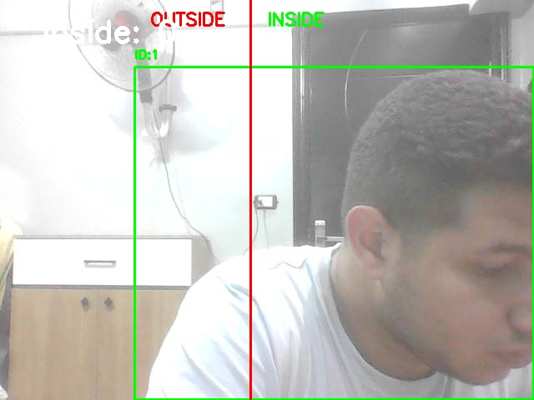
SNAPSHOT PIPELINE
The moment of detection becomes ground truth.
YOLOv11 confirms flame/smoke
capture affected-room frame
save detected_fires/alert_<ts>.jpg
dispatch to Telegram (non-blocking)
The saved frame is the exact image transmitted — on-screen detection and mobile alert are identical.
detected_fires\alert_20260619-001311-916843.jpg

Slide 30
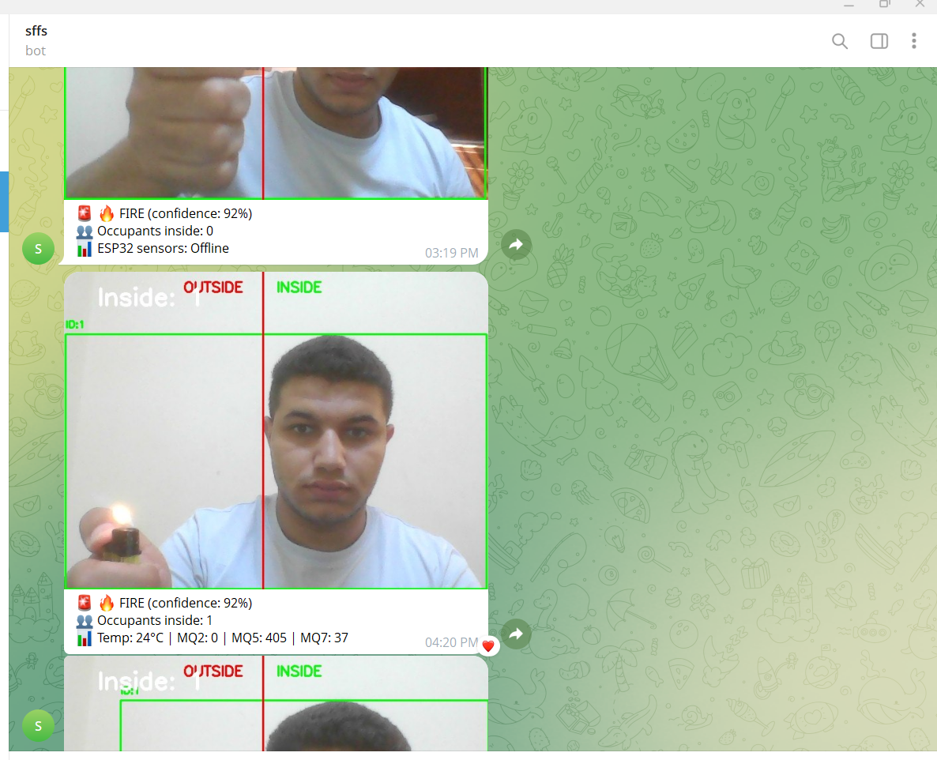
INSTANT VISUAL ALERTING
Image + metrics on the responder's phone.
State · confidence · source
Occupancy count (rescue priority)
Key sensor metrics (gas / temp)
Annotated detection image
AlertGate — 45 s cooldown per severity · escalation BYPASSES the cooldown (worsening event never silenced) · return to SAFE resets the high-water mark
photos\telegram masseg.png

Slide 31
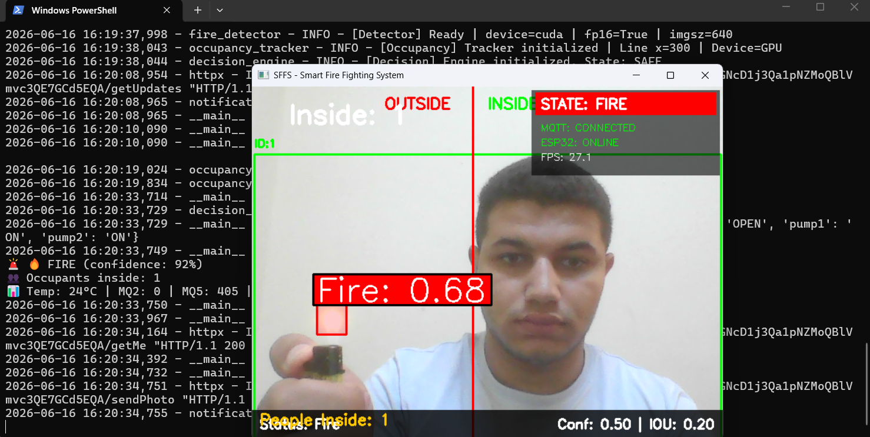
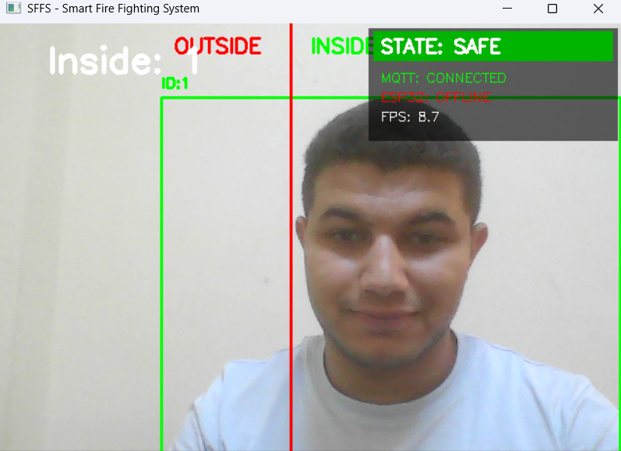
EDGE BENCHMARK
Real-time on the edge: 23 FPS GPU, 7 FPS CPU.
23 FPS
7 FPS
GPU · RTX 3050 (FP16)
CPU (ONNX, every 3rd)
GPU — fire case
CPU — safe case

Slide 32
DUAL-MODE VISION
Count everyone, identify no-one — yet.
Line-Crossing Headcount
Face-Identity Layer
DELIVERED
ROADMAP
Persistent-ID person tracking; a vertical boundary at x = 300 yields a live, directional occupancy count that feeds rescue-priority alerts.
A designed extension: per-person identification to drive named priority-rescue alerts. Deferred on privacy and compute grounds.

Slide 33
OCCUPANCY · DELIVERED
Occupancy by line-crossing: persistent tracks across x = 300.
x = 300
OUTSIDE
INSIDE
inside_count
+1
model.track(persist=True, classes=[0]) center_x > 300 = inside side change ⇒ ±1 (floored at 0)

Slide 34
ROADMAP
A face-identity tier for priority rescue.
ROADMAP — designed, not yet implemented
face embeddings
match known occupants
named priority-rescue alert
Deferred deliberately: identity adds privacy obligations and compute load. The delivered occupancy count already enables rescue prioritisation without identifying anyone.

Slide 35
FUSION
Sensors and vision agree before the structure escalates.
Source
State
Conf.
Manual override
FIRE
1.00
Gas / Flame / Camera (single)
FIRE
0.92
Multiple sources agree
FIRE
0.98
Temperature only
SENSOR_ALERT
0.65
None
SAFE
—
Asymmetric debounce: escalate immediately (safety first); de-escalate only after a 5 s cooldown.

Slide 36
OCCUPANCY-AWARE
Alert prioritisation today, suppression modulation next.
Occupancy-Aware Alerting
Occupancy-Modulated Suppression
DELIVERED
ROADMAP
The live head-count is embedded in the Telegram alert, raising rescue priority when people remain inside an active hazard zone.
A planned extension in which actuation adapts to protect occupants (e.g. holding an egress path). Not yet wired into the ESP32 control law.

Slide 37
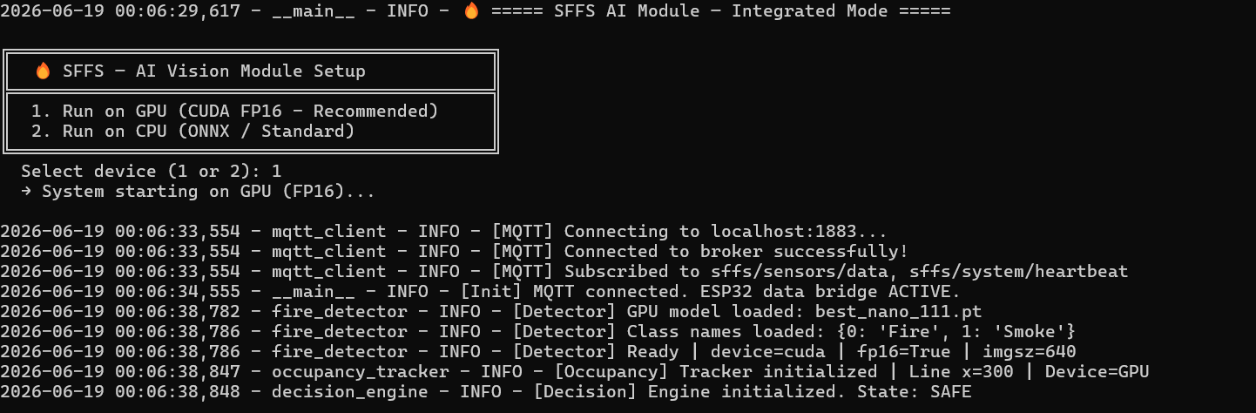
LIVE DEMONSTRATION
From detection to suppression — in front of you.
LIVE
Fallback demo video — insert .mp4
1 · induce gas in a room → local suppression fires
photos\running_cv_model.png
2 · present flame → global override
3 · show YOLO confirmation + snapshot → Telegram
4 · dashboard mirrors every state live

Slide 38
03
PILLAR 3
Validation & Experimental Results
Claims are only as good as the bench that proves them.

Slide 39
LATENCY BREAKDOWN
Where the milliseconds go: suppression is the fast path.
one control cycle
Local edge → actuation
~15 ms
GPU YOLOv11 inference
~43 ms (23 FPS)
Telegram remote alert
~1–3 s (network)
Network lane compressed for scale. Local suppression completes far ahead of — and is never gated by — the remote alert.

Slide 40
FALSE-ALARM MITIGATION
Tighter gates: fewer false alarms, no missed fire.
fire confidence
Gas: EMA α = 0.15 + 60 s warm-up + ADC ≥ 2000 gate
0.50
0.68
Fusion: OR-gate needs a real sensor/vision signal
smoke confidence
Temperature alone → soft SENSOR_ALERT (never FIRE)
0.75
0.82
Stability: 5 s de-escalation debounce + 45 s alert cooldown

Slide 41
ZONAL ACTUATION · OPTION A
Validated on the maquette: the right zone, every time.
Zone
Sensor
Trigger
Actuation
Room 1
MQ-7 (CO)
> 2000 / button
valve+door+pump 1
Room 2
MQ-6 (LPG)
> 2000 / button
door+pump 2
Room 3
MQ-5 (CH4)
> 2000 / button
door+window+pump 3
cross-zone isolation ✓
Room 4
MQ-2 (smoke)
> 2000 / button
door+window+pump 4
R1
R2
R3
R4
Water hysteresis (cut < 10% / resume ≥ 20%) confirmed under live pump load.

Slide 42
CONTRIBUTIONS
A modular, real-time, multi-agent fire platform.
Architectural modularity
Real-time multi-agent sync
Decoupled edge / perception tiers over MQTT — each independently restartable.
Deterministic ESP32 + probabilistic AI fused without blocking the control loop.
Fail-operational autonomy
Dissemination
Room-level detection and suppression independent of network and vision.
Paper-submission framework targeting IJADT.

Slide 43
CONSTRAINTS
Honest constraints: where the current design stops.
Edge-compute thermal throttling
sustained GPU inference bounds the RTX 3050 clock under load
Static camera FOV
single fixed view; out-of-frame ignition relies on the independent sensor path
Remote-alert network dependency
Telegram delivery needs IP connectivity — suppression does not
Scope bounds
occupancy is a count, not an identity; thresholds are ADC-domain, not ppm-calibrated

Slide 44
FUTURE VISION
From roadmap to active development.
ROADMAP
ACTIVE DEVELOPMENT
Face-Identity tier
named priority-rescue alerts (privacy + compute design)
ROADMAP
ACTIVE DEVELOPMENT
Occupancy-modulated suppression
actuation that protects egress and occupants
Platform extensions: MQTT-SN clustering · LoRaWAN fallback · TensorRT INT8 quantization

Slide 45
CONCLUSION
A fail-operational,
AI-confirmed,
room-level fire system that suppresses
in one control cycle — without waiting on the network.
Zonal Autonomy
AI-Confirmed Perception
Engineered Reliability

Slide 46
Thank you.
Questions & committee discussion.
Two-tier system
Zonal plant
Edge control loop
AI pipeline
Snapshot → Telegram
Results

Slide 47
APPENDIX A · BACKUP
Hardware & electrical reference.
Item
Value
MCU
ESP32-WROOM-32DA (LX6 dual-core, 240 MHz)
Gas (ADC1)
R1 GPIO35 MQ-7 / R2 34 MQ-6 / R3 33 MQ-5 / R4 32 MQ-2
Gas threshold
ADC 2000 (mid of 0–4095) · EMA α 0.15 · 60 s warm-up
Actuation
PCA9685 @0x40, 50 Hz · 9 servos · 4 relay pumps (active-LOW)
Flame / DHT22
GPIO27 active-LOW / GPIO26 one-wire
Water (HC-SR04)
TRIG 15 / ECHO 36 · cut < 10% resume ≥ 20%
Power budget
~4.1 A peak on 5 V / 5 A (20% margin)

Slide 48
APPENDIX B · BACKUP
Software & AI reference.
Item
Value
Vision
YOLOv11-nano best_nano_111.pt · CUDA FP16 · imgsz 640 · IoU 0.20
Confidence
fire 0.68 · smoke 0.82
Throughput
23 FPS GPU (RTX 3050) / 7 FPS CPU (ONNX, every 3rd frame)
Occupancy
yolo11n person track · line x = 300 · directional count
Fusion
manual 1.00 / gas|flame|cam 0.92 / multi 0.98 / temp 0.65
Alerting
Telegram sffs_bot · 45 s cooldown · escalation bypass
Resilience
edge predicate broker-independent · failsafe FSM · MQTT LWT

