Slide 1

PIERS BARBER
Dockerized Deployment
Dnd
Notes:
1

Slide 2

Contents
The Brief
Idea
Technologies
Design
Testing
Difficulties
Successes
Wrap up
1
Notes:
1

Slide 3

Brief
To create a service-orientated application that is composed of at least 4 services that work together.
Scope
Documentation
Deploy with docker
Rolling updates
Test coverage
Automated CI pipeline
1
Notes:
1

Slide 4
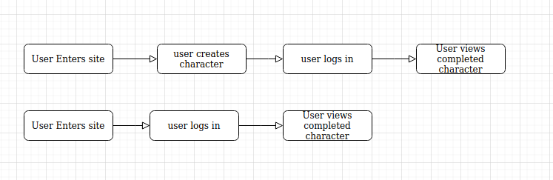
DnD Character gen
Yet another childhood obsession turned web-app
Idea
A service oriented web app for generating DnD Characters
Log in
Create new character
View existing Characters
1
Notes:
1

Slide 5

Technologies
Jenkins – CI Server
Docker – Write once, Run anywhere
Flask
Git – Source control
GCP – Cloud Provider
Python
MySQL – Database
Ansible – Automated Deployment
1
Notes:
<number>

Slide 6
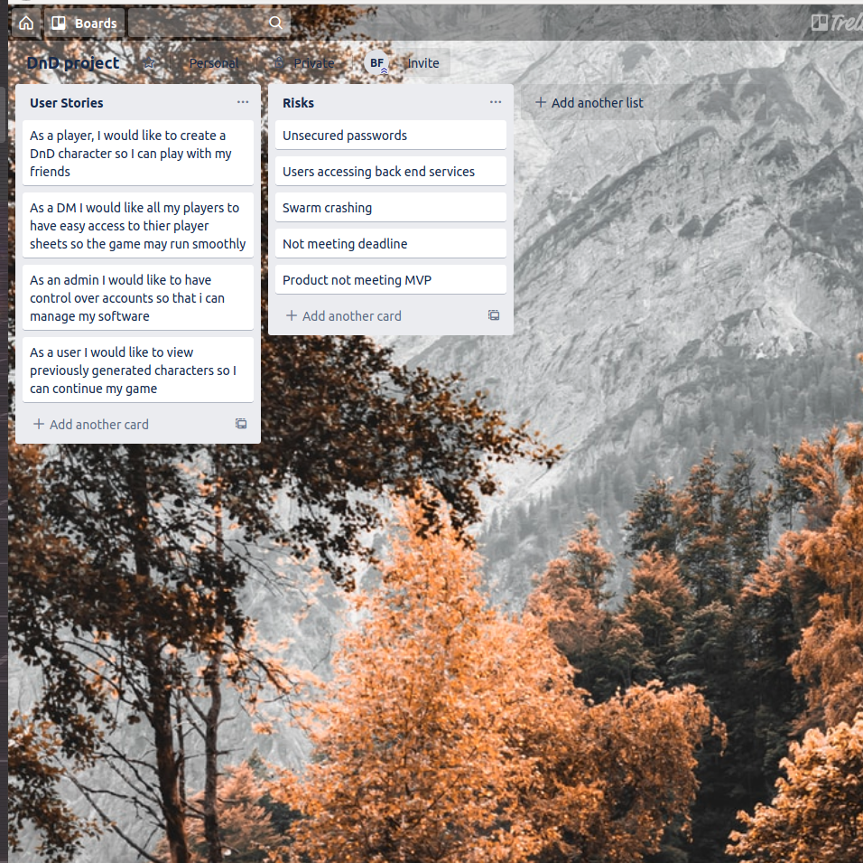
KANBAN
1
Notes:
<number>

Slide 7
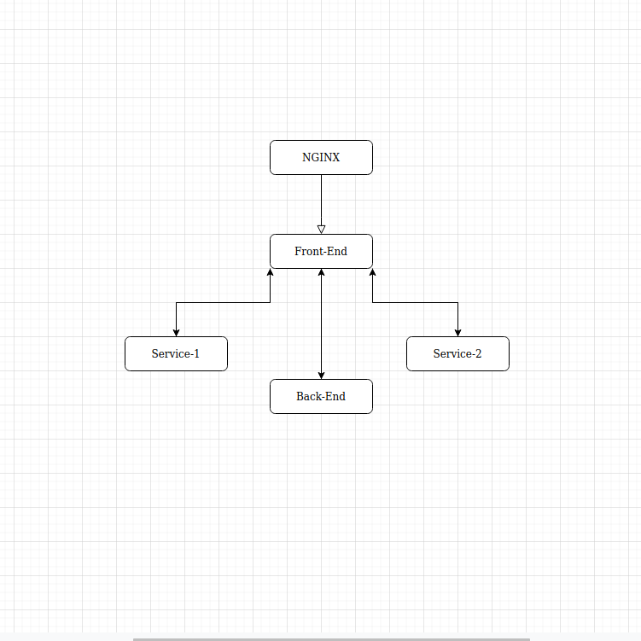
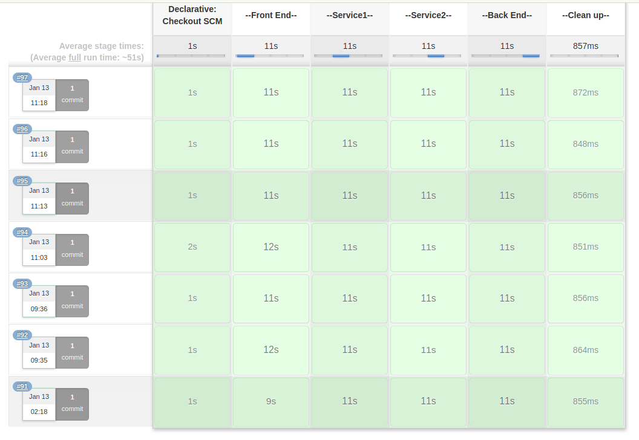
Architecture
Web server
1
Notes:
<number>

Slide 8
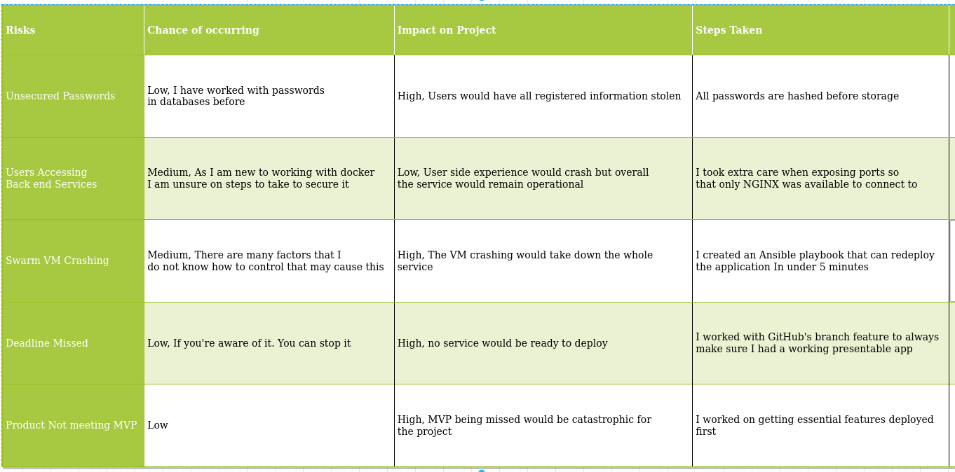
Risk Assesment
1
Notes:
<number>

Slide 9
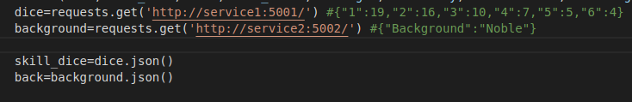
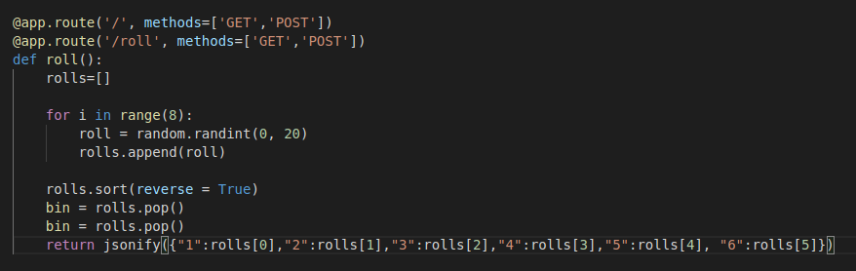
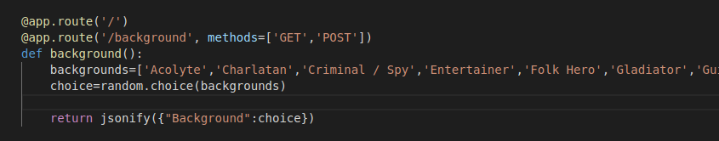
Service Communication
Front-End request
Service1 response
Service2 response
1
Notes:
<number>

Slide 10
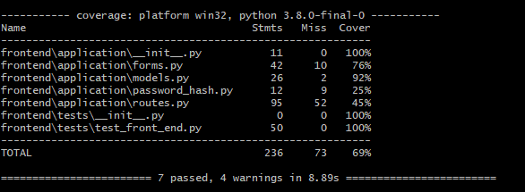
Testing
Improvements
Integration testing
Better architecture design
Pytest
1
Notes:
<number>

Slide 11
Difficulties
Design
Deployment with ansible
Rolling update functionality
Code
JSON
1
Notes:
<number>

Slide 12
Successes
Design
Services meet the MvP
Ansible Playbook
Code
JSON requests are handled quite well
1
Notes:
<number>

Slide 13
Wrap up
Deliverable
Fully functional deployed web app
Automated jenkins pipeline
Testing suite
Fully functional install
Rolling update capacity
Future Improvements
Improve aesthetic
User class’
Integration testing
Admin ability to delete users
Inventory system
1
Notes:
<number>

Slide 14
Live App
http://34.89.5.19/
GitHub: https://github.com/PCMBarber/PiersProject
1
Notes:
<number>

Slide 15

WOODGROVE BANK
THANK YOU for listening

