Slide 1

DriverPass System Analysis
Marc Aradillas
Notes:
[No speaker notes required for this slide.]

Slide 2

System Requirements
Functional Requirements:
User Enrollment
Lesson Scheduling
Non-Functional Requirements:
Performance
Security
Notes:
Speaker Notes: Functional and Non-Functional Requirements
Functional Requirements:
User Enrollment: This requirement ensures that potential students can easily find and enroll in courses that suit their needs. It allows them to browse available options, understand course details, and seamlessly complete the enrollment process with secure payment options. This functionality is crucial for DriverPass to attract users and generate revenue through course subscriptions.
Lesson Scheduling: This requirement addresses the need for students to connect with instructors for personalized learning experiences. It enables them to schedule lessons at their convenience based on instructor availability and preferences. This feature fosters interaction and guidance, enhancing the learning process beyond self-paced online materials.
Non-Functional Requirements:
Performance: A responsive system with fast loading times and smooth interaction is essential for user satisfaction and engagement. By aiming for a sub-3 second response time, DriverPass ensures a user-friendly experience that encourages continued platform usage and exploration.
Security: Protecting user data, including personal information and payment details, is paramount. Implementing robust security measures like encryption, authentication, and regular updates safeguards user privacy and builds trust in the platform. This is critical for DriverPass to maintain a positive reputation and attract users who value data security.

Slide 3
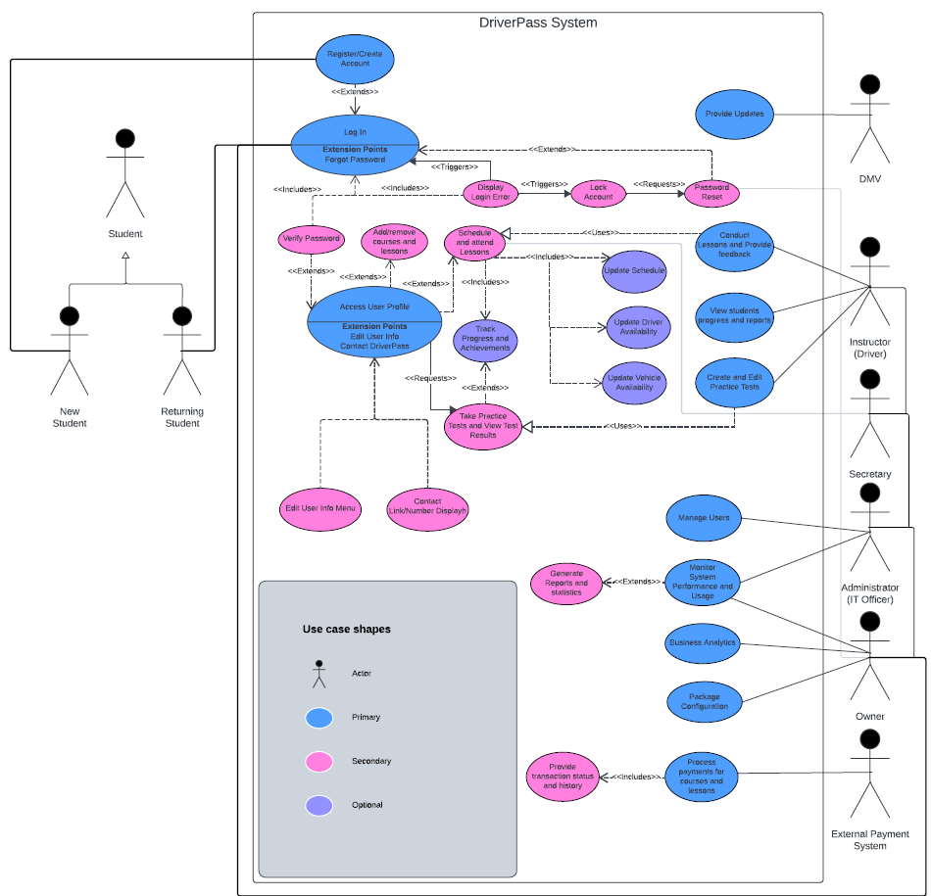
Use Case Diagram
Notes:
Speaker Notes: Understanding DriverPass Functionalities
Welcome everyone! Today, I'm excited to walk you through the functionalities of DriverPass, a platform designed to empower individuals on their journey to becoming licensed drivers.
Who can benefit from DriverPass?
Students: Whether you're a complete beginner or looking to brush up on your skills, DriverPass offers a range of courses and resources tailored to your needs.
Instructors: Share your expertise and connect with students seeking guidance through our platform's convenient scheduling and communication tools.
Secretaries: Streamline administrative tasks like lesson scheduling and payment processing with our user-friendly interface.
Administrators: Maintain control and ensure the smooth operation of the platform with comprehensive user management and system monitoring features.
What can you do on DriverPass?
Students: Explore a variety of courses covering different driving topics, enroll seamlessly, and test your knowledge with our practice tests.
Instructors: Design engaging course content, connect with students for personalized lessons, and track their progress to provide effective feedback.
Secretaries: Manage lesson bookings efficiently, handle payments securely, and generate reports to stay organized.
Administrators: Create and manage user accounts, monitor system performance for optimal functionality, and ensure data security for all users.
By addressing the diverse needs of each user group, DriverPass fosters a collaborative learning environment that empowers students, instructors, and staff to achieve their goals.

Slide 4
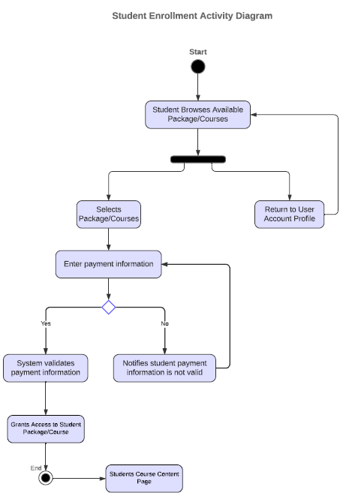
Activity Diagram
Notes:
Speaker Notes: Enrolling in a Course on DriverPass
Enrolling in a course on DriverPass is a quick and easy process! Here's a simple guide to get you started:
1. Explore Courses:
Browse through our diverse selection of courses designed to fit your learning preferences. You can search by category, difficulty level, or instructor to find the perfect course for you.
2. Find Your Perfect Fit:
Once you've identified a course that interests you, click on it to learn more. You'll see a detailed description, syllabus, and information about the instructor.
3. Enroll with Ease:
If you're ready to begin your learning journey, simply click the enrollment button and proceed to enter your payment information securely through our trusted payment gateway.
4. We've Got You Covered:
DriverPass prioritizes your security. Our system securely processes your payment information, ensuring a safe and reliable transaction.
5. Welcome Aboard!
Upon successful payment, you'll be automatically enrolled in the course and receive confirmation with login details and instructions to access the course materials.
DriverPass strives to make the enrollment process as smooth and efficient as possible, allowing you to focus on what matters most – learning to become a confident and safe driver.

Slide 5
Security
Addressing Security Concerns in the DriverPass System Design:
User Authentication and Authorization
Data Encryption
Secure Communication
Input Validation and Sanitization
Regular Security Audits and Updates
User Education and Awareness
Notes:
Speaker Notes: Security Here are some key security considerations incorporated into the DriverPass system design to protect user data and ensure platform integrity:
User Authentication and Authorization:
Implement strong password hashing and storage mechanisms to safeguard user credentials.
Enforce secure login practices like two-factor authentication for added security.
Assign roles and permissions to users (students, instructors, etc.) to restrict access to sensitive data and functionalities based on their roles.
Data Encryption:
Encrypt sensitive user data (e.g., personal information, payment details) at rest and in transit using industry-standard encryption algorithms.
Securely store encryption keys using appropriate key management practices.
Secure Communication:
Enforce HTTPS communication protocols to encrypt data transmission between users and the system, preventing eavesdropping and data manipulation.
Input Validation and Sanitization:
Implement robust input validation procedures to prevent malicious code injection attacks (e.g., SQL injection, XSS) through user inputs.
Sanitize all user inputs to remove potentially harmful characters or code before processing them.
Regular Security Audits and Updates:
Conduct regular security assessments and penetration testing to identify and address potential vulnerabilities in the system.
Maintain the system by applying security patches and updates promptly to address known vulnerabilities in software components and libraries.
User Education and Awareness:
Provide security awareness training to users on best practices for creating strong passwords, identifying phishing attempts, and protecting their personal information.
By implementing these security measures, the DriverPass system design aims to mitigate potential risks and ensure the confidentiality, integrity, and availability of user data and system resources. Remember, this is not an exhaustive list, and the specific security considerations may evolve based on the system's complexity and evolving threats.

Slide 6
System Limitations
Limitations of the DriverPass System:
Focus on Online Learning
Limited Scope of Practice
Dependence on Technology
Standardized Learning Approach
Instructor Availability
Potential for Misuse
Notes:
Speaker Notes: System Limitations
While DriverPass strives to provide a comprehensive learning experience, it's important to acknowledge some limitations to consider:
Focus on Online Learning: DriverPass primarily caters to online learning resources and functionalities. It may not encompass features for in-person classroom instruction, practical driving exercises, or instructor-led demonstrations that require physical presence. This is important to remember as users might seek a more comprehensive driving education experience that combines online learning with hands-on practice.
Limited Scope of Practice: The practice tests and learning materials may not cover every aspect of driver's education or preparation for the actual driving test, depending on the specific curriculum and regulations of the targeted region. It's important to be aware that DriverPass serves as a supplement to, not a replacement for, formal driver's education courses and professional instruction required to obtain a driver's license.
Dependence on Technology: Users require reliable internet access and compatible devices to utilize the system's features effectively. This might limit accessibility for individuals with limited technological resources or those residing in areas with poor internet connectivity. DriverPass should strive to find ways to bridge the digital divide and ensure inclusivity for all potential users.
Standardized Learning Approach: The system might not cater to individual learning styles or adapt to specific user needs in terms of pace, difficulty level, or preferred learning methods. While DriverPass offers a variety of courses and materials, it's important to acknowledge that individual learners may require additional support or personalized instruction to fully grasp the concepts and skills necessary for safe driving.
Instructor Availability: The scheduling system relies on the availability of instructors, and users might encounter limitations in booking lessons depending on instructor schedules and demand. DriverPass should continue to explore ways to optimize scheduling and instructor availability to meet the needs of students.
Closing Statement
DriverPass is a valuable platform that offers a flexible and accessible way to learn about driving. By acknowledging its limitations and continuously seeking improvement, DriverPass can ensure it remains a relevant and effective resource for individuals seeking to acquire the knowledge and skills necessary to become safe and responsible drivers.

