Slide 1
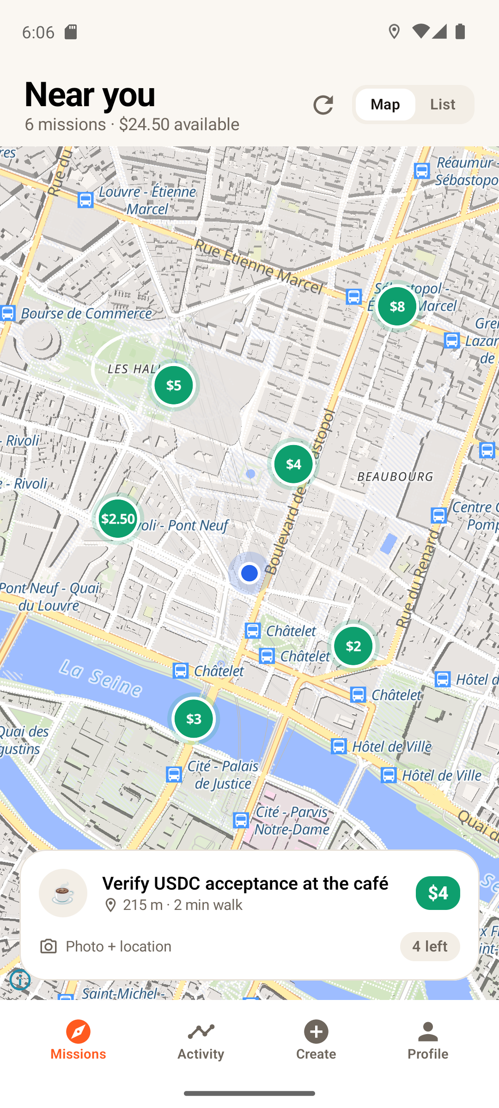
Legwork
Get paid for the legwork.
Paid, verified, real-world missions for Seeker owners. Funded in USDC, settled on Solana, proven with the phone in your pocket.
CLOCK IN · Solana Mobile hackathon · October 2026
Marc Donovici · github.com/Marc-Dvci/Legwork

Slide 2
Real-world facts go stale when nobody is looking
Does that café still accept USDC? Is the charger working? Is our poster still up? Someone has to go and look.
🏪
Merchants and directories
🔌
Infrastructure operators
Payment methods, opening hours and stock change weekly. A wrong listing costs a customer every time.
Chargers, kiosks and signage fail in the field long before a ticket is raised.
🎪
Events and communities
◎
The Solana ecosystem
Posters, booths and pop-ups exist for days. Verification by staff costs more than the campaign.
"Where can I actually pay with USDC?" is still answered by hearsay.
Today the options are an employee's afternoon, a contractor, a phone call nobody answers, or a gig platform with a 30% take and no proof.
Legwork · CLOCK IN, the Solana Mobile hackathon · Marc Donovici

Slide 3
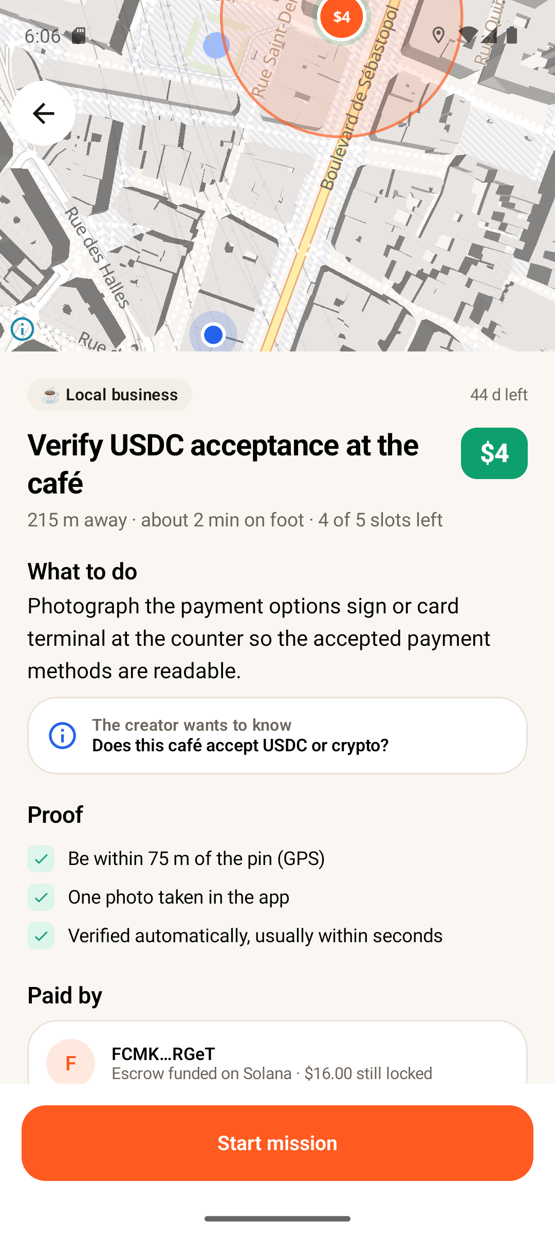
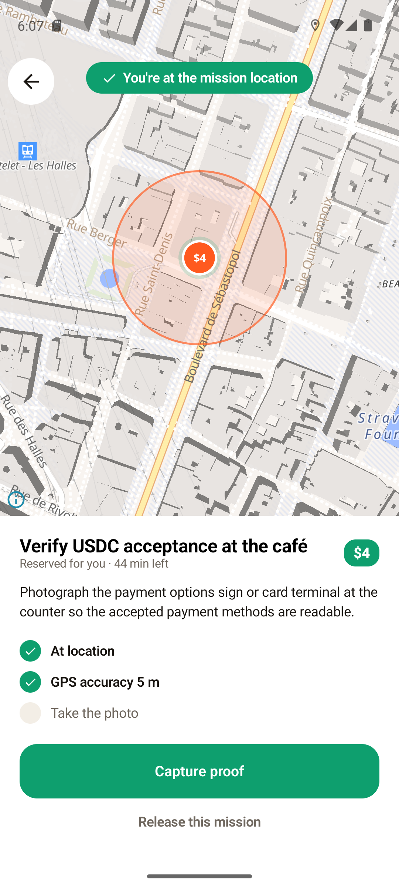
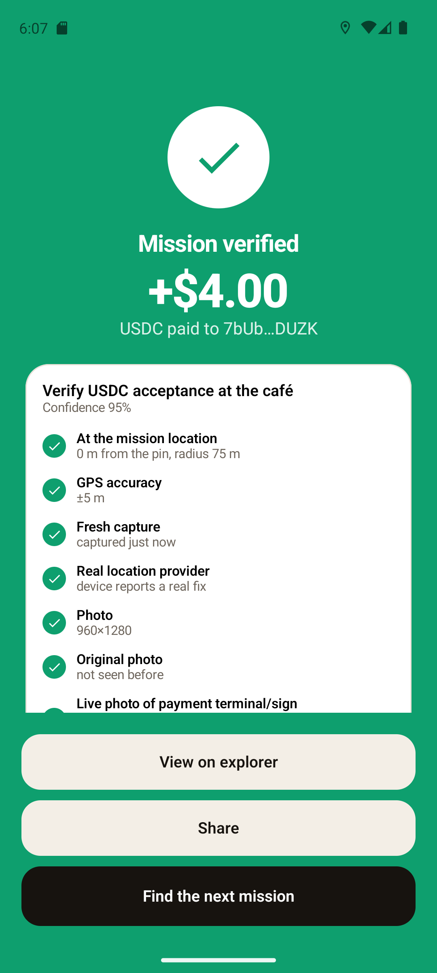
Seeker owners become a paid verification network
A creator funds a mission in USDC. A nearby worker walks there, proves it with GPS and the camera, and is paid from escrow in seconds.
Missions near you, priced
What to do, what proves it
GPS confirms arrival
Verified and paid
Legwork · CLOCK IN, the Solana Mobile hackathon · Marc Donovici

Slide 4
One loop, six steps, every one of them on the phone
1
Discover
2
Reserve
3
Walk
Reward pins on a live map. Alerts when a mission lands within your radius.
A slot is held for 45 minutes on chain. Gasless for the worker.
Live distance, navigate intent, and a green state the moment you are inside the radius.
4
Prove
5
Verify
6
Get paid
In-app camera only. The photo carries GPS, accuracy, timestamp and device signals.
Location policy, freshness, duplicate detection, then a vision judge with named checks.
approve_completion moves USDC from the vault to your wallet and writes the proof hash.
Score, streak and earnings update from chain, and the map already shows the next one.
Legwork · CLOCK IN, the Solana Mobile hackathon · Marc Donovici

Slide 5
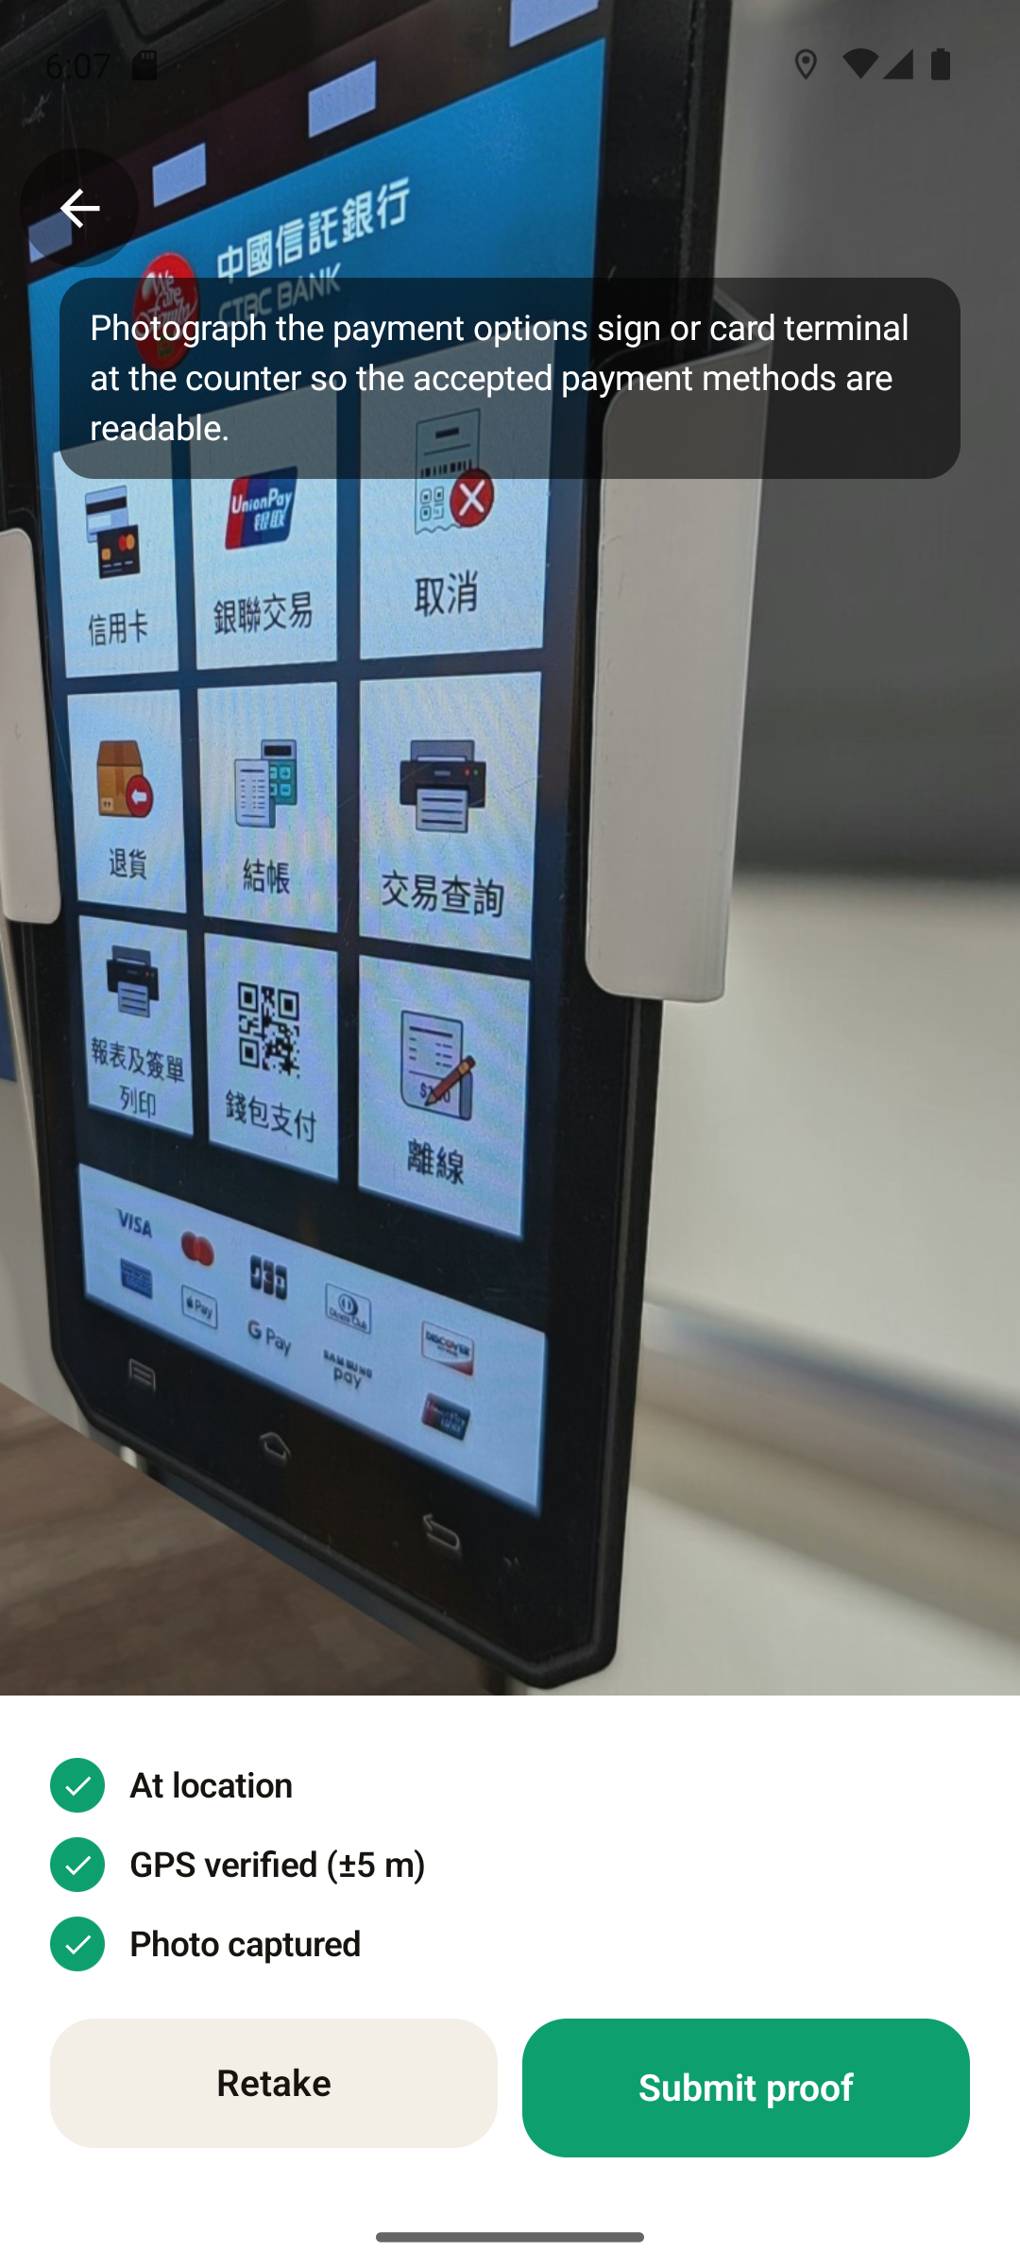
Remove the phone and the product stops working
Legwork is not a web app in a wrapper. The phone is part of the protocol.
📍
GPS is the first proof
Presence inside the mission radius, accuracy-aware, mock providers rejected.
📸
The camera is the second
Live capture only. No gallery uploads. Perceptual hashes catch re-used photos.
📱
The Seeker is the third
The Seeker Genesis Token binds one device to one worker for Seeker-only missions.
🔔
Notifications bring people back
"$8 mission 400 m away", computed on the device every 15 minutes from the last position.
🚶
Movement is the mechanic
Distance counts down live; arrival flips the screen green and unlocks the shutter.
Checklist on the capture screen
Legwork · CLOCK IN, the Solana Mobile hackathon · Marc Donovici

Slide 6
The chain is the database
Missions, escrow, reservations, completions, reputation, streaks and stake are accounts of one Anchor program. The verifier holds no state.
Mission + vault
Escrow you can inspect
A PDA per mission with its own USDC token account. The creator funds reward × slots in one signature.
"$12.00 still locked" on the mission page is the vault balance.
Reservation
Instant global settlement
Held for a worker by the verifier's signature. The worker never pays a fee.
A worker in Paris is paid by a creator anywhere, in seconds, with a transaction link.
Completion
Permissionless reads
Proof hash, confidence and the yes/no answer, written in the same transaction as the payout.
Leaderboards and creator analytics are getProgramAccounts calls.
WorkerProfile
Verifier is a key, not a database
Approved, rejected, streak, score, categories, SKR stake, Seeker binding. Readable by any client.
It can only pay a reserved worker from that mission's vault, once.
Legwork · CLOCK IN, the Solana Mobile hackathon · Marc Donovici

Slide 7
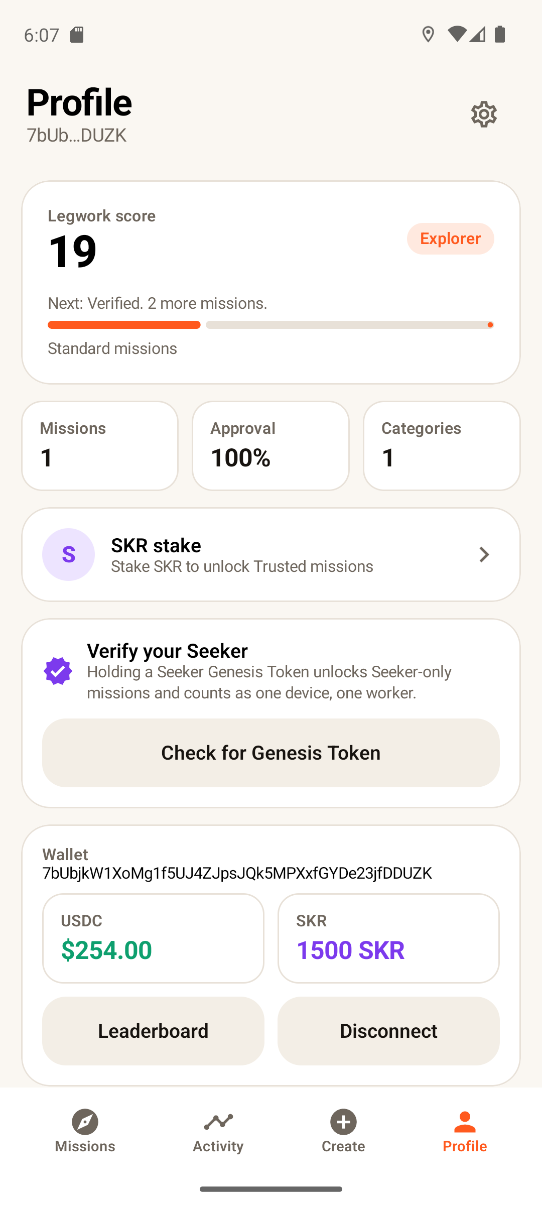
Seeker hardware gets real marketplace utility
Seeker verified badge
One device, one worker
The app inspects the wallet's Token-2022 accounts for a Seeker Genesis Token (mint authority, metadata pointer, token group), then the verifier binds it on chain.
A Device PDA maps each Genesis Token mint to a single wallet. Sponsored campaigns can pay once per Seeker, not once per keypair.
Seeker-only missions
Verified tier from day one
Creators tick "Seeker only"; the program refuses approvals from unbound wallets. Ecosystem campaigns land in Seeker owners' pockets first.
A bound Seeker skips the Explorer tier: priority verification and a badge on the leaderboard.
Legwork · CLOCK IN, the Solana Mobile hackathon · Marc Donovici
Profile: tier, stake, Seeker check

Slide 8
SKR is the commitment behind trust
Remove SKR and the marketplace loses its trust tiers and its fee schedule. Staking is enforced by the program, not by a spreadsheet.
Explorer
Standard missions
0 missions
Creators stake 500 SKR
Platform fee drops from 10% to 5% on every mission they fund. Computed on chain at funding time.
Verified
Badge, priority verification
3 missions or a Seeker
Trusted
Higher-value missions, two reservations
10 missions + 100 SKR
Workers stake to climb
Stake is locked in a config-owned vault and can be withdrawn at any time. Creators can require a minimum score.
Expert
Premium campaigns, dispute reviewer
40 missions + 1000 SKR
Mainnet SKR mint SKRbvo6Gf7GondiT3BbTfuRDPqLWei4j2Qy2NPGZhW3 · a test mint stands in on devnet
Legwork · CLOCK IN, the Solana Mobile hackathon · Marc Donovici

Slide 9
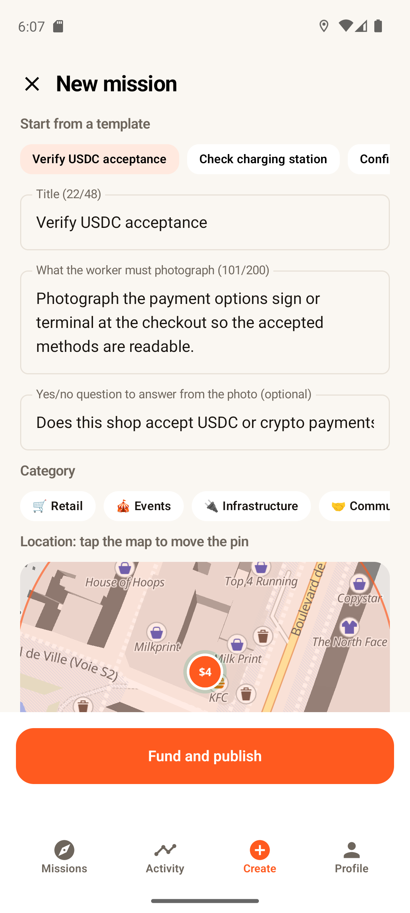
Creators deploy people in one signature
Templates
USDC acceptance, charger check, poster check, shelf availability, opening hours.
Pin on the map, set the radius
Reward, number of completions, deadline, Seeker-only, minimum score.
Fund and publish
One wallet signature creates the mission, its vault, the escrow and the fee.
Answers, not just photos
A yes/no question is answered on chain per completion; the dashboard tallies Yes / No / Unclear.
Close and recover
Whatever is not claimed comes back to the creator's wallet.
Legwork · CLOCK IN, the Solana Mobile hackathon · Marc Donovici
New mission with funding summary

Slide 10
Every proof passes named checks the worker can see
✓
At the mission location
distance ≤ radius + min(accuracy, 50 m) + 25 m
Privacy by construction
✓
GPS accuracy
≤ 100 m, mock-location flag rejected
Photos are judged in memory and discarded. Only the hash goes on chain. Precise location is read only while a mission screen is open.
✓
Fresh capture
timestamp within 10 min of server time
✓
Original photo
SHA-256 not on chain, dhash Hamming > 6 from recent
Live photo, not a screen
vision judge flags re-photographed screens and prints
Keys stay in the wallet
✓
Sign-in, funding and staking go through Mobile Wallet Adapter. The verifier key can only pay a reserved worker from that mission's vault.
✓
Photo matches the mission
relevant, fulfils the instructions, confidence ≥ 60
✓
2 to 4 mission-specific checks
e.g. "accepted payment methods are readable"
Legwork · CLOCK IN, the Solana Mobile hackathon · Marc Donovici

Slide 11
A marketplace fee, paid at funding time, on chain
10%
5%
$0
platform fee on funded rewards
for creators staking 500 SKR
for workers: reservations and payouts are gasless
Worker reward $5 · creator pays $5.50 · Legwork treasury receives $0.50, in the same transaction that funds the escrow.
🏪
Commerce intelligence
🔌
Infrastructure
🎪
Events
◎
Solana ecosystem
Payment methods, shelf checks, price and opening-hour verification for directories and brands.
Chargers, kiosks, signage and accessibility checks for operators and cities.
Poster presence, booth check-ins, conference scavenger missions.
"Pay with USDC here" merchant maps, Seeker-only campaigns, community verification drives.
Legwork · CLOCK IN, the Solana Mobile hackathon · Marc Donovici

Slide 12
Built and running on devnet
9
7
14
7
program instructions
on-chain account types
app screens
named proof checks
· Android: Kotlin, Jetpack Compose, Mobile Wallet Adapter 2.0 (Sign-in-with-Solana, signTransactions), MapLibre, CameraX, WorkManager
· Program: Anchor 1.0, program id 86V9Vw6jPnoy4R6feJK6atwMK3x1oUootvvbqb8iZHD6, committed IDL
· Verifier: FastAPI, stateless, Gemini vision judge with structured verdicts, dhash duplicate detection, SIWS sessions
· Repository someone else can clone and run: pinned Docker build for the program, local validator script, devnet seeding, unit tests
github.com/Marc-Dvci/Legwork
Legwork. Get paid for the legwork.
Legwork · CLOCK IN, the Solana Mobile hackathon · Marc Donovici

