Slide 1
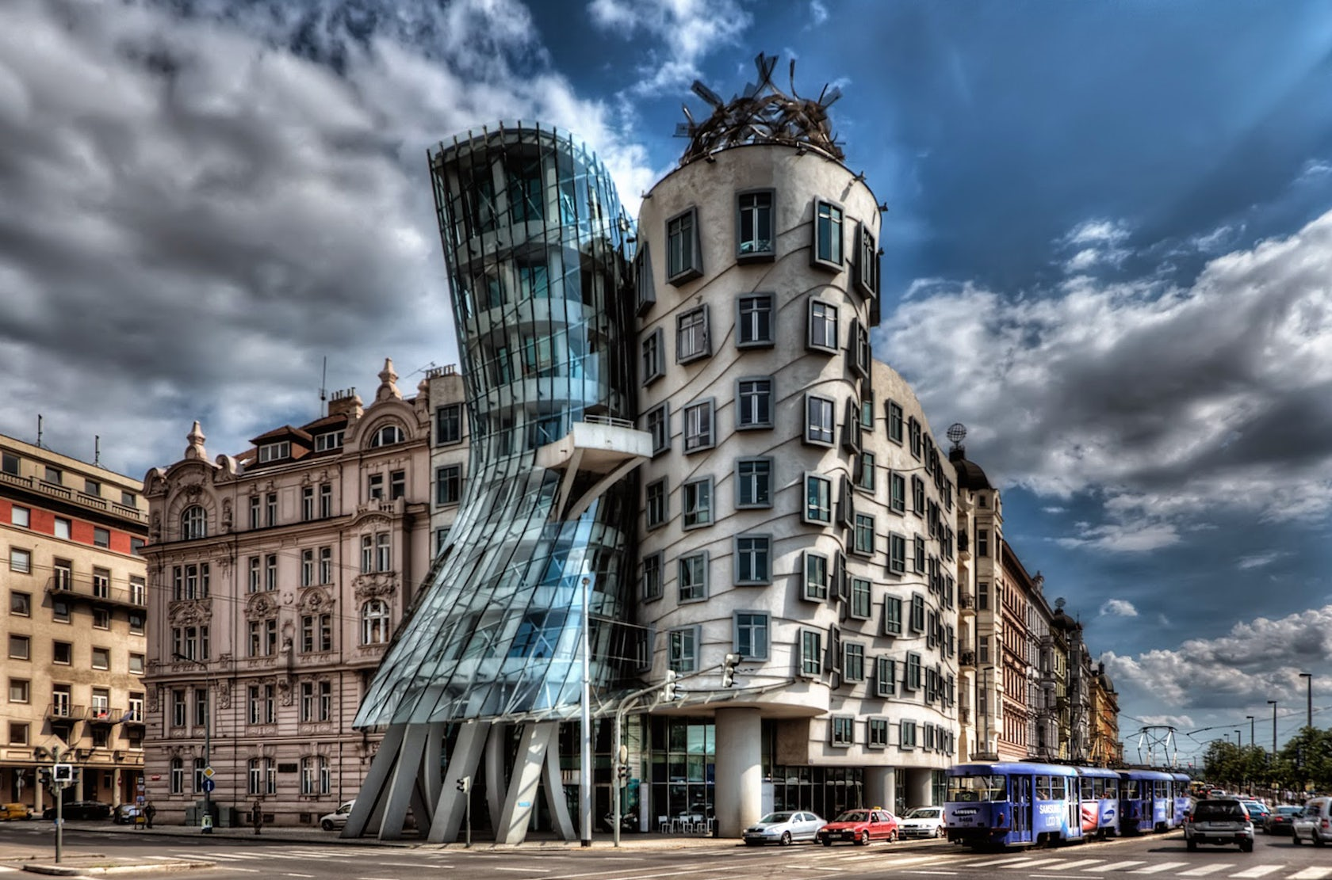
ARCHITECTURAL AMBITIONS
Note: local national toponymy used to conform to current fashion
Praha, Česko (not digitally altered)

Slide 2
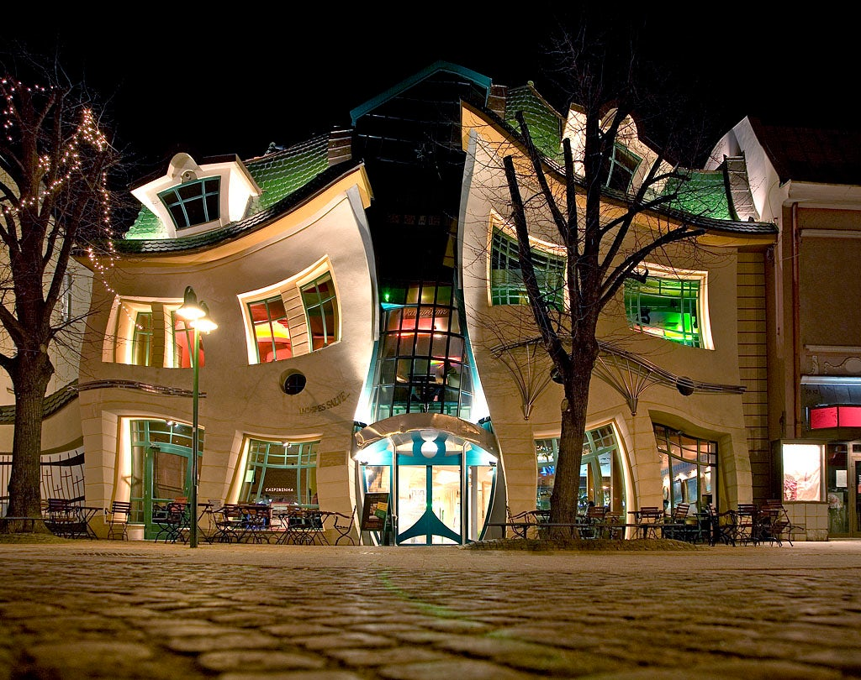
ARCHITECTURAL AMBITIONS
Sopot, Polska (not digitally altered)
Note: local national toponymy used to conform to current fashion

Slide 3


GEOPOLITICAL AMBITIONS
Česko (digitally altered)
Note: local national toponymy used to conform to current fashion

Slide 4


GEOPOLITICAL AMBITIONS
Polska (digitally altered)
Note: local national toponymy used to conform to current fashion

