Slide 1
Recommendation systems
Group : RiMaYa
Rithy SOCHET
Marc KASPAR
Yannis FONTAINE

Slide 2
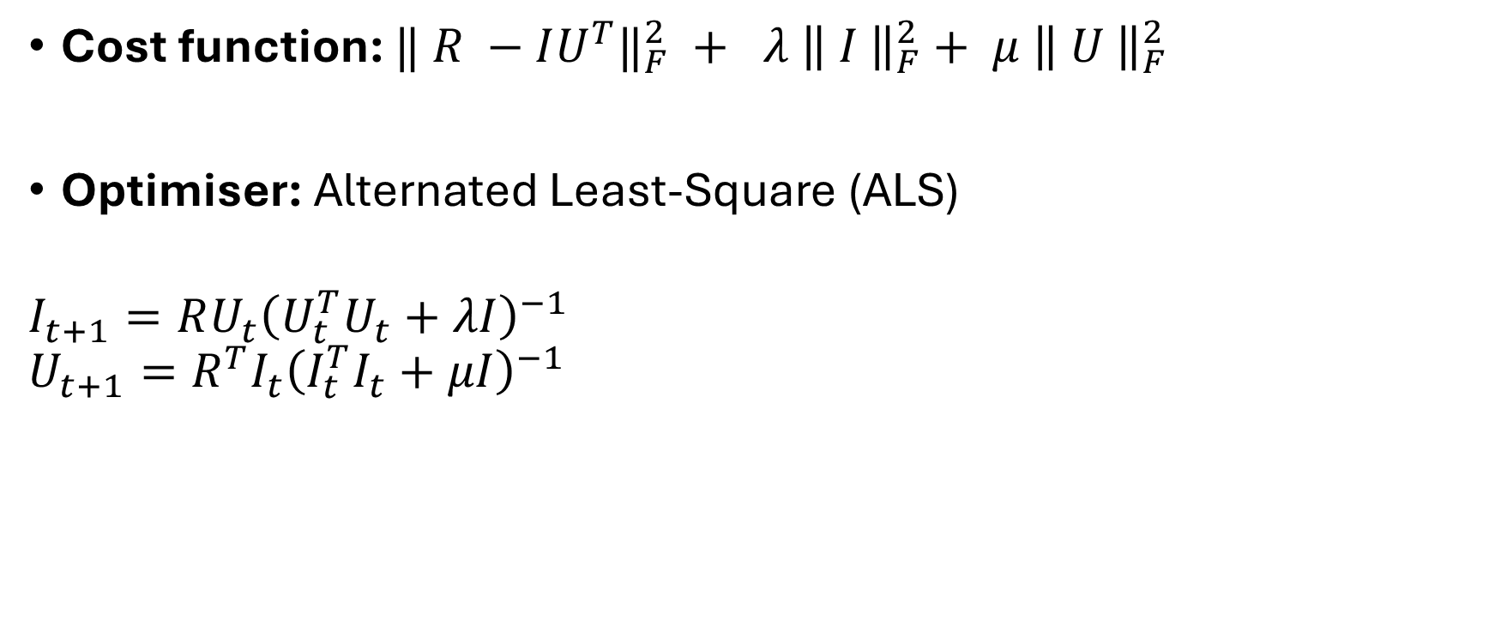
Matrix factorisation
Cost function: ${‖ R −IU^{T}‖}_{F}^{2} + λ{ \left\| I \right\|}_{F}^{2}+ μ{ \left\| U \right\|}_{F}^{2}$
Optimiser: Alternated Least-Square (ALS)
$$I_{t+1}=RU_{t}{\left(U_{t}^{T}U_{t}+λI\right)}^{−1}$$
$$U_{t+1}=R^{T}I_{t}{\left(I_{t}^{T}I_{t}+μI\right)}^{−1}$$

Slide 3
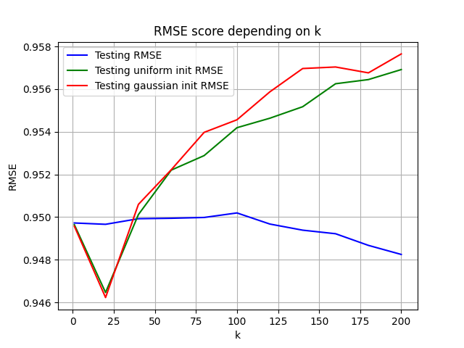
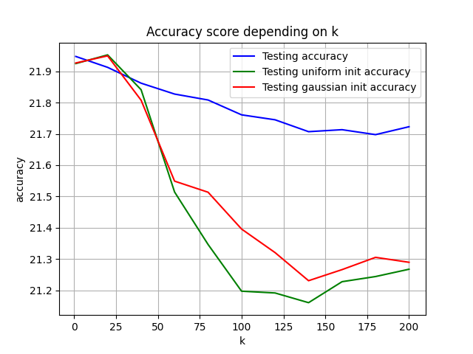
Some results: different initialisation

Slide 4
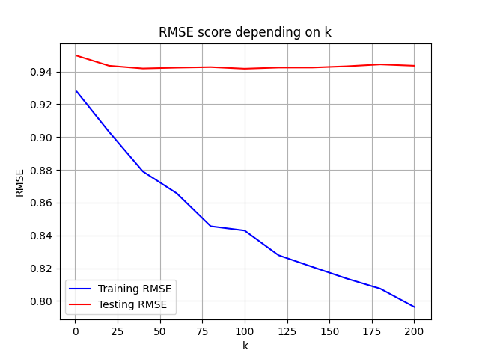
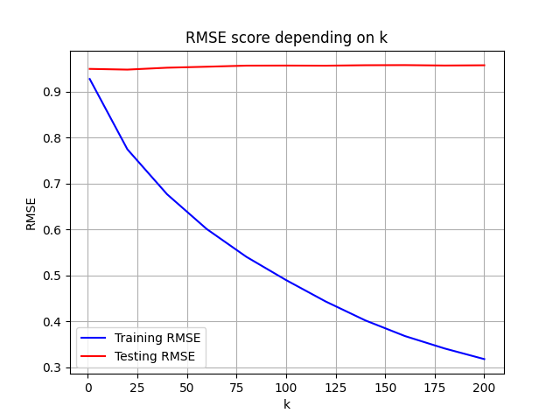
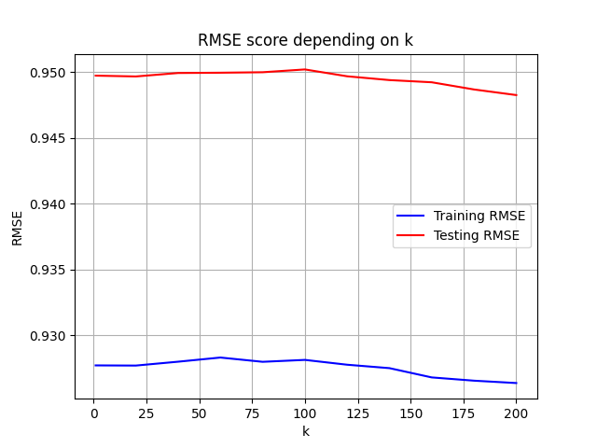
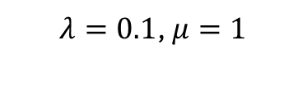
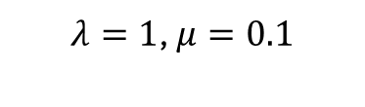
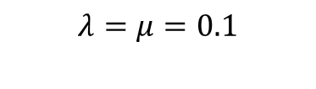
Some results: regularisation
$λ=0.1$, $μ=1$
$$λ=μ=0.1$$
$λ=1$, $μ=0.1$

Slide 5
Deep matrix factorisation
How it works:
Pros and cons
Some results

Slide 6
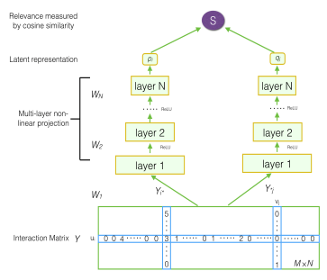

Architecture

Slide 7
Neural Collaborative Filtering
Advantages:
- It captures more complex non-linear relationships between users and items
- Generalization of Matrix Factorization
Disadvantages:
- Risk of overfitting

Slide 8
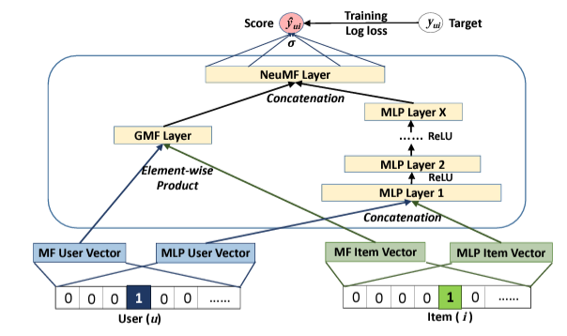
Architecture

Slide 9
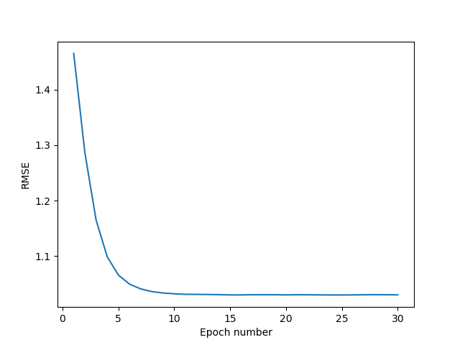
Some results
Parameters:
Optimizer: Stochastic Gradient Descent
with learning rate = 0.001
Batch size: 128
Number of epochs: 30
MLP structure: [64,32, 16, 8]
Test results:
RMSE = 1.0379
Accuracy = 0
Time = 17.22s
With Rounding:
RMSE= 1.1473
Time = 17.38s
Evolution of RMSE for NCF

