Slide 1
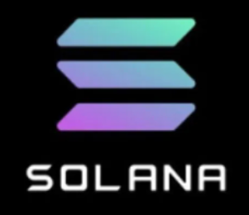






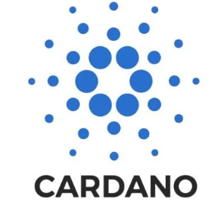


Count of Monti Crypto

Slide 2
Executive Summary
The target user for the Count of Monti Crypto Project is a new investor in the Crypto Currency market. The key goal is to provide a dashboard to visually explain and tell a story about past performance and relative risk of crypto assets. Using this analysis another tab on the dashboard will visually display a “Monti Carlo Simulation” of the future performance of given cryptocurrency assets.

Slide 3
Concept
Description: Using an API build a dataframe of historical cryptocurrency pricing data. Use this data to peform an analysis and visually display results.
Motivation for development: Interest in cryptocurrency and further exploring data analysis of historical asset prices.
User Story: As a new investor in the cryptocurrency market, I need a tool to determine risk of assests and peform a historical analysis of crypto prices. My goal is to mitigate risk and chose investments that have the greatest potential of gains.

Slide 4
Data Techniques
The data source for this project was the Alpaca Trade API. Daily metrics were pulled on 10 cryptocurrencies dating back to 2021-01-25.
Approximately 1.25 years of data were pulled for this analysis. Given the historical volatility and rapid growth of leading cryptocurrencies we chose to keep a relative short timeframe for our analysis.
An API call was made for each cryptocurrency. Each dataframe was then reformatted dropping unneeded datapoints. The dataframes were then concatenated and used for analysis.

Slide 5
Approach
Technologies used: Python libraries imported (os, requests, pandas, dotenv, alpaca_trade_api, numpy, panel, plotly) Anaconda and Python3(ipykernal) notebook used for coding. Github used for collaberation and merging of code.
Breakdown of tasks and roles:
API setup, Construct dataframes, perform analysis, visualization of analysis, dashboard display, monti carlo simulation, visualization of monti carlo results
Challenges: Initial API requests, Concatenation of dataframes. Some crypto’s had data from multiple exchanges that needed to be reformatted. PotlyExpress and displaying histograms.
Successes: Overcame challenges using trial and error, research/documentation. Worked through visualization hurdles and restructed code

Slide 6
Questions
Which three Crypto assets show the most stability and least risk?
Which Crypto asset shows the most volatility and has greatest risk?
How do alternative coins stack up in volitivity against bitcoin?
Which crypto assets have high volume/liquidity and does this correlate with the risk of the asset?
What are the simulated returns on our chosen crypto assets over the next year?
Notes:
1. Displayed, Anualized Standard Devs, Beta

Slide 7
Code/Demo

Slide 8
Next Steps
Additional topics to research: More robust library/tool for constructing a dashboard and having filtering chart options.
Plan for future development: Add ability to pick and choose portfolio and weights for the monti carlo simulation. Add more robust datasources with more historical data.
Add machine learning and blockchain fundamentals that we will learn later in this course
Open issue to solve: Incorporate density plot of daily return

Slide 9
Links
Deployed application.
GitHub: https://github.com/MarcAgnew055/Project-1

