Slide 1
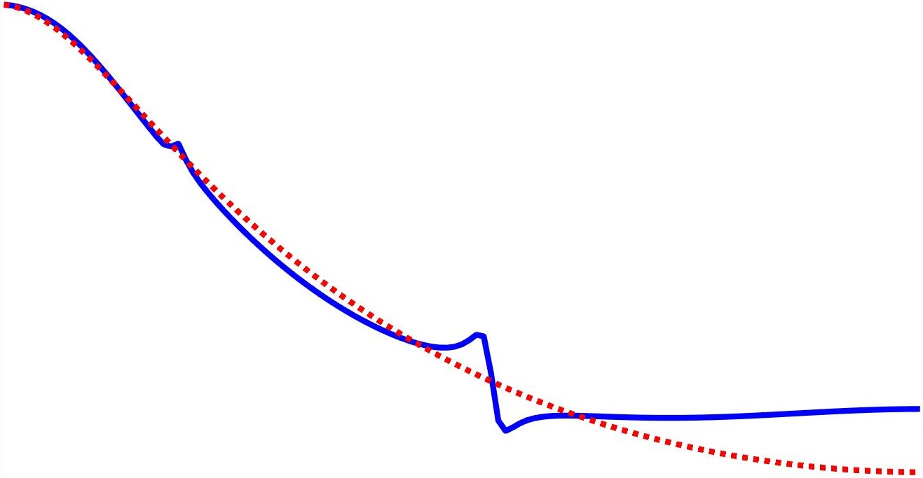
A frequency domain approach to data-driven control
Marc Berneman
With the supervision of Prof. Dr. Ir. Rik Pintelon
and the co-supervision of Prof. Dr. Ir John Lataire

Slide 2
Table of contents
LTI systems
Discrete Fourier Transform
Frequency domain approach
Data-driven control

Slide 3
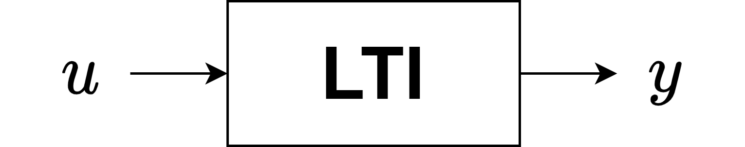
LTI systems

Slide 4

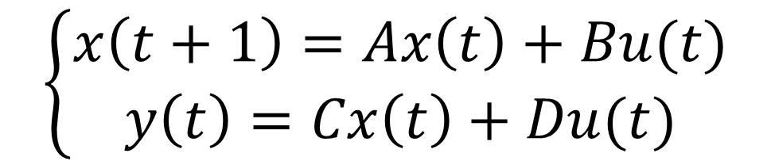
LTI systems
Single-input single-output
Linear Time-Invariant System
$$\left\{\begin{aligned}x\left(t+1\right)=Ax\left(t\right)+Bu(t) \\ y\left(t\right)=Cx\left(t\right)+Du(t)\end{aligned}\right.$$
$$Y\left(z\right)=G\left(z\right)U(z)$$
Transfer function
State space

Slide 5
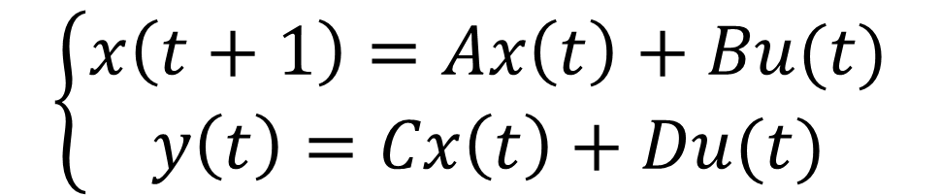



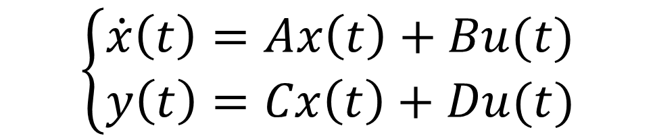

LTI systems
Transfer function
State space
Discrete time
$$\left\{\begin{aligned}x\left(t+1\right)=Ax\left(t\right)+Bu(t) \\ y\left(t\right)=Cx\left(t\right)+Du(t)\end{aligned}\right.$$
$$Y\left(z\right)=G\left(z\right)U(z)$$
Continuous time
$$\left\{\begin{aligned}\dot{x}\left(t\right)=Ax\left(t\right)+Bu(t) \\ y\left(t\right)=Cx\left(t\right)+Du(t)\end{aligned}\right.$$
$$Y\left(s\right)=G\left(s\right)U(s)$$
$$G\left(Ω\right)$$
$$Ω=s,z$$
Model
$$(A,B,C,D)$$

Slide 6
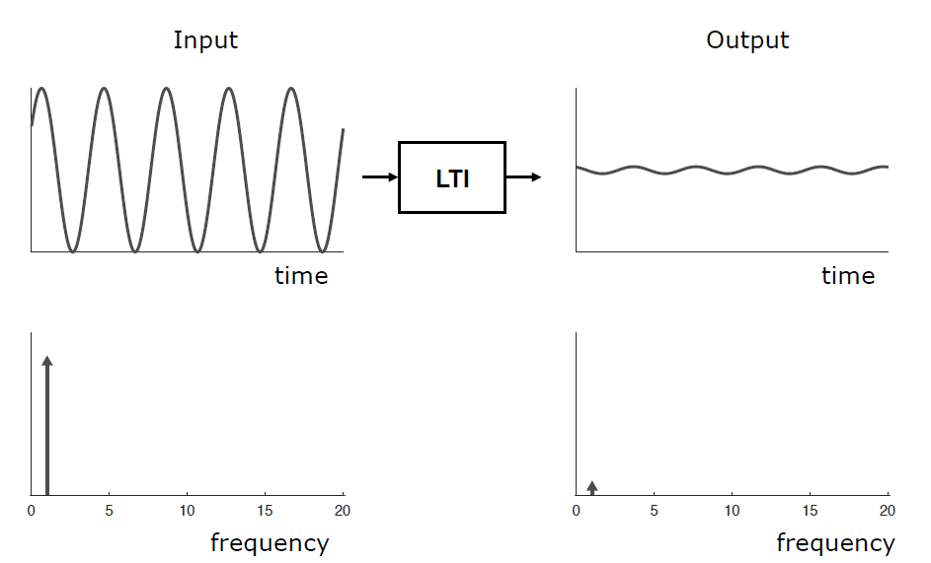
LTI systems
Ref. Lataire [2017]

Slide 7
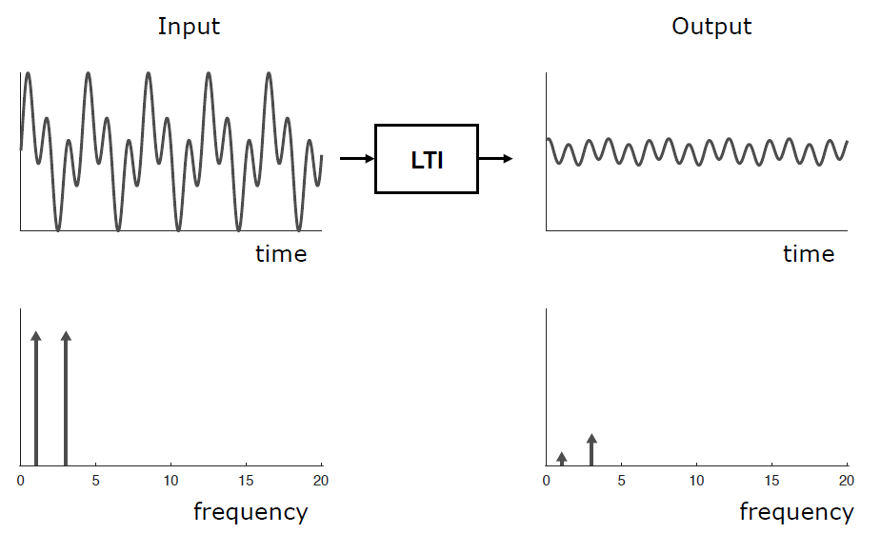
LTI systems
Ref. Lataire [2017]

Slide 8
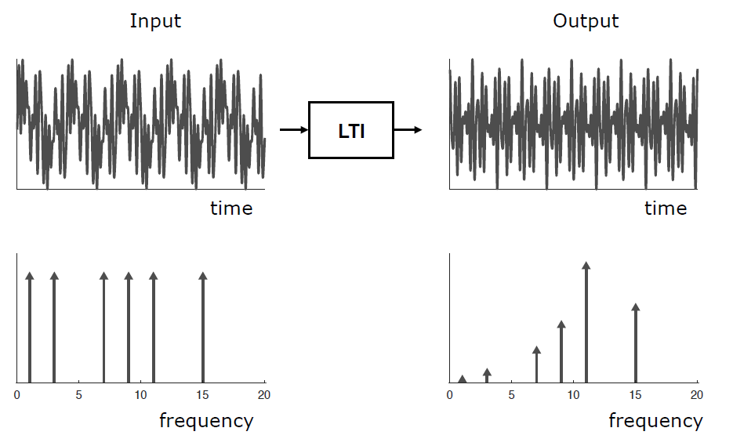
LTI systems
Ref. Lataire [2017]

Slide 9
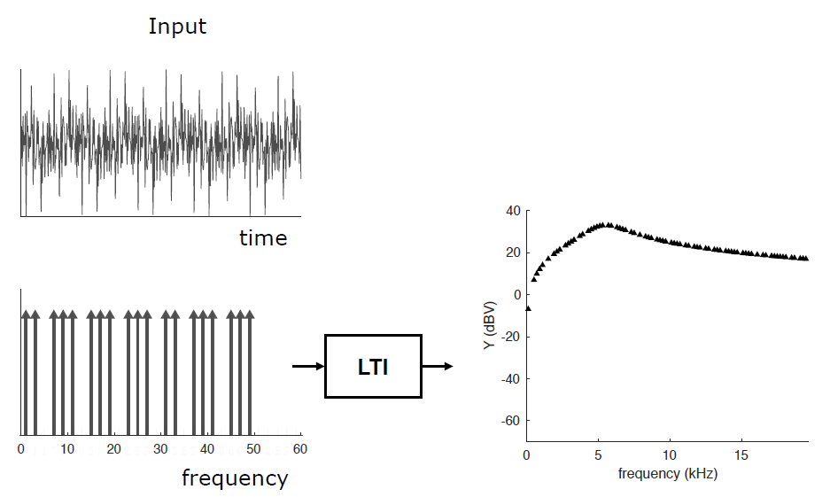
LTI systems
Multisine
Ref. Lataire [2017]

Slide 10
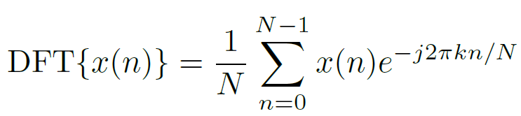
Discrete Fourier Transform

Slide 11
Discrete Fourier Transform
When does the DFT contain the same information as the Fourier Transform?

Slide 12
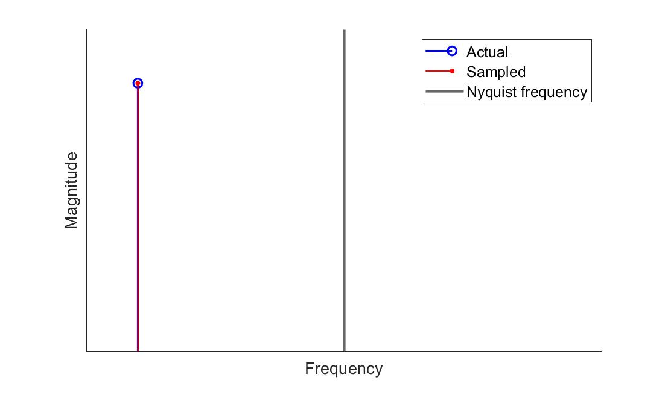
Discrete Fourier Transform
1. Nyquist-Shannon theorem

Slide 13
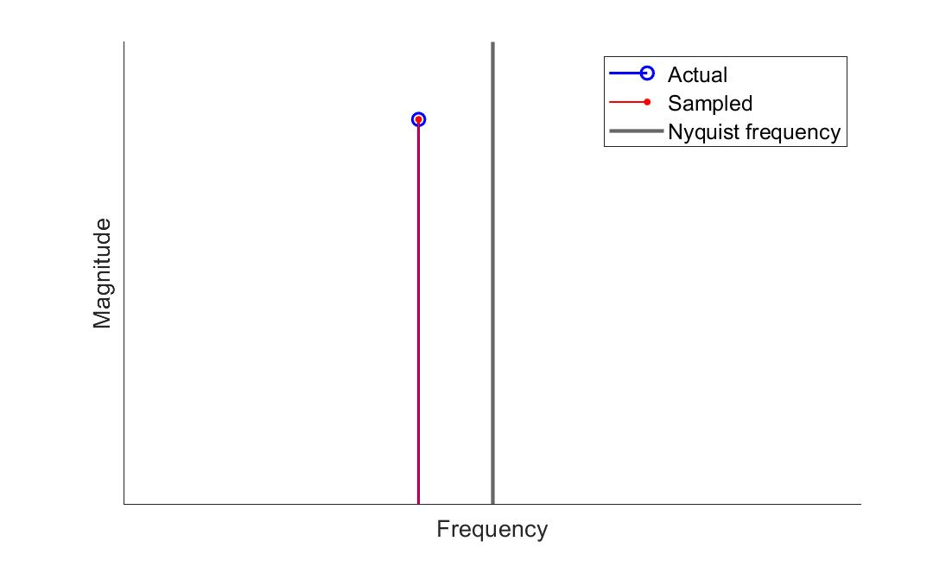
Discrete Fourier Transform
1. Nyquist-Shannon theorem

Slide 14
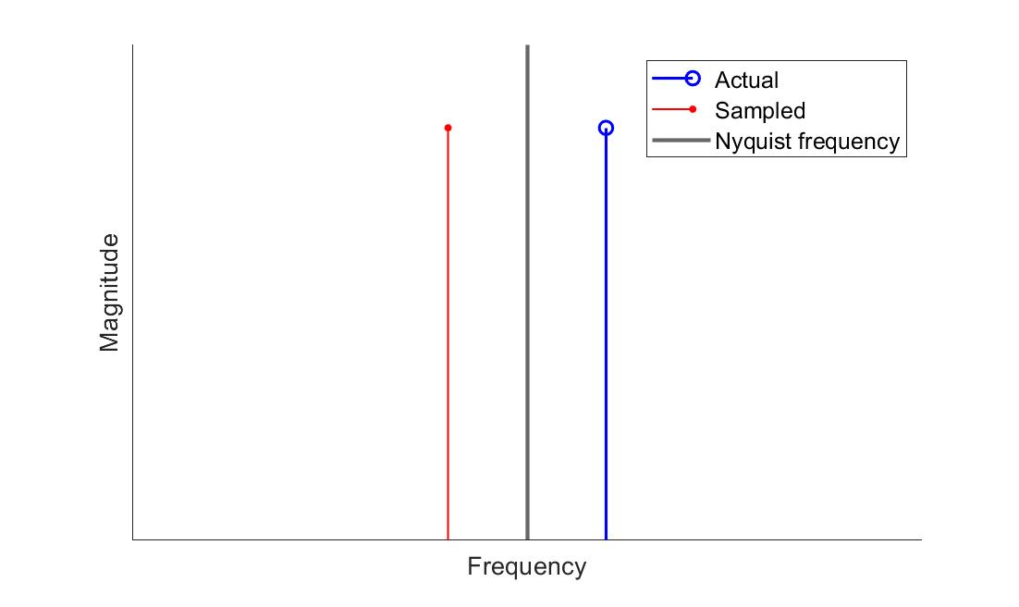
Discrete Fourier Transform
1. Nyquist-Shannon theorem

Slide 15
Discrete Fourier Transform
2. Periodicity
DFT assumes that the underlying signal is periodic for all time.

Slide 16
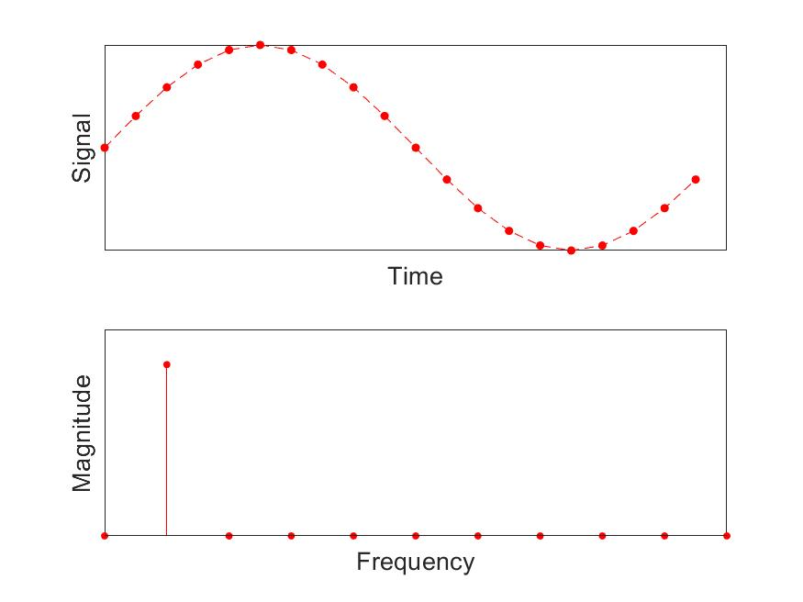
Discrete Fourier Transform
3. Leakage

Slide 17
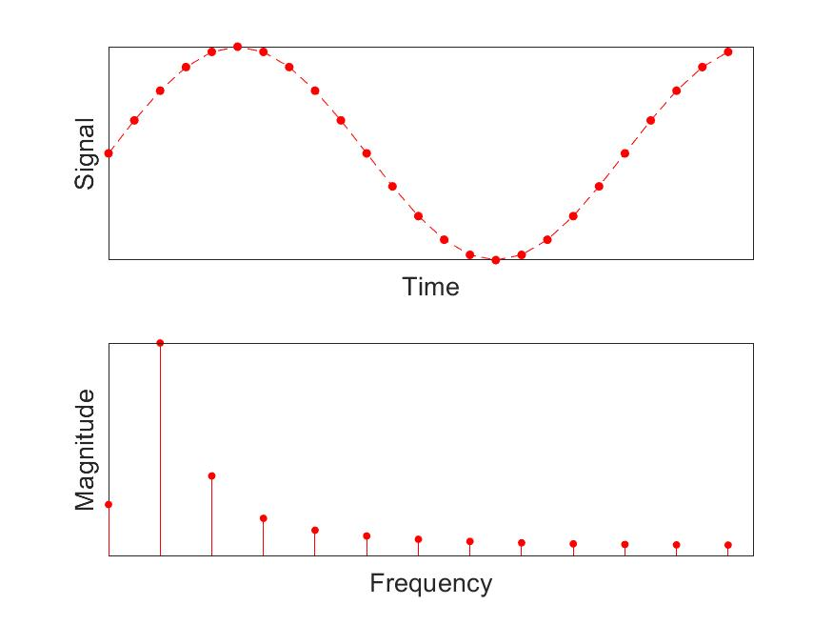
Discrete Fourier Transform
3. Leakage

Slide 18

Discrete Fourier Transform
3. Leakage
The measurement time must contain an integer number of periods of the measured signal

Slide 19
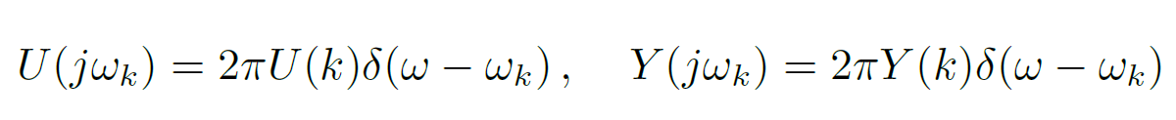
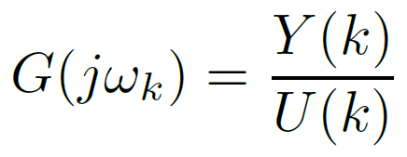
Discrete Fourier Transform
1. Nyquist-Shannon theorem
2. Periodicity
3. Leakage
Fourier spectrum
DFT spectrum

Slide 20
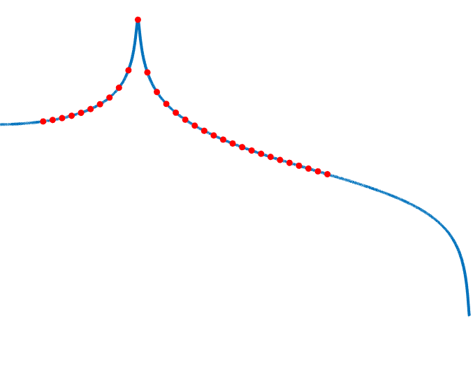
Frequency domain approach

Slide 21
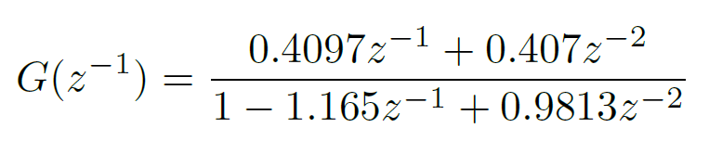
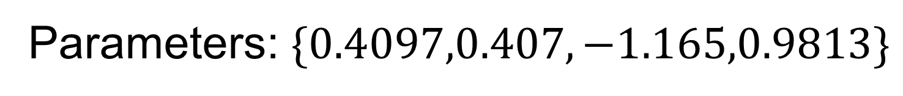
Frequency domain approach
Parametric model
Parameters: $\{0.4097,0.407,−1.165,0.9813\}$
Nonparametric model?

Slide 22
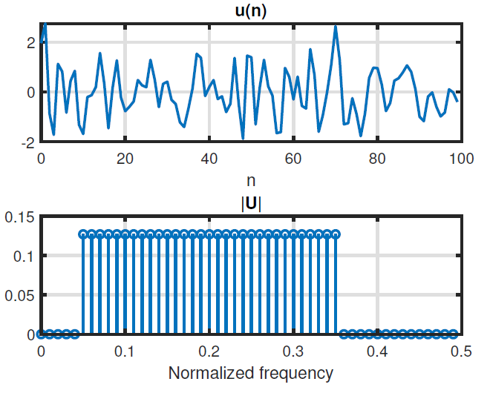
Frequency domain approach

Slide 23
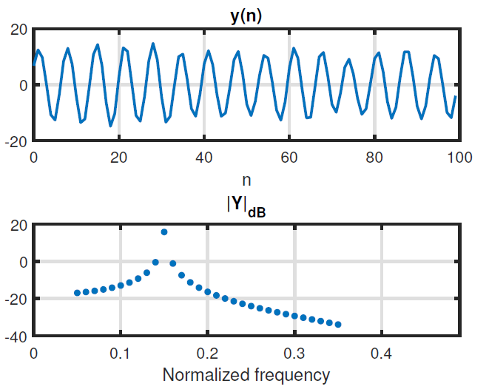
Frequency domain approach

Slide 24
Frequency domain approach

Slide 25
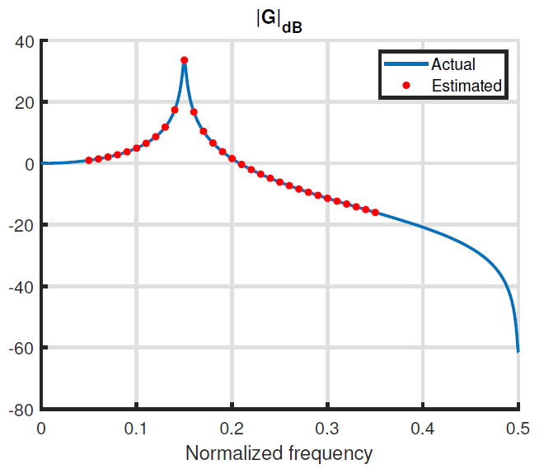




Frequency domain approach
$$G(k=34)$$
$$G(k=5)$$
$$G(k=35)$$
$$G(k=6)$$

Slide 26
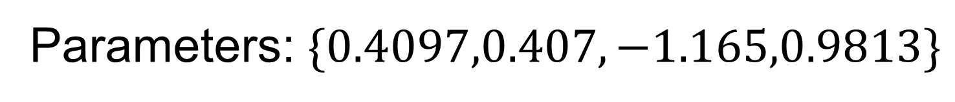
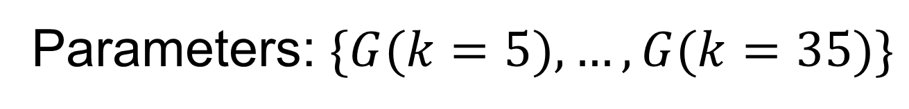
Frequency domain approach
Nonparametric model
Parameters: $\{G(k=5),…,G(k=35)\}$
Number of parameters can grow with the amount of data
Parametric model
Parameters: $\{0.4097,0.407,−1.165,0.9813\}$

Slide 27
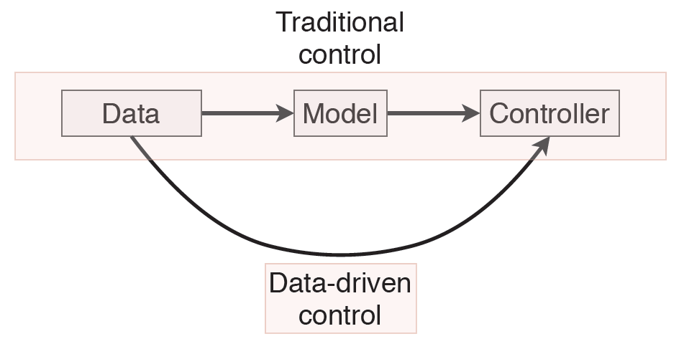
Data-driven control

Slide 28
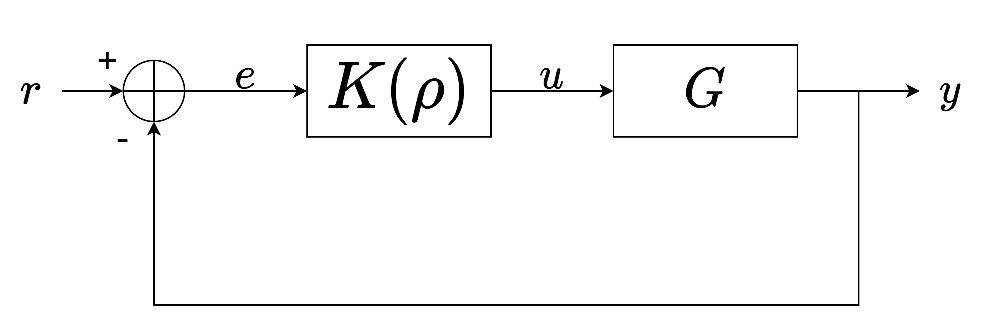
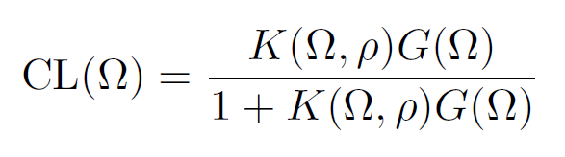
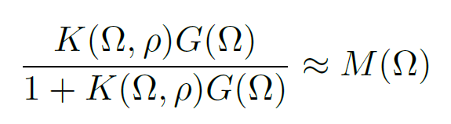
Data-driven control
User-defined reference model
“model reference control”

Slide 29
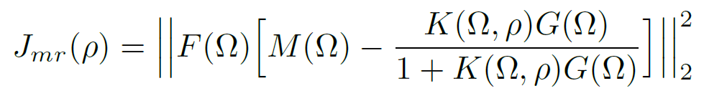
Data-driven control
Weighing filter
Not convex ☹

Slide 30

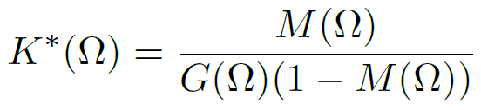
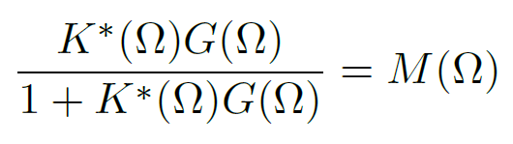
Data-driven control
Ideal controller:

Slide 31


Data-driven control
Convex ☺

Slide 32
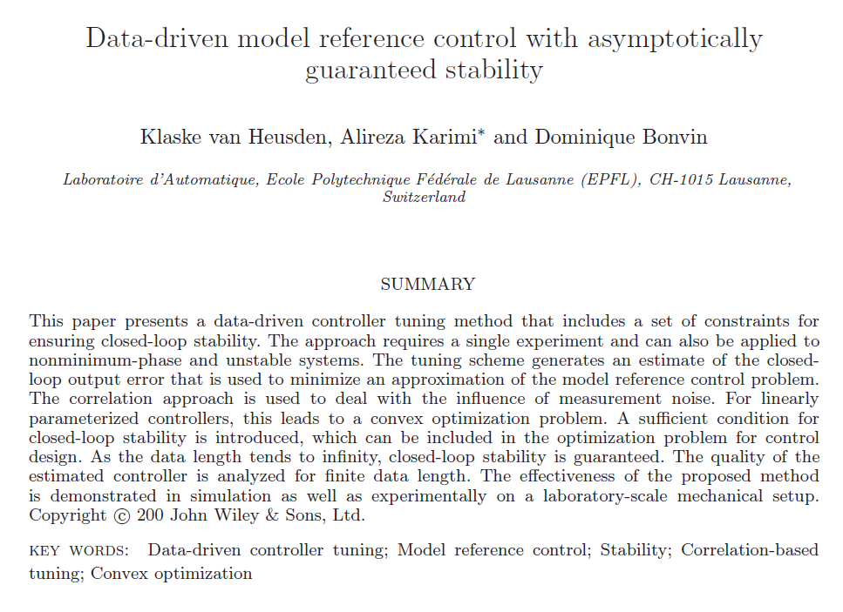
Data-driven control
Ref. van Heusden et al. [2011]

Slide 33
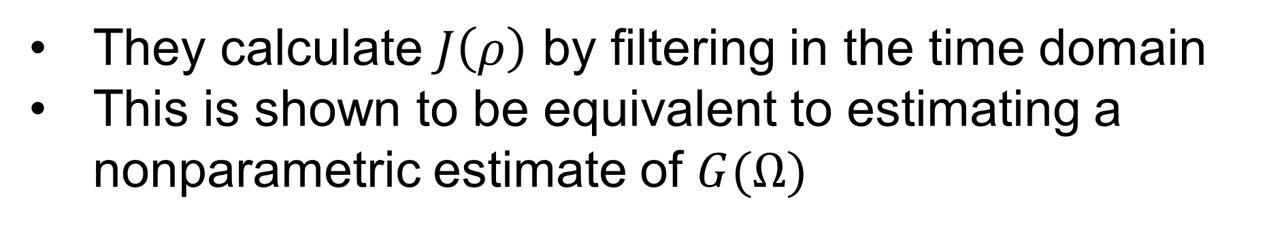
Data-driven control
They calculate $J\left(ρ\right)$ by filtering in the time domain
This is shown to be equivalent to estimating a nonparametric estimate of $G(Ω)$
Only possible for discrete time systems
Also possible for continuous time

Slide 34
subsection

Slide 35
Title
Sample text
Sample text 2
Image caption

