Slide 1
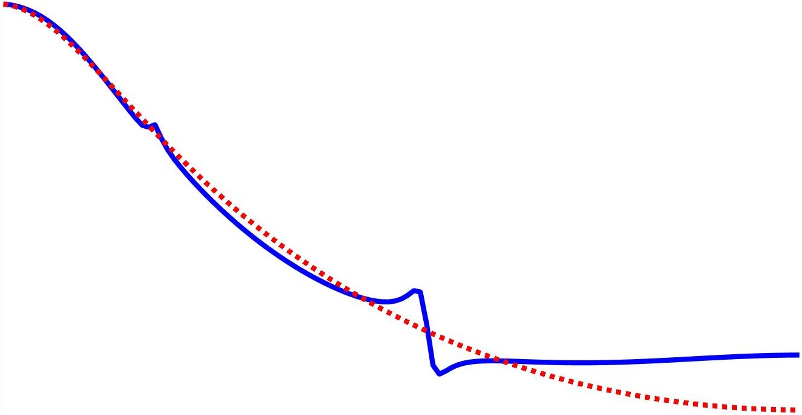
A frequency domain approach to data-driven control
Marc Berneman
With the supervision of Prof. Dr. Ir. Rik Pintelon
and the co-supervision of Prof. Dr. Ir John Lataire

Slide 2
Table of contents
Data-driven control
LTI systems
Discrete Fourier Transform
Frequency domain approach

Slide 3
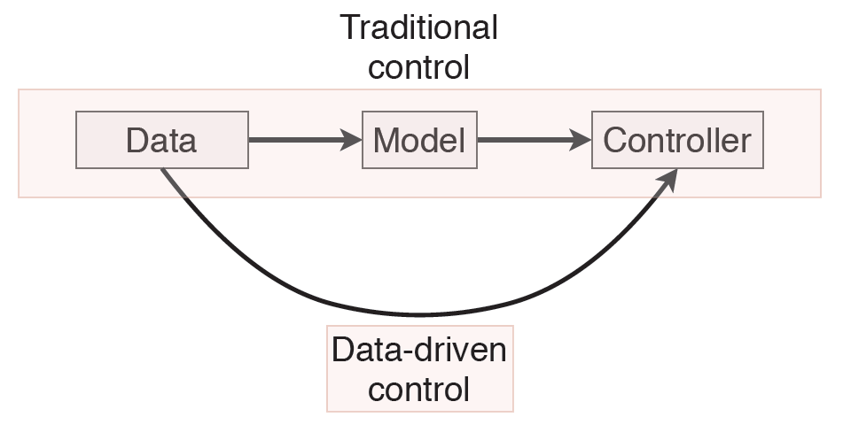
Data-driven control

Slide 4
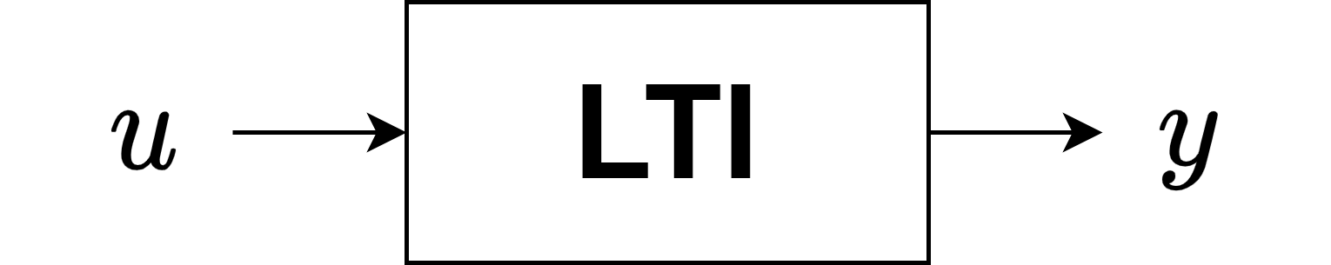
LTI systems

Slide 5

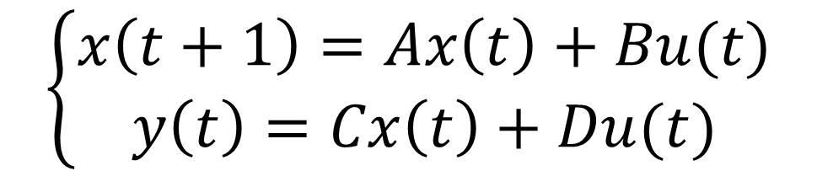
LTI systems
Single-input single-output
Linear Time-Invariant System
$$\left\{\begin{aligned}x\left(t+1\right)=Ax\left(t\right)+Bu(t) \\ y\left(t\right)=Cx\left(t\right)+Du(t)\end{aligned}\right.$$
$$Y\left(z\right)=G\left(z\right)U(z)$$
Transfer function
State space

Slide 6
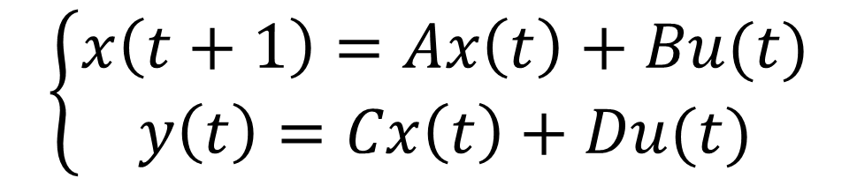



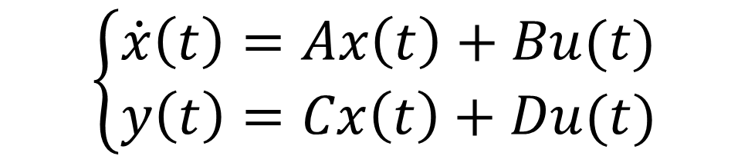

LTI systems
Transfer function
State space
Discrete time
$$\left\{\begin{aligned}x\left(t+1\right)=Ax\left(t\right)+Bu(t) \\ y\left(t\right)=Cx\left(t\right)+Du(t)\end{aligned}\right.$$
$$Y\left(z\right)=G\left(z\right)U(z)$$
Continuous time
$$\left\{\begin{aligned}\dot{x}\left(t\right)=Ax\left(t\right)+Bu(t) \\ y\left(t\right)=Cx\left(t\right)+Du(t)\end{aligned}\right.$$
$$Y\left(s\right)=G\left(s\right)U(s)$$
$$G\left(Ω\right)$$
$$Ω=s,z$$
Model
$$(A,B,C,D)$$

Slide 7
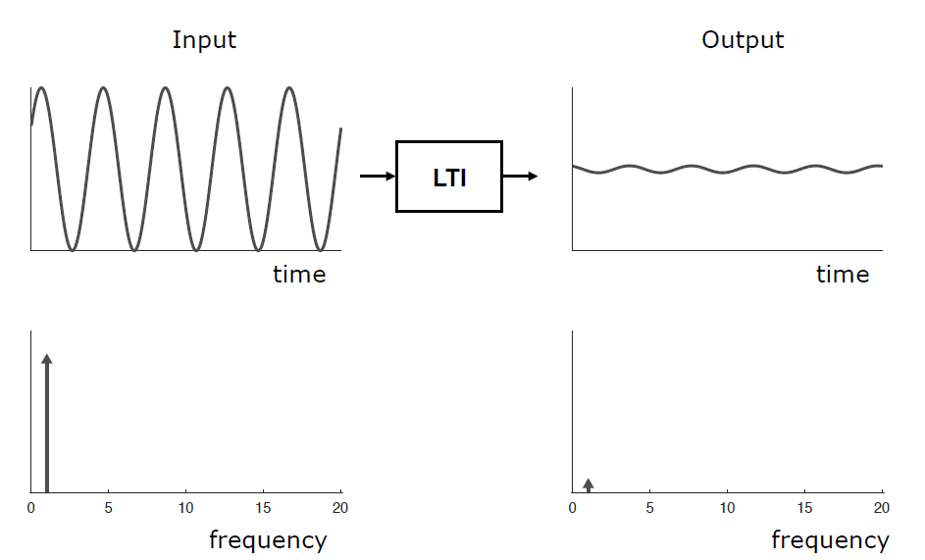
LTI systems
Ref. Lataire [2017]

Slide 8
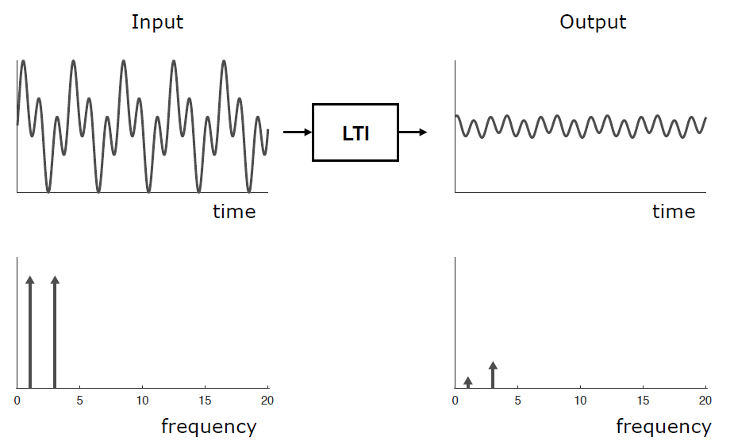
LTI systems
Ref. Lataire [2017]

Slide 9
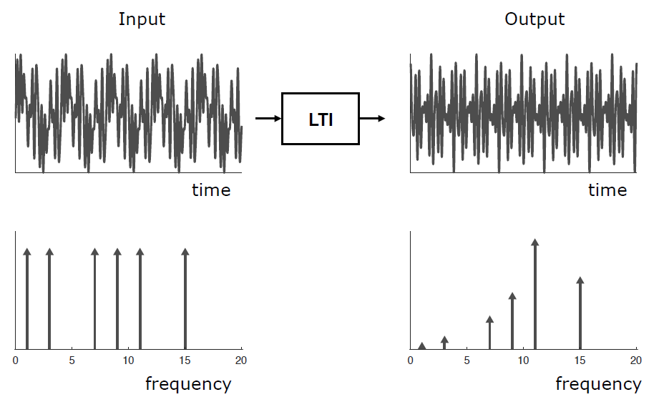
LTI systems
Ref. Lataire [2017]

Slide 10
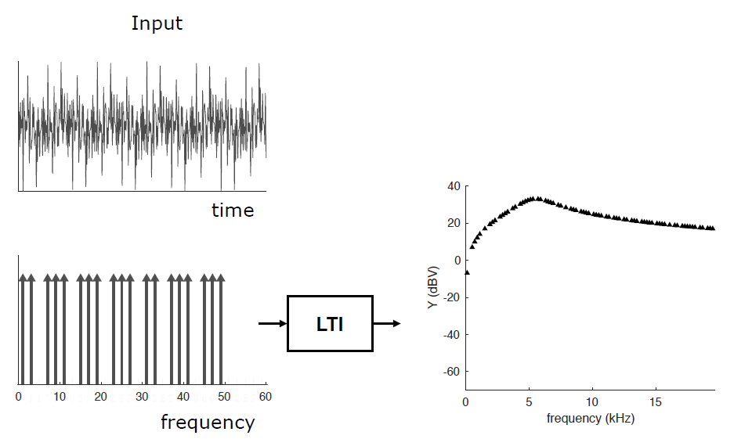
LTI systems
Multisine
Ref. Lataire [2017]

Slide 11
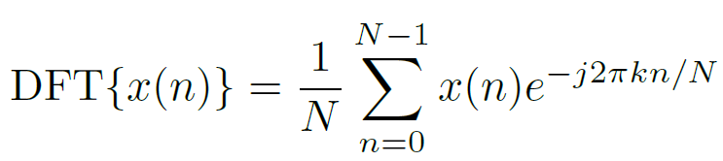
Discrete Fourier Transform

Slide 12
Discrete Fourier Transform
When does the DFT contain the same information as the Fourier Transform?

Slide 13
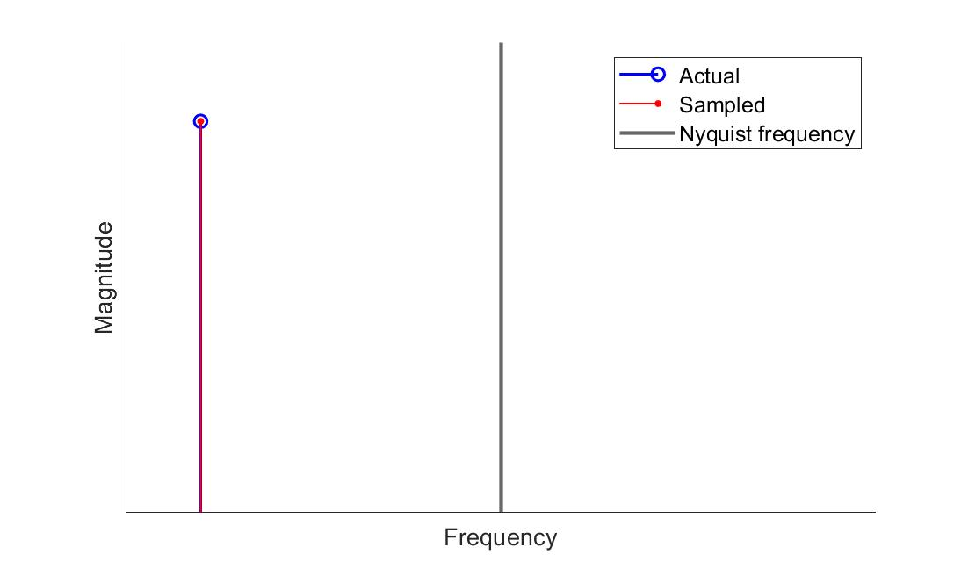
Discrete Fourier Transform
1. Nyquist-Shannon theorem

Slide 14
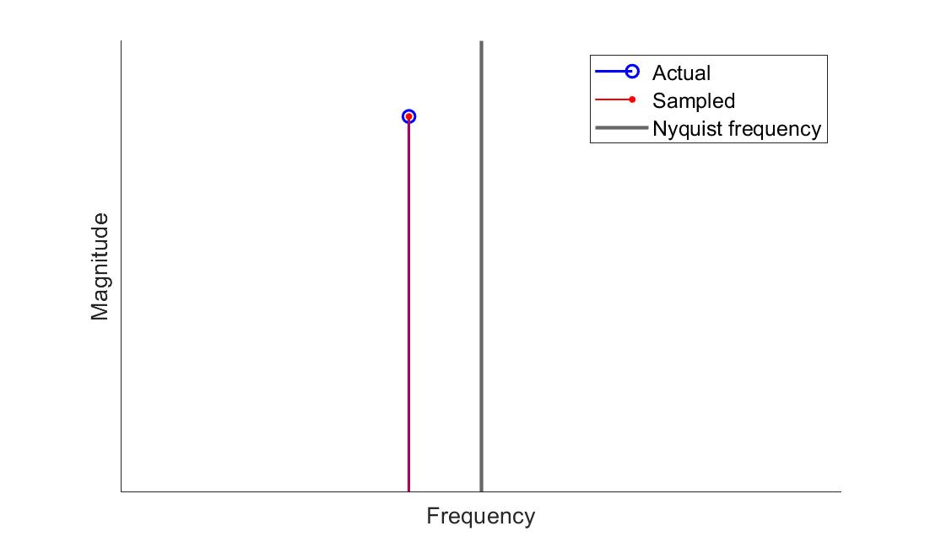
Discrete Fourier Transform
1. Nyquist-Shannon theorem

Slide 15
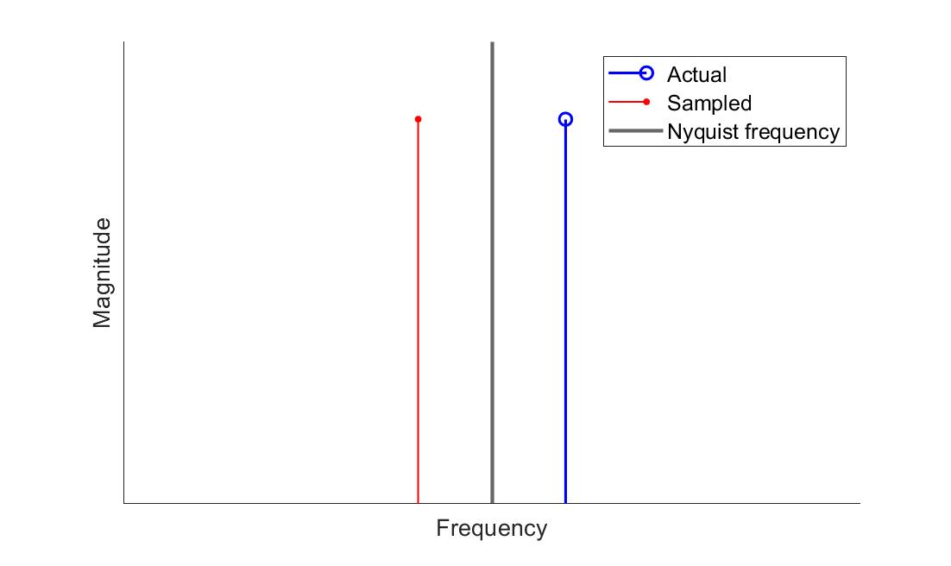
Discrete Fourier Transform
1. Nyquist-Shannon theorem

Slide 16
Discrete Fourier Transform
2. Periodicity
DFT assumes that the underlying signal is periodic for all time.

Slide 17
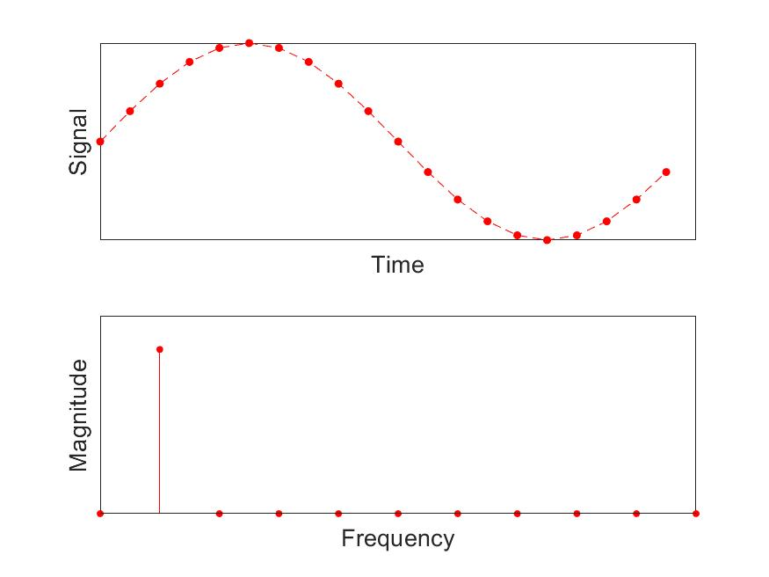
Discrete Fourier Transform
3. Leakage

Slide 18
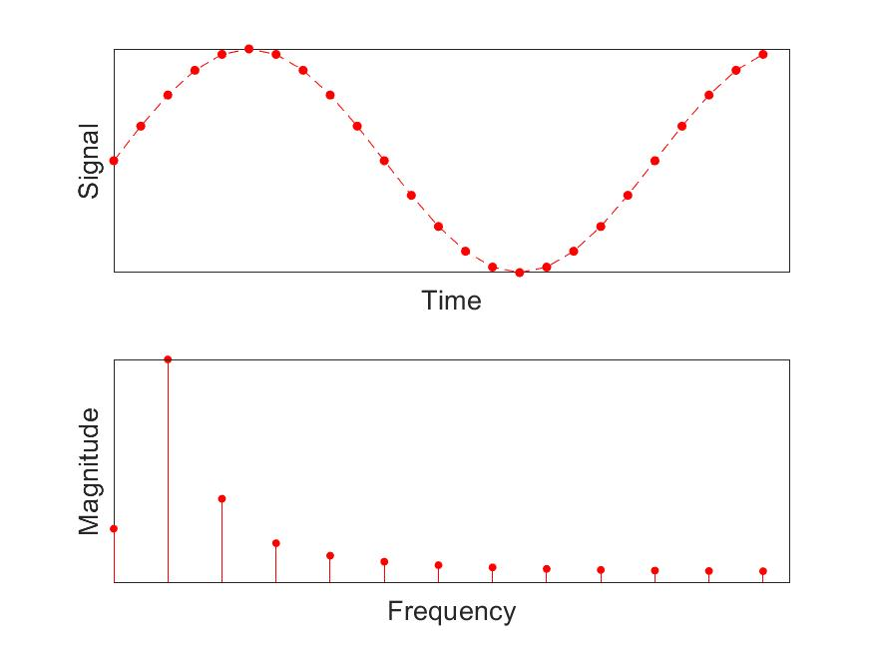
Discrete Fourier Transform
3. Leakage

Slide 19

Discrete Fourier Transform
3. Leakage
The measurement time must contain an integer number of periods of the measured signal

Slide 20
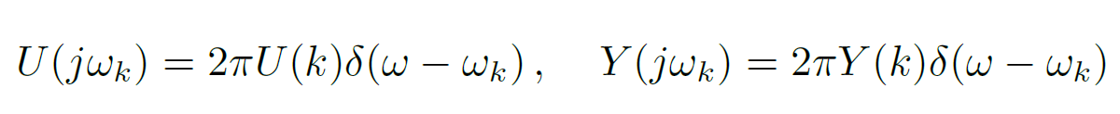
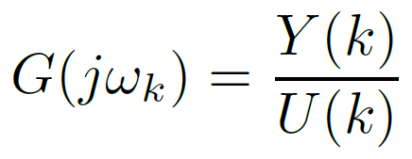
Discrete Fourier Transform
1. Nyquist-Shannon theorem
2. Periodicity
3. Leakage
Fourier spectrum
DFT spectrum

Slide 21
Frequency domain approach

Slide 22
subsection

Slide 23
Title
Sample text
Sample text 2
Image caption

