Slide 1


Slide 2
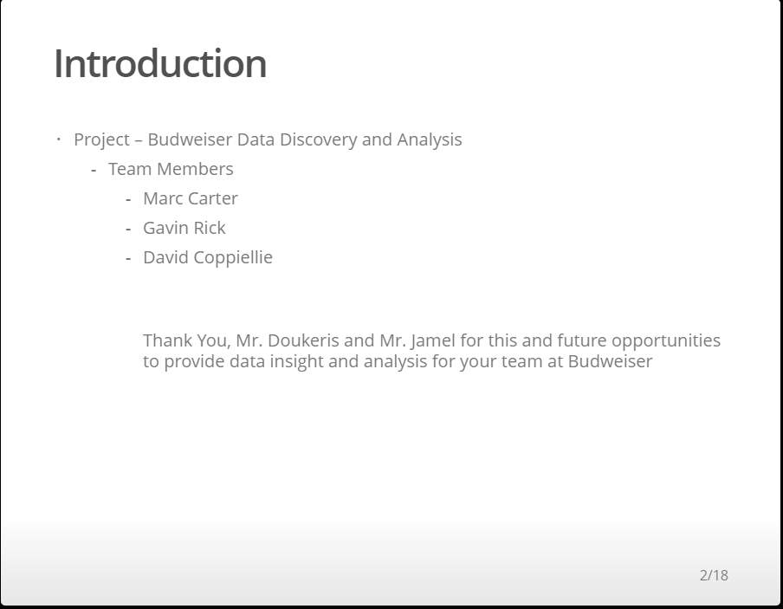

Slide 3
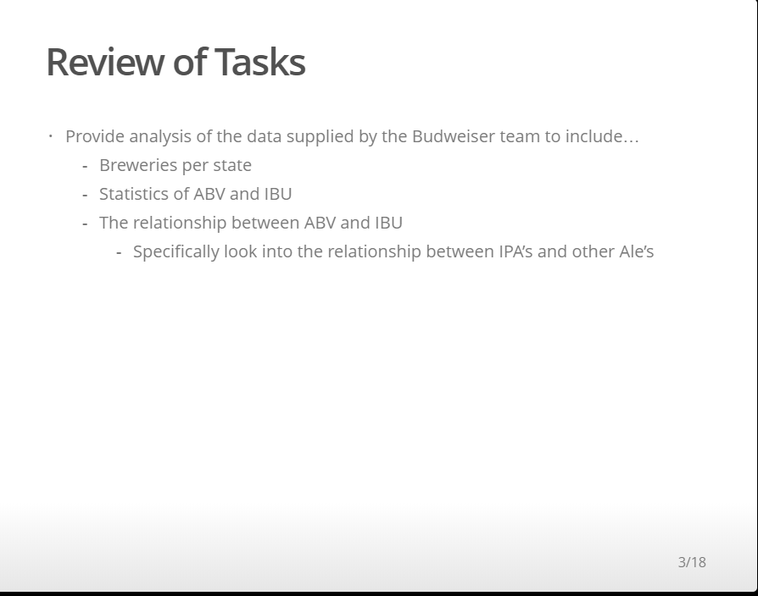

Slide 4
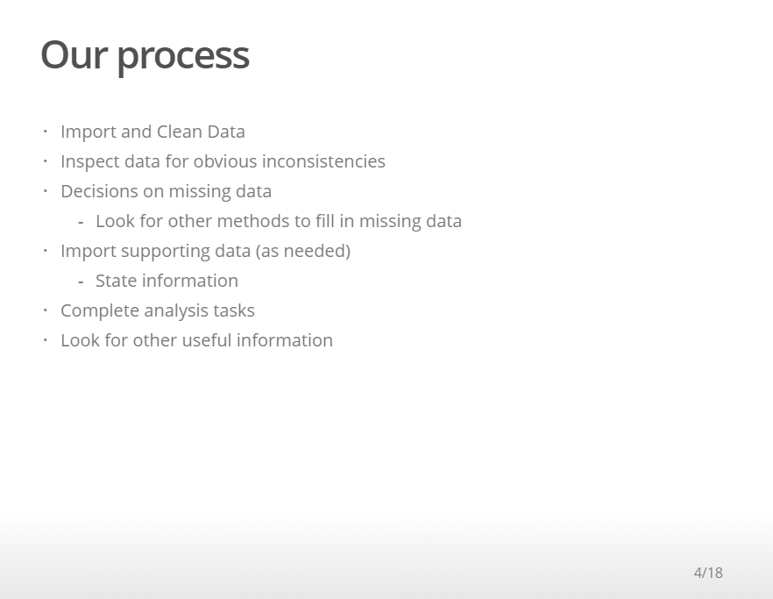

Slide 5
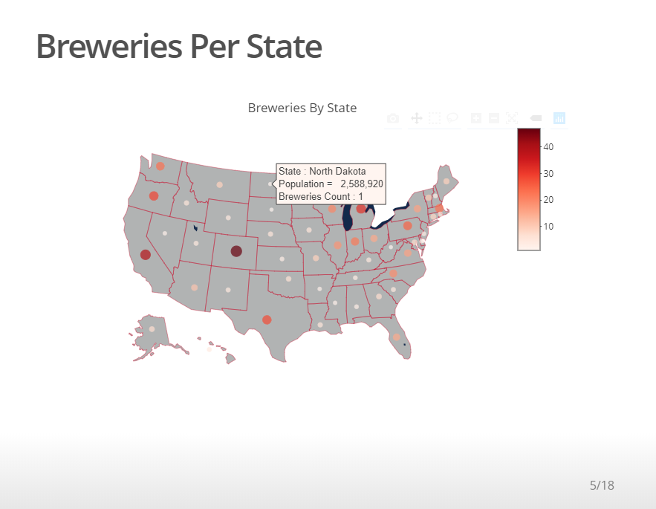

Slide 6
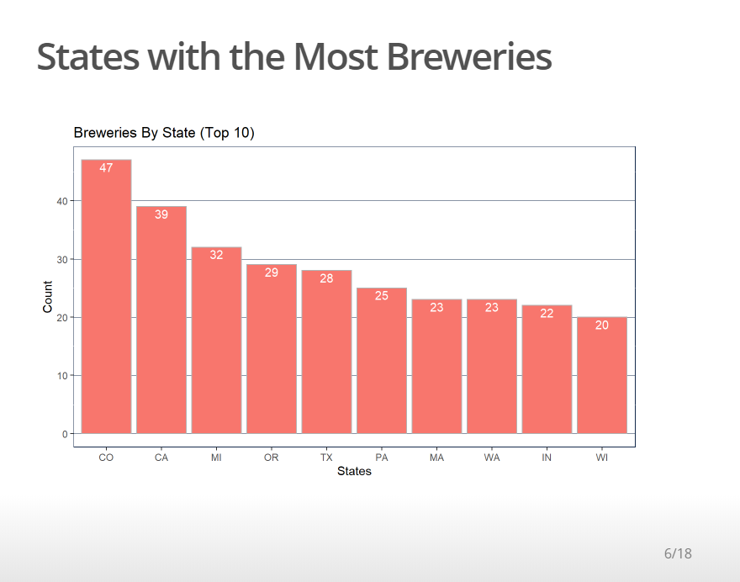

Slide 7
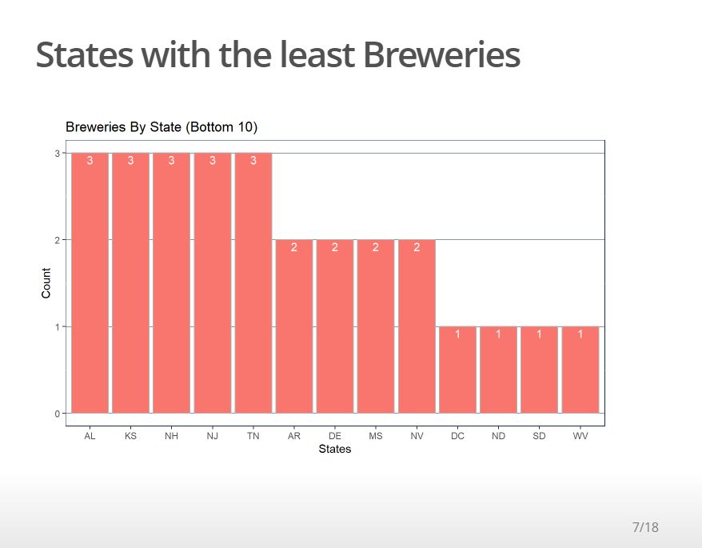

Slide 8
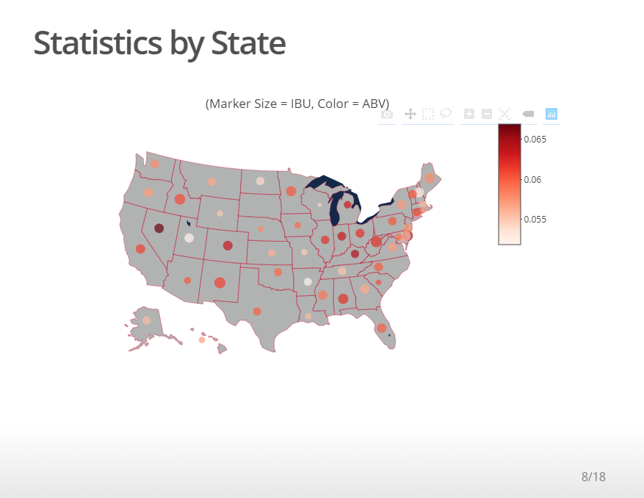

Slide 9
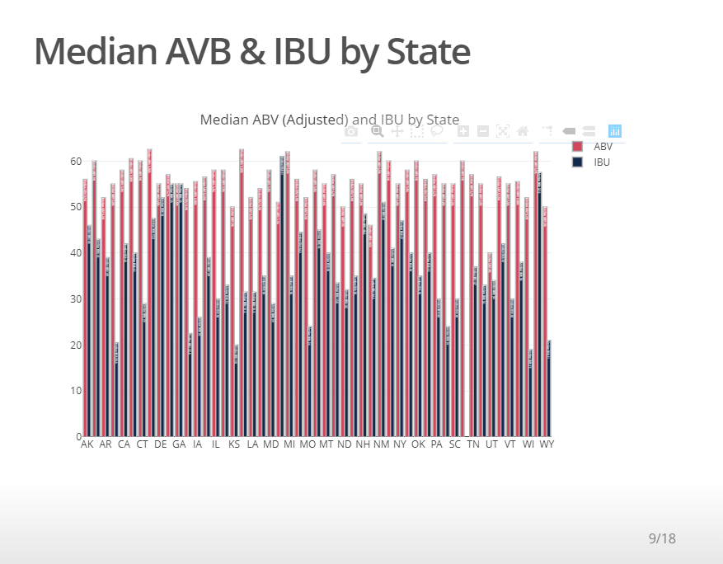

Slide 10
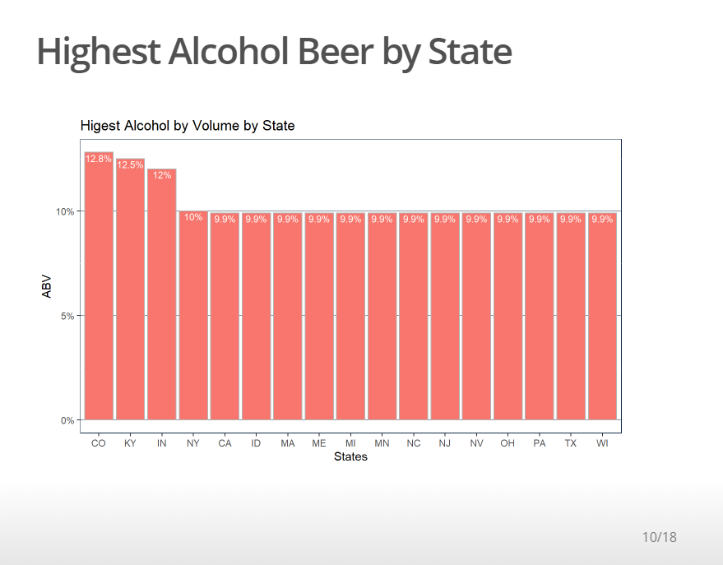

Slide 11
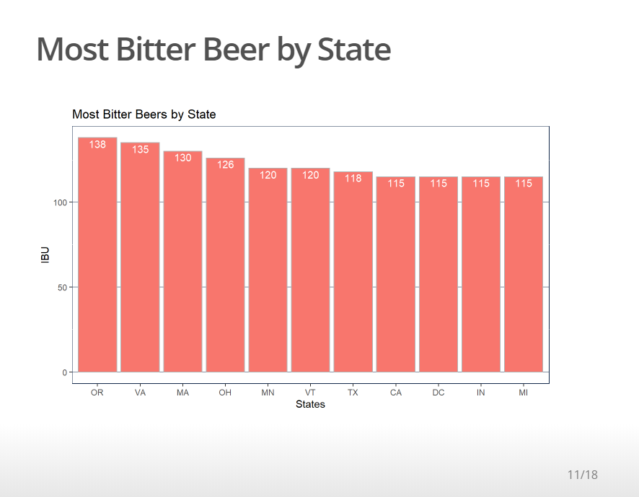

Slide 12
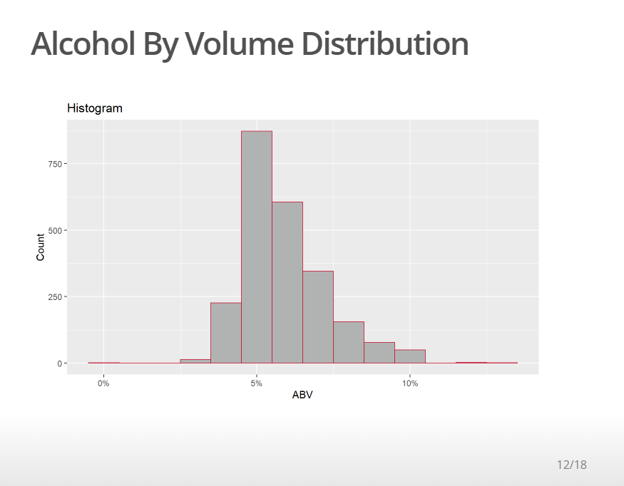

Slide 13
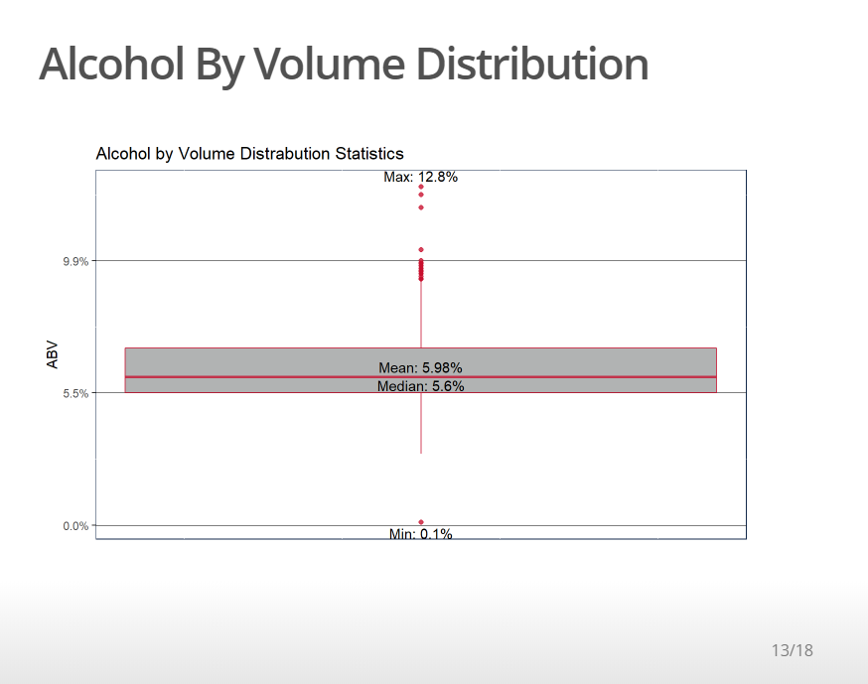

Slide 14
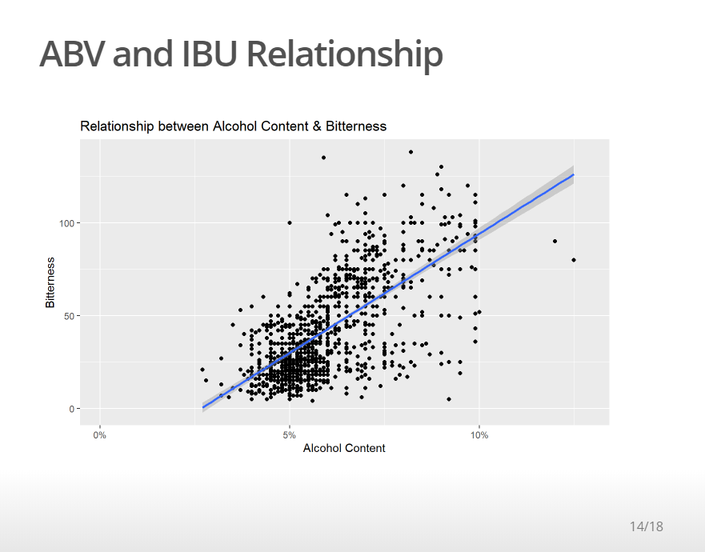

Slide 15
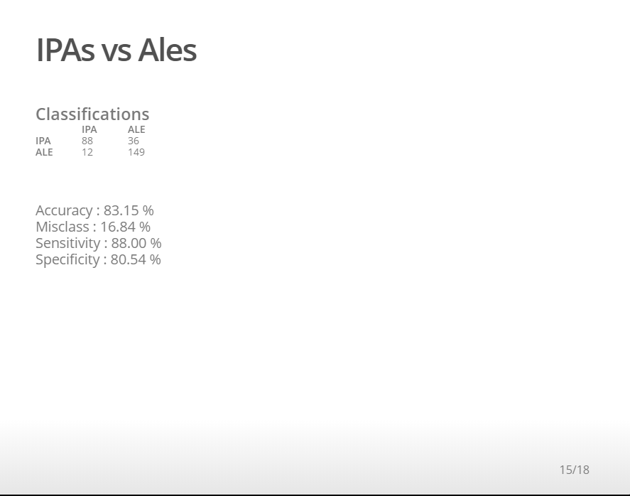

Slide 16
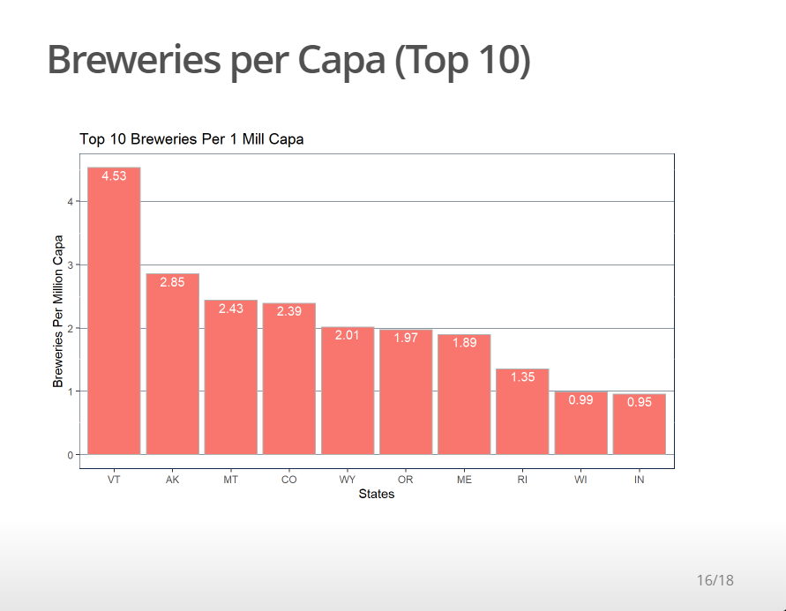

Slide 17
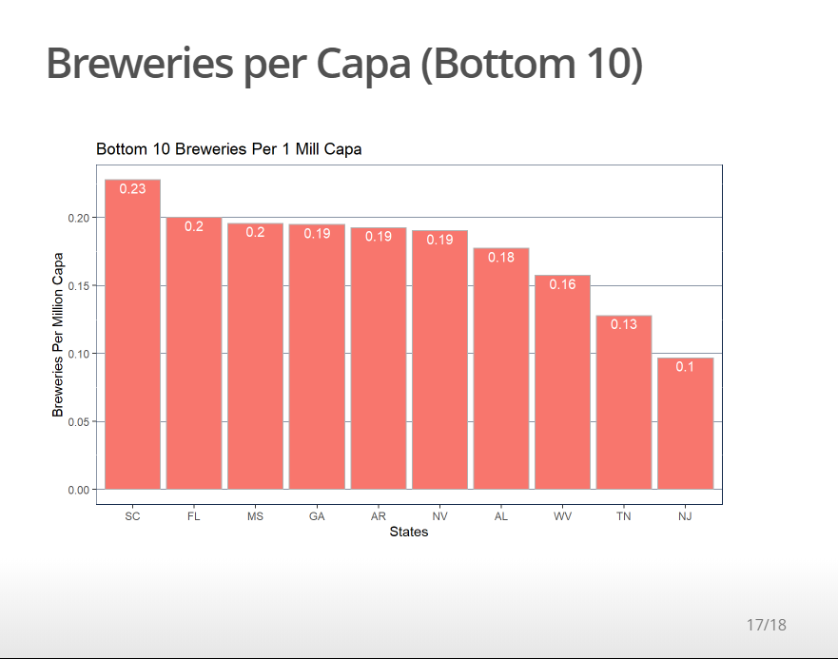

Slide 18
Conclusion
In conclusion we suggest you sell new conceptual products to the states that have the most breweries per capita. Also, you should continue to do a hard push in the states that have the least amount of breweries per capita. Even possibly a new product with a lower ABV as it appears there is a market for a lower ABV product.
We would like to do more research on this with actual sales data to provide even more confirmation to where they should focus on new and existing products. Possibly partner with our distribution and retail chains for their beer year over year beer sales.

Slide 19
YouTube Links
Gavin Rick’s Video Presentation
https://www.youtube.com/watch?v=a3jZGByGLlo
Marc Carter’s Video Presentation
https://www.youtube.com/watch?v=S60m4cP_2HQ
David Coppiellie’s Video Presentation
https://www.youtube.com/watch?v=RwETl6hMuu8&feature=youtu.be

