Slide 1
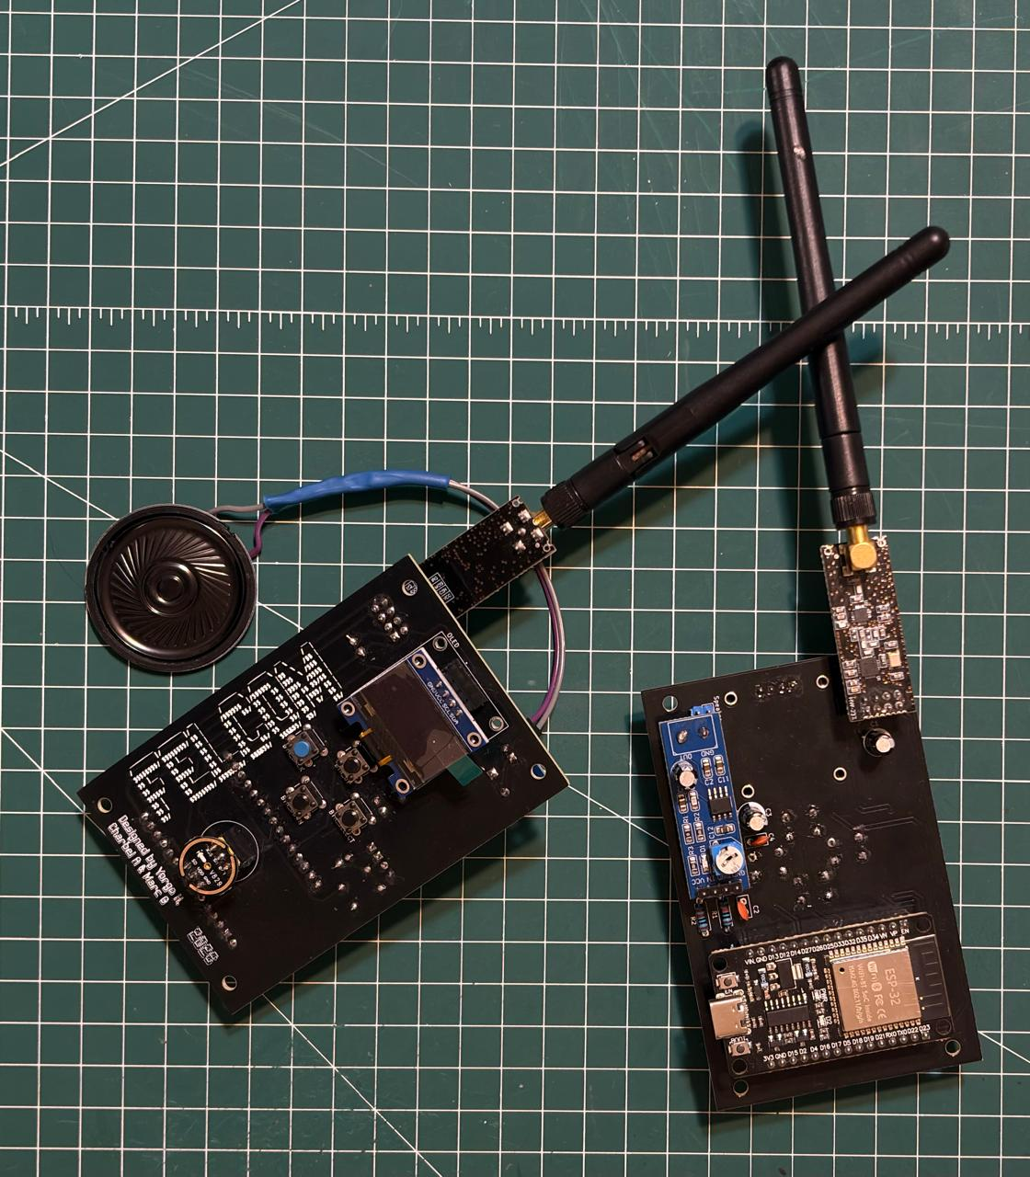
FELCOM
A Secure Handheld Communication Device
Marc Gedeon · Yorgo Hassabou · Charbel Assaad
Mini-Project · 2025 / 2026
Presented to: Dr. Hadi Jerdek
Lebanese University · Faculty of Engineering

Slide 2
Outline
1 Motivation & goals
2 System overview
3 Frequency hopping & sync
4 Packet protocol
5 Forward error correction
6 Real-time audio
7 Security & applications
8 Results & conclusion
FELCOM · Secure Handheld Communication Device
2

Slide 3
Why FELCOM?
Networks rely on fixed infrastructure: a single point of failure.
Off-grid need: a direct link, no third party.
A fixed-frequency radio is easy to jam and intercept.
Answer: spread spectrum, constantly change the frequency.
FELCOM · Secure Handheld Communication Device
3

Slide 4
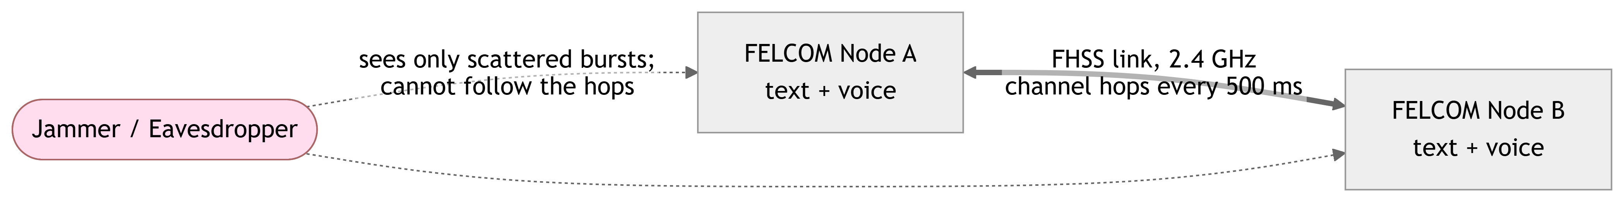
What We Built
Text + live voice over 2.4 GHz, no infrastructure.
Software FHSS: jam and detection resistance.
Custom 32-byte packet protocol with FEC.
Text encryption, BER test, and a Pong demo.
FELCOM · Secure Handheld Communication Device
4

Slide 5
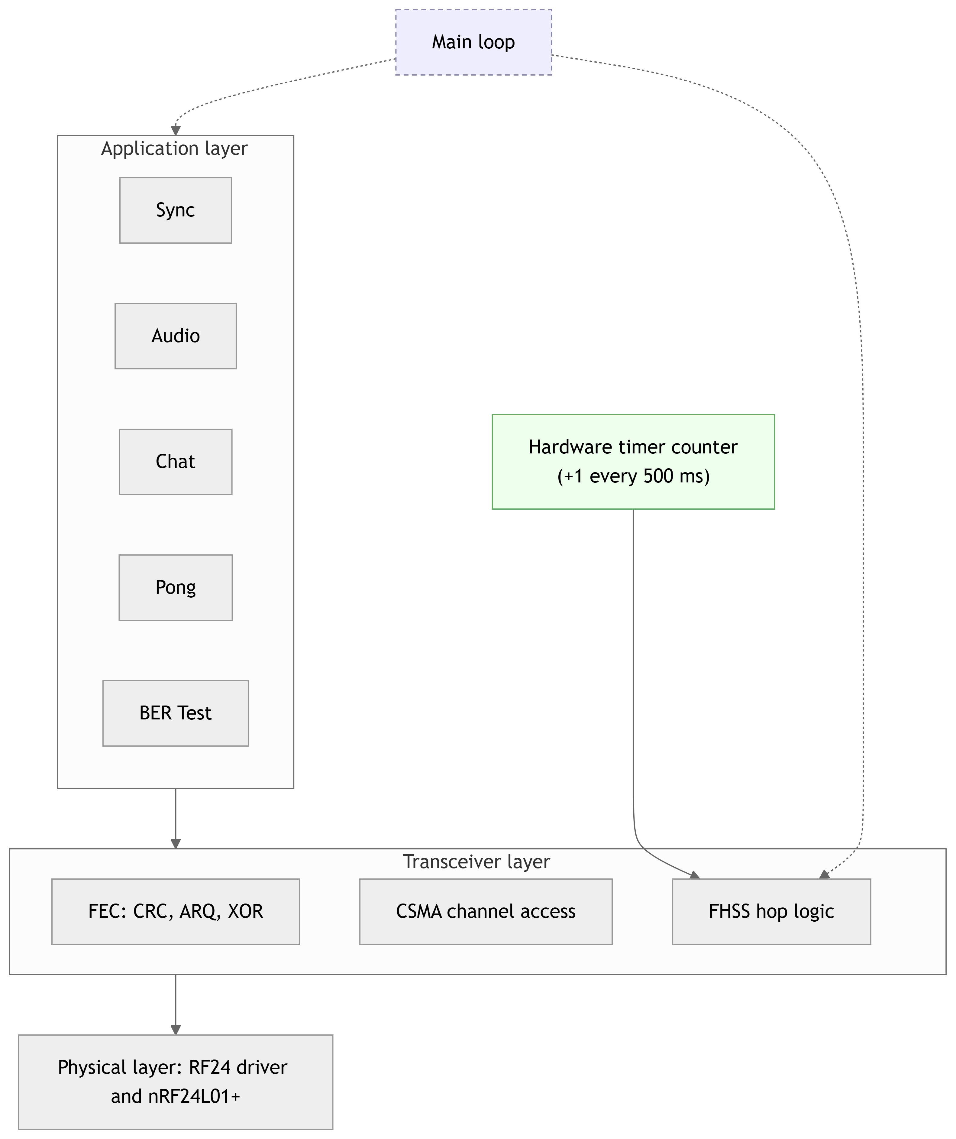
System Overview
ESP32 + nRF24L01+ 2.4 GHz radio (SPI).
INMP441 mic; DAC + LM386 + speaker.
OLED + buttons; custom PCB.
Layered firmware; non-blocking loop.
FELCOM · Secure Handheld Communication Device
5

Slide 6
Frequency Hopping & Synchronization
Six channels (110 to 115), above Wi-Fi.
Hop every 500 ms; full sweep in 3 s.
A jammer only spoils the few matching hops.
A shared counter keeps both nodes aligned.
Manual Sync once, then stable: no drift over 3 h.
// hop every 500 ms from // the shared counter
slot = readCounter() % 6;
setChannel(HOPPING[slot]);
FELCOM · Secure Handheld Communication Device
6

Slide 7
One 32-Byte Frame for Everything
Fixed 32-byte frame (the nRF24 maximum).
Header: src, dst, packet type, FEC metadata.
28 data bytes; one frame for text, voice, control (0xFF = broadcast).
src
1 B
dst
1 B
type + fec
2 B
data
28 B
user payload
26 B
CRC-16
2 B
CRC in the last 2 of the 28 data bytes; ARQ uses the first 2 for a sequence number.
FELCOM · Secure Handheld Communication Device
7

Slide 8
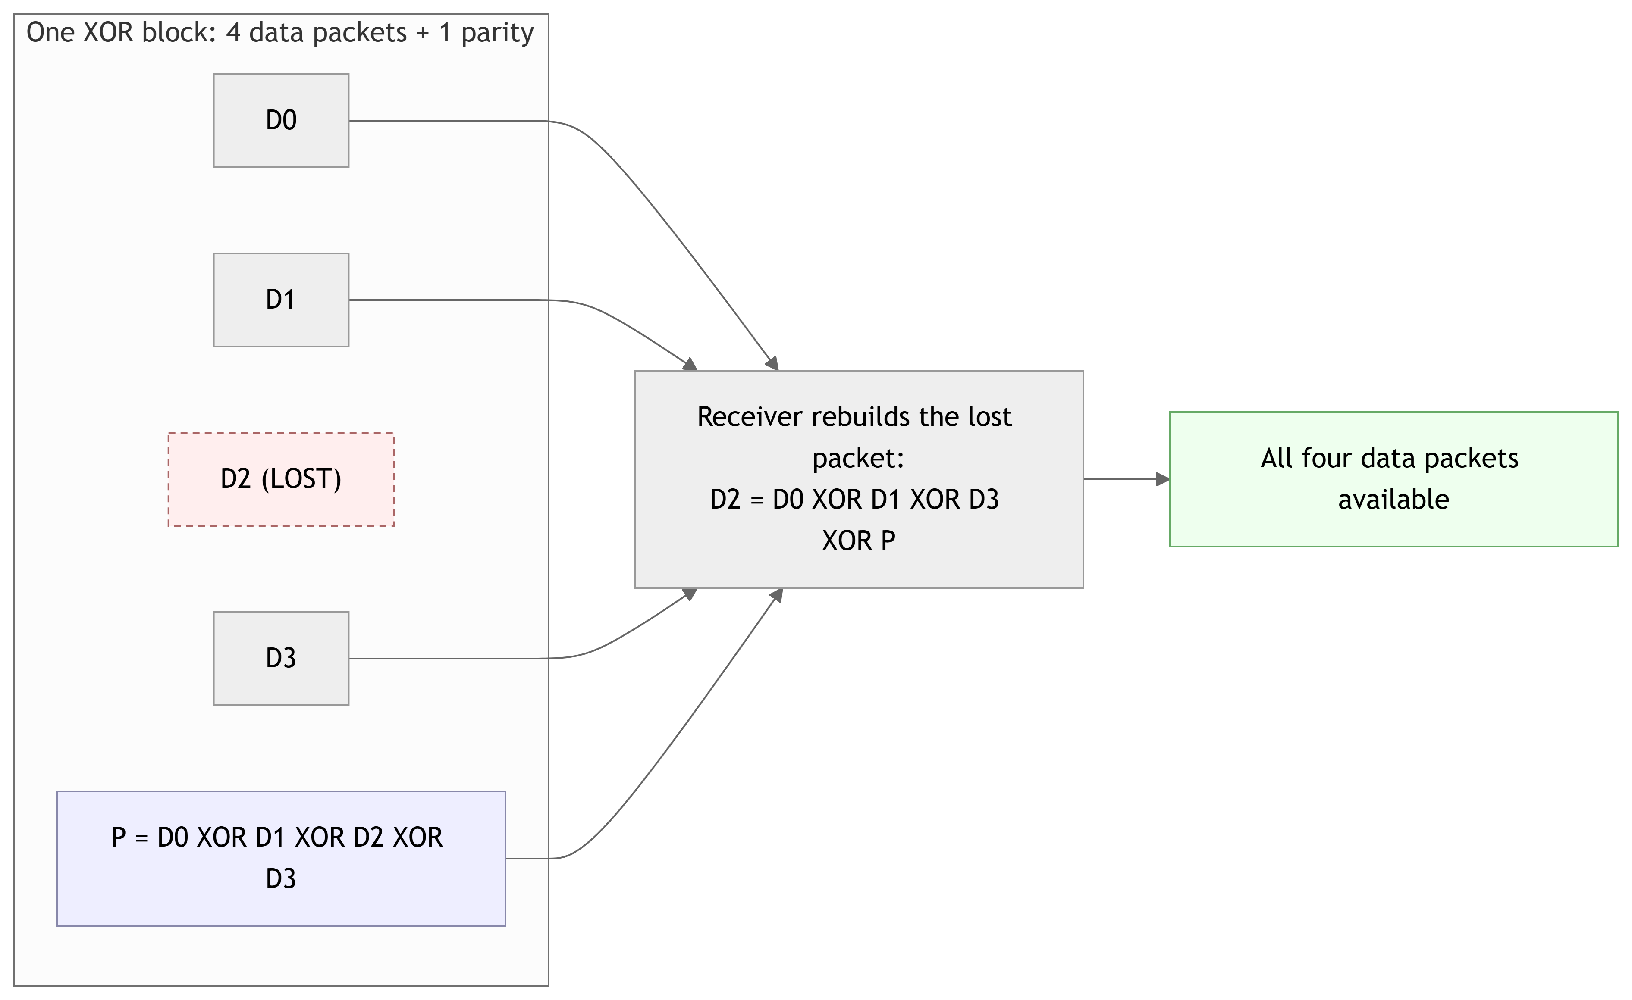
Forward Error Correction
Our own error control (radio CRC and ACK off).
CRC-16: detect and drop corruption.
ARQ (chat): retransmit until acknowledged.
XOR (audio): rebuild one lost packet per block of four.
FELCOM · Secure Handheld Communication Device
8

Slide 9
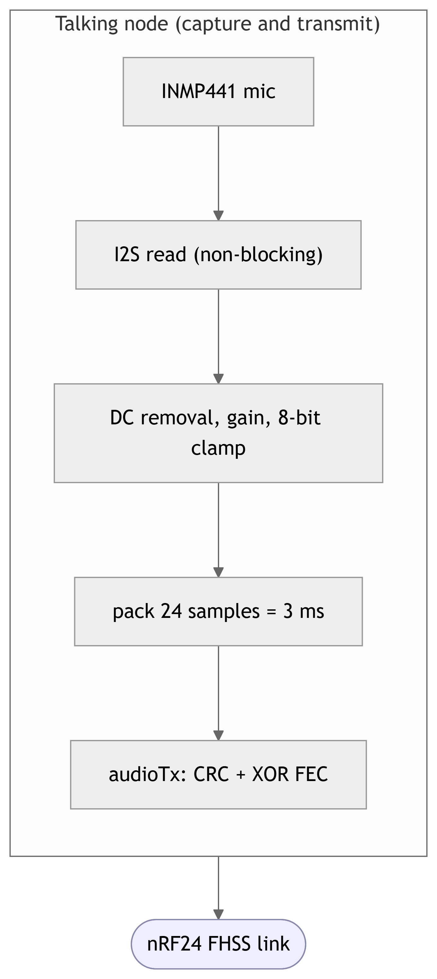
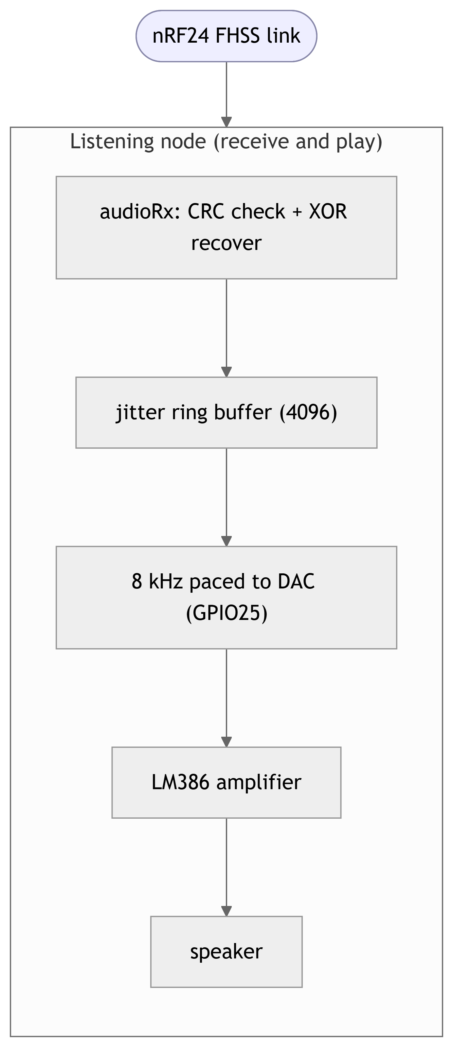
Real-Time Voice
Half-duplex walkie-talkie.
8 kHz, 8-bit voice.
Non-blocking: streams while hopping.
Protected by CRC + XOR FEC.
Transmit (talk)
Receive (listen)
FELCOM · Secure Handheld Communication Device
9

Slide 10
Security & Applications
Security
Application Modes
XOR cipher on chat text.
Obfuscation, not strong crypto.
Hopping makes capture hard.
Sync: align the hop counters.
Chat: reliable encrypted text.
Audio: voice walkie-talkie.
Pong: real-time game.
RF/BER Test: link diagnostics.
FELCOM · Secure Handheld Communication Device
10

Slide 11
Results
Metric | FHSS | No FHSS
Delivered | 85.4% | 48%
Lost | 14.6% | 52%
Bit-error rate | 1% | 19%
Error correction
ARQ: 29 / 32 delivered, 0 corrupt.
XOR: 516 packets rebuilt.
CRC: 2,027 corrupt dropped.
FHSS cut packet loss from 52% to 14.6% on the same channel set.
FELCOM · Secure Handheld Communication Device
11

Slide 12
Challenges & Future Work
Challenges
Future Work
Sync: manual alignment (auto deferred).
Audio pipeline: DAC rework, skip CSMA.
nRF24L01+ modules unreliable.
AES authenticated encryption.
Automatic synchronization.
Larger buffer / stronger code for audio.
FELCOM · Secure Handheld Communication Device
12

Slide 13
Conclusion
Jam-resistant text and voice on cheap hardware.
FHSS is the key: packet loss 52% to 14.6%.
FEC matched per traffic type: CRC, ARQ, XOR.
Built on a custom PCB, validated on real hardware.
Future work: AES encryption and automatic synchronization.

Slide 14
References
[1] Nordic Semiconductor, nRF24L01+ Transceiver Product Specification.
[2] Espressif Systems, ESP32 Technical Reference Manual and Datasheet.
[3] InvenSense (TDK), INMP441 I2S Microphone Datasheet.
[4] Texas Instruments, LM386 Audio Power Amplifier Datasheet.
[5] TMRh20, RF24: Optimized driver for nRF24L01(+) (open source).
[6] Lamarr & Antheil, Secret Communication System, U.S. Patent 2,292,387, 1942.
[7] ITU-T Recommendation V.41, CRC-16-CCITT.
[8] A. Goldsmith, Wireless Communications, Cambridge University Press.
FELCOM · Secure Handheld Communication Device
14

Slide 15
Acknowledgments
We would like to thank Dr. Hadi Jerdek, for his supervision of this project and for the valuable knowledge he shared with us through the telecommunications courses he taught.
We also thank the Lebanese University for allowing us to use its open air to test our devices.
Thank you · Questions?

