Slide 1

Statecharts for the many:
Algebraic State Transition Diagrams
Marc Frappier
GRIL – Groupe de recherche en ingénierie du logiciel

Slide 2
Plan
Statecharts and information system specifications
ASTD : Algebraic State Transition Diagrams
Semantics of ASTD
Conclusion

Slide 3
Statecharts
graphical notation
hierarchy + orthogonality
  hierarchical states
  AND states (parallel)
  OR states (choice)
nice for single instance behaviour
parameterized states in Harel’s seminal paper (SCP 87)
  “never” implemented or formalised

Slide 4
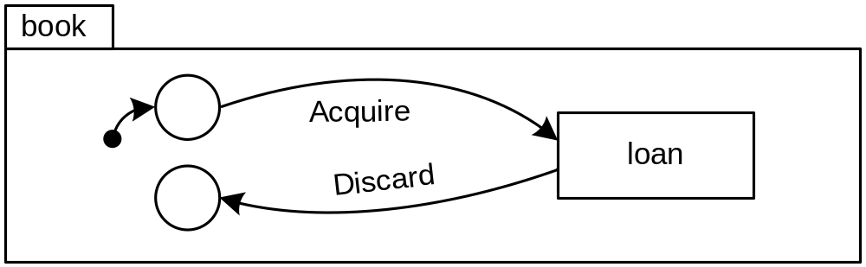
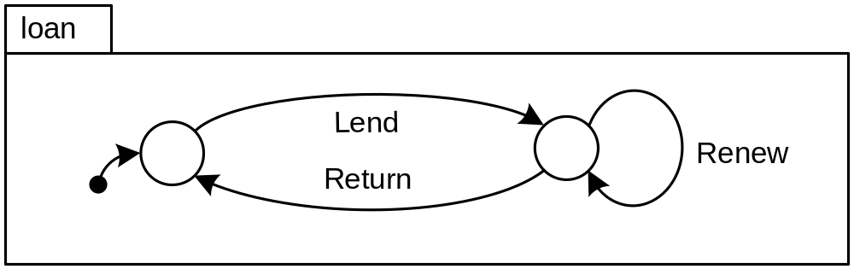
A library in statecharts

Slide 5
Problems
only describes behaviour of a single book
  how to deal with several books?
    put n copies of book in parallel
      not defined in statecharts or UML
      available in ROSE RT, but it is not quite what we want here
can discard an unreturned book
  could add a guard to discard
    unnecessary complexity
  could make discard a transition from an inner state of loan
    introduce coupling between book and loan

Slide 6
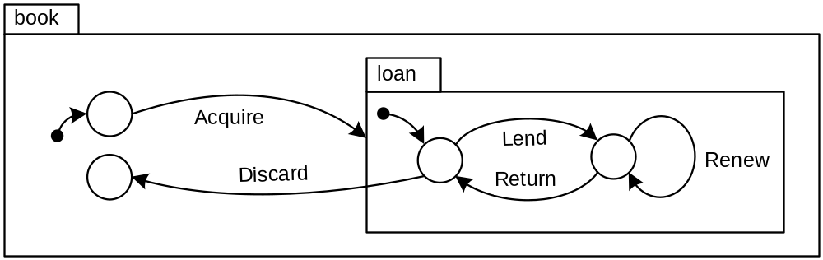
Potential solutions
book knows about the structure of loan
  makes loan less reusable
  makes maintenance more difficult

Slide 7
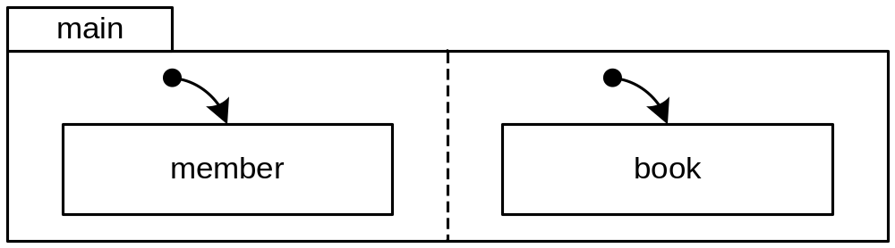
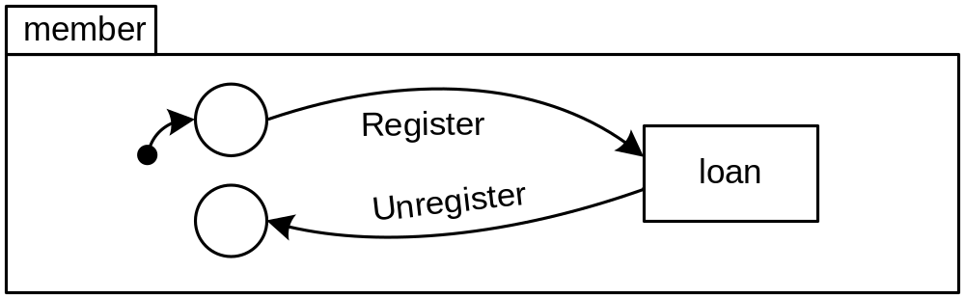
Adding members

Slide 8
Problems
a member can borrow several books in parallel
  can’t “easily” express that in statecharts or UML
    State explosion
two calls to loan
  one in member, one in book
  they both get the lend event
  OK if only one member
  KO if we have several members trying to borrow the same book
    could remove loan from member
      must add guard to Unregister to check for completed loan
      loose visual ordering constraint
Notes:
UML RT
each copie of a capsule has its own port; hence, an event for a boo must be sent to the port of that book

Slide 9
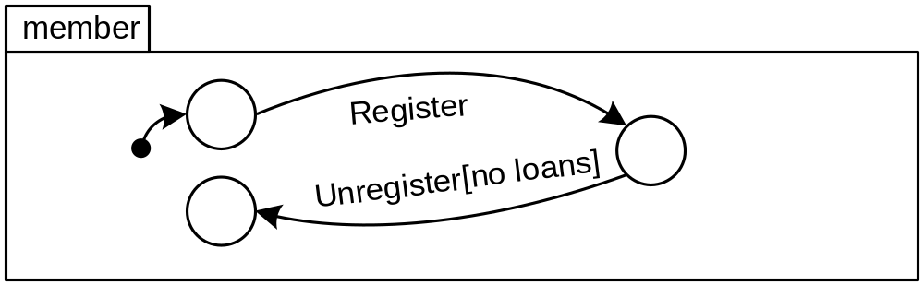
Potential solutions
remove loan from member
  loose visual ordering constraint between member and loan
    replaced by a guard
  need state variable

Slide 10
The single instance view:
A weakness of statecharts
both statecharts and UML state machines are designed to represent a single instance
  eg, controller, object of a class, etc
they offer no convenient means to express relationships between multiple instances
in practice, designers only describe the single instance behaviour
  leave it to the implementer to figure out the multiple instance case

Slide 11
A solution: Process algebra
CCS, CSP, ACP, LOTOS, EB³, ...
algebra
  operators to combine process expressions
    sequence, choice, interleave, synchronisation, guard, ...
    quantification
  operators are the essence of abstraction
    combine small units to build large units
    operators foster abstraction by masking internal details

Slide 12
A Process expression for books
book(b : BookId ) =
Acquire(b,_)
•
loan( _, b)
•
Discard(b)
matches any value
Sequential composition
Kleene closure

Slide 13
A process expression for loans
guard
loan(mId:Member, IDbId:BookID ) =
nbLoans(mId) < maxNbLoans(mId)
 Lend(mId, bId)
•
Renew(bId)
•
Return(bId)

Slide 14
A process expression for members
member(m : MemberId ) =
Register(m, _, _)
•
(  b : BookId : loan( m, b) )
•
Unregister(m)
interleave quantification over all books

Slide 15
Interleave quantification
 x : {1,2,3} : P(x)
=
P(1)  P(2)  P(3)

Slide 16
Main process expression
main =
(  b : BookId : book(b) )

(  m : MemberId : member(m) )
Synchronisation over common actions

Slide 17
Synchronisation over common actions
a(1) • b(1) • c(1)

|x : T : a(x) • b(x) • c(2)
=
a(1) • b(1) • STOP
quantified choice

Slide 18
ASTD
Algebraic State Transition Diagrams
ASTD = statecharts + process algebra
  graphical notation
  power of abstraction
statecharts become elementary process expressions
  combine them using operators
formal semantics
  operational semantics

Slide 19
ASTD Operators
⇨ : sequence
| : choice
  |x : quantified choice
 : Kleene closure
 : guard
|[ A ]|: parallel composition with synchronisation on A
   interleave,  parallel composition
  x, |[ ]|x : quantified version
ASTD call : allows recursive calls

Slide 20
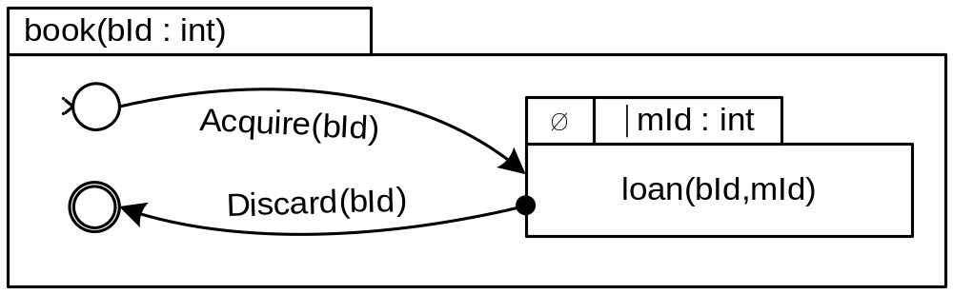
A book ASTD
initial state
operators applied from left to right
final transition:
can trigger only if its source is in a final state
final state

Slide 21
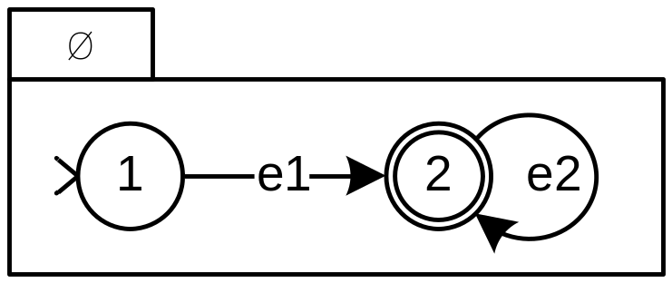
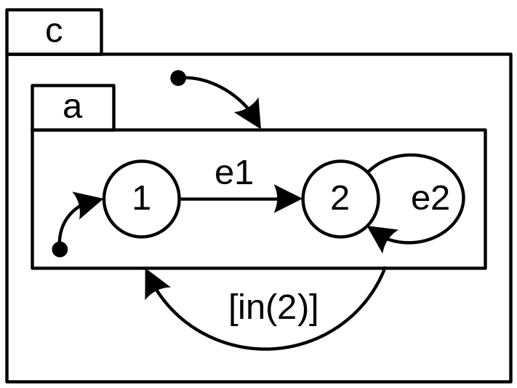
Closure applied to an ASTD
 means execute the ASTD an arbitrary number of times, including 0
  when the ASTD is in a final state, it can start again from its initial state
example traces are
  empty trace
  e1,e2,e2,...,e1,e1,e2, ...

Slide 22
The closure ASTD type
(, body )
 denotes the type constructor for a closure
body is an ASTD (of any type)

Slide 23
The closure state type
০ is the closure state type constructor
started? is a boolean value that indicates if its component has started its first iteration
s is the state of its component
( ০ ,started?, s )

Slide 24
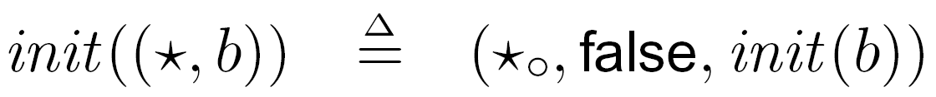
States of a closure
function that defines the initial state of an ASTD
closure ASTD
closure initial state
initial state
  is the initial state of its component
final states
  its initial state
  final states of its component
function that determines if a state is final

Slide 25
Final state
an ASTD does not terminate when its current state is final
a final state simply enables transitions of another ASTD within a
  closure
  sequence

Slide 26
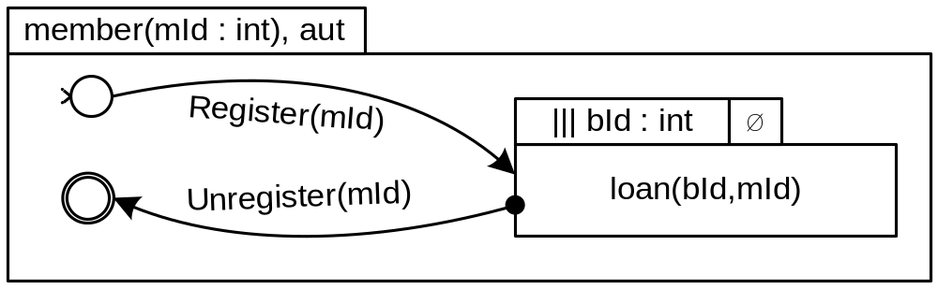
A member ASTD

Slide 27
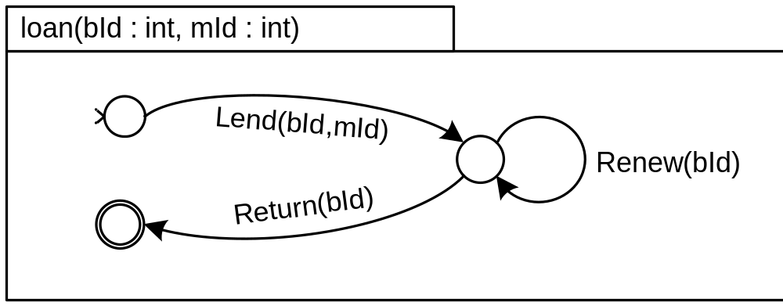
A loan ASTD

Slide 28
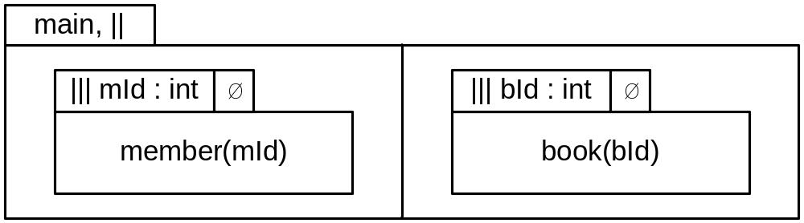
The main ASTD
n-ary operator
operands of ||

Slide 29
Power of abstraction
suppose you have two statecharts, a and b
you want to compose them as follows
  execute a an arbitrary number of times
  then execute b an arbitrary number of times
  then start over again, an arbitrary number of times
can’t do it in statecharts without peeking into a and b’s structure with guards
  introduce a dependency between the compound and the components

Slide 30
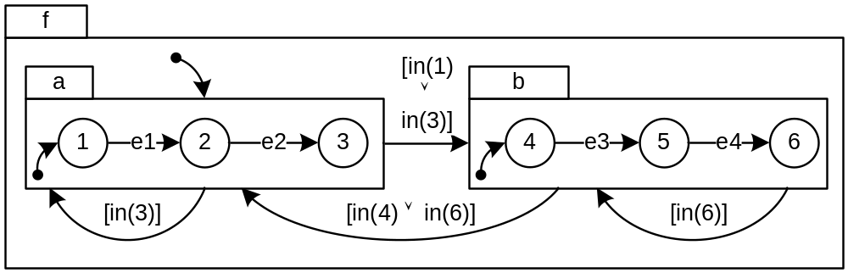
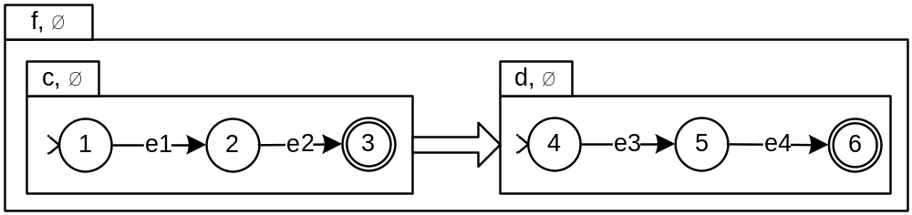
Power of abstraction
sequential composition

Slide 31
The sequence ASTD type
(⇨, left, right)
⇨ denotes the sequence ASTD type constructor
left and right are ASTDs

Slide 32
The sequence state type
⇨০ denotes the sequence state type constructor
side denotes the current side of the sequence
  left
  right
s denotes the state of the side component
(⇨০, side, s)

Slide 33
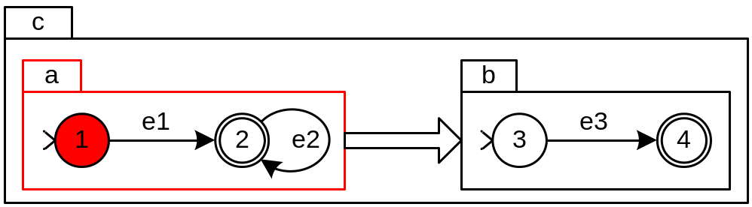
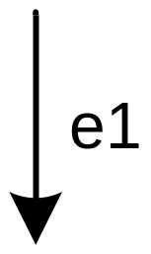
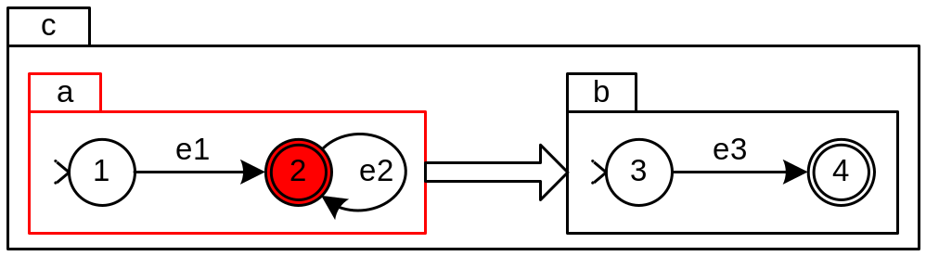
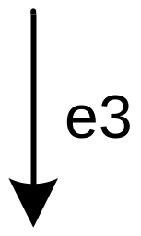
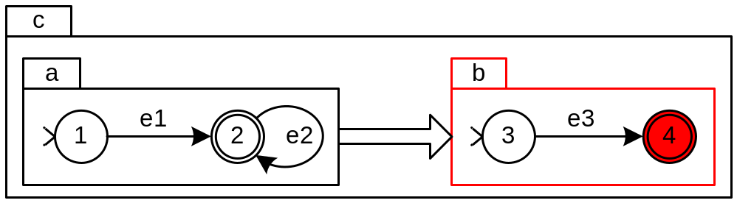
State transitions
(⇨০,left,1)
(⇨০,left,2)
(⇨০,right,4)

Slide 34

State transitions
(⇨০,left,1)
(⇨০,left,2)
(⇨০,left,2)

Slide 35
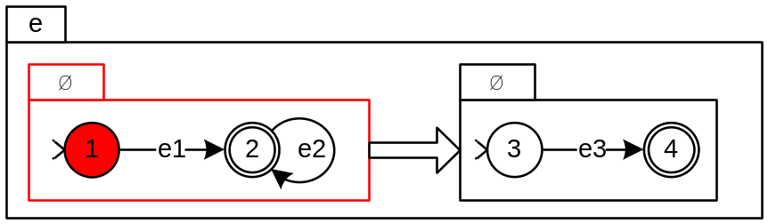
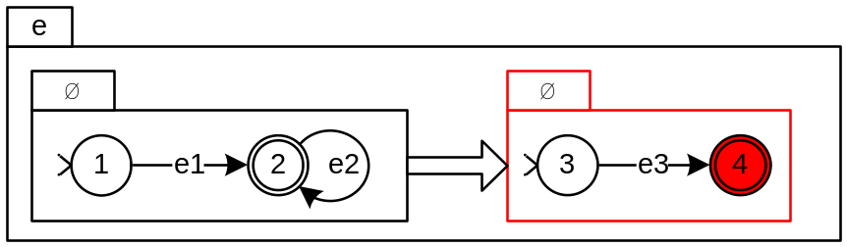
State transitions
(⇨০,left,(০,➢started, 1))
(⇨০,right,(০,started, 4))
(⇨০,right,(,started, 4))

Slide 36
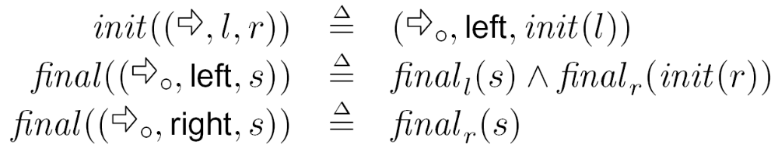
Initial and final states of a sequence ASTD

Slide 37
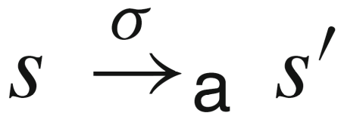
Operational semantics
first used by Milner for CCS
transitions
ASTD a can execute  from state s and move to state s’

Slide 38
Operational semantics
transitions defined by a set of inference rules
rules for each operator
allows non-determinism
  if several transitions can fire from s, then one is nondeterministically chosen
  no priority

Slide 39
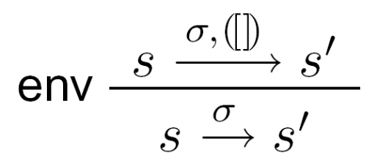
Inference rules
first rules deals with environment, noted ([ ]), to manage variables introduced by
  quantifications
  process parameters

Slide 40
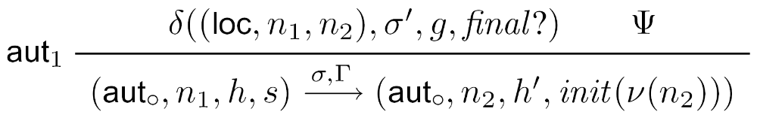
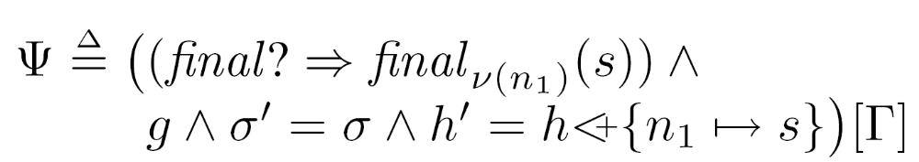
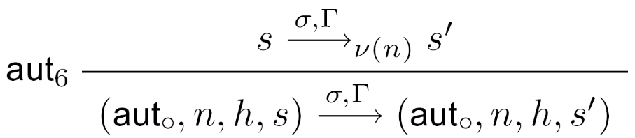
Automaton inference rules
similar to traditional  of an automaton
execute an automaton transition
execute a transition of the component

Slide 41
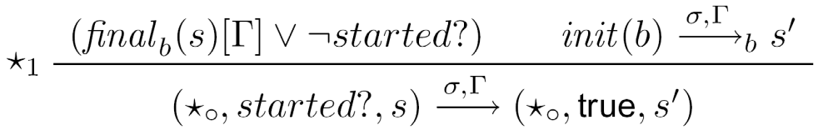
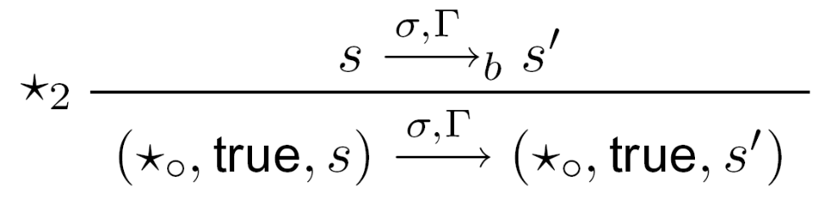
Closure inference rules
execute from the initial state of the component
execute the component when started

Slide 42
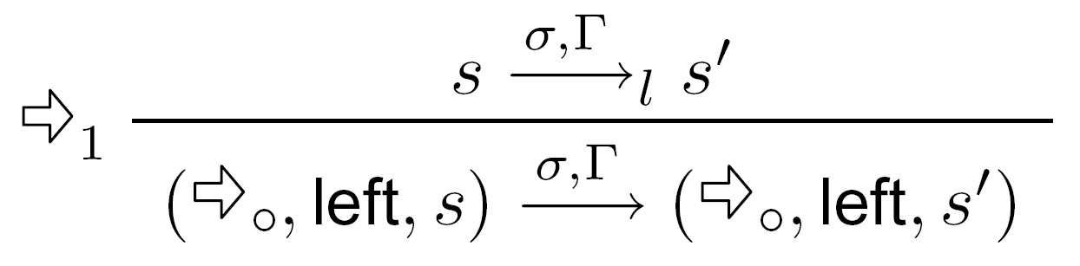
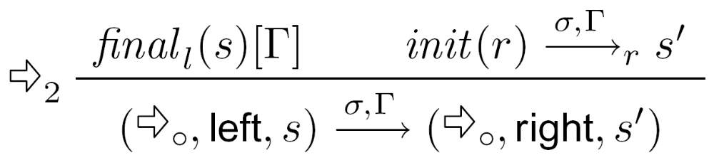
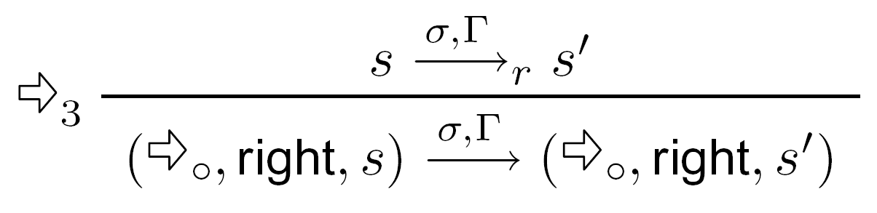
Sequence inference rules
execute on left
execute on right
when left is final
execute the right component

Slide 43
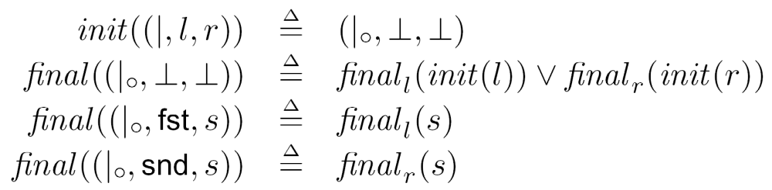
Choice: initial and final states
Choice state
(|০,side,s)

Slide 44
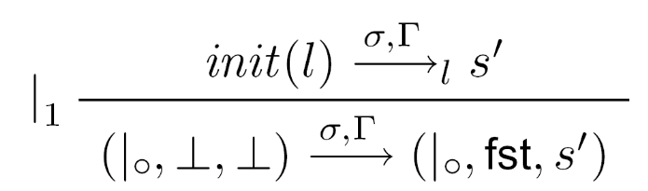
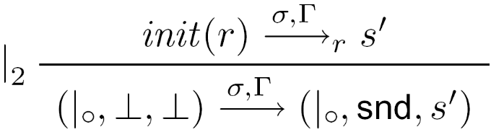
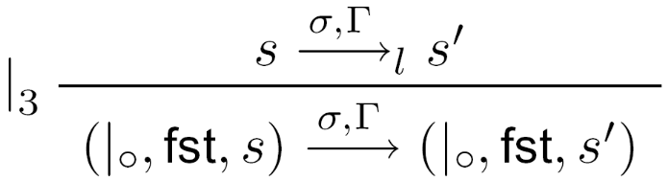
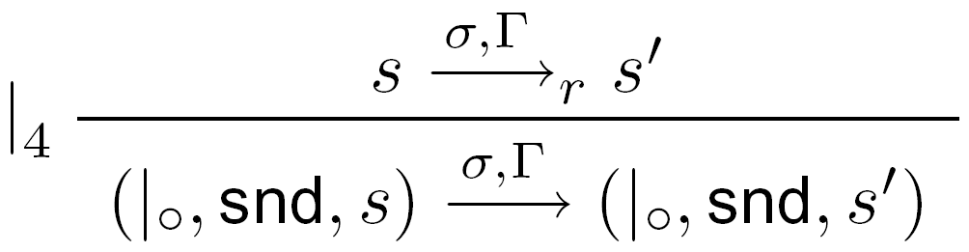
Choice inference rules
execute the first component from its initial state
execute the second component from its initial state
execute the first component when it has been selected
execute the second component when it has been selected

Slide 45
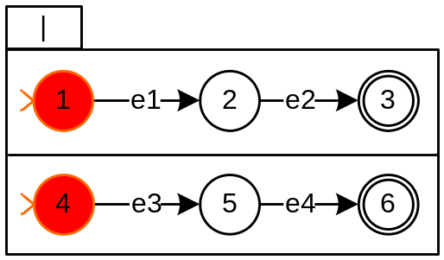
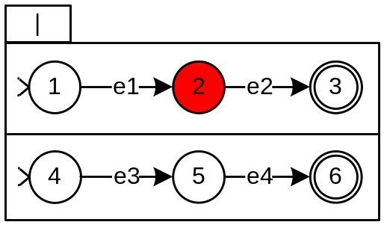
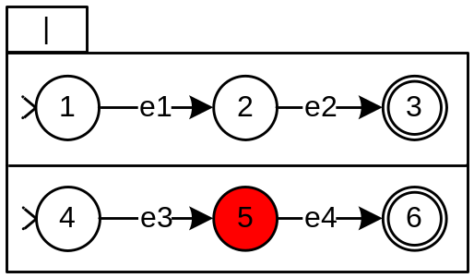
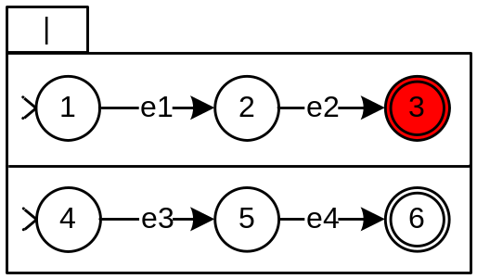
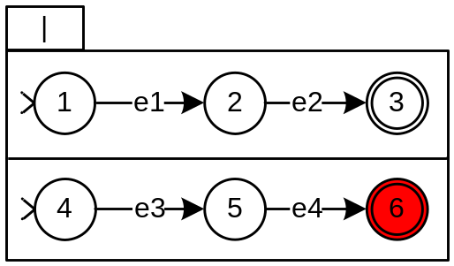
Choice example
(|০,,)
e1
e3
(|০,fst,2)
(|০,snd,5)
e2
e4
(|০,fst,3)
(|০,snd,6)

Slide 46
Integration with the business class diagram
loan
Lend
Renew
Return
book
date
member
Acquire
Discard
ListBook
1
Register
Unregister
*
borrower
memberId
name
nbLoans
maxNbLoans
bookId
title

Slide 47
State variables
the system trace is the only state variable
entity attributes are functions on this trace
attributes can be used anywhere in ASTDs
  guard, quantification sets, ...
nbLoans(mId : MemberId) =
Register(mId, _ ) : 0,
Lend(mId, _) : 1 + nbLoans(mId),
Return(bId) : if borrower(bId) = mId
then nbLoans(mId) - 1,
Unregister(mId, _ ) : ;

Slide 48
Conclusion
process algebra operators can improve the expressiveness of statecharts
complete, precise models of information systems
  not just single instance scenarios, but also multiple instance scenarios
future work
  tools for animation
  model checking
  code generation

