Slide 1
Dataflow Performance Modeling Tutorial
Marc Geilen, m.c.w.geilen@tue.nl
Electronic Systems, Dept. Electrical Engineering, Eindhoven university of Technology
Research funded by European Commission under grant agreement number 101070374

Slide 2
Context & Objectives
WP6, compositional analysis methods for design space exploration
Analysis techniques to assess performance of a proposed mapping
Feedback about bottlenecks or critical paths
to support exploration

Slide 3
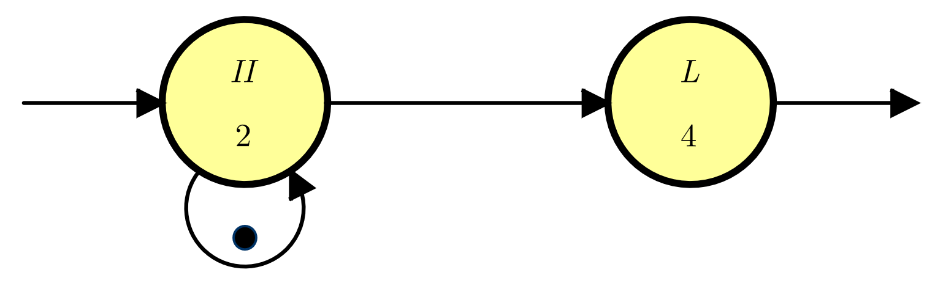
Dataflow Models
Dataflow: model of activities and dependencies

Slide 4
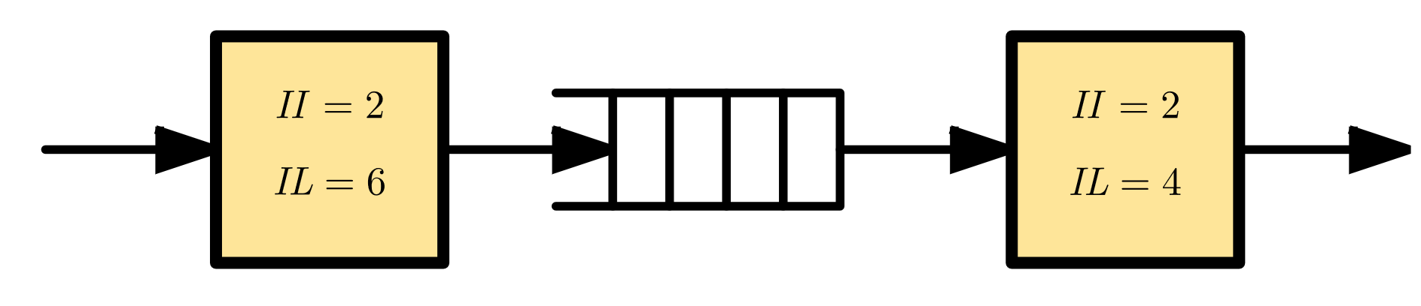
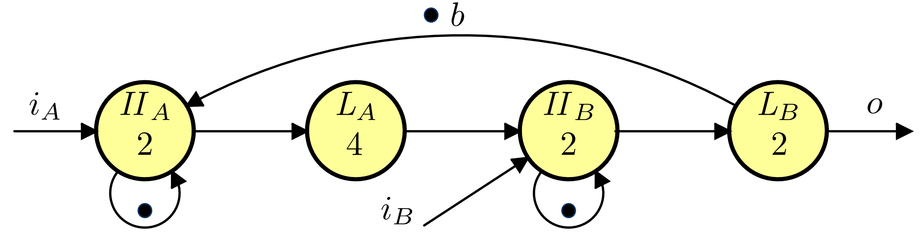
Example

Slide 5
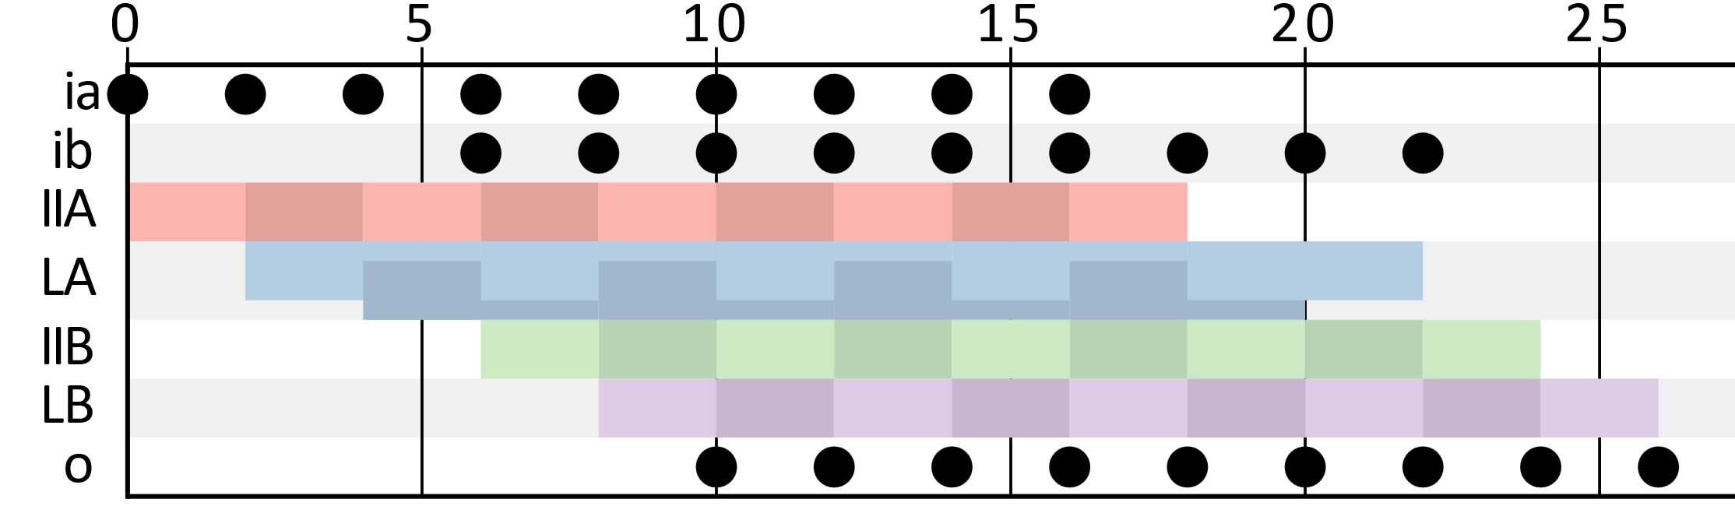
Gantt chart (1)
Maximum throughput ASAP execution

Slide 6
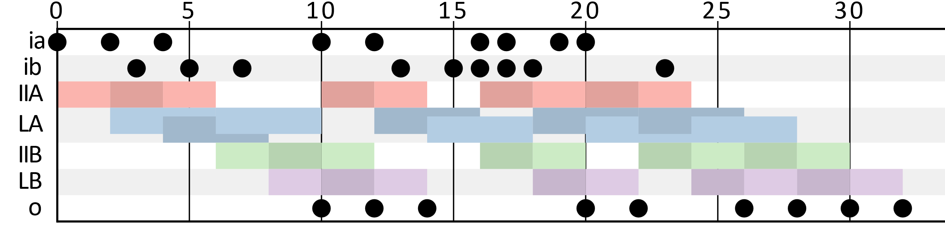
Gantt chart (2)
Input dependencies

Slide 7
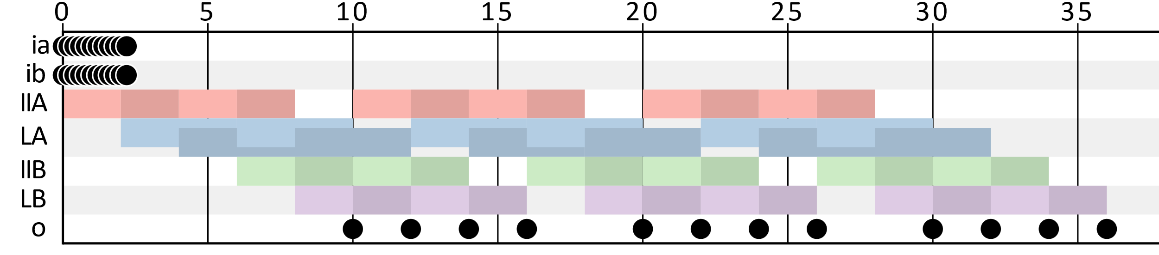
Gantt chart (3)
Buffer capacity bottleneck

Slide 8
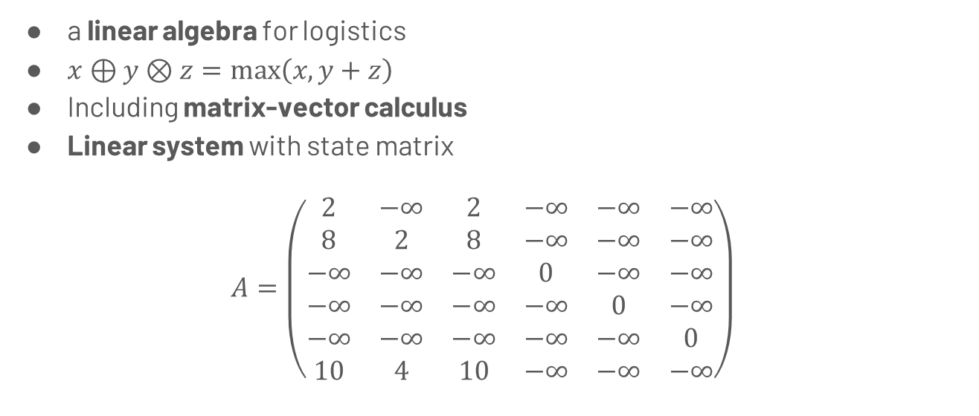
Max-plus Algebra
a linear algebra for logistics
$x⊕y⊗z=max\left(x,y+z\right)$
Including matrix-vector calculus
Linear system with state matrix
$$A=\left(\begin{matrix}2 & −∞ & 2 & −∞ & −∞ & −∞ \\ 8 & 2 & 8 & −∞ & −∞ & −∞ \\ −∞ & −∞ & −∞ & 0 & −∞ & −∞ \\ −∞ & −∞ & −∞ & −∞ & 0 & −∞ \\ −∞ & −∞ & −∞ & −∞ & −∞ & 0 \\ 10 & 4 & 10 & −∞ & −∞ & −∞\end{matrix}\right)$$

Slide 9
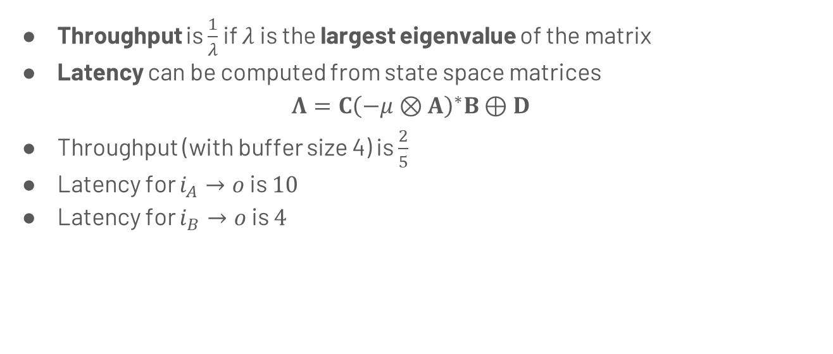
Performance analysis
Throughput is $\frac{1}{λ}$ if $λ$ is the largest eigenvalue of the matrix
Latency can be computed from state space matrices
$$Λ=C{\left(−μ⊗A\right)}^{∗}B⊕D$$
Throughput (with buffer size 4) is $\frac{2}{5}$
Latency for $i_{A}→​o$ is $10$
Latency for $i_{B}→​o$ is $4$

Slide 10
Analysis
Analysis provides performance numbers
Models allow (automatic) exploration of trade-offs between resource allocation and performance
e.g., buffer size vs throughput
feedback about performance bottleneck may provide guidance for design-space exploration.

Slide 11
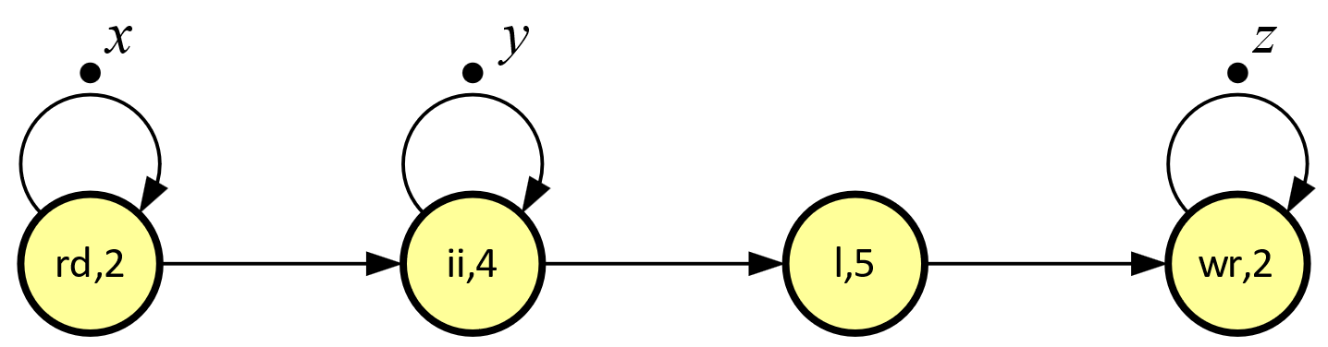
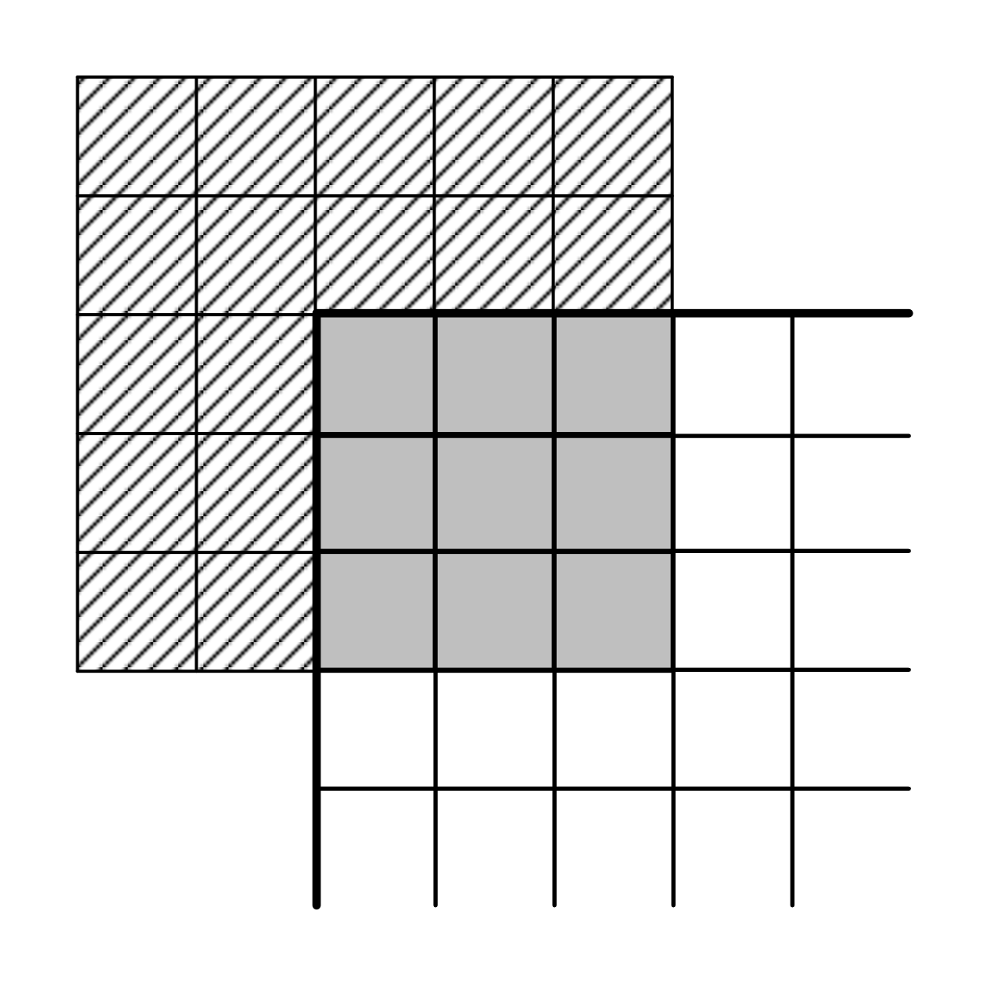
Scaling and Dynamism
we need to go to millions (?) of neurons
multi-rate
varying delays
modes / scenarios
mode | rd | ii | l | wr
ri | 2 | 2 | 0 | 0
cm | 2 | 4 | 5 | 2
ro | 0 | 3 | 4 | 2

Slide 12
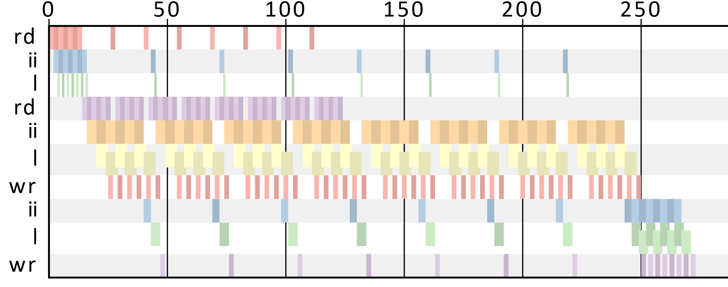

Gantt chart
$$ri^{6}⋅​{\left(ri⋅​{cm}^{6}⋅​ro\right)}^{8}⋅​ro^{6}$$

Slide 13

Compositionality
Computing the overall max-plus matrix is still efficient
$$A_{ri}^{6}{\left(A_{ri}A_{cm}^{6}A_{ro}\right)}^{8}A_{ro}^{6}$$
Tracking critical path still possible
Repetition patterns can be compositionally computed from modules
van der Vlugt, S., Alizadeh Ara, H., de Jong, R. et al. Modeling and Analysis of FPGA Accelerators for Real-Time Streaming Video Processing in the Healthcare Domain. J Sign Process Syst 91, 75–91 (2019). https://doi.org/10.1007/s11265-018-1414-3

Slide 14
Demo
http://computationalmodeling.info/cmwb
http://www.es.ele.tue.nl/sdf3
https://github.com/Model-Based-Design-Lab/cmlib
https://computationalmodeling.info/static/mpd/

