Slide 1
Object Recognition using BOLD Features
06/03/15
| <number>
Marc Groefsema (s2055236) & Marc de Groot (s2803445)

Slide 2
Previously on Alice gets BOLD
<<insert previous relevant slides explaining BOLD>>

Slide 3

Alice on LSD
Using a Line Segment Detector we can try and estimate the image using nothing but a bunch of lines.

Slide 4
When things get BOLD
Bunch of Lines from LSD
Extract angle information from the lines
Create histogram of angle tuples.
=> BOLD Feature!
We can store trained data, which can quickly be loaded at a later moment.

Slide 5
Alice getting BOLD
BOLD does not get the points.

Slide 6

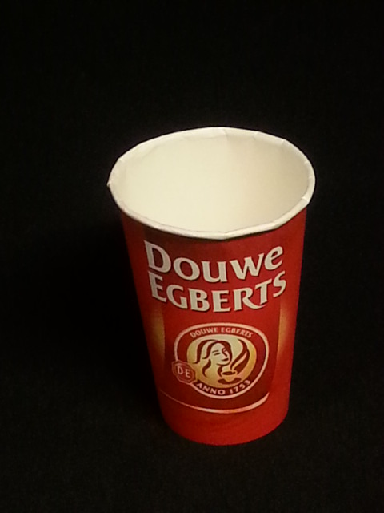
BVD_M01 – A custom training set.
Customized dataset.
Nearly every item from the BORG closet.
24 items.

Slide 7
Customized dataset.
Nearly every item from the BORG closet.
24 items.
Our BOLD classifier gets 40% correct in a 20-fold cross-validation with all items
(9% test,91% training)

