Slide 1
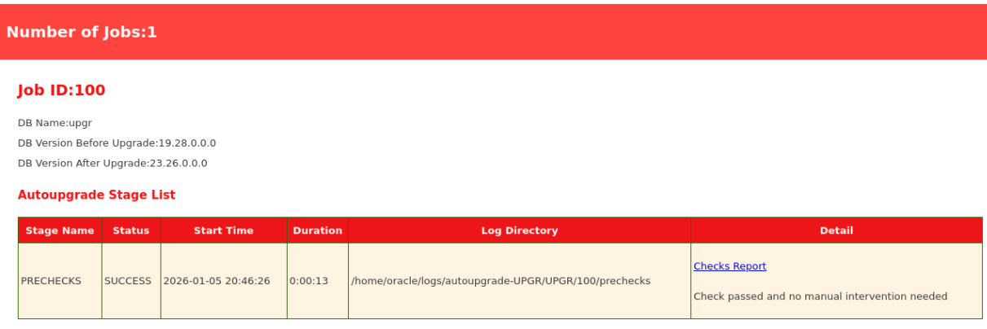

Slide 2
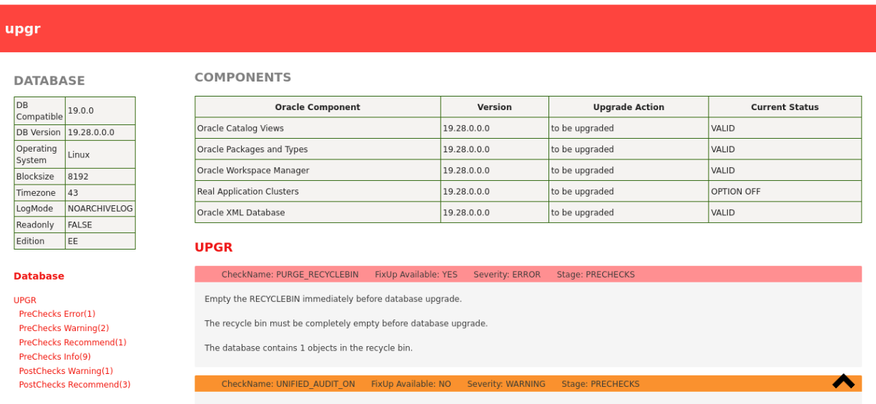

Slide 3
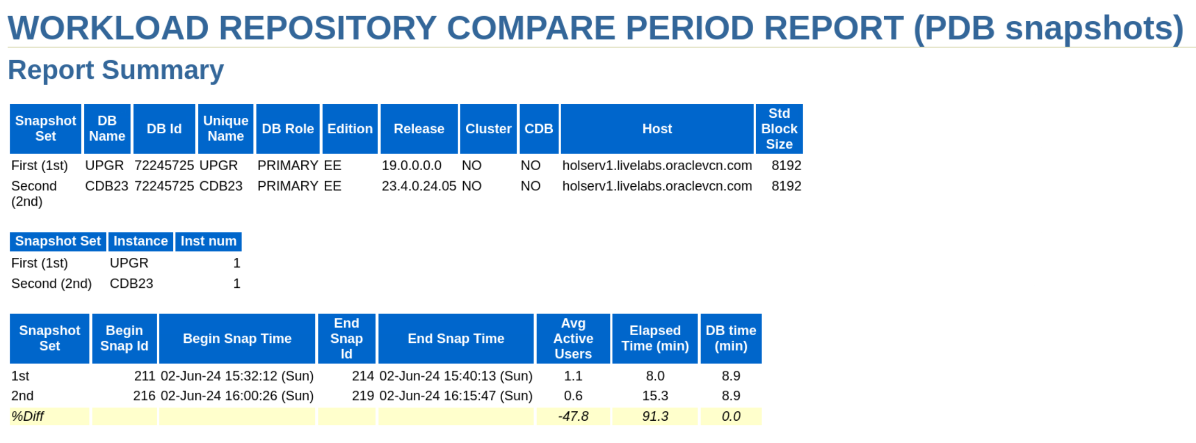
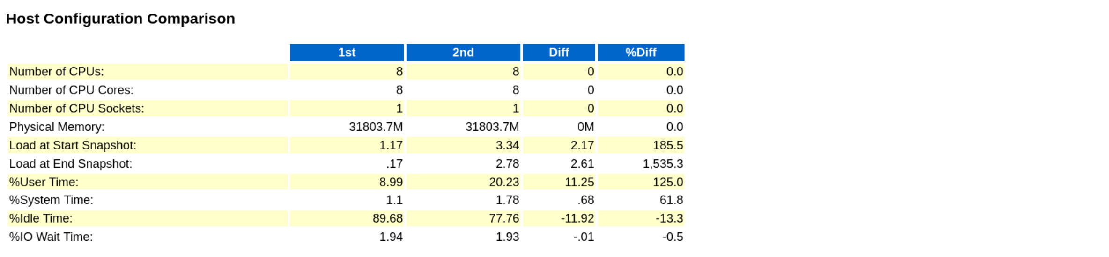

Slide 4
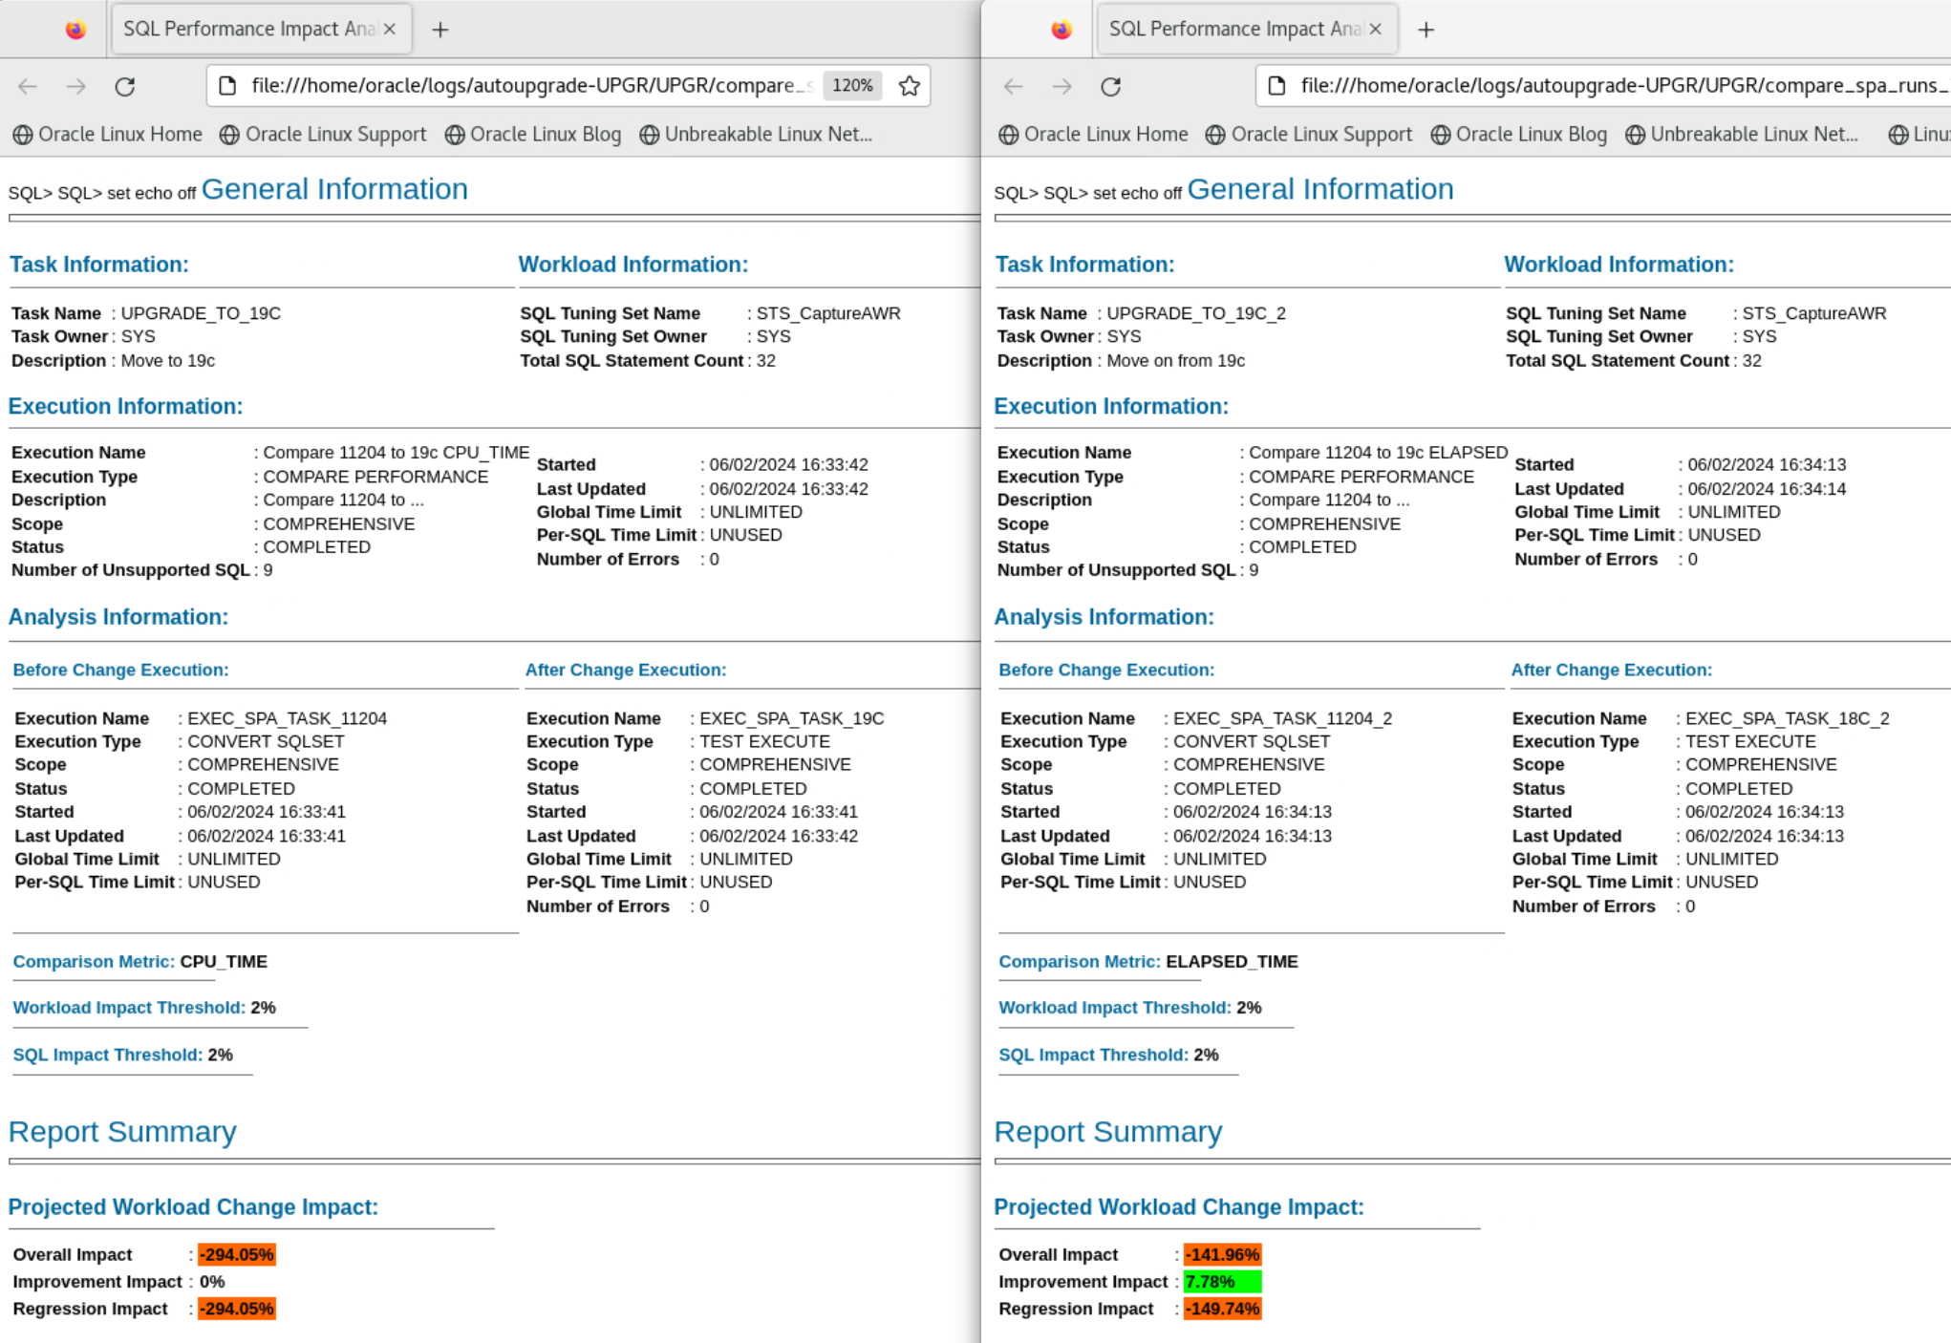
OLD

Slide 5
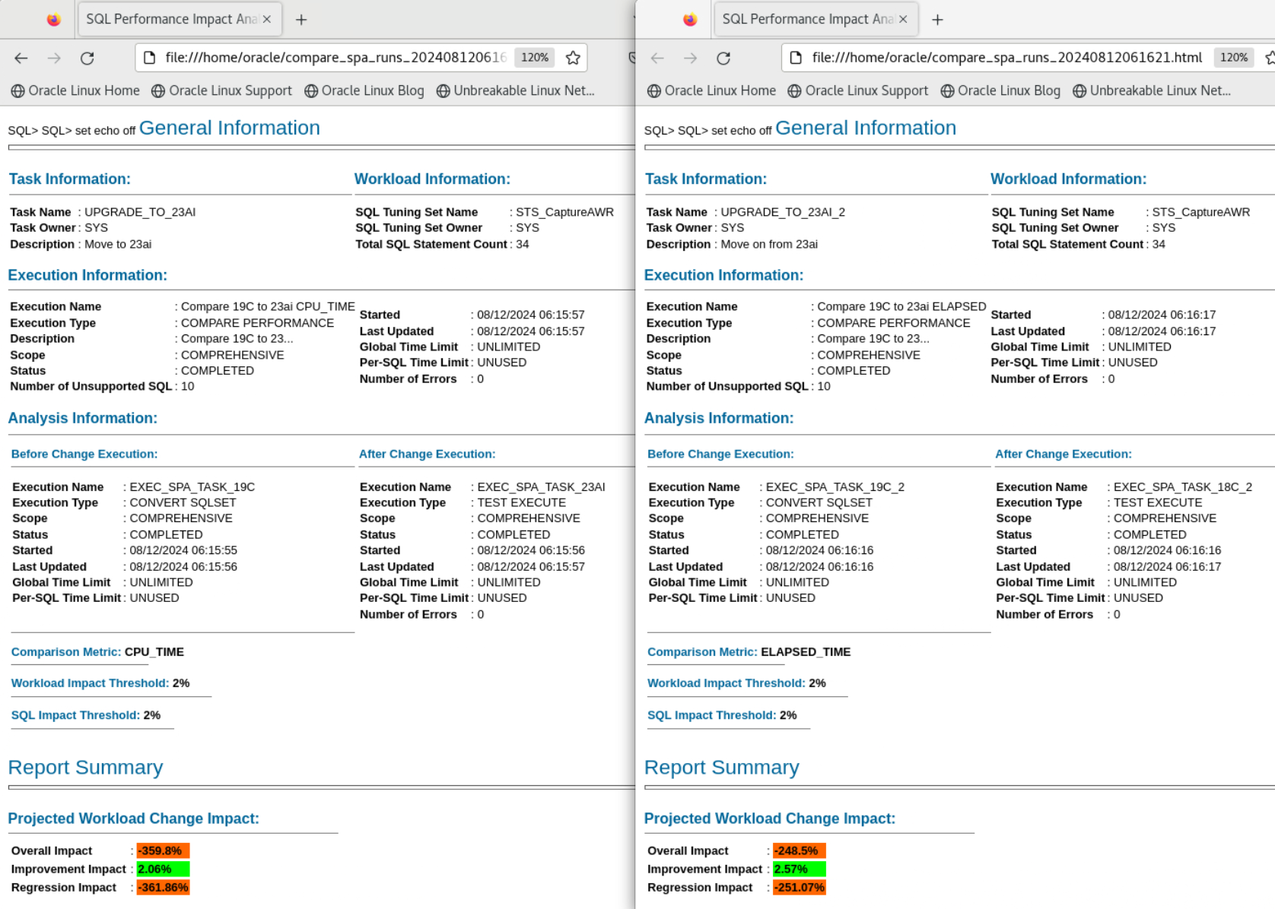

Slide 6
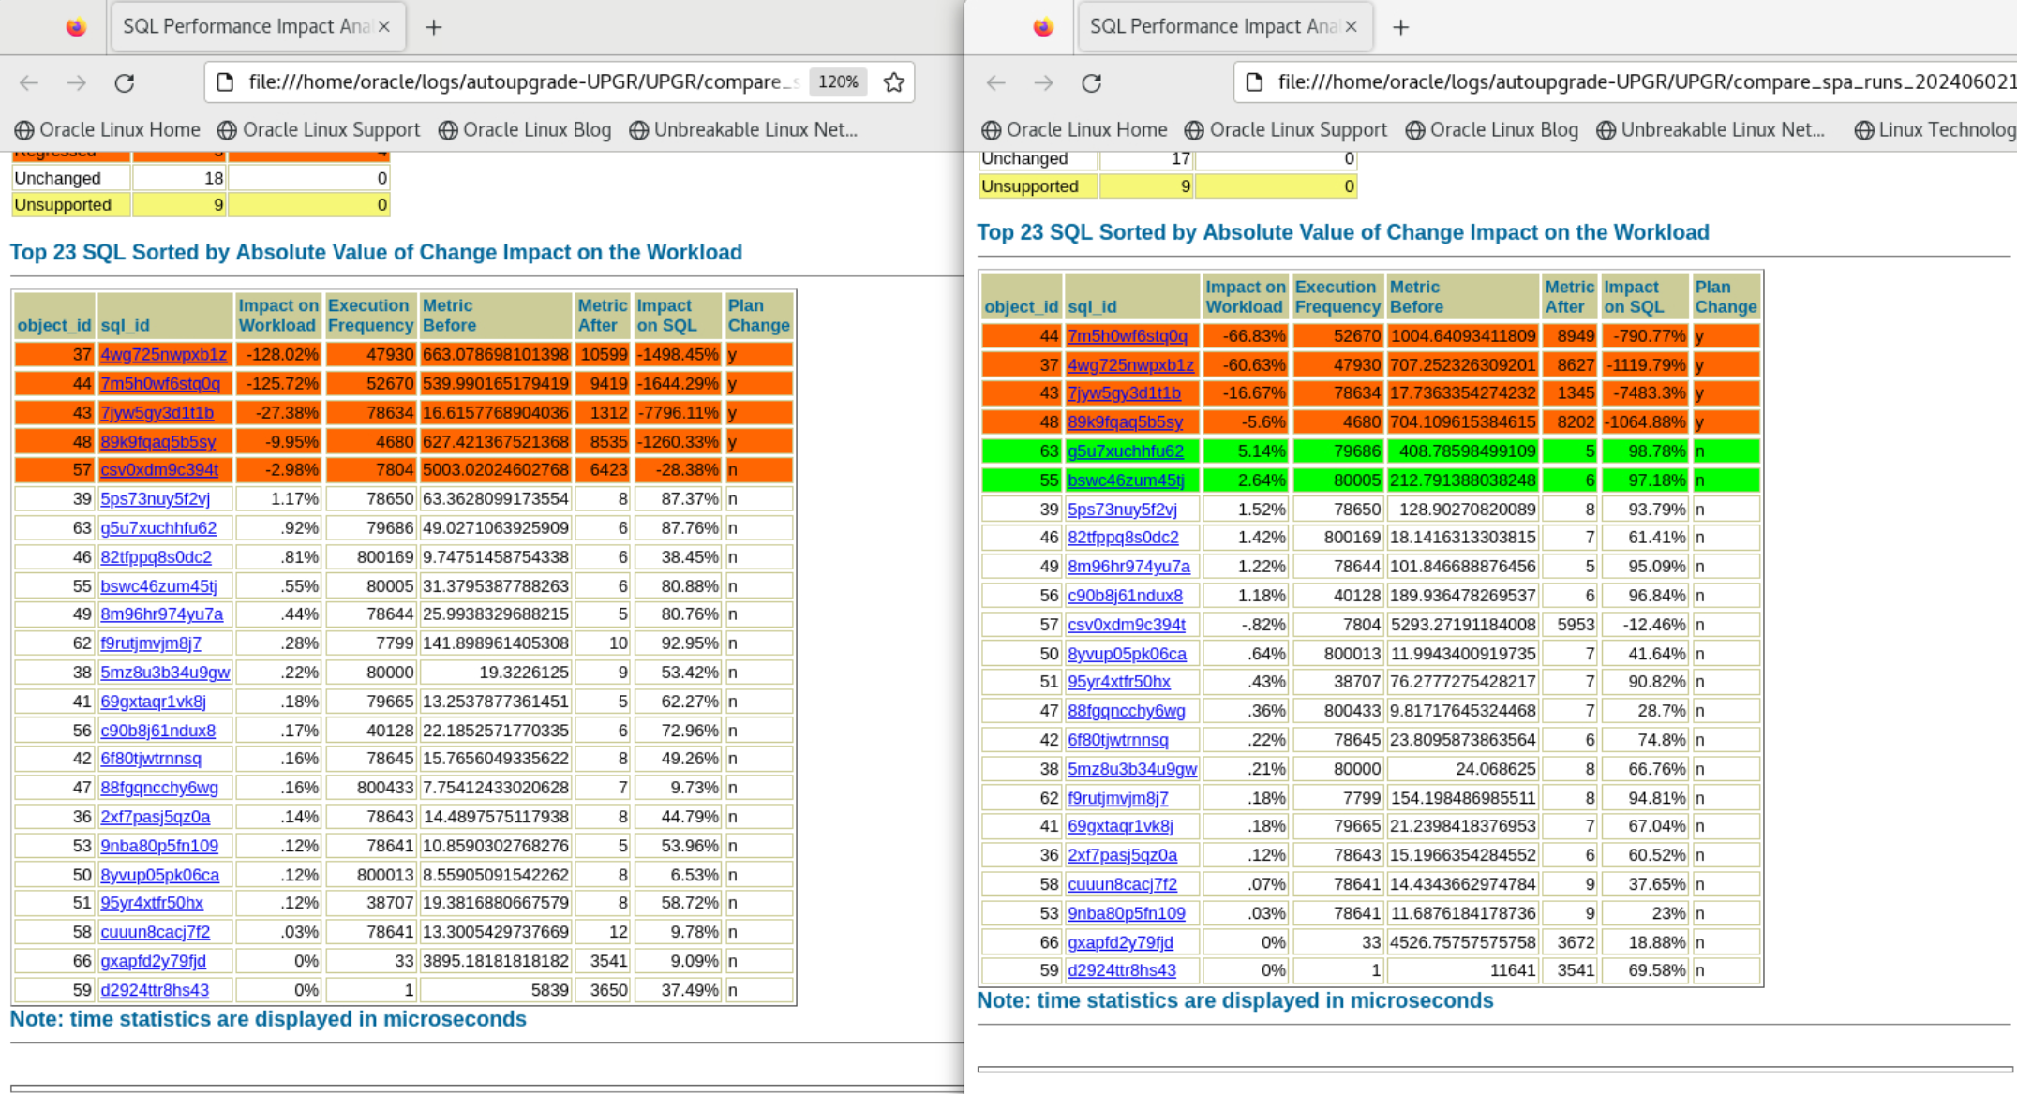
OLD

Slide 7
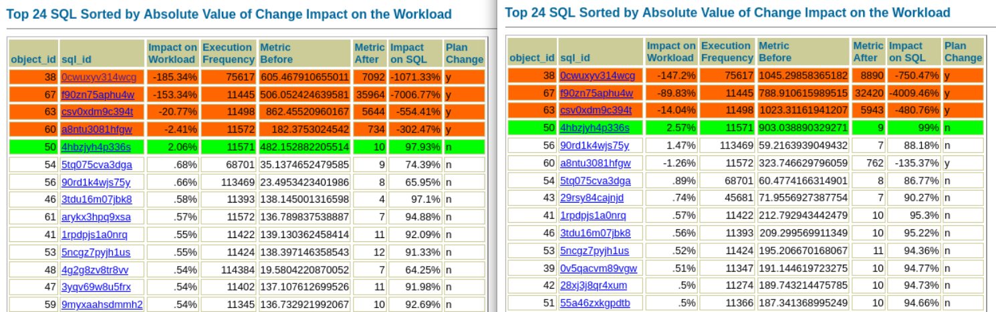

Slide 8
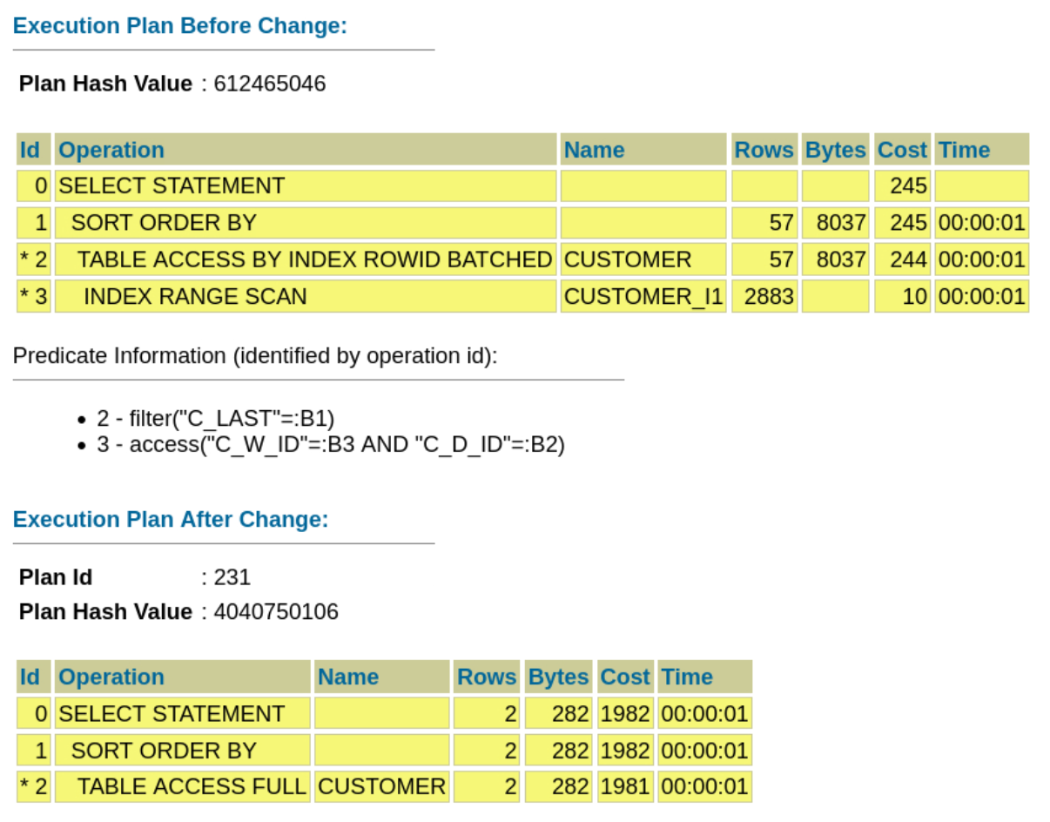
OLD

Slide 9
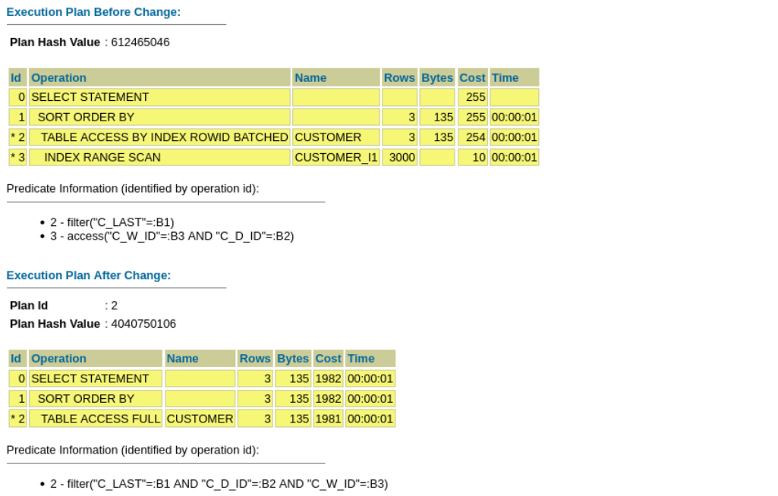

Slide 10
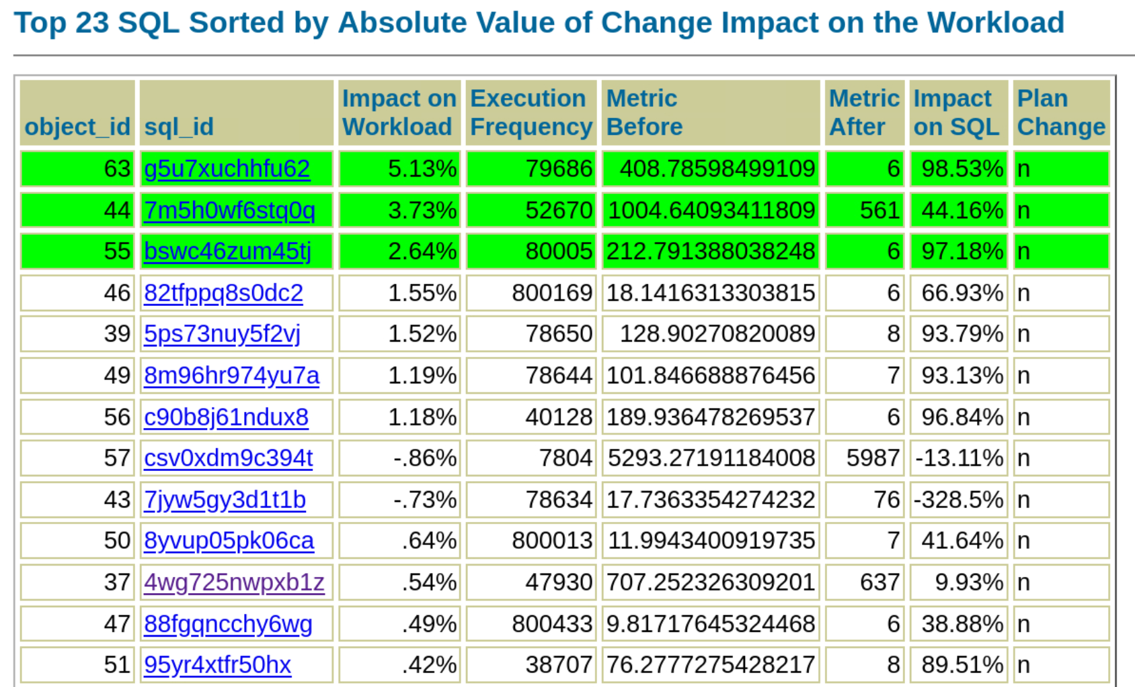
OLD

Slide 11
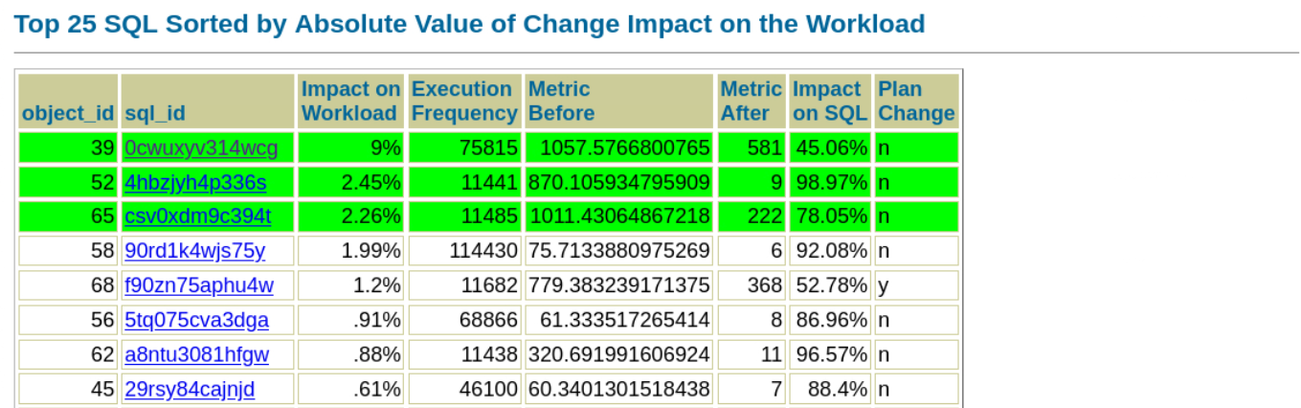

Slide 12
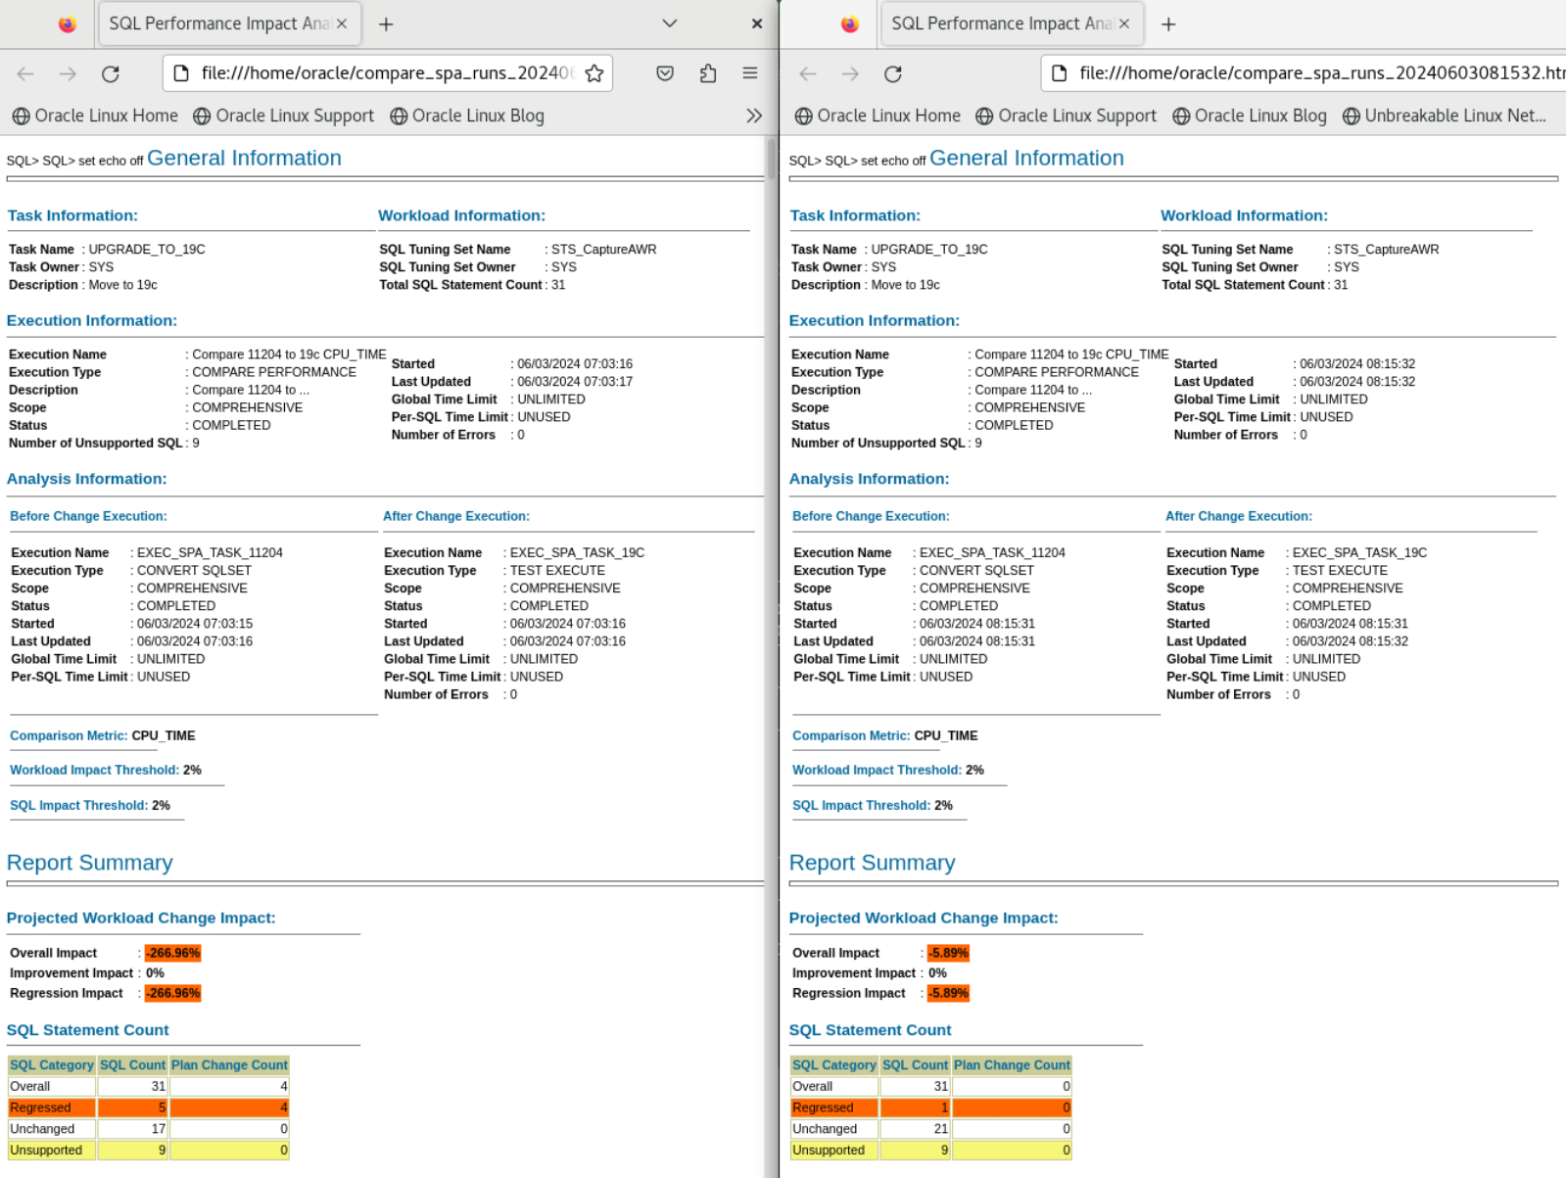

Slide 13
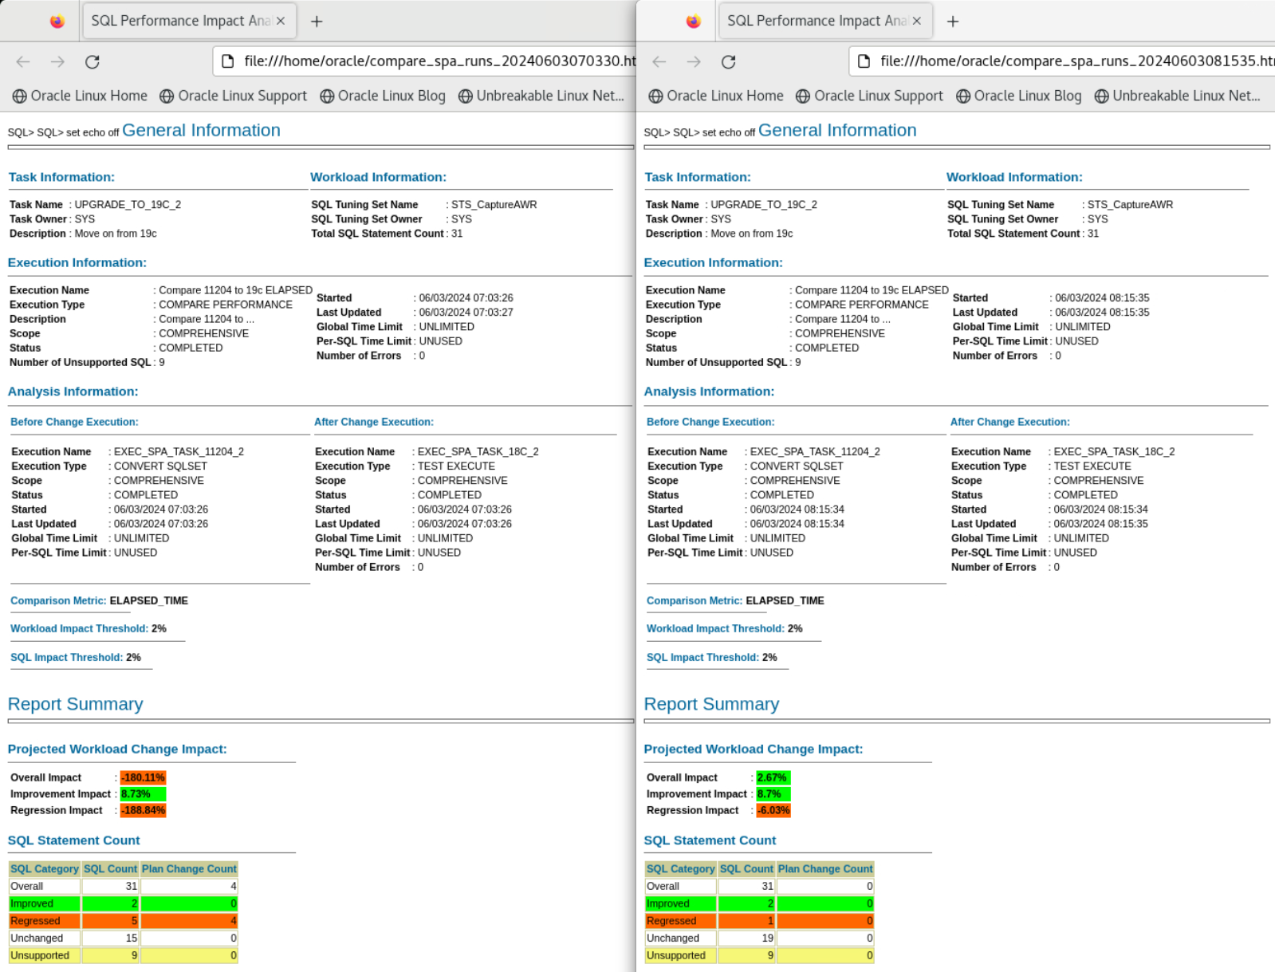

Slide 14
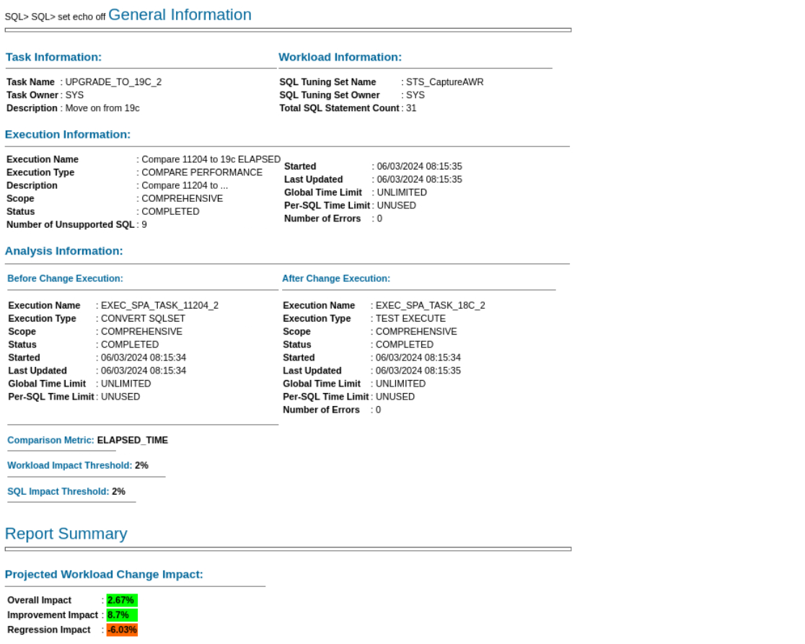
OLD

Slide 15
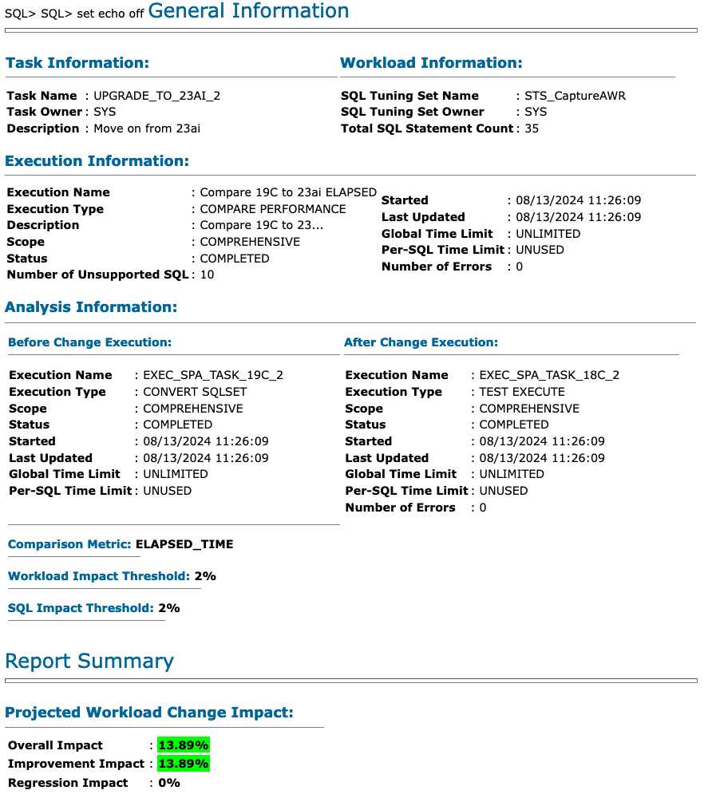

Slide 16
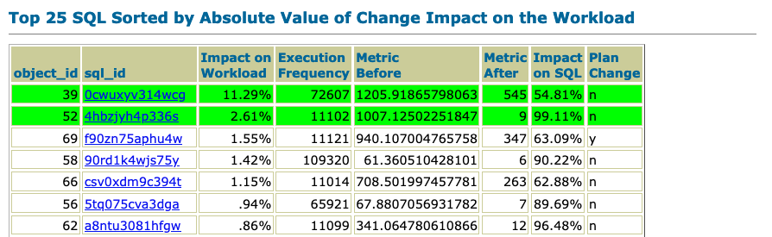

Slide 17



 | Database | PDBs | Set environment
Oracle Database 19c /u01/app/oracle/product/19
Oracle Database 21c /u01/app/oracle/product/21
Oracle Database 23ai /u01/app/oracle/product/23
Oracle AI Database 26ai /u01/app/oracle/product/26
UPGR
. upgr
FTEX
. ftex
CDB19
ORANGE
. cdb19
CDB23
. cdb23
CDB26
RED, BLUE, GREEN
. cdb26
CDB26COM
YELLOW
. cdb26com
CDBRES
GREY
. cdbres

Slide 18
Labs
1 | 2 | Track 1 | 3 | 4 | 5 | 6 | 7 | 8 | 9 | 14
 |  | Track 2 | 10 | 15
 |  | Track 3 | 11 | 12 | 13

