Slide 1
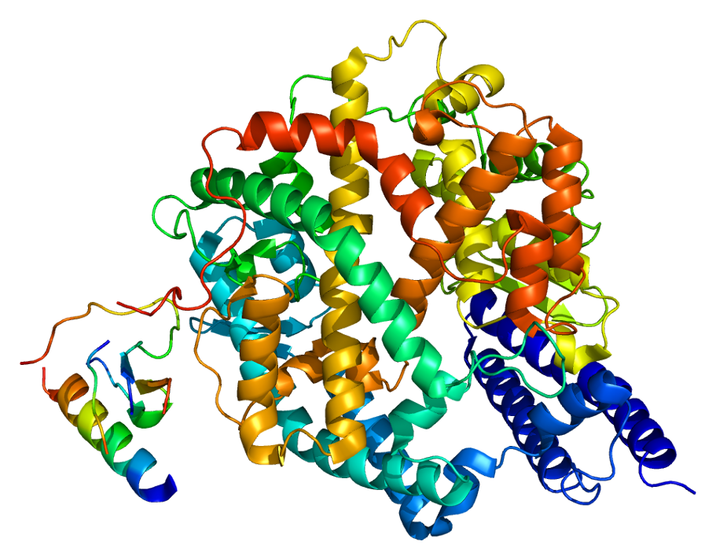
Novozymes Enzyme Stability Prediction
Help identify the thermostable mutations in enzymes
Entry Submitted by Marc Kolb

Slide 2



What is an Enzyme?
An enzyme is a protein that acts as a catalyst for specific chemical reactions often found in living organisms.

Slide 3
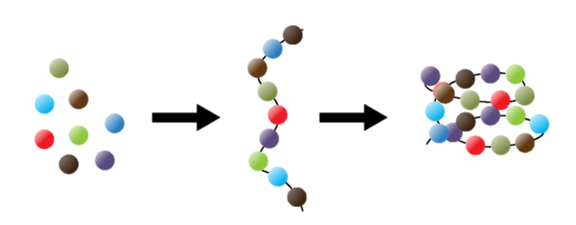

What is a Protein?
A protein is a chain of amino acids whose sequence is dictated by a cell’s RNA.
After the sequence is assembled, the protein will then fold into its secondary and tertiary forms.
In its final form, a protein that can act as a catalyst for a specific chemical reaction is called an Enzyme.
Individual
Amino Acids
Polypeptide Chain
(Protein Sequence)
Protein Structure

Slide 4

How Does an Enzyme Work?
A chemical (green) finds its way to the enzyme’s (red) active site.
The chemical (green) bonds with the enzyme’s (red) active site.
The chemical is broken up into two different chemicals (yellow and blue) and released.
This can also happen in reverse.

Slide 5
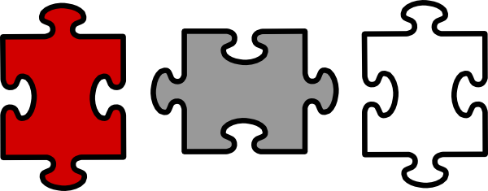
What Affects Stability?
An enzyme’s active site is precisely shaped to accommodate an ideal catalytic reaction.
If the shape of the active site changes, the enzyme will be a less stable catalyst.
Some factors that can affect an enzyme’s stability:
Temperature, pH, Inhibitors, and Other Factors.

Slide 6
The Data:
Sourced from Novoenzyme and Kaggle
Features:
seq_id (index) – Sequence Identification Number
protein_sequence – Amino Acid Sequence
pH – Measured pH
data_source – Source of the Experimental Data
tm – Target Column (Proportional to Stability)
Shape: (31390, 4)

Slide 7
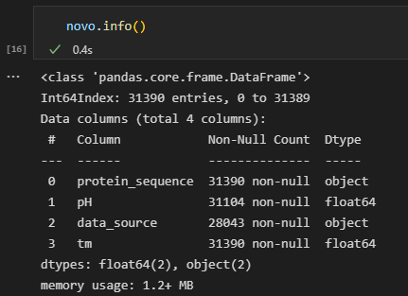
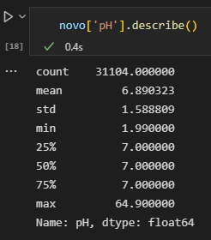

State of the Data:
Sourced from Novoenzyme and Kaggle
We are missing 286 values!
Our Max pH is 64.9!
Red Flag

Slide 8
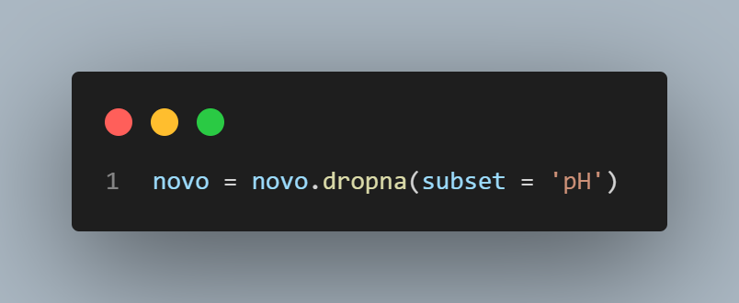



State of the Data:
Sourced from Novoenzyme and Kaggle
With 31104 non-null entries, dropping 286 of the entries should be acceptable.

Slide 9
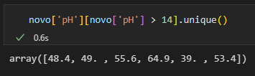
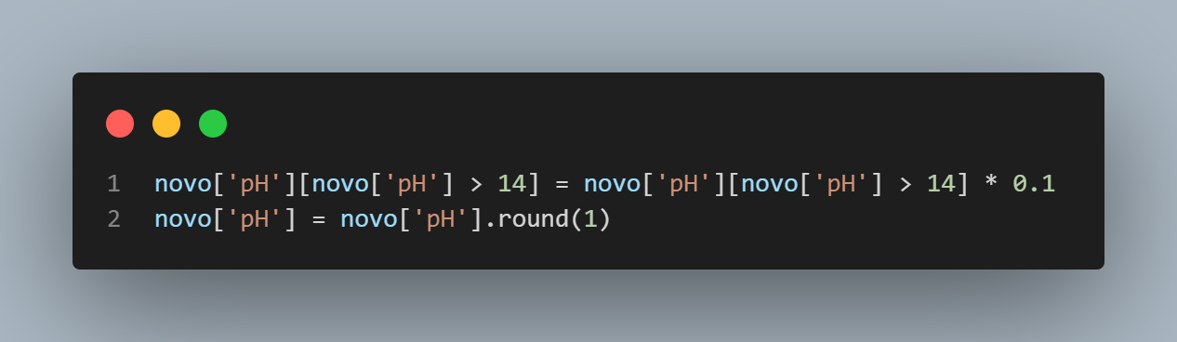
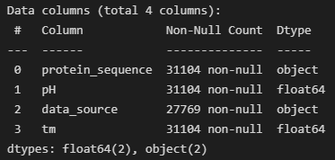
State of the Data:
Sourced from Novoenzyme and Kaggle
Corrective Action
Looks off by only a factor of ten.
This looks like a data entry error.

Slide 10

Feature Engineering:
Workable Features
Amino Acid Sequence
pH
String Data
Pearson Correlation:
0.073
Features

Slide 11

1st Idea:
Levenshtein Distance
In information theory, linguistics, and computer science, the Levenshtein distance is a string metric for measuring the difference between two sequences. Informally, the Levenshtein distance between two words is the minimum number of single-character edits (insertions, deletions or substitutions) required to change one word into the other.
https://en.wikipedia.org/wiki/Levenshtein_distance
If we were to use to sequence with the highest tm to compare each sequence to in terms of Levenshtein Distances, we would have another viable feature that we can correlate and compare.

Slide 12
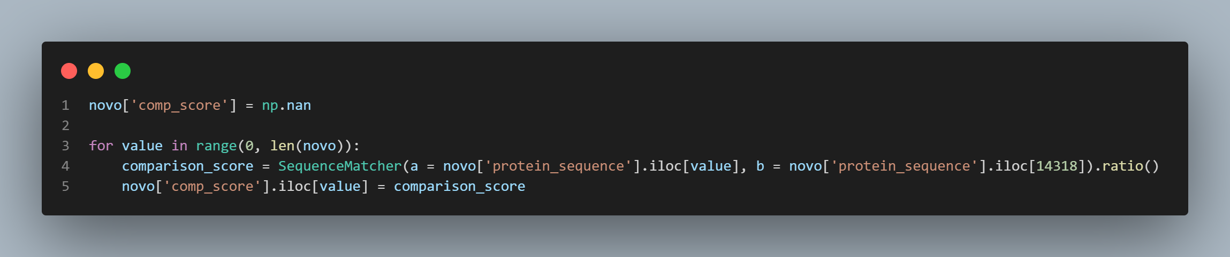
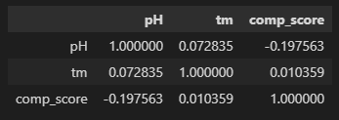
1st Idea:
Levenshtein Distance
Pearson Correlations
Looks like we might need more and better features to better predict stability.

Slide 13
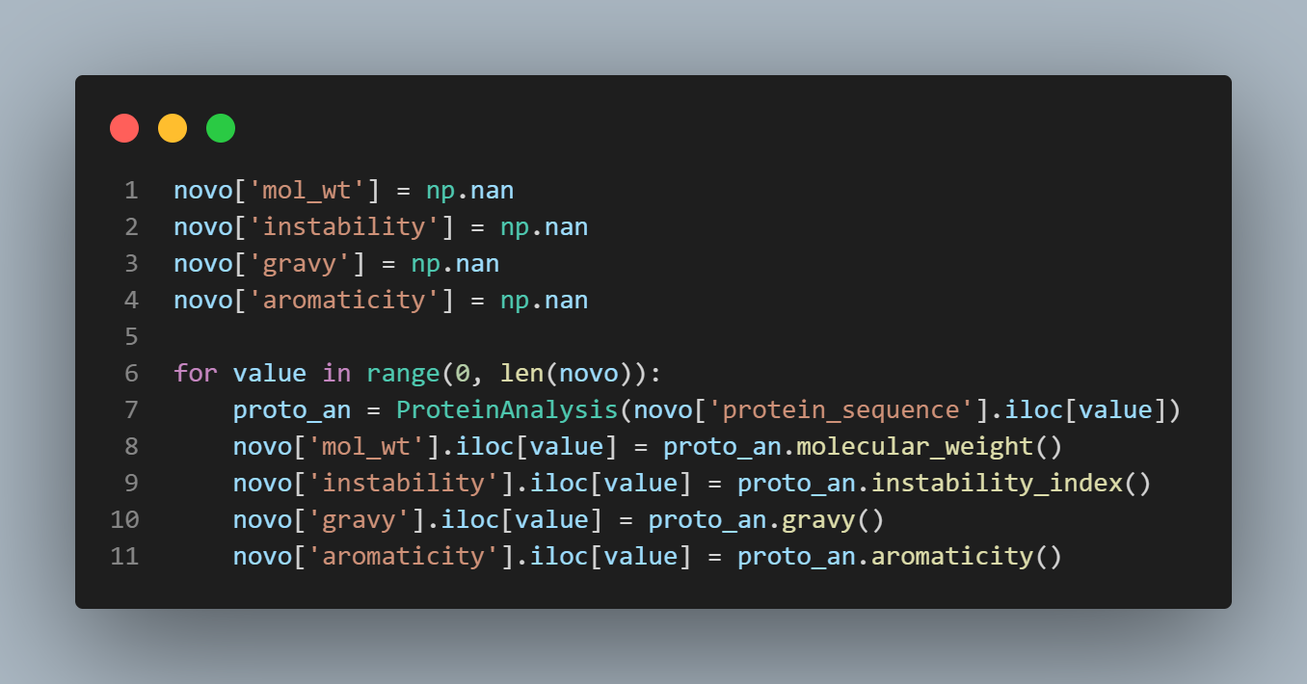
2nd Idea:
BioPython
Molecular Weight
Instability Index
Gravy
Aromaticity

Slide 14
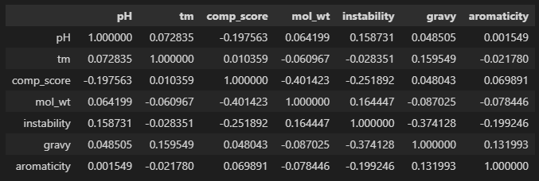

2nd Idea:
BioPython
Computer Modeling

Slide 15
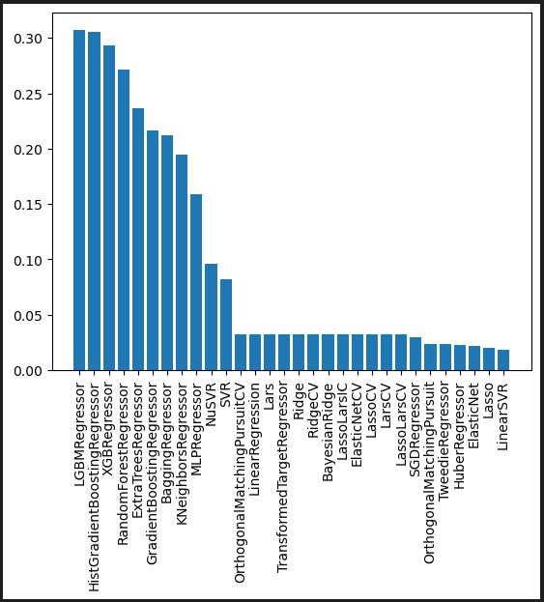
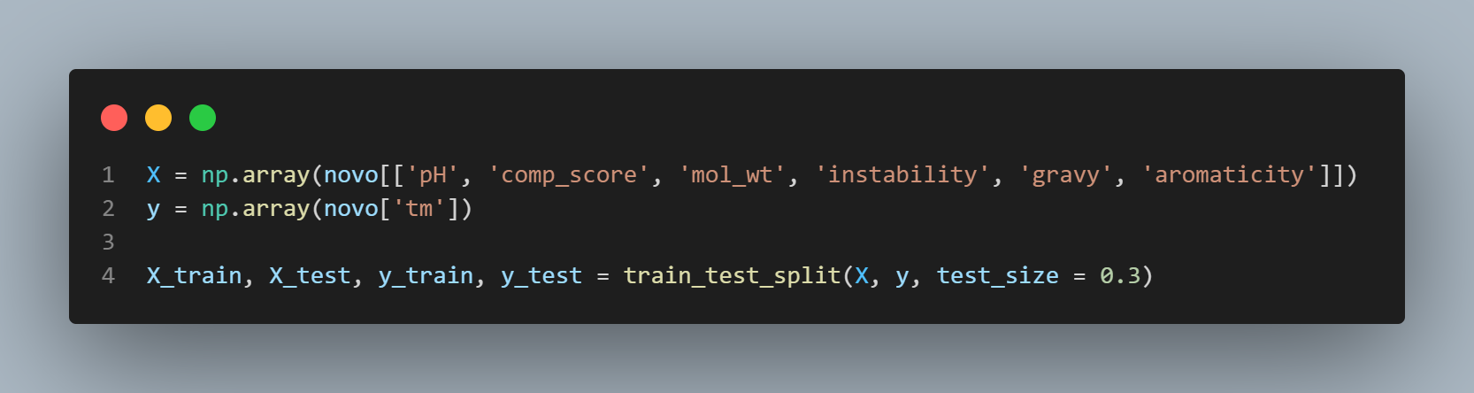
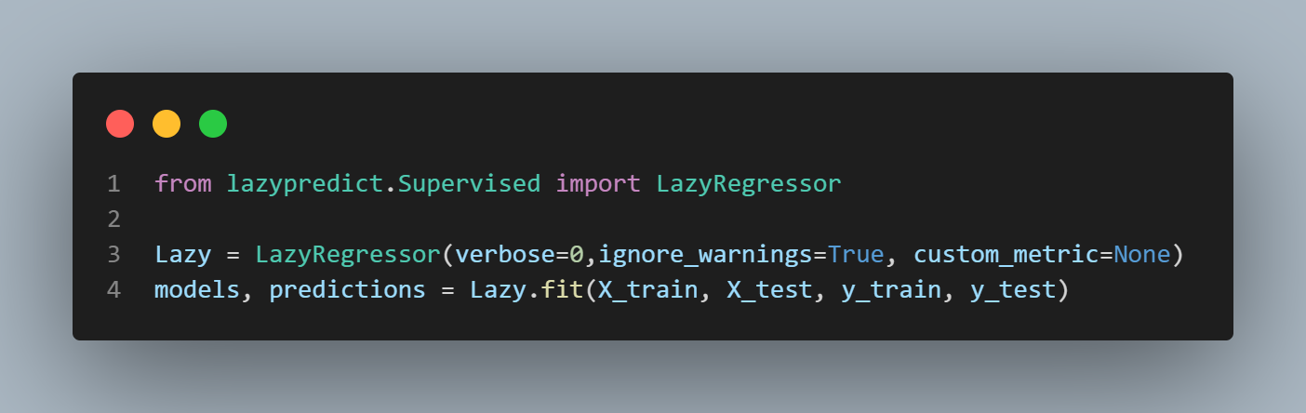
Checking All Models Using:
Lazy Predict

Slide 16
Checking All Models Using:
Lazy Predict
Top Three ML Models
Light GBM
XGBoost
Histogram-based Gradient Boosting Regression Tree

Slide 17
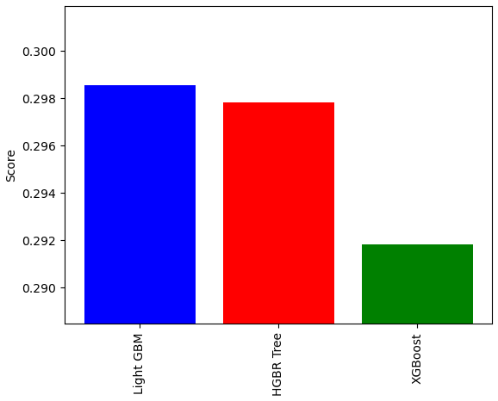
Hyperparameter Tuning the Models:
Winner:
Light GBM

