Slide 1
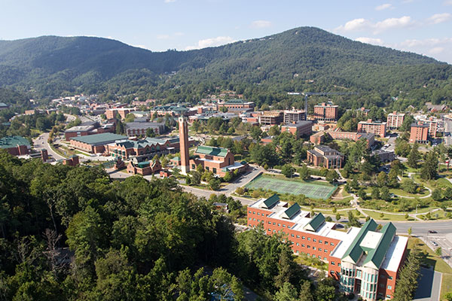
From Hominin to Humans:
Symbol-making, Niche-construction, and the Origins of Our Species
Marc Kissel
XXXXX
Appalachian State University

