Slide 1

Economy of agglomeration on Business Clusters
Capstone Project for IBM Data Science Certificate
Marc Pérez

Slide 2
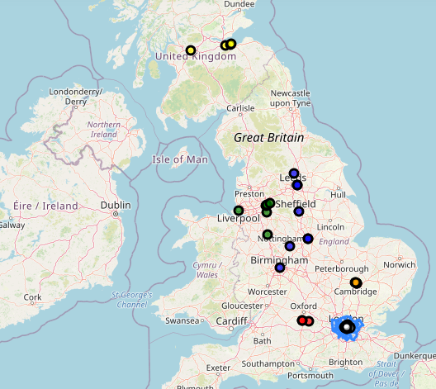
Index
- Introduction
- Data
- Methodology
- Discussion
- Results

Slide 3

Introduction
Economy of agglomeration
The economy of agglomerations is the discipline capable of grouping companies into territories in such a way that they create a benefit for them. The benefits can be financial character, creation of creative environment, and so on.

Slide 4
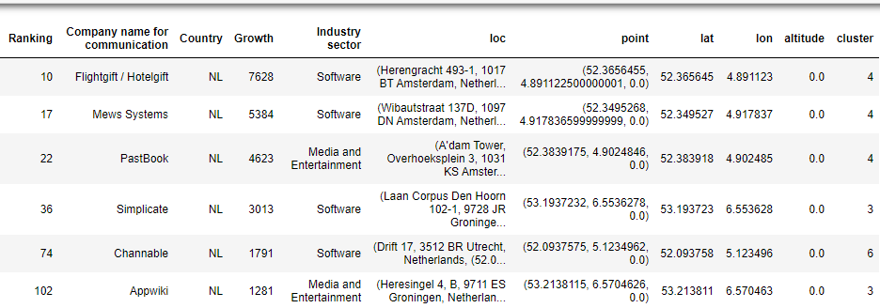
Data
The data used for this project is the PDF of Fast Growth 500 EMEA report from Deloitte.
This data is first converted from PDF to csv to DataFrame.
We clean the data selecting just the information for GB and NL as are the countries with more companies.
A new DataFrame is created adding the locations of the companies after get them with Geocoder API.
We merge the original DataFrame with the one that contains coordinates.
The last DataFrame Will contain the number of cluster as well after being treated.

Slide 5
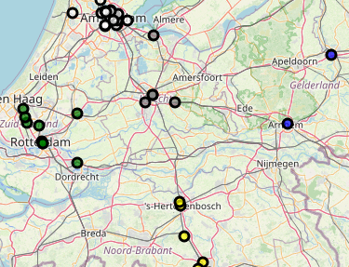
Methdology
Agglomerative Clustering
K-Means
We select 6 for the number of clusters in GB and 7 for the number of Clusters in NL.
Agglomerative Clustering is by default Euclidean.
Agglomerative Clustering do not allow the function to get the centroid, so we find centroids with kmeans.
The agglomerative cluster give us the number of cluster that is used to lacate them on the map.
Kmeans is a scikit-learn library that helps us to créate the clusters by coordinates.
We introduce the respective number of clusters selected in the agglomerative clustering library.
With 25 iterations the function k_means.cluster_center_ provide us with the centroids of every cluster.

Slide 6
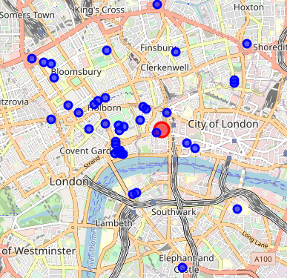
Methdology
GeoCoder API
FourSquare API
GeoCoder API has been used to get the address of the companies and the coordinates.
We chose this API because is the only one that had good results when introducing the name of the companies instead of the address directly as other API’s requiere.
This API is mandatory for the capstone project.
We have studied the ‘College & Universities’ venues around centroids.
The radius used has been 2km.

Slide 7




Discussion
We can affirm that being in one or another country and located around more succesful companies is a key factor.
It seems that a company is more likely to succed when is inside of academic environments.
What we have learnt?
The companies that have growth the most in Europe are in almost all the cases having Good comunications with other cities or even countries.
Due to the complexity of the project we can not say the exact correlation between the venues and the success of this companies altough we can find visualizing the maps posible correlations.
We can expect as well more correlations as more venues are analysed.
The companies that have growth the most are mainly in big capitals.

Slide 8
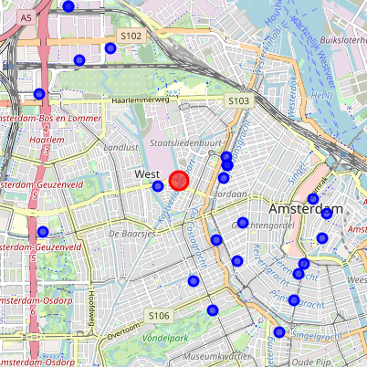
Results
Folium Maps
London Map
Venues within 2 km in the London centroid. More than 50.
Map of GB
This map show six clusters with companies really agglomerated in London, Cambridge and Oxford and more separation in the other clusters
Amsterdam Map
Venues within 2 km in the Amsterdam centroid. A total of 22 venues for 24 companies

