Slide 1

Womanium Quantum+AI Project: QML for Conspicuity Detection in Production
Marc Maußner

Slide 2
Agenda
Motivation
Step 1
Step 2
Step 3
Step 4
Take away

Slide 3
Motivation
Get familiar with Pennylane
Get deeper understanding of QML workflow (e.g. algorithms for state preparation, importance of taking the right loss function,…)
Get deeper understanding of applying quantum computing for machine learning
Notes:
Bei Neuerungen steht zunächst die Funktion im Fokus, d.h.
was kann man mit Technologie erreichen
Welche Vorteile bieten sich
Auf Risken oder die Verbindung mit anderen Domänen wie FuSi oder Cybersecurity, Qualität wird meist erst danach eingegangen
Abgrenzung
Scope eher highlevel

Slide 4
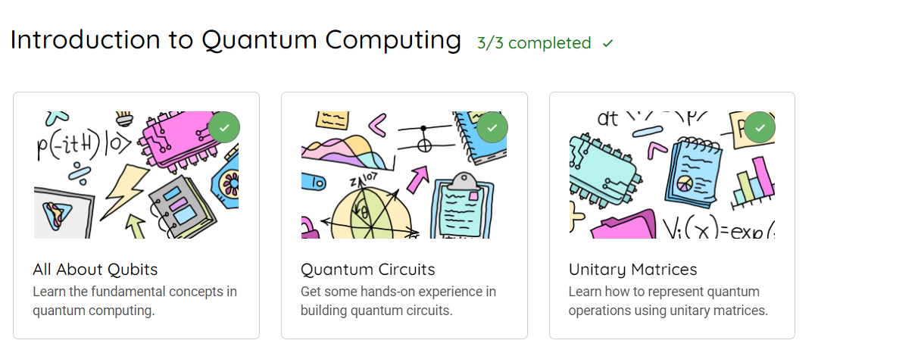
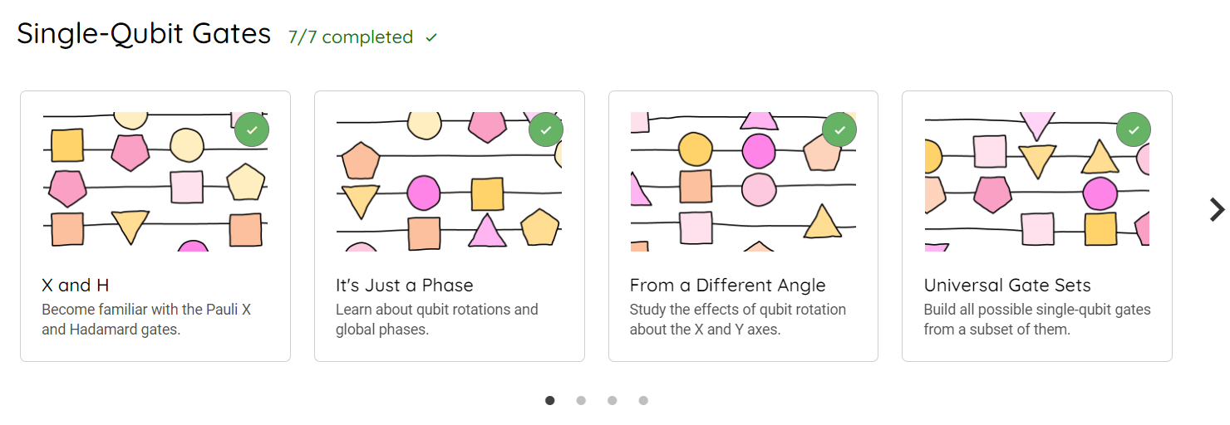
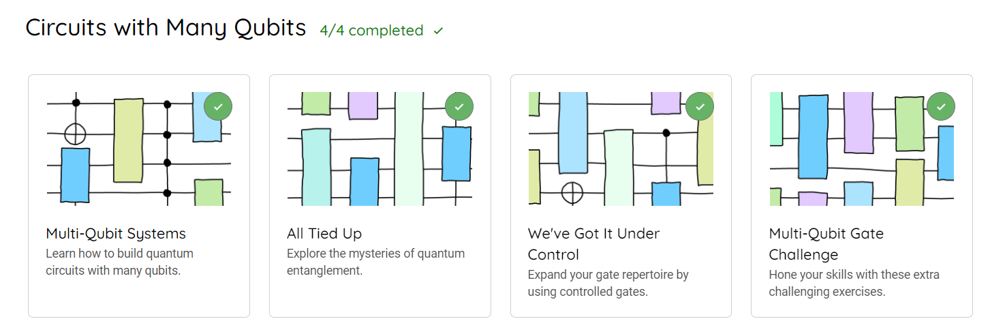
Step 1 – Familiarize with pennylane
Introduction to quantum computing
Single-Qubit Gates
Circuits with Many Qubits

Slide 5
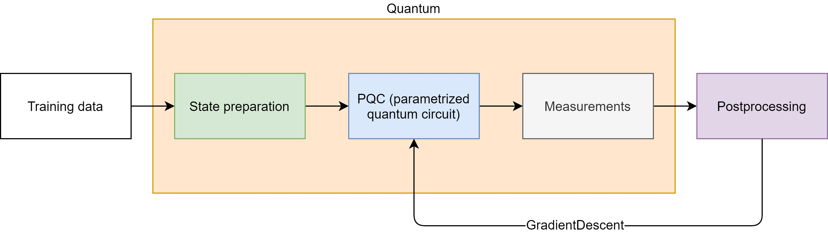
Step 2 – Familiarize with basic workflow for QML
The basic setup in QML is as follows (*):
In the notebook we do the following steps for Parity and for Iris dataset
Construct variational circuit (state preparation + Ansatz)
Define loss, accuracy and cost function
Load data and initialize parameters of variational circuit
Train variational circuit and optimize parameters
Evaluate results
* Based on M. Schuld, A. Bocharov, K. M. Svore and N. Wiebe, "Circuit-centric quantum classifiers," Phys. Rev. A 101, 2020.

Slide 6
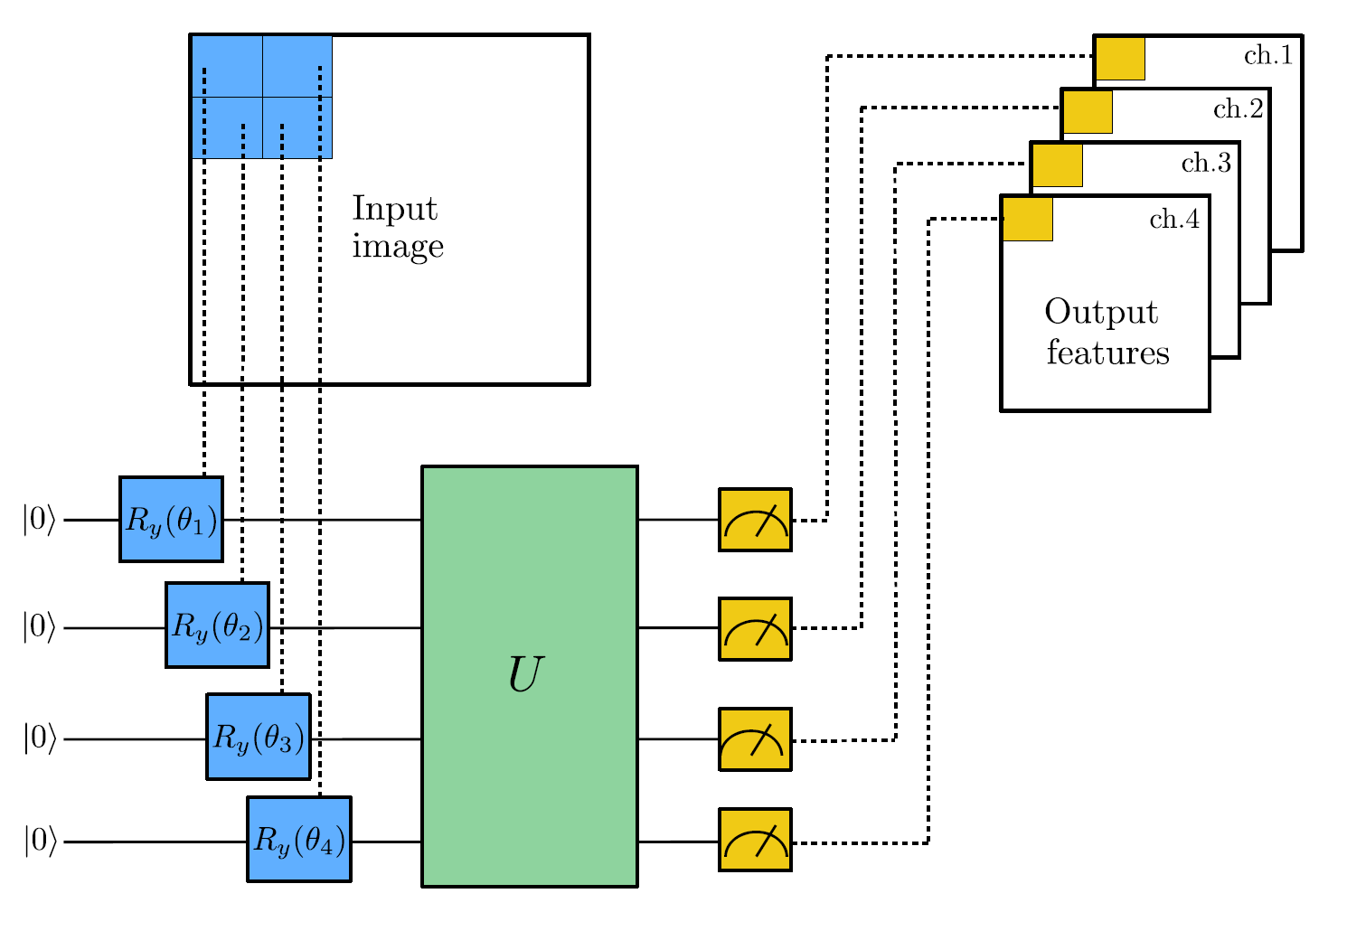
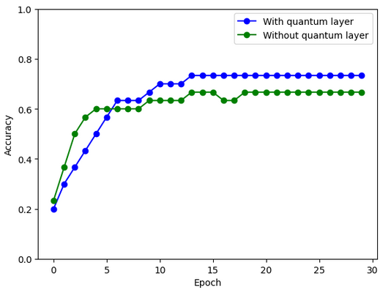
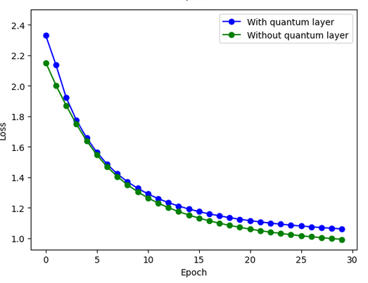
Step 3 – Quanvolution of MNIST
Steps to take
Load data from MNIST
Scale data to be used with AngleEncoding
Preprocess images with quantum circuit
Train model with quantum data
Train model with classical data
Compare results
Taken from: https://github.com/viventriglia/Quantum_Neural_Network_QNN
MIT License

Slide 7
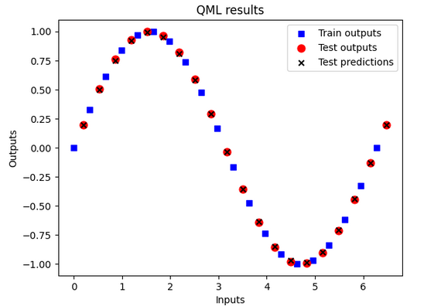
Step 4
Construct variational circuit (state preparation + Ansatz)
Use only one qubit circuit for learning the sine function
AngleEncoding
Ansatz: Universal Rotation with 3 params
Define loss, accuracy and cost function
Take accuracy as defined (#correct samples/#total)
For loss take square mean
Load data and initialize parameters of variational circuit
Use 20 datapoints
x_test x_train+0.2 -> data points shifted
Train variational circuit and optimize parameters
Evaluate results -> Accuracy 1.0!

Slide 8
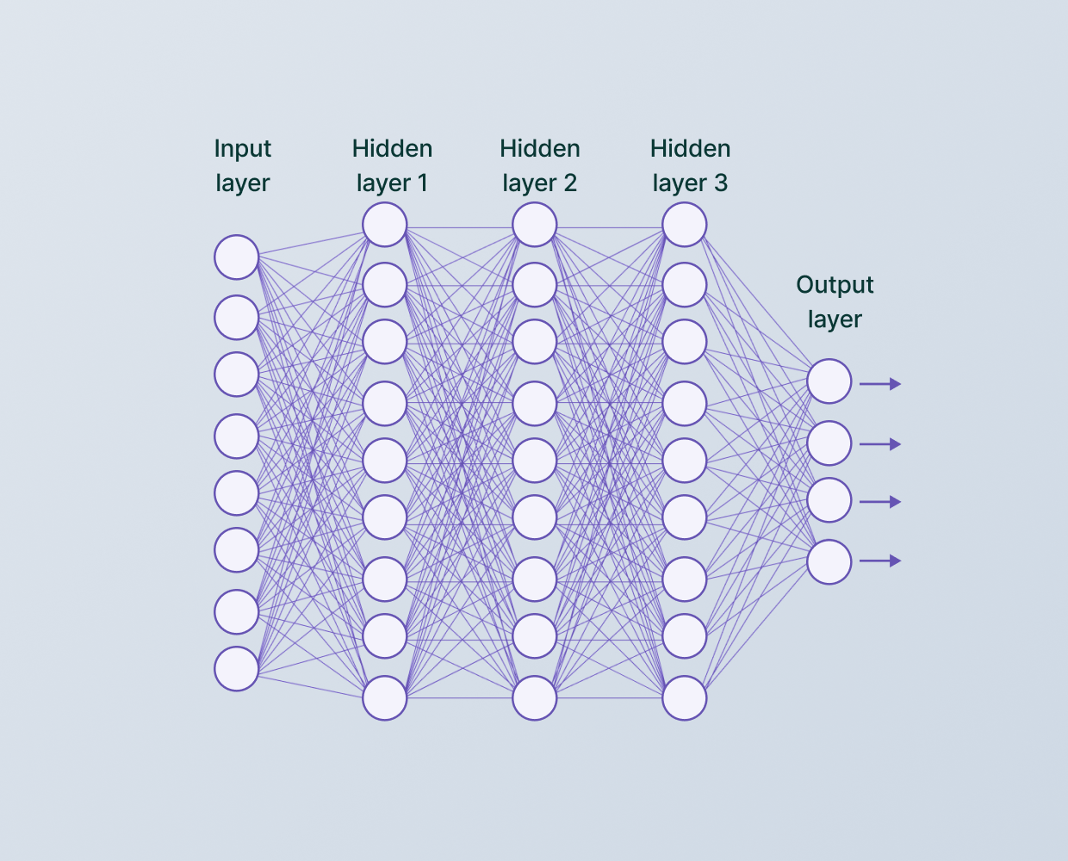
Take away
Efficient state preparation is crucial:
See Möttönen and CRZ decomposition in Step 2
Quantum Machine Learning consists of more than machine learning with models as variational quantum circuits
Preprocess the data in the workflow
Turn only one layer in the CNN to quantum
Definition of accuracy, loss and cost function is crucial:
When taking the original loss function in step 4, training might result in wrong results -> an analysis phase of your data is crucial.
Test and validate results of your models!
*
* Taken from: https://www.v7labs.com/blog/convolutional-neural-networks-guide

