Slide 1


Cover Page
HAMILTONIAN HARMONICS
presents
Adiabatic state preparation with Clifford gates
Qiskit Hackathon at World of Quantum 2023
Marc Maußner
Thierry Kaldenbach
Raphael Kopp
Lea Marlen Rektorschek

Slide 2

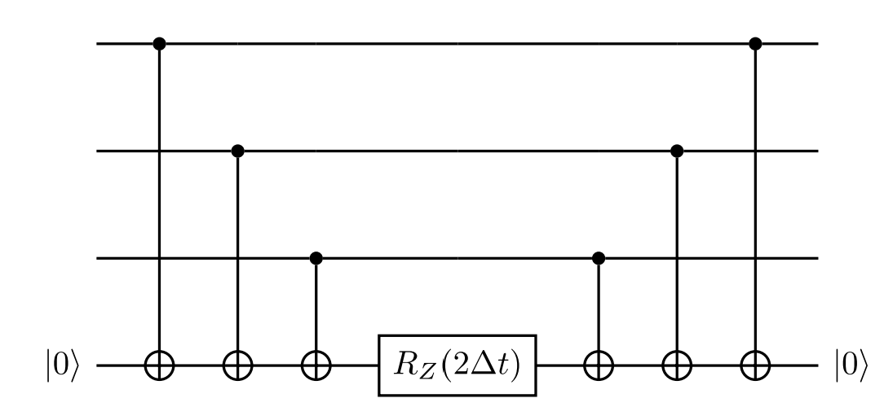
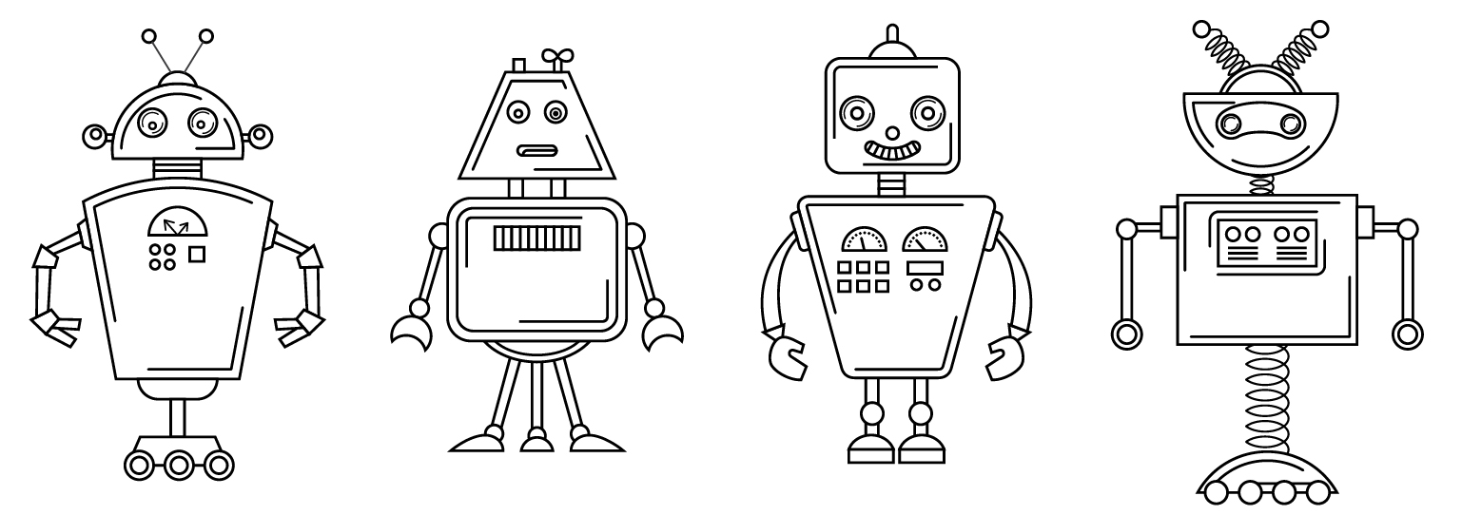

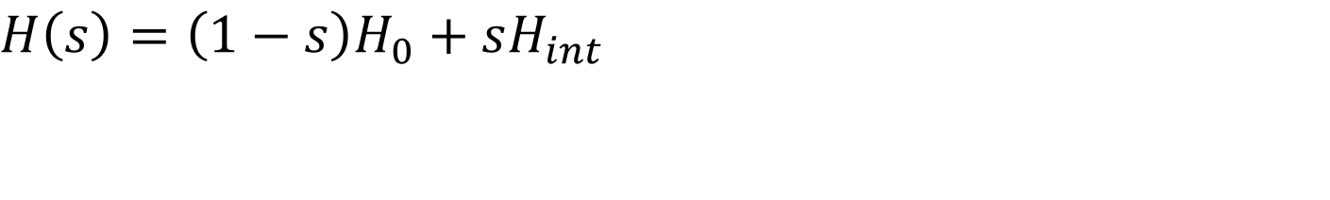



ROBOTS COLORING BOOK - PICTURE 4
Hamiltonian Mixer
$$H\left(s\right)=\left(1−s\right)H_{0}+sH_{int}$$
$$e^{−iZZZΔt}$$
$$S$$
$$S^{+}$$
$$Z$$

Slide 3
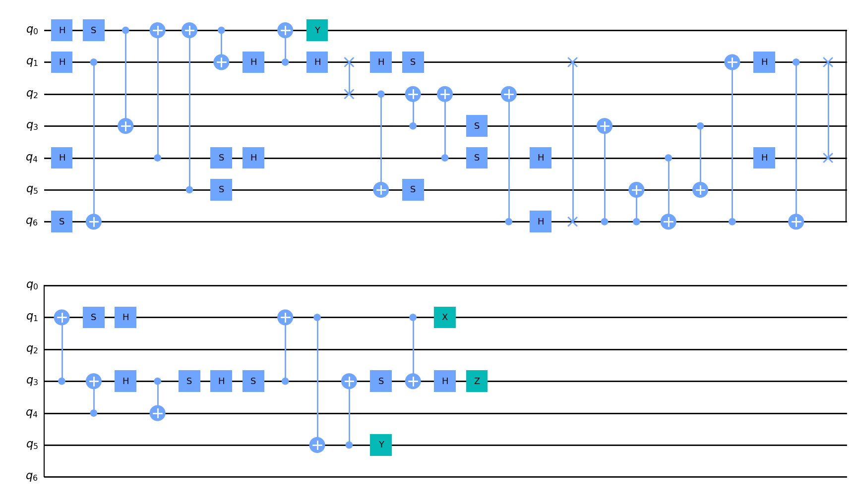
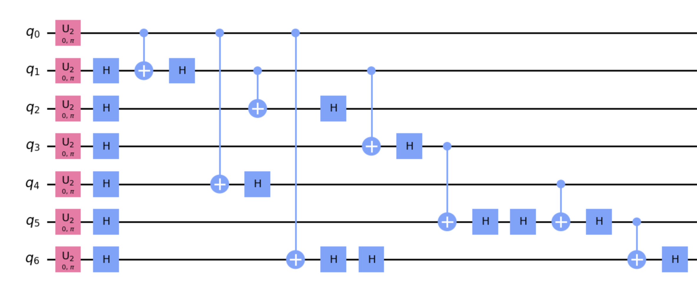
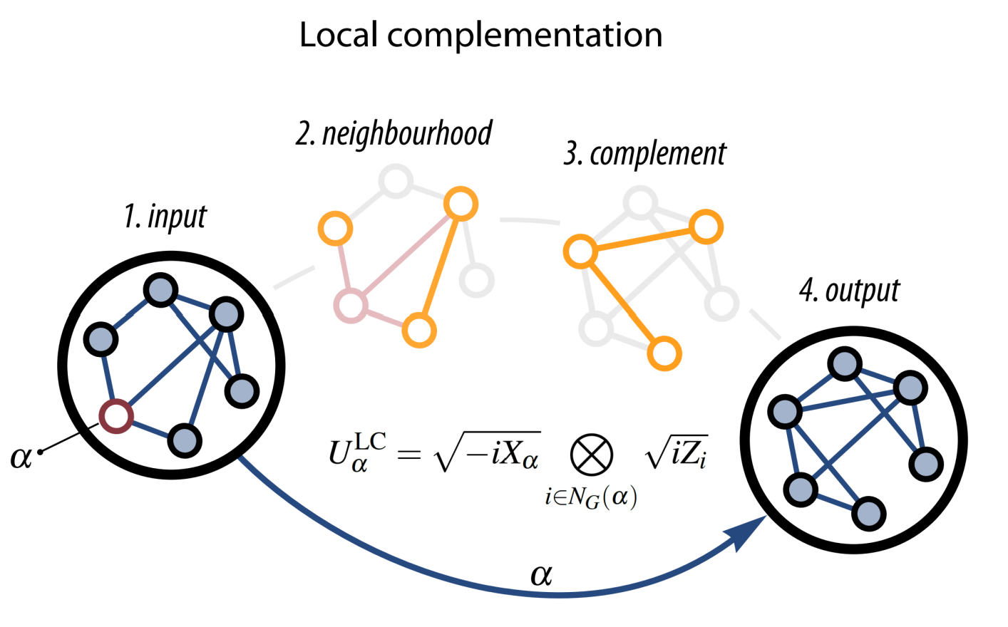
ROBOTS COLORING BOOK - PICTURE 4
Clifford Gates
Graph state simulator
J. C. Adcock et al. “Mapping graph state orbits under local complementation”. In: Quantum 4 (2020), p. 305.

Slide 4
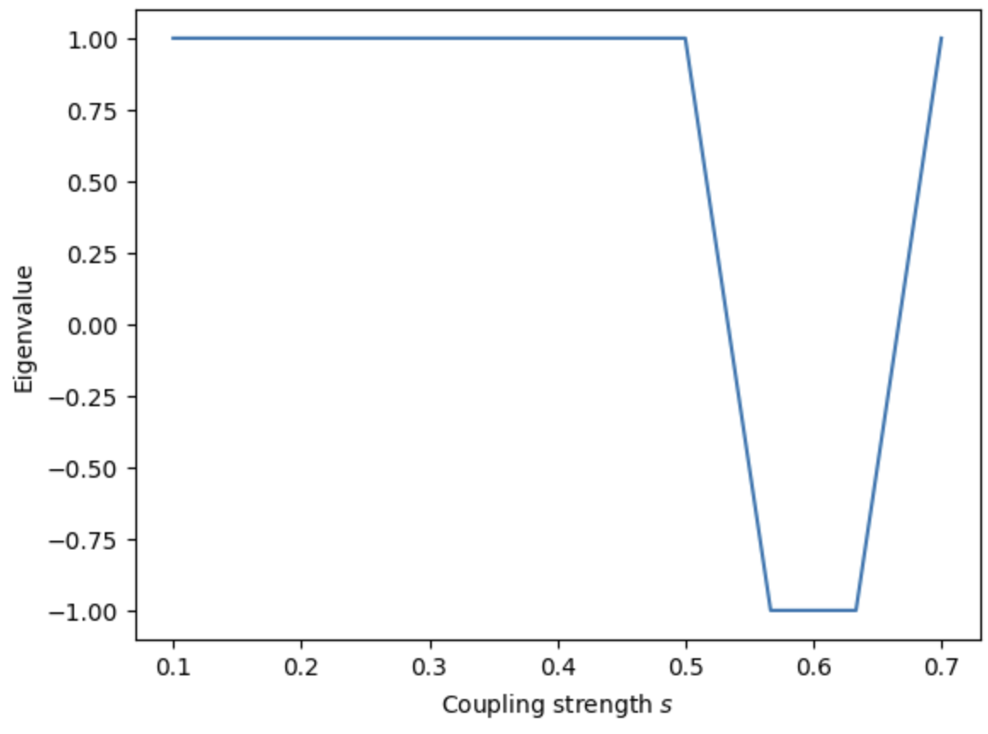
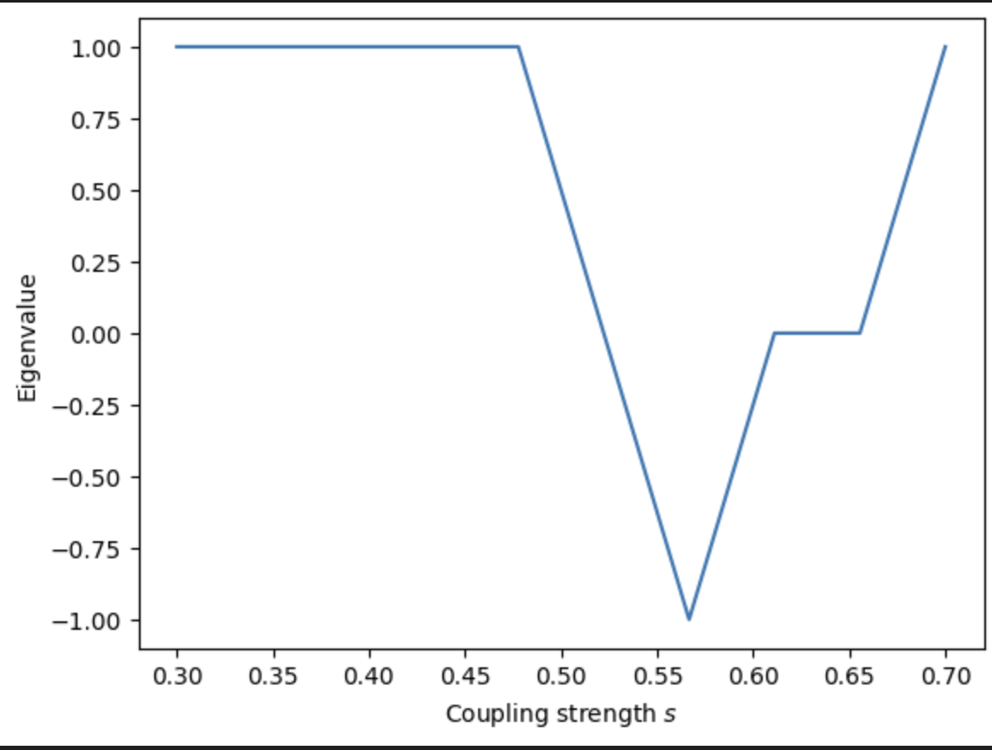


ROBOTS COLORING BOOK - PICTURE 4
Results and Outlook
2 Qubit $H_{0}=Z_{0}Z_{1}$
6 Qubit $H_{0}=Z_{0}Z_{1}Z_{2}Z_{3}Z_{4}Z_{5}$

Slide 5
ROBOTS COLORING BOOK - PICTURE 4
Thank you for your attention!

