Slide 1
Group Plan
Project of Implementing Bayesian Matting
Group name：Dragon Fire
Group members：
Aparna Sujatha Ramdoss
Jiacheng Li
Yujie Jia
Date 15/02/2024

Slide 2
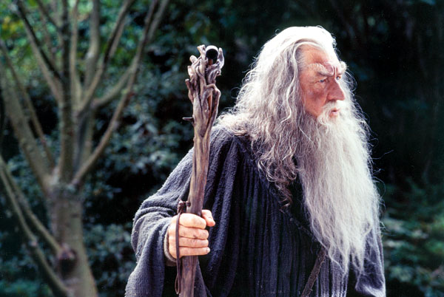
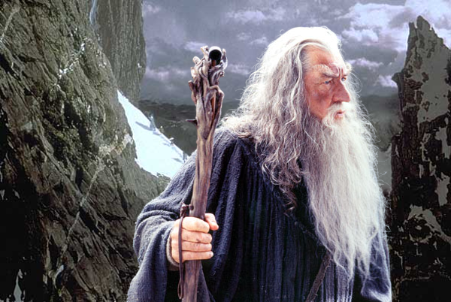
Introduction
Bayesian Matting
Digital Matting: Involves extracting a foreground element from a background image by estimating color and opacity for each pixel, known as alpha, essential for compositing elements into new scenes.

Slide 3
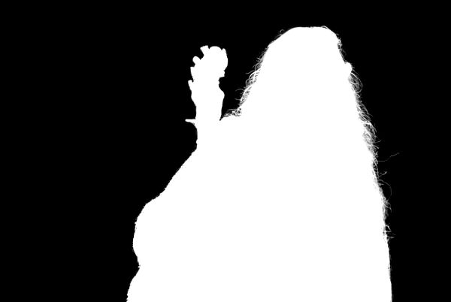
Introduction
Matting
To obtain the composite image from the input image, it must undergo a stage known as Matting, denoted as Alpha(𝛼)
Input Alpha(𝛼) Composite

Slide 4
Introduction
Comparison
Mishima's Algorithm
The algorithm uses a fractional interpolation of covariance for optimal color probability estimation independently of foreground and background.
Typically used for image denoising and smoothing while maintaining edge sharpness.
Knockout Algorithm
The algorithm uses a weighted sum approach for color estimation and projection-based methods for opacity calculation.
Designed for high-quality image matting, especially in complex backgrounds.
Ruzon-Tomasi Algorithm
The algorithm handles fractional blending for transparency and motion blurring effectively, providing accurate results for image matting tasks.
Concentrates on the combination of color and edge information to improve matting quality.

Slide 5
Introduction
Why Bayesian is considered better than all these methods?
Accuracy in Color and Transparency Estimation:
Unlike the Mishima algorithm, which focuses more on denoising and edge preservation, Bayesian Matting excels in accurately estimating both the color of the foreground and background as well as the transparency of each pixel. Which improved results for challenging cases like intricate boundaries and natural image matting.
Handling Semi-transparent and Blurred Edges:
Bayesian Matting is superior in dealing with semi-transparent and blurred edges, a scenario where the Knockout and Ruzon-Tomasi algorithms might struggle. It can effectively manage fractional blending, which is essential for realistic matting in complex scenes.
Flexibility and Adaptability:
Bayesian Matting provides a higher degree of flexibility and can be adapted to a wide range of images and specific matting requirements, unlike the Mishima and Ruzon-Tomasi algorithms, which might be more specialized in their application.

Slide 6
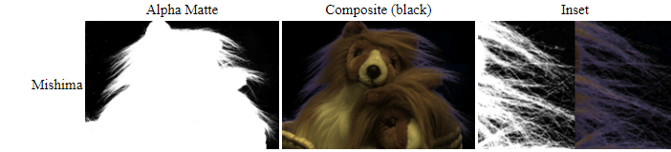
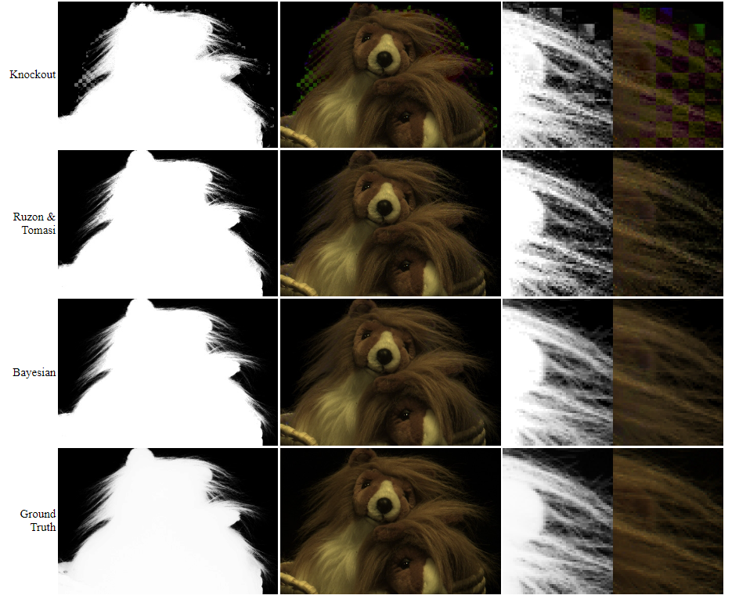
Introduction
Comparison
Bayesian is satisfactorily closer to the ground truth than compared to the other types of matting

Slide 7
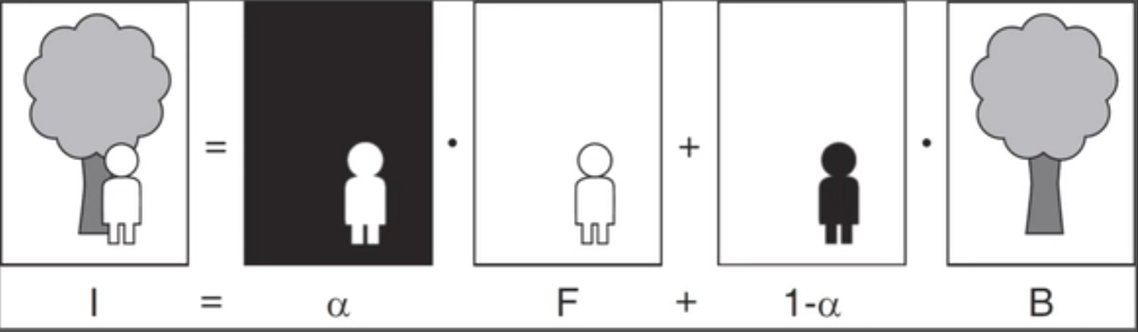
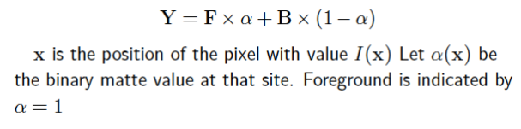
Mathematical Understanding
F = Foreground
B= Background
𝛼 = Matte
The foreground has a 3x1 vector and the background has a 3x1 vector and alpha as the constant making 3 equations in 7 unknowns. (𝛼, F_{R} ,F_{G},F_{b}, B_{R} , B_{G} , B_{B} ).
A composite image on the left side. There is a Foreground and background image as F and B and the alpha over here is matte which is a greyscale form where lots of shades of grey surround the object. Now the main job is to work on the grey shades known as unknown regions where the pixels will be computed to know where it is 1 (foreground) or 0 (background).
An example of bayesian matting
(1)
x is the position of the pixel with value I(x). Let 𝛼(x) be the binary matte value at that site. Foreground is indicated by 𝛼 = 1

Slide 8

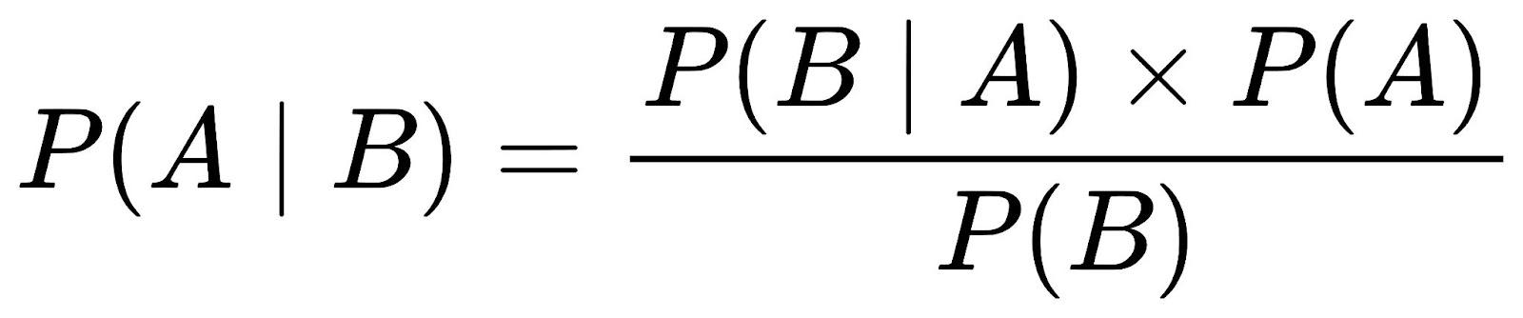

Mathematical Understanding
MAP Estimation
We have to solve for F, B, 𝛼 for every pixel given the composite image.
Bayes Theorem
The implicit assumption is that F, B, 𝛼 are not correlated so there is no conditional probability among F, B, 𝛼. From the Bayes equation of C,F, B, 𝛼 try to manipulate in negative likelihood and thus have to minimize the log likelihood of L(C|F, B, 𝛼)+L(F)+L(B)+L(𝛼).
(2)

Slide 9
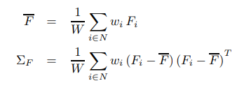
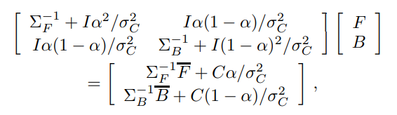


Mathematical Understanding
We assume that 𝛼 is a constant. Under this assumption, taking the partial derivatives of (2) with respect to F and B and setting them equal to 0 gives:
For each cluster, we calculate the weighted mean color F and the weighted covariance matrix 𝛴F
(3)
The log likelihoods for the foreground L(F) can then be modeled as being derived from an oriented elliptical Gaussian distribution, using the weighted covariance matrix as follows:
To get 𝛼, let F and B be constant, yielding a quadratic equation in α. We arrive at the solution to this equation by projecting the observed color C onto the line segment FB in color space:

Slide 10
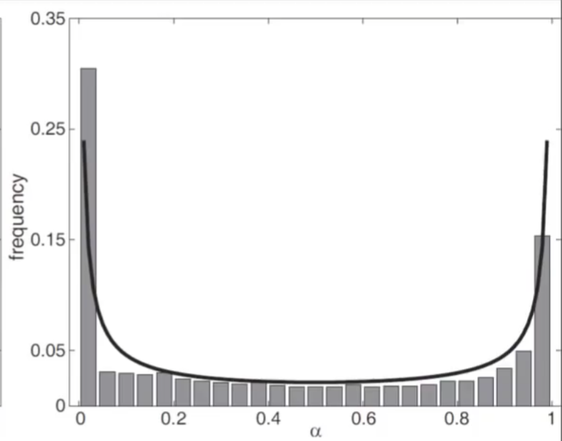
Mathematical Understanding
The alpha value in equation (3) remains constant, and its selection is informed by the graph below, illustrating how varying alpha impacts the smoothness of the output.

Slide 11
Our Algorithm and Implementation
Input: Input Parameters: Original image, trimap
Output: Composite Image
Start:
Initialize parameters and variables;
Load Images;
Read the original image and the trimap from the provided paths;
Preprocessing;
Convert the trimap to grayscale if necessary;
Thresholding;
Define foreground and background thresholds based on the trimap;
Segmentation;
Separate the image into foreground, background, and unknown regions based on the trimap and thresholds;
Compute Mean and Covariance;
Calculate the mean and covariance matrix for each region (foreground and background) in each colour channel;
Alpha Estimation;
Estimate the alpha (transparency) values for the unknown region using Bayesian matting:
for each pixel in the unknown region do:
Initialise alpha value
Iterate until convergence Compute alpha value iteratively using Bayesian matting formula;
End
New Background Selection;
Prompt the user to select a new background image if desired;
Compositing;
Combine the new background image with the foreground and background colours using the estimated alpha values to create the final composite image;
Output;
Display the composite image and save it as an output file;
End;

Slide 12
Flow Chart of Functional Building Blocks
F and B Split
Mathematical Computation

Slide 13
Flow Chart of Functional Building Blocks
Alpha Calculation
Comparison

Slide 14
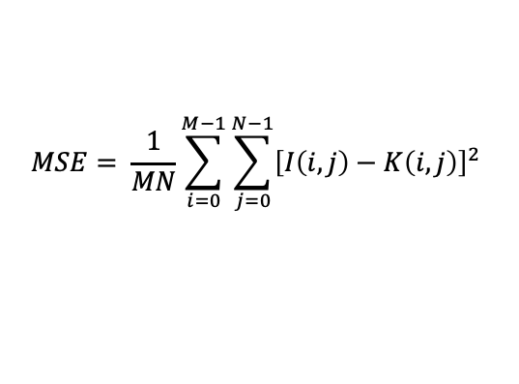
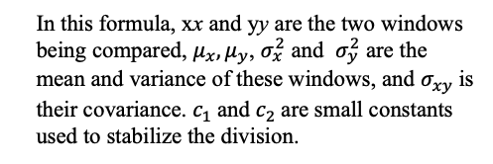
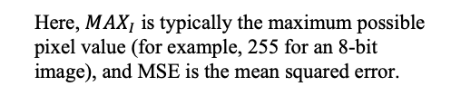


Metrics
MSE (Mean Squared Error) PSNR (Peak Signal-to-Noise Ratio) SSIM (Structural Similarity Index)
$$MSE= \frac{1}{MN}\sum_{i=0}^{M−1}{\sum_{j=0}^{N−1}{{\left[I\left(i,j\right)−K\left(i,j\right)\right]}^{2} }}$$
$$PSNR=20∙\log_{10}{(\frac{{MAX}_{I}}{\sqrt{MSE}})}$$
$$SSIM\left(x,y\right)= \frac{(2μ_{x}μ_{y}+c_{1})(2σ_{xy}+c_{2})}{(μ_{x}^{2}+μ_{y}^{2}+c_{1})(σ_{x}^{2}+σ_{y}^{2}+c_{2})}$$
Where I and K are the pixel values of the original and reconstructed or predicted images, respectively, and M and N are the dimensions of the image.
Here, ${MAX}_{I}$ is typically the maximum possible pixel value (for example, 255 for an 8-bit image), and MSE is the mean squared error.
In this formula, xx and yy are the two windows being compared, $μ_{x}, μ_{y}$, $σ_{x}^{2}$ and $σ_{y}^{2}$ are the mean and variance of these windows, and $σ_{xy}$is their covariance. $c_{1}$and $c_{2}$are small constants used to stabilize the division.
Measures the average difference in pixel values between images, suitable for precise quantification of errors but may not reflect the quality perceived by human vision.
Assesses the quality of a reconstructed image on a logarithmic scale, reflecting the strength of the signal relative to background noise, but not always consistent with human visual perception.
Incorporates luminance, contrast, and structure for a more human vision-aligned evaluation, though it is relatively complex to compute.

Slide 15
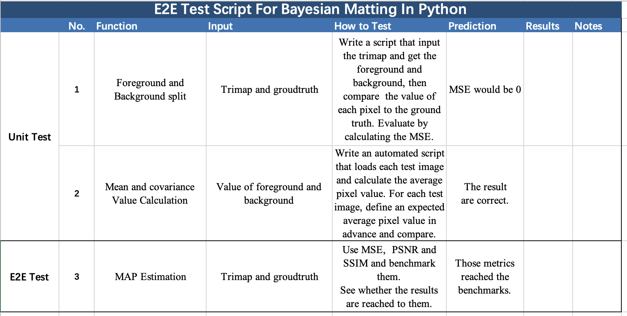
E2E test Description

Slide 16
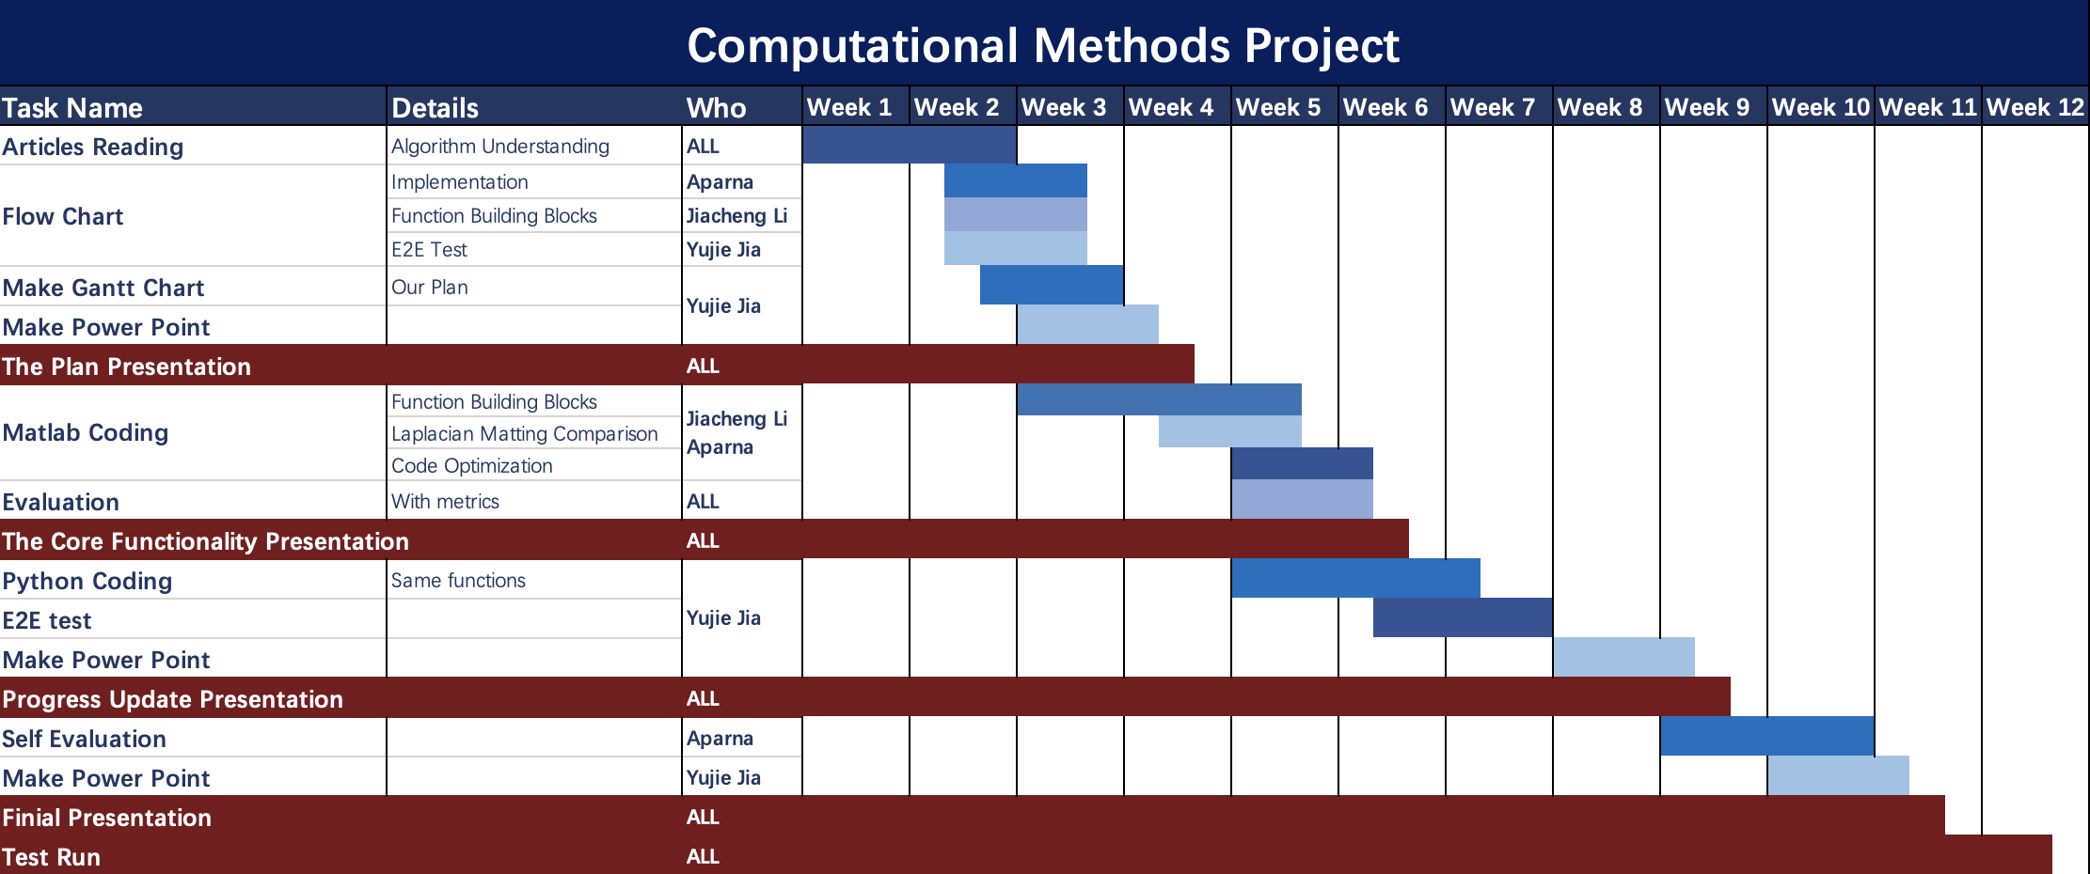
Roles and Timeline

Slide 17
Thank You

