Slide 1
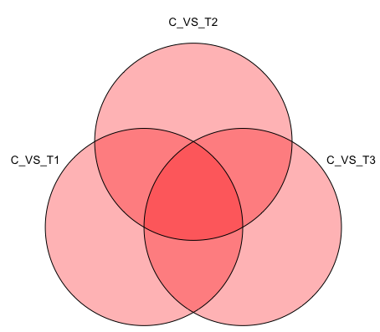
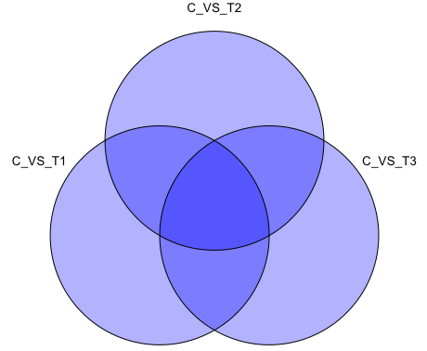
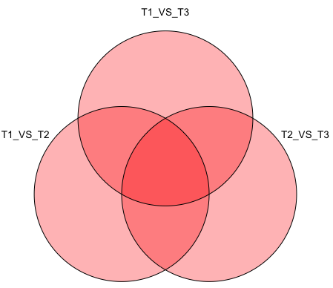
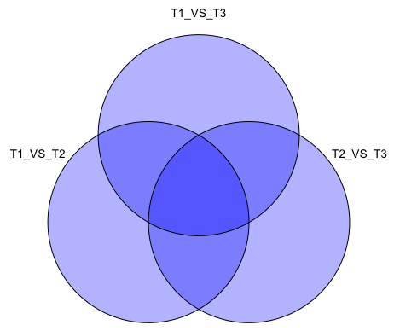
Saccharina
Hedophylum
10
78
90
Control vs. Scenarios
351
3
24
16
7
15
5
43
63
24
6
65
38
23
67
21
108
19
31
16
28
83
300
11
101
17
25
Scenarios vs. Scenarios
6
34
15
10
8
18
9
0
8
2
1
4
0
2
15
70
39
60
54
0
10
142
0
24
0
0

