Slide 1
Finlora Fraud Detection and
Risk Scoring
Machine-learning · Finlora Finance Flow
Presenter: Marc
Notes:
Good evening, I am here to present our work on fraud detection for Finlora.
In short, we have built a system that gives every payment a fraud score. We tested it on 126k transactions, and it is already running as a working tool.

Slide 2
Who is Finlora
Finlora Finance Flow is a growth-stage fintech that gives individuals and businesses a single financial command centre.
Payment processing
Real-time monitoring
Balance & asset tracking
Budgeting & cash flow
Markets
Nigeria · United States · United Kingdom (+ France, Germany)
Customers
Individuals and businesses, across three KYC tiers
KYC & compliance
Automated workflows
Channels
Mobile · Web · API · Card present · Card not present · USSD
Notes:
Finlora Finance Flow is a fintech company.
Today, many small businesses and individuals juggle several apps. One for payments, one for budgeting, another for compliance. Finlora brings all of that together. On the right you can see what the platform does: payments, real-time monitoring, balance tracking, budgeting, compliance and automated workflows.
We serve both individuals and businesses, mainly in Nigeria, the United States and the United Kingdom. Customers can pay through the mobile app, the website, card payments, our API and USSD.
This is strength. But it also creates a risk. Because we hold payments, balances and identity data in one place, we are a more attractive target for fraudsters.
So let us look at how we protect the platform today.

Slide 3
Context
24/7
multi-channel operation (mobile, web, API, card )
Today's monitoring
Fixed thresholds on amount, velocity and geography
Each transaction judged in isolation, without the account's history
Every alert carries equal urgency
Review effort grows linearly with volume
4
dimensions where fraud behaves differently: account type, KYC tier, channel, merchant
1
unified platform holding balances, identity and payments: a higher-value fraud target
Takeaway Rules built for low volume and simple fraud cannot scale with a unified, always-on platform.
Notes:
Finlora runs 24hrs hours a day, seven days a week, across many channels.
Fraud also looks different depending on the type of account, the level of identity checks, the channel and the type of merchant.
But today, our fraud monitoring uses fixed rules. For example, flag any payment above a certain amount. These rules look at each payment on its own, without knowing the customer's history. Every alert looks equally urgent. And as the business grows, the amount of checking grows with it.
This creates a very specific problem.

Slide 4
Problem
1
2
3
Missed fraud
Blocked customers
No prioritisation
Subtle fraud stays under fixed thresholds → direct losses and chargebacks
Legitimate payroll, wire and P2P transfers delayed → friction, support cost, churn risk
Analysts face an equal-urgency alert pile → time spent on low-value alerts
Takeaway Root cause: rules ignore each account's own behaviour, so one threshold can't fit every customer.
Notes:
The problem has three sides.
One: some fraud stays below the fixed limits, so it goes through. That means direct financial losses.
Two: the same rules block honest customers. A business paying its staff, or sending a large transfer, can be stopped or delayed. For a company that wants to be trusted with people's money, this is very damaging.
Three: every alert looks the same, so the team cannot focus on the most dangerous cases first.
The root cause is the same in all three cases. The rules do not know what is normal for each customer.
So here is what we set out to do.

Slide 5
Project overview
1
2
3
4
5
6
Frame
Clean
Explore
Engineer
Model & test
Deploy
Define fraud as a probability problem
Fix gaps and errors; merge tables
Find which behaviours signal fraud
Turn behaviour into model inputs
Train two models
Streamlit review queue
In scope: risk-scoring model, behavioural drivers, evaluation, Streamlit prototype
Out of scope: live payment integration, automatic blocking, retraining pipeline
Takeaway A complete prototype: question → clean data → insight → validated model → working tool.
Notes:
This slide shows the whole project at a glance, in six steps.
First, we defined the problem: instead of asking "is this fraud, yes or no?", we ask "how likely is this to be fraud?"
Second, we cleaned the data and combined the two tables.
Third, we explored the data to find which behaviours point to fraud.
Fourth, we turned those behaviours into inputs for the model.
Fifth, we trained two models and tested them on data they had never seen.
And sixth, we put the model into a simple web tool that analysts can use.
To be clear about the boundaries: this is a prototype. It is not yet connected to our live payment system, and it does not block payments automatically. Those are the next steps.
Here are the specific objectives we set.

Slide 6
Aim
Measure
Analyse
1
2
Assign each transaction a fraud probability from account and transaction behaviour
Identify which behavioural signals separate fraud from legitimate activity
Predict
Apply
3
4
Train and validate Logistic Regression (baseline) vs Random Forest (primary)
Deploy a prioritised, explainable review queue in Streamlit
Notes:
Our aim was to give every payment a fraud score that we can explain.
We had four objectives.
One: measure. Give each payment a probability of being fraud.
Two: analyse. Find out which customer behaviours really separate fraud from normal activity.
Three: predict. Build two models. A simple one that is easy to explain, and a more powerful one, and test both fairly.
Four: apply. Put the results in streamlit.
And we defined success in business terms: catch more fraud than the current rules, keep the number of false alarms manageable, and always be able to explain why a payment was flagged.
Now let me show you the data we worked with.

Slide 7
The datasets
126,000
7,200
3,352
19 mo
transactions
accounts (4,735 individual · 2,465 business)
confirmed fraud cases (2.66%)
Feb 2025 – Aug 2026
Transactions table (24 columns)
Accounts table (8 columns)
Amount, currency, time, channel, merchant category, country, device, velocity in the past hour, size vs. 30-day average, status, fraud label
Account type, KYC tier, home country, currency, opening date, personal spend baseline
Takeaway Joined on account ID, every payment can be judged against its own customer's history.
Notes:
We worked with Finlora's own data, covering 19 months, from February 2025 to August 2026.
There are 126k transactions from 7200 accounts. About two-thirds are individual accounts, and one-third are business accounts.
Of all those transactions, 3352 were confirmed as fraud. That is just 2.66%.
The data came in two tables. The transactions table tells us about each payment: the amount, the time, the channel, the type of merchant, the country, the device, and whether it was fraud. The accounts table tells us about each customer: the account type, the level of identity checks, and their usual spending.
We joined the two tables using the account number. That is important, because it lets us compare every payment to that customer's own history.
Before we could use it, though, the data needed cleaning.

Slide 8
Analysis · Data cleaning
Issue found | Rows | Treatment
Merchant blank on P2P / Payroll (structural) | 27,832 | Labelled 'N/A – No Merchant'
Merchant blank elsewhere (genuine gap) | 778 | Labelled 'Unknown'
Device not captured | 14,334 | Filled + new flag is_device_known
Negative amounts (sign errors, mostly 'Completed') | 291 | Absolute value
Negative 30-day average spend | 144 | Absolute value; ratio recomputed
Duplicates / broken account links | 0 | Verified clean
Takeaway 126,000 rows in, 126,000 out; fraud rate held at 2.66%, proving no signal was lost.
Notes:
Here are the main fixes.
About 28k payments had no merchant name. But almost all of them were person-to-person or salary transfers, which naturally have no merchant. So we labelled them clearly, separately from the 778 that were genuinely missing.
14k payments had no device recorded. Instead of hiding that, we kept it as a signal, because a missing device can itself be suspicious.
And 291 payments had a negative amount. So we corrected them.
The result: we started with 126k rows, and we finished with 126k rows. The fraud rate stayed exactly the same, which proves we did not lose any important information.

Slide 9
Analysis · EDA
2.66%
of transactions are fraud (a rare event)
Takeaway One prior transaction within the hour lifts fraud likelihood from 1.7% to over 88%.
Notes:
There are two things on this slide.
On the left: fraud is rare. Only about 2 or 3 payments in every 100. This matters, because a system that always says "not fraud" would be right 97% of the time, and it would catch nothing. So we do not judge the model on accuracy. We judge it on how much fraud it catches, and how many false alarms it creates.
On the right is our most important finding. When a customer has made no other payment in the past hour, the fraud rate is under 2%. But as soon as there is even one other payment in that hour, the fraud rate jumps to almost 90% percent or more.
In simple terms: fraudsters move fast. They try to take money out quickly before anyone notices.
The second strong signal is about how much someone spends, compared with their normal spending.

Slide 10
Analysis · EDA
6 ×
median fraud size vs. account norm (legit ≈ 1×)
Takeaway Payments above 5× an account's norm carry ~9× the fraud rate of normal-sized ones.
Notes:
This chart shows why fixed amount limits do not work.
If you only look at the amount in pounds, fraud and normal payments look very similar. There is no single amount that separates them.
But when we compare each payment to that customer's own average, the picture becomes very clear. Payments at a customer's normal level have a fraud rate of about 1%. Payments more than five times their normal level have a fraud rate of almost 12%. That is about nine times higher.
On average, a fraudulent payment is around six times bigger than what that customer usually spends.
This is exactly what our current rules cannot see, because they do not know what is normal for each customer.
We also found that fraud is concentrated in certain areas.

Slide 11
Analysis · EDA
Business accounts
3.9%
vs 2% individual
Tier 1 (Basic) KYC
3.3%
vs 2.2% Tier 3
New device
5.9%
vs 2.6% known device
Cross-border
3.4%
vs 2.6% domestic
Takeaway High-value, hard-to-reverse transfers and lightly-verified business accounts carry the most risk.
Notes:
Fraud is not spread evenly across the business.
On the left, by type of payment: wire transfers have the highest fraud rate, at 7.6%, almost three times the average. They are followed by salary transfers and crypto exchanges. These are large payments that are hard to reverse, so it makes sense that fraudsters target them.
On the right: business accounts have twice the fraud rate of personal accounts. Accounts with only basic identity checks are riskier than fully verified ones. A payment from a new device doubles the risk. And payments from abroad add a little more.
So how did we turn these findings into a model?

Slide 12
Analysis · Features & models
Behavioural features
Context features
Two models
Output
Velocity (1h)
Amount ÷ 30-day avg
New device · Cross-border
Device captured
Account type · KYC tier
Merchant category · Channel
Logistic Regression and
Random Forest
Fraud probability
0–100% per transaction
Takeaway One model to explain, one to perform — both tested on 31,500 unseen transactions.
Notes:
This slide shows how the model works, from left to right.
We feed it two kinds of information. First, customer behaviour: how many payments in the past hour, how big the payment is compared with normal, whether the device is new, and whether the payment is from abroad. Second, context: the type of account, the level of identity checks, the type of merchant, and the channel.
We then trained two models: logistic regression and random forest.
At the end, each payment gets a fraud score between zero and 100%.
We tested both models on 31500 payments that they had never seen before.
So, how well did they do?

Slide 13
Analysis · Evaluation
Random Forest
 | Pred. legit | Pred. fraud
Actual legit | 29,168 | 1,494
Actual fraud | 144 | 694
694 of 838 frauds caught; 1,494 legitimate payments sent for review (4.9% of legit traffic).
Takeaway Random Forest catches 83% of fraud; Logistic Regression trades a little recall for higher precision.
Notes:
Both models scored 0.93 on the main measure. That means they are very good at ranking fraud above normal payments.
On the right, you can see the results for the random forest. Out of 838 fraud cases in the test, it caught 694. That is 83%. The cost was about 29k honest payments sent for a check, which is about 5% of normal payments.
Logistic regression is a little more precise, but it catches slightly less fraud.
The two models are very close. We recommend the random forest because it catches more fraud, and we keep the simpler model as a check that is easy to explain to auditors.

Slide 14
Evaluation
70% recall · Lean team
~3 in 5 alerts are real fraud
80% recall · Balanced
~2 in 5 alerts are real fraud
90% recall · Max coverage
~1 in 8 — queue grows fast
Takeaway Set the dial to review capacity: 80% recall is the recommended starting point.
Notes:
This is where the model becomes a management tool.
Every extra fraud you want to catch means a few more payments to check. This chart shows that trade-off.
If we aim to catch 70% of fraud, about 3 in every 5 alerts are real fraud. The team's time is used very well.
If we aim for 80%, about 2 in 5 alerts are real fraud.
If we push to 90%, only about 1 alert in 8 is real fraud, and the number of checks grows quickly.
There is no single right answer. We recommend starting at eighty percent, which is what you will see in the live tool.
Before the demo, what does the model actually pay attention to?

Slide 15
Analysis · Drivers
76%
of decision weight from velocity + relative amount
Because the drivers are intuitive, every flag can be explained to an analyst, a customer, or a regulator in one sentence.
Takeaway Explainable by design — no black box: the score rests on behaviour analysts already understand.
Notes:
We asked the model which information it relies on most.
Two signals clearly lead. The number of payments in the past hour, and the size of the payment compared with the customer's normal spending. Together, they make up about three-quarters of the model's decisions.
This matches exactly what we saw in EDA. That gives us confidence that the model has learned real behaviour, not random patterns.
Now let me show you the tool itself.

Slide 16
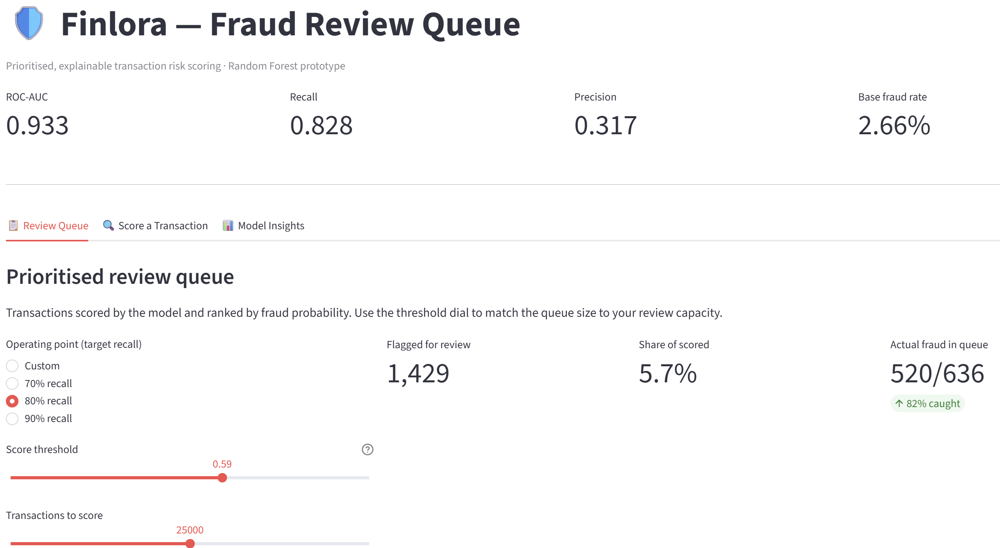
Deployment · Live app
From 25,000 scored transactions:
1,429 flagged for review (5.7%)
520 of 636 frauds in the queue: 82% caught
Threshold 0.59 = 80% recall preset
Notes:
This is the web tool we built, running on the trained model.
At the top, you can see the model's key results, which match what I showed you earlier.
In this test, the tool checked 25k payments. Using the 80% setting, it flagged 1429 payments for review. That is just 5.7% of all payments.
And inside that list, there were 520 636 fraud cases. That means 82% of the fraud was caught.
Put simply: we check about one payment in 18, and stop 4 frauds out of 5.
On the left, the team can switch between 70, 80, and 90% with one click, and the list updates straight away.
And the list is ranked, with a reason for every alert.

Slide 17
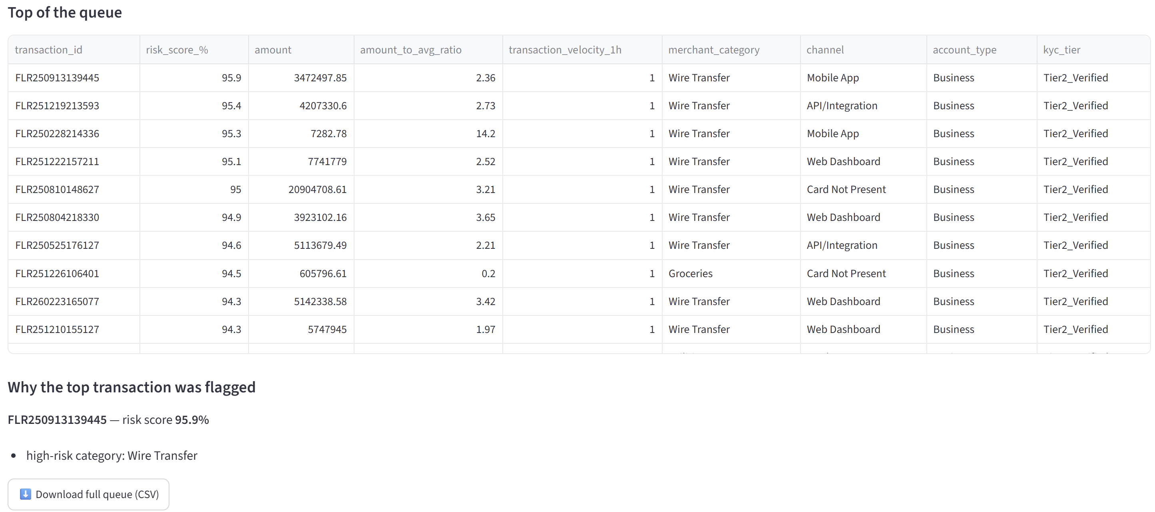
Deployment
Notes:
This is the review list itself, sorted from the highest risk down.
The top cases have fraud scores of 94 to 96%. And look at the pattern: they are almost all business accounts sending wire transfers, each with another payment in the previous hour. That is exactly the combination our analysis pointed to. So the tool is putting the most dangerous cases at the top.
So, what does all this mean for the business?

Slide 18
Strategic outcomes
Lower fraud losses
Less customer friction
83% of fraud intercepted at the default setting
Judging payments against each account's norm stops blunt blocks on legitimate payroll and wires
Governance & trust
Every flag has a stated reason; thresholds are explicit, documented business choices
Notes:
There are four main benefits for Finlora.
First, lower fraud losses. The model catches most fraud, including the subtle cases that slip under our current limits.
Second, happier customers. Because the model knows what is normal for each customer, a business paying its staff will not be blocked just because the amount is large. That protects trust in our platform.
Third, better governance. Every alert has a reason, and the level of strictness is a clear business decision. That is much easier to explain to auditors and regulators.
And finally, the clean data we built can be reused for future projects, such as credit risk or customer retention.

Slide 19
Behaviour beats thresholds
Fraud is best judged against each account's own behaviour.
A validated model (ROC-AUC 0.93) catches 4 in 5 frauds while reviewing ~6% of traffic.
The risk team controls the trade-off; every flag comes with a reason.
A working tool is ready for trials.
Thank you!
Notes:
To sum up.
First, fraud at Finlora is about behaviour. Fast bursts of payments, and payments far above a customer's normal spending, explain about three-quarters of the model. That is exactly why fixed limits fail.
Second, a model built on that behaviour works. It scores zero point nine three, and in the live tool it catches four frauds out of five while checking only about six percent of payments.
Third, it puts the business in control. The risk team decides how strict to be, and every alert comes with a reason.
And fourth, this is real. A working tool exists today, and the next step is a safe trial alongside our current rules.
Thank you very much for your attention.

