Slide 1
Who buys and rents from Veltrix
6 customer segments and what to do with each
Persona deck · Phase 4 · segmentation placeholder-A
100,573 customers · data to 30 Sep 2026

Slide 2
A few segments carry most of the value
Share of customers and share of deal value, 6 segments
Biggest share of value
42%
Home movers and downsizers, from 38% of customers
Priority 1 segments
79%
of deal value from 3 segments, 59% of customers
Veltrix segmentation · persona deck · placeholder-A · data to 30 Sep 2026
2

Slide 3
P1
Home movers and downsizers
38% of customers, 42% of deal value; budget around £395k; look most at flats in South East.
38,011
42%
17%
2.9%
49 d
customers (38%)
of deal value
conversion of closed leads
payments late
median days to decide
How they arrive
What they look for
What they ask about
· Rightmove · 32% of leads, converts 17%
· Zoopla · 15% of leads, converts 16%
· Veltrix website · 12% of leads, converts 17%
· Browse mostly on mobile
· South East: 18% of views
· London: 16% of views
· Flat: 39%
· Sale: £350k-600k: 36%
· Finance: Mortgage (55% of deals)
· School catchment (index 325)
· Retirement living (index 323)
· Chain and timescales (index 279)
· March 2025 rush: index 175
What to do P1: route to Regional sales desks (Senior agent first); first contact by Branch visit; First reply within 1 hour, 7 days a week.
Veltrix segmentation · persona deck · placeholder-A · data to 30 Sep 2026
3

Slide 4
P2
First-time buyers
22% of customers, 18% of deal value; budget around £245k; look most at flats in North West.
21,871
18%
12%
3.7%
60 d
customers (22%)
of deal value
conversion of closed leads
payments late
median days to decide
How they arrive
What they look for
What they ask about
· Rightmove · 28% of leads, converts 13%
· Zoopla · 14% of leads, converts 12%
· Veltrix website · 12% of leads, converts 12%
· Browse mostly on mobile
· North West: 16% of views
· London: 12% of views
· Flat: 53%
· Sale: £200k-350k: 47%
· Finance: Mortgage (97% of deals)
· Shared ownership (index 385)
· Mortgage and finance (index 228)
· Stamp duty (index 152)
· March 2025 rush: index 180
What to do P2: route to Regional sales desks (Mid or senior agent); first contact by Branch visit; First reply within 4 hours (working hours).
Veltrix segmentation · persona deck · placeholder-A · data to 30 Sep 2026
4

Slide 5
P3
UK renters
17% of customers, 1% of deal value; rent around £1,400 pcm; look most at flats in London.
16,818
1%
25%
12.3%
9 d
customers (17%)
of deal value
conversion of closed leads
payments late
median days to decide
How they arrive
What they look for
What they ask about
· Rightmove · 30% of leads, converts 26%
· Zoopla · 20% of leads, converts 23%
· Veltrix website · 11% of leads, converts 24%
· Browse mostly on mobile
· London: 30% of views
· North West: 15% of views
· Flat: 76%
· Rent: £1,000-2,000 pcm: 64%
· Finance: Renting (98% of deals)
· Referencing (index 512)
· Tenancy terms (index 449)
· Viewing arrangements (index 189)
· Rent paid late 14% of the time
· March 2025 rush: index 109
What to do P3: route to Regional lettings desks (Any agent or automated nurture); first contact by Email; Same day; automated reply immediately.
Veltrix segmentation · persona deck · placeholder-A · data to 30 Sep 2026
5

Slide 6
P1
UK investors and landlords
12% of customers, 26% of deal value; budget around £195k; look most at flats in North West.
11,902
26%
20%
3.0%
33 d
customers (12%)
of deal value
conversion of closed leads
payments late
median days to decide
How they arrive
What they look for
What they ask about
· Rightmove · 22% of leads, converts 20%
· Veltrix website · 16% of leads, converts 19%
· Referral · 14% of leads, converts 20%
· Browse mostly on desktop
· North West: 23% of views
· Yorkshire and the Humber: 16% of views
· Flat: 64%
· Sale: under £200k: 49%
· Finance: Buy-to-let mortgage (63% of deals)
· Rental yield (index 365)
· Offer and negotiation (index 204)
· Stamp duty (index 122)
· March 2025 rush: index 167
What to do P1: route to Investor desk (Senior agent first); first contact by Video call; First reply within 1 hour, 7 days a week.
Veltrix segmentation · persona deck · placeholder-A · data to 30 Sep 2026
6

Slide 7
P1
Overseas buyers and tenants
9% of customers, 11% of deal value; budget around £523k; look most at flats in London.
9,462
11%
17%
3.9%
38 d
customers (9%)
of deal value
conversion of closed leads
payments late
median days to decide
How they arrive
What they look for
What they ask about
· Overseas agent partner · 20% of leads, converts 13%
· Veltrix website · 15% of leads, converts 16%
· WeChat · 12% of leads, converts 14%
· Browse mostly on mobile
· 24% of sessions 00:00-06:00 UK
· London: 51% of views
· North West: 11% of views
· Flat: 80%
· Sale: £600k+: 34%
· Finance: Cash (37% of deals)
· Currency and transfers (index 998)
· Off-plan payment schedule (index 817)
· Visa and relocation (index 356)
· Rent paid late 2% of the time
· March 2025 rush: index 121
What to do P1: route to International desk (Senior agent first); first contact by Phone; First reply within 1 hour, 7 days a week.
Veltrix segmentation · persona deck · placeholder-A · data to 30 Sep 2026
7

Slide 8
P3
Corporate and relocation tenants
2% of customers, 1% of deal value; rent around £2,800 pcm; look most at flats in London.
2,509
1%
39%
1.5%
11 d
customers (2%)
of deal value
conversion of closed leads
payments late
median days to decide
How they arrive
What they look for
What they ask about
· Relocation partner · 55% of leads, converts 39%
· Veltrix website · 11% of leads, converts 41%
· Rightmove · 10% of leads, converts 37%
· Browse mostly on desktop
· London: 44% of views
· South East: 11% of views
· Flat: 59%
· Rent: £2,000+ pcm: 61%
· Finance: Company let (98% of deals)
· Visa and relocation (index 2307)
· Tenancy terms (index 769)
· Referencing (index 253)
· Rent paid late 1% of the time
· March 2025 rush: index 133
What to do P3: route to Corporate lettings (Any agent or automated nurture); first contact by Phone; Same day; automated reply immediately.
Veltrix segmentation · persona deck · placeholder-A · data to 30 Sep 2026
8

Slide 9
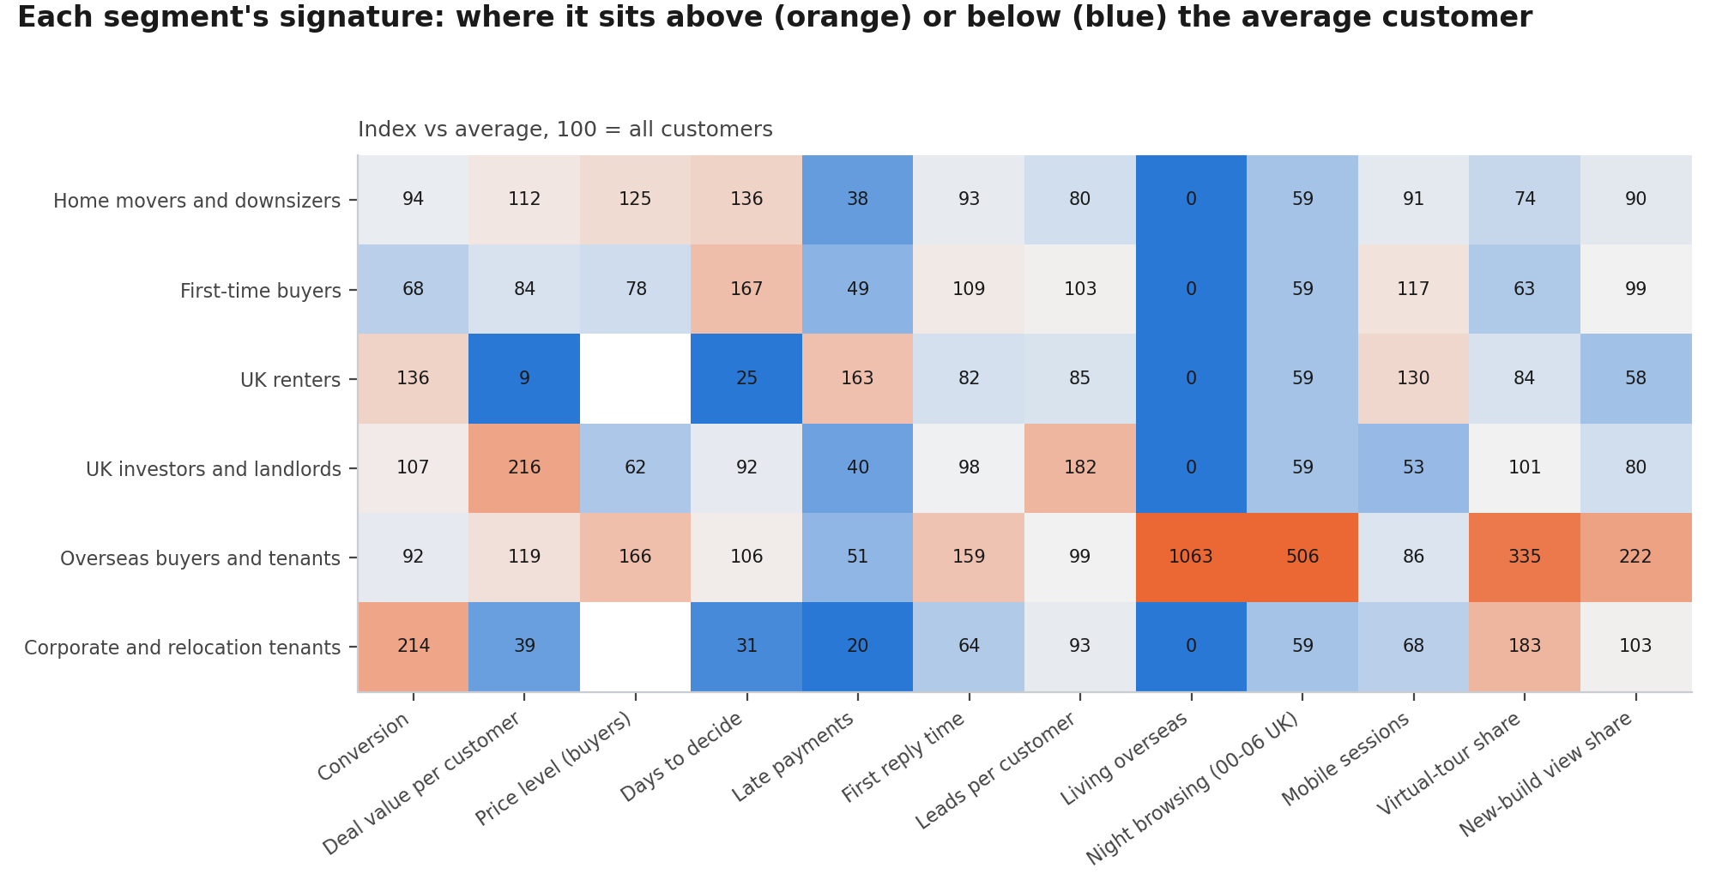
Each segment has a clear signature
Index vs the average customer (100); orange = above, blue = below
Veltrix segmentation · persona deck · placeholder-A · data to 30 Sep 2026
9

Slide 10
Not every segment rushed before the stamp duty change
Leads in March 2025 against each segment's normal month (100)
Contact first next time
First-time buyers ran at 180 and Home movers and downsizers at 175: their enquiries jump when tax rules change.
Less sensitive
UK renters stayed near 109.
Veltrix segmentation · persona deck · placeholder-A · data to 30 Sep 2026
10

Slide 11
Sign-off: do these personas describe our customers?
Gate for Phase 5: the heads of sales, lettings and marketing approve the persona cards
Head of sales
Head of lettings
Head of marketing
Name:
Approved / changes:
Date:
Name:
Approved / changes:
Date:
Name:
Approved / changes:
Date:
Next: segment names and tiers go into the CRM, routing rules go live, and the first six-week test starts (Phase 5).

