Slide 1
Advanced Web Design Project
marko nedelkovski 213280

Slide 2
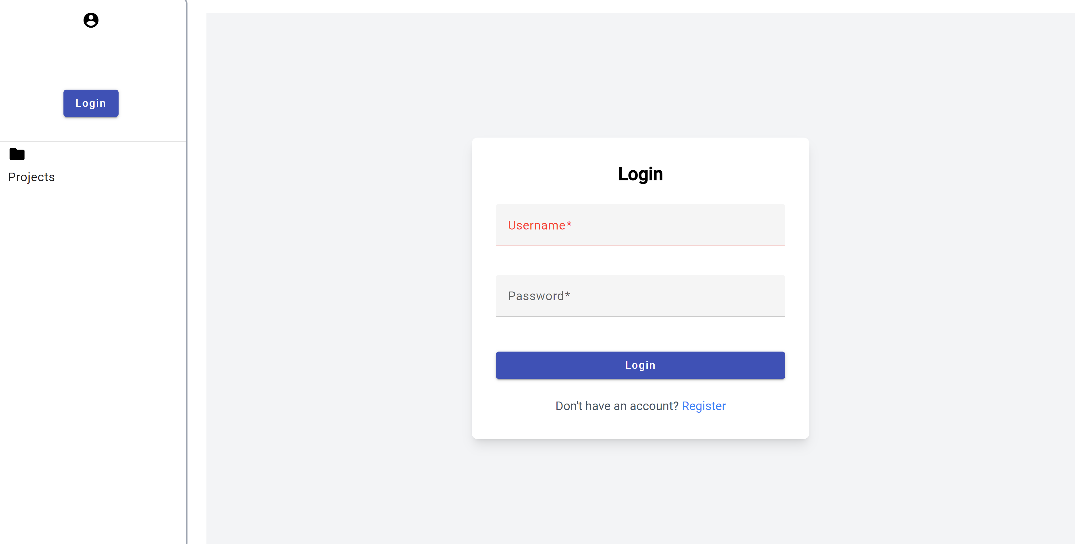
Login Form

Slide 3
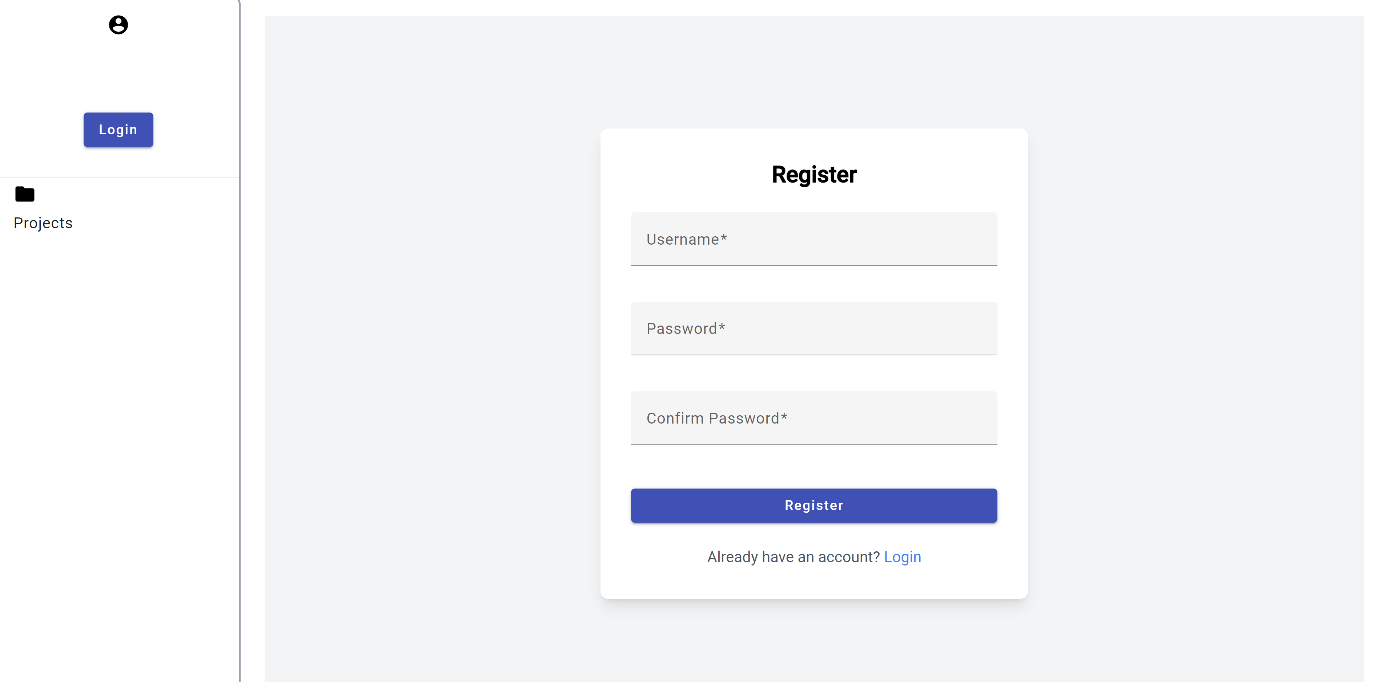
Register form

Slide 4

Login and Register Page Design Overview
Both the login and register pages practice a simple, yet elegant design that’s easy on the eyes for the user that visits the application.
The forms also implement error handling for the user inputs.

Slide 5
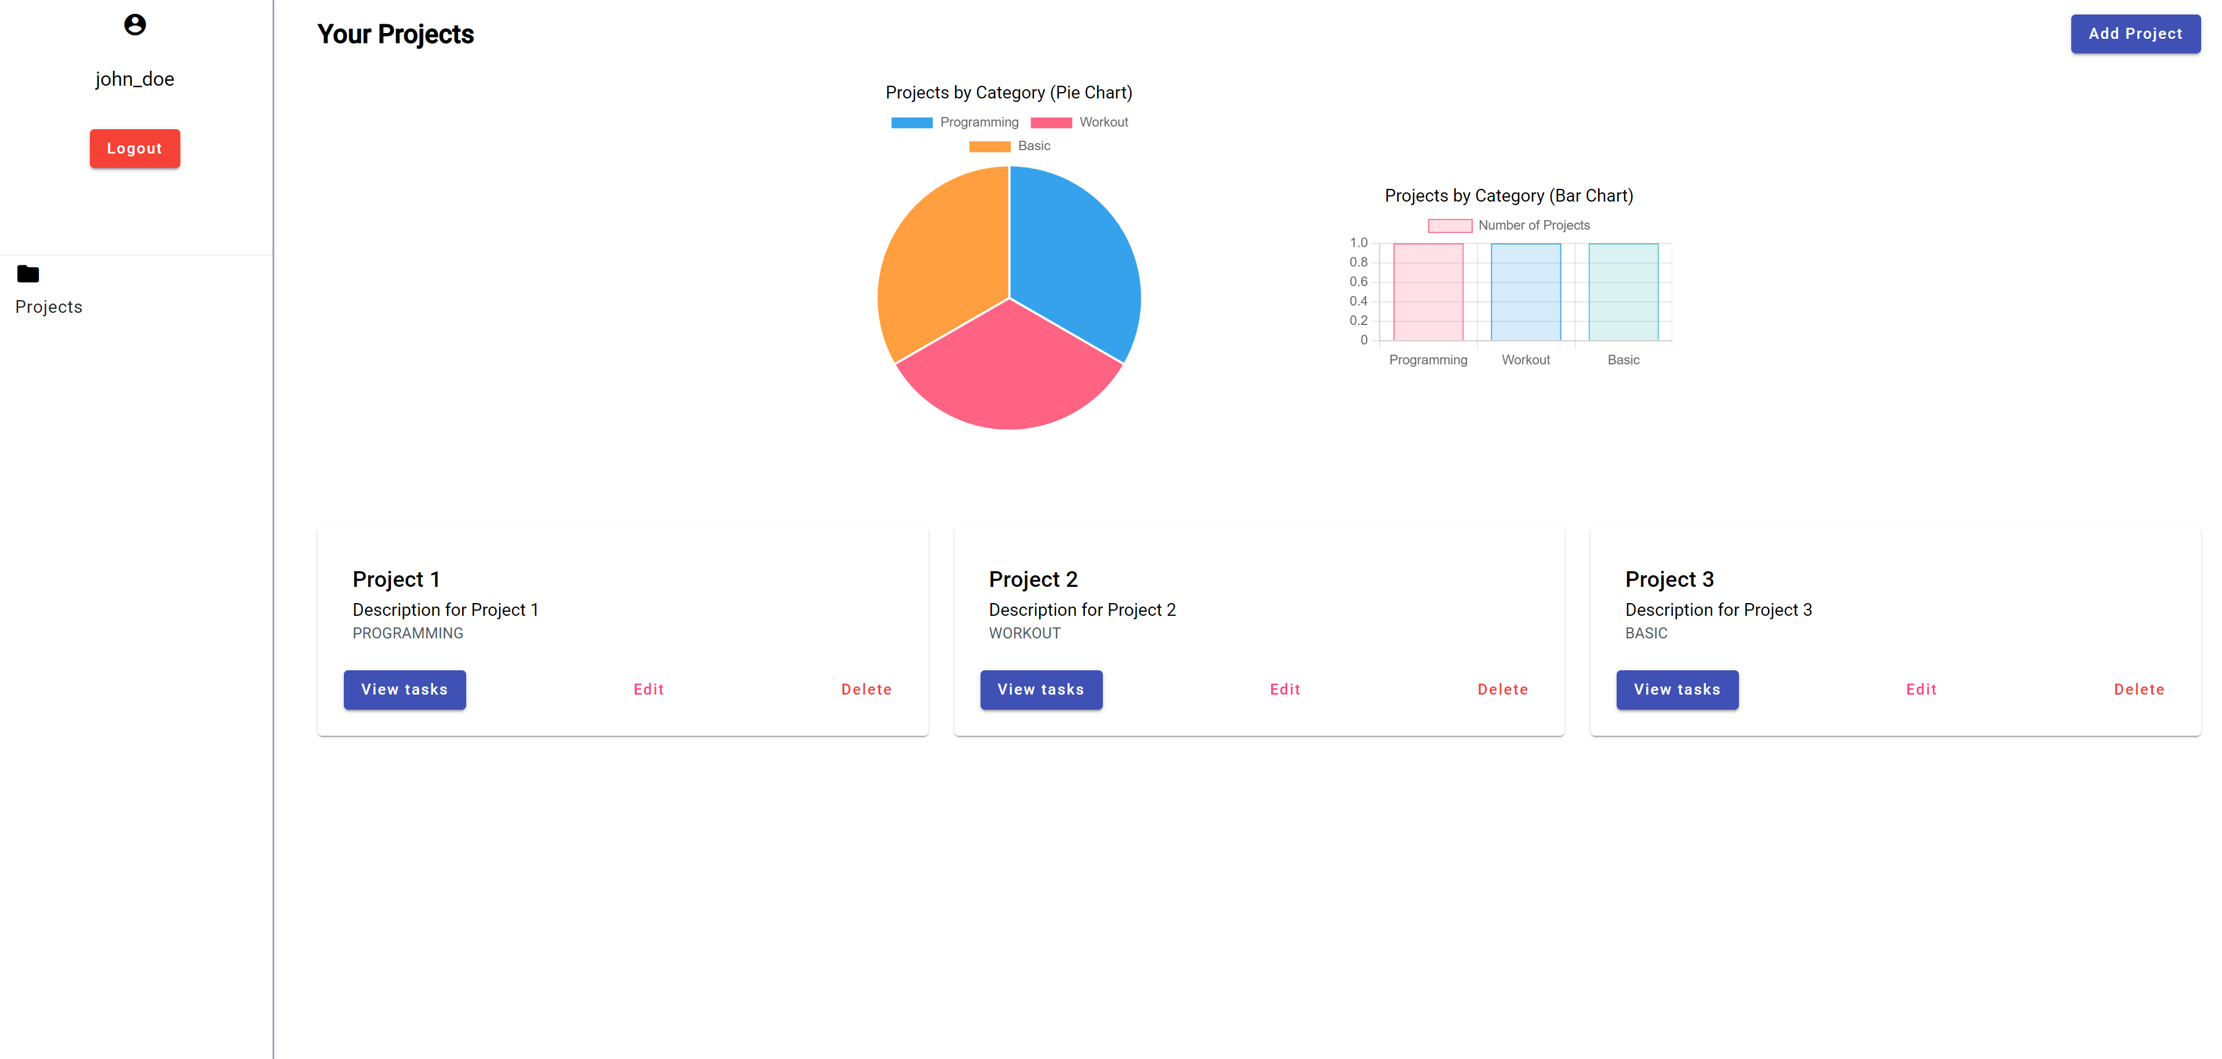
Projects page
The project page is also the main page of the application. Here the user is able to see his projects, as well execute all the CRUD operations and also view the nice visual charts displayed on the screen.

Slide 6
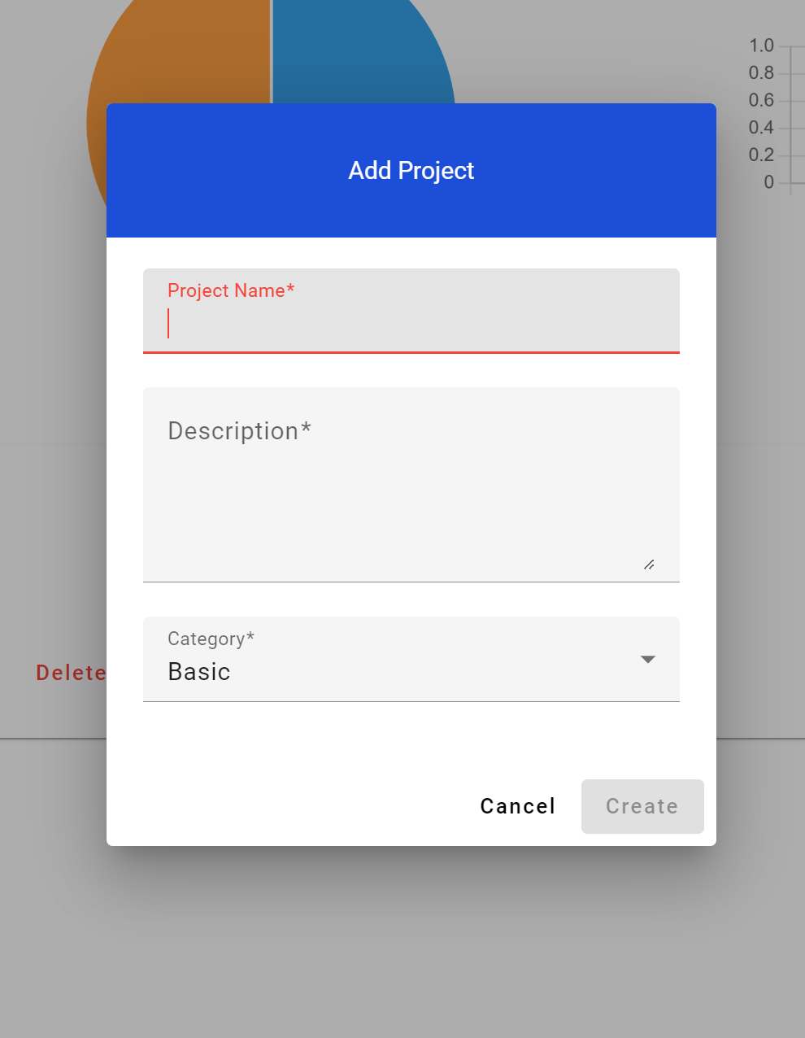
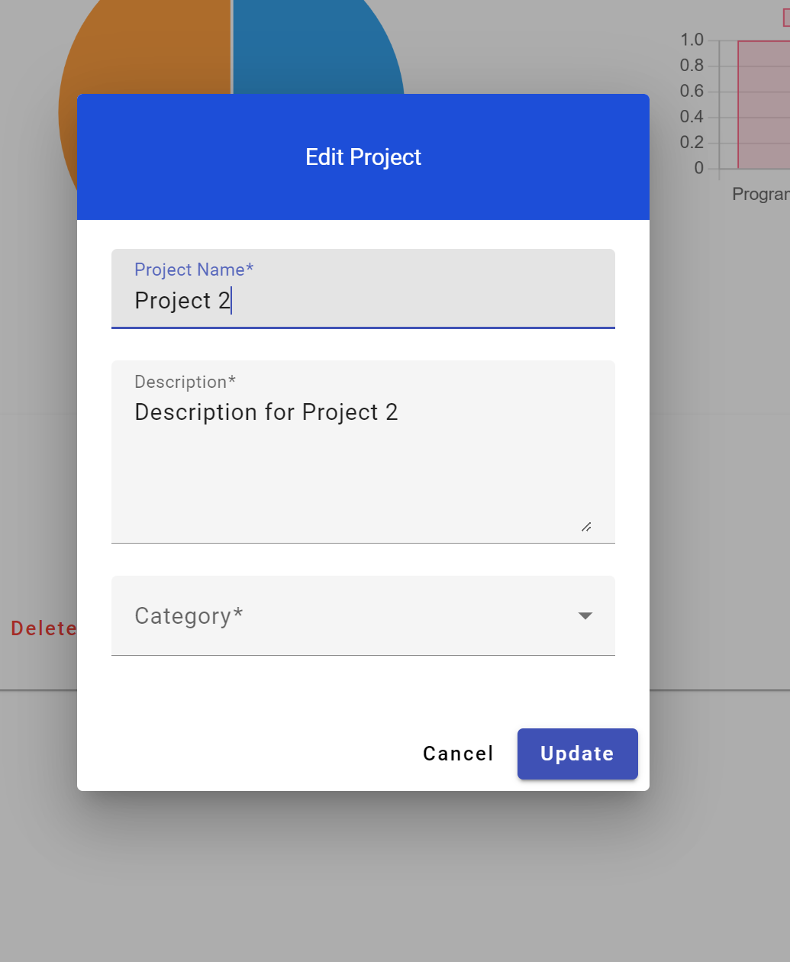
Project Add/Edit Form
At the middle of the screen there are popup modal panels, for adding or editing the project, that follow a nice flow that suits the application.

Slide 7
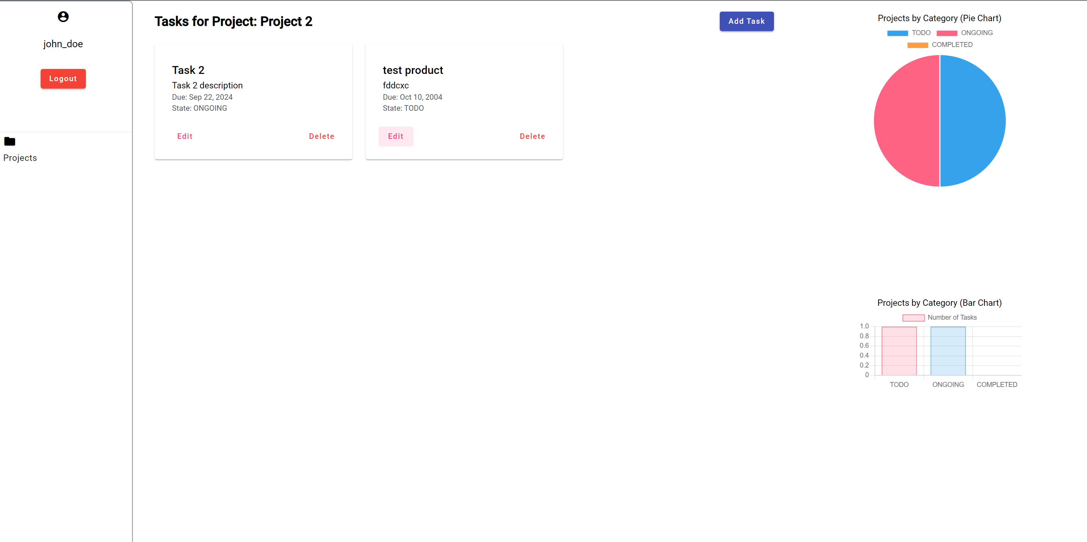
Tasks Page
This is the page where the tasks for the project are shown. The user is presented with a similar page as the one with the projects.

Slide 8
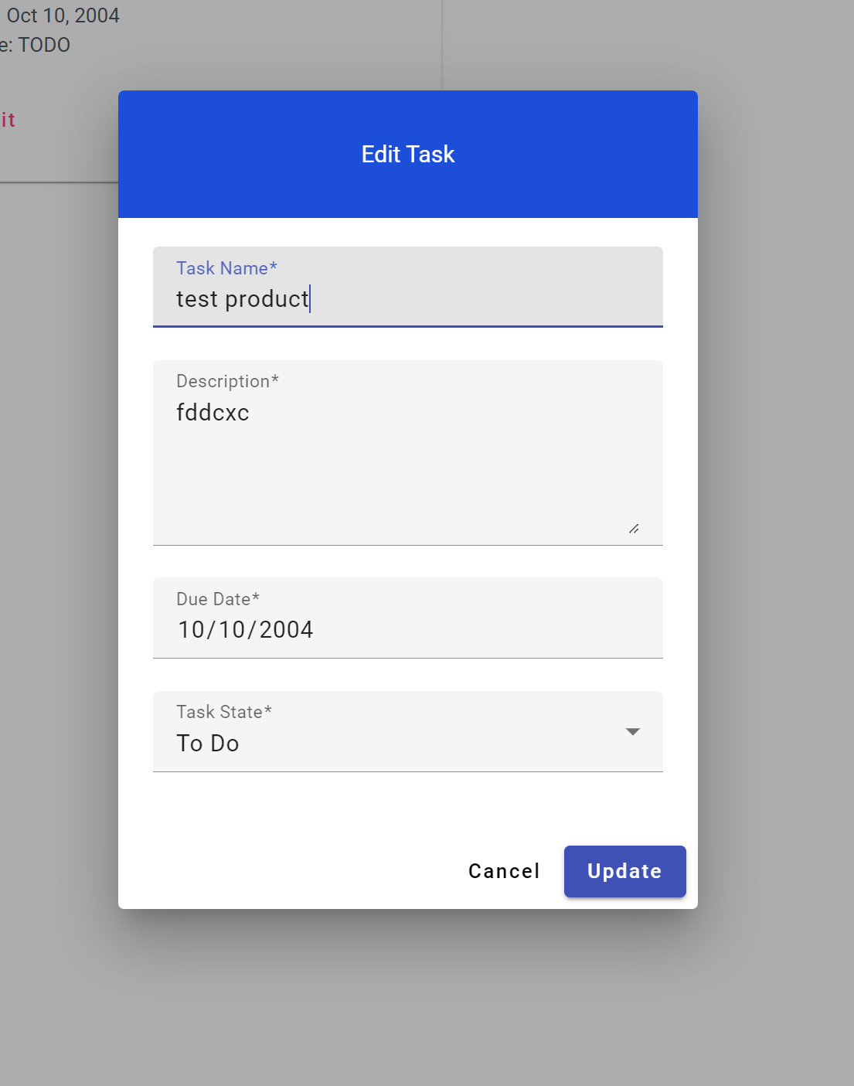
Task Add/Edit Page
At the middle of the screen there are popup modal panels, for adding or editing the task, that follow a nice flow as the one for the projects modals.

Slide 9
Thank you all for listening!

