Slide 1
Bakery Sales Prediction
Project Presentation for Opencampus
„Einführung in Data Science and Machine Learning 24/25“
Group 3: Marcel Agena, Loky Stein, Sebastian Megow

Slide 2
Variablen & Feature Engineering
'Datum', 'Bewoelkung', 'Temperatur', 'Windgeschwindigkeit', 'Wettercode', 'id', 'Warengruppe', 'Umsatz', 'KiWo', 'Ferien', 'Is_Ferien', 'Holiday', 'ID', 'Wochentag', 'Is_Weekend', 'Weihnachten_Sommer', 'Christmas_Sales', 'Sommerferien_Flag', 'Ferien_Category', 'Temperature_Category', 'Windgeschwindigkeit_Beaufort', 'Rain_Status', 'Cloud_Status',

Slide 3
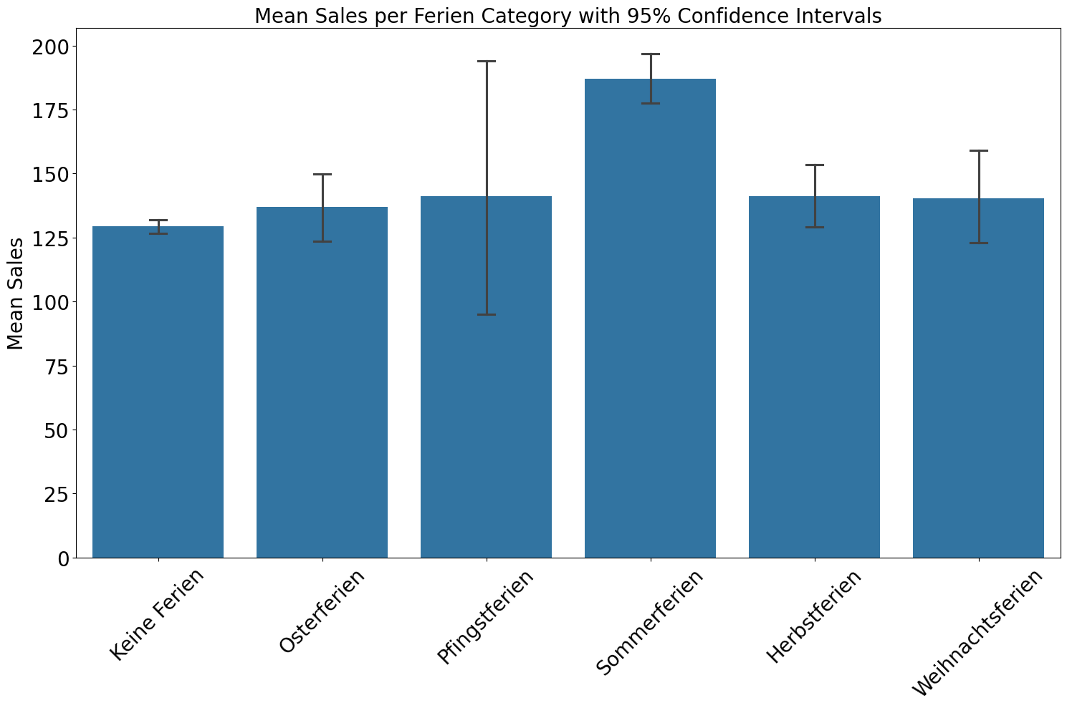
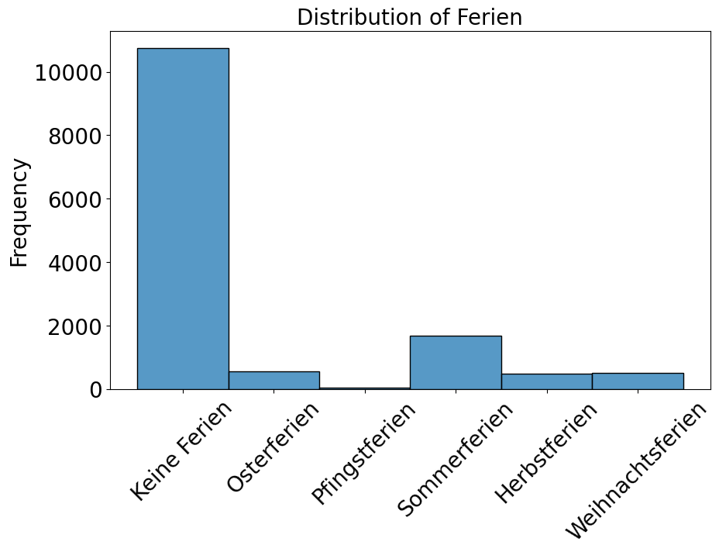
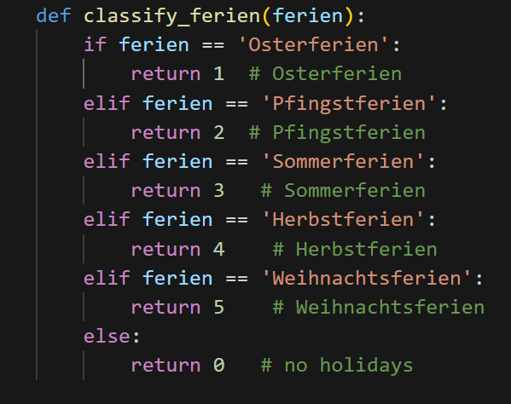
Beispiel: Umsätze Nach Ferien

Slide 4
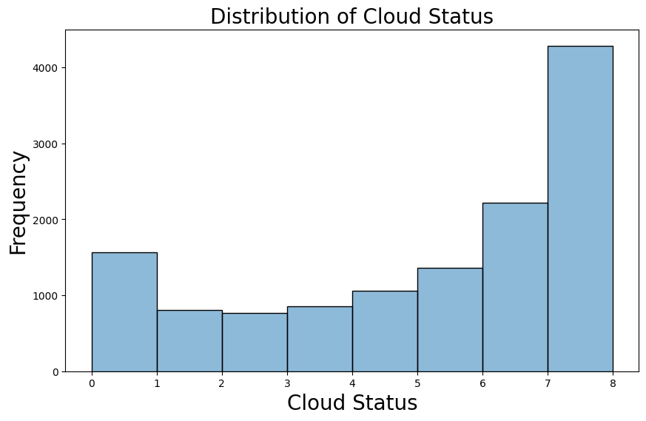
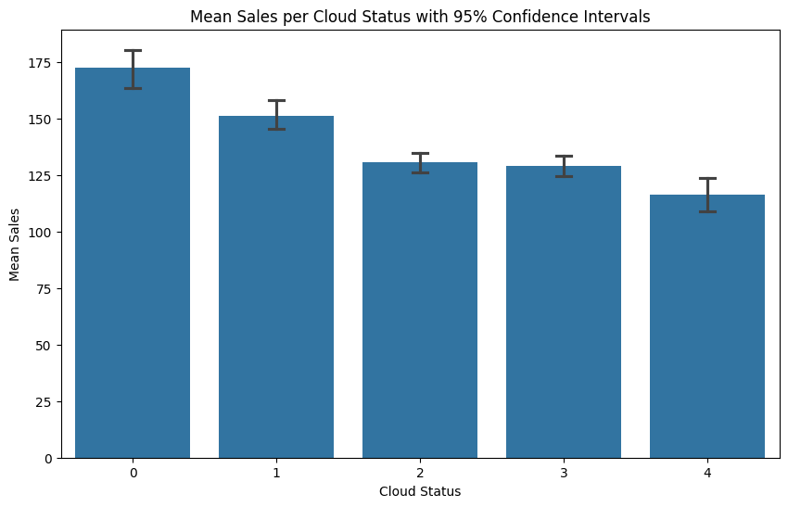
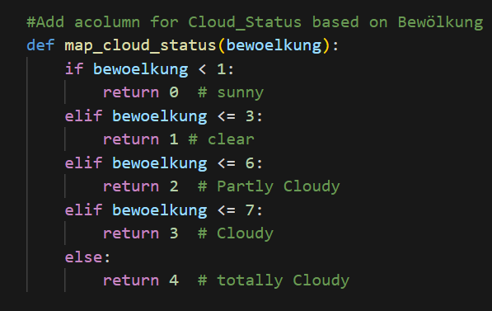
Beispiel: Umsätze Nach Bewölkung

Slide 5
Lineares Modell

Slide 6
Missing Value Imputation

Slide 7
Source Code zur Definition des neuronalen Netzes
# Build the neural network model
model = Sequential([
Dense(64, input_dim=X_train.shape[1], activation='relu', kernel_regularizer=l2(0.01)), # Input layer with L2 regularization
Dropout(0.3), # Dropout layer
Dense(32, activation='relu', kernel_regularizer=l2(0.01)), # Hidden layer with L2 regularization
Dropout(0.3), # Dropout layer
Dense(16, activation='relu', kernel_regularizer=l2(0.01)), # Hidden layer with L2 regularization
Dropout(0.3), # Dropout layer
Dense(1, activation='linear') # Output layer for regression
])
# Compile the model
model.compile(optimizer=Adam(learning_rate=0.001), loss='mse', metrics=['mae'])

Slide 8
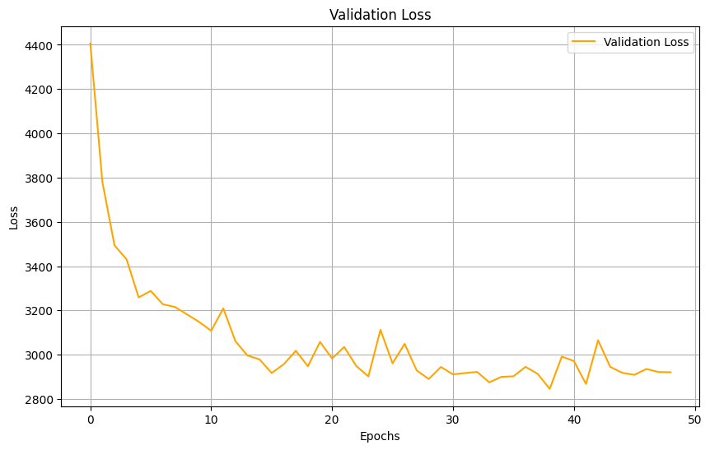
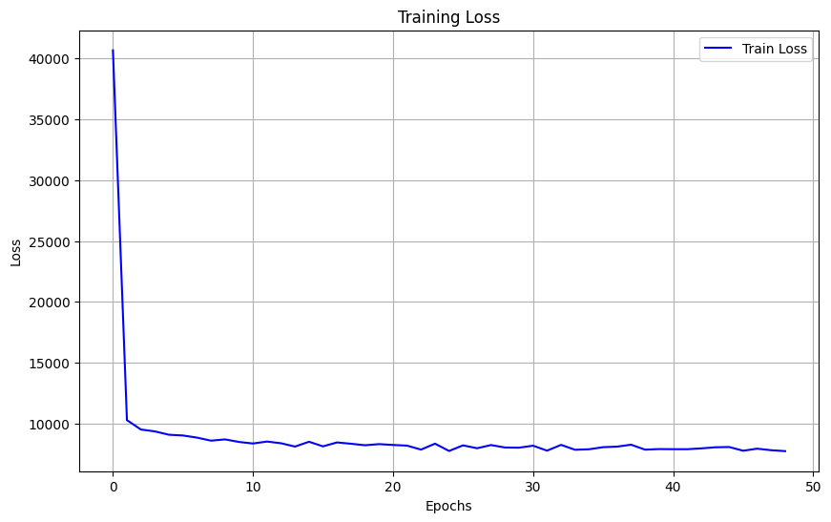
Source Code zur Definition des neuronalen Netzes
MAPEs by Warengruppe: Warengruppe_1: 24.14% Warengruppe_2: 14.76% Warengruppe_3: 21.08% Warengruppe_4: 23.68% Warengruppe_5: 16.18% Warengruppe_6: 51.67%

Slide 9

Worst Fail Not starting early

