Slide 1
Practical Course:
3D Scanning and Spatial Learning
Marcel Bruckner, Kevin Bein, Moiz Sajid
Multi-view RGB-D Capture Setup

Slide 2
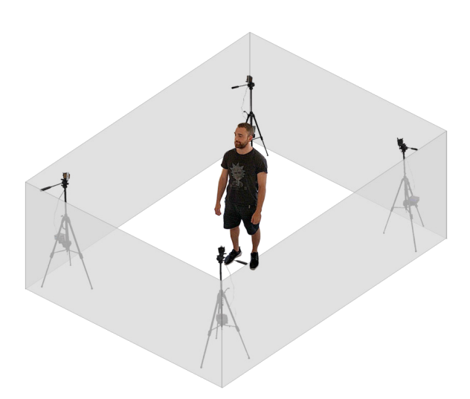
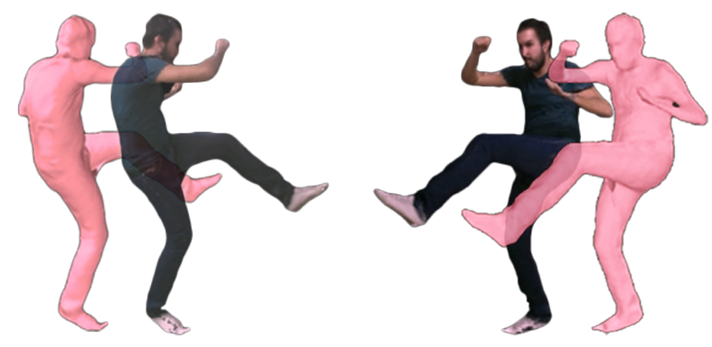
Multi-view RGB-D Capture Setup

Slide 3
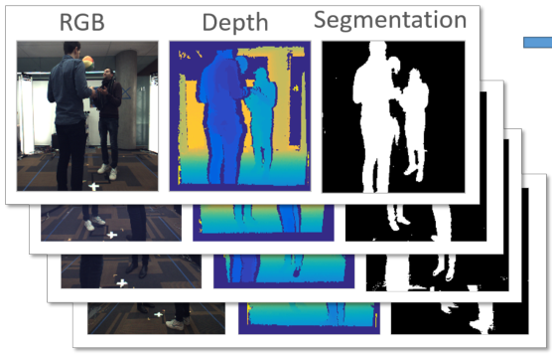
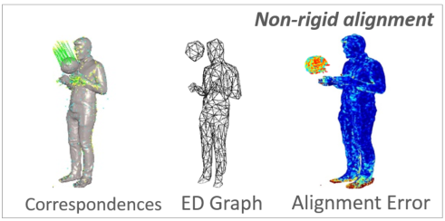
Multi-view RGB-D Capture Setup
Image preprocessing
  Depth filtering, background subtraction, visual hull computation
Non-rigid shape reconstruction
  Sparse voxel grid
  Deformation graph construction
Non-rigid tracking
  Projective depth ICP
  Global sparse correspondences

Slide 4
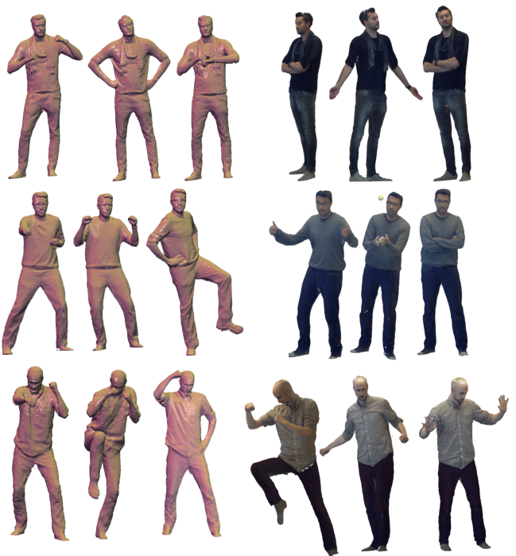
Multi-view RGB-D Capture Setup
Data:
  4x Intel Realsense D415
Literature:
  Motion2Fusion: Real-time Volumetric Performance Capture [Dou et al.]
  Fusion4D: Real-time Performance Capture of Challenging Scenes [Dou et al.]
  DynamicFusion: Reconstruction and Tracking of Non-rigid Scenes in Real-Time [Newcombe et al.]

Slide 5
Thank you for your attention!

