Slide 1
3D Scanning and Spatial Learning
Multi-view 4D Volumetric Capture
Marcel Bruckner, Kevin Bein, Moiz Sajid

Slide 2
Current Work – Optimization

Slide 3
Current Work – Optimization

Slide 4
Current Work – Optimization

Slide 5
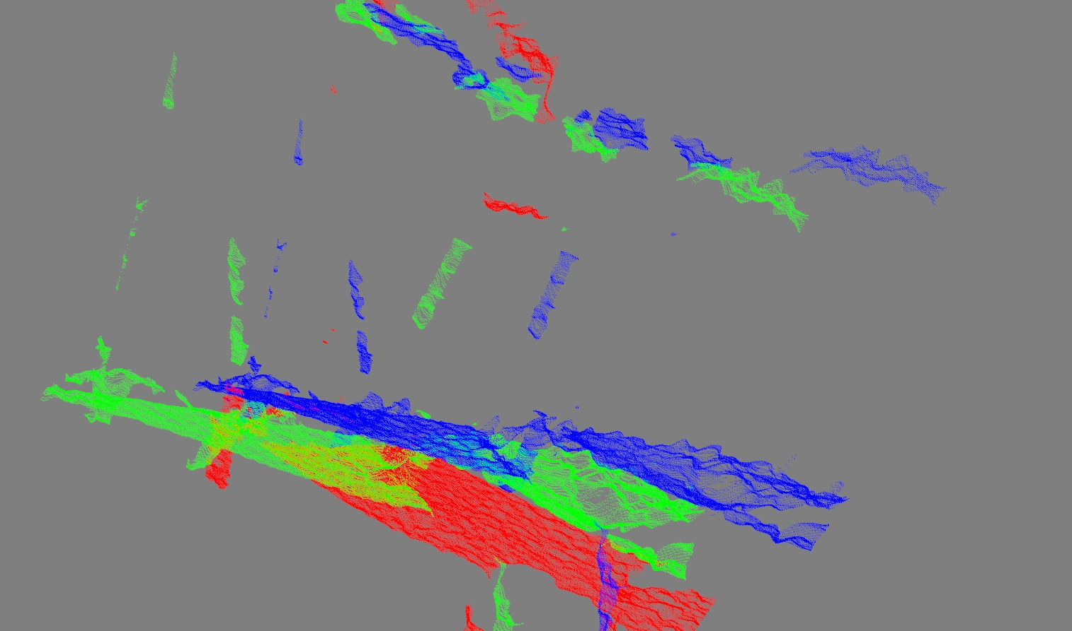
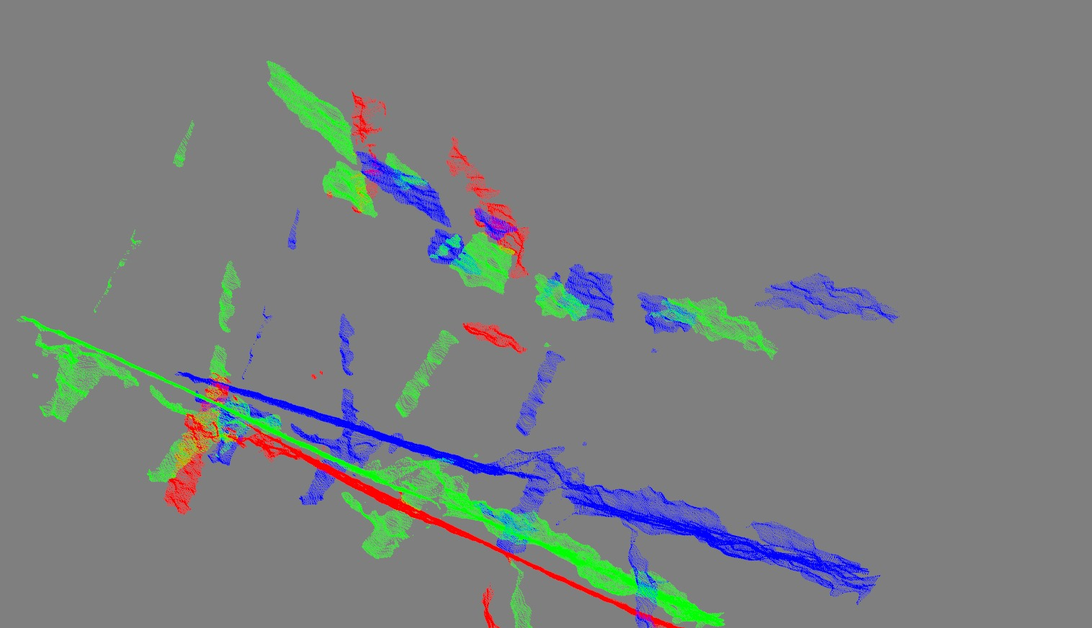
Current Work – PCL

Slide 6
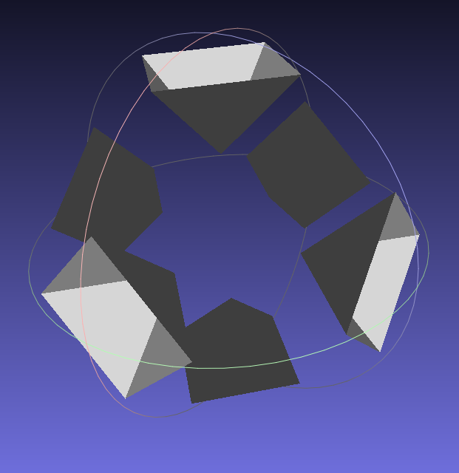
Current Work – Voxelgrid & Marching Cubes

Slide 7
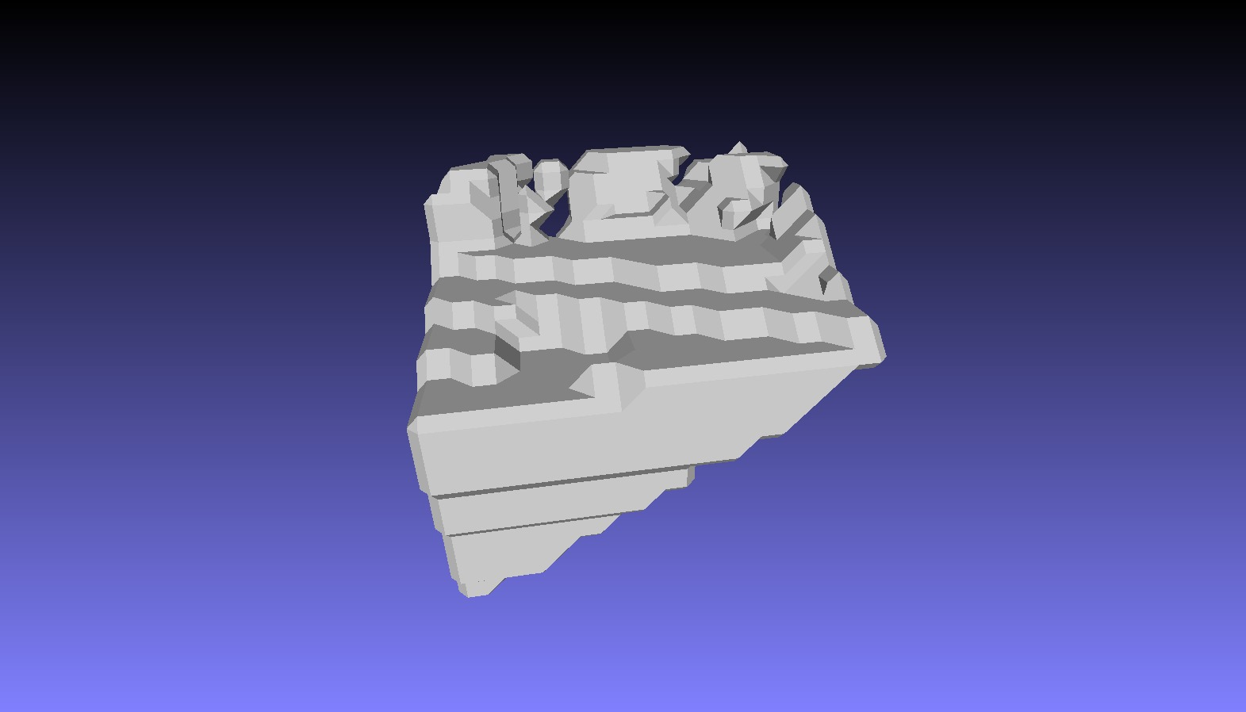
Current Work – Voxelgrid & Marching Cubes

Slide 8
Future work
Optimization
  Finish Ceres point correspondence error optimization
Volumetric Fusion
  GPGPU implementation of voxelgrid / tsdf
  Marching cubes for extraction of isosurface
Point Cloud Library
  Integrate PCL for surface extraction and ICP

Slide 9
Thank you!

