Slide 1
3D Scanning and Spatial Learning
Volumetric Fusion
Marcel Bruckner, Kevin Bein, Moiz Sajid

Slide 2
Last week
Pose estimation
  Marker cube assembled
  Procrustes working with new setup
  ICP for further alignment
Voxelgrid
  GPU approach improved
Marching Cubes
  GPU approach improved
Hardware Sync

Slide 3
Next week
Pose estimation
  Finish marker cube
  Fix Bundle Adjustment for new setup
  ICP for further alignment
Voxelgrid & Marching Cubes
  Push framerate
Hardware Sync
Final presentation

Slide 4
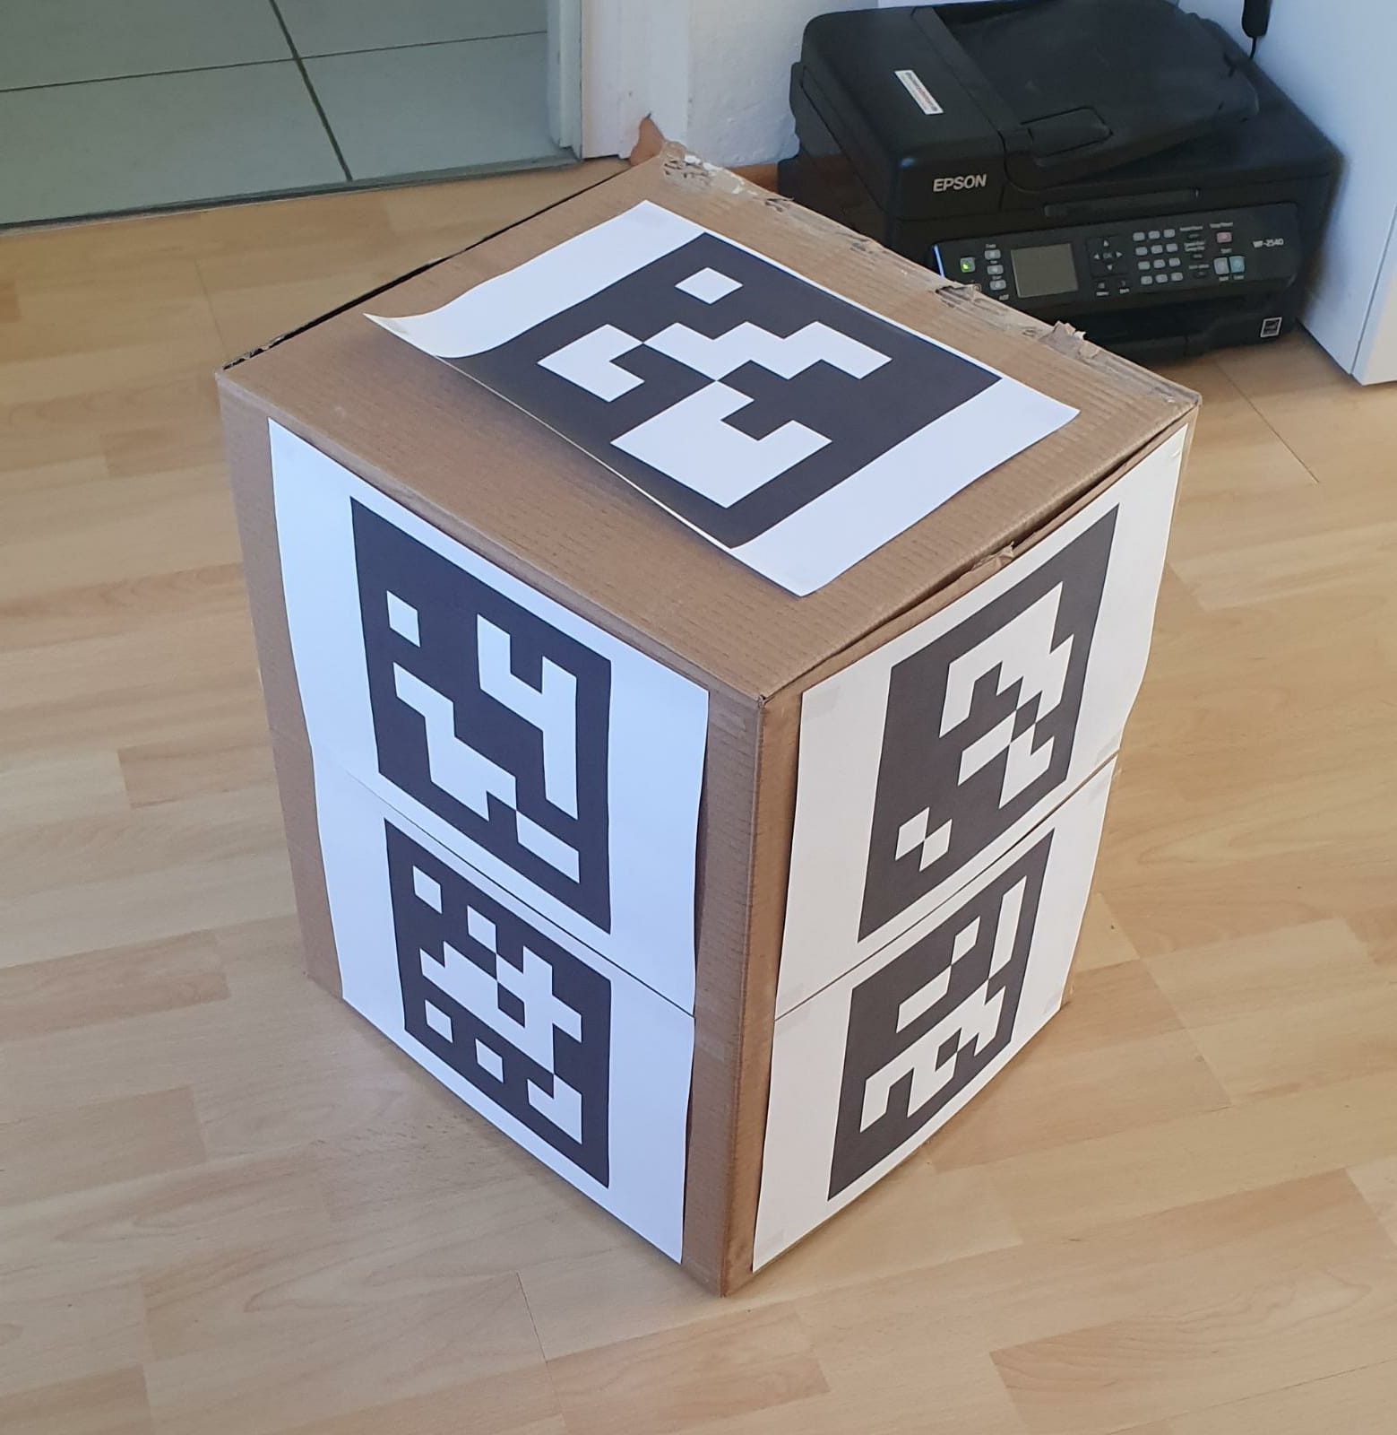
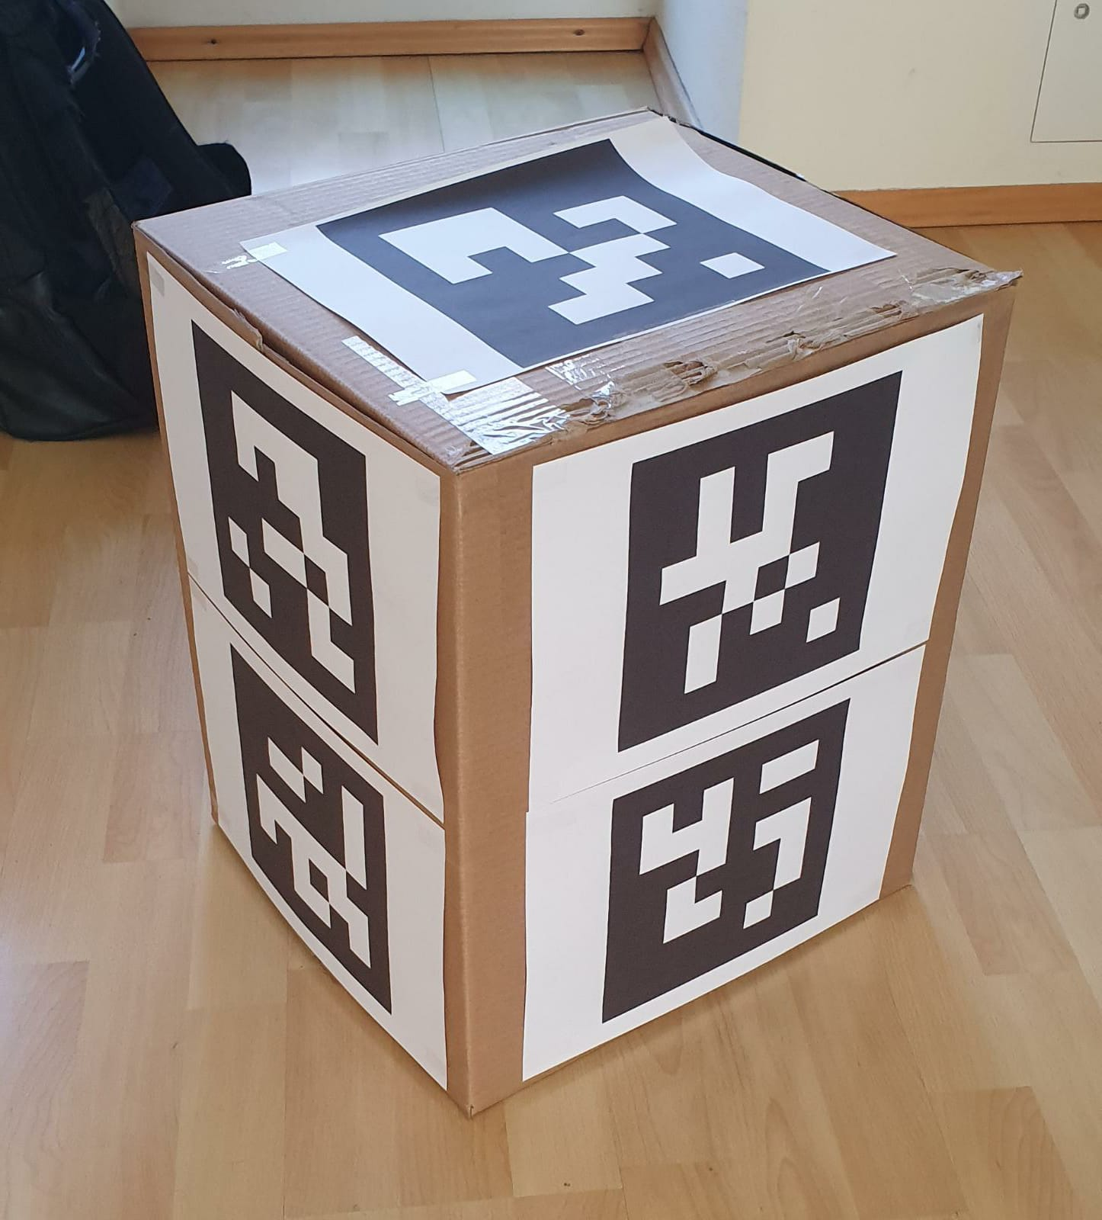
Marker Cube

