Slide 1
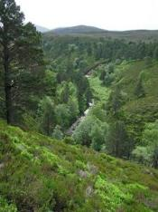
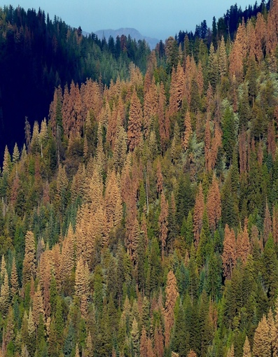
4. Introduction to BDT
USGS CC PDM 1.0
Workshop IBS-Germany & DVFFA, Lübeck, 2025-09-24-26

Slide 2
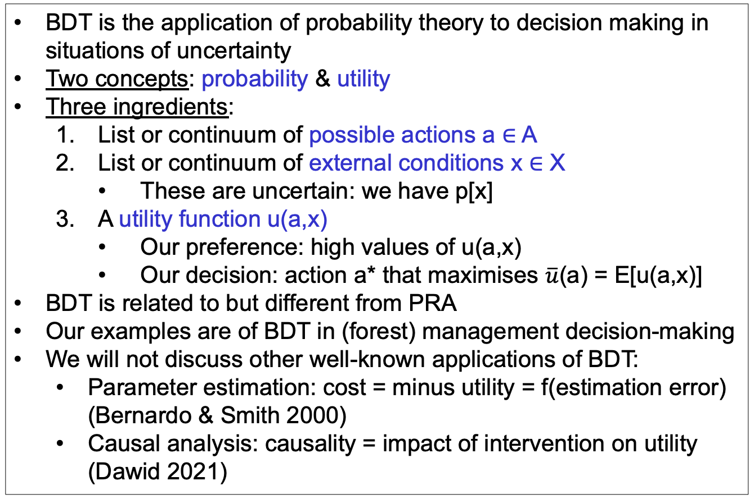
Bayesian Decision Theory (BDT)
BDT is the application of probability theory to decision making in situations of uncertainty
Two concepts: probability & utility
Three ingredients:
List or continuum of possible actions a ∈ A
List or continuum of external conditions x ∈ X
These are uncertain: we have p[x]
A utility function u(a,x)
Our preference: high values of u(a,x)
Our decision: action a* that maximises $\overline{u}$(a) = E[u(a,x)]
BDT is related to but different from PRA
Our examples are of BDT in (forest) management decision-making
We will not discuss other well-known applications of BDT:
Parameter estimation: cost = minus utility = f(estimation error) (Bernardo & Smith 2000)
Causal analysis: causality = impact of intervention on utility (Dawid 2021)

Slide 3
Graphical models: From PRA to BDT
PRA
BDT
u
z
z
x
a
x
p[x,z] =
p[x] p[z|x]
p[x,z,u|a] =
p[x] p[z|a,x] p[u|a,z]

Slide 4
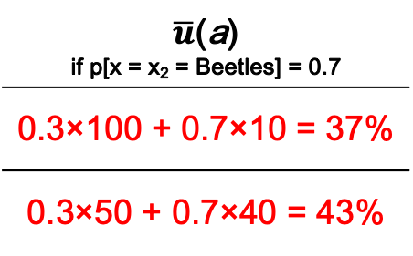
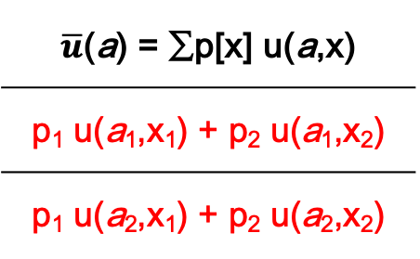
Utility matrix for discrete u(a,x)
 | x = x₁ | x = x₂
a = a₁ | u(a₁,x₁) | u(a₁,x₂)
a = a₂ | u(a₂,x₁) | u(a₂,x₂)
$\overline{u}$(a) = ∑p[x] u(a,x)
p₁ u(a₁,x₁) + p₂ u(a₁,x₂)
p₁ u(a₂,x₁) + p₂ u(a₂,x₂)
u
z
% Tree survival | No beetles | Beetles
No thin | 100% | 10%
50% thin | 50% | 40%
$\overline{u}$(a) if p[x = x₂ = Beetles] = 0.7
0.3×100 + 0.7×10 = 37%
0.3×50 + 0.7×40 = 43%
a
x
We want to maximise expected utility $\overline{u}$(a), so we choose a₂

Slide 5
Value of Information: Impact on expected utility
Only prior information p[x]:
Specific information y:
Information yet to be received Y = {y}:
‘Perfect’ information so you can always (for every x) choose the best action:

Slide 6
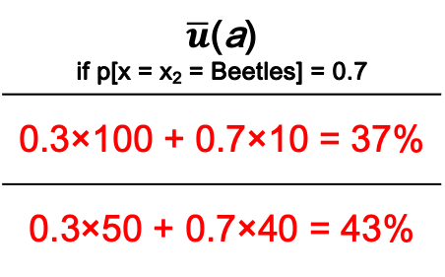
Value of Information in the tree beetle example
If y = {y₁,y₂} and
p[y₁|x₁] = p[y₂|x₂] = 0.6
u
VoI_{partial} = 43.6 – 43 = 0.6%
VoI_{perfect} = 58 – 43 = 15%
z
% Tree survival | No beetles | Beetles
No thin | 100% | 10%
50% thin | 50% | 40%
$\overline{u}$(a) if p[x = x₂ = Beetles] = 0.7
0.3×100 + 0.7×10 = 37%
0.3×50 + 0.7×40 = 43%
a
x

Slide 7
Value of bad Information …
What would happen to VoI_{partial} if p[y₁|x₁] = p[y₂|x₂] = 0.5?

Slide 8


Decision tree
u₁₁ = 100%
No beetles
p=0.3
x
$\overline{u}$(a₁) = 37%
No thin
Beetles
p=0.7
u₁₂ = 10%
a
Thin
No beetles
p=0.3
u₂₁ =50%
x
$\overline{u}$(a₂) = 43%
Beetles
p=0.7
u₂₂ =40%

Slide 9
Sequential decisions
No beetles
p=0.3
x
No thin
Beetles
p=0.7
a
Thin
No beetles
p=0.3
x
Beetles
p=0.7

Slide 10
Graphical models: From PRA to BDT
PRA
BDT
u
u
u
cost
benefit
cost
benefit
z
z
z
z
𝜺
x
a
x
a
x
a
x
𝝑
p[x,z] =
p[x] p[z|x]
p[x,z,u|a] =
p[x] p[z|a,x] p[u|a,z]
z = f(a,x,𝝑) + 𝜺
p[x], p[𝝑], p[𝜺]

Slide 11
BDT for forestry
Utility
u
Management costs
cost
benefit
Timber sale
Forest growth
z
𝜺
Model error
Management actions
a
x
𝝑
Model parameters
Climate

Slide 12
Two realisations of the network
100.00
--------
Model
£ 180.00 ha⁻¹ y⁻¹
WUE
Irrigation
u
YC
Rain
200.00
-----
300.00
--------
z = 0.01 (x + a)
u = 30 z - 0.5 a
£ 0.00
ha⁻¹ y⁻¹
cost
benefit
£ 180.00 ha⁻¹ y⁻¹
Timber
price
Irrigation costs
10
---
YC = 6
m³ ha⁻¹ y⁻¹
z
𝜺
𝜺 = 0
m³ ha⁻¹ y⁻¹
a
x
𝝑
400
--
Irrigation = 0 mm y⁻¹
Rain = 600 mm y⁻¹
WUE = 0.01
m³ ha⁻¹ mm⁻¹

Slide 13
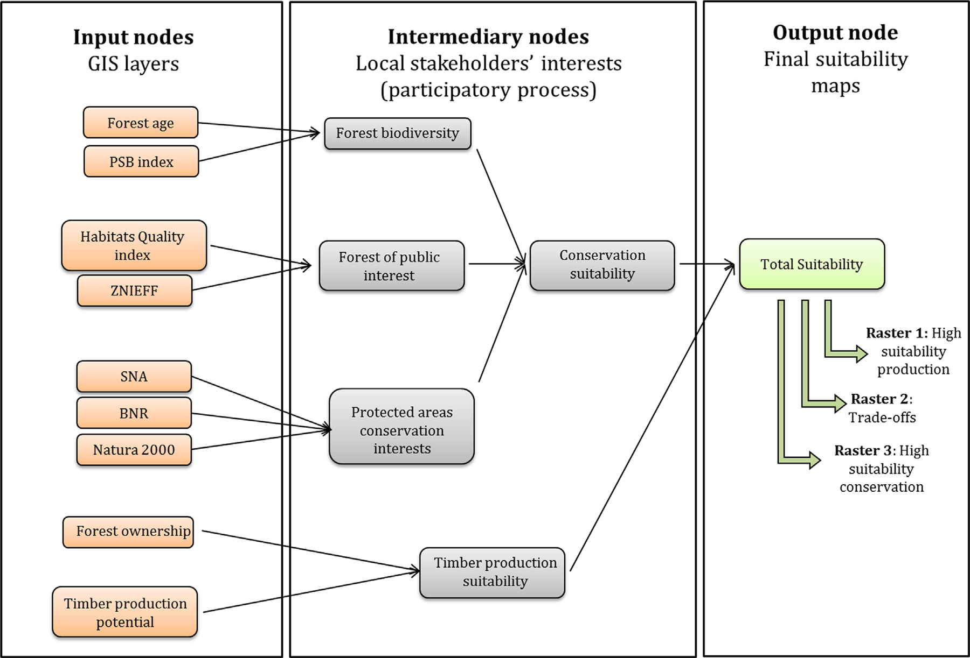
Gonzales-Redin et al. (2016)
Gonzalez Redin, J. et al. (2016). Spatial Bayesian belief networks as a planning decision tool for mapping ecosystem services trade-offs on forested landscapes. Environmental Research 144: 15-26.

Slide 14
5. Links between PRA and BDT
USGS CC PDM 1.0
Workshop IBS-Germany & DVFFA, Lübeck, 2025-09-24-26

Slide 15
6. General discussion
USGS CC PDM 1.0
Workshop IBS-Germany & DVFFA, Lübeck, 2025-09-24-26

Slide 16
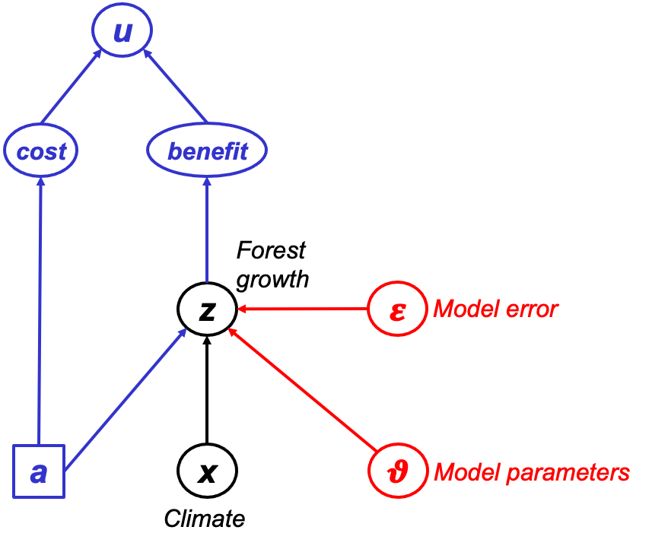
Theory development: PRA & BDT
Probabilistic Risk Analysis (PRA)
Risk = Expected loss = probability(Hazard) * Vulnerability
p(Drought)
Risk
Vulnerability
Bayesian Decision Theory
(BDT)

Slide 17

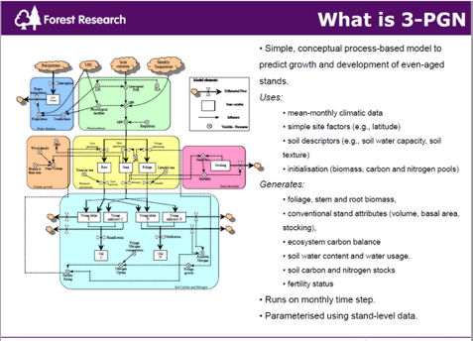
Data & Process-Based Modelling (PBM)
Data
Performance of conifer spp. in UK, Spain, Finland
Environmental conditions (soil, past & future climate)
Forest management
Model drivers
Model test data
Model calibration data
PBM
BASFOR, 3PGN, …
Quantifying past & future forest performance
Analysing forest vulnerability to drought
Analysing impacts of management

Slide 18
Project flowchart & Decision Support System (DSS)
Data
PRA
DSS
PBM
BDT
Need to know where/what to plant to ensure 'climate-smart' forestry

Slide 19
Lecina-Diaz et al. (2020)

Slide 20
Lecina-Diaz et al. (2020)

Slide 21
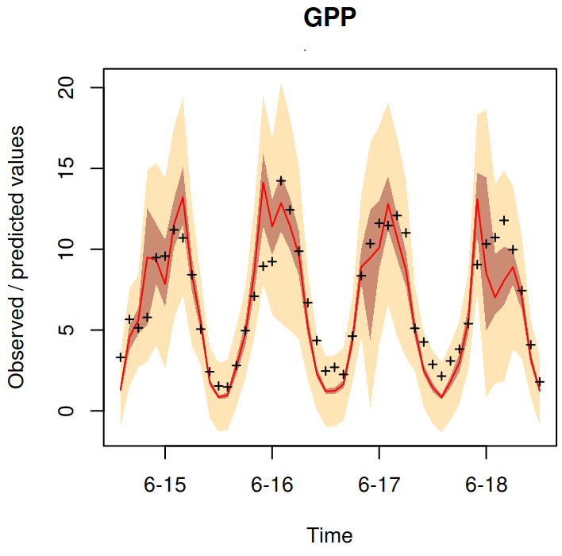
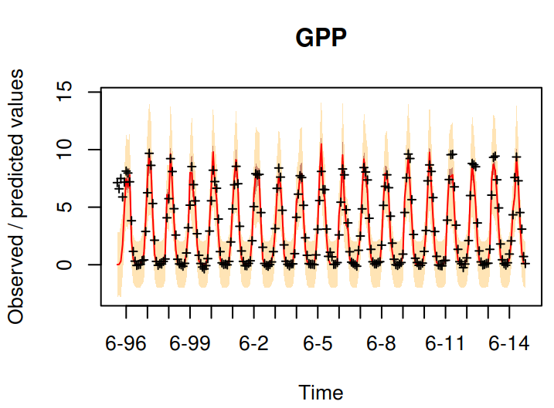
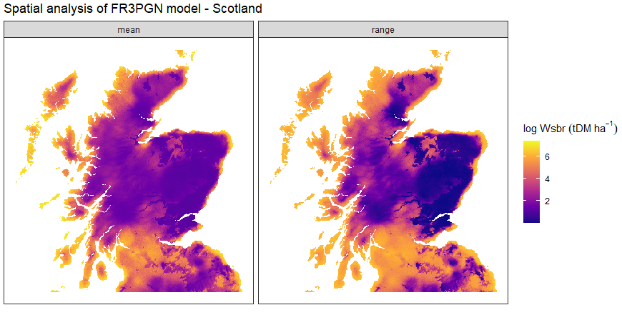
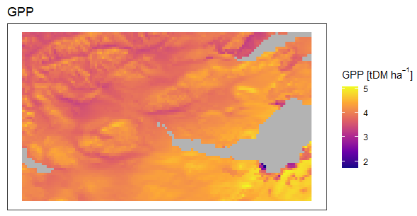
Process-models for forest drought vulnerability
Climate models (GCMs)
Process-based forest models (BASFOR, 3PGN, …)
Identify key factors that drive present and future forest drought vulnerability
Forest data to test and calibrate the models
Bayesian Calibration to reduce uncertainties in model parameters
Bayesian Model Comparison to reduce uncertainty in model error

Slide 22
Appendices
USGS CC PDM 1.0
Workshop IBS-Germany & DVFFA, Lübeck, 2025-09-24-26

Slide 23
Condition for V being threshold-independent

Slide 24
Six datasets where E[z|x] = a + b F_{x}[x]
x
p[x]
z
a
b F_{x}[x]
𝜺
x_U <- runif(n) ; z_U <- 0.5 + x_U/2 + rnorm(n,0,0.05)
x_E <- rexp(n) ; z_E <- 1 - exp(-x_E)/2 + rnorm(n,0,0.05)
x_B <- rbeta(n,5,1) ; z_B <- 0.5 + pbeta(x_B,5,1)/2 + rnorm(n,0,0.05)
x_t <- rt(n,1,30) ; z_t <- 0.5 + pt(x_t,1,30)/2 + rnorm(n,0,0.05)
x_G <- rnorm(n) ; z_G <- 0.5 + pnorm(x_G)/2 + rnorm(n,0,0.05)
x_L <- rnorm(n) ; z_L <- 0.5 + 0.5/(1+exp(-2*x_L)) + rnorm(n,0,0.05)
We now will do single-threshold PRA on each of these six datasets.
We vary the location of the threshold: 5% quantile of x, 10%, …, 95%.
(So p[H] will vary accordingly.)

Slide 25
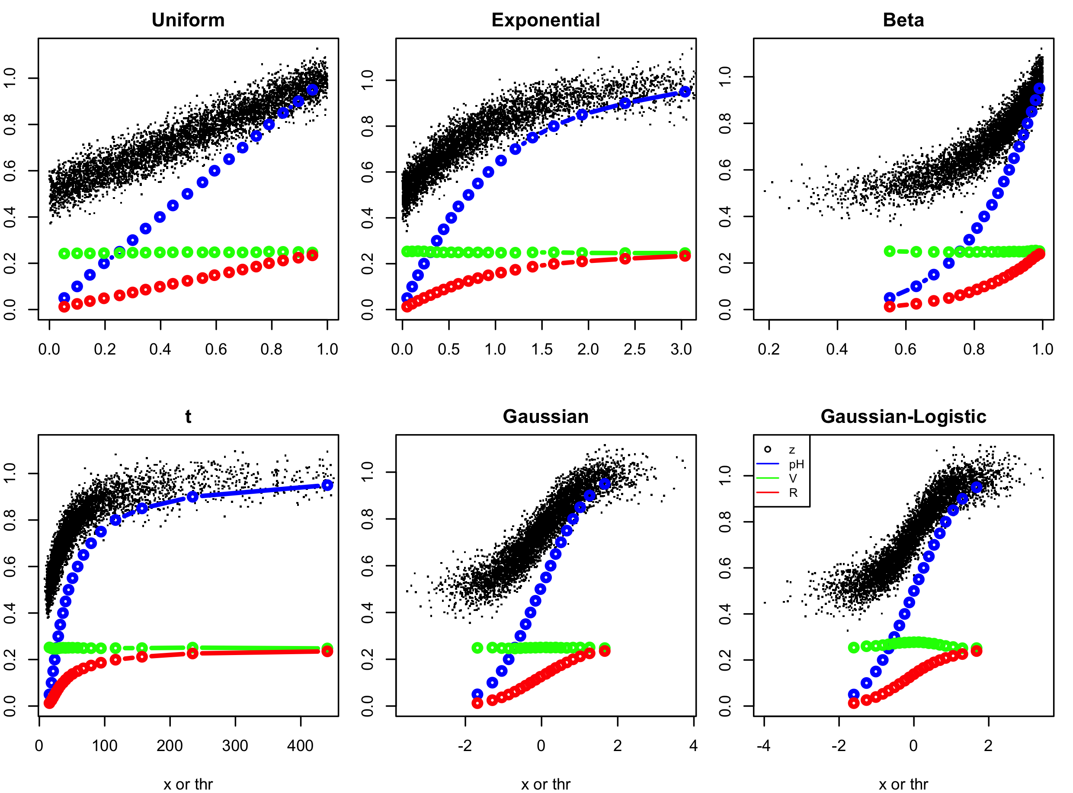
Single-threshold PRA on the six datasets

Slide 26
EXERCISE
What kind of figures do you expect to see if we carry out multi-threshold PRA on these six datasets, using the same 19 threshold levels to define our x-intervals?
Would V still be constant, i.e. independent of the x-interval?
How would p[H] vary between the intervals?

Slide 27
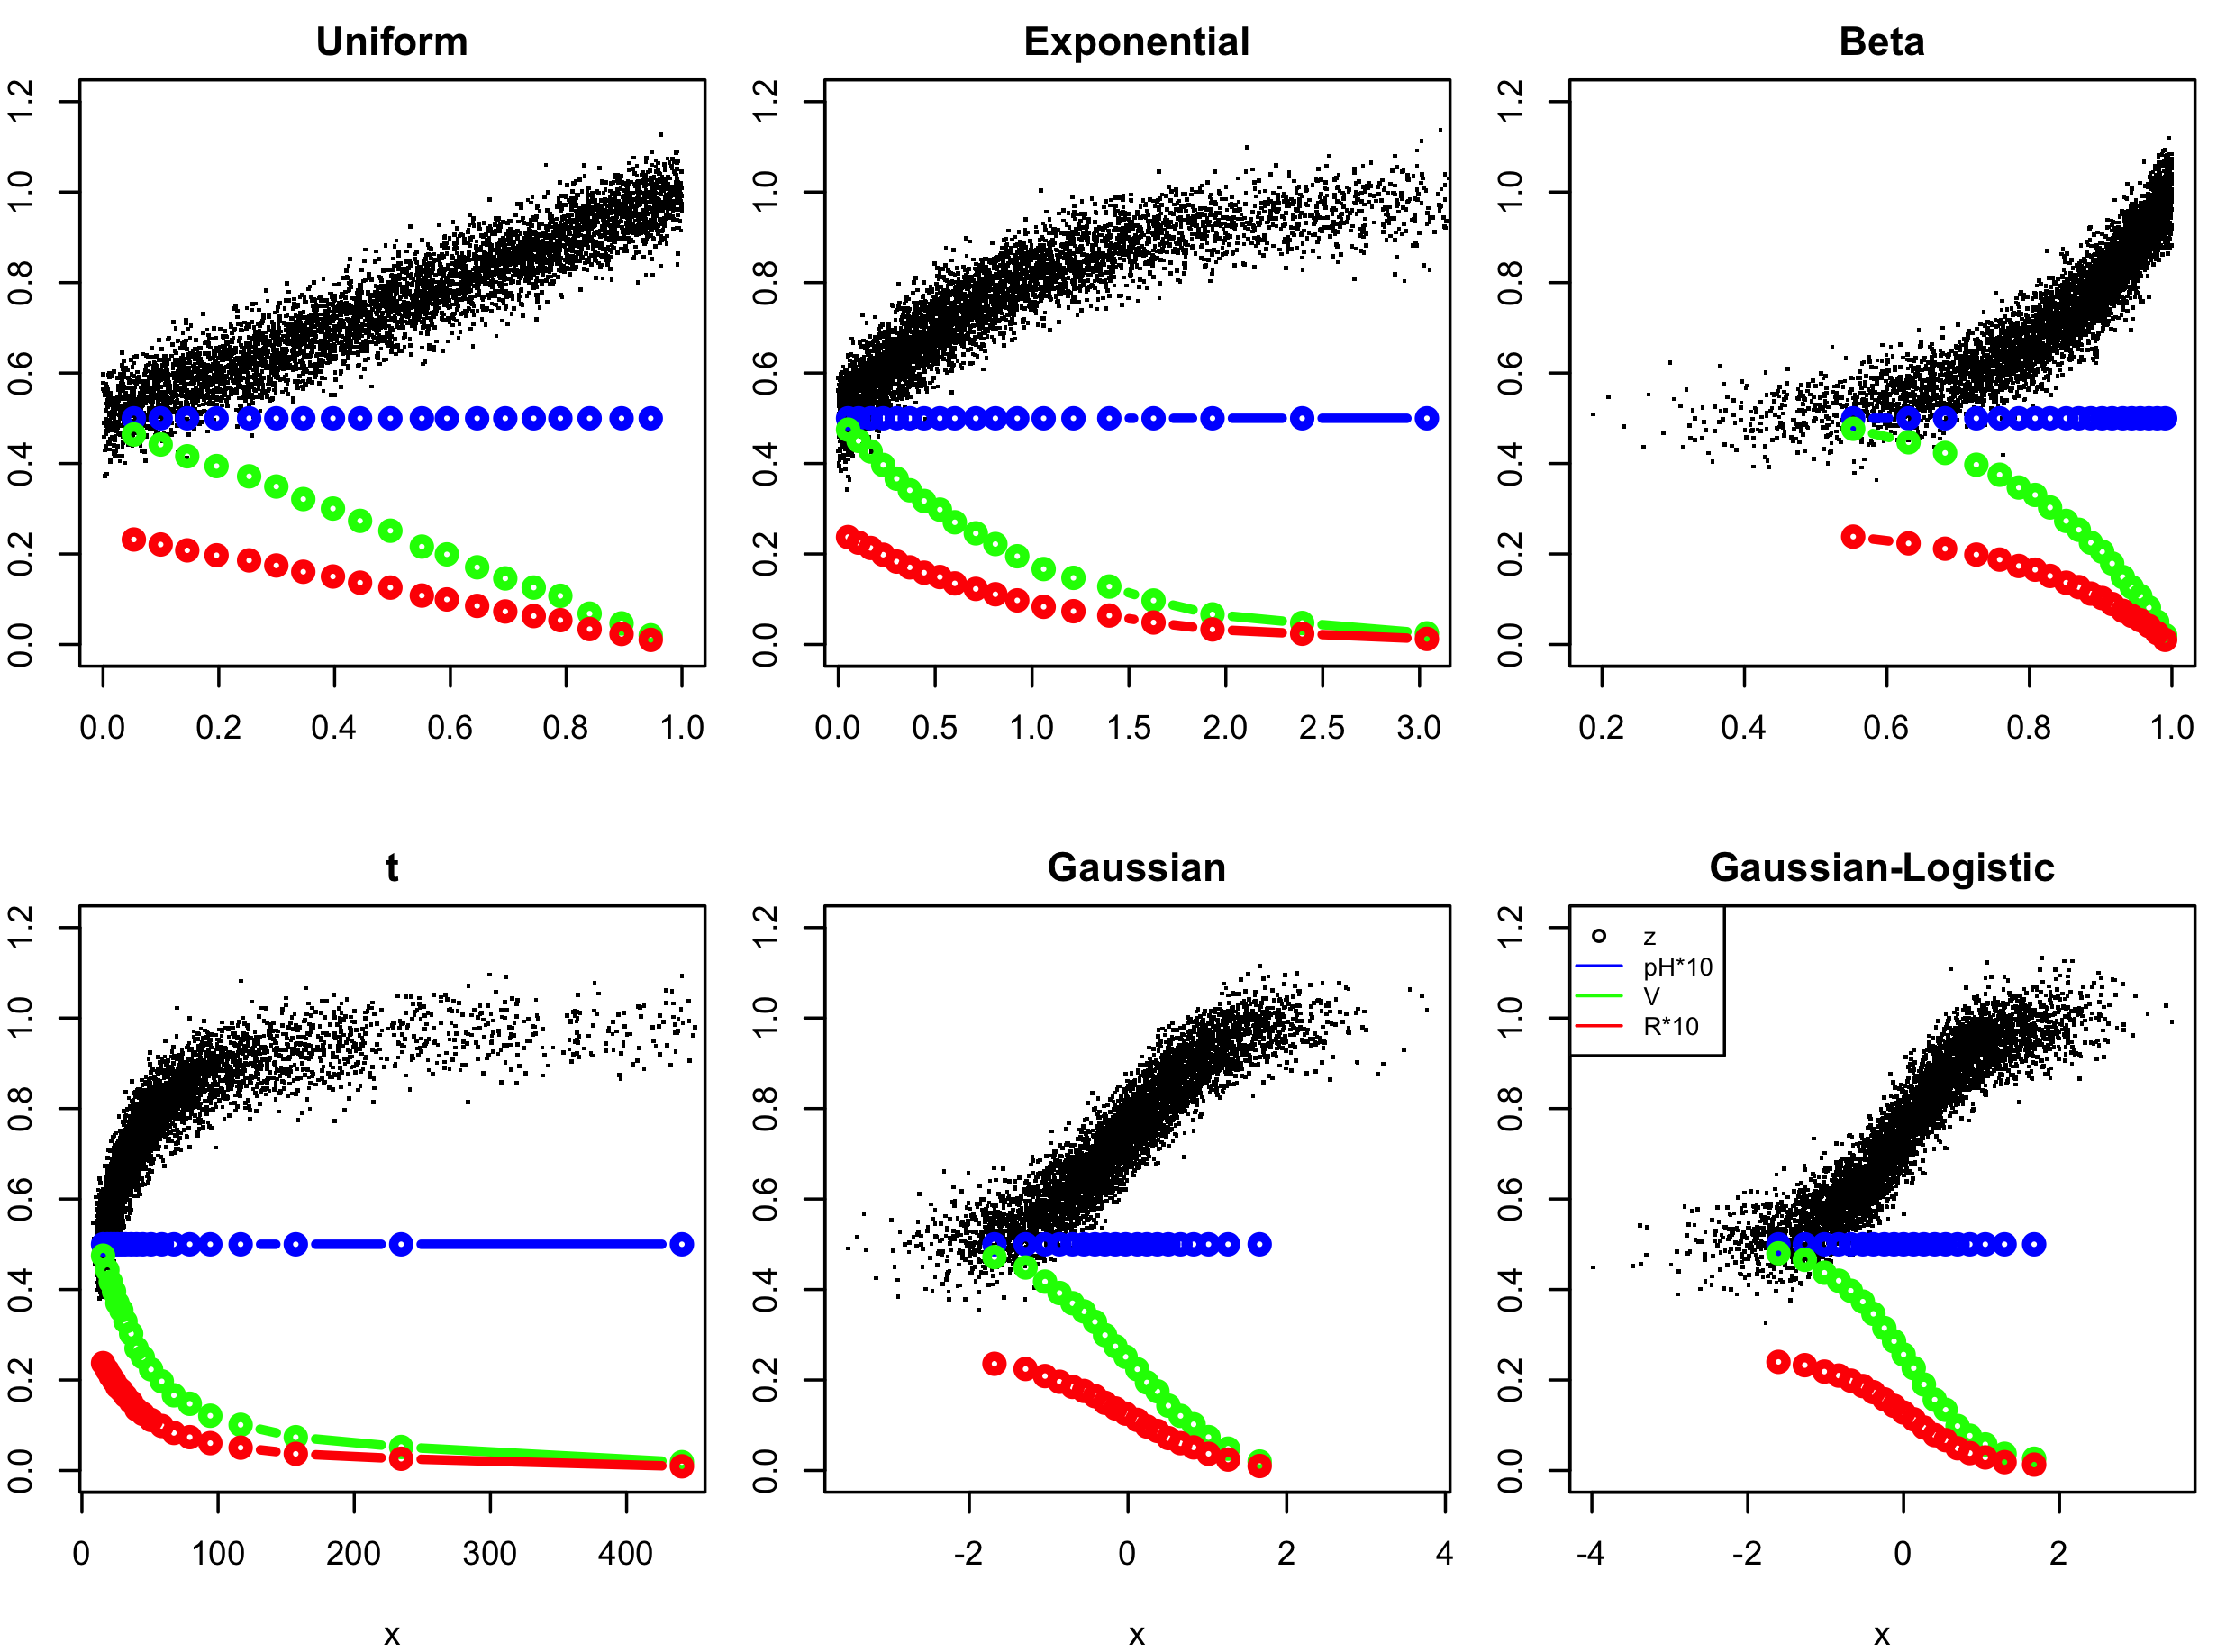
Multi-threshold PRA with equal-p[H] intervals

Slide 28
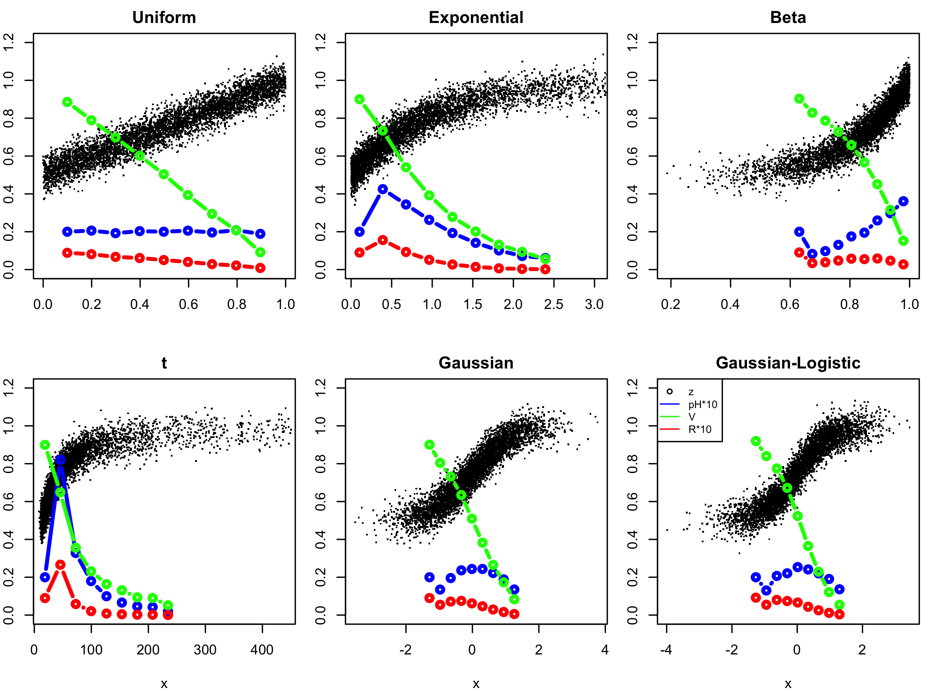
Multi-threshold PRA with equal-x-width intervals

