Slide 1
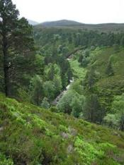
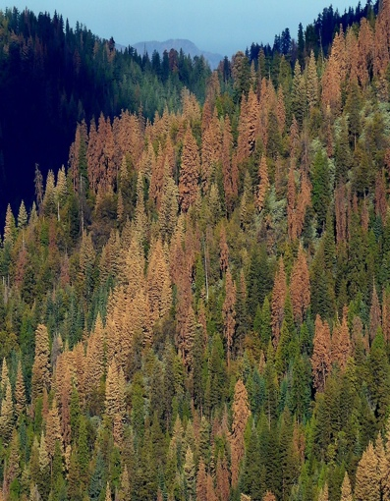
3. Beyond the basic theory
USGS CC PDM 1.0
Workshop IBS-Germany & DVFFA, Lübeck, 2025-09-24-26

Slide 2
Extending the PRA to 2 hazardous conditions or more

Slide 3
Extending the PRA to 2 hazardous conditions or more
Drought level (or category) 1
Drought level (or category) 2

Slide 4
Multi-threshold PRA
Retrieving total (single-threshold) PRA

Slide 5
‘PRAm’: R-function for multi-threshold PRA
PRAm <- function( x, z, thr=-1:1 ) {
n <- length(x) ; n_thr <- length(thr)
n_H <- pH <- V <- R <- s_pH <- s_V <- s_R <- rep(NA,n_thr)
H <- vector("list",n_thr)
H[[1]] <- which( x < thr[1] ) ; n_H[1] <- length(H[[1]])
for(i in 2:n_thr) { H[[i]] <- which( thr[i-1] <= x & x < thr[i])
n_H[i] <- length(H[[i]]) }
n_notH <- n - sum(n_H) ; H.all <- which( x < thr[n_thr] )
pH <- n_H / n ; s_pH <- sqrt( pH*(1-pH) / n )
Ez_notH <- mean( z[-H.all] )
s_Ez_notH <- sqrt( var(z[-H.all] ) / n_notH )
for(i in 1:n_thr) { Ez_Hi <- mean( z[ H[[i]]])
s_Ez_Hi <- sqrt( var(z[ H[[i]]]) / n_H[i] )
V[i] <- Ez_notH - Ez_Hi
s_V[i] <- sqrt( s_Ez_notH^2 + s_Ez_Hi^2 ) }
R <- pH * V
s_R <- sqrt( s_pH^2 * s_V^2 + s_pH^2 * V^2 + pH^2 * s_V^2 )
R.sum <- sum(R) ; pH.sum <- sum(pH) ; V.wsum <- R.sum / pH.sum
return( list( sum = c( pH.sum=pH.sum, V.wsum=V.wsum, R.sum=R.sum ),
seq = cbind( thr, pH, V, R, s_pH, s_V, s_R ) ) )
}
PRAm <- function( x, z, thr=-1:1 ) {
n <- length(x) ; n_thr <- length(thr)
n_H <- pH <- V <- R <- s_pH <- s_V <- s_R <- rep(NA,n_thr)
H <- vector("list",n_thr)
H[[1]] <- which( x < thr[1] ) ; n_H[1] <- length(H[[1]])
for(i in 2:n_thr) { H[[i]] <- which( thr[i-1] <= x & x < thr[i])
n_H[i] <- length(H[[i]]) }
n_notH <- n - sum(n_H) ; H.all <- which( x < thr[n_thr] )
pH <- n_H / n ; s_pH <- sqrt( pH*(1-pH) / n )
Ez_notH <- mean( z[-H.all] )
s_Ez_notH <- sqrt( var(z[-H.all] ) / n_notH )
for(i in 1:n_thr) { Ez_Hi <- mean( z[ H[[i]]])
s_Ez_Hi <- sqrt( var(z[ H[[i]]]) / n_H[i] )
V[i] <- Ez_notH - Ez_Hi
s_V[i] <- sqrt( s_Ez_notH^2 + s_Ez_Hi^2 ) }
R <- pH * V
s_R <- sqrt( s_pH^2 * s_V^2 + s_pH^2 * V^2 + pH^2 * s_V^2 )
R.sum <- sum(R) ; pH.sum <- sum(pH) ; V.wsum <- R.sum / pH.sum
return( list( sum = c( pH.sum=pH.sum, V.wsum=V.wsum, R.sum=R.sum ),
seq = cbind( thr, pH, V, R, s_pH, s_V, s_R ) ) )
}

Slide 6
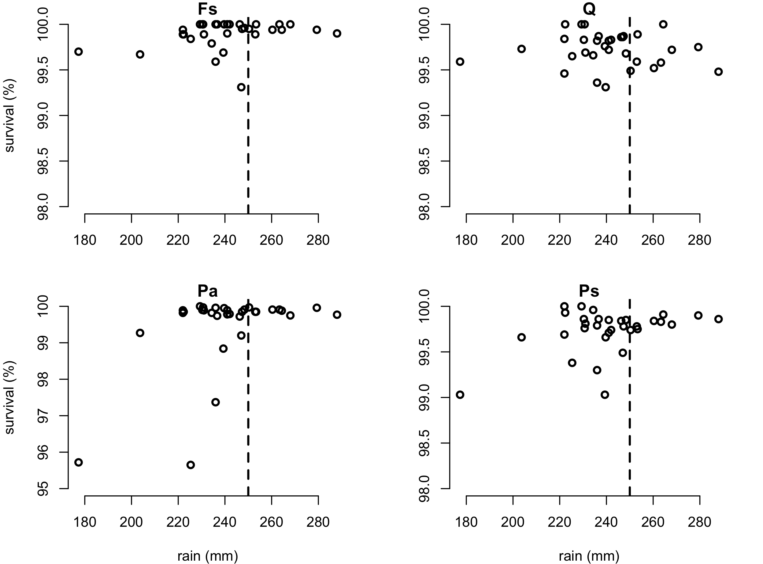
Forest survival data from Germany
Drought-threshold

Slide 7
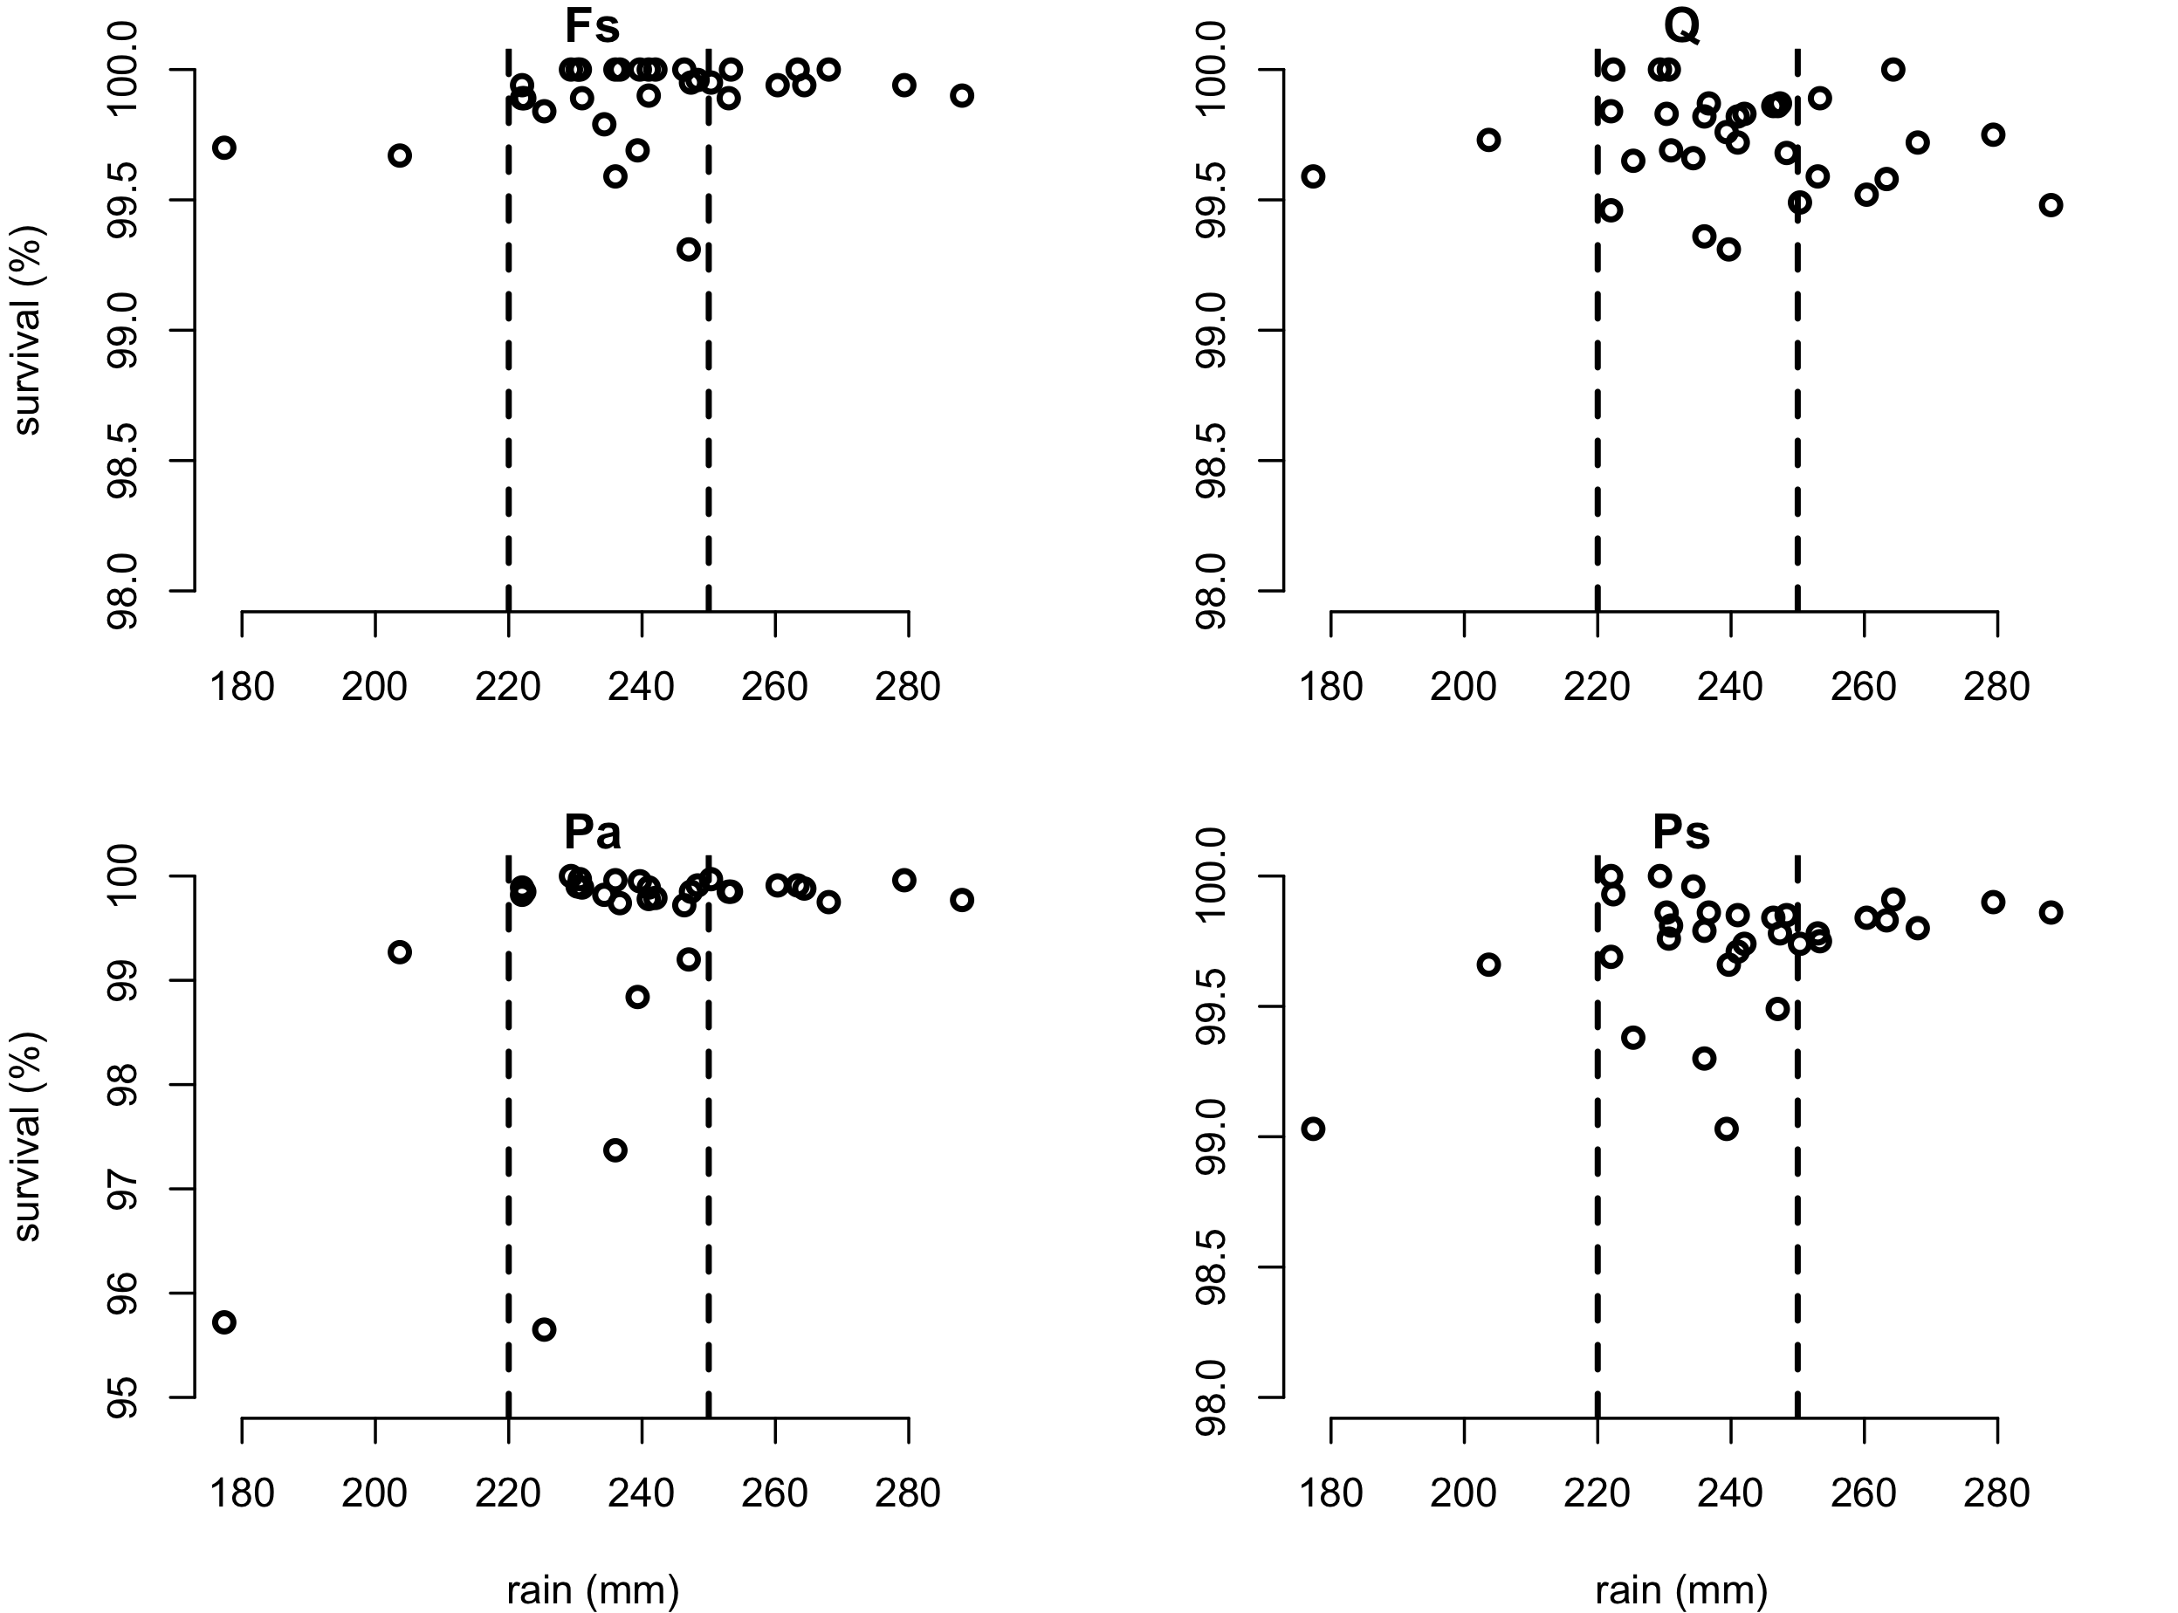
Forest survival data from Germany
Drought-thresholds
H1
H2

Slide 8
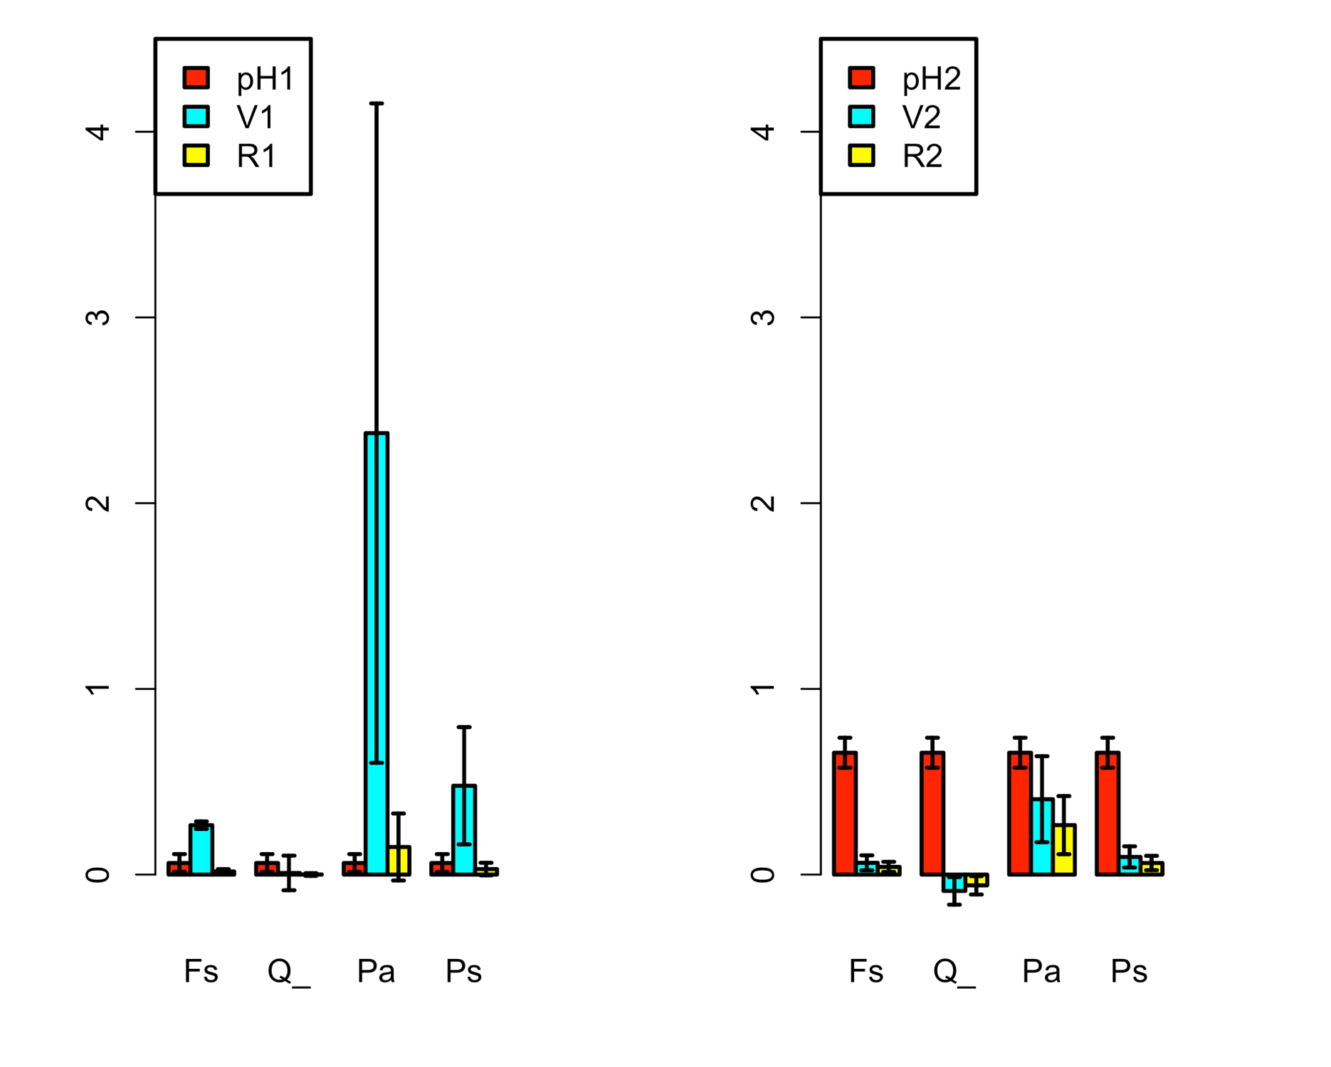
Forest data from Germany: Multi-threshold PRA

Slide 9
Forest data from Germany: EXERCISE 2
Change code: choose a series of multiple thresholds.
Discuss limitations of the multiple-threshold-PRA.

Slide 10
Forest data from Germany: EXERCISE 2
Change code: choose a series of multiple thresholds.
Discuss limitations of the multiple-threshold-PRA. Possible answers:
Mostly the same as for the single-threshold PRA.
Low n even more critical here?
…

Slide 11
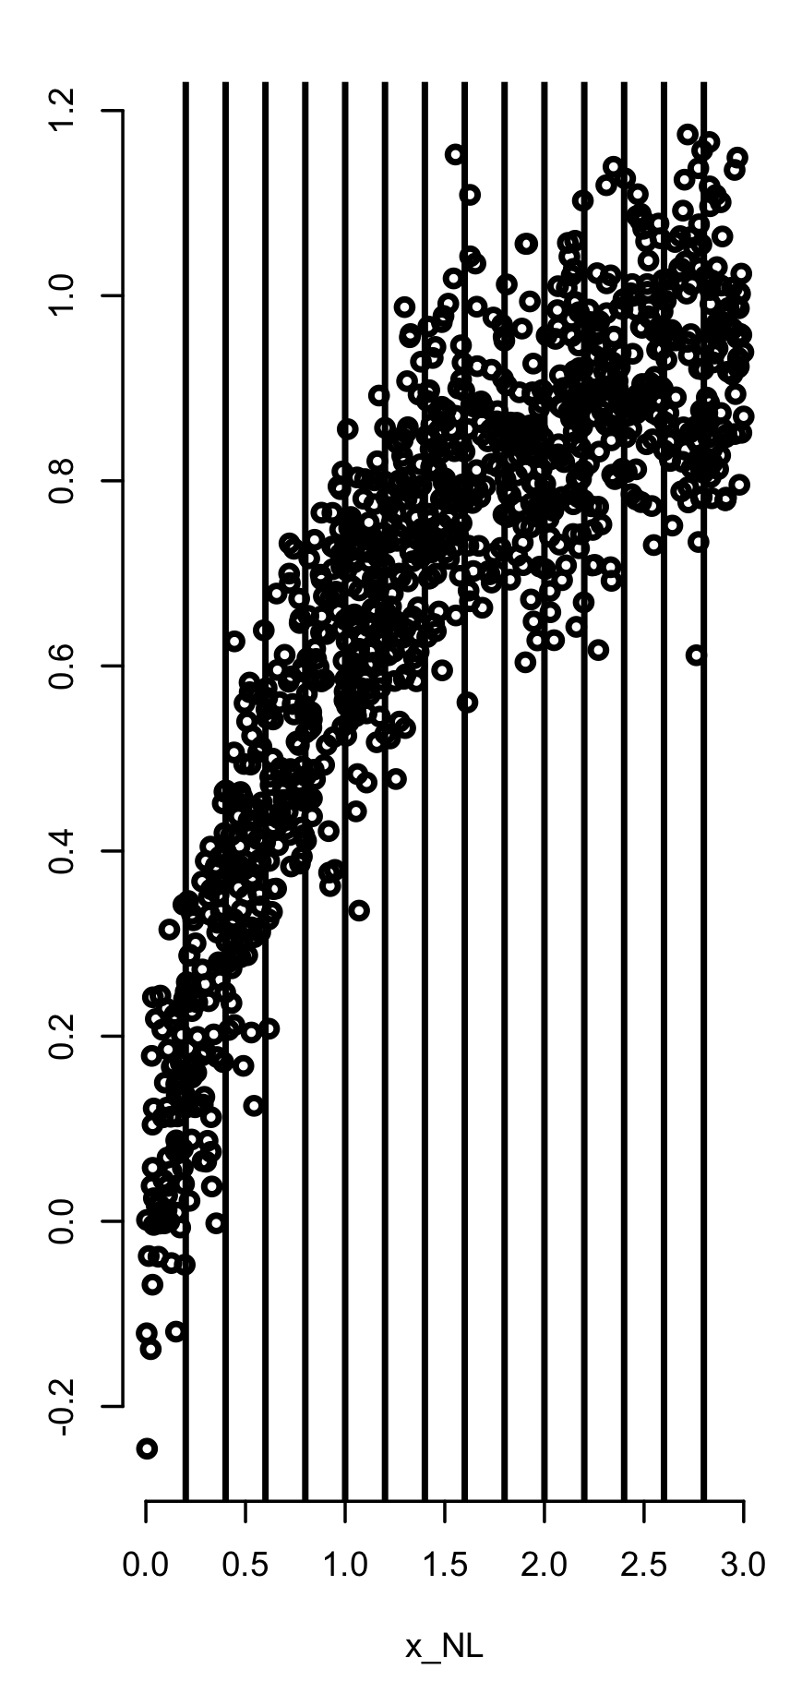
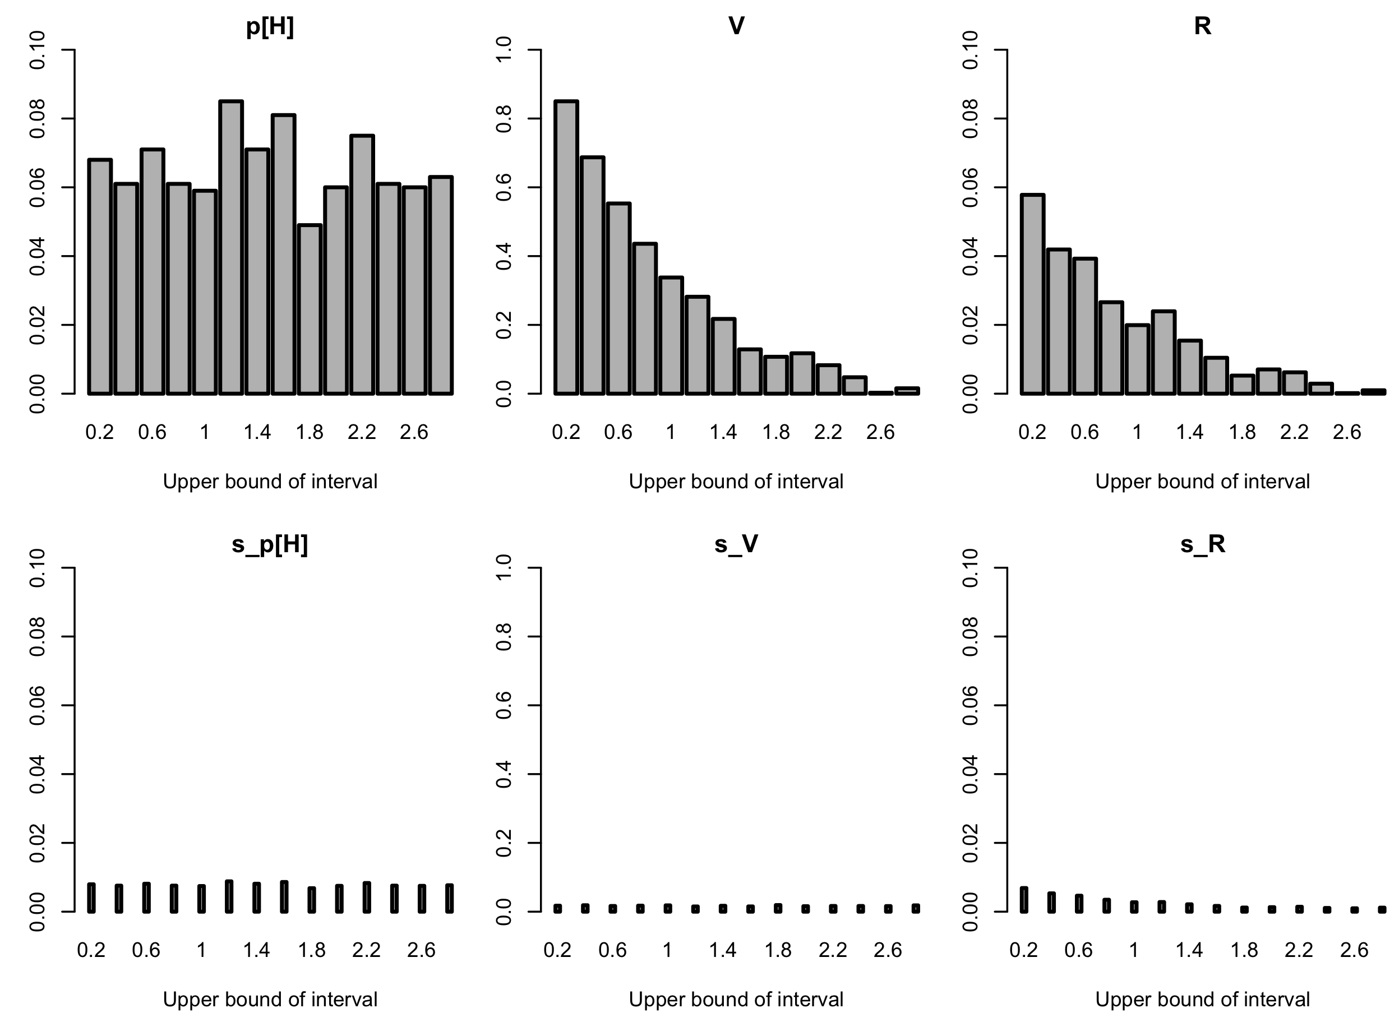
Multi-threshold PRA on a rich dataset

Slide 12
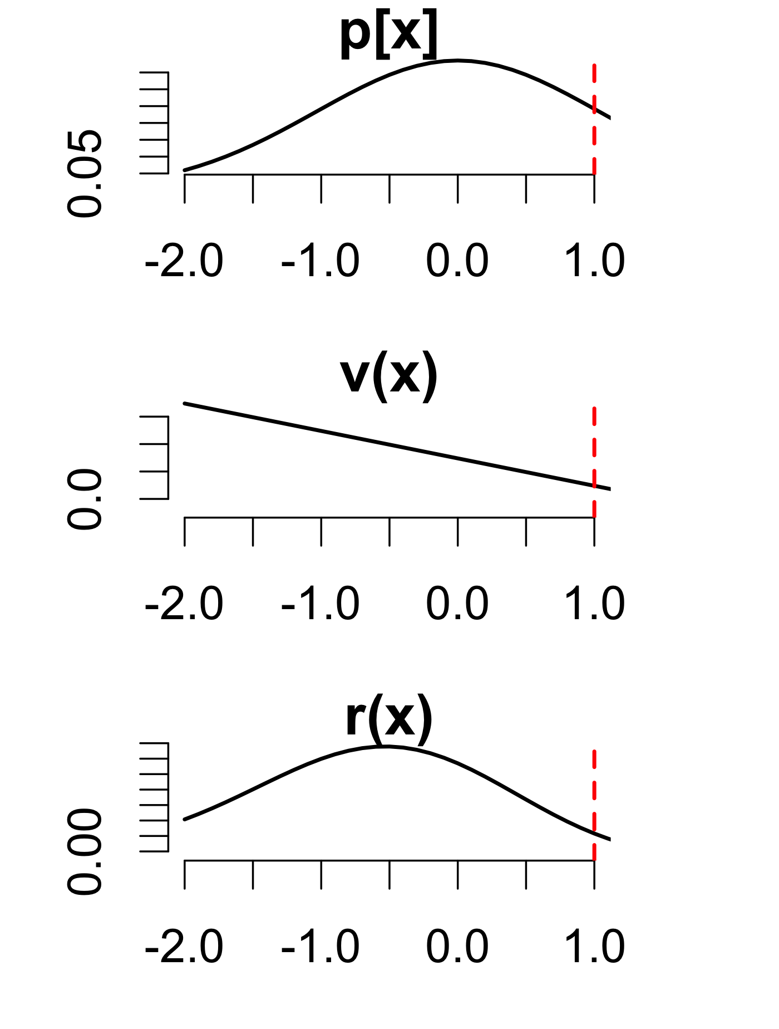
Continuous single-threshold PRA: Bivariate Gaussian
Retrieving total (single-threshold) PRA

Slide 13
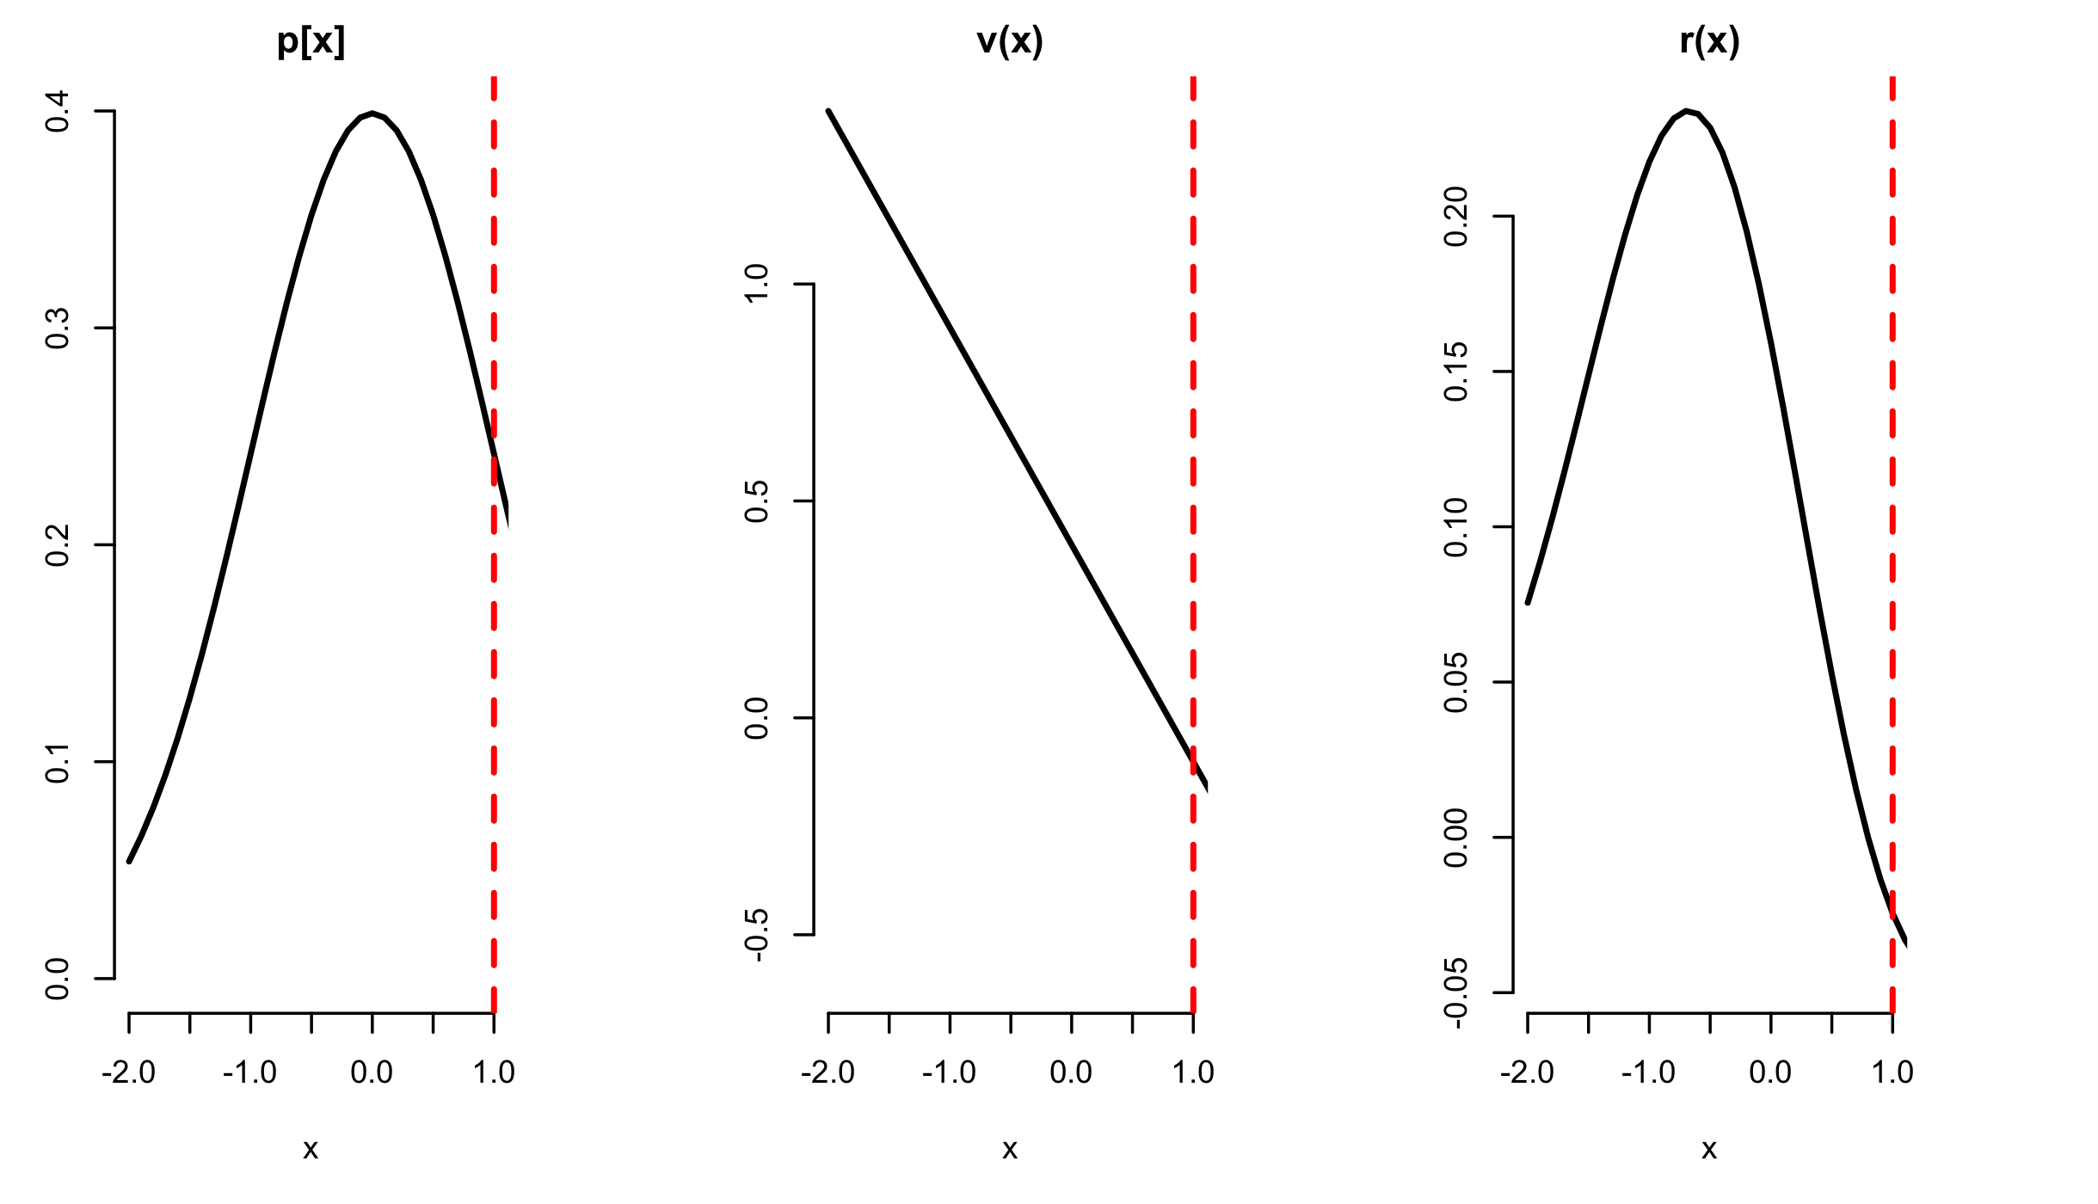
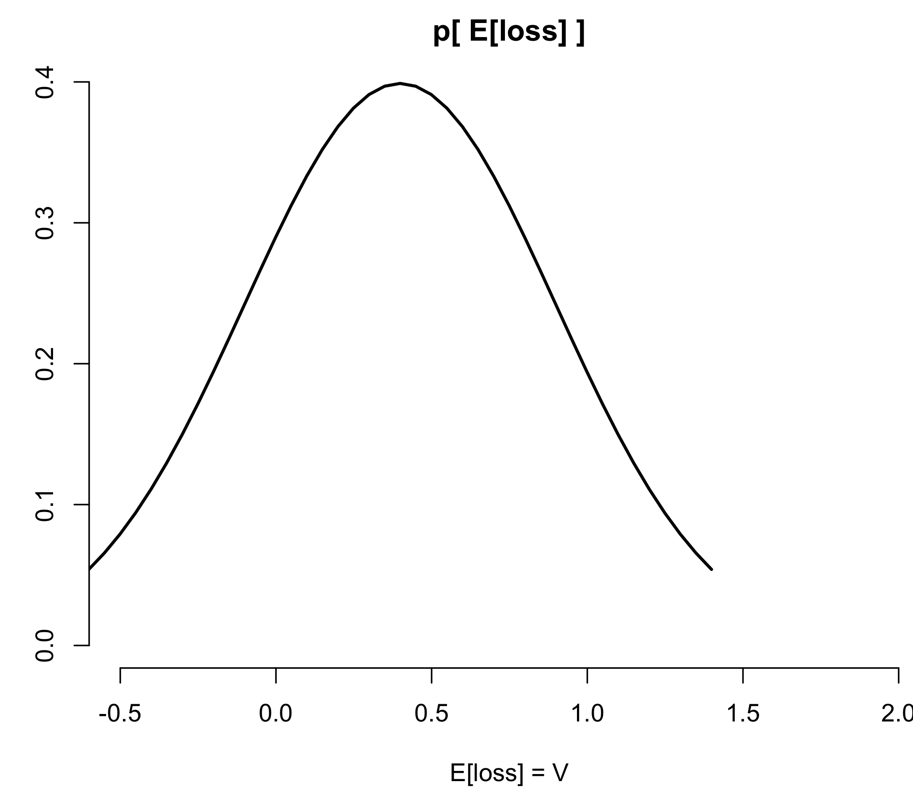
Loss distribution: Useful or not?

Slide 14
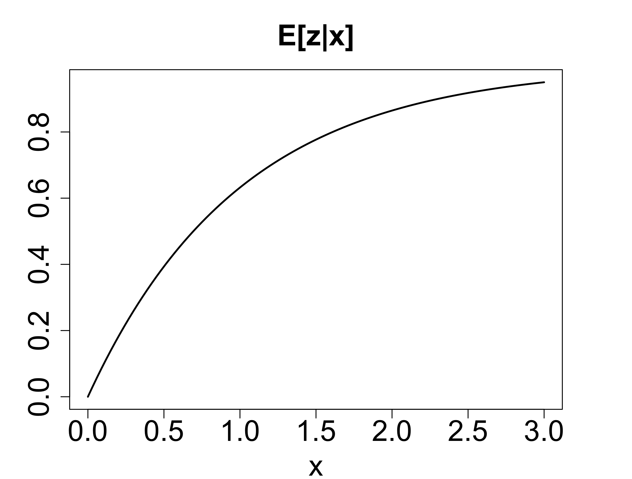
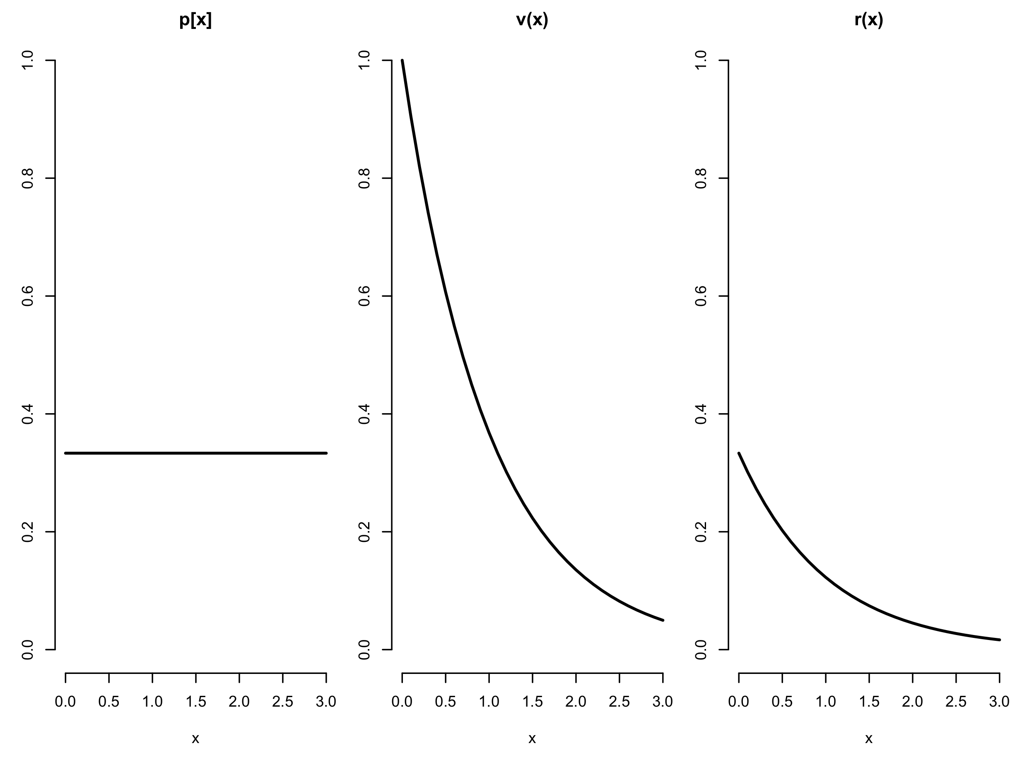
Continuous zero-threshold PRA: nonlinear model

Slide 15
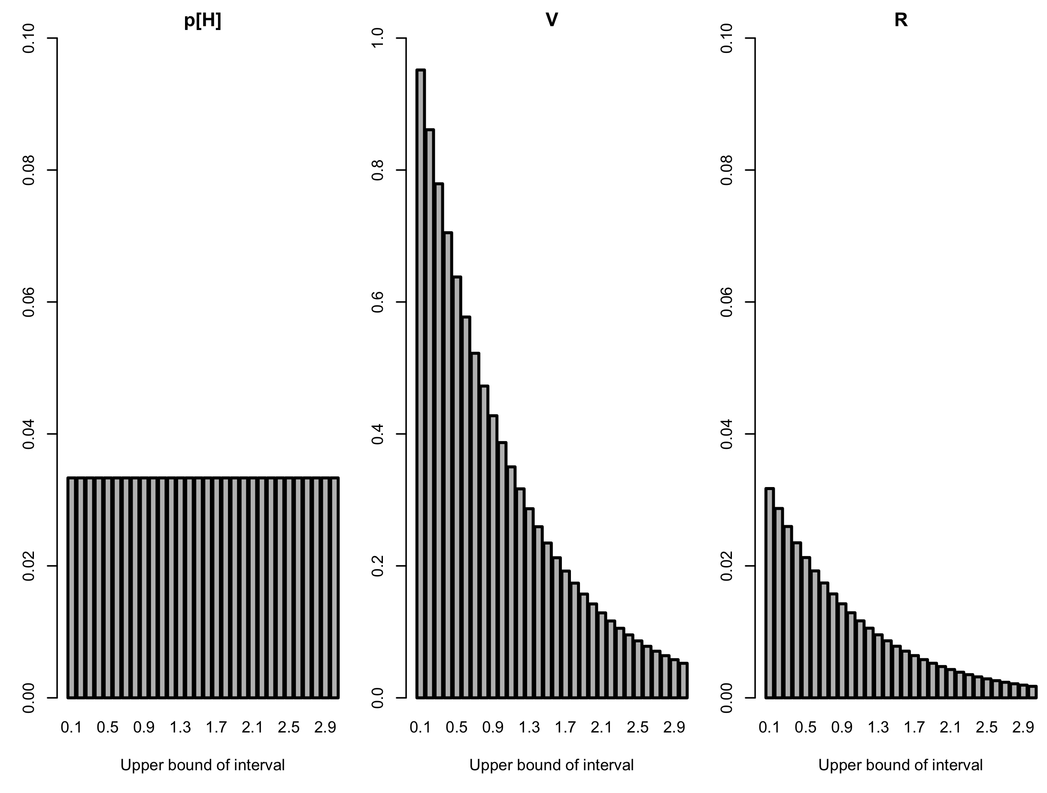
Discretizing a continuous PRA

Slide 16
Extending the PRA from 2 risk-components to 3
64 different
2-component PRAs at cell level:
1 single
3-component PRA at regional level:
P[H] = 0.27
Q = 37/64
V = 0.26
R = 0.04

Slide 17
Extension to R = Q p[H] V
g m⁻² y⁻¹
-
g m⁻² y⁻¹
R = p[H] V
g y⁻¹
m²
g m⁻² y⁻¹
-
R = Q p[H] V
Q = area (or # individuals) exposed to the risk factor

Slide 18
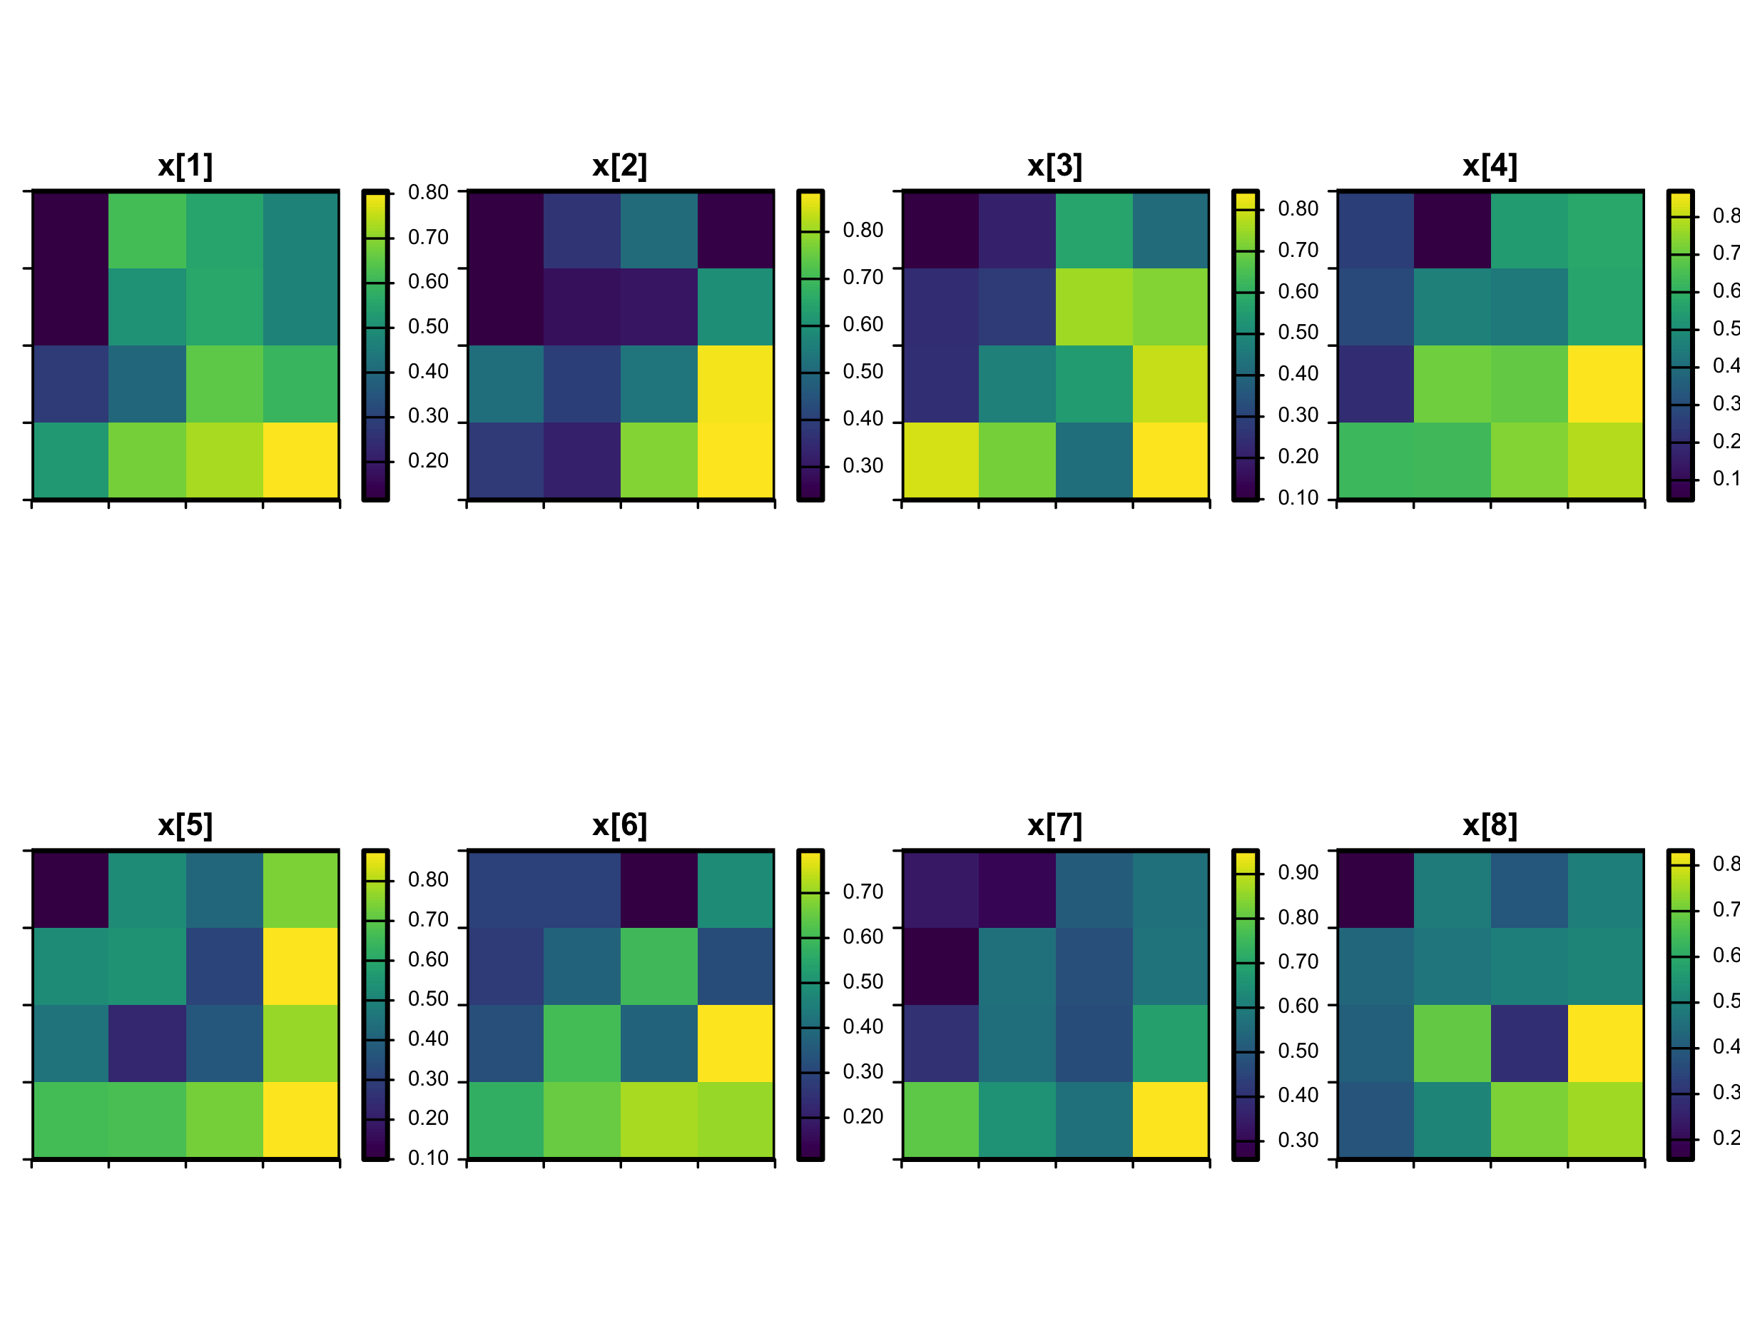
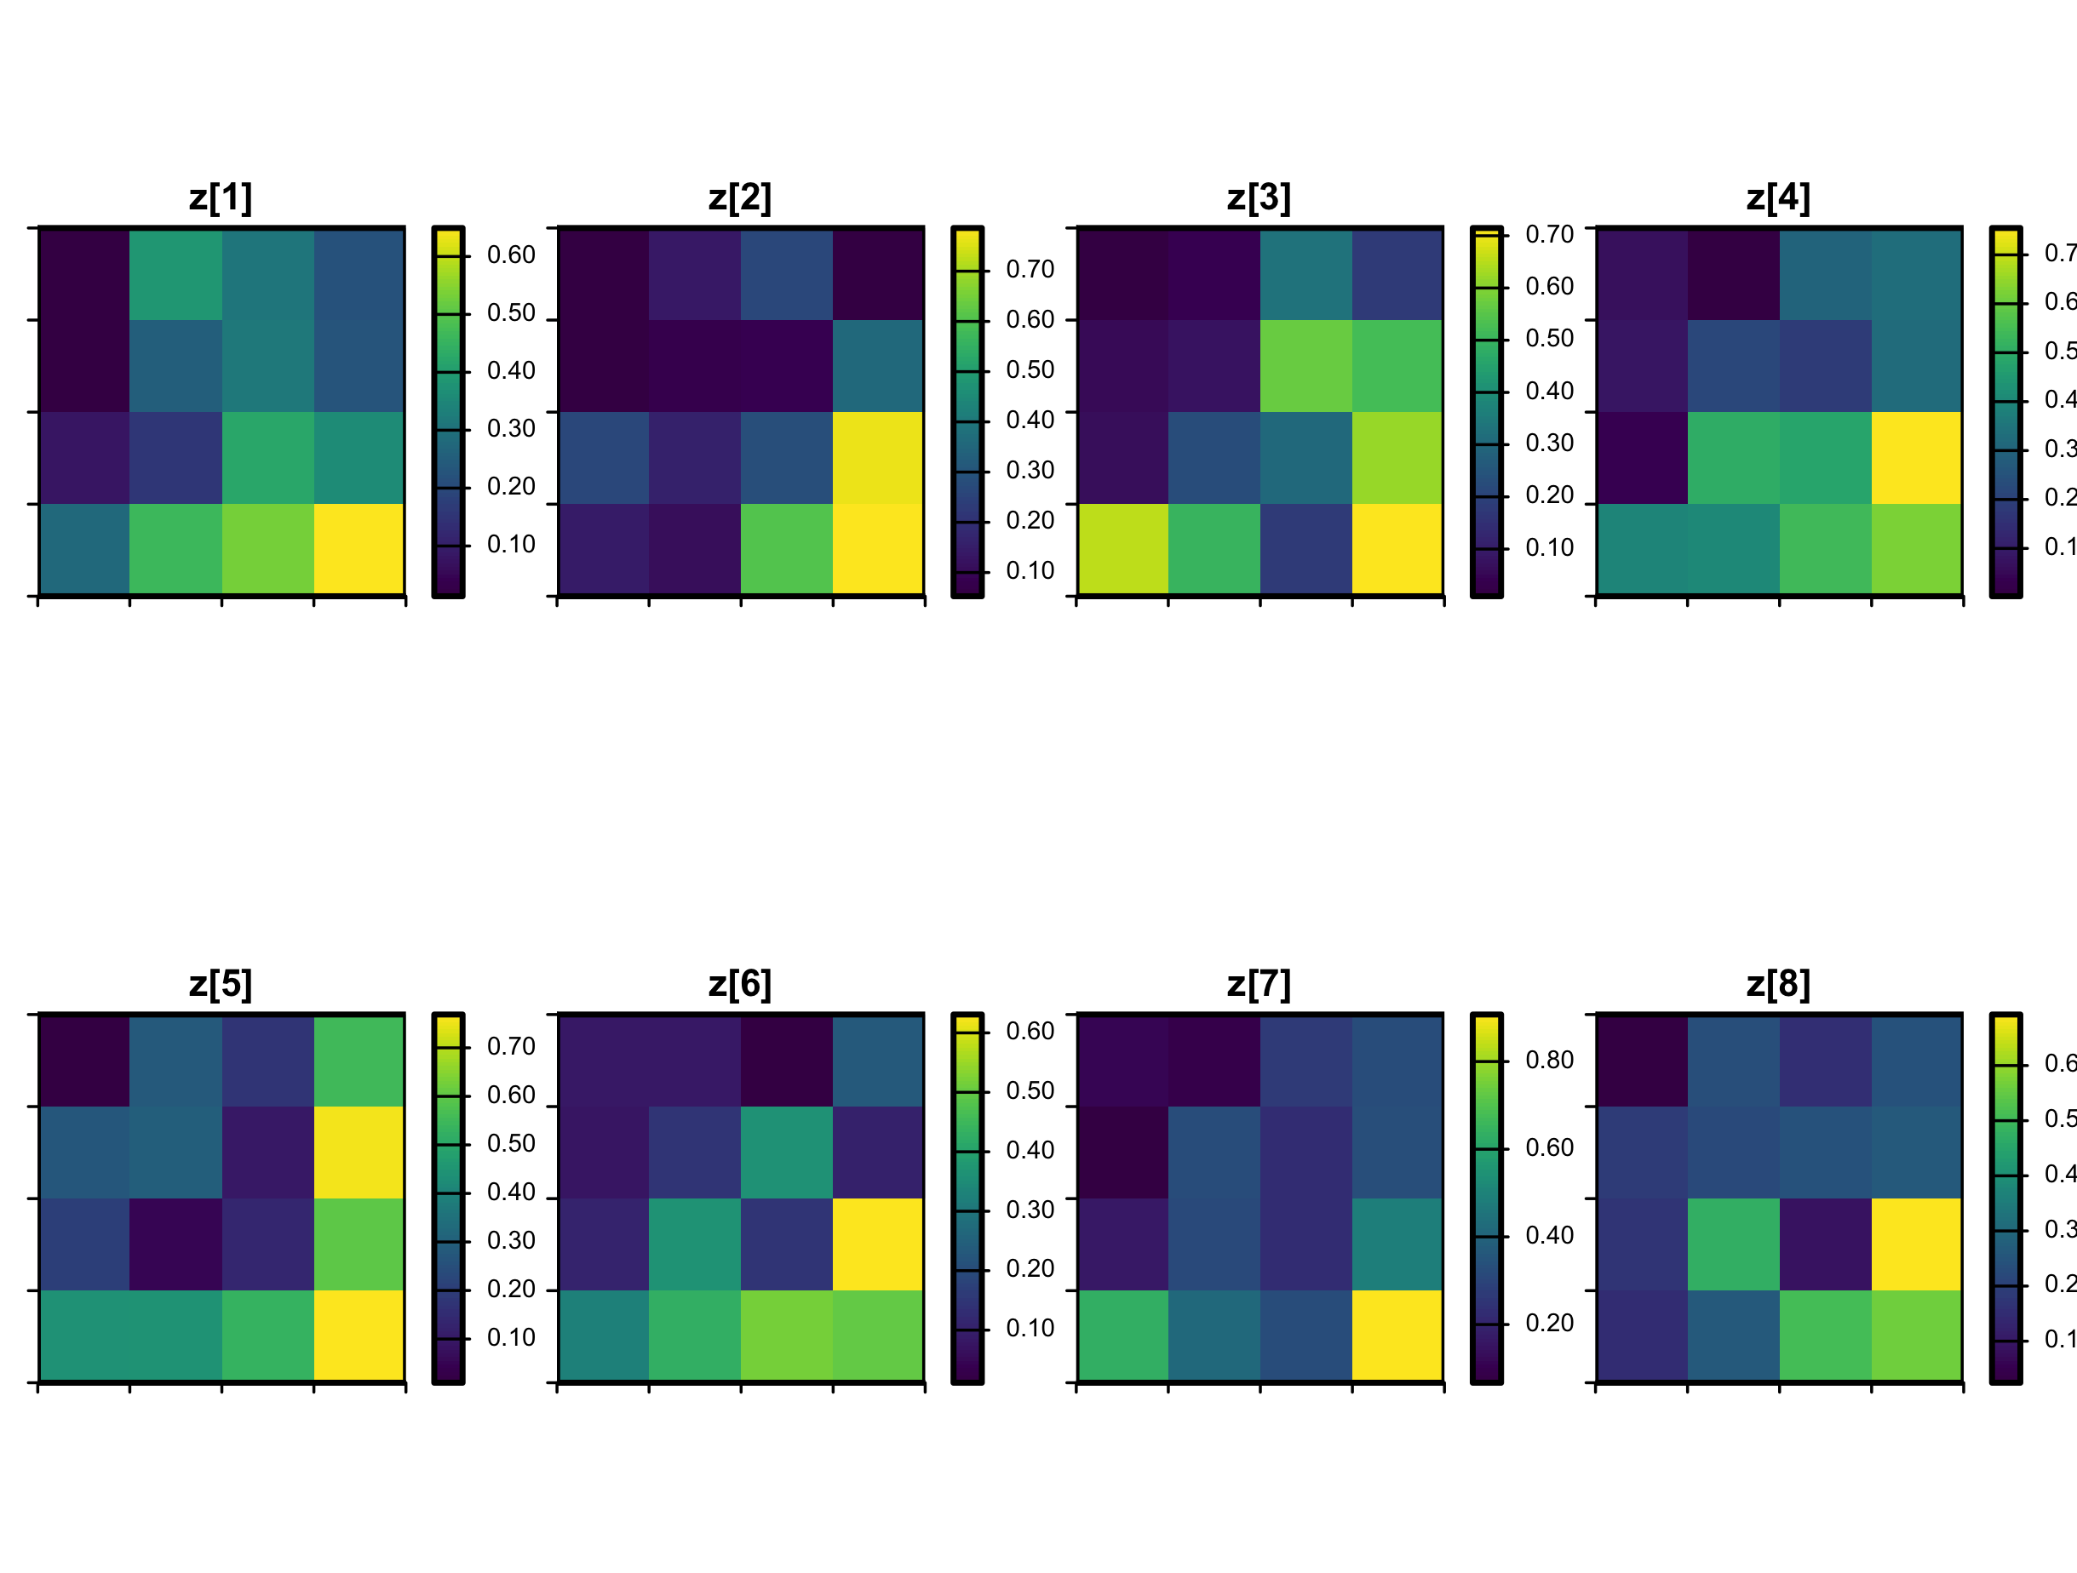
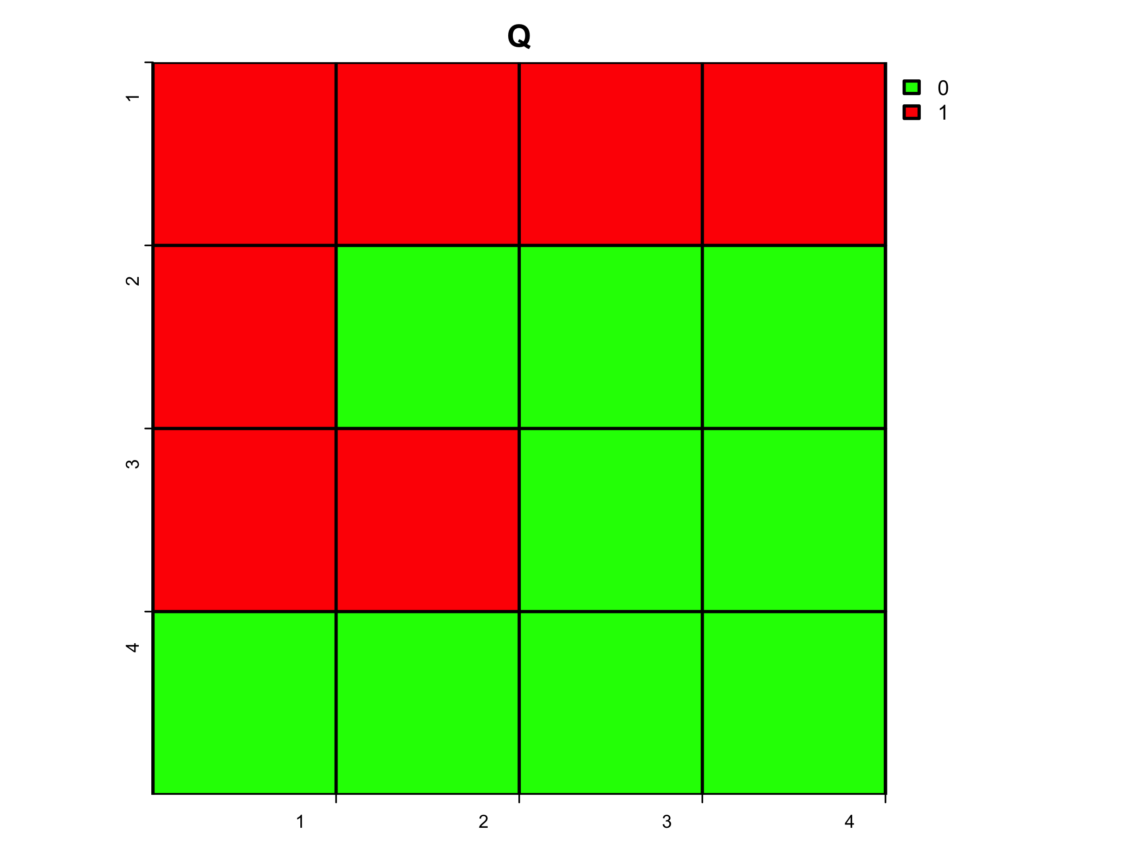
Three-component PRA
x in year 1:8
thr = 0.25
z in year 1:8
Q = 7/16

Slide 19
Three-component PRA
PRA3 <- function( x=array(dim=c(nlon,nlat,n_t)),
z=array(dim=c(nlon,nlat,n_t)), thr.=thr ) {
ns <- prod( dim(x)[1:2] ) ; n_t <- dim(x)[3]
freqH <- function(x,thr.=thr){ sum(x<thr.) }
n_tH <- apply(x, c(1,2), freqH)
siteQ <- which( n_tH > 0, arr.ind=TRUE ) ; nQ <- dim(siteQ)[1]
Q <- nQ / ns ; s_Q <- sqrt( Q*(1-Q) / ns )
xQ <- sapply( 1:n_t, function(i){x[,,i][siteQ]} )
zQ <- sapply( 1:n_t, function(i){z[,,i][siteQ]} )
PRAQ <- PRA( c(xQ), c(zQ), thr. )
pH <- PRAQ["pH"] ; V <- PRAQ["V"] ; R.Q <- PRAQ["R"]
s_pH <- PRAQ["s_pH"] ; s_V <- PRAQ["s_V"] ; s_R.Q <- PRAQ["s_R"]
R <- Q * R.Q
s_R <- sqrt( s_Q^2*s_R.Q^2 + s_Q^2*R.Q^2 + Q^2*s_R.Q^2 )
result <- c( Q , pH , V , R , s_Q , s_pH , s_V , s_R )
names ( result ) <- c( "Q", "pH", "V", "R", "s_Q", "s_pH", "s_V", "s_R" )
return( result ) }

Slide 20
Three-component PRA
x in year 1:8
thr = 0.25
z in year 1:8
Q = 7/16
Q pH V R
0.438 0.268 0.190 0.022
s_Q s_pH s_V s_R
0.124 0.059 0.020 0.009

Slide 21
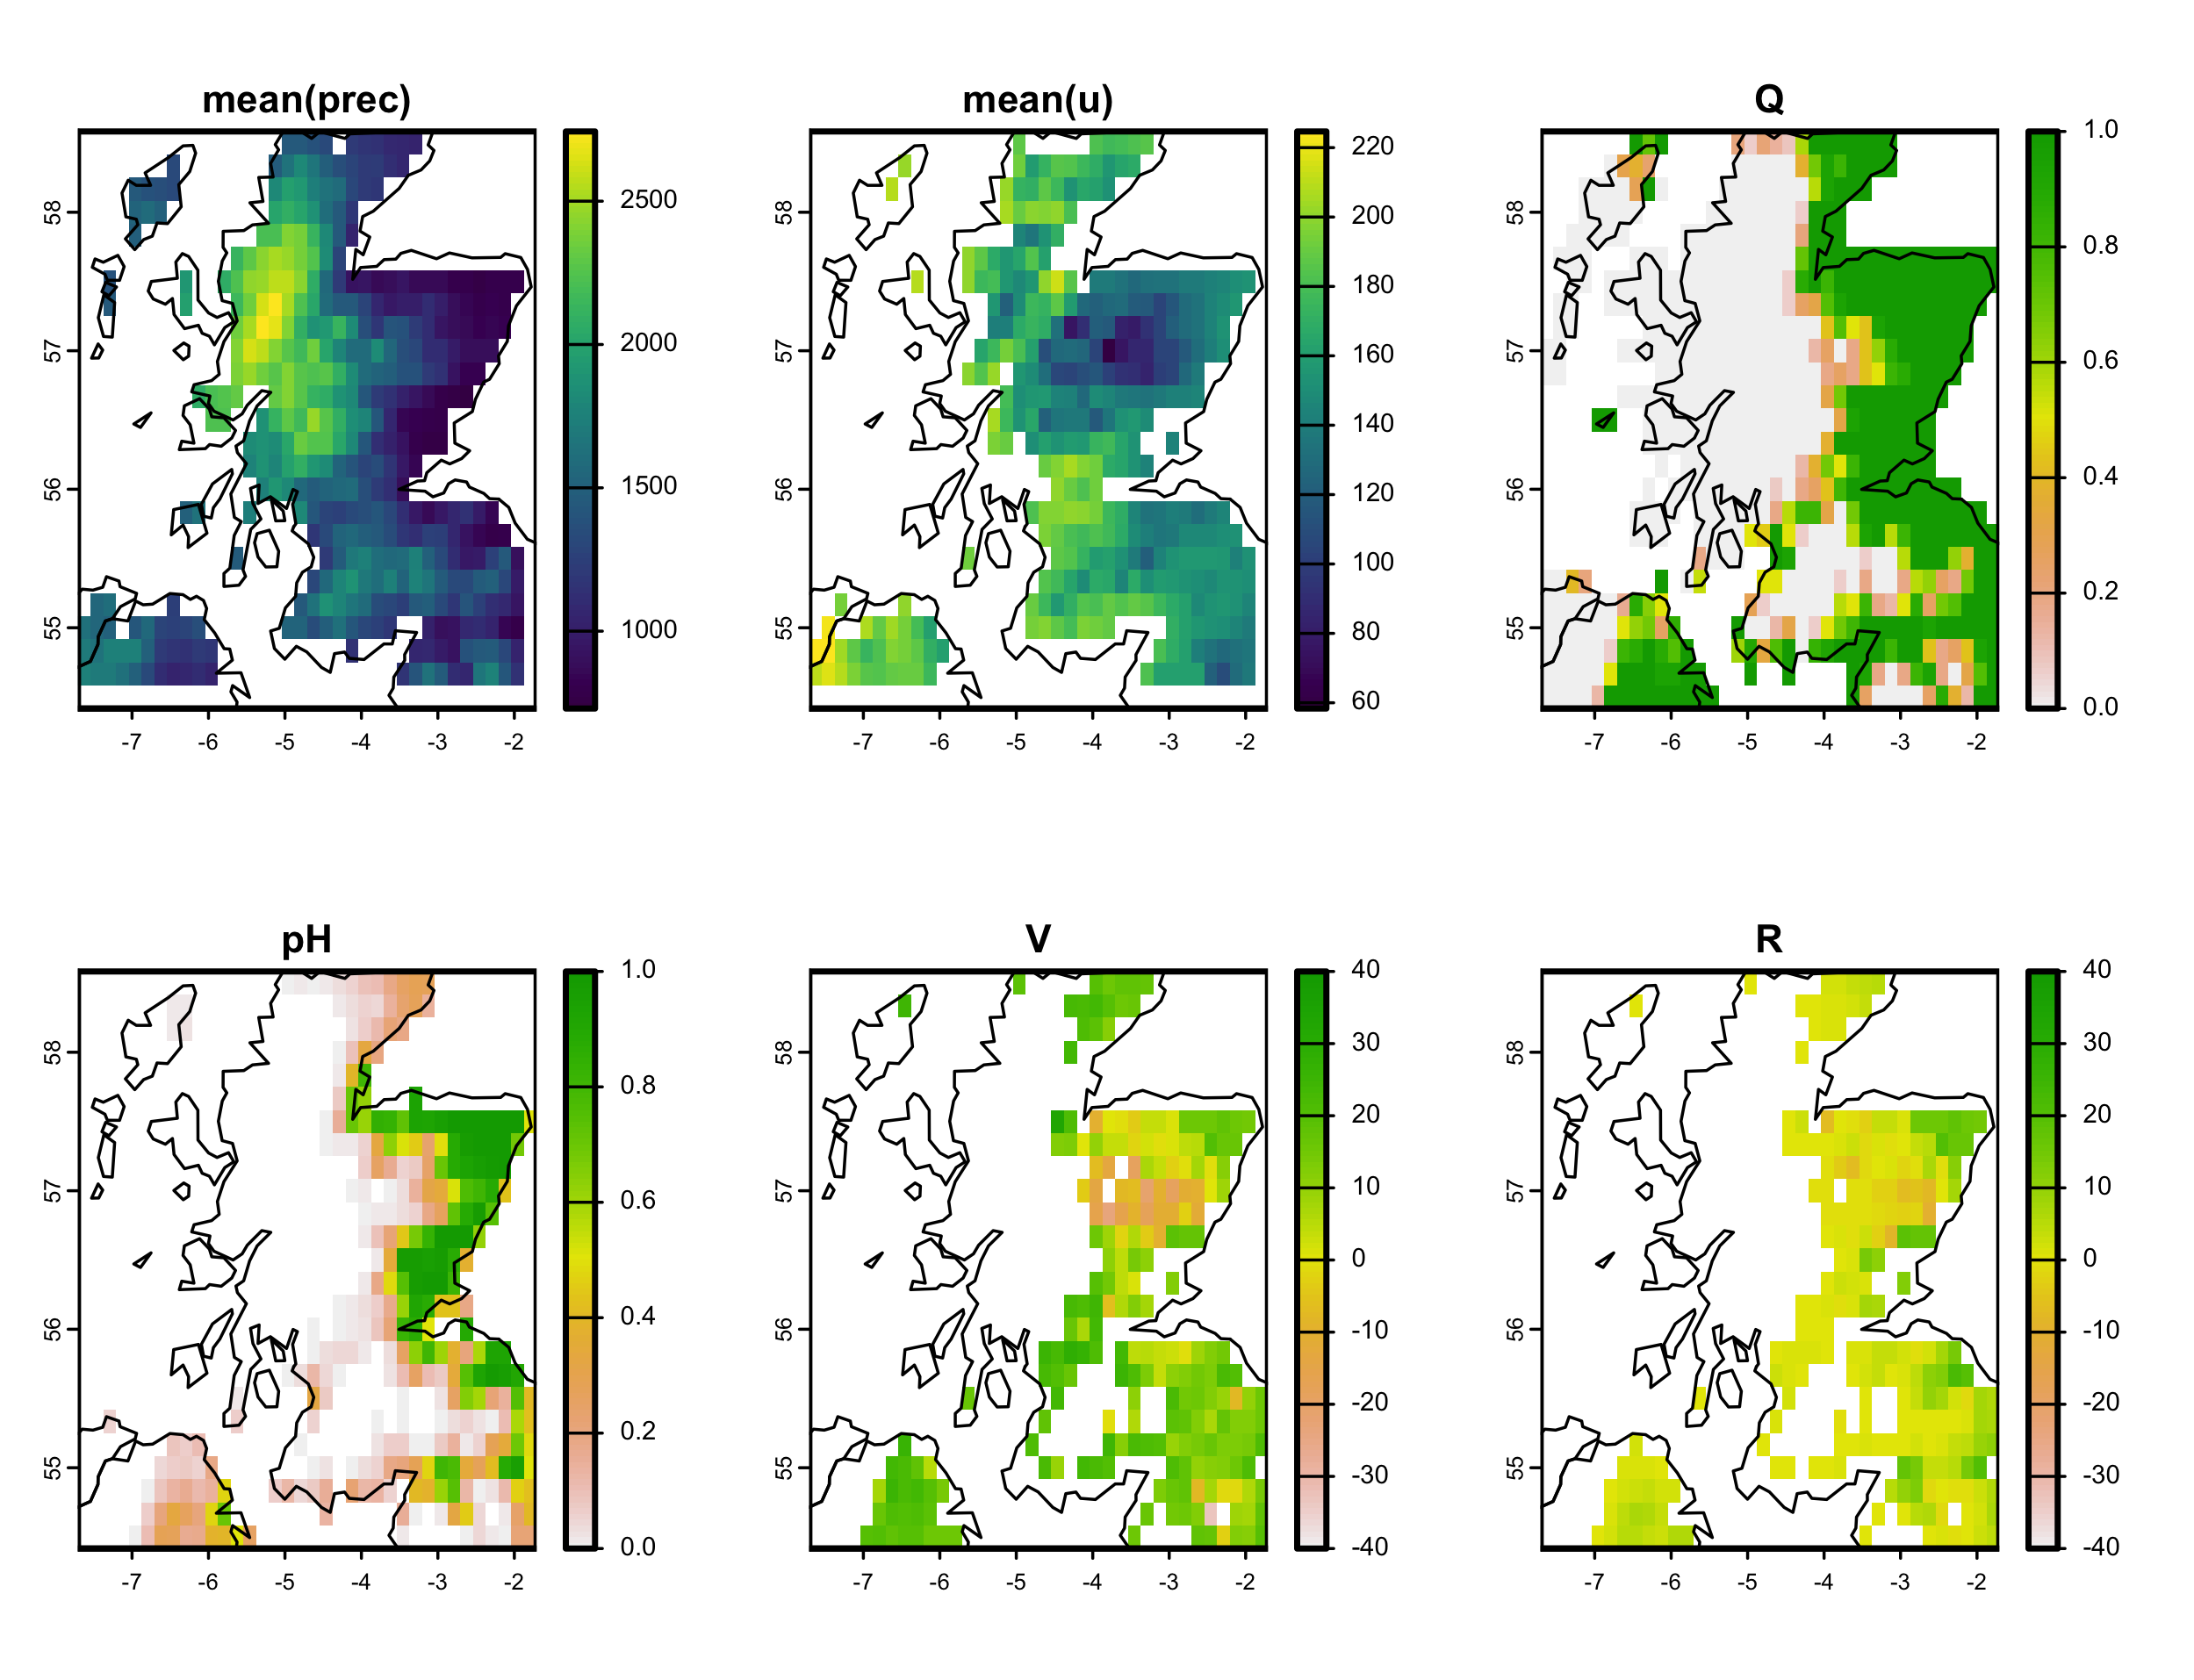
Three-component PRA Scotland

Slide 22
Hazardousness can be complicated !
More than 1 relevant hazard variable
Effects that depend on hazard time-scale
Effects that depend on hazard spatial distribution
Hazard modelling:
Fault-tree analysis (FTA)
Graphical modelling for p[H] or { p[ H₁, .. ,H_{n} ] }
Copulas
Extreme-value theory, Generalized extreme value distributions
Trivariate Gaussian p[x₁,x₂,z] generally too simple …

Slide 23
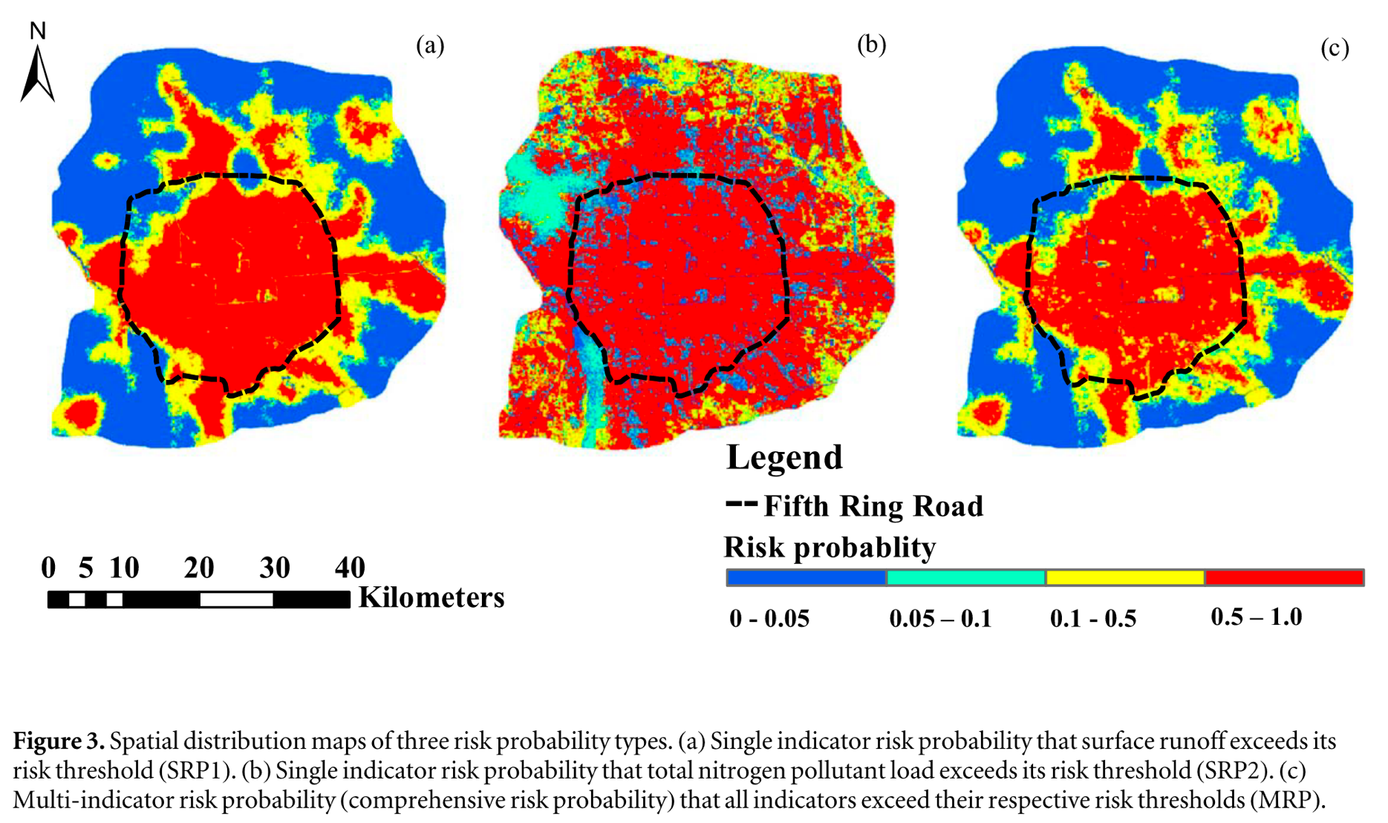
Liu et al. (2020). A new risk probability calculation method for urban ecological risk assessment
Two marginal hazard distributions
Joint distribution formed by copula

Slide 24
PRA for heatwaves (thr = 30°C) as f(mean(T),sd(T))

Slide 25
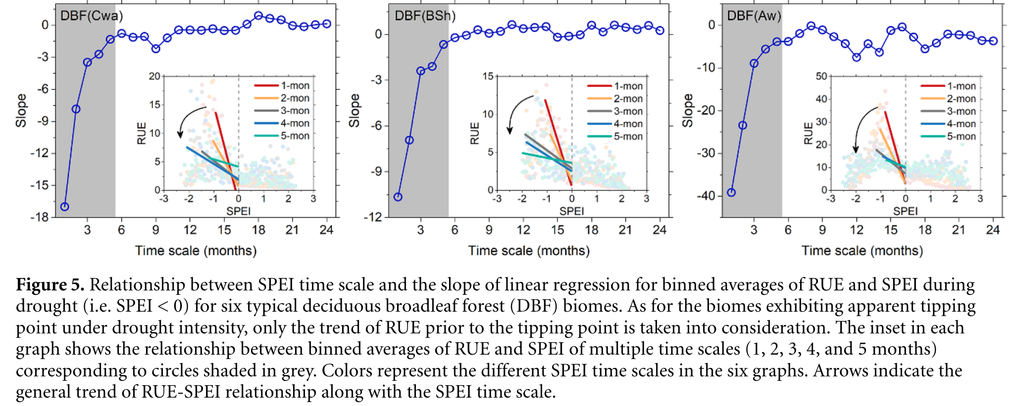
Chen et al. (2020). The collapse points of increasing trend of vegetation rain-use efficiency under droughts

Slide 26
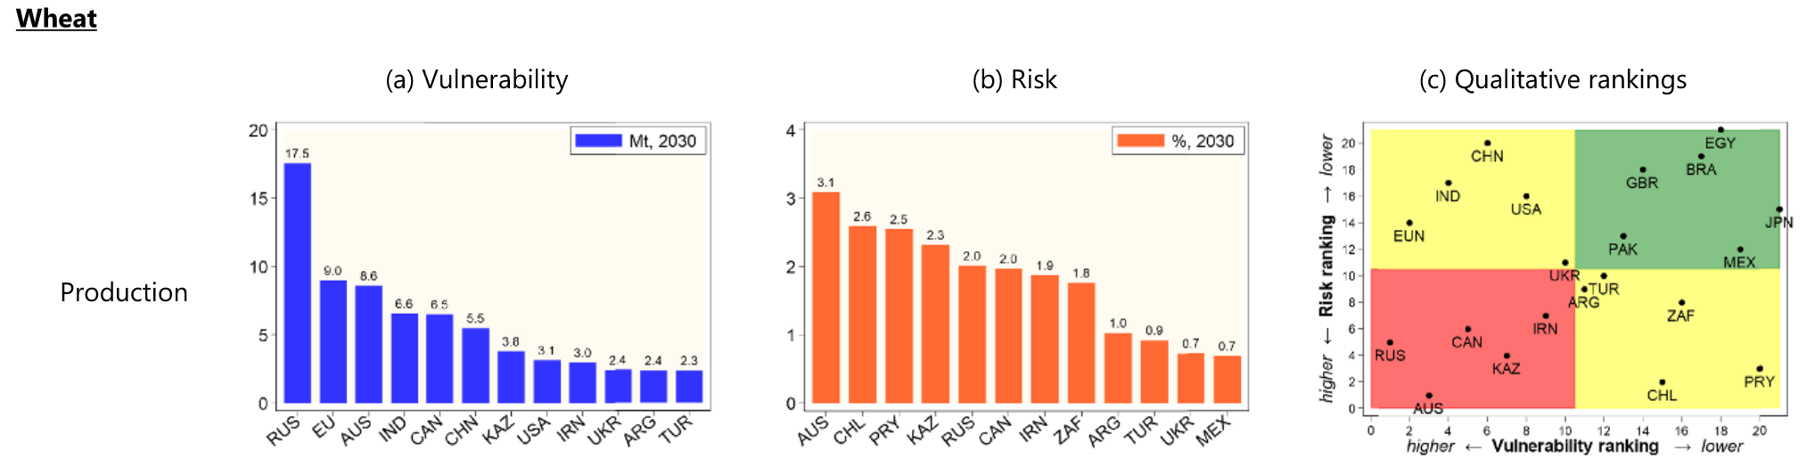
Chatzopoulos et al. (2021). Potential impacts of concurrent and recurrent climate extremes on the global food system by 2030
Concurrent climate extremes
Recurrent climate extremes
V_{glob} = f(spatial distrib. of H)
V_{glob} = f(temporal distrib. of H)

Slide 27
Two-hazard sampling-based PRA
PRAi <- function( xz, thr=c(0,0) ) {
x1 <- xz[,1] ; x2 <- xz[,2] ; z <- xz[,3]
n_c <- 2^2 - 1 ; n <- length(x1)
H <- vector("list",n_c)
n_H <- pH <- V <- R <- s_pH <- s_V <- s_R <- rep(NA,n_c)
H[[1]] <- which(x1 < thr[1] & x2 < thr[2]) ; n_H[1] <- length(H[[1]])
H[[2]] <- which(x1 < thr[1] & x2 >= thr[2]) ; n_H[2] <- length(H[[2]])
H[[3]] <- which(x1 >= thr[1] & x2 < thr[2]) ; n_H[3] <- length(H[[3]])
NotH <- which(x1 >= thr[1] & x2 >= thr[2]) ; n_NotH <- length(NotH)
pH <- n_H / n ; s_pH <- sqrt( pH*(1-pH) / n )
Ez_NotH <- mean( z[NotH] ) ; s_Ez_NotH <- sqrt( var(z[NotH] ) / n_NotH )
for(i in 1:n_c) {
Ez_Hi <- mean( z[ H[[i]] ] )
s_Ez_Hi <- sqrt( var ( z[ H[[i]] ] ) / n_H[i] )
V[i] <- Ez_NotH - Ez_Hi
s_V[i] <- sqrt( s_Ez_NotH^2 + s_Ez_Hi^2 ) }
R <- pH * V
s_R <- sqrt( s_pH^2 * s_V^2 + s_pH^2 * V^2 + pH^2 * s_V^2 )
R.sum <- sum(R) ; pH.sum <- sum(pH) ; V.wsum <- R.sum / pH.sum
return( list( sum = c( pH.sum=pH.sum, V.wsum=V.wsum, R.sum=R.sum ),
cat = cbind( 1:3, pH, V, R, s_pH, s_V, s_R ) ) ) }

Slide 28
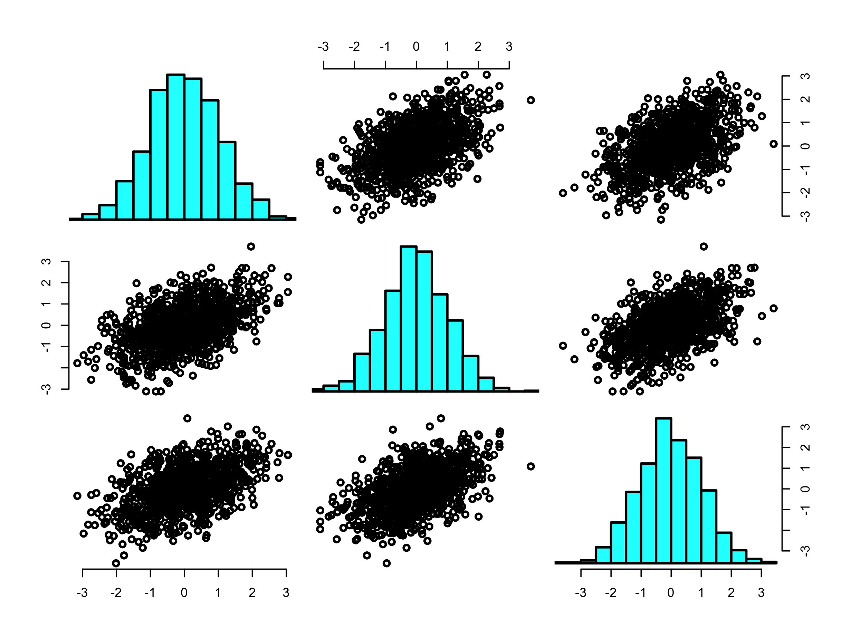
Two-hazard PRA (Trivariate Gaussian example)
x₁
x₂
z
Mean vector
0.006 0.001 -0.024
x₁
Covariance matrix
1.000 0.499 0.493
0.499 1.000 0.519
0.493 0.519 1.000
x₁
z
> PRAi(xz_G3,c(0,0))$cat
pH V R s_pH s_V s_R
[1,] 1 0.342 1.226 0.419 0.015 0.071 0.030
[2,] 2 0.160 0.625 0.100 0.012 0.083 0.015
[3,] 3 0.159 0.687 0.109 0.012 0.088 0.016
> PRAi(xz_G3,c(0,0))$sum
pH.sum V.wsum R.sum
0.661 0.951 0.629

Slide 29
EXERCISE
Create the following dataset:
set.seed(1)
n <- 1e2
x1 <- rbeta( n, 3, 3 ) ; x2 <- rbeta( n, 3, 3 )
z <- as.integer( x1 >= 0.5 | x2 >= 0.5 )
xz <- cbind( x1, x2, z )
Study the dataset. R-command: pairs(xz)
Run PRAi on this dataset using thr=c(0.5,0.5)
Explain the results, especially for V and s_V
PRAi( xz, c(0.5,0.5) )$cat
pH V R s_pH s_V s_R
[1,] 1 0.25 1 0.25 0.043 0 0.043
[2,] 2 0.22 0 0.00 0.041 0 0.000
[3,] 3 0.33 0 0.00 0.047 0 0.000

Slide 30
4. Introduction to BDT
USGS CC PDM 1.0
Workshop IBS-Germany & DVFFA, Lübeck, 2025-09-24-26

Slide 31
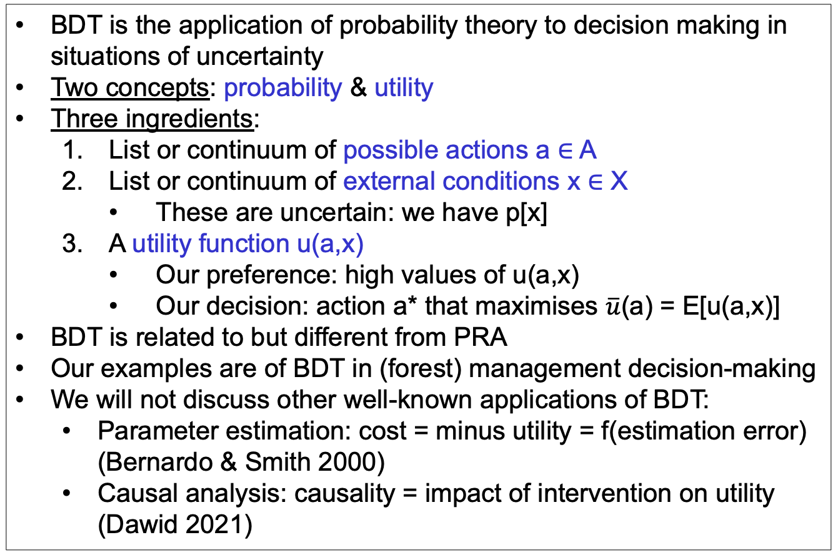
Bayesian Decision Theory (BDT)
BDT is the application of probability theory to decision making in situations of uncertainty
Two concepts: probability & utility
Three ingredients:
List or continuum of possible actions a ∈ A
List or continuum of external conditions x ∈ X
These are uncertain: we have p[x]
A utility function u(a,x)
Our preference: high values of u(a,x)
Our decision: action a* that maximises $\overline{u}$(a) = E[u(a,x)]
BDT is related to but different from PRA
Our examples are of BDT in (forest) management decision-making
We will not discuss other well-known applications of BDT:
Parameter estimation: cost = minus utility = f(estimation error) (Bernardo & Smith 2000)
Causal analysis: causality = impact of intervention on utility (Dawid 2021)

Slide 32
Graphical models: From PRA to BDT
PRA
BDT
u
z
z
x
a
x
p[x,z] =
p[x] p[z|x]
p[x,z,u|a] =
p[x] p[z|a,x] p[u|a,z]

Slide 33


Decision tree
u = Tree survival
u₁₁ = 100%
No beetles
p=0.3
$\overline{u}$(a₁) = 37%
No thin
Beetles
p=0.7
u₁₂ = 10%
a
Thin
No beetles
p=0.3
u₂₁ =50%
$\overline{u}$(a₂) = 43%
Beetles
p=0.7
u₂₂ =40%
We choose a₂ !

Slide 34
Sequential decisions
No beetles
p=0.3
No thin
Beetles
p=0.7
a
Thin
No beetles
p=0.3
Beetles
p=0.7

Slide 35
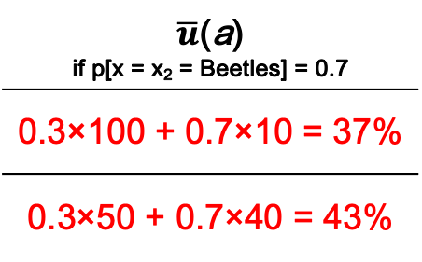
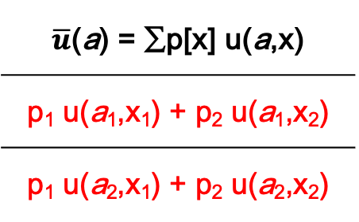
Utility matrix for discrete u(a,x)
 | x = x₁ | x = x₂
a = a₁ | u(a₁,x₁) | u(a₁,x₂)
a = a₂ | u(a₂,x₁) | u(a₂,x₂)
$\overline{u}$(a) = ∑p[x] u(a,x)
p₁ u(a₁,x₁) + p₂ u(a₁,x₂)
p₁ u(a₂,x₁) + p₂ u(a₂,x₂)
u
z
% Tree survival | No beetles | Beetles
No thin | 100% | 10%
50% thin | 50% | 40%
$\overline{u}$(a) if p[x = x₂ = Beetles] = 0.7
0.3×100 + 0.7×10 = 37%
0.3×50 + 0.7×40 = 43%
a
x
We choose a₂ !

Slide 36
Value of Information: Impact on expected utility
Only prior information p[x]:
Specific information y:
Information yet to be received Y = {y}:
‘Perfect’ information so you can always (for every x) choose the best action:

Slide 37
Value of Information in the tree beetle example
If y = {y₁,y₂} and
p[y₁|x₁] = p[y₂|x₂] = 0.6
u
VoI_{partial} = 43.6 – 43 = 0.6%
VoI_{perfect} = 58 – 43 = 15%
z
a
x

Slide 38
EXERCISE - Value of bad Information …
What would happen to VoI_{partial} if p[y₁|x₁] = p[y₂|x₂] = 0.5?

Slide 39
Graphical models: From PRA to BDT
PRA
BDT
u
u
u
cost
benefit
cost
benefit
z
z
z
z
𝜺
x
a
x
a
x
a
x
𝝑
p[x,z] =
p[x] p[z|x]
p[x,z,u|a] =
p[x] p[z|a,x] p[u|a,z]
z = f(a,x,𝝑) + 𝜺
p[x], p[𝝑], p[𝜺]

Slide 40
BDT for forestry
Utility
u
Management costs
cost
benefit
Timber sale
Forest growth
z
𝜺
Model error
Management actions
a
x
𝝑
Model parameters
Climate

Slide 41
Two realisations of the network
100.00
--------
Model
£ 180.00 ha⁻¹ y⁻¹
WUE
Irrigation
u
YC
Rain
200.00
-----
300.00
--------
z = 0.01 (x + a)
u = 30 z - 0.5 a
£ 0.00
ha⁻¹ y⁻¹
cost
benefit
£ 180.00 ha⁻¹ y⁻¹
Timber
price
Irrigation costs
10
---
YC = 6
m³ ha⁻¹ y⁻¹
z
𝜺
𝜺 = 0
m³ ha⁻¹ y⁻¹
a
x
𝝑
400
--
Irrigation = 0 mm y⁻¹
Rain = 600 mm y⁻¹
WUE = 0.01
m³ ha⁻¹ mm⁻¹

Slide 42
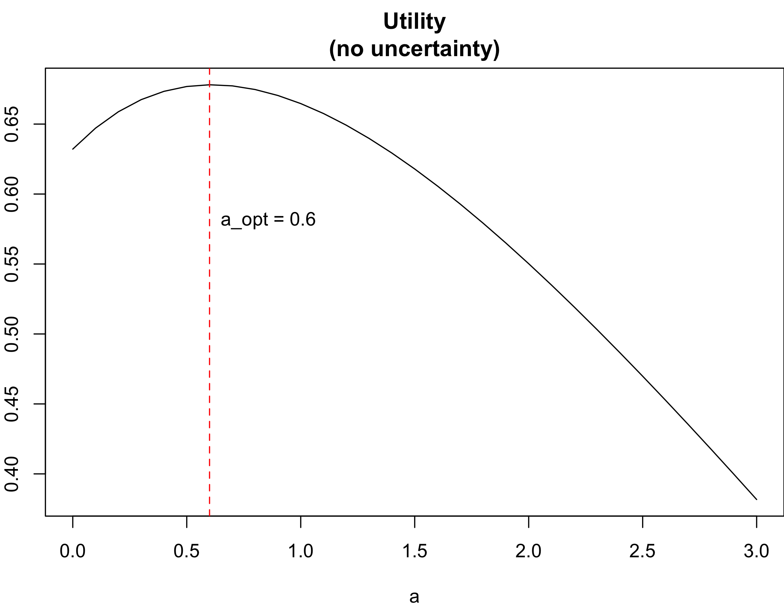
BDT with continuous nonlinear z-response function
u
u <- function( a, x=1, t=1, e=0, ka=0.2, kz=1 ) {
z <- t*(1-exp(-a-x)) + e
cost <- ka*a ; benefit <- kz*z
return( benefit - cost ) }
cost
benefit
z
𝜺
a
x
𝝑

Slide 43
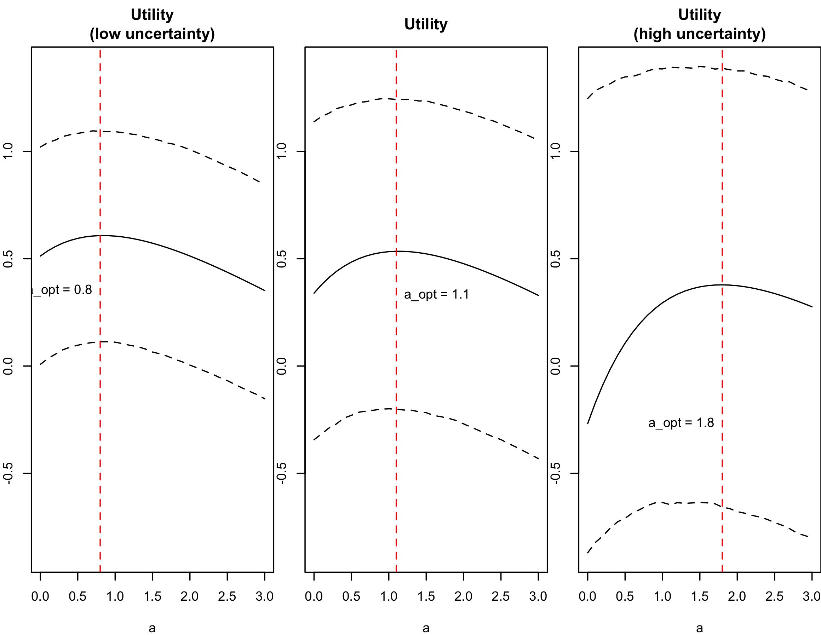
BDT with continuous nonlinear z-response function
Low uncertainty
Medium uncertainty
High uncertainty

Slide 44
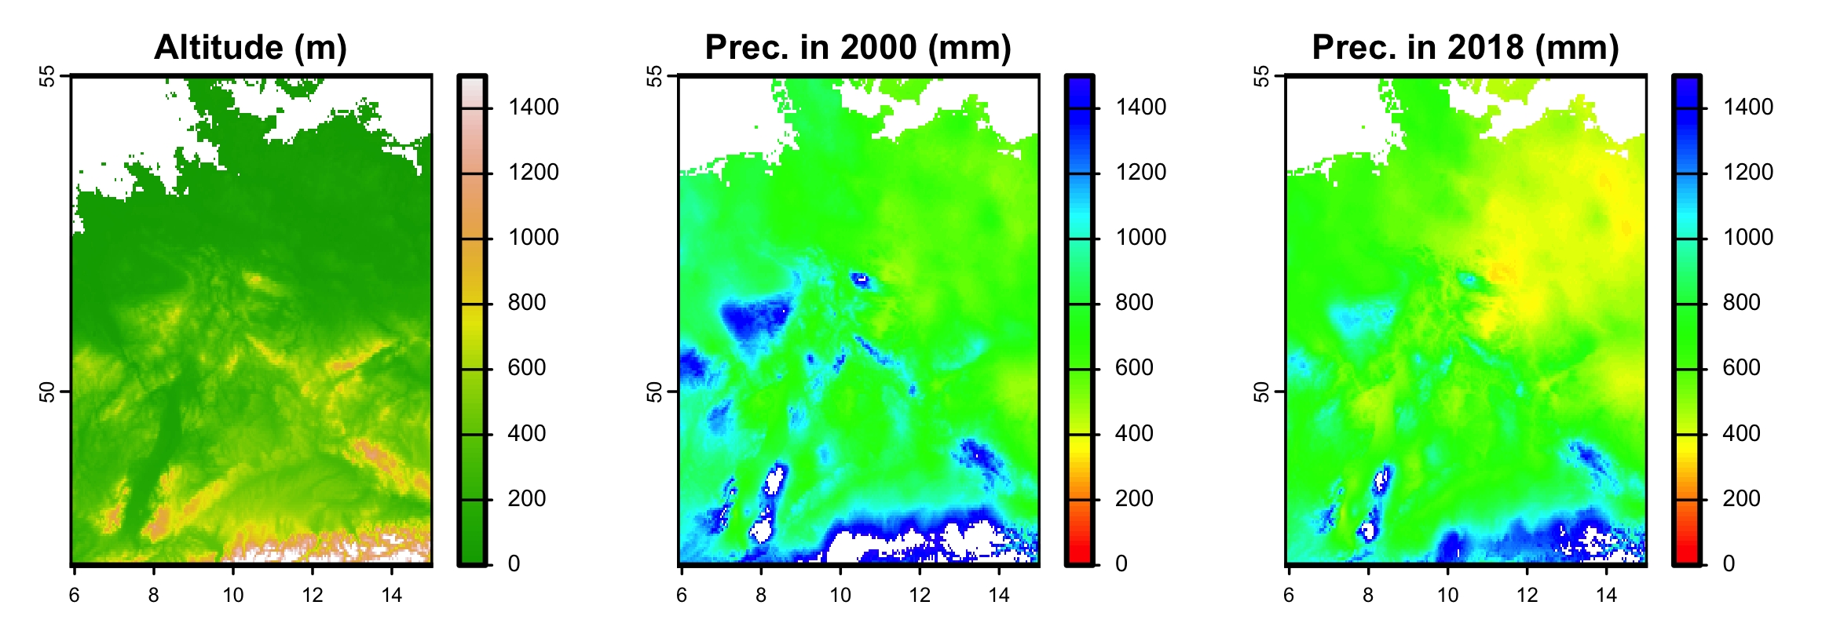
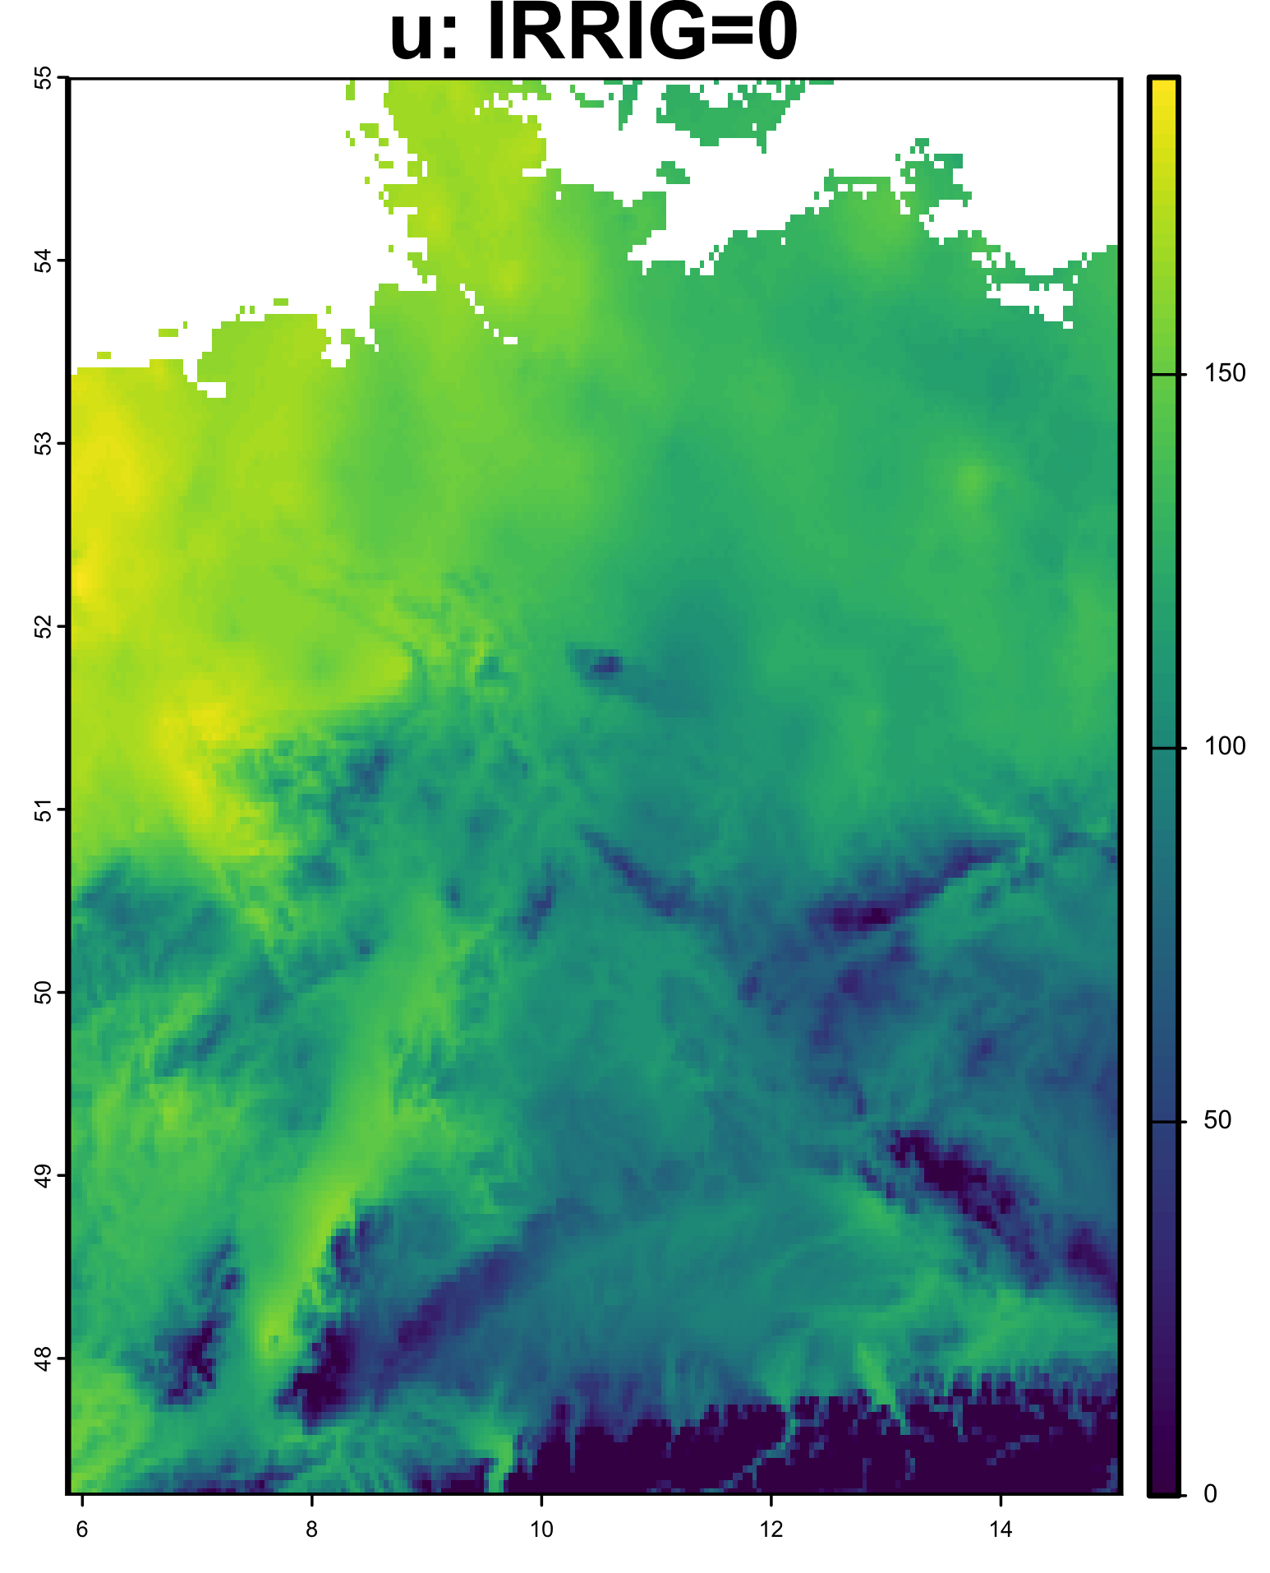
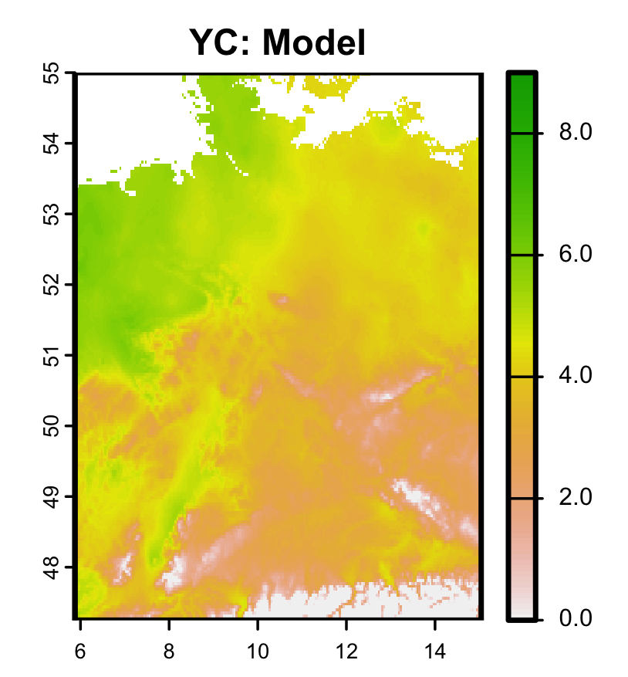
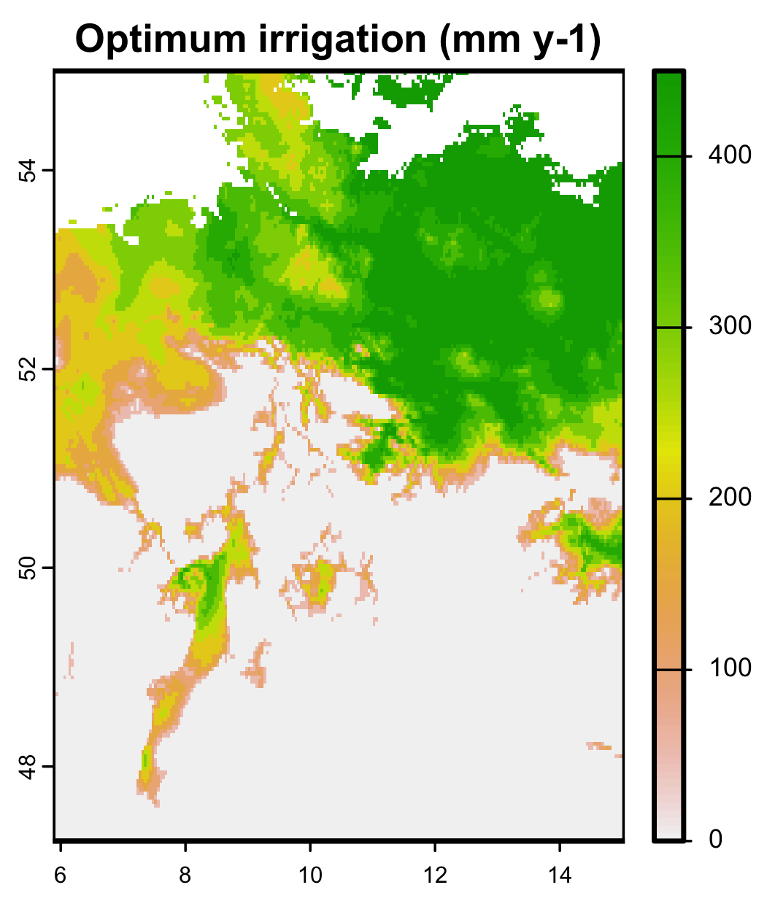
A spatial BDT example
Models for z = forest yield class (m³ ha⁻¹ y⁻¹), and u:
YC = 10 * (1-exp(-water/1000)) * (1–altitude/1000)
u = 30 * YC - 0.1 * IRRIG

Slide 45
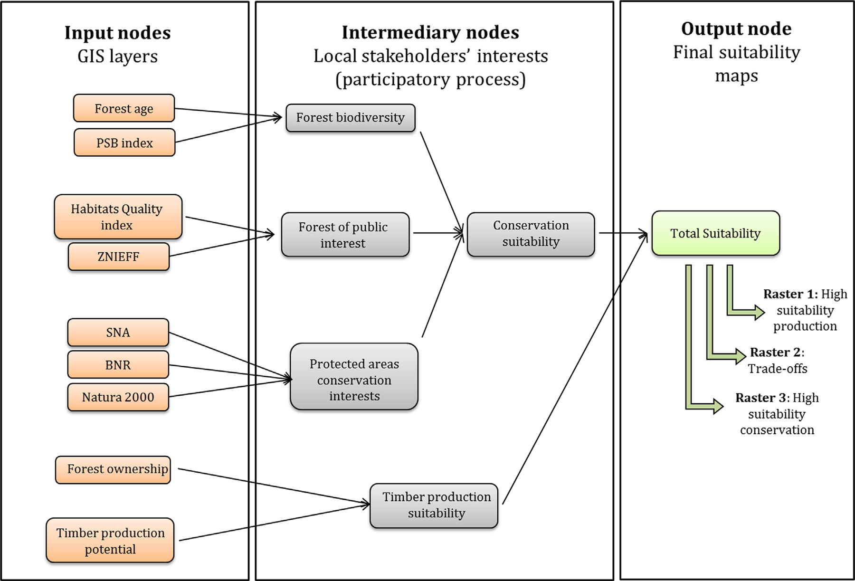
Gonzales-Redin et al. (2016)
Gonzalez Redin, J. et al. (2016). Spatial Bayesian belief networks as a planning decision tool for mapping ecosystem services trade-offs on forested landscapes. Environmental Research 144: 15-26.

Slide 46
5. Links between PRA and BDT
USGS CC PDM 1.0
Workshop IBS-Germany & DVFFA, Lübeck, 2025-09-24-26

Slide 47
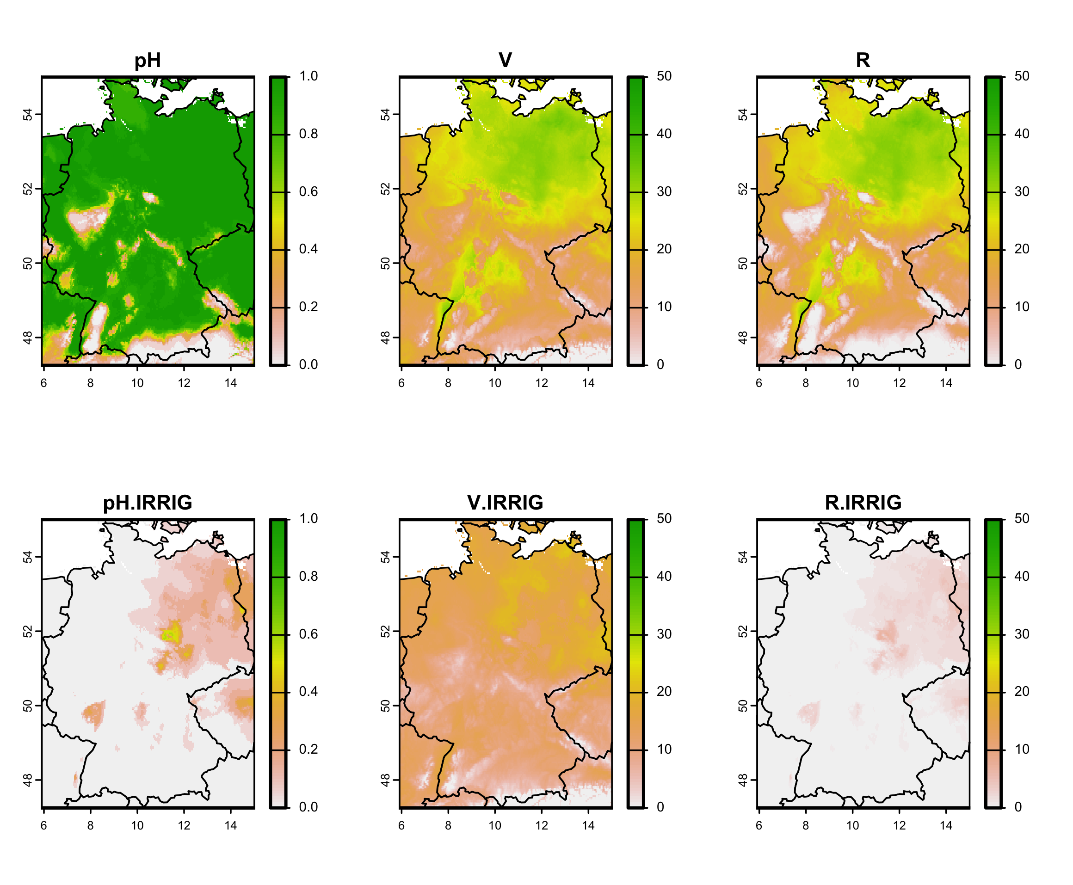
A spatial BDT example
Models for z = forest yield class (m³ ha⁻¹ y⁻¹), and u:
YC = 10 * (1-exp(-water/1000)) * (1–altitude/1000)
u = 30 * YC - 0.1 * IRRIG
thr = 1000 mm y⁻¹

Slide 48
Maximizing utility vs. minimizing risk
PRA: irrigation reduces R to nearly zero everywhere…
Why did the BDT then only suggest irrigation in the North?
⇒ minimizing R is not the same as maximizing E[u].
We define ‘Risk corrected for costs and benefits’ as:

Slide 49
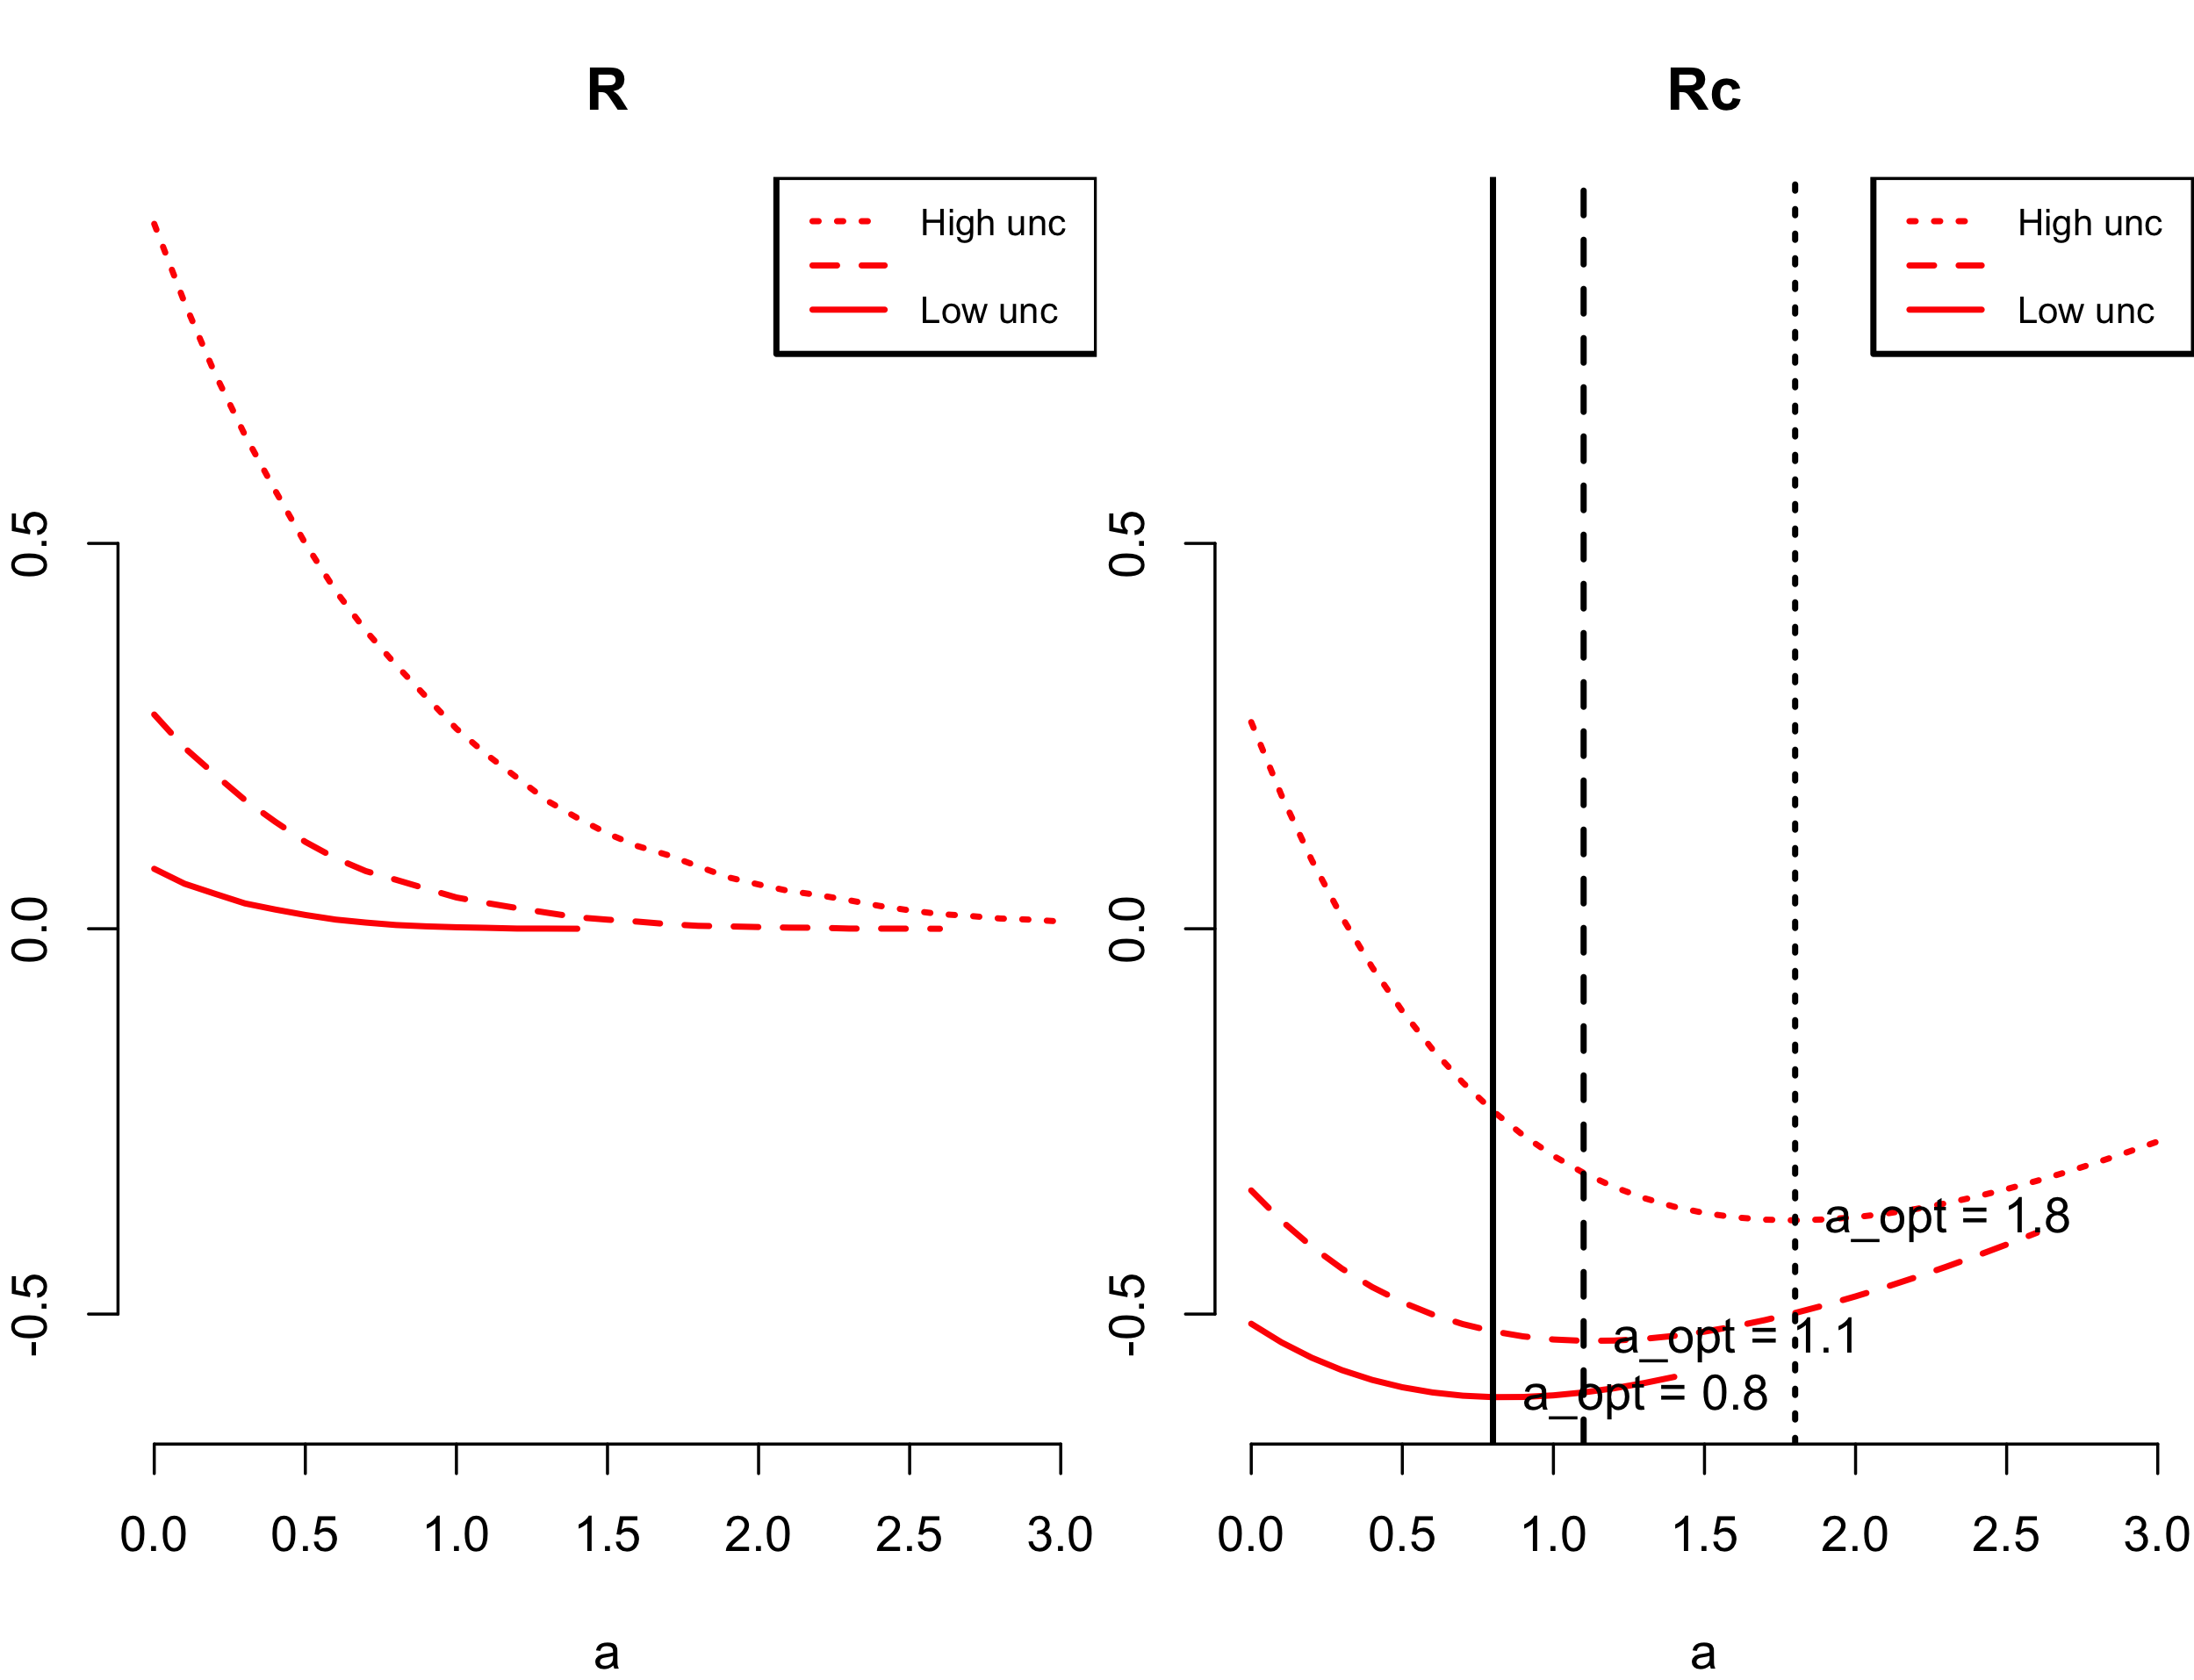
BDT with continuous nonlinear z-response function

Slide 50
6. General discussion
USGS CC PDM 1.0
Workshop IBS-Germany & DVFFA, Lübeck, 2025-09-24-26

Slide 51
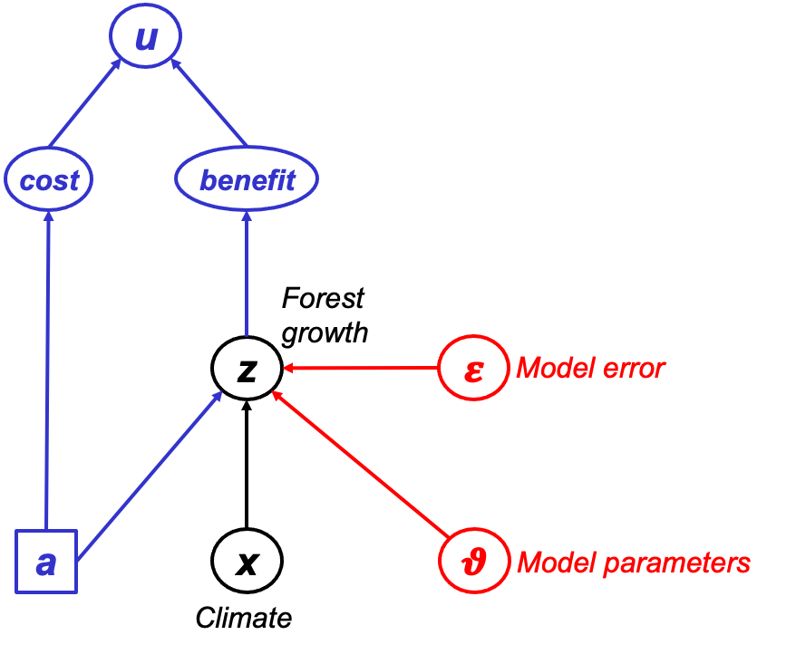
Theory development: PRA & BDT
Probabilistic Risk Analysis (PRA)
Risk = Expected loss = probability(Hazard) * Vulnerability
p(Drought)
Risk
Vulnerability
Bayesian Decision Theory
(BDT)

Slide 52
Two questions …
Main questions to all:
What is missing from these lectures and/or VO & B (2022)?
Which of the methods could you use in your own work?

Slide 53
Complications: Analysis of z, H and V (Lecina-Diaz et al. 2020)

Slide 54
Complications: Analysis of z, H and V (Lecina-Diaz et al. 2020)

Slide 55

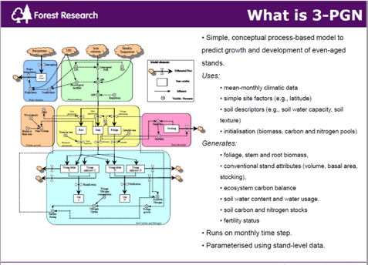
Data & Process-Based Modelling (PBM)
Data
Performance of conifer spp. in UK, Spain, Finland
Environmental conditions (soil, past & future climate)
Forest management
Model drivers
Model test data
Model calibration data
PBM
BASFOR, 3PGN, …
Quantifying past & future forest performance
Analysing forest vulnerability to drought
Analysing impacts of management

Slide 56
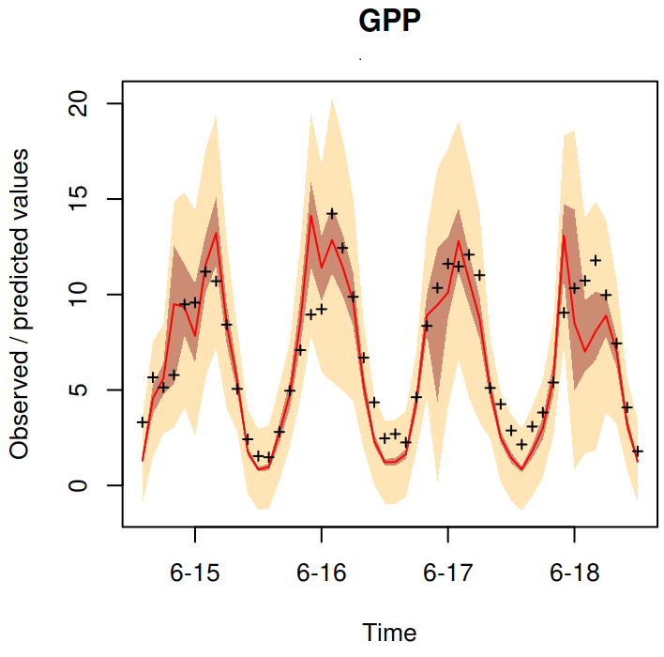
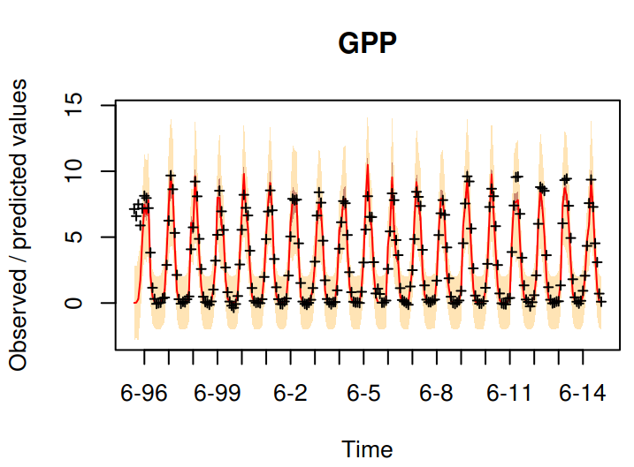
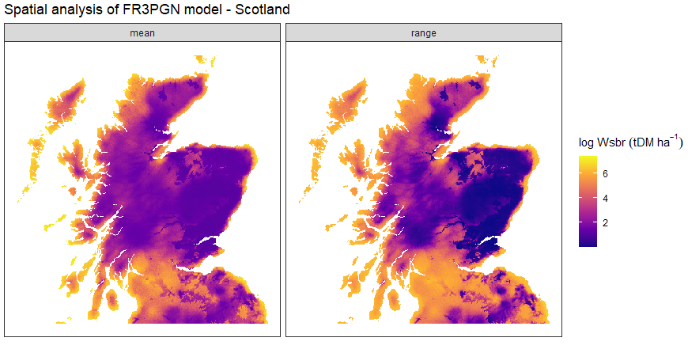
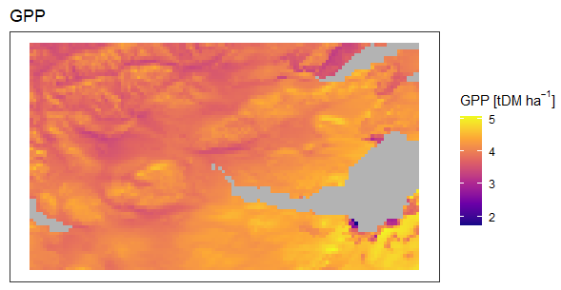
Process-models for forest drought vulnerability
Climate models (GCMs)
Process-based forest models (BASFOR, 3PGN, …)
Identify key factors that drive present and future forest drought vulnerability
Forest data to test and calibrate the models
Bayesian Calibration to reduce uncertainties in model parameters
Bayesian Model Comparison to reduce uncertainty in model error

Slide 57
Project flowchart & Decision Support System (DSS)
Data
PRA
DSS
PBM
BDT
Need to know where/what to plant to ensure 'climate-smart' forestry

Slide 58
Issues to discuss
Which type of PRA to choose?
Nature of x and z, Main questions of interest, Available data and model output
Data needs and computational demand of PRA
Data needs and computational demand: model-based > distr.-based > sampling-based
Data needs: increasing when p[x,z] varies over time and/or space
Need for ‘extreme’ data
Model error = f(x)
BDT
Agreed-upon utility function?
Computational demand of BDT
High because: 1. Quadruple iteration (actions, parameters, space, time), 2. Slow models
PRA as a tool for simplifying and elucidating BDT
PRA can be decomposed ⇒ easier to explain? BDT more relevant to decision-making
Parameter and model uncertainties
Bayesian calibration and Bayesian model comparision: effective but data-hungry and slow
Modelling, PRA and BDT for forests
Complex system requiring multi-hazard, multi-benefit approach
Spatial statistics
Spatially correlated hazards ⇒ Regional risk is not the sum of local risks. [Hochrainer-Stigler et al. (2019) used a PBM, EVT & copulas to upscale drought risk in space & time.]

Slide 59
Appendices
USGS CC PDM 1.0
Workshop IBS-Germany & DVFFA, Lübeck, 2025-09-24-26

Slide 60
Condition for V being threshold-independent

Slide 61
Six datasets where E[z|x] = a + b F_{x}[x]
x
p[x]
z
a
b F_{x}[x]
𝜺
x_U <- runif(n) ; z_U <- 0.5 + x_U/2 + rnorm(n,0,0.05)
x_E <- rexp(n) ; z_E <- 1 - exp(-x_E)/2 + rnorm(n,0,0.05)
x_B <- rbeta(n,5,1) ; z_B <- 0.5 + pbeta(x_B,5,1)/2 + rnorm(n,0,0.05)
x_t <- rt(n,1,30) ; z_t <- 0.5 + pt(x_t,1,30)/2 + rnorm(n,0,0.05)
x_G <- rnorm(n) ; z_G <- 0.5 + pnorm(x_G)/2 + rnorm(n,0,0.05)
x_L <- rnorm(n) ; z_L <- 0.5 + 0.5/(1+exp(-2*x_L)) + rnorm(n,0,0.05)
We now will do single-threshold PRA on each of these six datasets.
We vary the location of the threshold: 5% quantile of x, 10%, …, 95%.
(So p[H] will vary accordingly.)

Slide 62
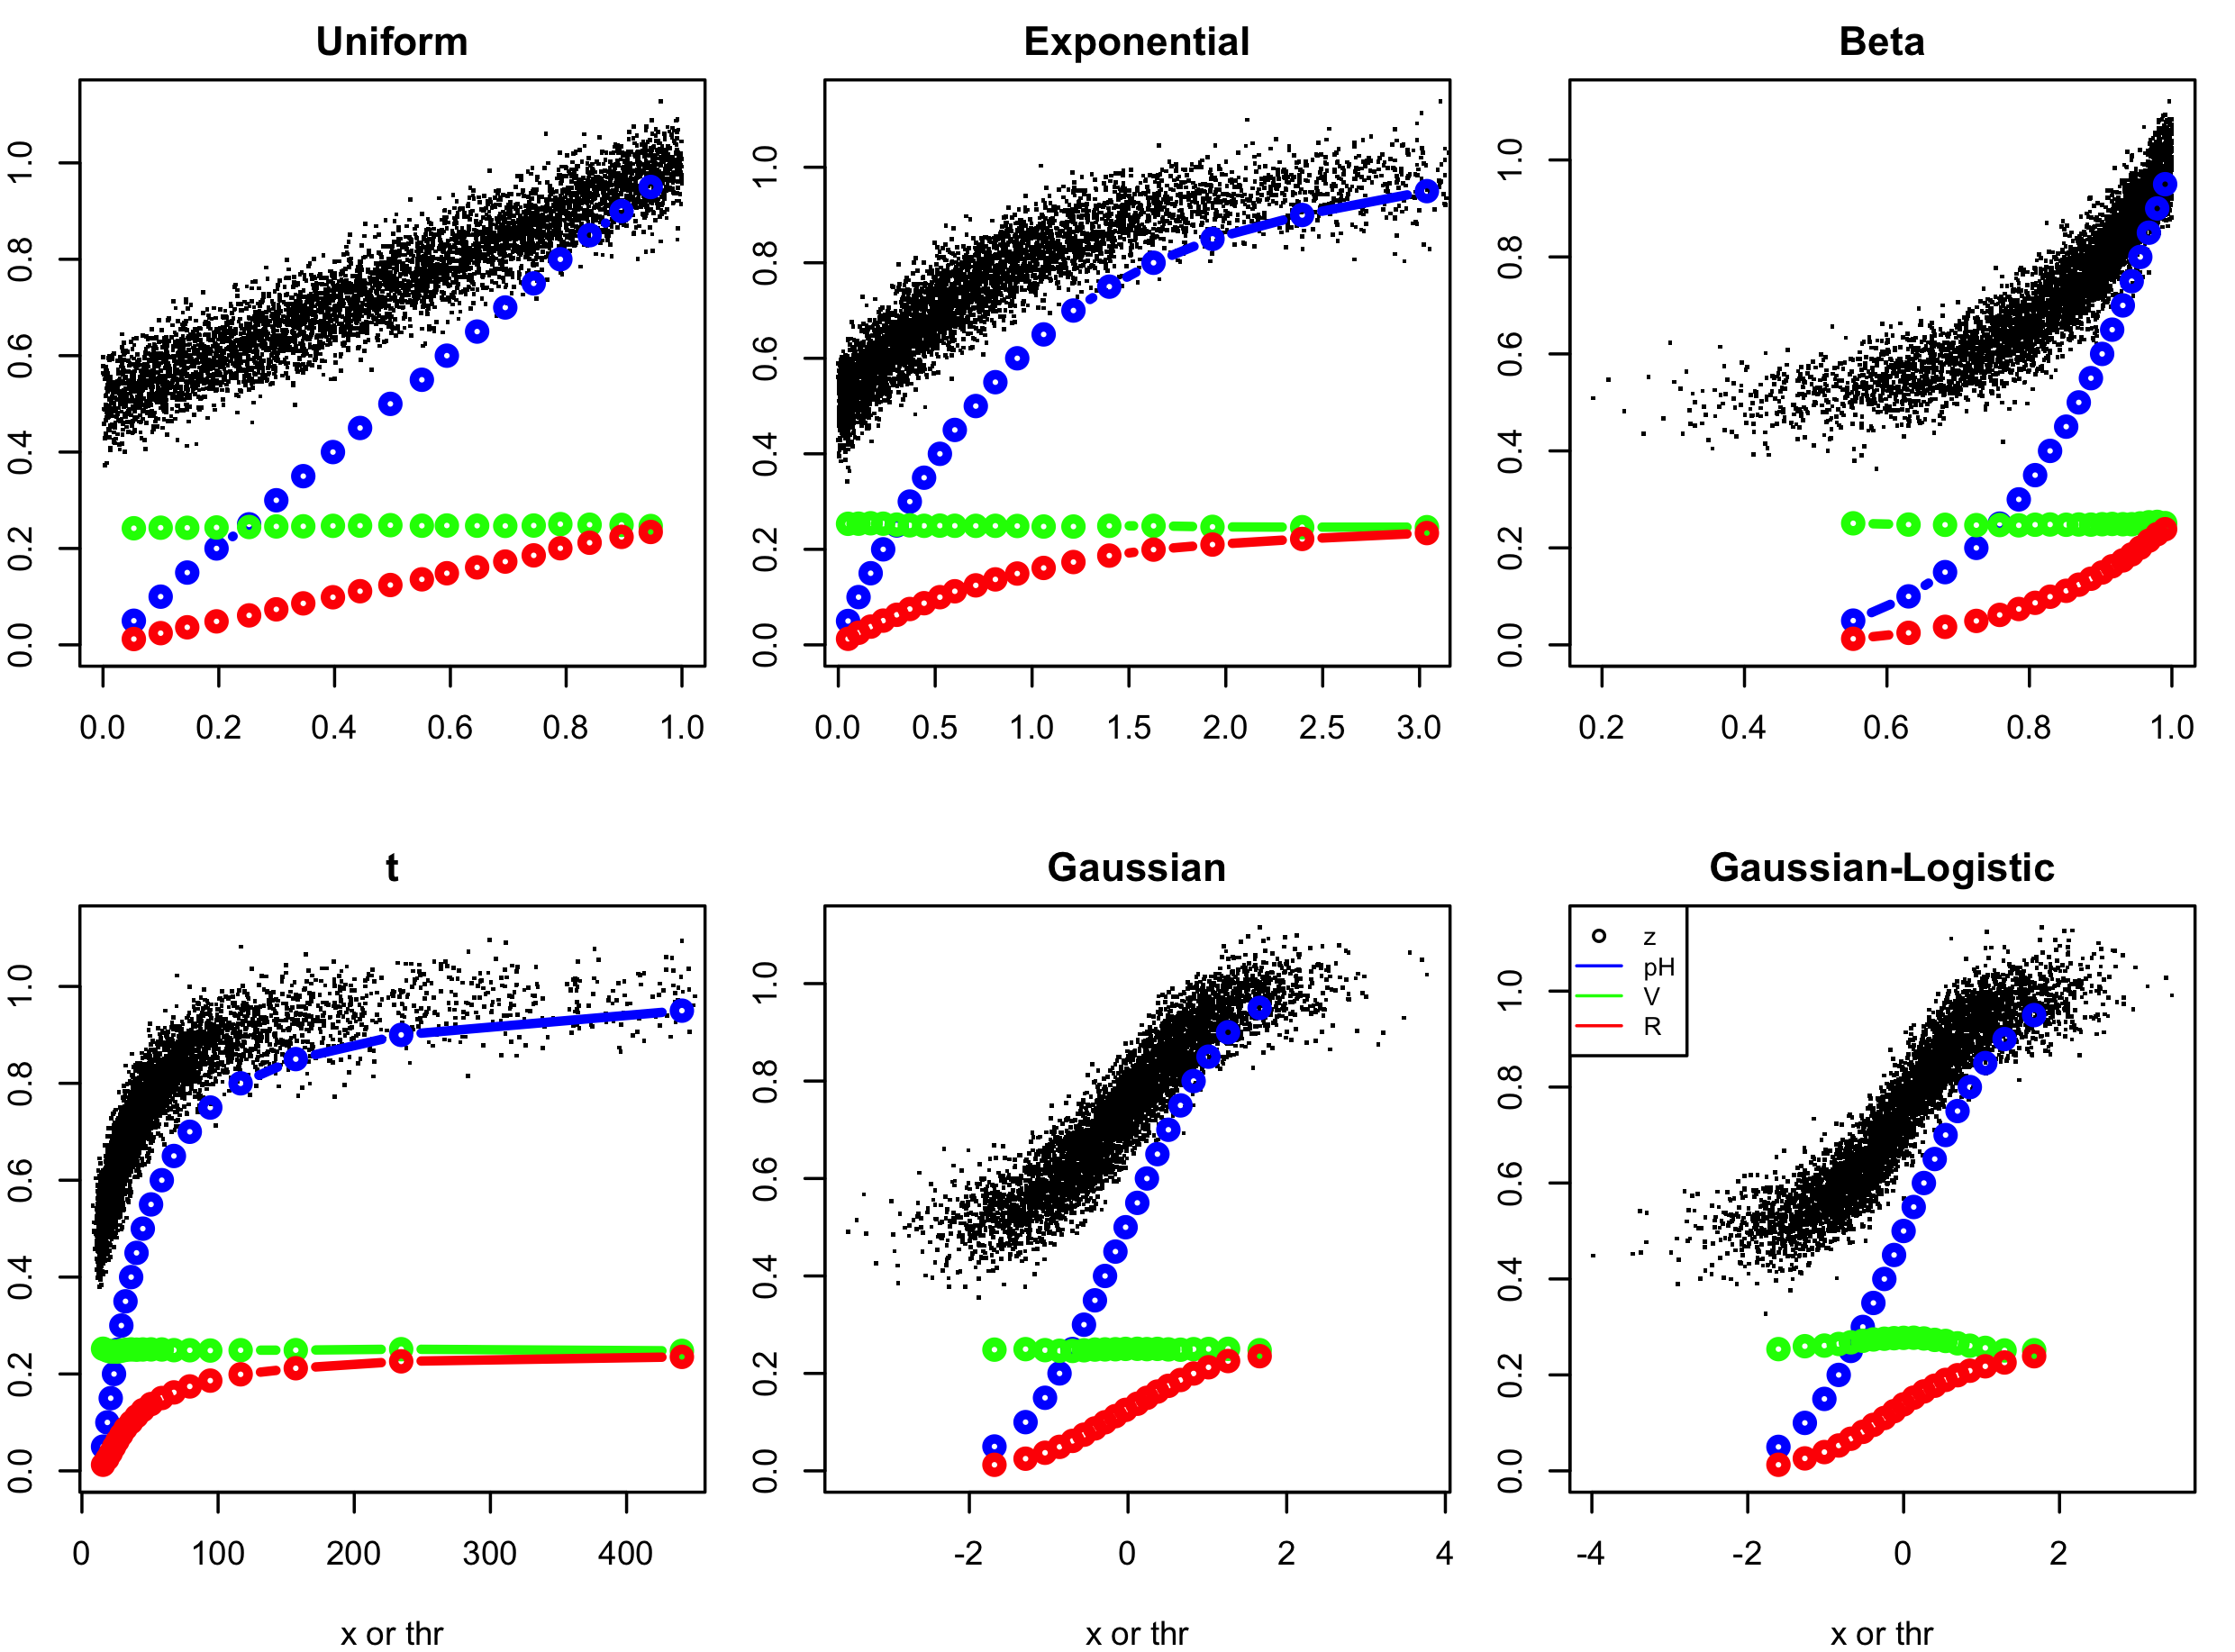
Single-threshold PRA on the six datasets

Slide 63
EXERCISE
What kind of figures do you expect to see if we carry out multi-threshold PRA on these six datasets, using the same 19 threshold levels to define our x-intervals?
Would V still be constant, i.e. independent of the x-interval?
How would p[H] vary between the intervals?

Slide 64
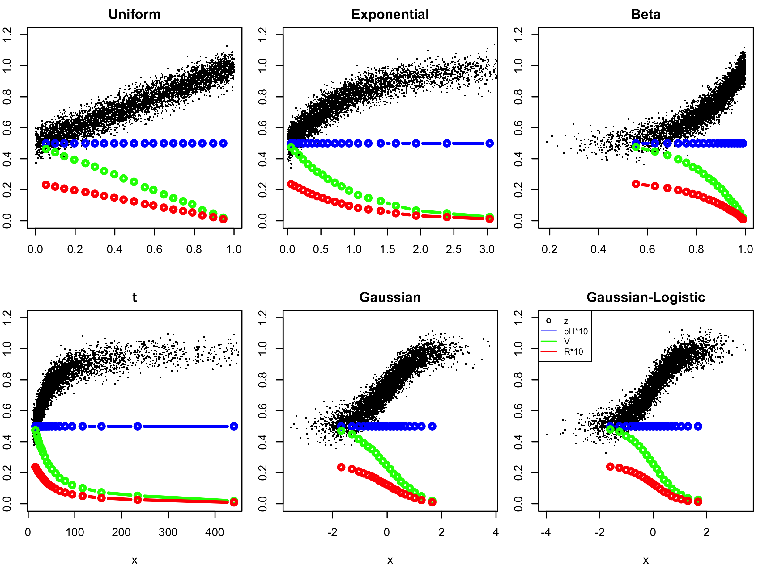
Multi-threshold PRA with equal-p[H] intervals

Slide 65
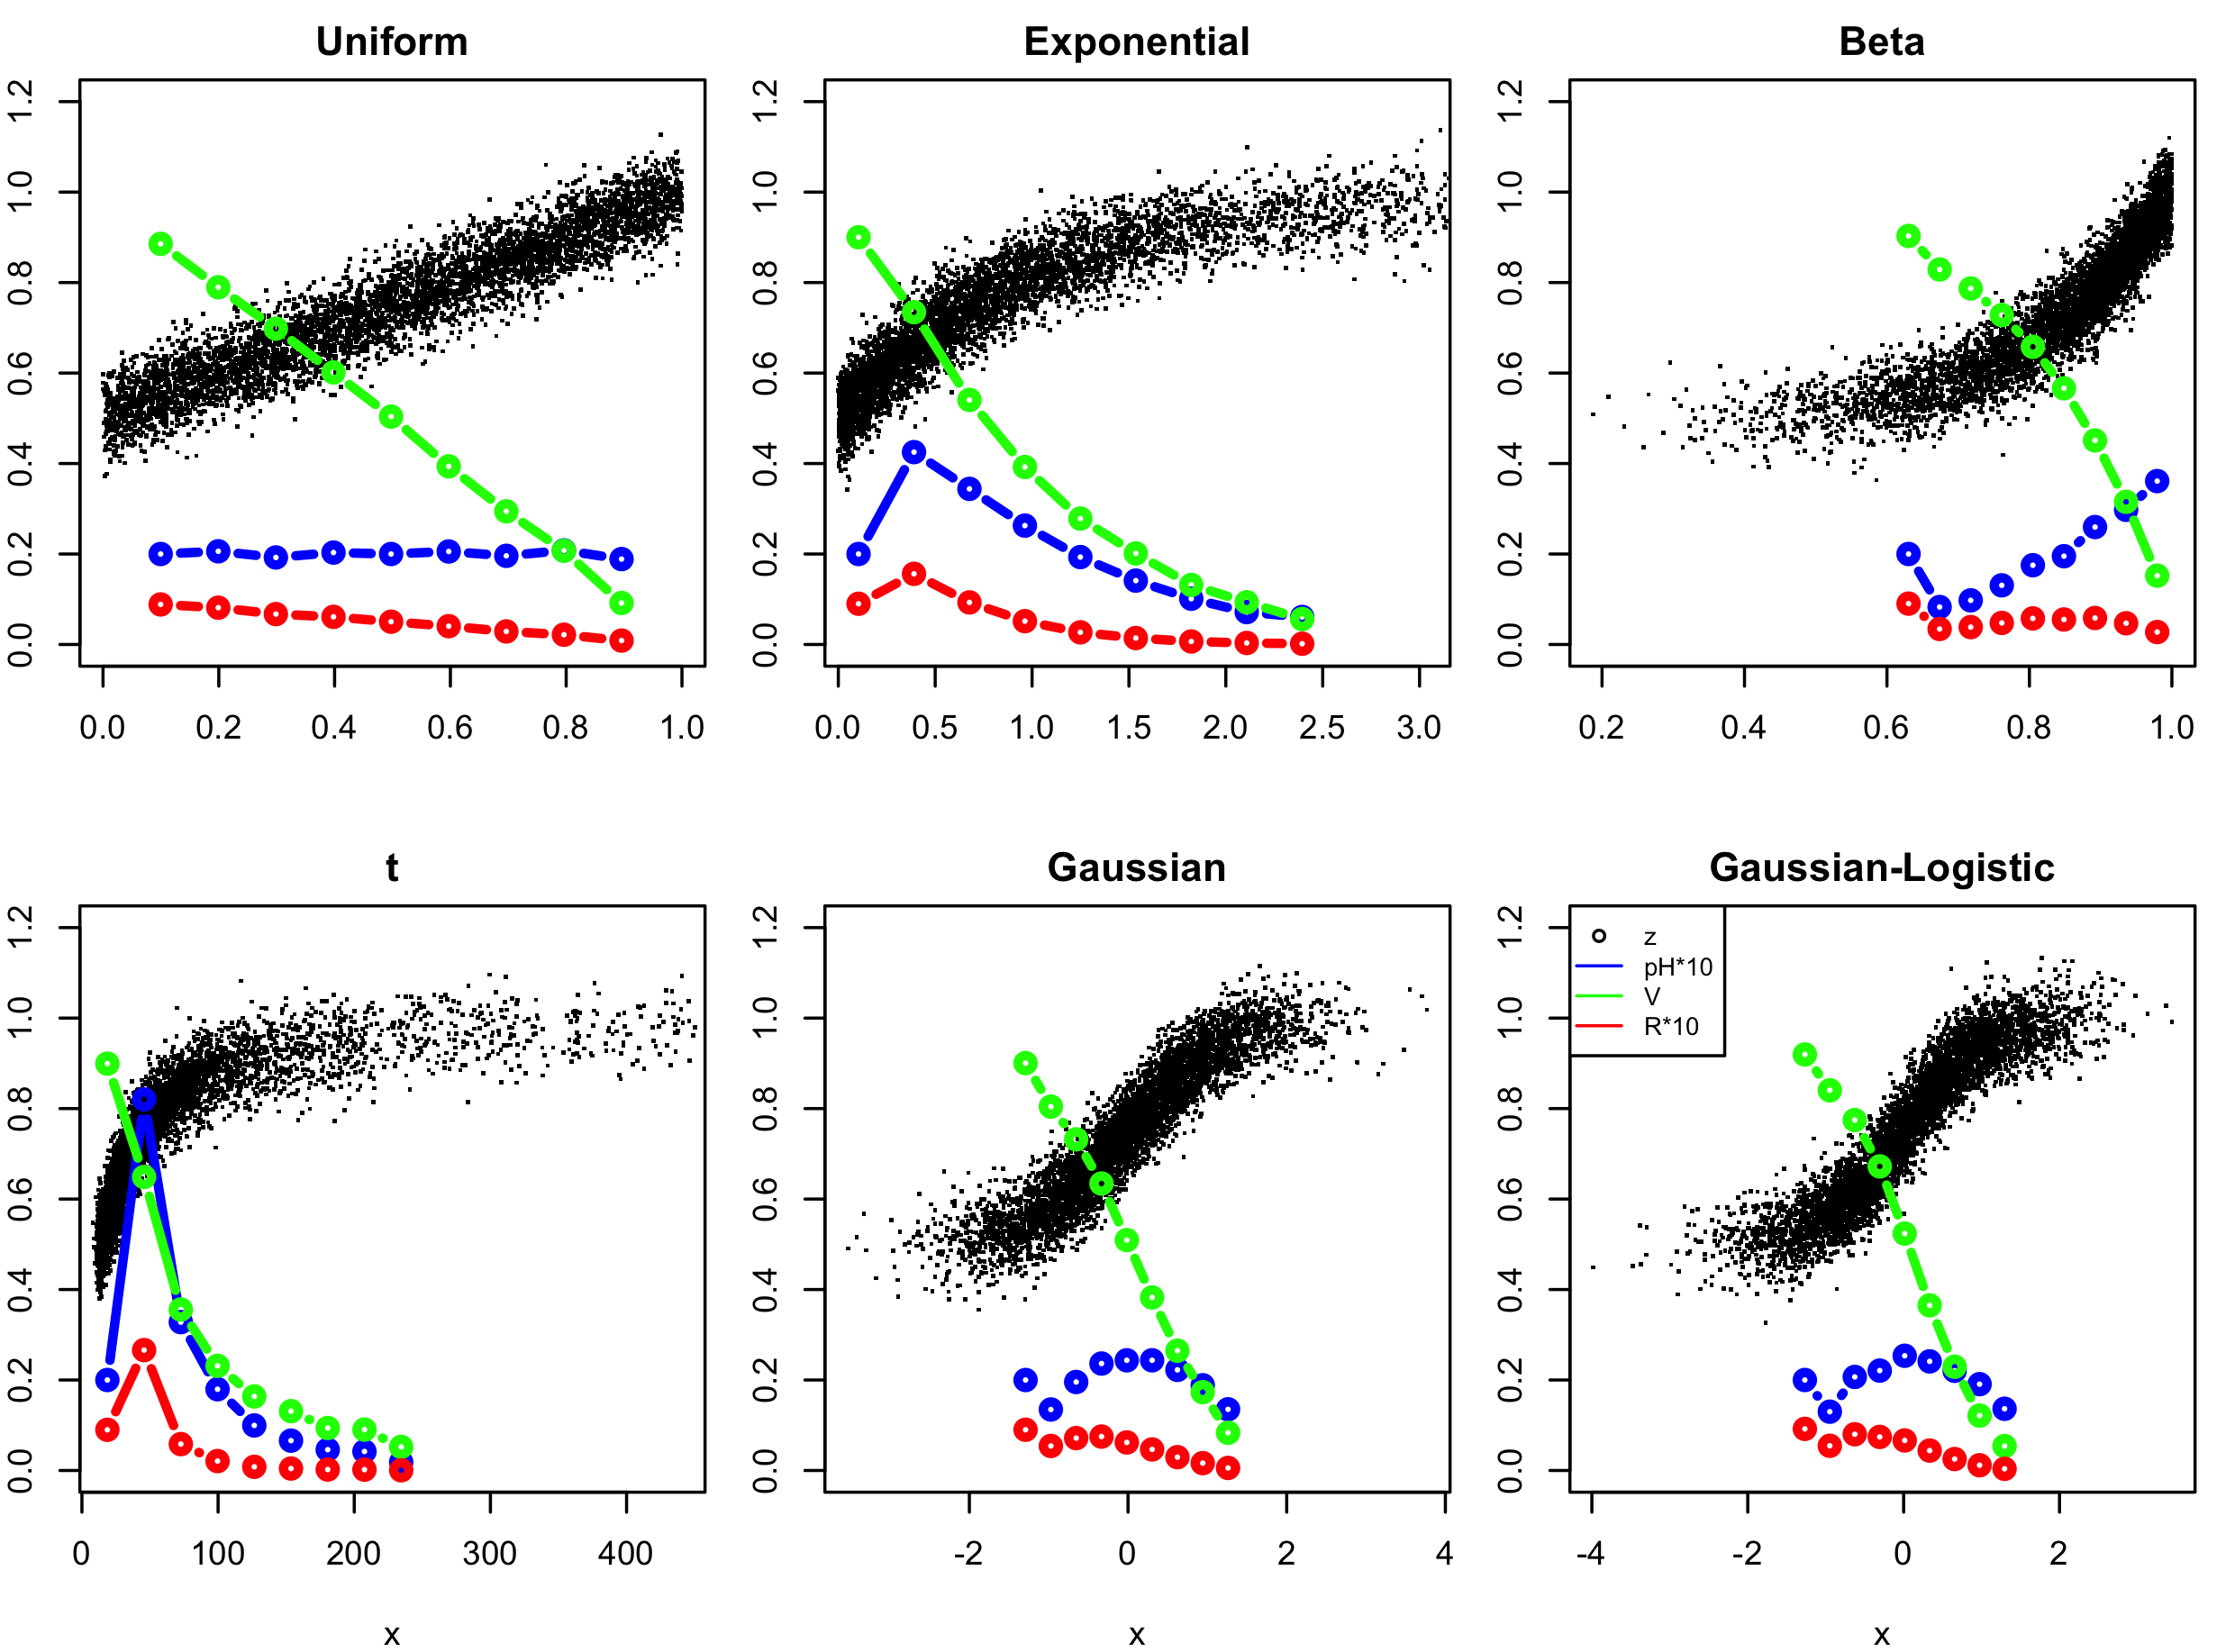
Multi-threshold PRA with equal-x-width intervals

Slide 66
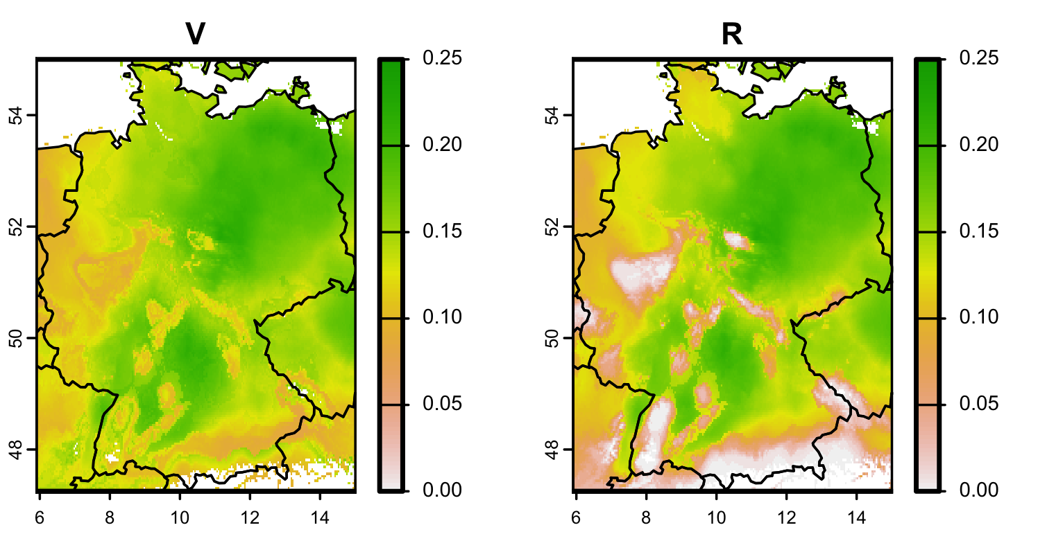
Absolute or relative?
Absolute units (m³ ha⁻¹ y⁻¹, kg, €, £, …)
Relative units (%)

