Slide 1
How randomisation trumps deterministic approach: an example in code cracking

Slide 2
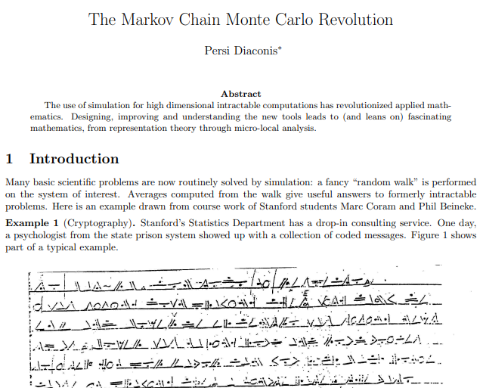
Reference
Diaconis, P., 2009. The Markov chain Monte Carlo revolution. Bulletin of the American Mathematical Society, 46(2), pp.179-205.
Notes:
An oldie back from my days of undergraduate course work – this paper was shown in our class as an example of MCMC

Slide 3

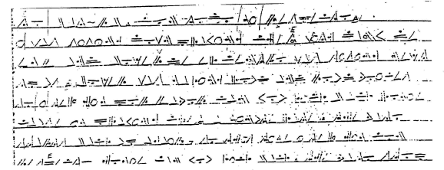
Background
Prison psychologist approaches Stanford statisticians with a coded message from prison inmates

Slide 4
Problem
Prison psychologist approaches Stanford statisticians with a coded message from prison inmates
Asks to decode it
Notes:
This is from an American state prison, so the language is English. There are white spaces between the characters and several characters are repeated.
Assuming each character represents an English letter, the deterministic approach is to allocate each character a letter of the English alphabet and check if it makes sense

Slide 5
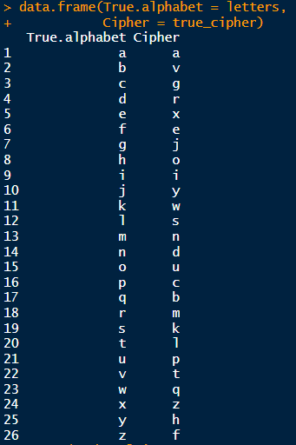
Create a cipher
Notes:
Example of random permutation for a cipher.
Note!!!
It’s a permutation problem, as the order of the letters matter – not a combinatorial problem.
Therefore, the problem is of the order of 26!

Slide 6
Create a cipher
Deterministic approach:
26! combinations to try
Or 4.0329e26
Takes a super computer ~11 years
Notes:
Example of random permutation for a cipher.
Note!!!
It’s a permutation problem, as the order of the letters matter – not a combinatorial problem.
Therefore, the problem is of the order of 26!

Slide 7
Code message
Notes:
Example to decipher for today: Shakesphere

Slide 8
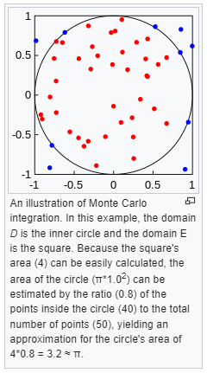
Markov Chain Monte Carlo (MCMC)
https://en.wikipedia.org/wiki/Monte_Carlo_integration

Slide 9
How MCMC will work:
Specifically: Metropolis-Hastings
Start somewhere random
Make a proposal
With some probability (information from the likelihood) either
Accept proposal
Reject proposal
Repeat 2. and 3.
Notes:
Example to decipher for today: Shakesphere

Slide 10
How MCMC will work:
Specifically: Metropolis-Hastings
Start somewhere random
Make a proposal
With some probability (information from the likelihood) either
Accept proposal
Reject proposal
Repeat 2. and 3.
Notes:
Example to decipher for today: Shakesphere

Slide 11

First: prepare likelihood
Need lots of English text
(500,000+ words will do)
We’re using R and want to download free book
Why?
Because combination
‘the’ = very likely
‘vzb’ = very unlikely
Notes:
Example to decipher for today: Shakesphere

Slide 12


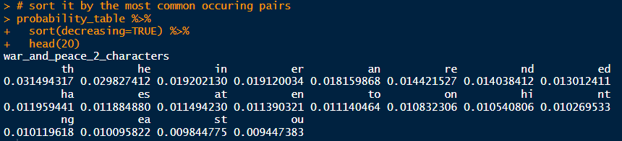
First: prepare likelihood
Notes:
Example to decipher for today: Shakesphere

Slide 13
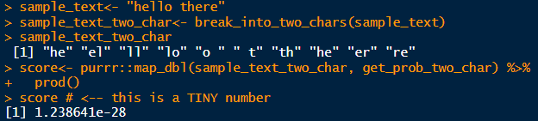

First: prepare likelihood
Log-likelihood
Notes:
Example to decipher for today: Shakesphere

Slide 14
How MCMC will work:
Specifically: Metropolis-Hastings
Start somewhere random
Make a proposal
With some probability (information from the likelihood) either
Accept proposal
Reject proposal
Repeat 2. and 3.
Notes:
Example to decipher for today: Shakesphere

Slide 15
How MCMC will work:
Specifically: Metropolis-Hastings
Start somewhere random
Make a proposal
With some probability (information from the likelihood) either
Accept proposal
Reject proposal
Repeat 2. and 3.
Notes:
Example to decipher for today: Shakesphere

Slide 16
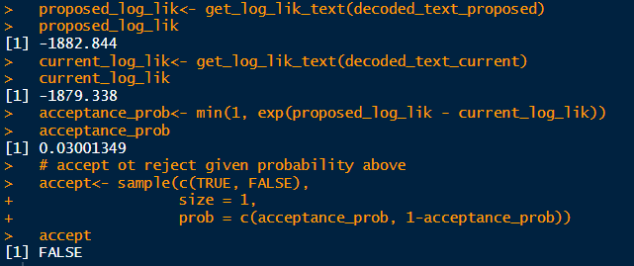
How MCMC will work:
Specifically: Metropolis-Hastings
Start somewhere random
Make a proposal
With some probability (information from the likelihood) either
Accept proposal
Reject proposal
Repeat 2. and 3.
Notes:
Example to decipher for today: Shakesphere

Slide 17
How MCMC will work:
Specifically: Metropolis-Hastings
Start somewhere random
Make a proposal
With some probability (information from the likelihood) either
Accept proposal
Reject proposal
Repeat 2. and 3.
Notes:
Example to decipher for today: Shakesphere

Slide 18
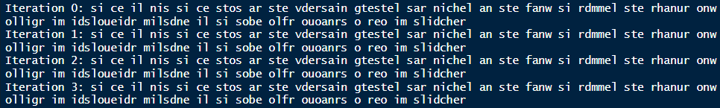
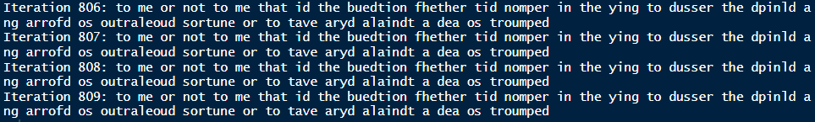
How MCMC will work:
Notes:
Example to decipher for today: Shakesphere

Slide 19
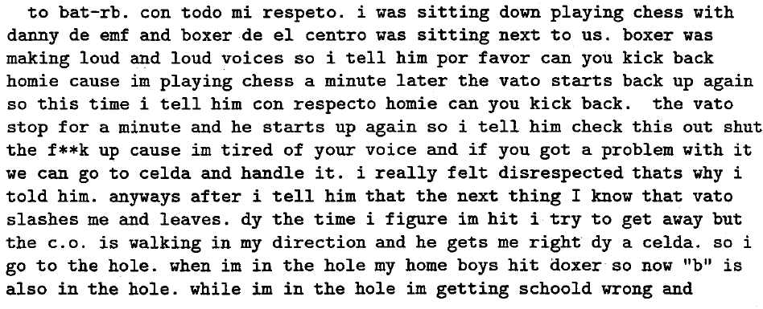
Back to Prison Problem
Notes:
This is from an American state prison, so the language is English. There are white spaces between the characters and several characters are repeated.
Assuming each character represents an English letter, the deterministic approach is to allocate each character a letter of the English alphabet and check if it makes sense

Slide 20
Thank you
Notes:
Example to decipher for today: Shakesphere

