Slide 1

YouTube Trending Dashboard
This interactive dashboard presents an analysis of trending videos on YouTube, focusing on categories, countries, and variation over time.
Author: Marcela Maris
Course: Data Analysis – TripleTen
02 July 2025

Slide 2
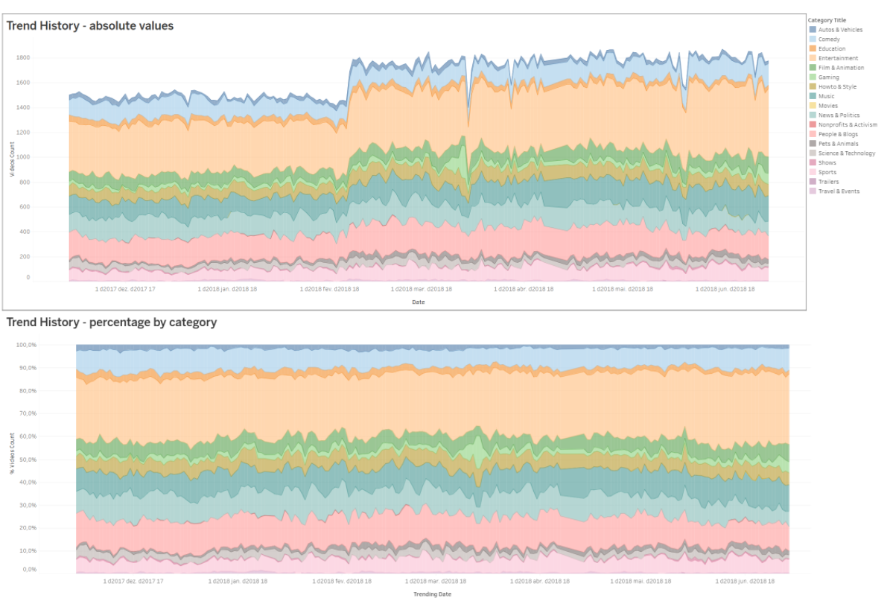
Trend History (Absolute & Percentage Views)
The top chart shows the total number of trending videos by category over time.
The bottom chart presents the same data as percentages, highlighting each category’s relative share.

Slide 3
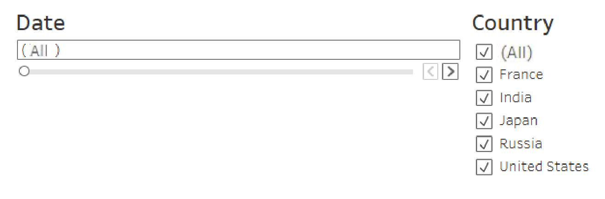
Filters and Interactivity
The dashboard includes two main filters:
Date filter: focus on specific time ranges.
Country filter: dynamically updates charts based on the selected country.
All visual elements respond simultaneously to these filters.

Slide 4
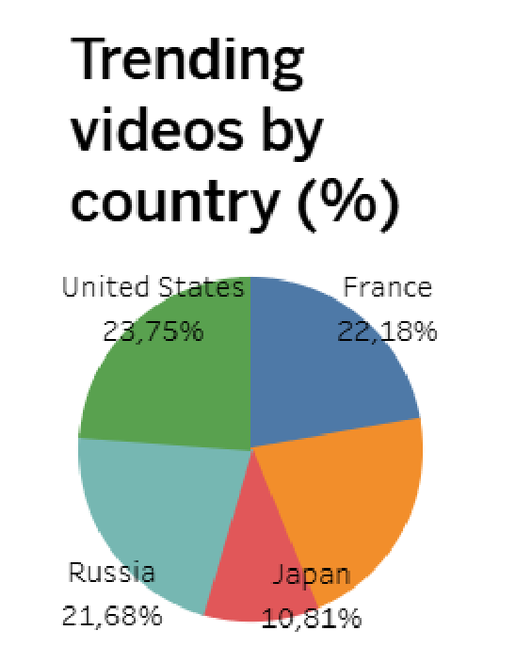
Trending Videos by Country
Displays the percentage distribution of trending videos by country.
Shows cumulative totals over the selected date range.
All visuals respond to the same date and country filters.

Slide 5
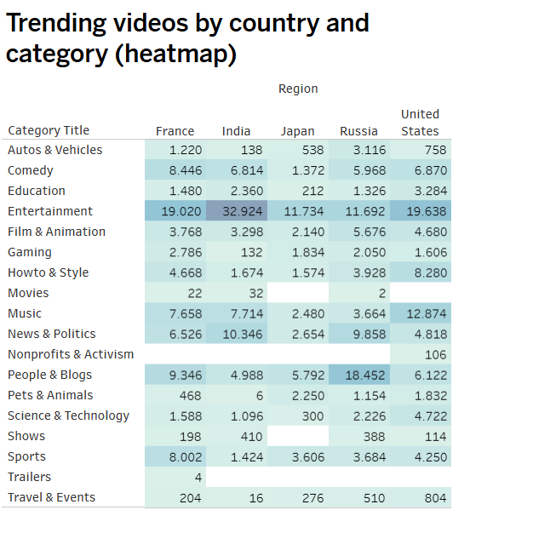
Trending Videos by Country and Category (Heatmap)
Shows the number of trending videos by category and country.
Colour intensity makes it easy to spot higher or lower values.
Helps compare the presence and popularity of categories across different regions.

Slide 6
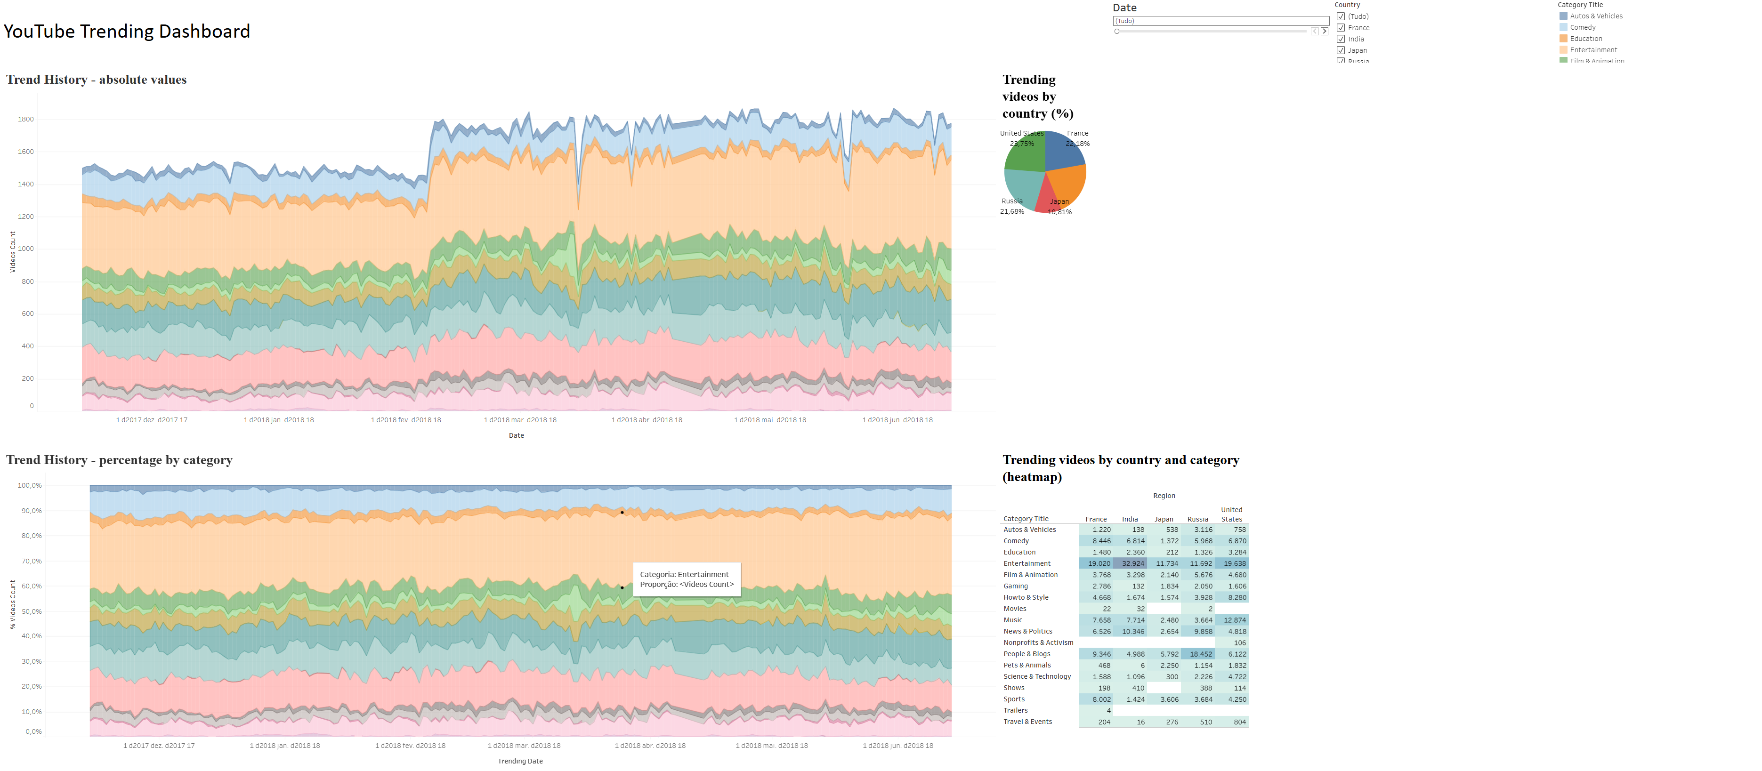
Answering the Initial Questions
Using data from November 2017 to June 2018:
1 - Which categories appeared most often in Trending?
2 - How were they distributed across countries?
3 - Which categories were especially popular in the United States, and how did that compare with other countries?

Slide 7

1 - Most Frequent Categories
Entertainment, Music, and People & Blogs were the most common categories in the Trending section.
Entertainment led globally, while Music maintained consistent visibility across all regions.

Slide 8
2 - Distribution by Country
United States & France: similar profiles dominated by Entertainment, Music, and People & Blogs.
India: strong peaks in Entertainment and notable presence of Education.
Japan: more diverse, with Gaming, Music, and Comedy taking the lead.
Russia: stable, with People & Blogs, Music, and News & Politics standing out.

Slide 9
3 - Categories Popular in the United States
Top categories in the US:
Music
Entertainment
People & Blogs
While similar categories trend globally, their proportions vary:
Music holds greater weight in the US.
Japan features more Gaming; India, more Education.
Russia shows stronger engagement in News & Politics.

Slide 10
Access the Dashboard
Explore the full dashboard with filters and charts on Tableau Public:
https://public.tableau.com/app/profile/marcela.stephanie.pereira.maris1628/viz/YoutubeTreendingDashboard-final/Dashboard1

