Slide 1


Brassicaceae microbiome response to insect herbivory: summarizing random forest, network analysis, and differential abundance
How I focus the discussion in
1 out of 1.111 taxonomic groups!
Pedro Beschoren da Costa
Marcela Aragón Gómez
Zulema Carracedo Lorenzo
Karen Kloth
Erik Poelman
Marcel Dicke
Postdoc - Entomology Department – Wageningen University (NL)

Slide 2
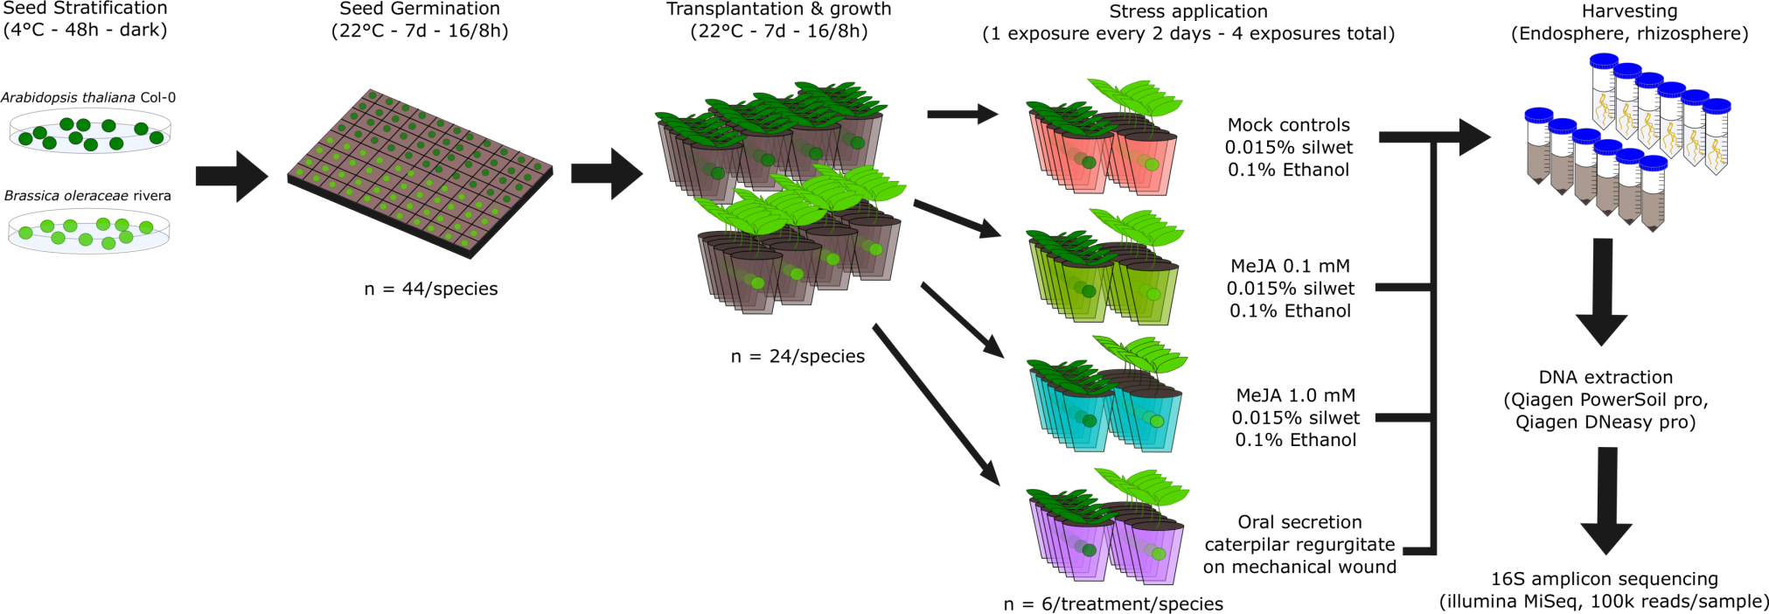
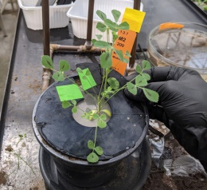
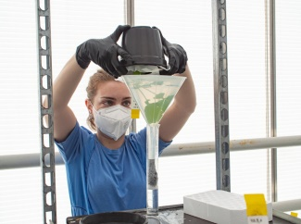
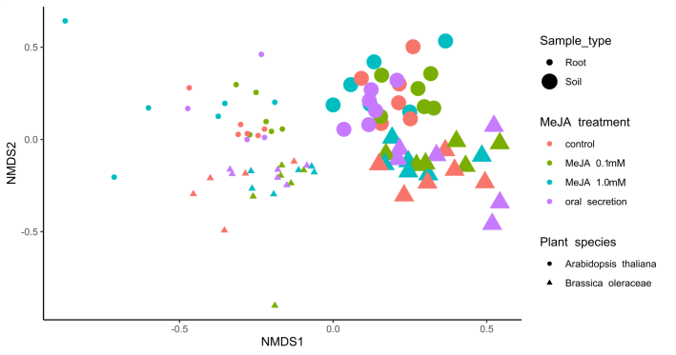
We exposed Arabidopsis and cabbage to herbivory stress…
Clear root/soil effect
Clear plant species effect
Subtle treatment effect
Dataset partitioned in 4
pedro.beschorendacosta@wur.nl

Slide 3
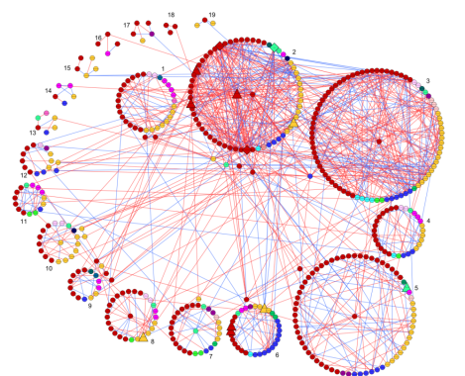
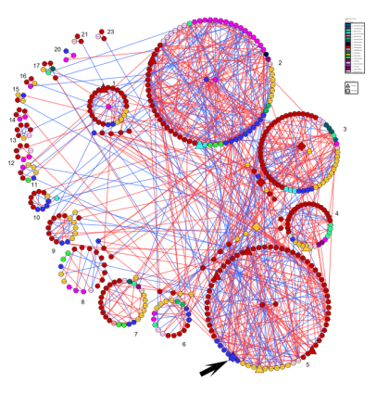
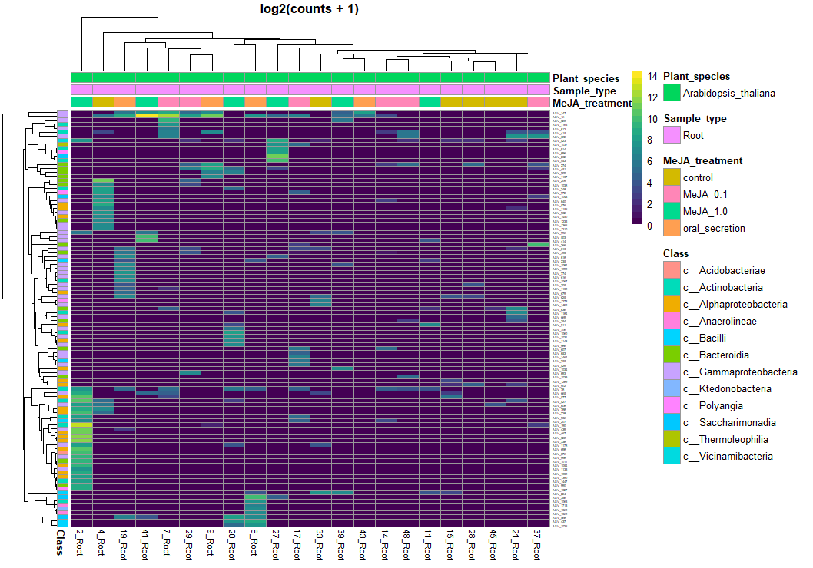
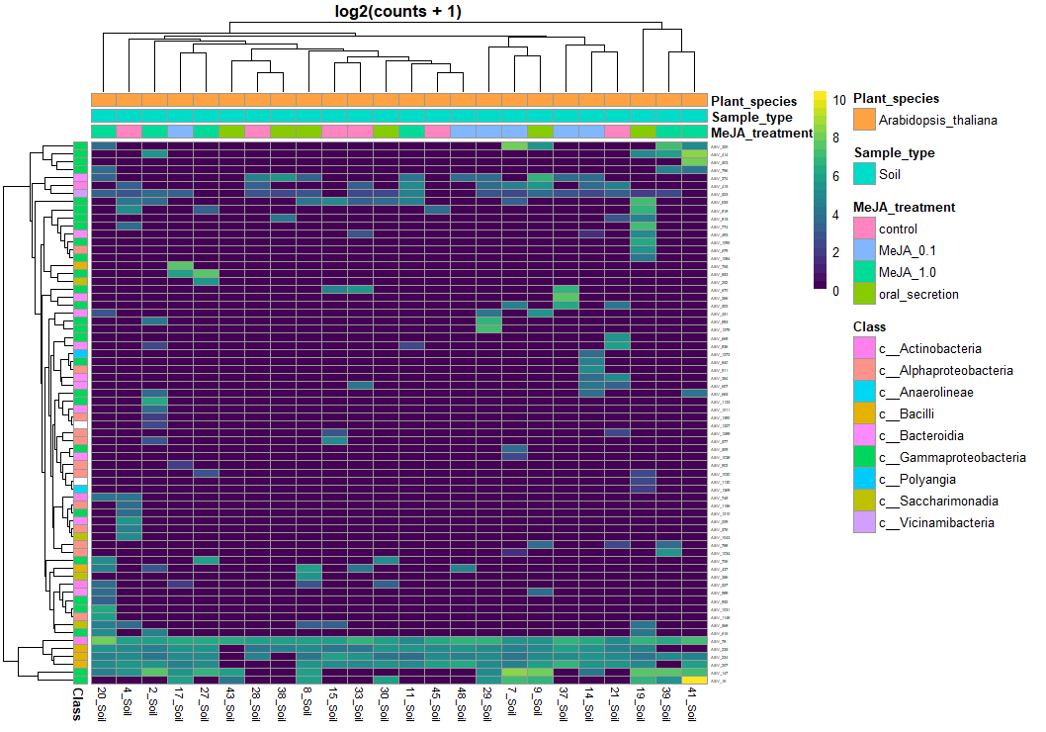
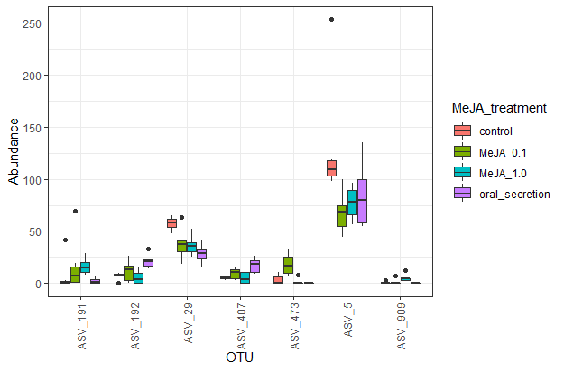
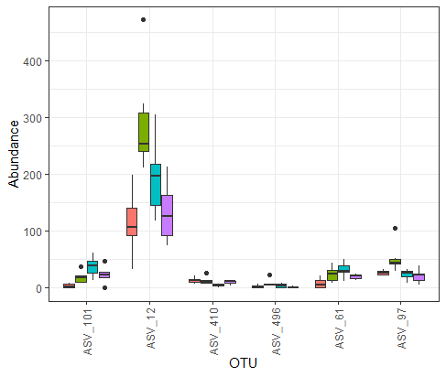
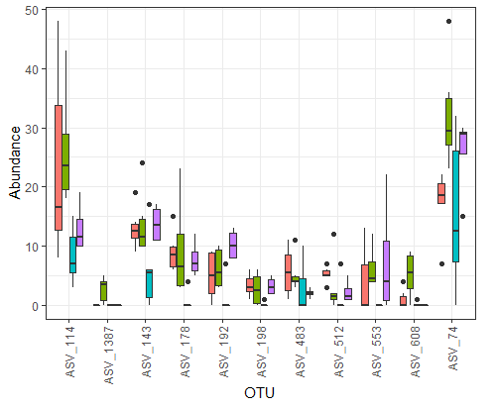
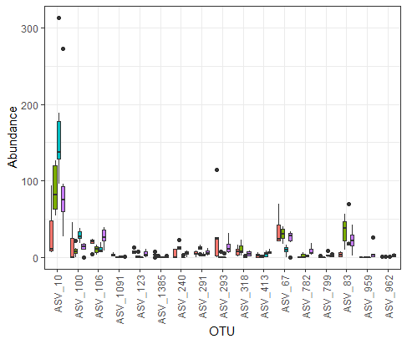
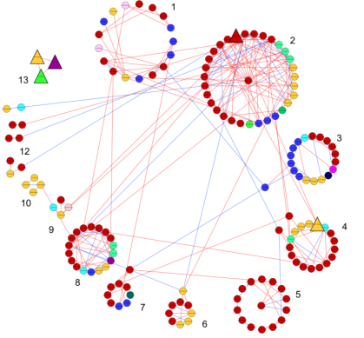
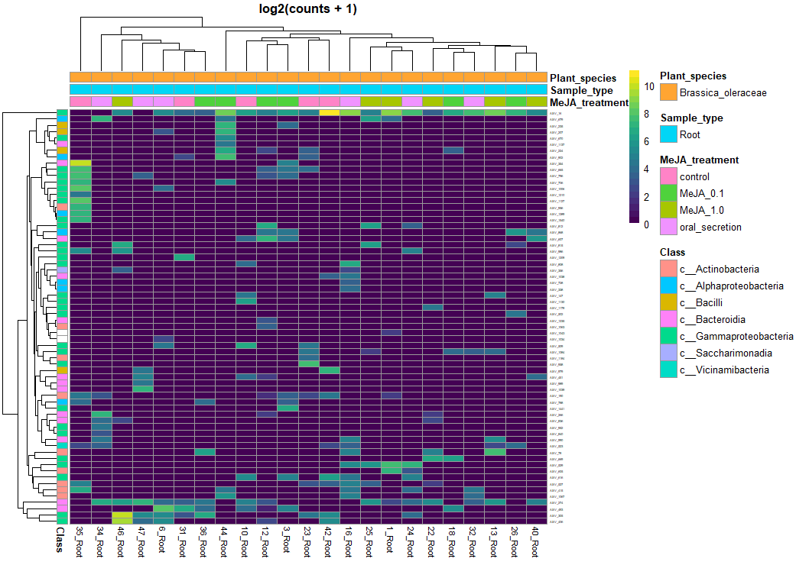
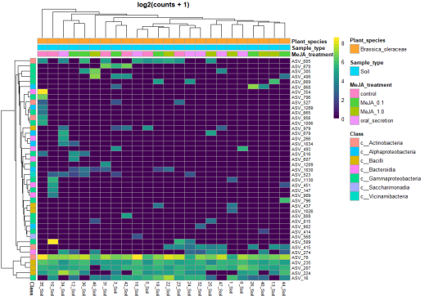
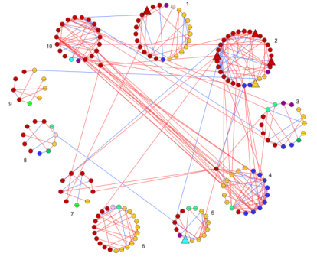
Many methods can highlight “important” taxa…
Random Forest
Network analysis
Differential abundance
41 ASVs
81 ASVs
224 ASVs
How to analyze a list of 350 ASVs that are tagged as “important”?
While there are many packages to run such methods, getting a conclusion of the full output is a challenge in our field!
pedro.beschorendacosta@wur.nl

Slide 4
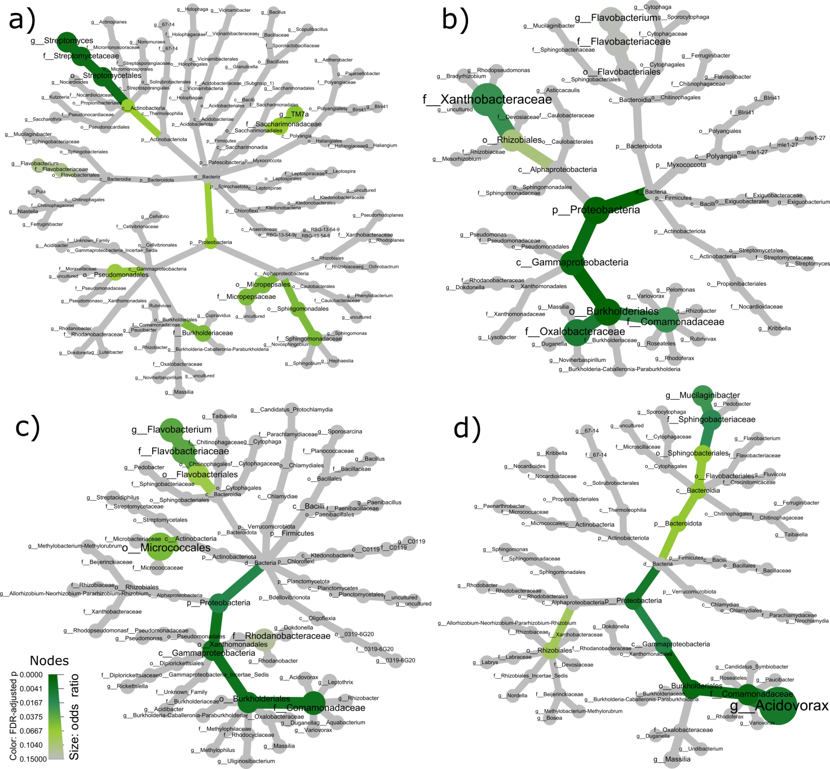
Summarizing output by comparing proportions
​Cabbage Rhizosphere | “Important” ​ASVs | Other ASVs | Total (R)​
Mucilaginibacter ASV​s | 5​ | 57​ | 62​
ASVs in other genus​ | 48​ | 2442​ | 2490​
Total (C)​ | 53​ | 2499​ | 2557​
A Fisher test shows a that the proportion of Mucilaginibacter is higher in the “important” ASV set than on “non-important” ASVs (p = 0.01061)
This is performed on all taxa groups
p values and odds ratio extracted & inserted in a heat tree
Relies on an automation routine that is easy to reproduce
Highlights family Comamonadaceae – common in plants & insect guts, they may have 2 hosts, like Enterobacter
Helps to focus discussion in 1 of 1.111 taxonomic groups!
Complete code fully available once published
pedro.beschorendacosta@wur.nl

Slide 5
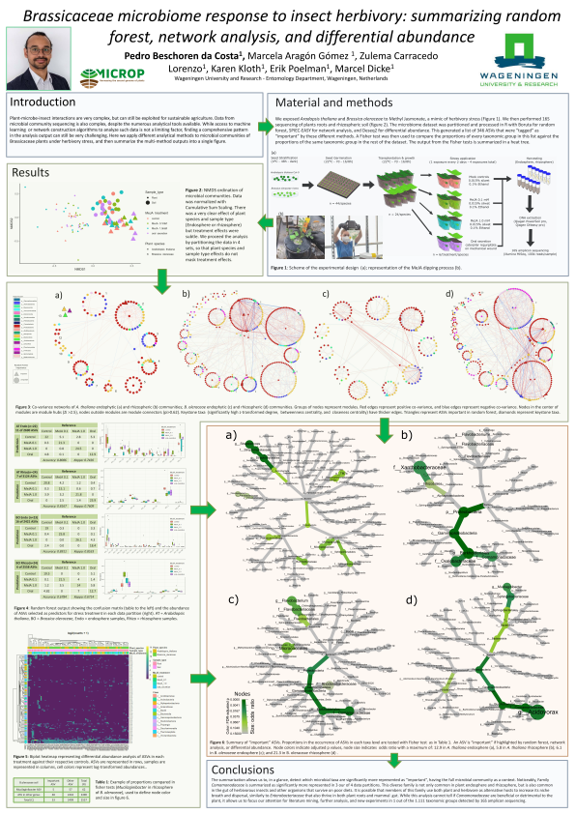
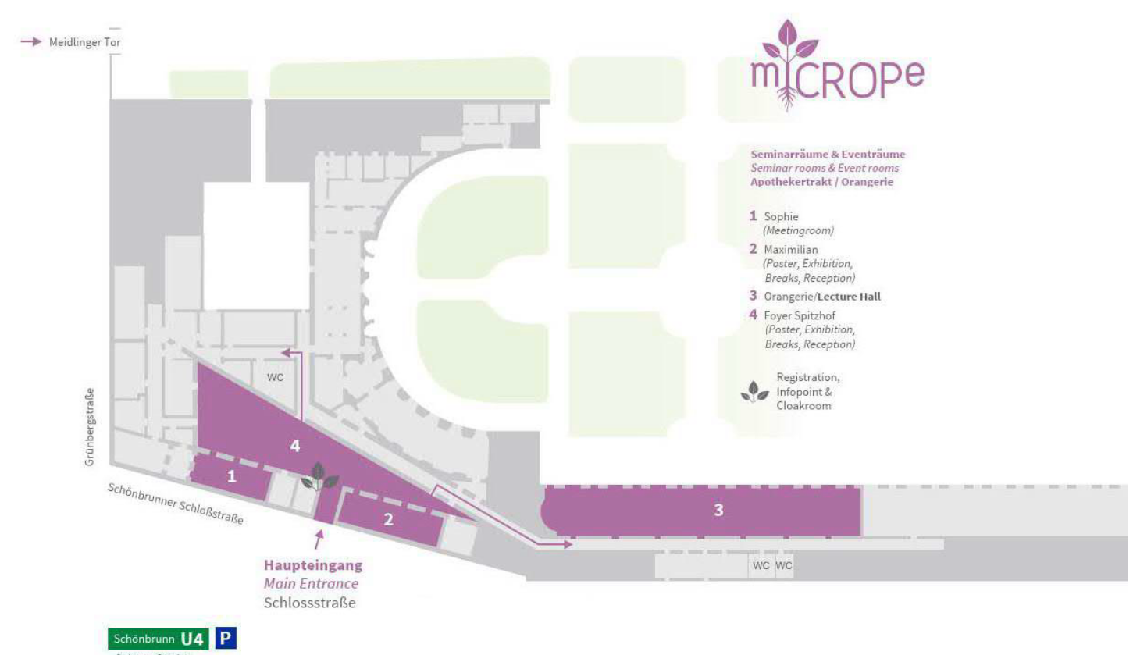
Come to discuss these topics!
Machine Learning & AI
Network Analysis
Family Comamonadaceae
Plant-to-gut microbiome relationships (human & insect)
Available on job market from Feb/2023!
Poster # PS2-S7-SF13
pedro.beschorendacosta@wur.nl

