Slide 1


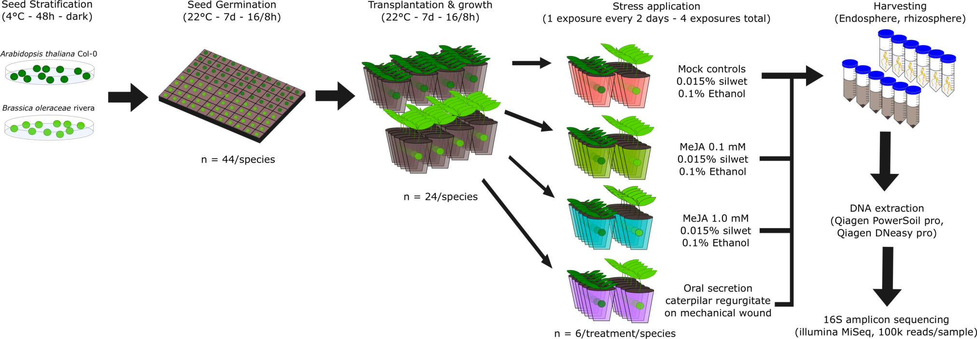
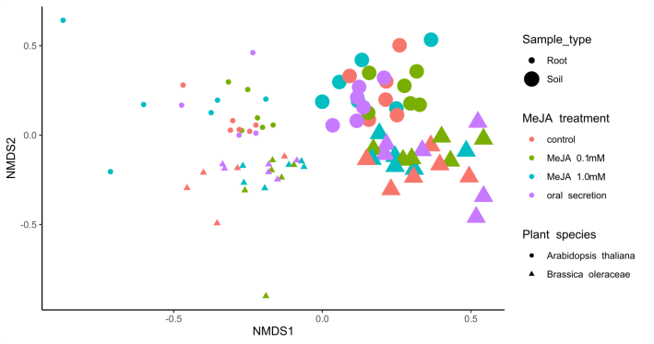
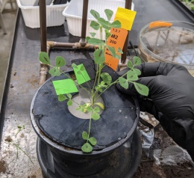
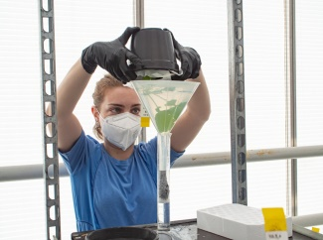
Brassicaceae microbiome response to insect herbivory: summarizing random forest, network analysis, and differential abundance
Pedro Beschoren da Costa
Marcela Aragón Gómez
Zulema Carracedo Lorenzo
Karen Kloth
Erik Poelman
Marcel Dicke
Entomology Department – Wageningen University
Clear sampling location effect
Clear plant species effect
Subtle treatment effect
Dataset partitioned in 4

Slide 2
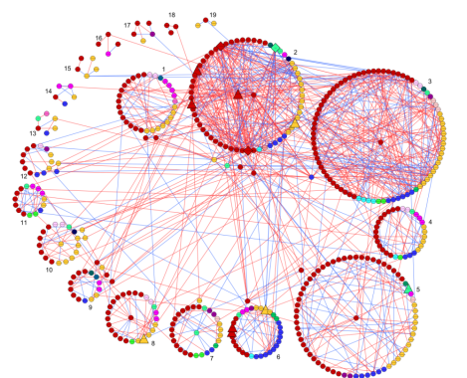
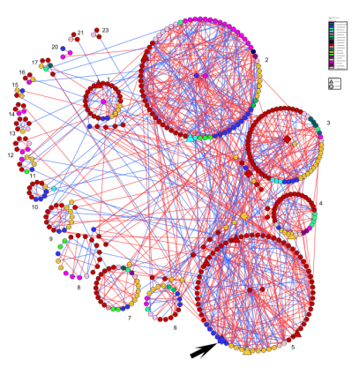
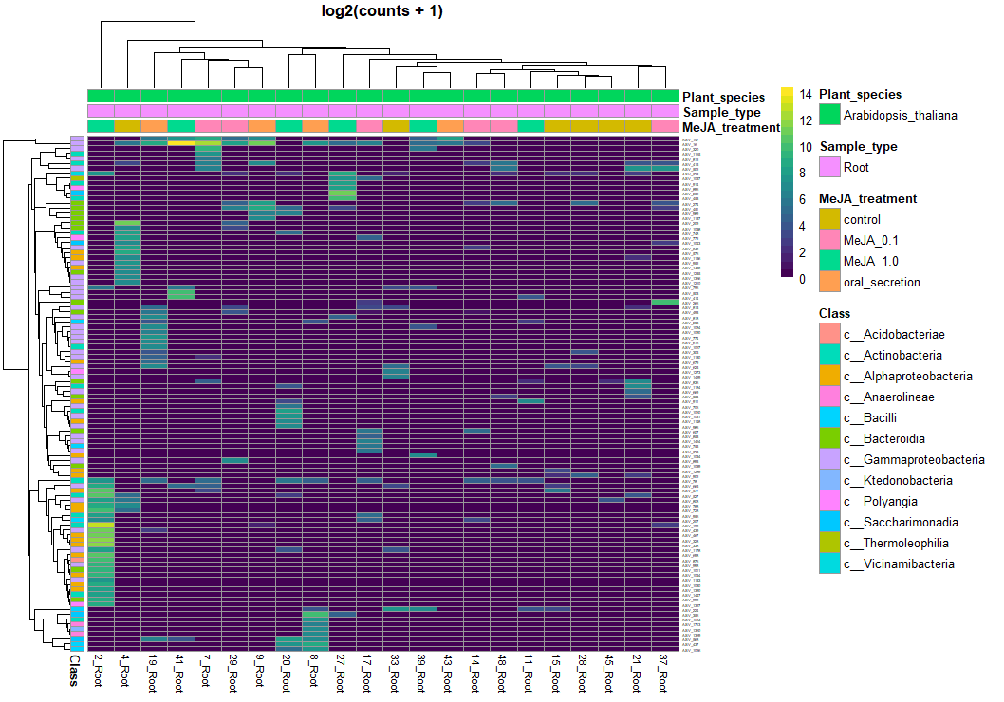
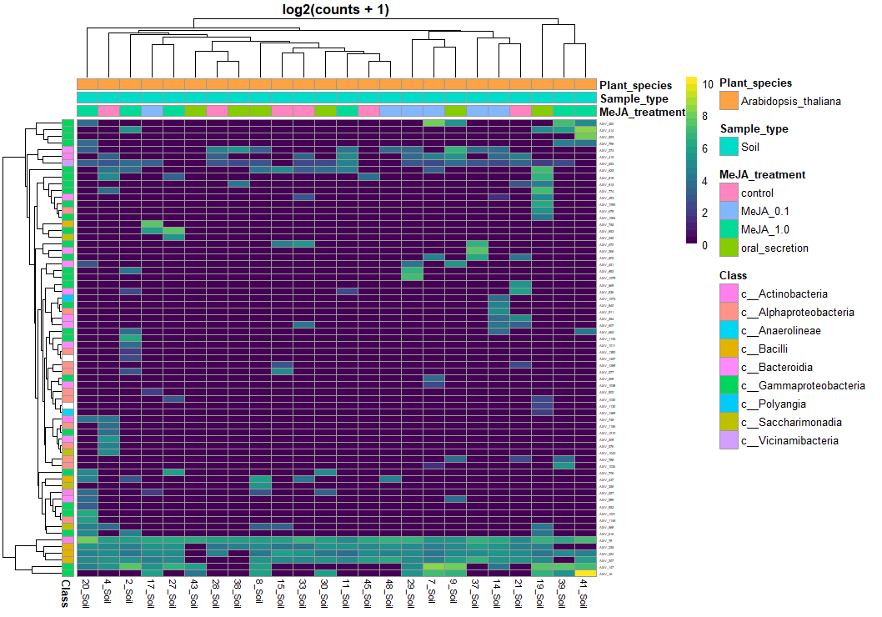
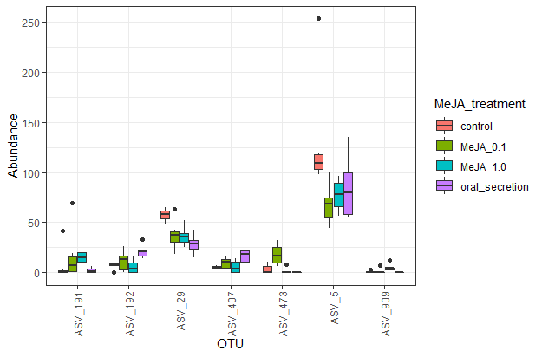
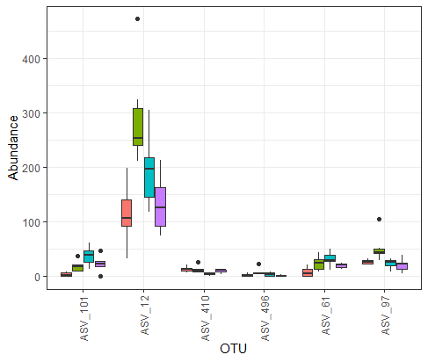
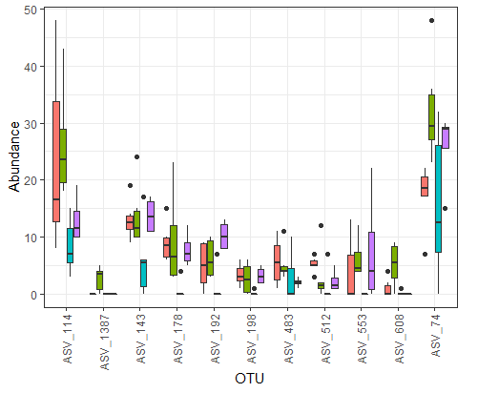
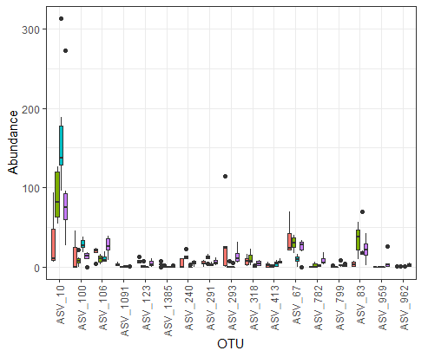
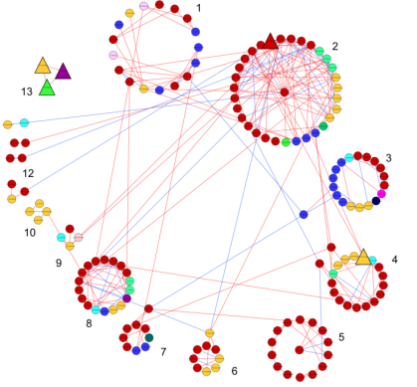
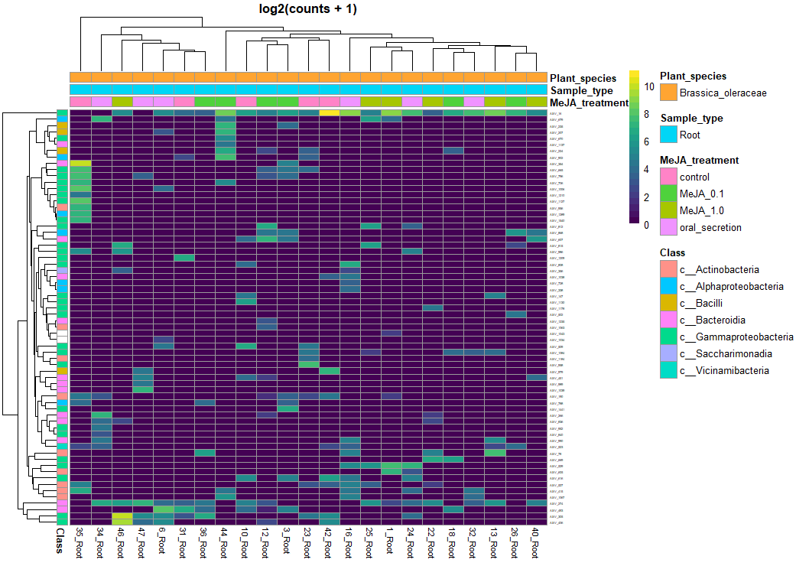
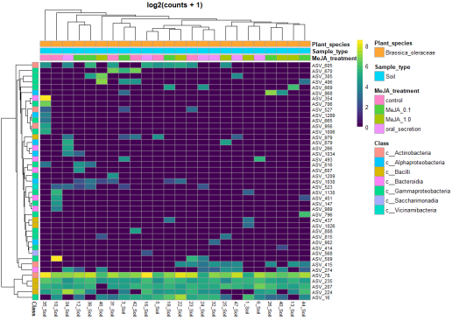
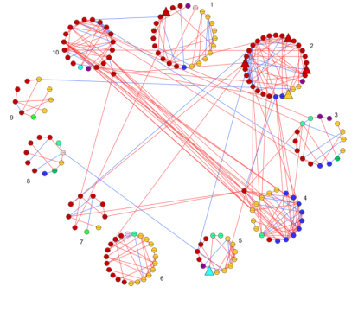
Many methods can highlight “important” taxa…
Random Forest
Network analysis
Differential abundance
41 ASVs
81 ASVs
224 ASVs
How to analyze a list of 350 ASVs that are tagged as “important”?
While there are many packages to run any of these 3 methods, getting a conclusion of the full output is challenging!

Slide 3
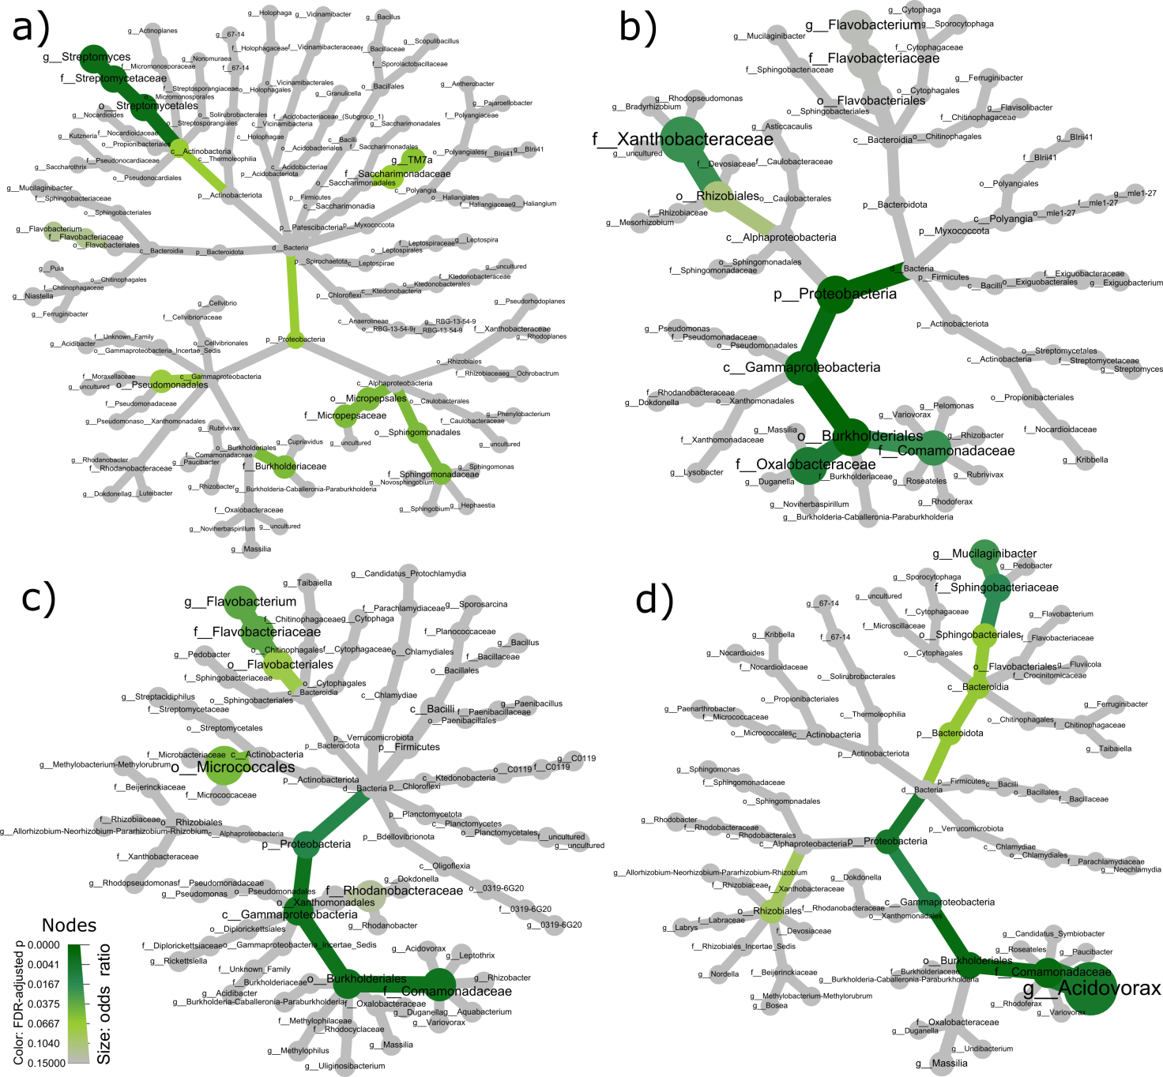
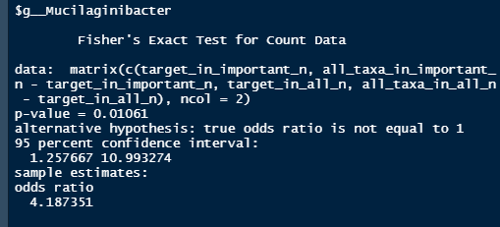
Summarizing output by comparing proportions
​B.oleraceae Rhizosphere | Important ​ASV ​​ | Other ASV | Total (R)​
Mucilaginibacter ASV​ | 5​ | 57​ | 62​
ASV in other genus​ | 48​ | 2442​ | 2490​
Total (C)​ | 53​ | 2499​ | 2557​
Uses the automation routine I’ve shown – split, analyze, extract key information, summarize
Highlights family Comamonadaceae – common in plants & insect guts, they may have 2 hosts, like Enterobacter
Helps to focus discussion in 1 of 1.111 taxonomic groups!
Complete code fully available to all MICROP PhDs!

