Slide 1

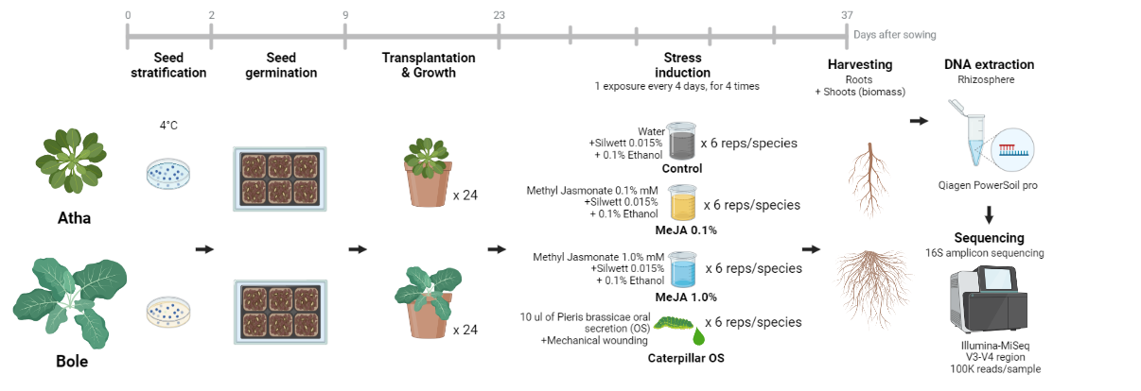
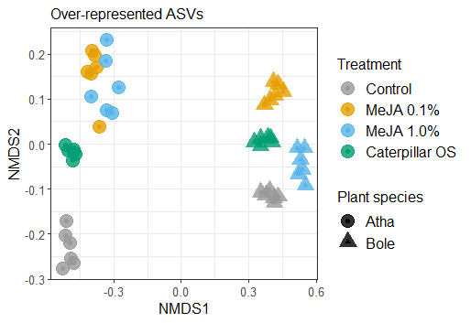
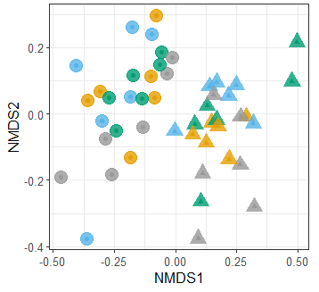


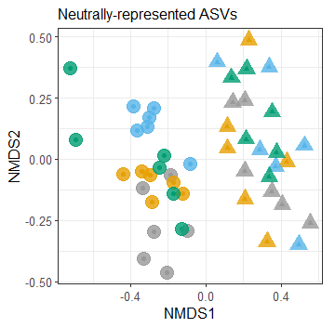

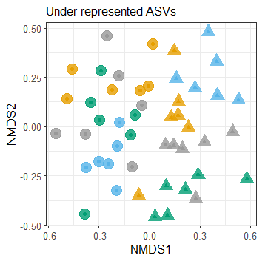

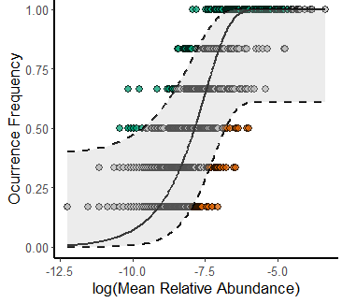
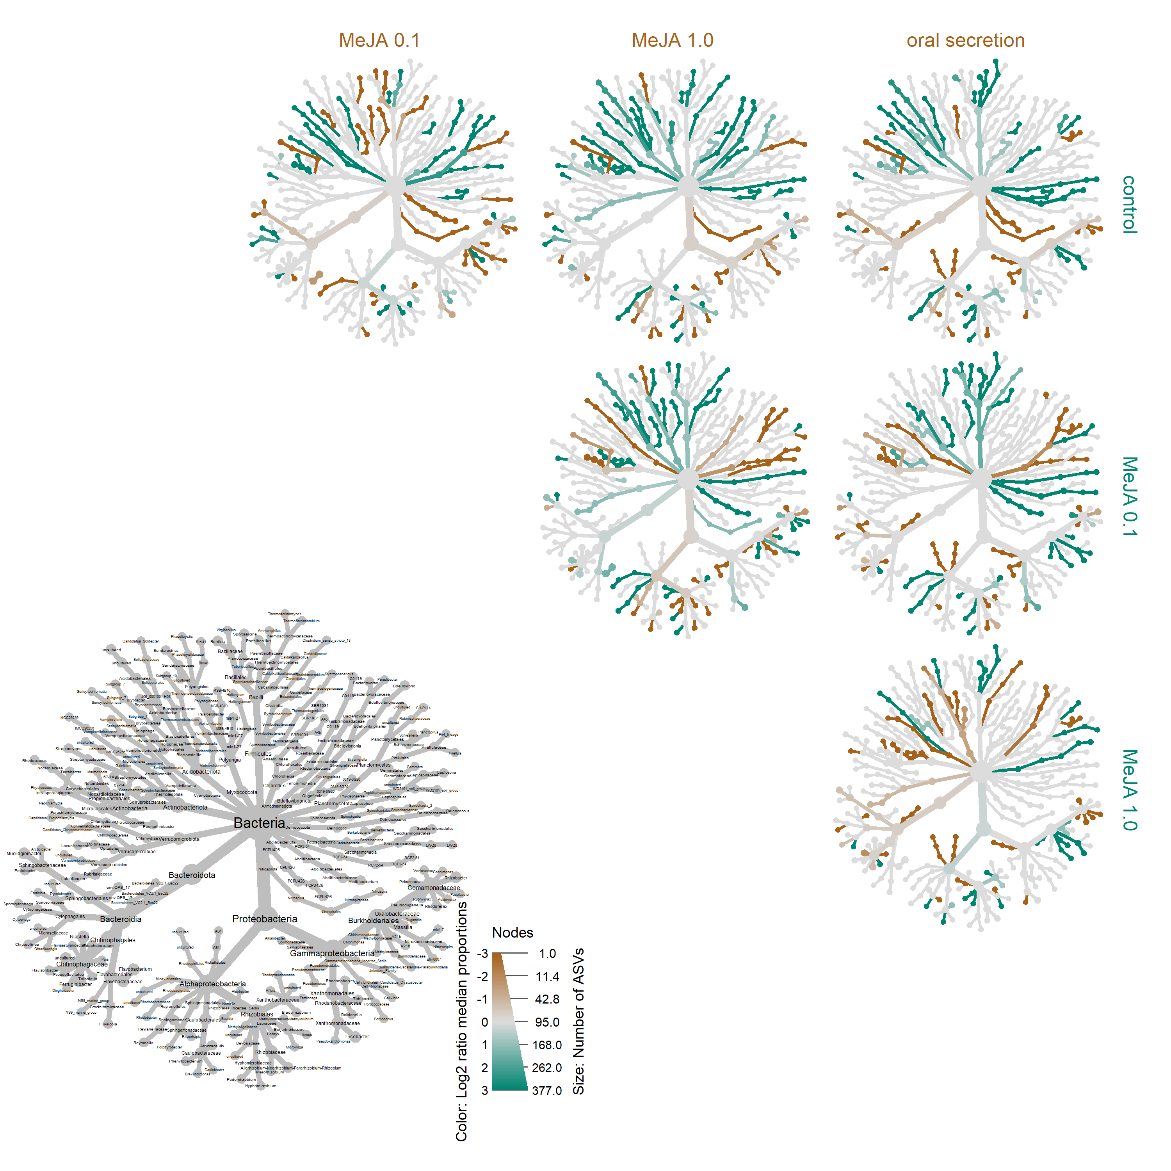
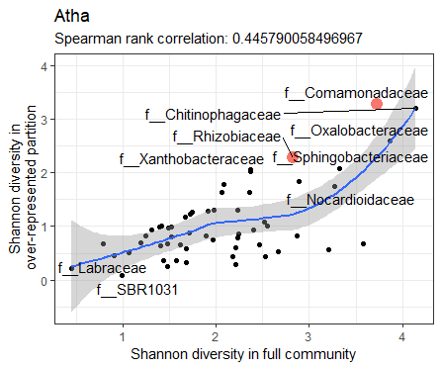

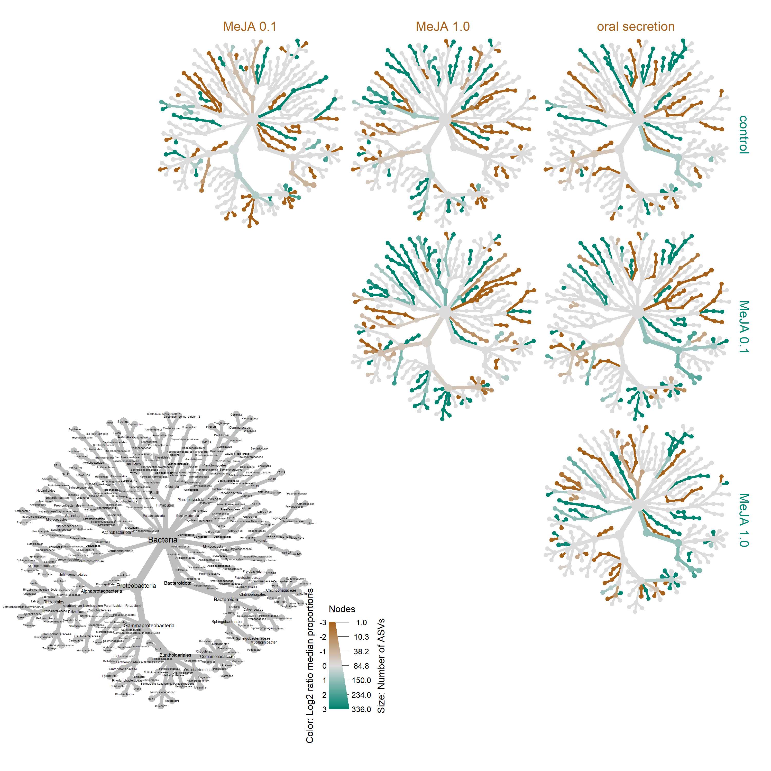
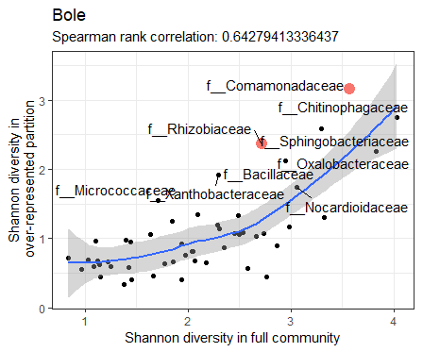



Brassicaceae microbiome response to insect herbivory: using a neutral community model to explore over-represented taxa
.
Marcela Aragón Gómez ¹ , Pedro Beschoren da Costa¹, Zulema Carracedo Lorenzo¹,
Karen Kloth¹, Erik Poelman¹, Marcel Dicke¹
¹ Laboratory of Entomology, Wageningen University and Research, The Netherlands
Introduction
Materials and Methods
As a possible mechanism to cope with insect herbivory stress plants could recruit beneficial microbes from the soil as a ‘cry for help’ strategy¹.The latter implies that microbial taxa with stress-suppressive functions need to be actively and positively selected by different plant species². One approach to explore which microbes might be under selection, is to determine how neutral and non-neutral processes structure communities according to a Neutral Community Model (NCM)^{3.}
The NCM predicts the frequency of each microbe in a given local community to the average relative abundance from a metacommunity. Microbes that fit the prediction of the NCM are inferred to have assembled neutrally from the metacommunity, while microbes that are over-represented are inferred to be structured by non-neutral processes such as host selection, amongst others⁴.
Figure 1. Scheme of experimental design.
Figure created in Biorender.com
We exposed Arabidopsis thaliana (Atha) and Brassica oleracea (Bole) plants growing on the same type of soil to two concentrations of Methyl Jasmonate (MeJA) to mimic insect herbivory stress and used oral secretion (OS) from Pieris brassicae caterpillars as a negative control. We then performed 16S amplicon sequencing of plant roots (Fig. 1). The microbiome dataset was partitioned and processed in R using phyloseq to calculate beta diversity (Fig. 2) and tyRa package to model and plot the fit to the NCM. Each of the 4 treatments was used as a local community and the pool of them was used as a metacommunity to fit the NCM (Fig. 3a) and obtain neutral and non-neutral partitions (over- and under-represented ASVs) (Fig 3b). From the subset of taxa predicted to be above expected the metacoder package was used to visualize pairwise differential abundance for every taxon and detect diversity hotspots (Fig. 4). To test if such hotspot taxa were not diverse in the over-represented subset simply because they were also more diverse in the base dataset, Shannon diversity of the subset was fitted against the total ASV pool (Fig 5).
Results
Clear plant-species effect, but no stress-effect on root microbial community composition in full community
Only over-represented taxa show a clear response to stress compared to neutrally- and below-represented taxa
a)
b)
Metacommunity
.. V ..
Local
communities
Factors: | p | R2
Treatment | 0.193 | 0.06
Plant Species | 0.001 | 0.14
T*S | 0.064 | 0.06
.. V ..
Control
MeJA 0.1%
MeJA 1.0%
Caterpillar OS
Factors: | p | R2
Treatment | 0.001 | 0.29
Plant Species | 0.001 | 0.40
T*S | 0.001 | 0.25
Figure 2. Non-metric multidimensional scaling (NMDS) ordination based on the Bray-Curtis similarity of the full community of Atha and Bole rhizosphere samples. Data was normalized with CSS.Table shows PERMANOVA results of significance (p) and explained variance (R2) of tested factors for 999 permutations.
Figure 3. Neutral community model (NCM) fit to obtain over-represented ASVs per treatment. a) schematic approach to fit the NCM for each treatment independently (local communities) using the full plant species community (metacommunity), red circles point to the over-represented ASVs. b) NMDS ordination based on the Bray-Curtis similarity of each of the neutral and non-neutral partitions of Atha and Bole rhizosphere samples, the over-represented partition is emphasized. Data was normalized with CSS. Table shows PERMANOVA results of significance (p) and explained variance (R2) of tested factors for 999 permutations. From the total ASVs in the metacommunity, 12% (377 ASVs) were predicted to be over-represented for Atha, and 13% (336 ASVs) for Bole.
Microbes from Rhizobiales and Comamonadacea family are potential candidates to be recruited by both Arabidopsis thaliana and Brassica oleracea in response to insect herbivory stress
Figure 4. Heat trees of differentially abundant ASVs from the over-represented partition of Atha (top) and Bole (bottom). Hierarchical taxonomies of ASVs are depicted in a large grey tree, with the small trees highlighting differentially abundant ASVs for each pairwise comparison as indicated in rows and columns. Node sizes show the number of ASVs and color the Log2 ratio of median proportions. Red arrows highlight the node of the Comamonadacea family and Rhizobiales as diversity hotspots.
.
MeJA 0.1%
MeJA 1.0%
Caterpillar OS
Control
MeJA 0.1%
MeJA 1.0%
Caterpillar OS
Control
Figure 5. Shannon diversity index per family of the over-represented partition plotted against diversity of the full community for Atha (top) and Bole (bottom). Plots show a non-linear (Lasso) regression with expected values depicted in the blue line. Red dots point to Comamonadacea and Rhizobiacea families as examples of taxa that are relatively more diverse in the over-represented partition than in the base dataset.
Conclusions
NCM allows recognition and exploration of microbial taxa assembled by non-neutral processes
Microbes from Rhizobiales and Comamonadaceae family are potential candidates to be recruited by two different plant species from the Brassicacea family when faced with insect herbivory stress.
¹ Liu et al., 2020. Microbiome-mediated stress resistance in Plants. Trends in Plant Science, 25(8), 733–743
² Jones et al., 2019. Plant Host-Associated Mechanisms for Microbial Selection. Front Plant Sci, 10:862
³Sloan et al., 2006. Quantifying the roles of immigration and chance in shaping prokaryote community structure. Environmental Microbiology, 8(4), 732–740
⁴ Burns et al., 2016. Contribution of neutral processes to the assembly of gut microbial communities in the zebrafish over host development. ISME Journal, 10(3), 655–664.

