Slide 1
Fish out and organize information from Manucritp_draft_Pedro-HP: From Discussion onwards
Introduction we leave at the end
Visual summary
Slide 67 onwards
Analysis_flowchart → inkscape → make shorter (at the end)
Look for code for figures of plant biomass:
Fix picture → look for close-up pictures of necrotic wound

Slide 2
Pedro’s to-do list
Fix picture → look for close-up pictures of necrotic wound
Upload raw data for qPCR and code of the figure
Review in literature necrotic spot, what is it?

Slide 3
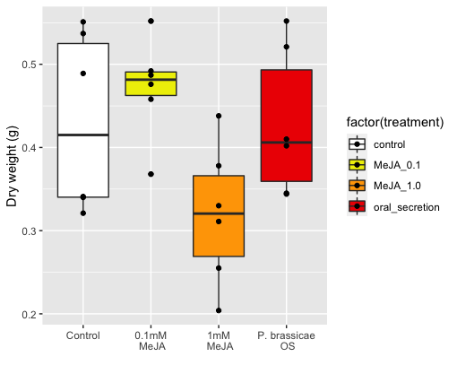
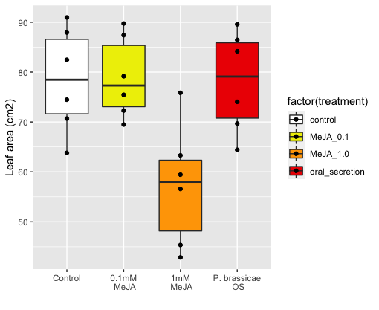
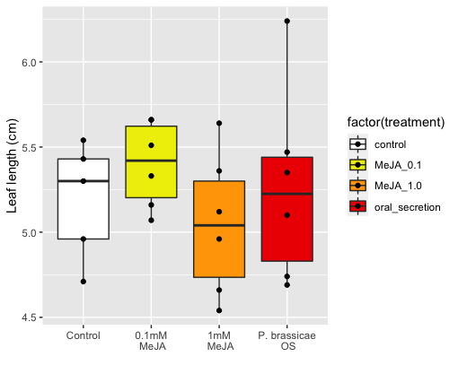
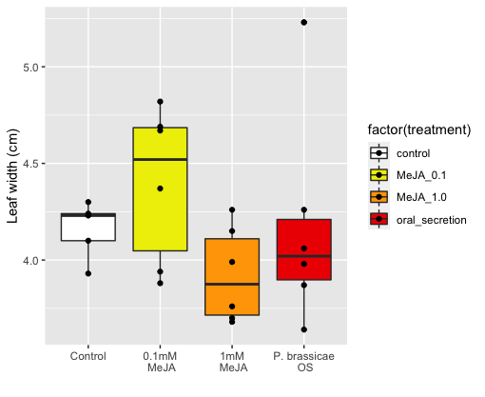




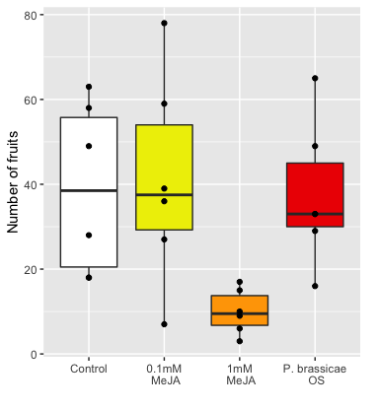
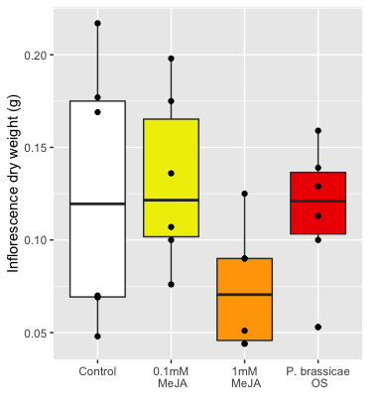


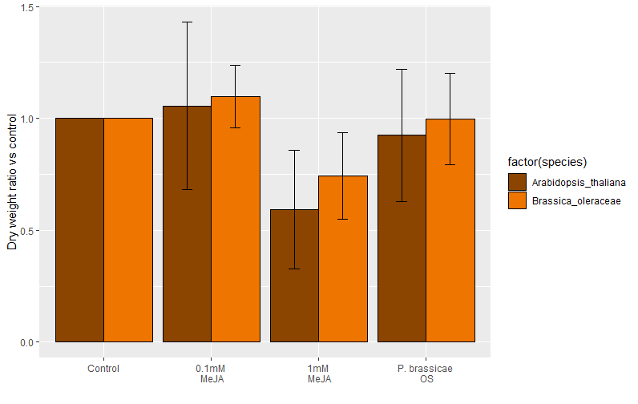
a)
b)
c)
d)
e)
f)
g)
Cohen's d
d estimate: -0.008485888 (negligible)
95 percent confidence interval:
lower upper
-1.294908 1.277936
figure_plant_phenotype: measured plant traits from brassica oleraceae (a-d) and Arabidopsis thaliana (e-f). Cohen’s D (g) shows dry weight fold comparisons to respective controls;
Cohen's d
d estimate: 0.4871191 (small)
95 percent confidence interval:
lower upper
-0.818236 1.792474
Cohen's d
d estimate: -1.148179 (large)
95 percent confidence interval:
lower upper
-2.5365490 0.2401916
MeJA is reducing plant biomass
Compared to their controls both species show the same effect (even though magnitude is different)
Figure 1: g) done properly, a-f figures in supplementary
Cohen’s D paper Use of cohens D to compare multiple experiments/controls: https://nph.onlinelibrary.wiley.com/doi/full/10.1111/nph.15504

Slide 4
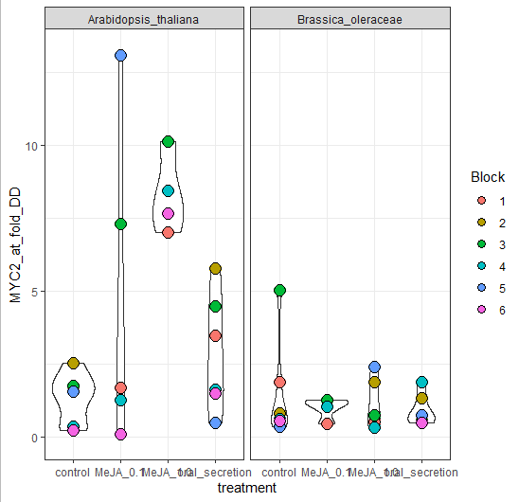
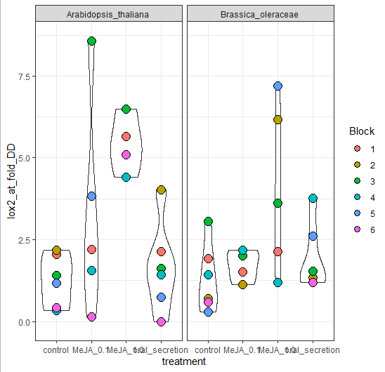
Point for discussion: Do we really want to include this plots?
figure_qPCR: leaf expression of MYC2 (a) and Lox2(b), 3h after the final hormone dipping event and 2 days before harvesting
There’s higher MYC2 and LOX2 expression in MeJA 1% but only in Arabidopsis thaliana
However, no difference in Brassica oleracea
Fix figure with bar plots or gene-expression standard plots, → Supplementary (IF ever included)
Add stats to plot

Slide 5
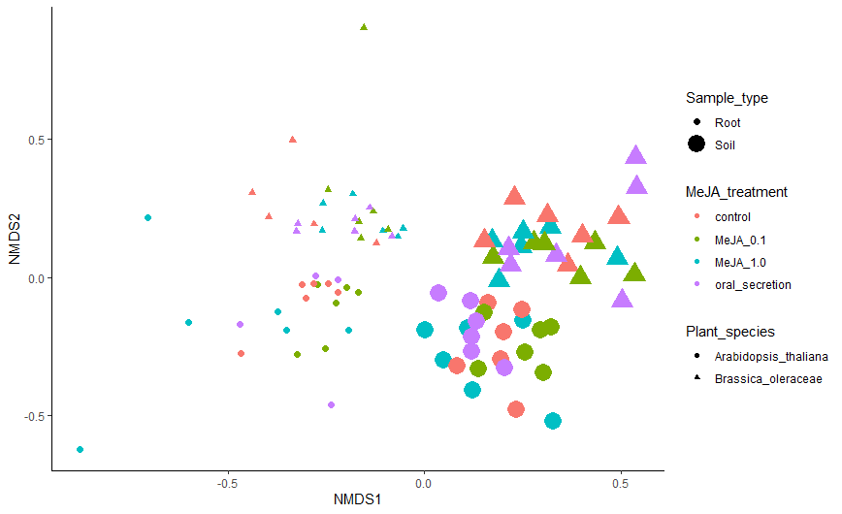
CCS normalization
R script: 2_Beta_diversity
Code chunk: 2.1 - Beta Diversity plots
Stress: 0.1521784 (ok)
Figure 1.
There is a clear effect of root and soil as expected
There is a clear species effect as expected
Treatment effects are not visible
Resonining behind why splitting in 4 the analysis afterwards
+ PERMANOVA RESULTS OVERALL FOR ALL SAMPLES
Figure_Beta_diversity_all_samples : NMDS plot showing clear clustering by plant species and sample types, and mixed treatment effects
Make it pretty
Change labels: Endosphere and Rhizosphere

Slide 6
To make tables for each data partitions with permanova result + pairwise comparisons
Significant treatment effect in all but in Bo-Rhizosphere
There is a significant effect of MeJA for both At and Bo for the endosphere community
PERMANOVA RESULTS OF BETA DIVERSITY – PARTITIONED IN 4
Bo-Endo
Bo-Rhizo
At-Endo
At-Rhizo
+PAIRWISE COMPARISONS
Bo-Endo
Bo-Rhizo
At-Endo
At-Rhizo
Figure 1/Table 1
There is a clear effect of root and soil as expected
There is a clear species effect as expected
Treatment effects are not visible
Resonining behind why splitting in 4 the analysis afterwards

Slide 7
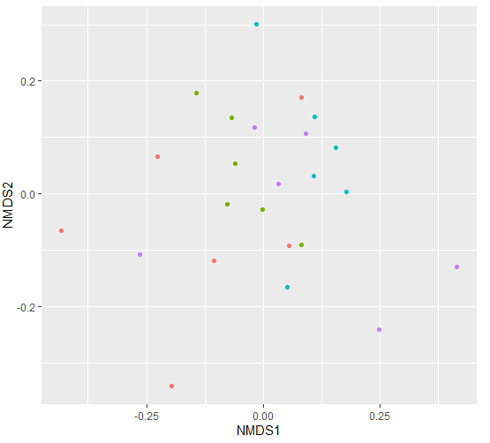
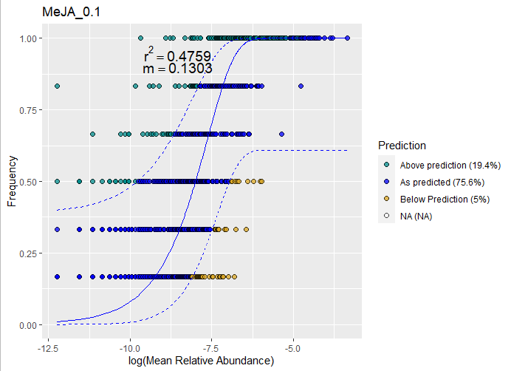
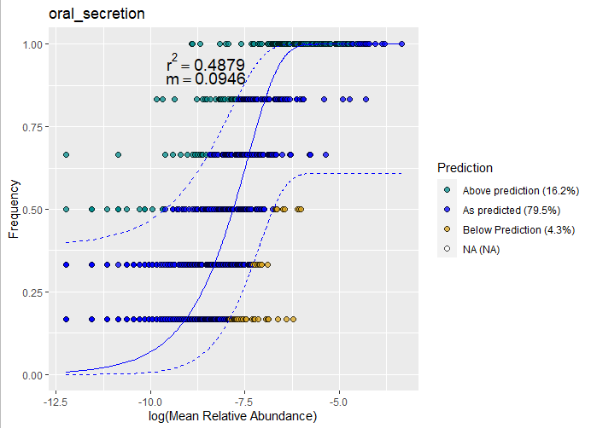
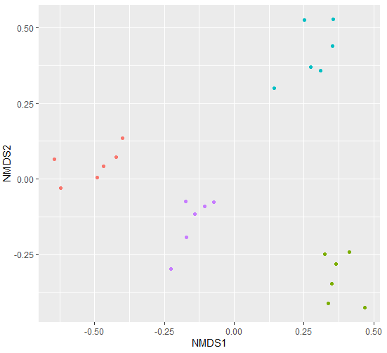
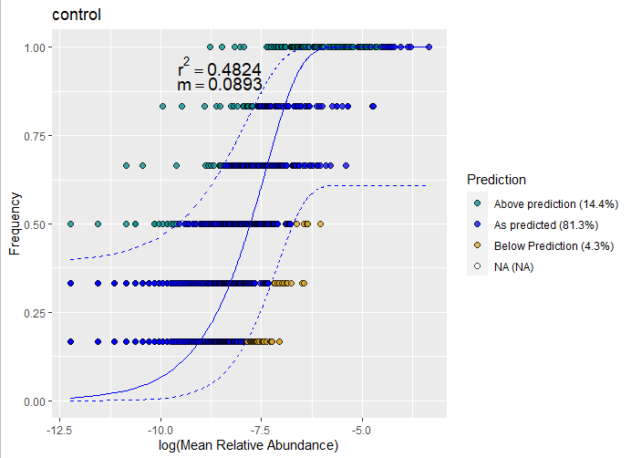

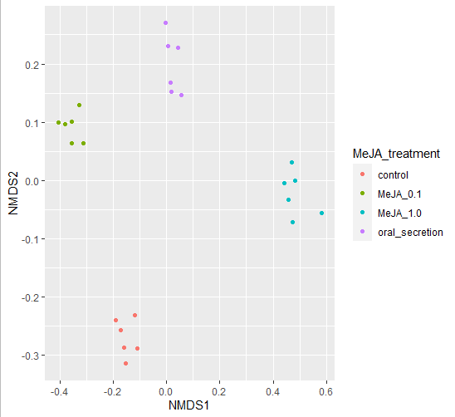
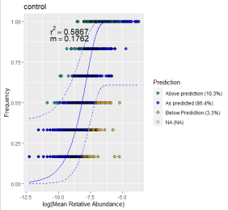
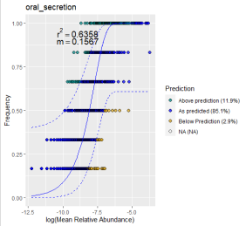
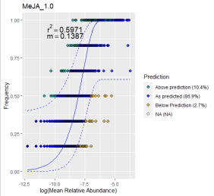
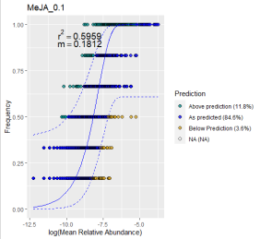
Figure 2. NM fit of rhizosphere samples for both AT and BO.
16S communities not neutrally assembled (<R2)
Once above-expected communities are selected and ordinated it’s clear that they are different and that there is an effect of the treatment p<0.001
For AT, difference between control and treatments are explained by NMDS2
For Bo, there is not a clear split
NMDS Stress = 0.0850
MeJA effect p = 0.001
MeJA effect R2 = 0.63
Stress = 0.065
R² = 0.72
P = 0.001
A): Ordinated by Beta Diversity, B) neutral model fit for partitions C) Ordination with Above expected.
Having a clear conclusion for both species

Slide 8
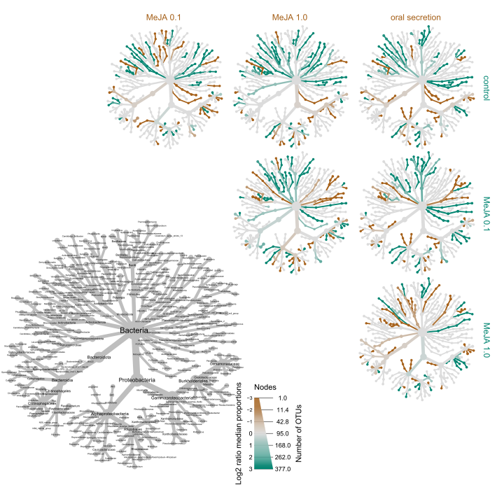
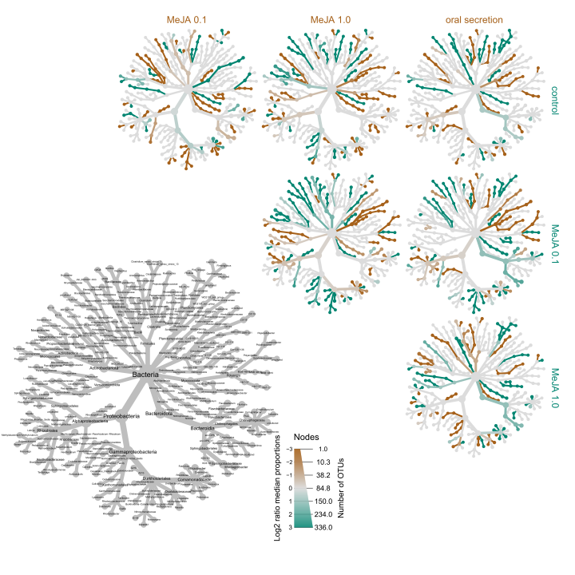
A)
B)
Fig. 3
Neutral_heat_trees: Matrix of heat trees showing differential abundance of ASVs occurring above the expected tresholds in a neutral model for A. thaliana (A) and B oleracea (B). The grey tree serves as a legend for labels. The brown color indicates higher abundance of the ASVs of the treatment indicated by columns, while the teal color indicates higher abundance in the treatments indicated by the rows

Slide 9
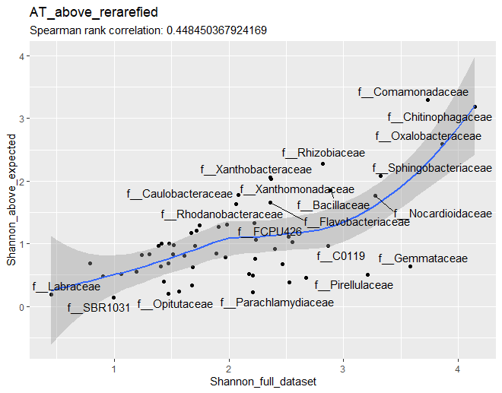
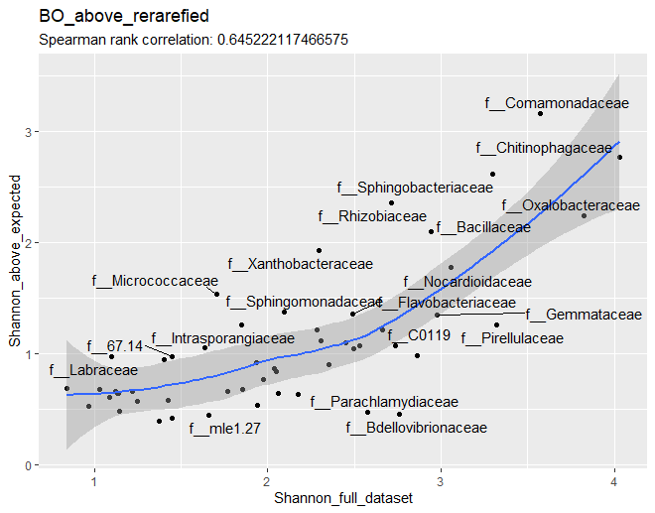
Fig. 4. Alpha correlation Shannon –
Only Family (maybe)
Order for supplementary + other diversity index
figure_alpha_correlation_shannon: Correlation between the Shannon diversity in the neutraly-selected subset with the full dataset, for Class (left), Order (center), and Family (right) in A. thaliana (top) and B. oleraceae (bottom)
(MAYBE WE SHOULD SHOW RESIDUALS TO THE FIT??)
Notes:
Overall alpha-diversity goes in supplementary
+Differential abundance in supplementary

Slide 10
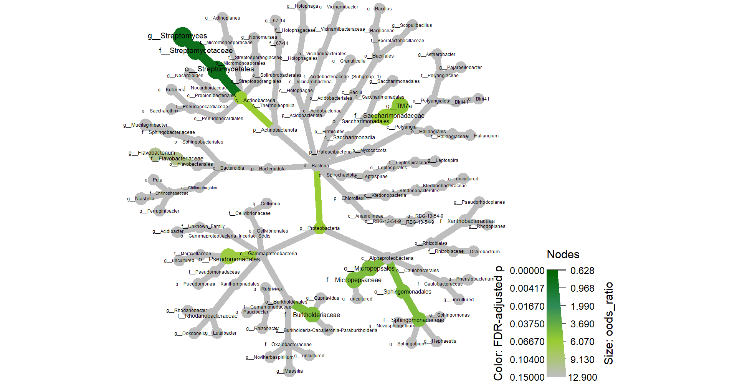
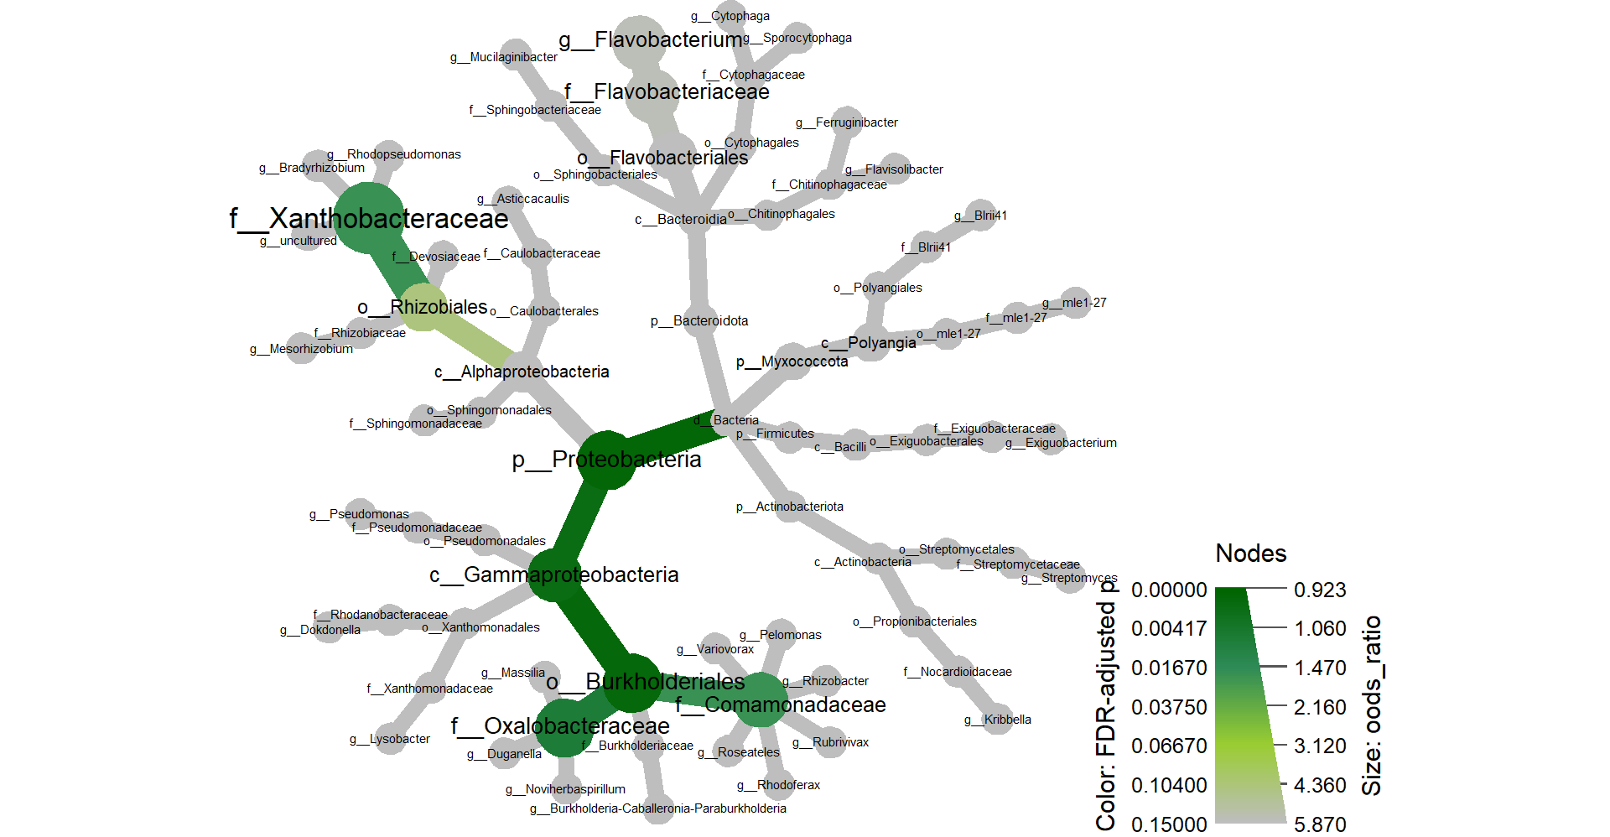
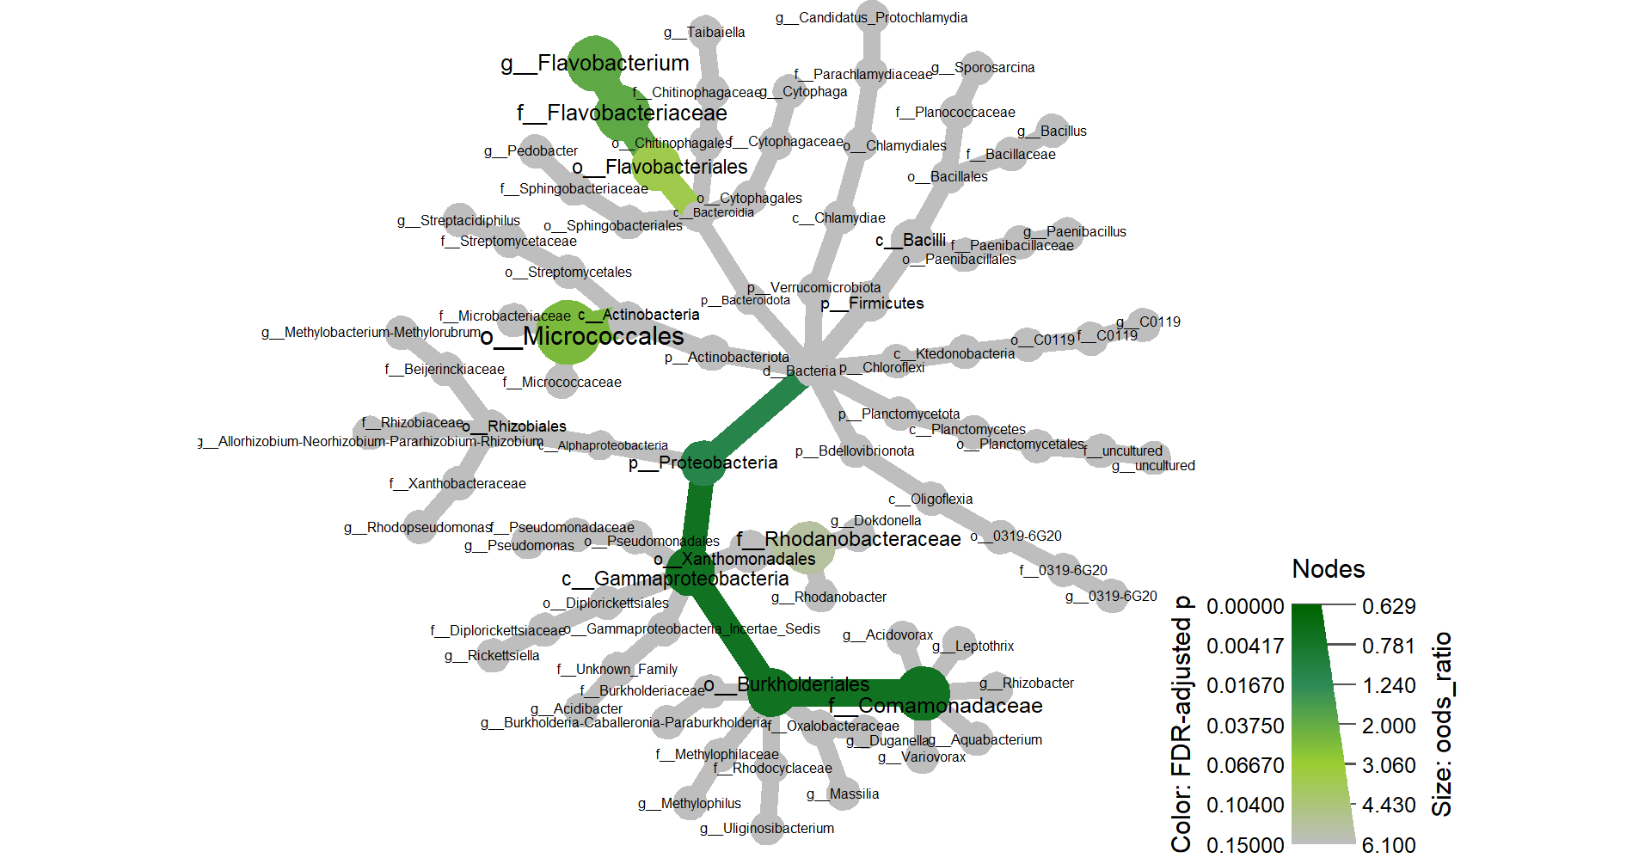
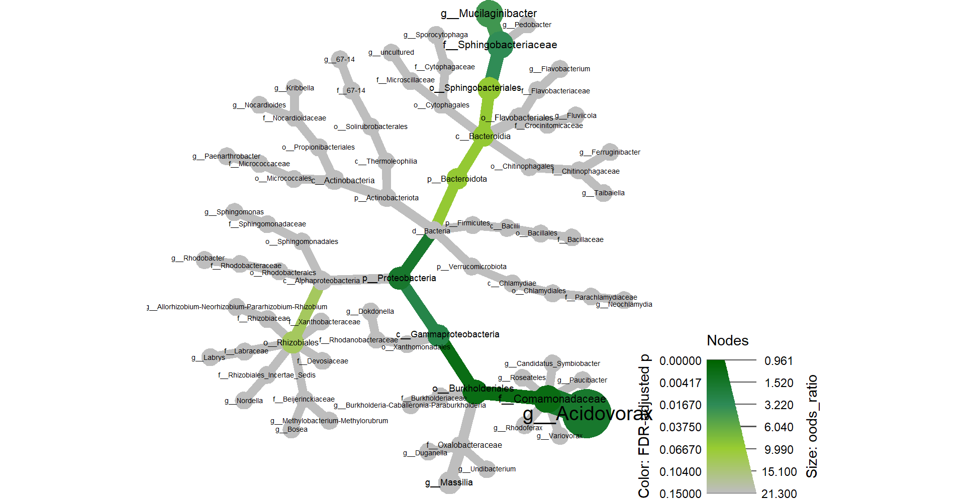
AT_root
AT_soil
BO_root
Fig. 5. Heat tree
BO_soil
Fisher_test_relevance: Heat trees of all ASVs tagged as 1) important in the Random Forest analysis with Boruta; 2) keystone taxa, module hub or module connector in the network analysis with SpiecEasi ; or 3) differentially abundant in treatment-control comparisons in the differential abundant analysis with deseq2. These form the relevant ASV set for each sample parition. Node and branch colours indicate adjusted p values of a fisher test that compares the proportion of a taxa in the relevant ASV set against the same taxa in the rest of the ASVs. Node size shows the odds ratio of the same test. All p values above 0.15 are colored grey.

Slide 11
Diversity and Abundance of Full data
Above expected by NMs
Diversity and Abundance
in important ASVs (heat-trees)
Fig. 6. Validation/Here we show the importance of the pipeline to highlight important ASVs focused on these 2 families
Stats missing per family
Figure_alpha_diversity_above_expected: Shannon diversity index for taxa higlighted as above expected in the neutral models

Slide 12
Supplementary figures

Slide 13
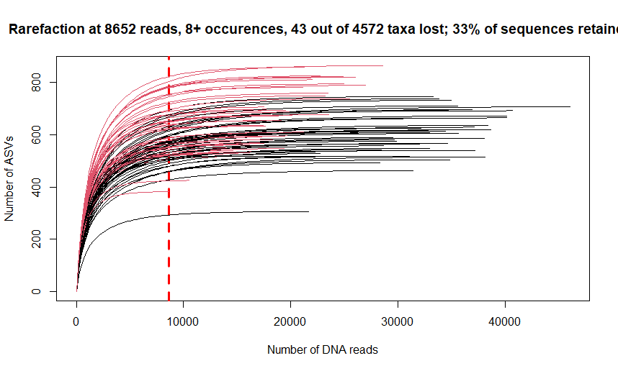
Figure_rarefaction: rarefaction curve for filtered (min 8 occurences) ASVs. Curved black lines represent root samples. Curved red lines represent soil samples. The dashed red line shows the minimum library size
Supp 1: Minimum library size of the smallest library had about 8,000 reads, proof of rarefaction

Slide 14
Notes:
Let’s look a Random Forest in microbiome papers
+Abundance of ASVs flagged as important by Boruta (4 plots) in supplementary

Slide 15
Notes:
+Differential abundance in supplementary

Slide 16
Notes:
+Network analysis
+Check Network analysis in papers of microbiome

