Slide 1
Fish out and organize information from Manucritp_draft_Pedro-HP: From Discussion onwards
Introduction we leave at the end
Visual summary
Slide 67 onwards
Analysis_flowchart → inkscape → make shorter (at the end)
Look for code for figures of plant biomass:
Fix picture → look for close-up pictures of necrotic wound

Slide 2
Pedro’s to-do list
Fix picture → look for close-up pictures of necrotic wound
Upload raw data for qPCR and code of the figure
Review in literature necrotic spot, what is it?

Slide 3
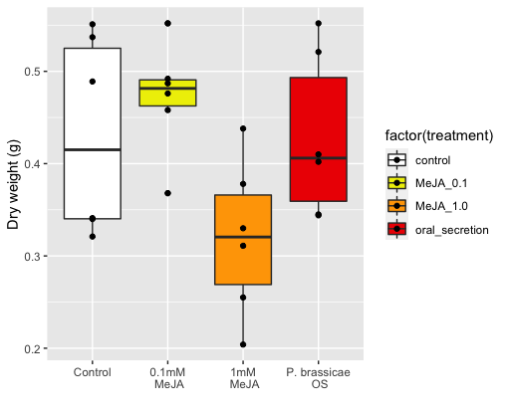
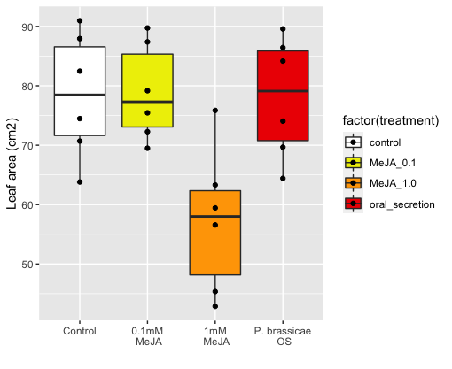
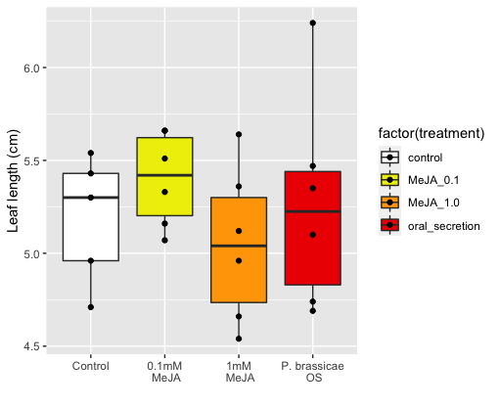
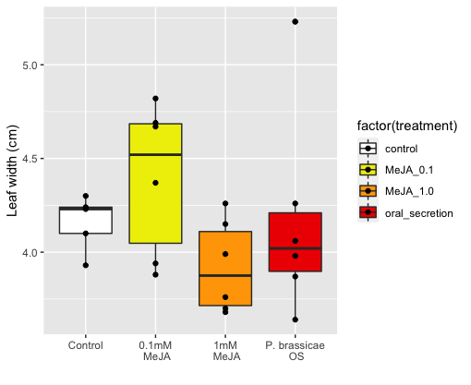




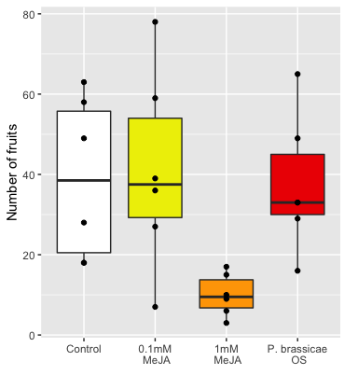
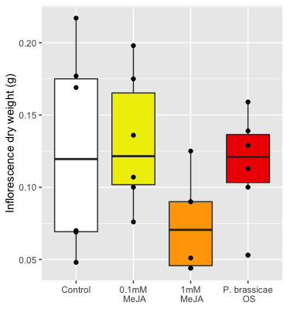


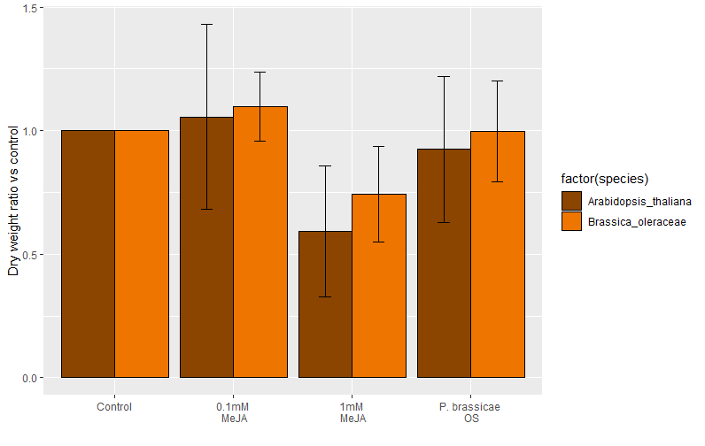
a)
b)
c)
d)
e)
f)
g)
Cohen's d
d estimate: -0.008485888 (negligible)
95 percent confidence interval:
lower upper
-1.294908 1.277936
figure_plant_phenotype: measured plant traits from brassica oleraceae (a-d) and Arabidopsis thaliana (e-f). Cohen’s D (g) shows dry weight fold comparisons to respective controls;
Cohen's d
d estimate: 0.4871191 (small)
95 percent confidence interval:
lower upper
-0.818236 1.792474
Cohen's d
d estimate: -1.148179 (large)
95 percent confidence interval:
lower upper
-2.5365490 0.2401916
MeJA is reducing plant biomass
Compared to their controls both species show the same effect (even though magnitude is different)
Figure 1: g) done properly, a-f figures in supplementary
Cohen’s D paper Use of cohens D to compare multiple experiments/controls: https://nph.onlinelibrary.wiley.com/doi/full/10.1111/nph.15504

Slide 4
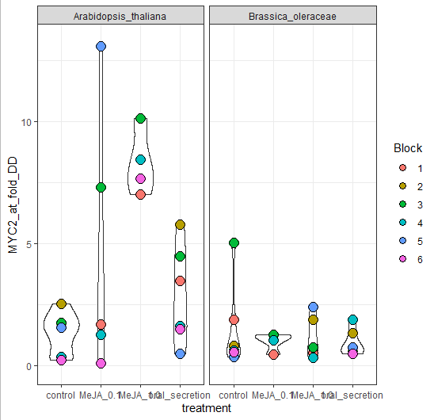
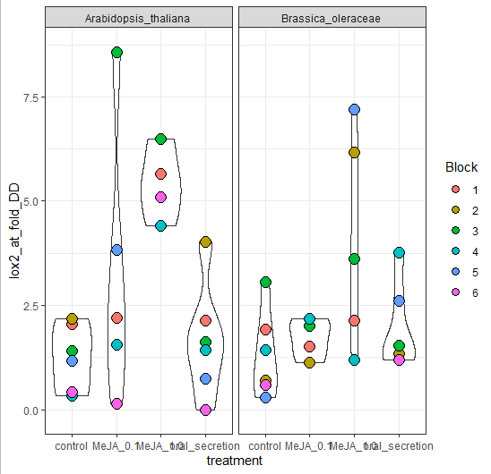
Point for discussion: Do we really want to include this plots?
figure_qPCR: leaf expression of MYC2 (a) and Lox2(b), 3h after the final hormone dipping event and 2 days before harvesting
There’s higher MYC2 and LOX2 expression in MeJA 1% but only in Arabidopsis thaliana
However, no difference in Brassica oleracea
Fix figure with bar plots or gene-expression standard plots, → Supplementary (IF ever included)
Add stats to plot

Slide 5
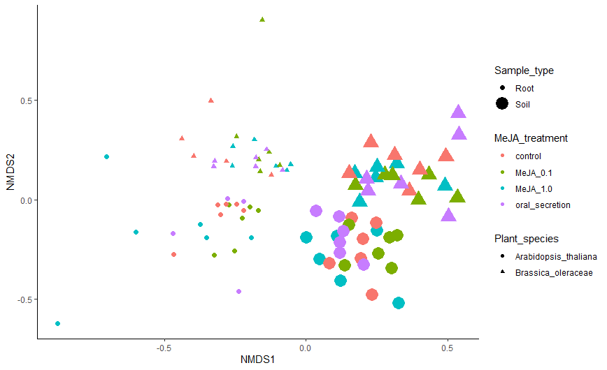
CCS normalization
R script: 2_Beta_diversity
Code chunk: 2.1 - Beta Diversity plots
Stress: 0.1521784 (ok)
Figure 1.
There is a clear effect of root and soil as expected
There is a clear species effect as expected
Treatment effects are not visible
Resonining behind why splitting in 4 the analysis afterwards
+ PERMANOVA RESULTS OVERALL FOR ALL SAMPLES
Figure_Beta_diversity_all_samples : NMDS plot showing clear clustering by plant species and sample types, and mixed treatment effects
Make it pretty
Change labels: Endosphere and Rhizosphere

Slide 6
To make tables for each data partitions with permanova result + pairwise comparisons
Significant treatment effect in all but in Bo-Rhizosphere
There is a significant effect of MeJA for both At and Bo for the endosphere community
PERMANOVA RESULTS OF BETA DIVERSITY – PARTITIONED IN 4
Bo-Endo
Bo-Rhizo
At-Endo
At-Rhizo
+PAIRWISE COMPARISONS
Bo-Endo
Bo-Rhizo
At-Endo
At-Rhizo
Figure 1/Table 1
There is a clear effect of root and soil as expected
There is a clear species effect as expected
Treatment effects are not visible
Resonining behind why splitting in 4 the analysis afterwards

Slide 7
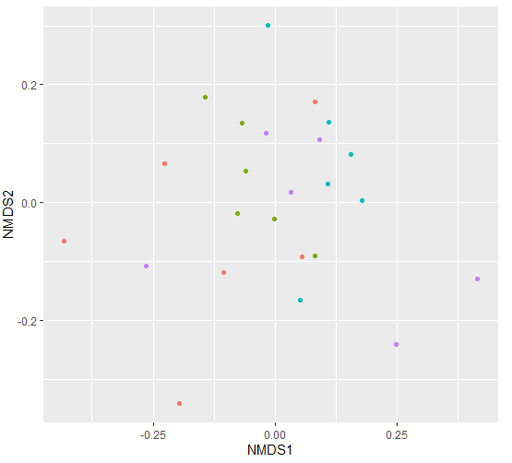
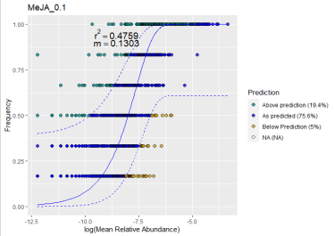
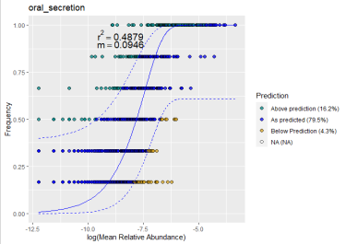
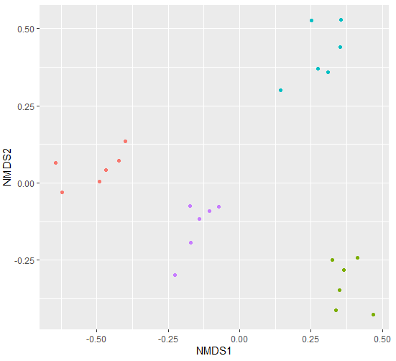
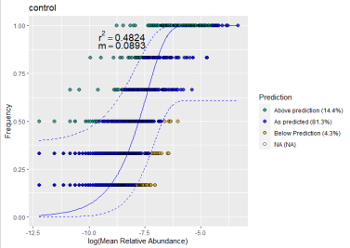
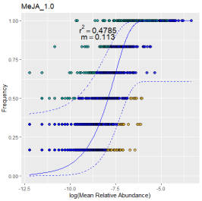

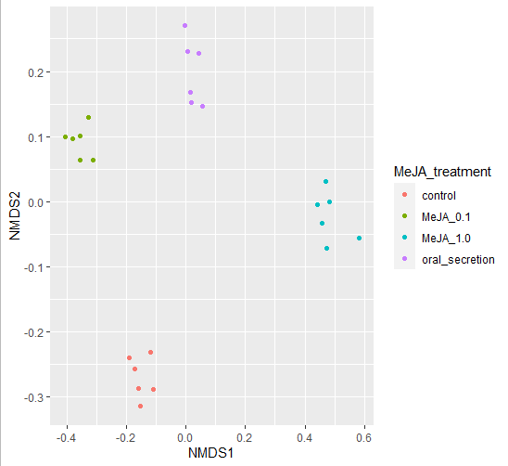
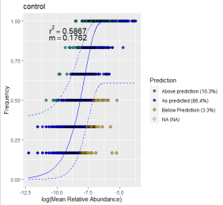
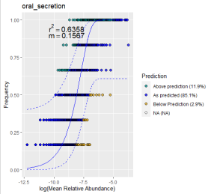
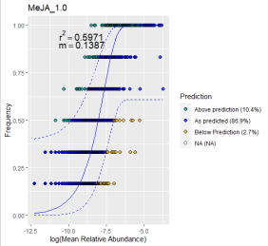
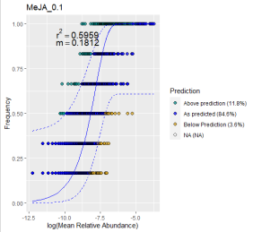
Figure 2. NM fit of rhizosphere samples for both AT and BO.
16S communities not neutrally assembled (<R2)
Once above-expected communities are selected and ordinated it’s clear that they are different and that there is an effect of the treatment p<0.001
For AT, difference between control and treatments are explained by NMDS2
For Bo, there is not a clear split
NMDS Stress = 0.0850
MeJA effect p = 0.001
MeJA effect R2 = 0.63
Stress = 0.065
R² = 0.72
P = 0.001
A): Ordinated by Beta Diversity, B) neutral model fit for partitions C) Ordination with Above expected.
Having a clear conclusion for both species

Slide 8
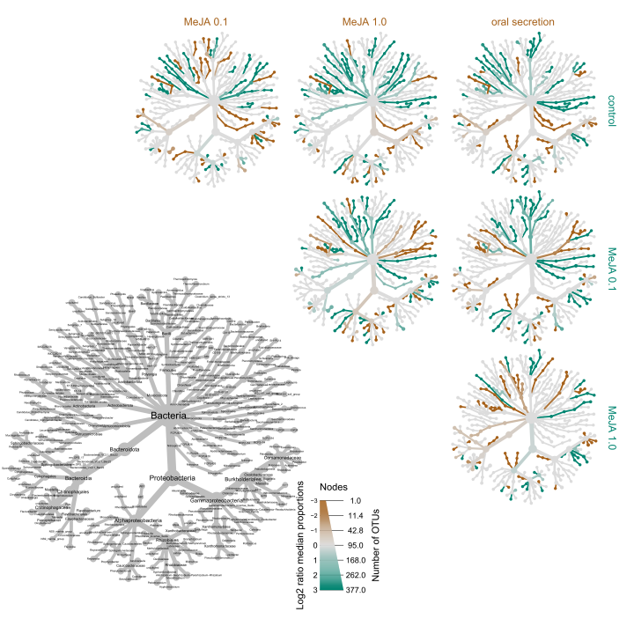
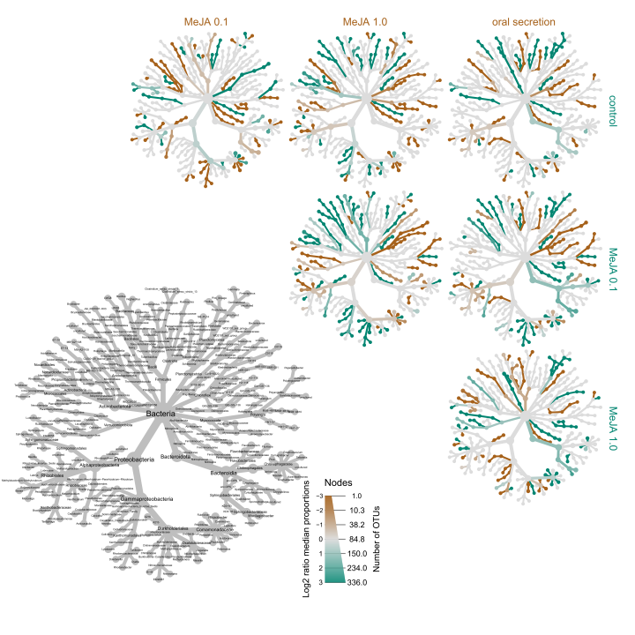
A)
B)
Fig. 3
Neutral_heat_trees: Matrix of heat trees showing differential abundance of ASVs occurring above the expected tresholds in a neutral model for A. thaliana (A) and B oleracea (B). The grey tree serves as a legend for labels. The brown color indicates higher abundance of the ASVs of the treatment indicated by columns, while the teal color indicates higher abundance in the treatments indicated by the rows

Slide 9
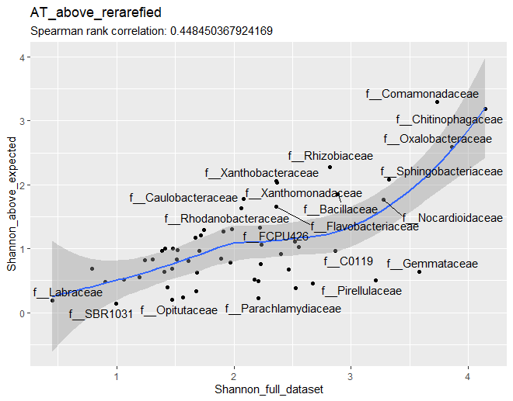
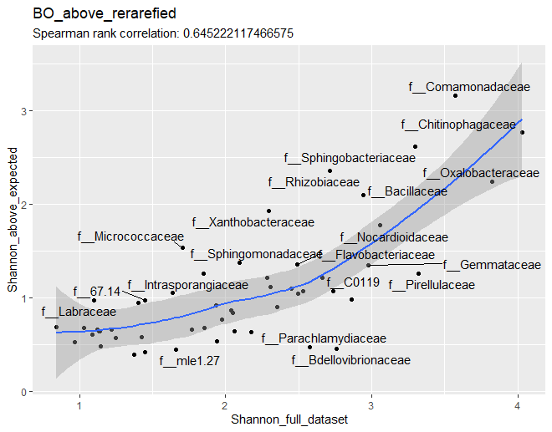
Fig. 4. Alpha correlation Shannon –
Only Family (maybe)
Order for supplementary + other diversity index
figure_alpha_correlation_shannon: Correlation between the Shannon diversity in the neutraly-selected subset with the full dataset, for Class (left), Order (center), and Family (right) in A. thaliana (top) and B. oleraceae (bottom)
(MAYBE WE SHOULD SHOW RESIDUALS TO THE FIT??)
Notes:
Overall alpha-diversity goes in supplementary
+Differential abundance in supplementary

Slide 10
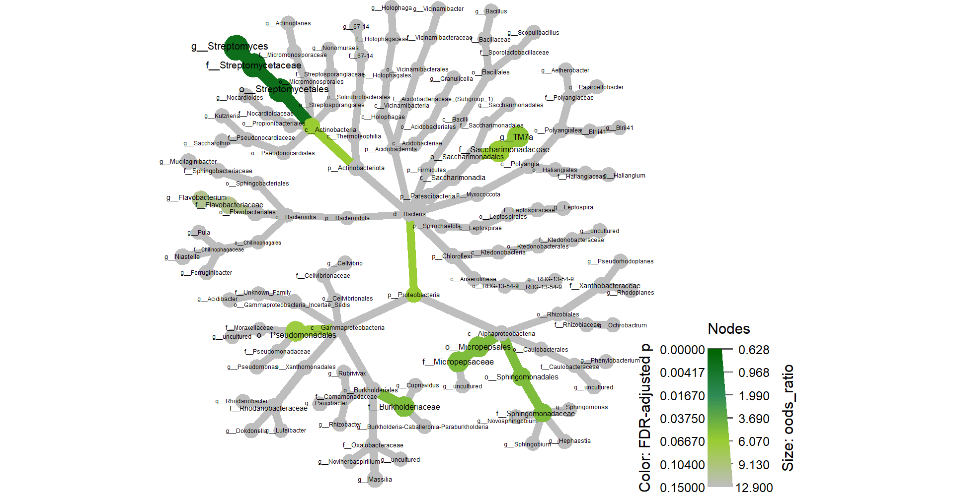
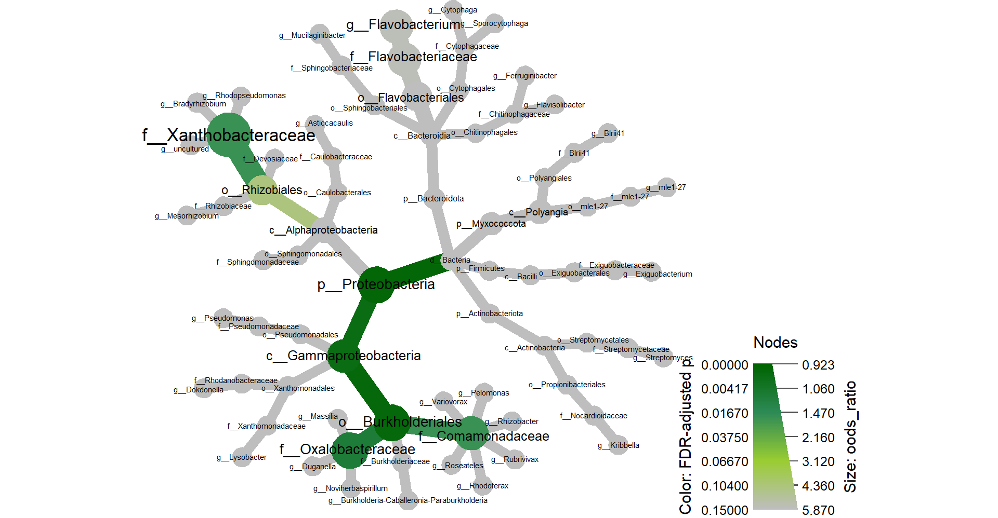
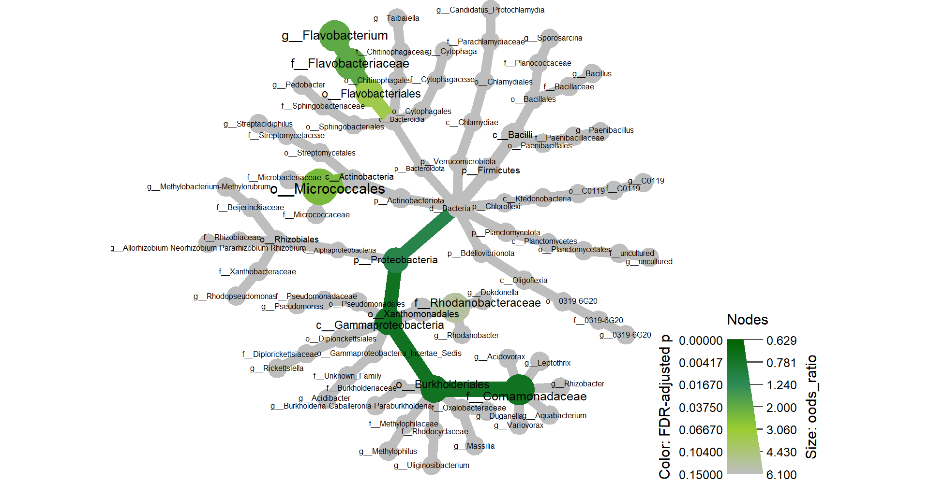
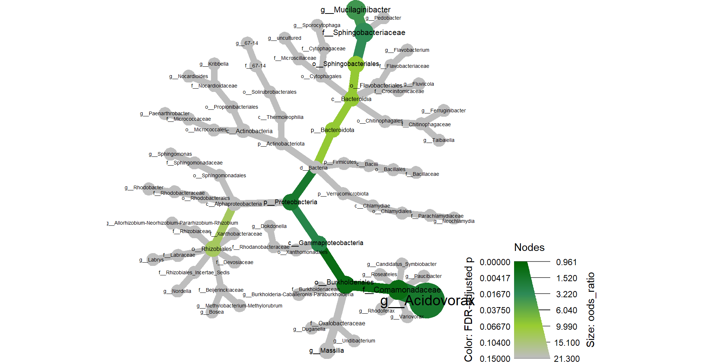
AT_root
AT_soil
BO_root
Fig. 5. Heat tree
BO_soil
Fisher_test_relevance: Heat trees of all ASVs tagged as 1) important in the Random Forest analysis with Boruta; 2) keystone taxa, module hub or module connector in the network analysis with SpiecEasi ; or 3) differentially abundant in treatment-control comparisons in the differential abundant analysis with deseq2. These form the relevant ASV set for each sample parition. Node and branch colours indicate adjusted p values of a fisher test that compares the proportion of a taxa in the relevant ASV set against the same taxa in the rest of the ASVs. Node size shows the odds ratio of the same test. All p values above 0.15 are colored grey.

Slide 11
Diversity and Abundance of Full data
Above expected by NMs
Diversity and Abundance
in important ASVs (heat-trees)
Fig. 6. Validation/Here we show the importance of the pipeline to highlight important ASVs focused on these 2 families
Stats missing per family
Figure_alpha_diversity_above_expected: Shannon diversity index for taxa higlighted as above expected in the neutral models

Slide 12
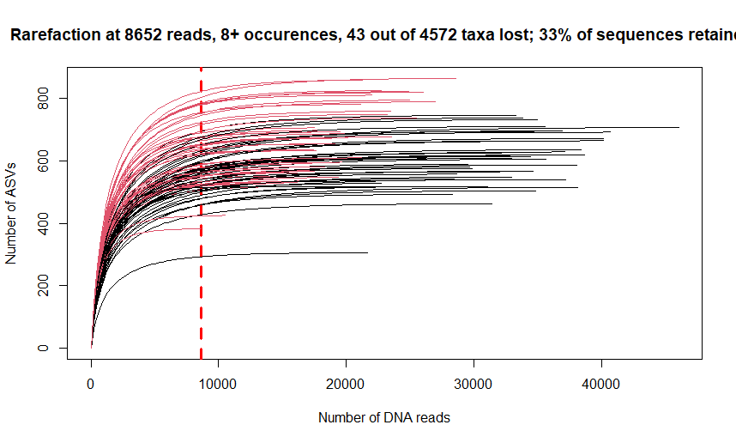
Figure_rarefaction: rarefaction curve for filtered (min 8 occurences) ASVs. Curved black lines represent root samples. Curved red lines represent soil samples. The dashed red line shows the minimum library size
Supp 1: Minimum library size of the smallest library had about 8,000 reads, proof of rarefaction

Slide 13
Paper outline – ppt presentation mode
We will show the outline we have for the paper, and then all figures and tables section by section
Ultimatetly, our research shows Comamonadaceae is overly present in lists of ASVs that were defined as relevant by different methods. This is consistent across plant species and plant compartments
One of the reasons Comamonadaceae can be important is because they are also present and functional in the gut of herbivorous insects. Our research helps to blur the (artificial) line that divides plant microbiome from insect microbiome, while focusing new efforts in a specific group of microbes.
We would like your opinion on whether we place some figures as supplementary or main

Slide 14
Essential paper outline
Introduction
plant-insect-microbe interaction
Holobiont
data deluge
Methodology
Partially written, repository gets published/open
1 figure showing the experimental design [MAIN]
1 fluxogram figure showing code & data [SUP]
Results
Plant growth & qPCR (show plants were stressed)
1 figure with 4 pannels, raw plant biomass values [SUP or MAIN?]
1 figure, Cohen’s D effect size across pecies and variables [SUP or MAIN?]
1 figure, qPCR plot [ SUP]
Beta & alpha diversity (Basic analysis present in any paper)
1 Figure, rarefaction curve [SUP]
1 Figure, full community beta diversity [MAIN]
3 tables, PERMANOVAs and pairwise comparison [3 SUP]
1 figure, full community Shannon diversity [MAIN]
2 tables, ANOVA and post-hoc [2 SUP]
Neutral models [3 figures, 2 sup tables]:
1 Figure with 6 pannels: full rhizosphere ordination + Neutral model fits + above-expected rhizosphere ordination re-plotting [MAIN]
2 tables, PERMANOVA table and pairwise comparisons [2 SUP]
1 table, 100 PERMANOVAs bootstrapping to Check artifacts [SUP]
Above-expected differential abudances (heat tree focus on comamonadaceae)
1 figure with 2 pannels, has complex matrix of heat trees [MAIN]
Alpha diversity regression (focus on comamonadaceae)
1 figure with 6 pannels (observed, Shannon and simpson diversity at Family level for BO and AT) [MAIN]
2 figures with 6 pannels each (observed, Shannon and simpson diversty at Family level for BO and AT) [2 SUP]
Random forest (show ASVs that matter on prediction)
1 Figure with 4 panels, ASV abundance per treatment [MAIN or SUP?]
3 tables: sample size + precision + kappa, confusion matrix, ASV taxonomies [3 SUP]
Network analysis (describe networks, ASVs with importance tags, Leave module discussion on supplementary text)
1 figure with 4 panels showing the networks [MAIN or SUP?]
1 table showing differences to 1000 random networks [SUP]
1 figure showing PCA of network metrics [SUP]
1 figure with 4 panels showing module correlation to metadata [SUP]
Differential abundance (keep very short)
1 Fig, bi-plot heatmap [SUP or MAIN?]
Fisher Summary (describe figure, highlight comamonadaceae)
1 figure with 4 pannels, showing fisher results on tree
Discussion
Methyl Jasmonate triggers plant defense
Validate Experimental approach
MeJA impacts the microbial community similarly to Oral Secretion, thus MeJA can be used in place of real insects
Show methodological variation on MeJA applications (foliar spray and sealed chamber)
Stress treatments were subtle on the structure of the full community but clear on the taxa occuring above neutraility
Advantages Methodological approach on neutral models
Compare base alpha and beta diversity to other references
the neutral spliting-and-joining can help see subtle treatment effects ;
the neutral tree can help locate a diversity hotspot (mention rhizobiales but limit discussion)
“Fishing” with Fisher: 1 out of 1.111 taxa highlighted by 3 different methods
Show how the excess of information complicates analysis
Show that after using several methods we still have a complex dataset
the fisher test in a heat tree helps summarizing findings (approach to data deluge)
Family Commonadaceae was relevant across treatments, plant species, sample types, and analysis methods
show that comamonadaceae was highlighted independently in both approaches
Show how common they are on the roots
Show how common they are in the insect gut
Fit them in the holobiont approach (insects do more than giving a ride to Bac)
CONCLUSION:
Comamonadaceae are important in insect-plant interactions

Slide 15
Introduction
Not started yet!
Give the basic overview of plant-insect-mirobe interaction
Frame it in the concept of the holobiont, groups of microbes
Show how the excess of information can hinder analysis and decisions (data deluge)
Maybe compare tools and targets of old microbiome research with new microbiome research because…
Old methods (differential abundance, alpha/beta diversity) do not account for group of ASVs (like in RF or networks).
Most references stop at differential abundance, while ASV prevalence in multiple samples, network degree, prediction importance can be largely independent of number of sequences
Popularization of code-based analysis favors development of new pipelines

Slide 16
## Here we have .svg figures that need to be edited for publication
Analysis_flowchat: indicates the steps and tools used in the R script
deseq_family: differential abudance analysis showing taxonomy at family level
Exp_design_fig: figure shwing pots, treatments, plant species
fisher_fourpartiitons: the summarity heat tree for fisher tests, with one tree for each data partition
ordination_all_samples: base ordination with full community of all samples
differential_heat_tree_AT.pdf: pdf file with matrix of heat trees for AT, including only above-expected ASVs
differential_heat_tree_BO.pdf: pdf file with matrix of heat trees for BO, including only above-expected ASVs
Rarefaction_curve: shows library size per sample (blaock lines for root samples, no action needed)
PCA_network_metrics: network metrics of the 4 networks, no alterations needed
## to do:
put all 4 network svg files (Network_AT_root, BO_soil...) into a single 4-pannel figure
put all 4 Ranfom forest svg files( RF_ASVs_BO_soil, RF_ASVs_BO_root...) into a single 4-pannel figure [ACTION: ADD AN ASTERISK FOR COMAMONADACEAE ASVS; DATA ON TABLE SUP_ table_rf_taxonomies]
Put the following in a 6-pannel:
A) AT_soil_fullCommunity_NMDS + BO_soil_fullCommunity_NMDS
B) AT_neutral_models_plot + BO_neutral_models_plot
C) AT_above_NMDS + AT_above_NMDS
###from MeJA-Pilot\R output\Neutral_models:
make pannel for Family diversity (Observed, Shannon and Simpson for AT and BO) [ACTION: COLOR COMAMONADACEAE IN RED]
make pannel for Class diversity (Observed, Shannon and Simpson for AT and BO)
make pannel for Order diversity (Observed, Shannon and Simpson for AT and BO)

Slide 17
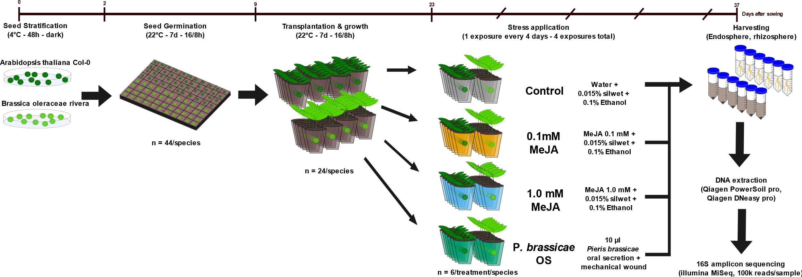
Methodology
Figure X. Scheme of experimental design [MAIN].

Slide 18
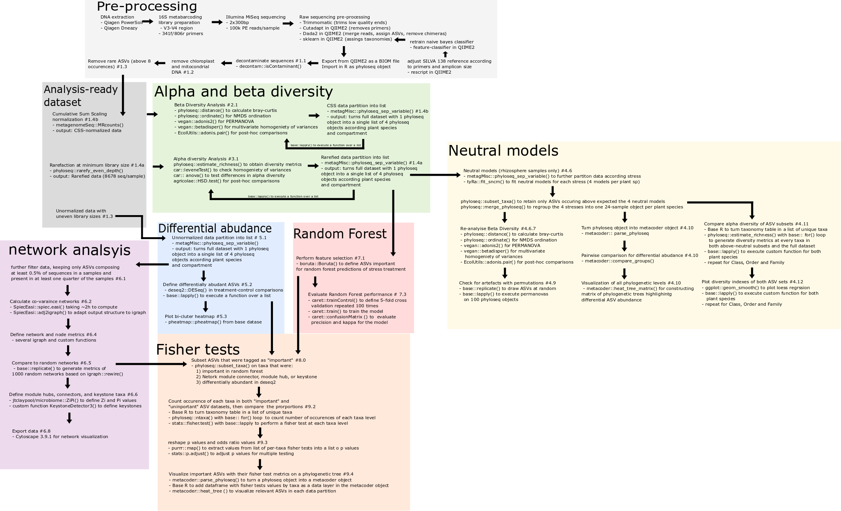
Methodology
Sup X. Fluxogram figure showing code & data [SUP]. Detailed workflow for bioinformatics approach

Slide 19
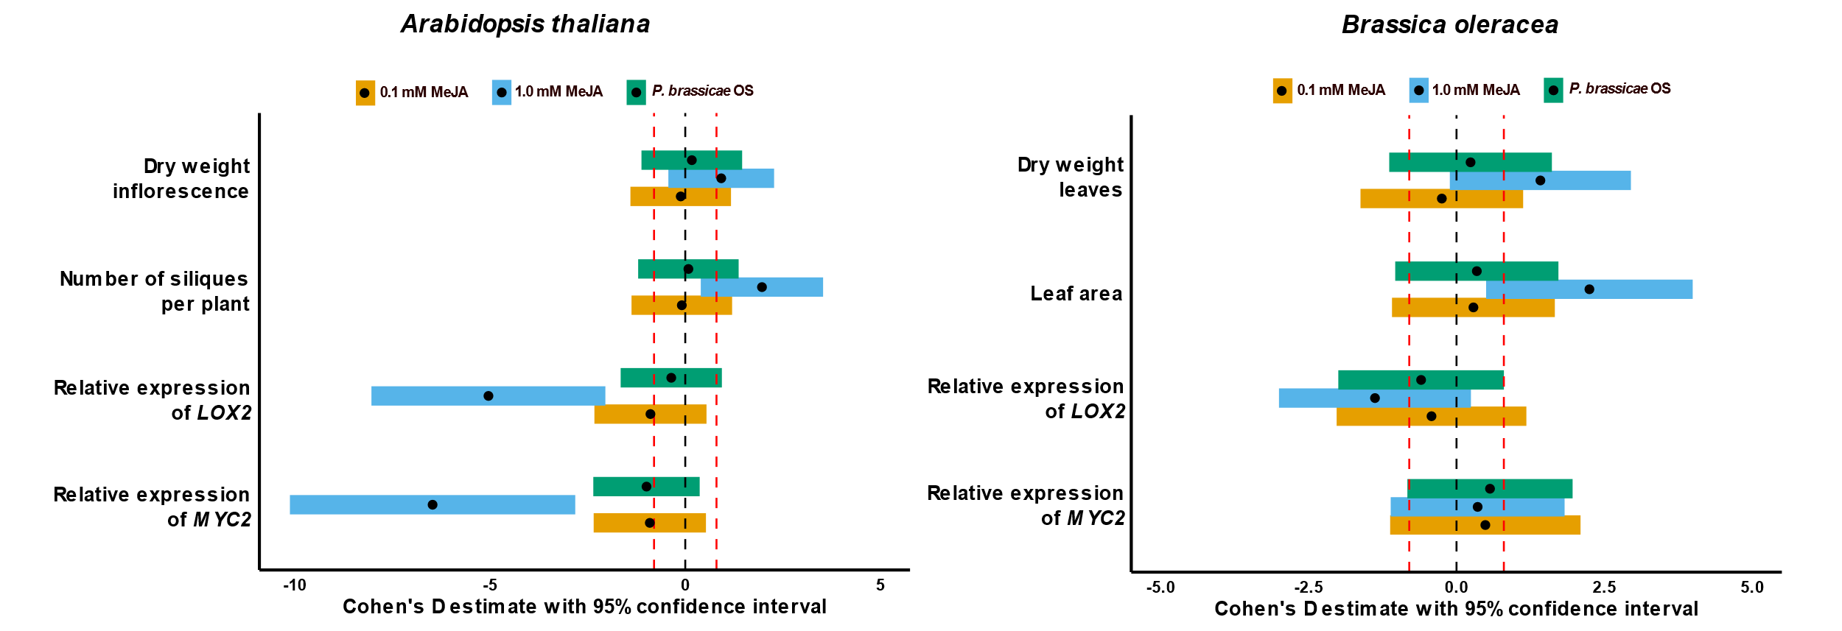
Results
Plant growth & qPCR (show plants were stressed)
1 figure, Cohen’s D effect size across pecies and variables [SUP or MAIN?]
1 figure, qPCR plot [ SUP]

Slide 20
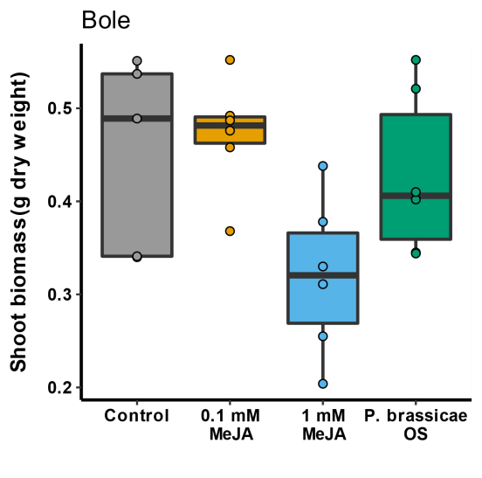
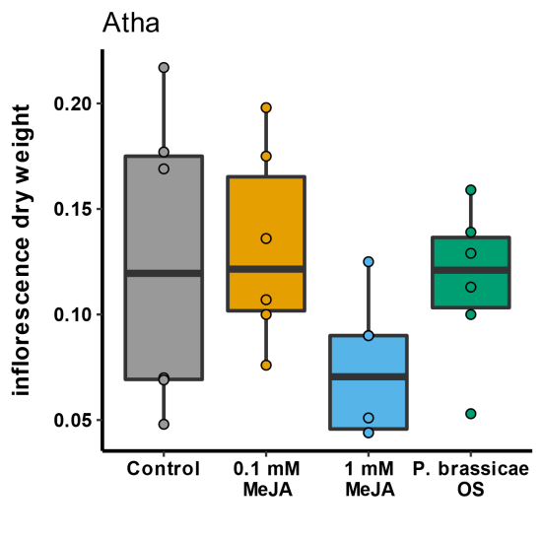
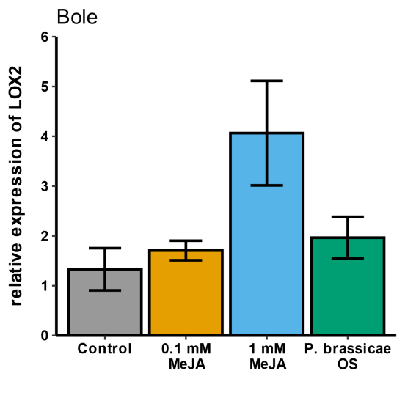
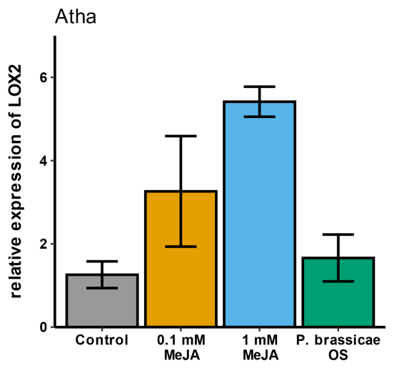
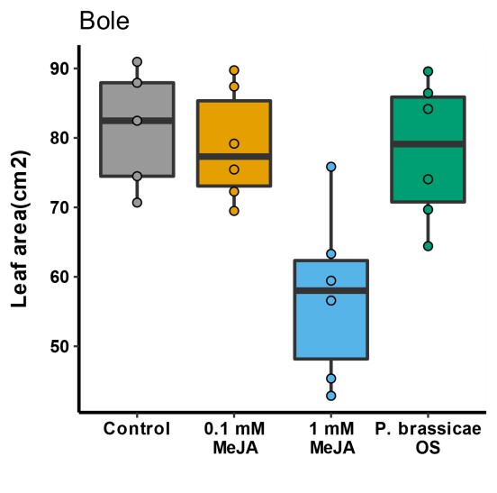
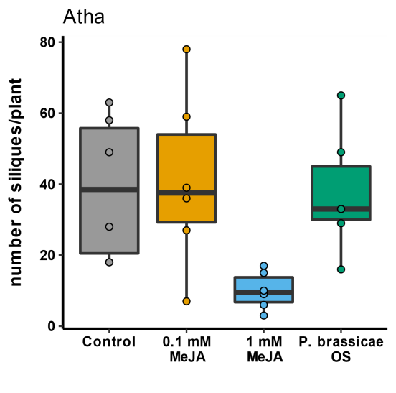
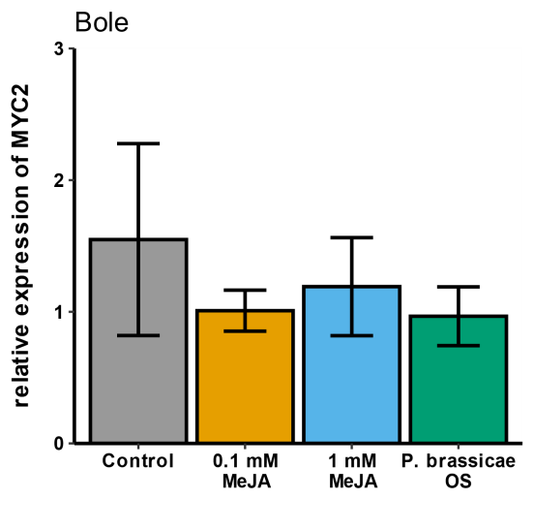
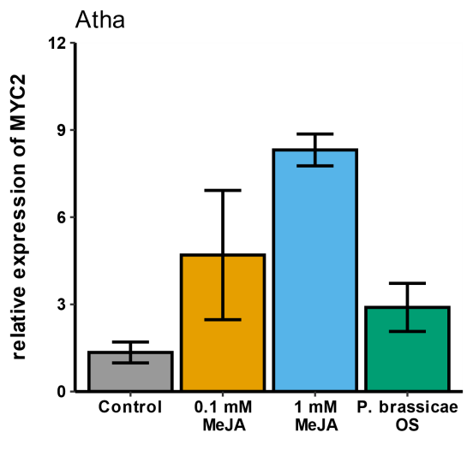
Results
Plant growth & qPCR (show plants were stressed)
1 figure with 8 pannels, raw plant biomass values [SUP or MAIN?]

Slide 22
Results
Beta & alpha diversity (Basic analysis present in any paper)
1 Figure, rarefaction curve [SUP]
1 Figure, full community beta diversity [MAIN]
3 tables, PERMANOVAs and pairwise comparison [3 SUP]
1 figure, full community Shannon diversity [MAIN]
2 tables, ANOVA and post-hoc [2 SUP]
Notes:
Let’s look a Random Forest in microbiome papers
+Abundance of ASVs flagged as important by Boruta (4 plots) in supplementary

Slide 23
Results
Neutral models
1 Figure with 6 pannels: full rhizosphere ordination + Neutral model fits + above-expected rhizosphere ordination re-plotting [MAIN]
2 tables, PERMANOVA table and pairwise comparisons [2 SUP]
1 table, 100 PERMANOVAs bootstrapping to Check artifacts [SUP]
Above-expected differential abudances (heat tree focus on comamonadaceae)
1 figure with 2 pannels, has complex matrix of heat trees [MAIN]
Alpha diversity regression (focus on comamonadaceae)
1 figure with 6 pannels (observed, Shannon and simpson diversity at Family level for BO and AT) [MAIN]
2 figures with 6 pannels each (observed, Shannon and simpson diversty at Family level for BO and AT) [2 SUP]
Notes:
+Differential abundance in supplementary

Slide 24
Results
Random forest (show ASVs that matter on prediction)
1 Figure with 4 panels, ASV abundance per treatment [MAIN or SUP?]
3 tables: sample size + precision + kappa, confusion matrix, ASV taxonomies [3 SUP]
Notes:
+Network analysis
+Check Network analysis in papers of microbiome

Slide 25
Results
Network analysis (describe networks, ASVs with importance tags, Leave module discussion on supplementary text)
1 figure with 4 panels showing the networks [MAIN or SUP?]
1 table showing differences to 1000 random networks [SUP]
1 figure showing PCA of network metrics [SUP]
1 figure with 4 panels showing module correlation to metadata [SUP]

Slide 26
Results
Differential abundance (keep very short)
1 Fig, bi-plot heatmap [SUP or MAIN?]

Slide 27
Results
Fisher Summary (describe figure, highlight comamonadaceae)
1 figure with 4 pannels, showing fisher results on tree

Slide 28
Discussion
Methyl Jasmonate triggers plant defense
Validate Experimental approach
(plenty of references already use MeJA to stress plants, we don’t need to give much attention)
MeJA impacts the microbial community similarly to Oral Secretion, thus MeJA can be used in place of real insects
(there are “ifs” and “buts” here, so we don’t really have definitive evidence on this. The real evidence is that the plant is stressed)
Show methodological variation on MeJA applications (foliar spray and sealed chamber)
(our method provides a better entry of MeJA to the plant than foliar spray, but it is less arguably less work & resource intensive than release in a sealed chamber. We also better avoid direct contact of MeJA with soil)

Slide 29
Discussion
Stress treatments were subtle on the structure of the full community but clear on the taxa occuring above neutraility
Compare base alpha and beta diversity to other references
(other references only use the basic analysis methods on roots and soils but do not highlight comamonadaceae,.they also only test a single plant species on every report, no use of neutral models, network or random forest)
Advantages Methodological approach on neutral models
(a model-based selection of ASVs that can be further analyzed, has clear definitions and is easely reproducible)
the neutral splitting-and-joining can help see subtle treatment effects ;
(turns sublte treatment effects into very clear community differences – it helps in finding the differences that matter to treatments without directly looking at differences in ASV abudance between treatments)
the neutral tree can help locate a diversity hotspot (mention rhizobiales but limit discussion)
(Modern visualization allows us to screen all phylogenetic levels and their relationships, pinponting key drivers for differences and similarities between treatments)

Slide 30
Discussion
“Fishing” with Fisher: 1 out of 1.111 taxa highlighted by 3 different methods
Show how the excess of information complicates analysis
(Adress complexity of microbiomes and their analysis methods)
Show that after using several methods we still have a complex dataset
(even on a small subset of 346 ASVs, we have several different classifications, imporance tags, and 4 distinct base datasets)
the fisher test in a heat tree helps summarizing findings (approach to data deluge)
(checks against the proper context to the subset of ASVs, evaluating and displaying all taxonomic levels)
(can be used on any list of relevant/irrelevant ASVs)

Slide 31
Discussion
Family Commonadaceae was relevant across treatments, plant species, sample types, and analysis methods
show that comamonadaceae was highlighted independently in both approaches
(this is very valuable: there are no “ifs” and “buts” on the relevance of comamonadaceae; both methods used the same dataset but were independent! Our analysis has consistency and taxonomic resolution!)
Show how common they are on the roots
(literature refereces)
Show how common they are in the insect gut
(literature refereces)
Fit them in the holobiont approach (insects do more than giving a ride to Bac), poiting the similarity to Enterobacter
(enterobacter is well known to inhabit both plants and mammal guts. Comamonadaceae are doing the same thing, but for insects)
We must be careful with this because we have not screened any insect, much less an insect microbiome!
CONCLUSION:
Comamonadaceae are important in insect-plant interactions.
This is far more n depth than defining that proteobacteria are impotnat players in plants
Next studies need strain-level resolution, function definitions, and also insect microbiome screening

