Slide 1
Android Storage

Slide 2
There are several options for storage of data with Android
We can put data into a preferences file.
We can put data into a ‘normal’ file.
We can send data across the network to a service.
We can use a database.

Slide 3
Preference files are a light-weight option
We can put data into a preferences file.
Call Context.getSharedPreferences() to read and write values as key-value pairs.
Use Activity.getPreferences() with no name to keep them private to the calling activity
These are not sharable across applications, unless you expose them as a ‘content provider’.

Slide 4
We can write larger data to file
You can only access files available to the application
You can either write to a new file, or to a pre-included file under res/raw/mydata
To can read data from a file, call Context.openFileInput() and pass it the local name and path of the file. It returns a standard Java FileInputStream object.
To write to a file, call Context.openFileOutput() with the name and path. It returns a FileOutputStream object.

Slide 5
We can place data elsewhere on the network
Use a web service to store data elsewhere.
Can make this automatic, or at user discretion. (twitter apps, or photo capture)

Slide 6
We can also persist data to a db
Android API uses the built-in SQLite db.
Each db is private to the application. In principle you could expose the data, if you expose the application as a content provider.
All databases, SQLite and others, are stored on the device in /data/data/package_name/databases.

Slide 7
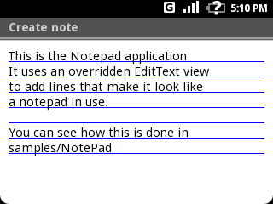
Android Notepad tutorial uses database
Useful db helper class for access and crud details

Slide 8
Context Menu is special
Acquire context menu by holding down selection key, which then pops up context menu

Slide 9
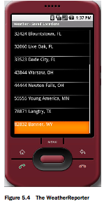
Unlocking Android db example covers more complex example
Stores locations to database within application as objects

Slide 10
Android app uses db helper classes with sql
public static class Location {
public long id;
public long lastalert;
public int alertenabled;
public String zip;
// include city and region because geocode is expensive
public String city;
public String region;
public Location() { }
public Location(final long id, final long lastalert, final int alertenabled, final String zip,
final String city, final String region) {
this.id = id;
this.lastalert = lastalert;
this.alertenabled = alertenabled;
this.zip = zip;
this.city = city;
this.region = region;
}
Part of DBHelper class showing
Location object
Class also holds crud details to map object to sql
Bruce Scharlau, University of Aberdeen, 2009

Slide 11
Android app maps objects to sql for ease
public void insert(final Location location) {
ContentValues values = new ContentValues();
values.put("zip", location.zip);
values.put("city", location.city);
values.put("region", location.region);
values.put("lastalert", location.lastalert);
values.put("alertenabled", location.alertenabled);
this.db.insert(DBHelper.DB_TABLE, null, values);
}
public void update(final Location location) {
ContentValues values = new ContentValues();
values.put("zip", location.zip);
values.put("city", location.city);
values.put("region", location.region);
values.put("lastalert", location.lastalert);
values.put("alertenabled", location.alertenabled);
this.db.update(DBHelper.DB_TABLE, values, "_id=" + location.id, null);
}
Mapping makes coding easier
Bruce Scharlau, University of Aberdeen, 2009

Slide 12
SQLite provides advanced db features
There is transaction support
You can use prepared statements based on java.sql and set items as have done before – faster and more secure
You have a cursor to keep track of location within a resultset

Slide 13
Can map objects to db
Can read items from network as xml and convert to objects, which map to db
Enables off network use and can sync later when connected
Might be pushing limits of device though with extra classes and memory usage

Slide 14
Summary
Can use preferences for each app
Can write/read files as with Java
Can persist/read items over network (when available)
Can use SQLite one db per app

