Slide 1

CONFIDENTIAL

Slide 2
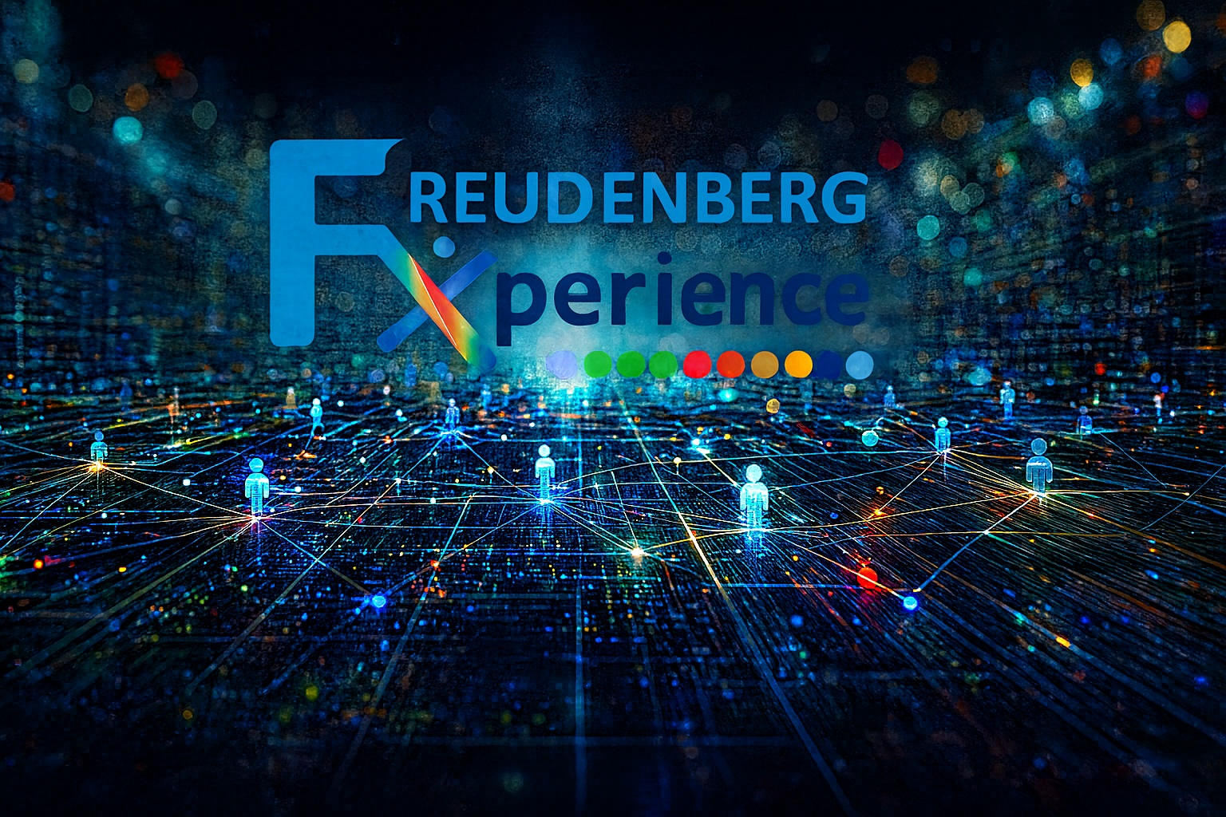
CONFIDENTIAL

Slide 3


FX Experience
Global Talent Exchange & Development Platform
Global Talent Exchange & Development Platform
Freudenberg Group | 2026
CONFIDENTIAL

Slide 4



What is FX Experience?
A complete platform to manage the entire global exchange cycle
All-in-one digital platform
Manages global exchanges, professional development, innovation and mentoring across 9+ Freudenberg business units
Connects employees across departments and geographies for cross-functional skills development and organizational knowledge transfer.
SKIPPER AI (FollowLabs) integrated across 8+ features, from course creation to diary analysis and A3 report generation.
16+
9+
Integrated
Modules
Business
Units
8+
3
Functions with
AI Integrated
Languages
(PT/EN/DE)
FX Experience · Freudenberg Group · FollowLabs
CONFIDENTIAL
4 / 21

Slide 5
Platform Architecture
16+ integrated modules organized in 4 strategic pillars
Exchange
& Mobility
Learning
& Development
Innovation
& Ideation
Management
& Insights
> Exchange Center
> Approvals (11 steps)
> Calendar & Events
> Enrollment
> Learning Hub
> Mentorship
> Diary 4.0
> A3 Reports
> Innovation Labs
> Submit Idea + ICE
> Idea Workflow
> Catalog & Analytics
> Admin Dashboard
> World Talent Map
> AI Resources Hub
> Settings & Audit
FX Experience · Freudenberg Group · FollowLabs
CONFIDENTIAL
5 / 21

Slide 6

Home Dashboard
Central panel with real-time program overview
4
3
2
5
Active Participants
Open Opportunities
Innovation Challenges
Ideas Submitted
Activity Feed — Real Time
World Talent Map
• Ana Silva completed Design Thinking module
• Bruno Costa submitted new idea in Innovation Labs
• Eduarda Lima scheduled mentoring with Fábio Pereira
• Gabriela Ramos approved Carla Dias' checklist
Interactive map with
global participant locations
Filters by unit, status and period
FX Experience · Freudenberg Group · FollowLabs
CONFIDENTIAL
6 / 21

Slide 7


Exchange Center & Approvals
Complete cycle: from opportunity to exchange execution
Exchange Center
Approvals — 11 Steps
Job rotation opportunities
01 Formal Manager & HR approval
02 LGPD & NDA signature
03 Detailed agenda definition
04 Mentor assignment
05 Ticket issuance
06 Accommodation reservation
07 Personal documentation
08 Company policies and rules
09 Pre-exchange briefing
10 Platform access verification
11 Emergency contact communication
Cards with title, company, duration, skills and location
Smart filters
By area, competency or Freudenberg unit
Gold highlights
Priority positions with gold border
Pre-filled form
Application with opportunity context
FX Experience · Freudenberg Group · FollowLabs
CONFIDENTIAL
7 / 21

Slide 8


Diary 4.0 — Digital Journal
Real-time exchange experience documentation
Entries
Goals
AI Summary
> Text, image or video
> Up to 3 attachments per entry
> Timeline visualization
> Mentor comments
> Development targets
> Progress 0-100%
> Attached evidence
> Status: Not Started → In Progress → Completed
> Analysis of 10+ entries
> Automatic narrative summary
> 3-6 extracted insights
> Overall sentiment analysis
FX Experience · Freudenberg Group · FollowLabs
CONFIDENTIAL
8 / 21

Slide 9
Innovation Labs
From idea to validation — 5 integrated sub-modules
Challenges
→
Submit
Idea
→
Workflow
6 stages
→
Catalog
→
Analytics
ICE Score — Idea Evaluation
Workflow — 6 Stages
Impact
0-10 Business impact potential
1. Submitted
2. Under Review
3. Approved
Confidence
0-10 Confidence level in execution
Effort
0-10 Required effort (divisor)
4. In Sprint
5. Validated
6. Scaled
Strategic
0-10 Strategic alignment
Tags: processo · segurança · custo · ESG · produto · RH
Formula: (I × C × S) / E
FX Experience · Freudenberg Group · FollowLabs
CONFIDENTIAL
9 / 21

Slide 10

Learning Hub
Continuous learning with courses, paths and generative AI
152
68%
88
430h
Enrollments
Completion
Avg Score
Study Hours
Course Catalog
AI Integrated with Learning
DPX Platform Tutorial
5 modules
Onboarding
AI Course Creation
Generates complete course from topic + source: modules, quizzes, suggested videos (1-10 modules)
Design Thinking in Practice
4 modules
Innovation
AI Coach
Advanced Consultative Selling
5 modules
Sales
Personalized path recommendations based on participant profile and goals
Situational Leadership
6 modules
Leadership
AI Playlists
Personalized course sequences based on completion history
FX Experience · Freudenberg Group · FollowLabs
CONFIDENTIAL
10 / 21

Slide 11


Mentorship
Complete mentor-mentee relationship management
Mentor View
Mentee View
> Mentee cards with avatar, name, role, unit and progress bar
> Visual alerts: red (critical) and yellow (attention) for overdue tasks
> Task table with priority levels (high/medium/low)
> Scheduling 1:1 and group sessions with calendar integration
> AI-generated reports on mentee progress
> Assigned mentor profile and contact
> Personal progress tracking
> Scheduled session visualization
Program Metrics
75%
80%
92%
Completion Rate
Diary Adherence
Feedback Delivery
FX Experience · Freudenberg Group · FollowLabs
CONFIDENTIAL
11 / 21

Slide 12



Calendar · Reports · Alumni
Event management, documentation and post-program networking
Calendar
Reports & A3
Alumni Network
> Monthly view with colored dots
> Daily event panel on click
> Consolidated table visualization
> Types: Presentation, Mentoring, Deadline, Training
> Colored badges by event type
> AI-powered A3 report generator
> Compiles diary + feedback + learning
> Automatic narrative summary
> Achievements, challenges and lessons
> Recommendations + editable before export
> Alumni grid with detailed cards
> Metrics: ideas, exchanges, courses, talks
> Search by name or unit
> Send Message button for networking
> History by cohort (ex: Cohort 2023)
FX Experience · Freudenberg Group · FollowLabs
CONFIDENTIAL
12 / 21

Slide 13


Admin Dashboard & Access Control
Consolidated program view with 4 access profiles (RBAC)
Admin Dashboard
Settings
> 25 Total Transfers · 8 Active · 28 days average
> Flow chart between units · Complete transfer table
> World Talent Map · Filters by unit, period and status
> Profile and notification management
> Custom logo upload · Unit management
> Activity log (audit with IP and timestamps)
> Complete data export (JSON)
Access Profiles (RBAC)
Participant
(Mentee)
Mentor
Manager
(Manager)
Admin
Diary, Exchange Center, Innovation Labs,
Learning, Mentorship, Calendar, Alumni
Diary (others), Mentorship,
Reports, Calendar, Alumni, Events
Approvals, Innovation Analytics,
Learning Analytics, Mentorship, Settings
Full access: Admin Dashboard,
Settings, Export, Unit Management
FX Experience · Freudenberg Group · FollowLabs
CONFIDENTIAL
13 / 21

Slide 14



SKIPPER AI — Intelligent Assistant
8+ AI-integrated features across the entire platform — powered by FollowLabs
Diary AI Summary
Course Creation
A3 Report
Idea Assistant
Analyzes 10+ entries, extracts insights and sentiment
Generates complete courses: modules, quizzes, videos
Compiles diary + feedback into structured evaluation
Refines problem/solution, suggests ICE improvements
Business Fit AI
Learning Path AI
Mentorship Report
Collaboration Finder
Evaluates strategic alignment of ideas
Personalized recommendations based on profile
Automatically documents mentee progress
Identifies cross-department partnerships
FX Experience · Freudenberg Group · FollowLabs
CONFIDENTIAL
14 / 21

Slide 15
Tech Stack & Integrations
Modern, scalable and secure architecture
Development Stack
Artificial Intelligence
Framework
Next.js 15.3.8 (App Router)
SKIPPER AI — FollowLabs proprietary AI engine
Frontend
React 18 + TypeScript
UI Library
shadcn/ui (Radix Primitives)
Styling
Tailwind CSS + CSS Custom Properties
Cloud & Infrastructure
Animation
Framer Motion 11.5.7
Charts
Recharts (data visualization)
Hosting
100% Cloud — secure and scalable storage
Icons
Lucide React
Authentication
SSO, OAuth2, MFA — integration with corporate identity providers
Themes
next-themes (light/dark mode)
Customization
Adaptable to customer server (Freudenberg infrastructure)
i18n
Custom LanguageContext (PT/EN/DE)
Multi-tenant
Each customer operates in isolated and configurable environment
Fonts
Inter (Google Fonts)
FX Experience · Freudenberg Group · FollowLabs
CONFIDENTIAL
15 / 21

Slide 16
Native Multi-language
Automatic translation of entire platform — independent of who writes or views
How It Works
Multilingual Attachment Preview
Automatic Interface Translation
Attached documents (PDFs, reports, forms) keep the original file intact.
When selecting another language, the platform generates a translated preview for viewing, without changing the original document.
Original Document (intact) → Preview in Selected Language
When selecting a language (PT/EN/DE), the entire interface is translated instantly: menus, labels, buttons, tooltips and system messages.
User-Generated Content
Text written by anyone (diaries, ideas, comments, reports) is automatically translated into the language selected by the viewer.
Independence from Origin
No matter what language the content was written in — each user sees everything in their preferred language, independent of the original author.
Translation Flow
Expandable
Author
writes in
any language
→
SKIPPER AI
translates in
real time
→
Reader sees
in selected
language
Native support for PT/EN/DE with architecture ready for inclusion of any new language on demand.
FX Experience · Freudenberg Group · FollowLabs
CONFIDENTIAL
16 / 21

Slide 17
FX Experience
Transforming global exchanges into high-impact experiences
Transforming global exchanges into high-impact experiences
Marcelo Gomes
Executive Consultant — FollowLabs
+55 19 98408 8833 | marcelo.gomes@followlabs.com.br
www.followlabs.com.br
CONFIDENTIAL

Slide 18

APPENDIX | Platform Access Instructions
1. Client Portal Access
Header Features
Access the client portal and click on "Access to Client"
User View
Switch between Mentee, Manager, Mentor and Admin
Themes
Choose from visual themes (sun, water, star)
Credenciais / Credentials
URL: followlabs.com.br/acessocliente/
Login: Freudenberg Senha: 123456
Language
Portuguese, English or German
HR Support
Direct access to Human Resources support
01
Log in with the credentials above
Important Notes
02
Watch the demo video (EN/PT)
> Prototype: may contain language errors or non-functional items — demonstrative in nature
> It is possible to integrate training and event manager as additional tool
> Freudy AI available as text chatbot and video avatar
03
Click on "Login" in the top right corner
04
On the FX Experience screen, click on the gold "Login" button (no password)
05
Explore modules and switch views (Mentee, Manager, Mentor, Admin)
FX Experience · Freudenberg Group · FollowLabs
CONFIDENTIAL
18 / 21

Slide 19

APPENDIX | Demo Video
Watch the Platform Demo
Watch the Platform Demo
▶ https://youtu.be/0s-wRBkWJ0c
Available in English | Disponível em Inglês
CONFIDENTIAL

Slide 20
APPENDIX | Access Simulation & Notes
Access Profile Simulation
Important Notes
The demo allows you to simulate the complete experience of each user profile through the selector "Simulate View As" in the platform header:
Demo Version
This is a demo version for presentation and validation purposes. Features may exhibit partial or simulated behaviors.
Mentored User
Design & Branding Policy
The current visual design (colors, typography, Glass & Gold layout) is demonstrative. The final version will be adjusted according to Freudenberg's branding policy and visual guidelines.
Participant view: Diary, Exchange Center, Learning Hub, Innovation Labs, Mentorship
Color Palette & Identity
Manager
The color palette will be customized according to the client's official brand guidelines. The current colors serve only as a style reference.
Manager view: Approvals, Innovation and Learning Analytics, Mentorship
Logo Usage
Mentor
The logos displayed on the platform (Freudenberg, business units) are purely illustrative. The final application will follow approved brand usage standards.
Mentor view: Mentee management, Others' Diary, Reports, Calendar
Administrator
Full view: Admin Dashboard, Settings, Data Export, Unit Management
FX Experience · Freudenberg Group · FollowLabs
CONFIDENTIAL
20 / 21

Slide 21
CONFIDENTIAL

