Slide 1
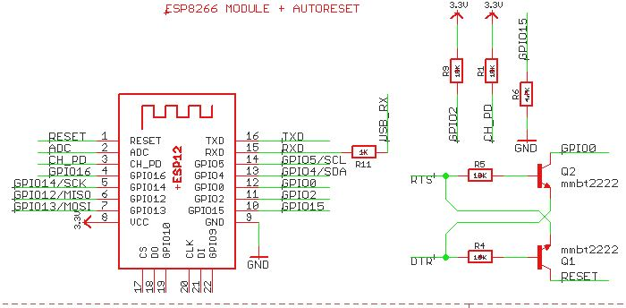
R-US_R0805
esp-12
R-US_R0805
R-US_R0805
R-US_R0805
trans_npn-mmbt2222al
R-US_R0805

Slide 2
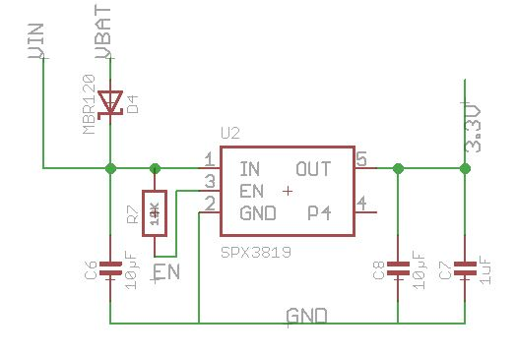
DIODESMA
SPX3819
R-US_R0805
C-USC0805
C-USC0805
C-USC0805

Slide 3
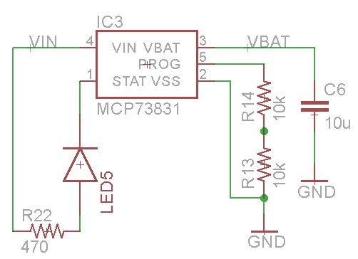
MCP73831
C-USC0805
R-US_R0805
LEDSML0805
R-US_R0805

Slide 4
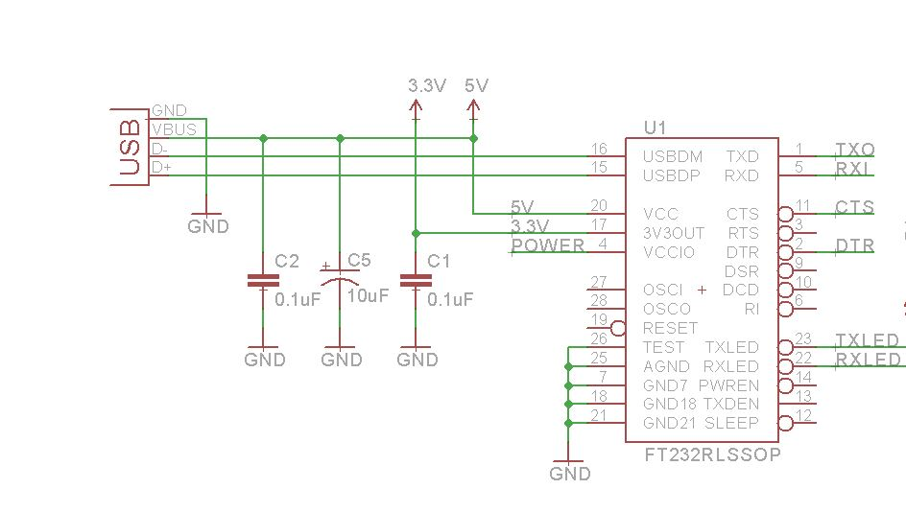
USBMINIB
VIN
VIN
C-USC0805
C-USC0805
C-USC0805
FT232RLSSOP

Slide 5
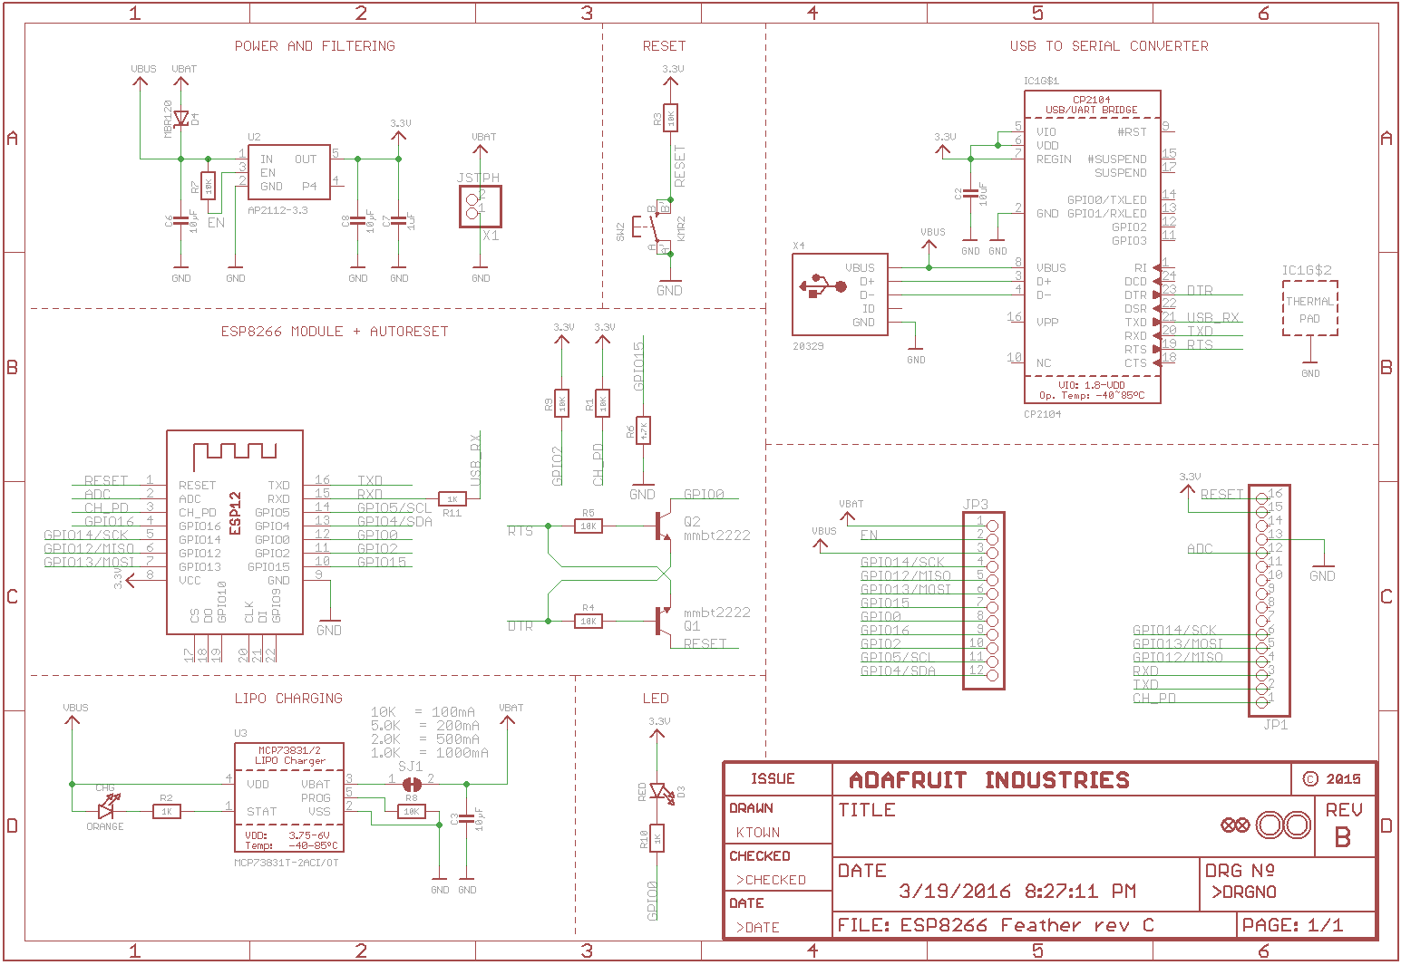
VIN
CONN_02POLAR
CONN_12
CONN_16

Slide 6
LEDSML0805
R-US_R0805
GND

