Slide 1
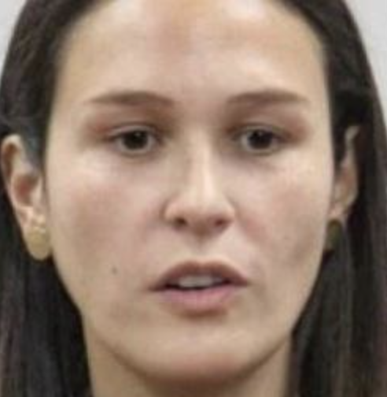
Object
Detection

Slide 2
boundingbox.csv
x1 x2 y1 y2
:
74.5544 | 110.1314 | 84.0287 | 101.0438
156.122 | 188.6185 | 81.9217 | 101.4196
91.1291 | 171.287 | 157.8583 | 187.3547
FM000048_02.jpg
:
(x1,y1)
(x1,y1)
Ojos:
Clase 0
N = 256
(x2,y2)
(x2,y2)
(x1,y1)
Boca:
Clase 1
(x2,y2)
M = 256

Slide 3
boundingbox.csv
File x1 x2 y1 y2 c
:
FM000048_01.jpg | 156.122 | 188.6185 | 81.9217 | 101.4196 | 0
FM000048_01.jpg | 91.1291 | 171.287 | 157.8583 | 187.3547 | 1
FM000048_02.jpg | 74.5544 | 110.1314 | 84.0287 | 101.0438 | 0
FM000048_02.jpg | 156.122 | 188.6185 | 81.9217 | 101.4196 | 0
FM000048_02.jpg | 91.1291 | 171.287 | 157.8583 | 187.3547 | 1
FM000048_03.jpg | 74.5544 | 110.1314 | 84.0287 | 101.0438 | 0
FM000048_03.jpg | 156.122 | 188.6185 | 81.9217 | 101.4196 | 0
x
FM000048_02.jpg
y
:
(x1,y1)
(x1,y1)
Ojos:
Clase 0
FM000048_02.txt
N = 256
(x2,y2)
(x2,y2)
c xn yn wn hn
(x1,y1)
Boca:
Clase 1
0 0.3607 0.3615 0.1390 0.0665
0 0.6733 0.3581 0.1269 0.0762
1 0.5125 0.6742 0.3131 0.1152
(x2,y2)
M = 256

