Slide 1

Visión por Computador
Domingo Mery
Departamento de Ciencia de la Computación
Escuela de Ingeniería
Universidad Católica de Chile
Points, lines and planes in 2D

Slide 2
[ Point ]
y
( x , y )
x

Slide 3
[ Line ]
y
( x , y )
x

Slide 4
[ Line ]
y
( x , y )
b
m
1
y = m x + b
x

Slide 5
[ Line ]
Two representations of m:
Cartesian coordinates
Homogeneous coordinates
y
( x , y )
m
l : a x + b y + c = 0
x
l = [ a b c ]^{T}
l m = 0
•
m = [ x y 1 ]^{T}
l ^{T} m = 0

Slide 6
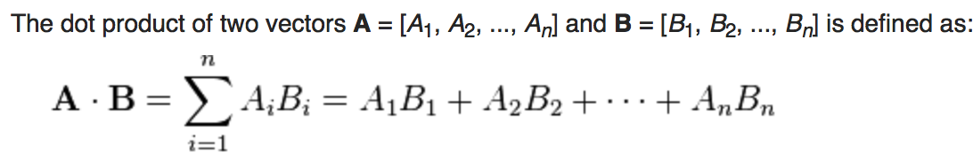
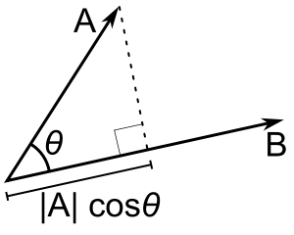
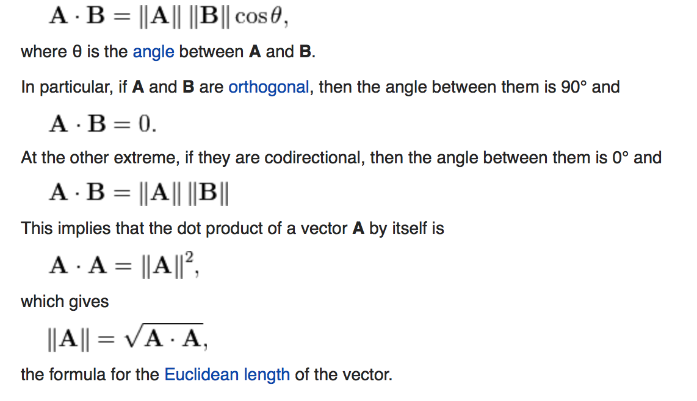
[ Dot Product ]
http://en.wikipedia.org/wiki/Dot_product

Slide 7
[ Dot Product ]
l = [ a b c ]^{T}
l m
•
= a x + b y + c = 0
m = [ x y 1 ]^{T}

Slide 8
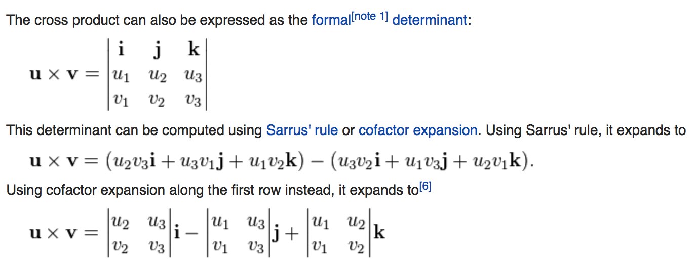
[ Cross Product ]
http://en.wikipedia.org/wiki/Cross_product

Slide 9
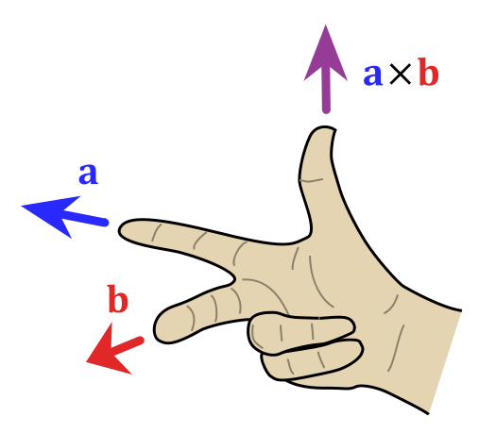
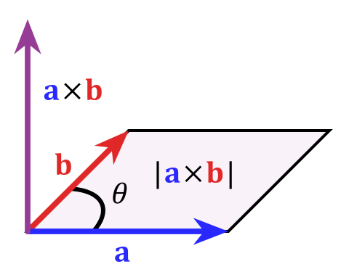
[ Cross Product ]
http://en.wikipedia.org/wiki/Cross_product

Slide 10
[ Cross Product ]
http://en.wikipedia.org/wiki/Cross_product

Slide 11
[ Intersection of two lines ]
We look for m so that
l₁ m = 0 and l₂ m = 0
y
•
•
( x , y )
m
l₁ : a₁ x + b₁ y + c₁ = 0
l₂ : a₂ x + b₂ y + c₂ = 0
x
l₁ = [ a₁ b₁ c₁ ]^{T}
l₁ w = ?
l₁ x l₂ = w
•
l₂ w = ?
l₂ = [ a₂ b₂ c₂ ]^{T}
•

Slide 12
[ Intersection of two lines ]
We look for m so that
l₁ m = 0 and l₂ m = 0
y
•
•
SOLUTION
( x , y )
m = l₁ x l₂
m
l₁ : a₁ x + b₁ y + c₁ = 0
l₂ : a₂ x + b₂ y + c₂ = 0
x
l₁ = [ a₁ b₁ c₁ ]^{T}
l₁ w = 0
l₁ x l₂ = w
•
l₂ w = 0
l₂ = [ a₂ b₂ c₂ ]^{T}
•

Slide 13
[ Line from two points ]
We look for l so that
l m₁ = 0 and l m₂ = 0
y
•
•
( x₁ , y₁ )
m₁
( x₂ , y₂ )
m₂
l : a x + b y + c = 0
x
m₁ w = ?
m₁ = [ x₁ y₁ 1 ]^{T}
•
m₁ x m₂ = w
m₂ w = ?
m₂ = [ x₂ x₂ 1 ]^{T}
•

Slide 14
[ Line from two points ]
We look for l so that
l m₁ = 0 and l m₂ = 0
y
•
•
( x₁ , y₁ )
SOLUTION
l = m₁ x m₂
m₁
( x₂ , y₂ )
m₂
l : a x + b y + c = 0
x
m₁ w = 0
m₁ = [ x₁ y₁ 1 ]^{T}
•
m₁ x m₂ = w
m₂ w = 0
m₂ = [ x₂ x₂ 1 ]^{T}
•

Slide 15
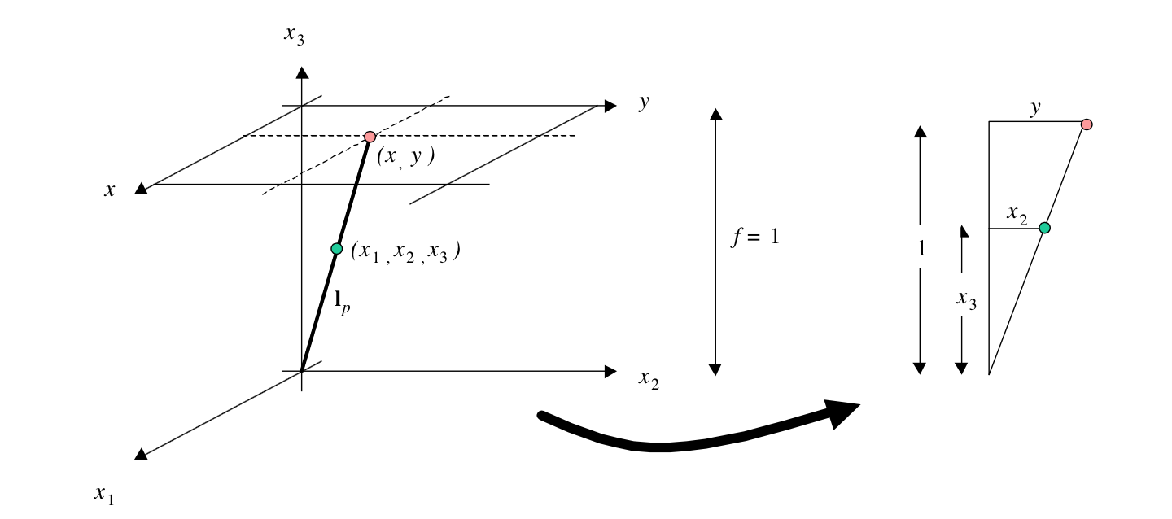



[ Homogeneous Coordinates ]

Slide 16
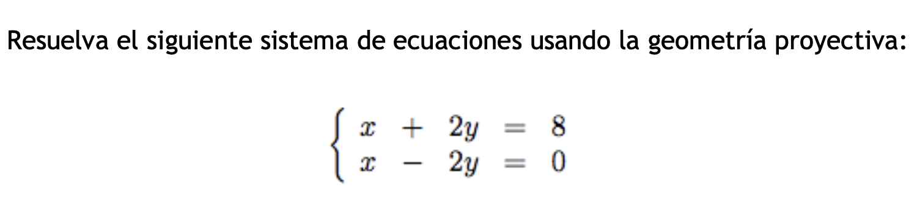
[ Ejercicio 1 ]

Slide 17
[ Ejercicio 2 ]
Encuentre la recta que pasa por los puntos (10,20) y (20,30)

Slide 18
[ Ejercicio 3 ]
Encuentre la distancia entre los puntos que intersectan las rectas

