Slide 1
Dynamic Programming II
__
Marcelo B. Barata Ribeiro
William Sena
Notes:
4 steps: http://syllabus.cs.manchester.ac.uk/ugt/2018/COMP26120/lab/knapsack.pdf

Slide 2
Summary
1 Longest Subsequence
2 Knapsack
Unbounded Knapsack
0/1 Knapsack
3 Independent Sets

Slide 3
When does Divide & Conquer work?
Notes:
Falar de mergesort e Fibonacci.

Slide 4
Divide & Conquer recap
In divide-and-conquer, a problem is expressed in terms of subproblems that are substantially smaller, say half the size.
In contrast, in a typical dynamic programming formulation, a problem is reduced to subproblems that are only slightly smaller. For instance, L(j) relies on L(j-1). Thus the full recursion tree generally has polynomial depth and an exponential number of nodes.
However, it turns out that most of these nodes are repeats, that there are not too many distinct subproblems among them.

Slide 5
Dynamic Programming
The idea:
Compute the solutions to the sub-problems once and store the solutions in a table, so that they can be reused (repeatedly) later.
We trade space for time!

Slide 6
4 steps of dynamic programming
When developing a dynamic-programming algorithm, we follow a sequence of four steps:
1. Characterize the structure of an optimal solution.
2. Recursively define the value of an optimal solution.
3. Compute the value of an optimal solution, typically in a bottom-up fashion.
4. Construct an optimal solution from computed information.

Slide 7
4 steps of dynamic programming
Step1: Structure
Characterize the structure of an optimal solution.
Decompose the problem into smaller problems, and find a relation between the structure of the optimal solution of the original problem and the solutions of the smaller problems.

Slide 8
4 steps of dynamic programming
Step2: Principle of Optimality
Recursively define the value of an optimal solution.
Express the solution of the original problem in terms of optimal solutions for smaller problems.

Slide 9
4 steps of dynamic programming
Step 3: Bottom-up computation
Compute the value of an optimal solution in a bottom-up fashion by using a table structure.

Slide 10
4 steps of dynamic programming
Step 4: Construction of optimal solution
Construct an optimal solution from computed information.
Note that if we need only the value of an optimal solution, and not the solution itself, then we can omit step 4.

Slide 11
Longest subsequence

Slide 12
Longest Common Subsequence

Slide 13
Knapsack

Slide 14
Knapsack
Step 1: Decompose the problem into smaller problems. We construct an array 1 2 345 36 . For " / / , and / / , the entry 1 278(6 will store the maximum (combined) computing time of any subset of files !#" %$&(9) of (combined) size at most . If we can compute all the entries of this array, then the array entry 1 275 6 will contain the maximum computing time of files that can fit into the storage, that is, the solution to our problem.

Slide 15
Knapsack
Let’s run our algorithm on the following data:
n = 4 (# of elements)
W = 5 (max weight)
Elements (weight, value): (2,3), (3,4), (4,5), (5,6)

Slide 16
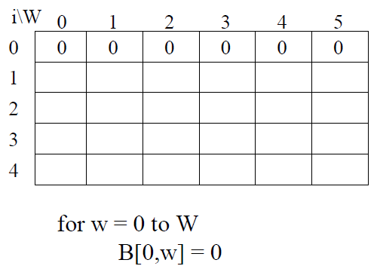
0/1 Knapsack

Slide 17
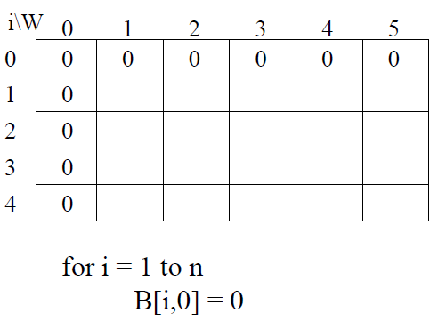
0/1 Knapsack

Slide 18
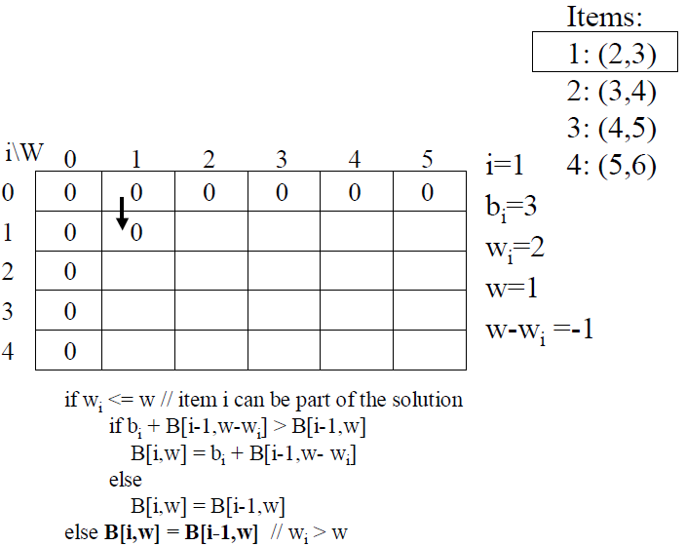
0/1 Knapsack

Slide 19
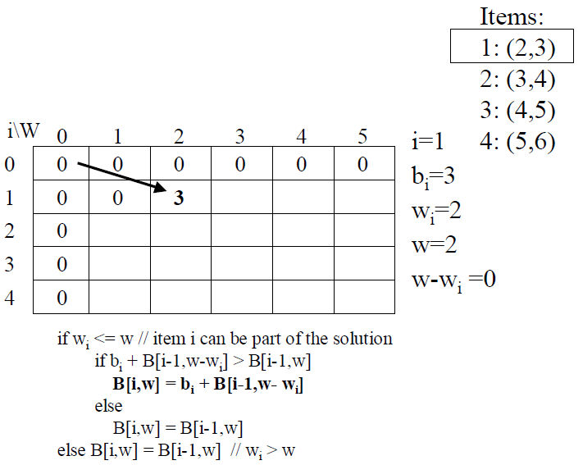
0/1 Knapsack

Slide 20
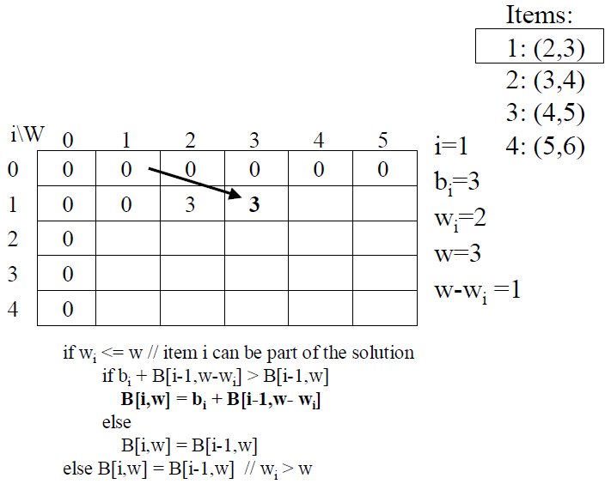
0/1 Knapsack

Slide 21
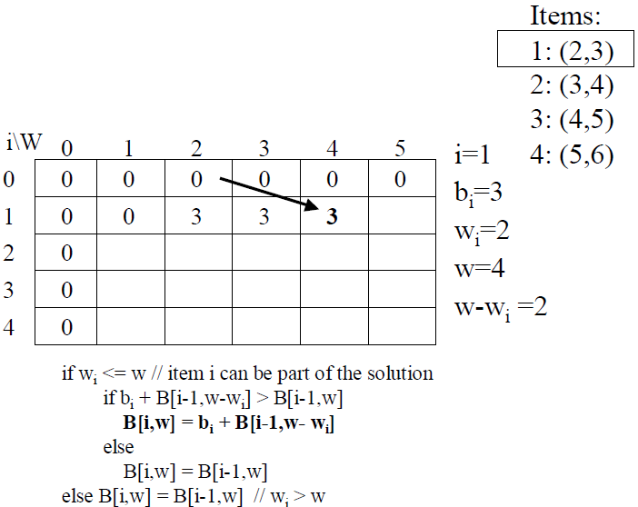
0/1 Knapsack

Slide 22
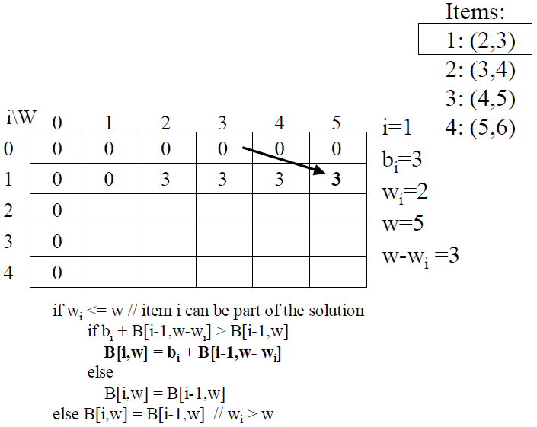
0/1 Knapsack

Slide 23
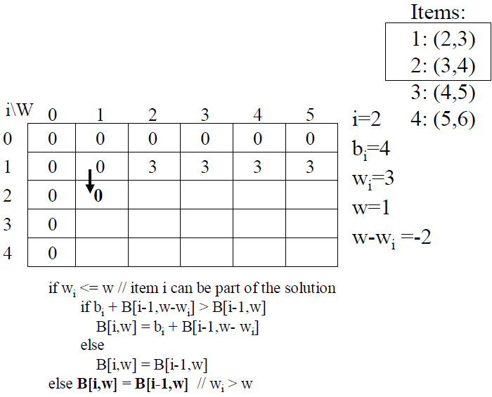
0/1 Knapsack

Slide 24
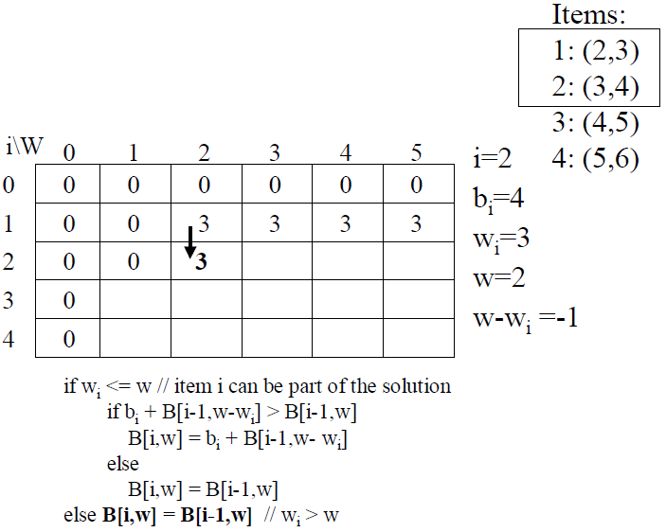
0/1 Knapsack

Slide 25
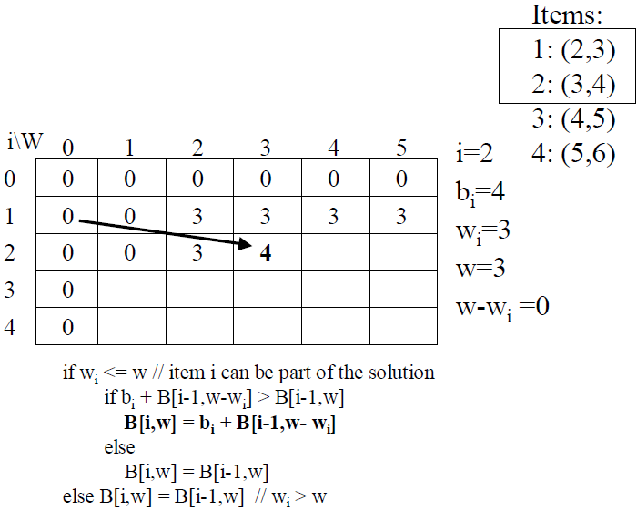
0/1 Knapsack

Slide 26
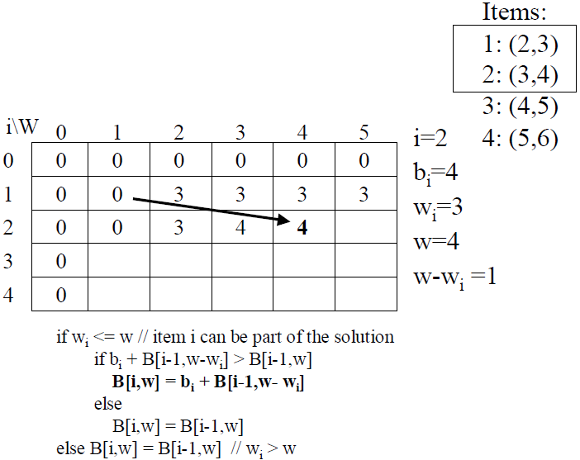
0/1 Knapsack

Slide 27
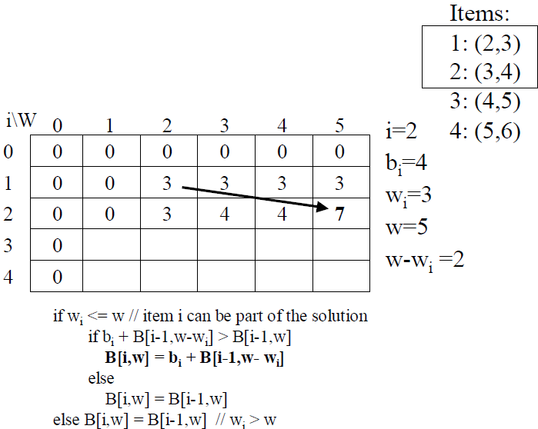
0/1 Knapsack

Slide 28
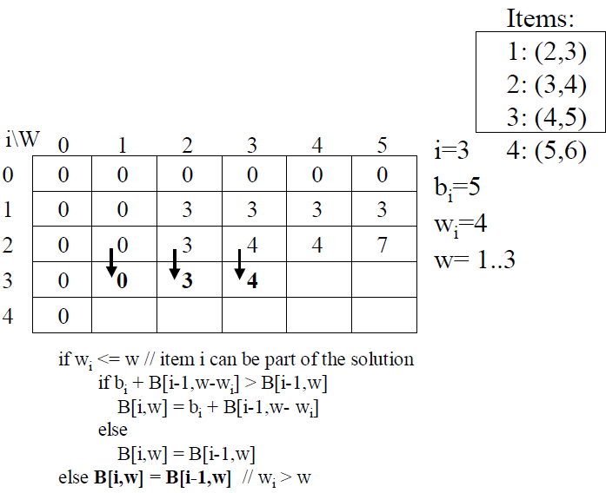
0/1 Knapsack

Slide 29
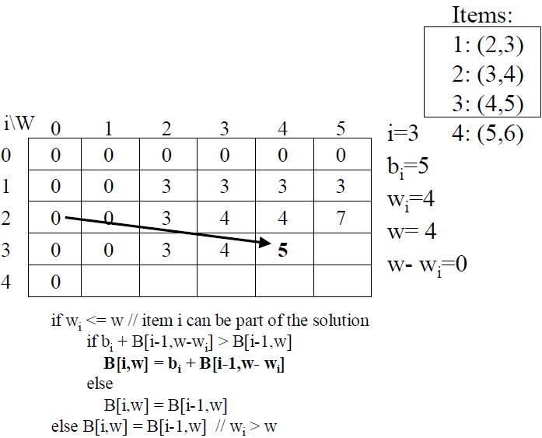
0/1 Knapsack

Slide 30
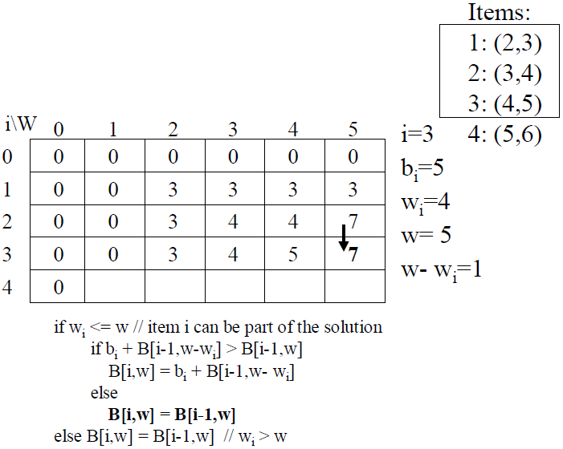
0/1 Knapsack

Slide 31
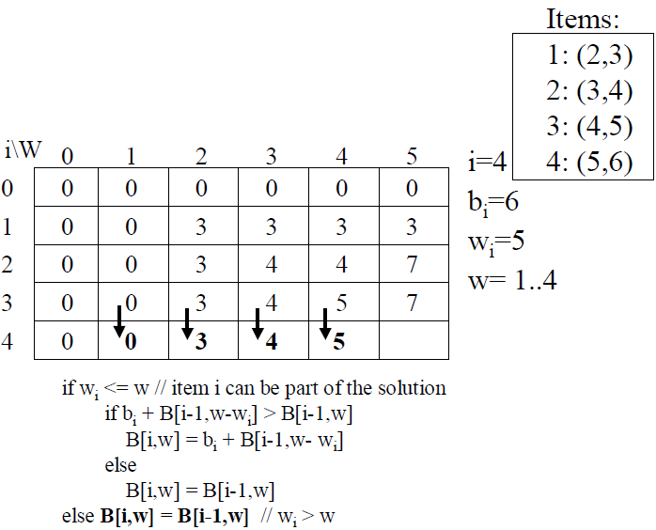
0/1 Knapsack

Slide 32
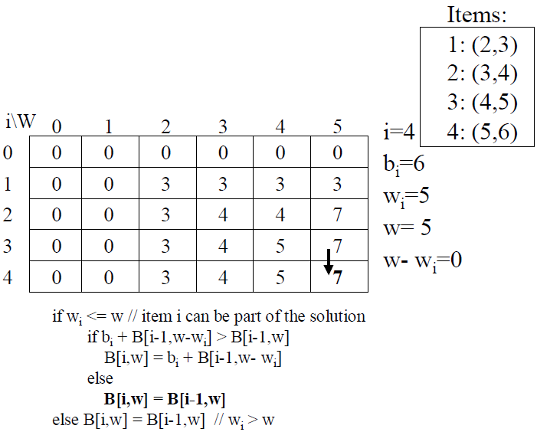
0/1 Knapsack

Slide 33
Independent Set

Slide 34
Independent Set

Slide 35
Thanks
Marcelo Barata Ribeiro marcelobbribeiro@gmail.com
•
William Sena
will182neves@gmail.com

