Slide 1
Adventure Works Cycles
Profitability drop analysis

Slide 2
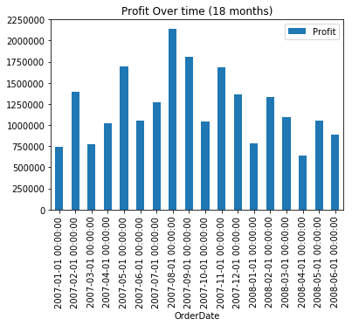
Profit Over time
Profit (defined as (unit price – unit cost) *Quantity sold for all items) has been showing a decreasing tendency since Aug 2007 with some fluctuation, Feb being the strongest month in 2008.
The first point to investigate is whether or not the drop in profit comes from a drop in sale quantity or a drop in profitability per item sold, which is addressed in the next slide.

Slide 3
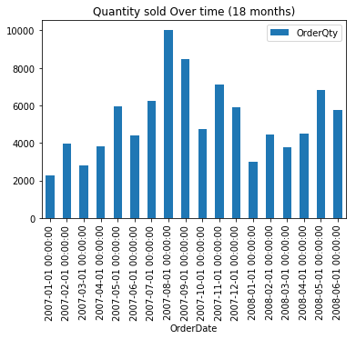
Items sold
The number of sold items over time shows some fluctuation, with a low count in January that might be seasonal.
The most important aspect here is that the decrease in profits is not coming from a decrease in items sold, but from a decrease in profitability of each item sold as can be clearly seen in June 2018 by a high sales volume and low profit.

Slide 4
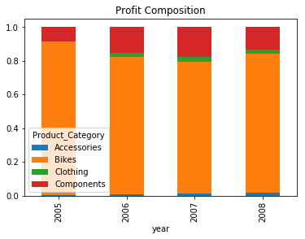
Profit Breakdown
Bikes are by far the largest contribution to profit, followed by components, while Clothing and Accessories make up a small share of overall profits.
Given this composition it makes sense to devote most of the attention to bikes.
Ideally another such chart could be created to show monthly or quarterly profit decomposition.

Slide 5
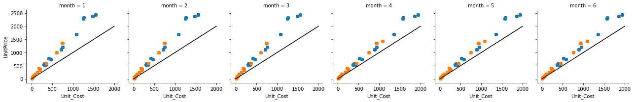
Price Vs Cost
Given that profit depends on the difference between sale price and cost, it makes sense to focus on their relation over the months of 2008. The next 3 slides deal with prices and costs.
On the charts below Unit Price and Unit Cost are plotted for Bikes (blue) and Components (orange) for 2008. The dark 45 degree line indicates that for that item price = cost, so in the absence of additional costs, it means no profits.
Comparing the different months it can be seen that some higher priced bikes suffered an increase in costs with no corresponding increase in prices.

Slide 6
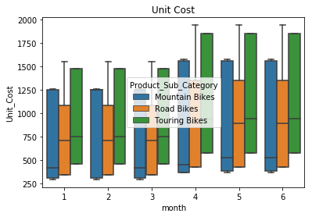
Cost per bike subcategory
The boxplot on the right displays unit costs for bikes, broken down by subcategory over the year of 2008.
Median costs increased for all 3 types of bikes, but most notedly for Touring and Road bikes.
It’s important that here it’s not a model by model comparison, so different basket compositions can influence the costs.
The action point from here is determining why is the cost of bikes sold increasing.

Slide 7
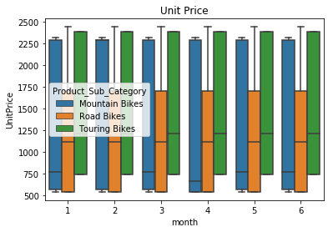
Price per bike subcategory
In contrast to the previous chart, prices of bikes remained constant over time.
The disconnection between cost and price fluctuations is the main driver for the profit decrease in 2008.

Slide 8
Cost increases per model
Comparing the evolution of prices for each model, looking at median unit cost in June there’s a 25% increase compared to January (change took place in May) for every bike model that was on sale in both months, so the observed cost increase is not due to a change in consumer basket. Additionally, there was no change in the median price of each model.
The overall recommendation is to investigate the causes of the cost increase, if they can be reverted or mitigated and prevent further cost increases in the future.

Slide 9
Further investigation
It’d be interesting to investigate the price elasticity. Given a x% change in price what % change can we expect in demand (items sold). Given the data this should be possible to estimate, assuming there are no marketing or other effects in play. This could help decide if there should be a price increase, just a cost reduction or a bit of both.
A similar exploration (as done in previous slides) for Component parts could help understand what is driving the costs of bikes up. Maybe the frames are responsible for a higher share of cost increase than wheels for example.
Additionally, while the US is by far the largest market for the company, exchange rates were not investigated at all but could help explain the increase in costs or the flat prices.
There were no seasonality concerns here, but it might be interesting to understand how profit fluctuates over months.
Markup (Price/Cost) was not analyzed here, but it be interesting to study which items have the highest gain relative to their cost and how that affects profitability.
Further investigation into Unit_Freight_Cost would also be needed. It’s not clear if Adventure World Cycles or the customer bears the cost. If it is covered by AWC then Accessories and Clothing seem to be operating at a loss, which despite small in global profits, would need to be addressed. Freight costs are cheaper on average for clothing and accessories (23% compared to bikes), but could be optimized for light items to improve branding (assuming it’s a strategy of AWC).

