Slide 1
XenoFind
By XenoFriends
Jayson Sumabat, Yujia Huang, Sebastian Peck, Nicholas Lai

Slide 2
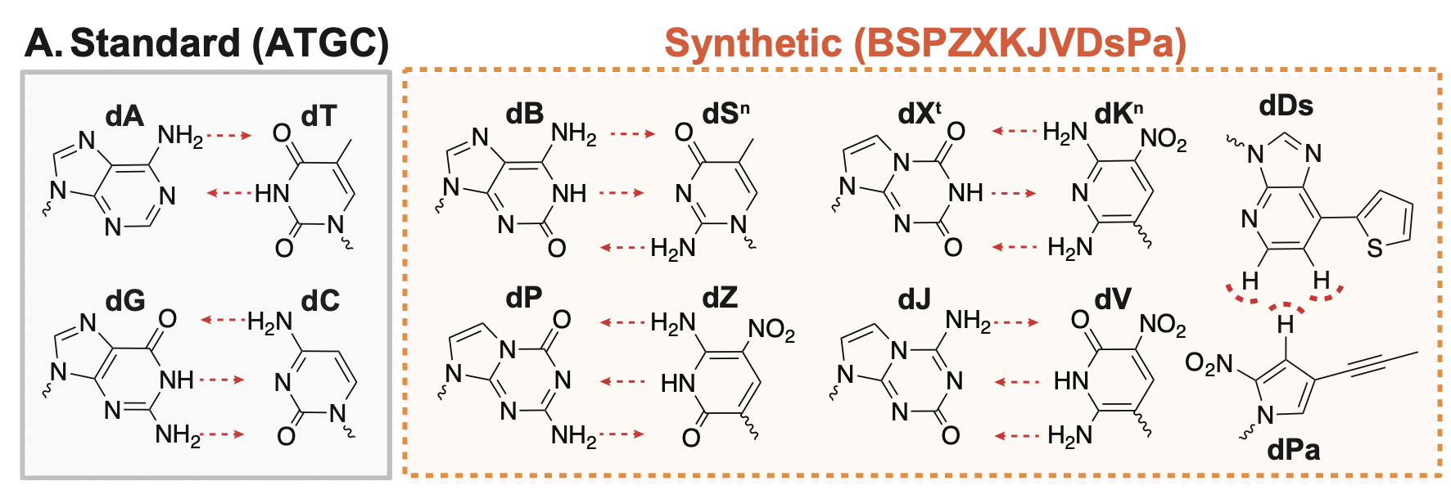
Introduction
Life evolved primarily using four nucleobases within DNA (A, T, G, C)

Slide 3
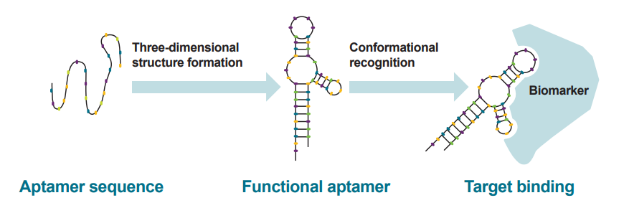
Motivation
These bases can construct aptamers - short DNA that binds to targets similar to antibodies

Slide 4
Motivation
However, aptamers formed by these standard bases are generally not as effective as antibodies
Notes:
FDA has only approved 2 adtamer drug so far

Slide 5
Motivation
There are synthetic bases beyond ATGC that can provide more functional diversity

Slide 6
Challenge
Problem: Tools do not exist to easily sequence these nucleotides de novo
Solution: A bioinformatics pipeline that can tell us where and what that modified base is
Capstone Goal: Develop tools to identify these bases, beginning with potential regions of interest

Slide 7
Current Progress
XenoFind
xf_consensus
xf_low_qual
XNA labeled fasta file
xf_consensus
Preliminary consensus fasta file
xf_low_qual
XNA labeled fasta file
Preliminary consensus fasta file
xf_low_qual performs XNA detection by analyzing and performing a statistical test on low ‘quality score’ regions
Takes in a fast5/pod5 dataset from Nanopore Sequencing and outputs a consensus fasta file to be used downstream for XNA location identification
Barcode
Region of Interest
Barcode
GGTCTGGTGCCACTGGTCTGCTACGAGTGATGGTANNNNNNNNNNNNNNNNNNNNTTGTAACGCACCCGATCACGATAGGCAACCACACC

Slide 8
Consensus Sequence
User Inputs:
Desired working directory
pod5 or fast5 dataset
a temporary reference file containing the following structure:
Barcode
Region of Interest
Barcode
GGTCTGGTGCCACTGGTCTGCTACGAGTGATGGTANNNNNNNNNNNNNNNNNNNNTTGTAACGCACCCGATCACGATAGGCAACCACACC

Slide 9
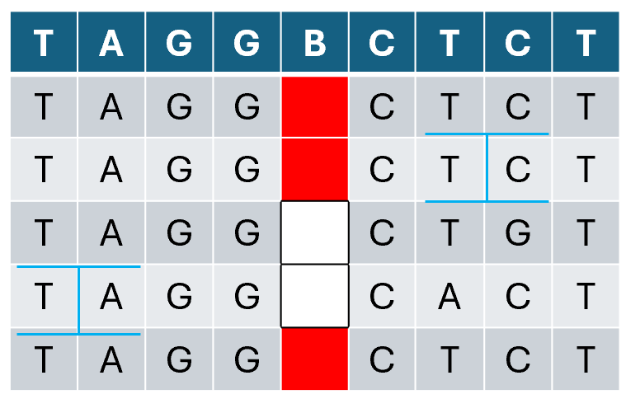
Consensus Sequence
The consensus sequence contain the most abundant nucleotide at each position.
Insertion
Deletion
Non-standard bases
Notes:
This example we know ground truth for the sake of development.

Slide 10
Statistical Method
Wilcoxon Test:
Does not assume data are normally distributed
Works for pair/match data
GGTCTGGTGCCACTGGTCTG
GTC
TCT

Slide 11
Statistical Method
Wilcoxon Test:
Does not assume data are normally distributed
Works for pair/match data
GGTCTGG

Slide 12
Development Challenges
Code structure
working with predeveloped code
Dependency/compatibility issues
Developing unit test
Index problem

Slide 13
Moving Forward
Spring Quarter Goals:
Expand on XNA detection with more robust methods
Signal level analysis
Hidden Markov Models
Machine learning
Visualization tools
Similar to BlastN / IGViewer
Compare ground truth (if known) to consensus sequences

Slide 14
Question?

