Slide 1
Optimal Public Policy
CASE № 4
Summer school in research methods 2020

Slide 2
COVID-19
Presented by: Maya, Lingling, Georgi, Vlado & Stefan

Slide 3





Our Team Infographic
CASE-4
Team history: Team was created in the first day of summer school. Our team consist of 5 individuals. 2 of them had previous experience with software and data analytics, one of them has experience in field of statistics, one has management & moderator experience and one has international experience studying in Beijing. Because of that diversity of interests it was easy to have everybody working and helping the team.
Team members:
Team skills
1. Мая Иванова
2. Lingling Ma
3. Георги Драгоманов
4. Владо Йорданов
5. Стефан Григоров

Slide 4
Content:
01
COVID-19 Outbreak and Impact
.
02
Cluster analysis
How and why we choose the countries.
03
Belgium, Kosovo & Latvia
Large correlation matrix; PCA; Correlation with policy index; linear model; distributions of residuals; Q-Q plot; trees
04
Propose optimal public policy
Get a modern PowerPoint Presentation that is beautifully designed. I hope and I believe that this Template will your Time.

Slide 5
Background
COVID-19
Progress steps
2019.12
2020.01
2020.02
2020.03
2020.04
The Wuhan Municipal Health Commission publicly notified the pneumonia epidemic for the first time, saying that 27 cases of "viral pneumonia" have been detected in the city, and 7 of them are in serious condition.
The National Health Commission of China has confirmed that the "new coronavirus" is the pathogen of the epidemic.
In China, 36,000 people have been infected with the new type of coronavirus pneumonia, and more than 800 people have died. The death toll exceeds the global record of SARS.
The WHO has issued a strategic preparedness and response plan for the international community to help protect countries with weak health systems.
The WHO is deeply concerned about the shocking spread and severity of the epidemic, and it is also deeply concerned about the shocking degree of inaction. Therefore, the assessment believes that COVID-19 can be classified as a pandemic.
The number of new cases has shown an almost exponential growth trend, covering almost every country, territory and region.
Wuhan City, where the epidemic first broke out, lifted the 77-day-long Li Han Li Hubei channel control measures and resumed external traffic.

Slide 6
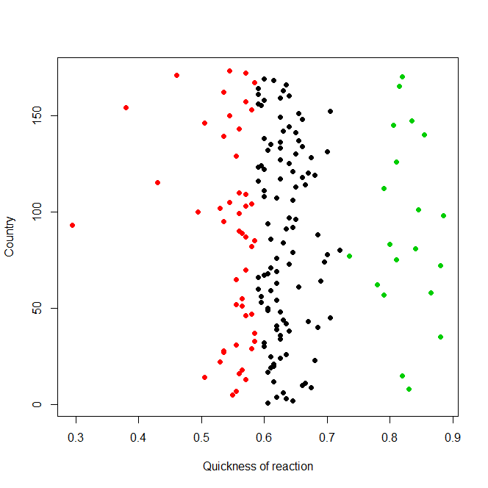
Research object
Cluster Analysis -Stringency index
Red – countries who are not affected or with no measures
Kosovo
Black – countries that are in the middle
Latvia
Green – countries that make quick and right decisions
Belgium

Slide 7
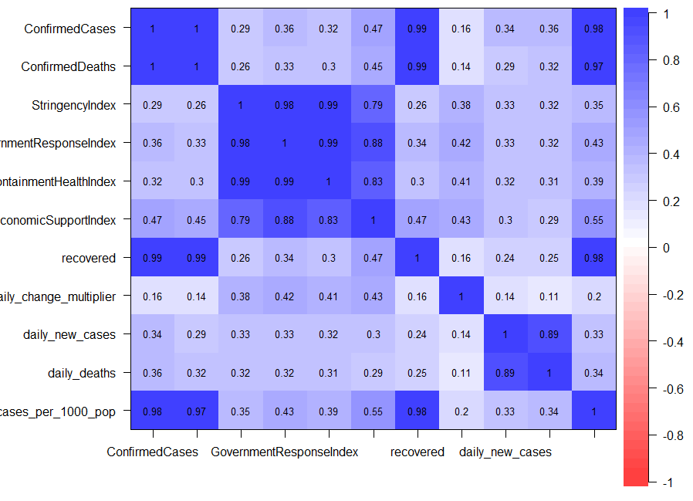
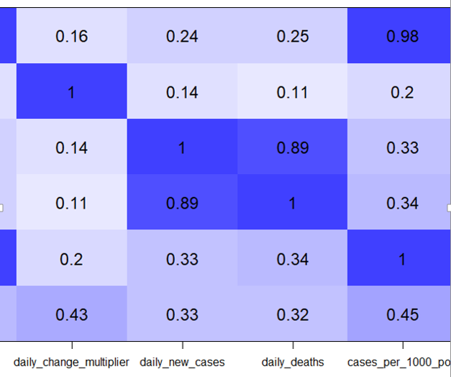
Data Analysis Result
Large correlation matrix
Correlation with policy index

Slide 8
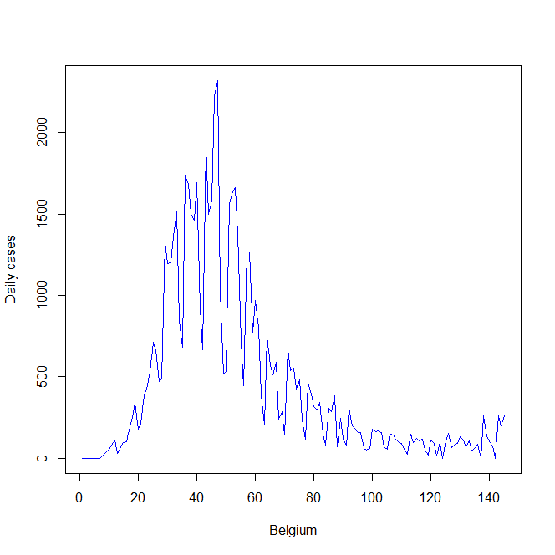
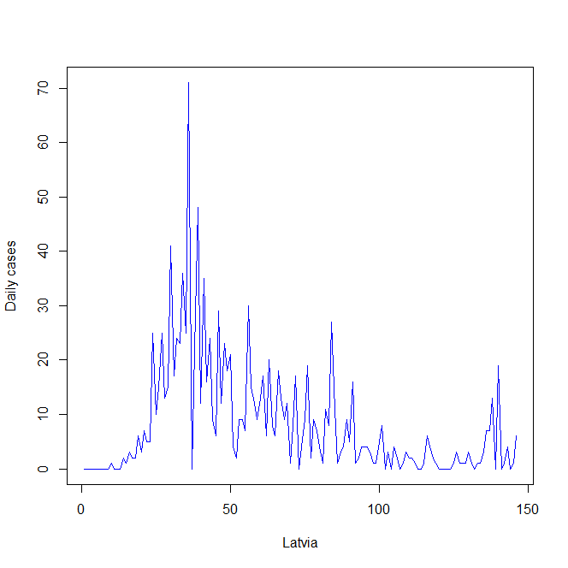
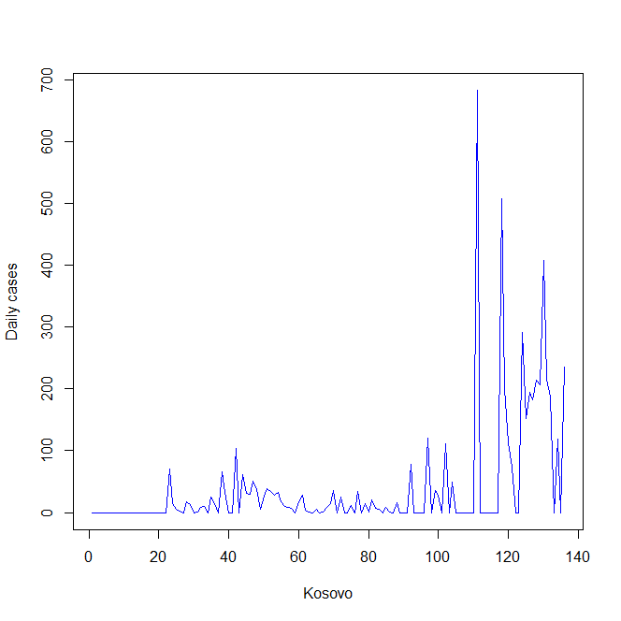
Data Analysis Result
Daily cases charts for the 3 sample countries

Slide 9
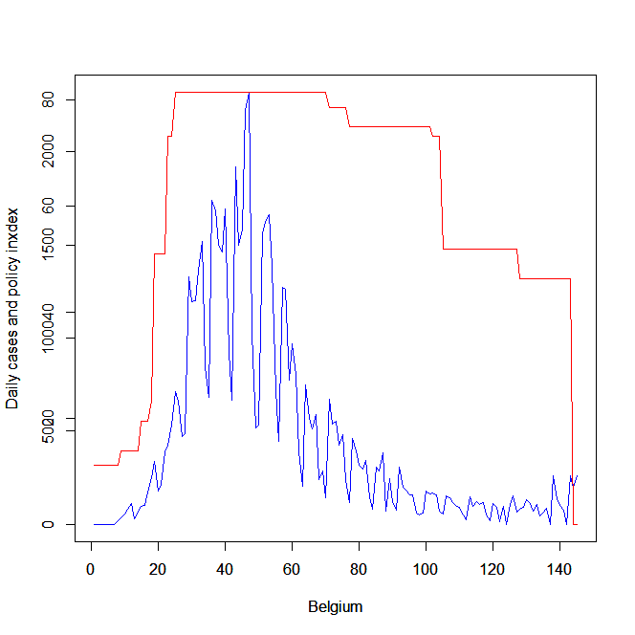
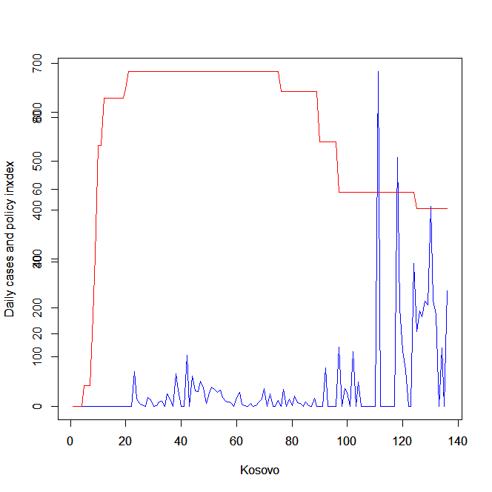
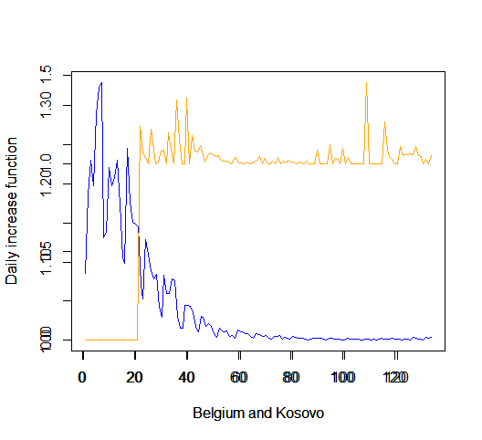
Data Analysis Result
Belgium and Kosovo policy analysis
The policy index variance is statistically significant for the 2 countries

Slide 10
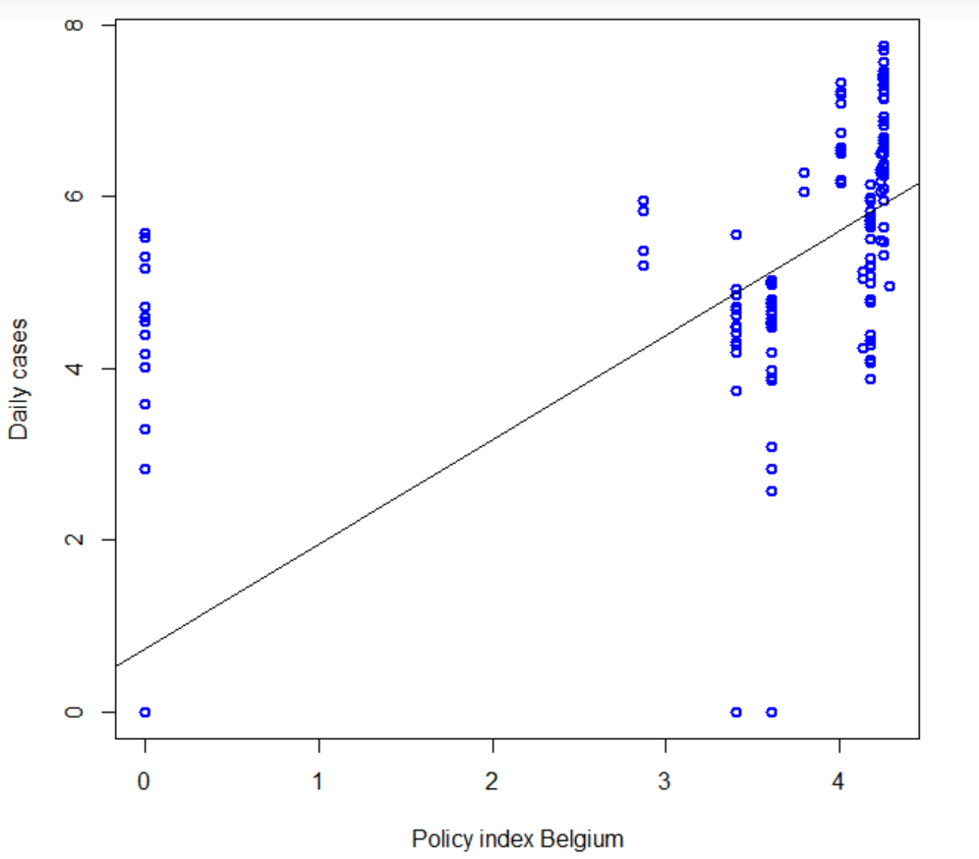
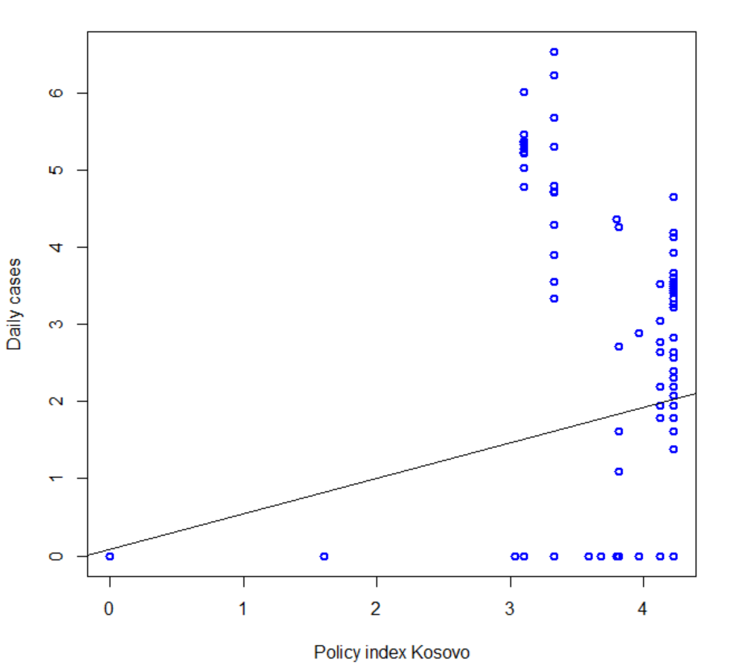
Data Analysis Result
Policy index impact on daily cases
Res.Df Df F Pr(>F)
1 176
2 179 -3 9.5973 6.673e-06 ***
Res.Df Df F Pr(>F)
1 176
2 179 -3 0.0192 0.9964

Slide 11
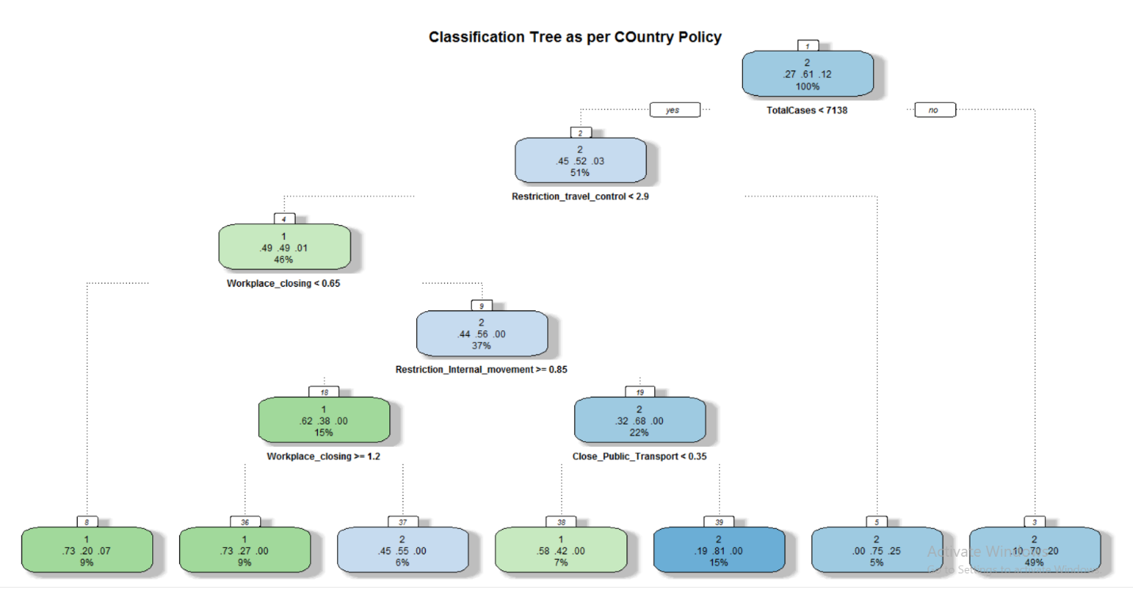
Data Analysis Result
Tree

Slide 12
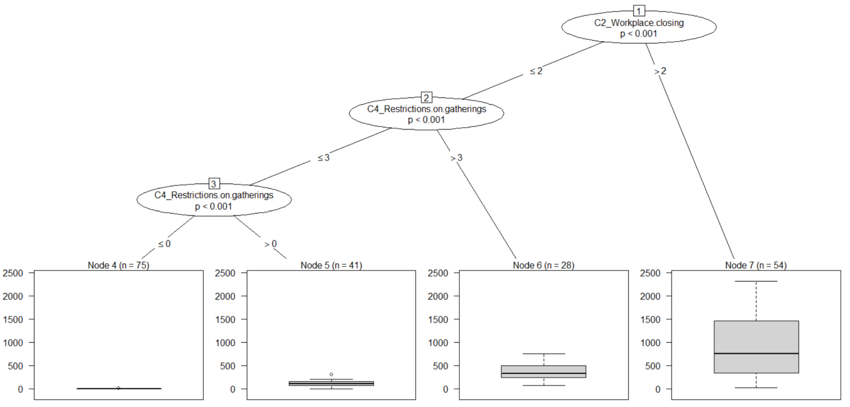
Data Analysis Result
#Variable Importance for the Classification Tree Example: Policy classifier for Belgium
rpart[["variable.importance"]]
C4_Restrictions.on.gatherings
C8_International.travel.controls
46.096388 43.967316
C1_School.closing
C3_Cancel.public.events
43.101382 42.637372
C2_Workplace.closing
C6_Stay.at.home.requirements
42.500855 21.474807
C7_Restrictions.on.internal.movement
1.056911

Slide 13
Data Analysis Result
Infographic confirmed cases
PCA
5472
Confirmed
Kosovo(1 810 463 population)
63,499
Confirmed
Belgium (11.5 million population)
 | PC1 | PC2 | PC3
Standard deviation | 64.8527 | 18.2609 | 3.15754
Proportion of Variance | 0.9245 | 0.0733 | 0.00219
Cumulative Proportion | 0.9245 | 0.9978 | 1.00000

Slide 14
Every country have to take different measures depending on their situation.
Still there are things that every person can do:
Our research make us think that:

Slide 15
Wash your
Hands often

Slide 16
FINAL ADVICE.

Slide 17
THANK YOU
Stay Healthy, Be responsible

