Slide 1
Introduction to Reinforcement learning
This slides contain slides or modifications of David Silver’s and Emma Brunskill RL courses

Slide 2
Plan
Basic model
Types of RL
RL vs Supervised learning (discussion)
Q-learning (if time permits)
Policy gradient (if time permits)

Slide 3
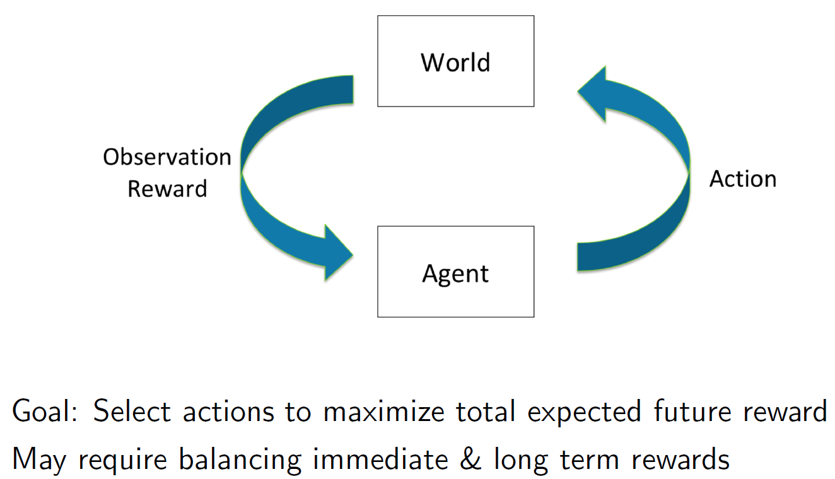
Sequential Decision Making
Select actions to maximize expected cumulative reward

Slide 4
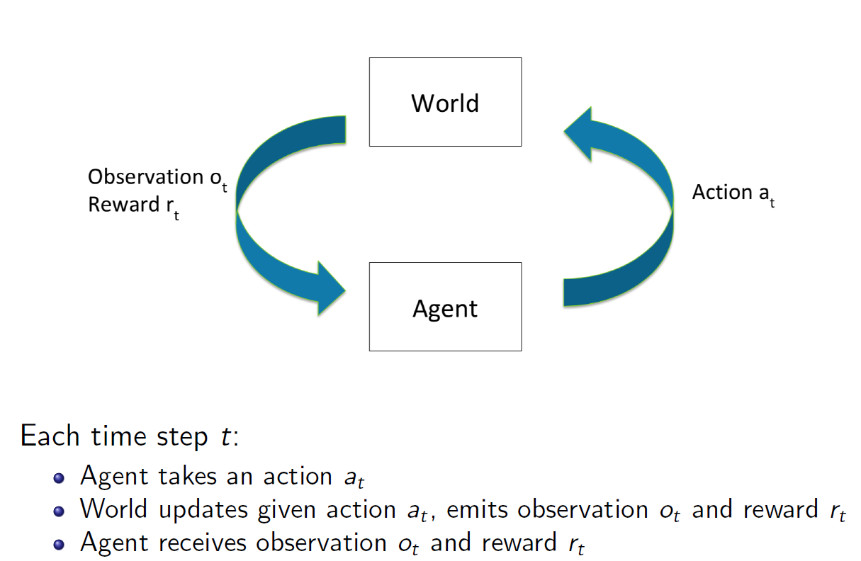
Sequential Decision Making
State s_{t}
History h_{t} = (a₁ , s₁ , r₁ , ... a_{t} , s_{t} , r_{t} )

Slide 5
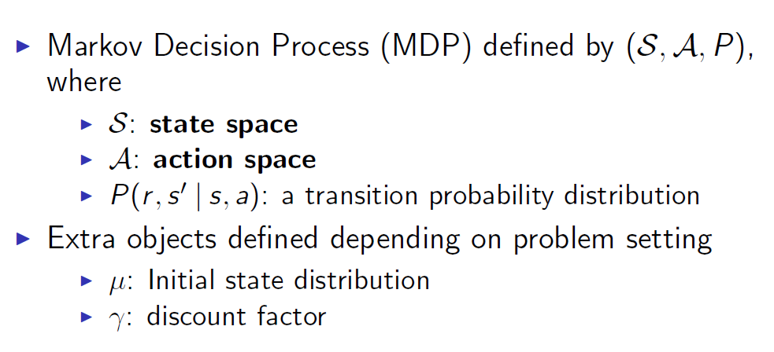
Definitions

Slide 6
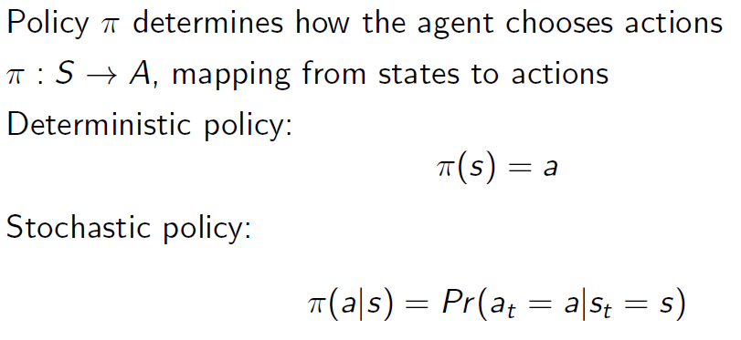
Policy

Slide 7
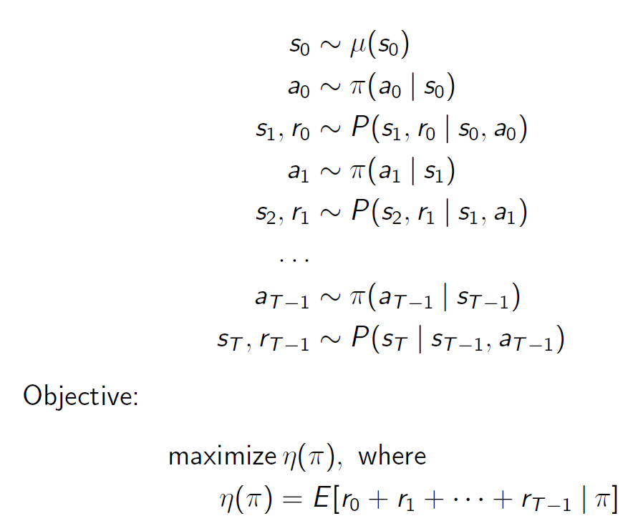
Episodes

Slide 8
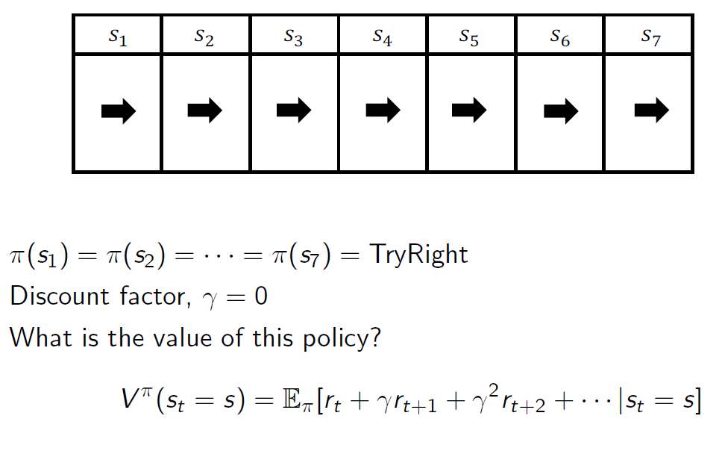
Example

Slide 9
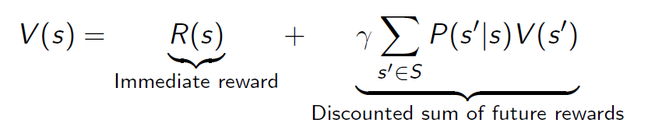
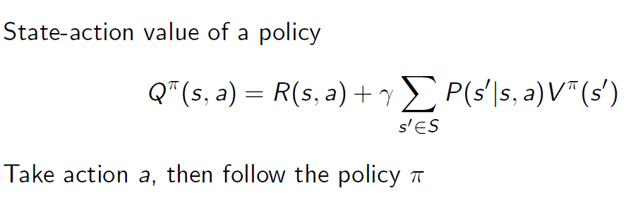
Value of MDP
Markov property provide structure

Slide 10
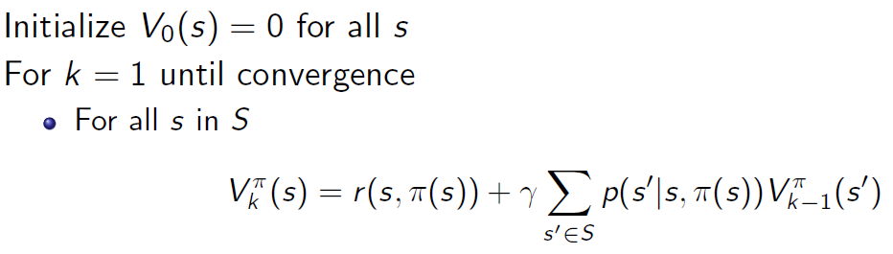
Policy evaluation

Slide 11
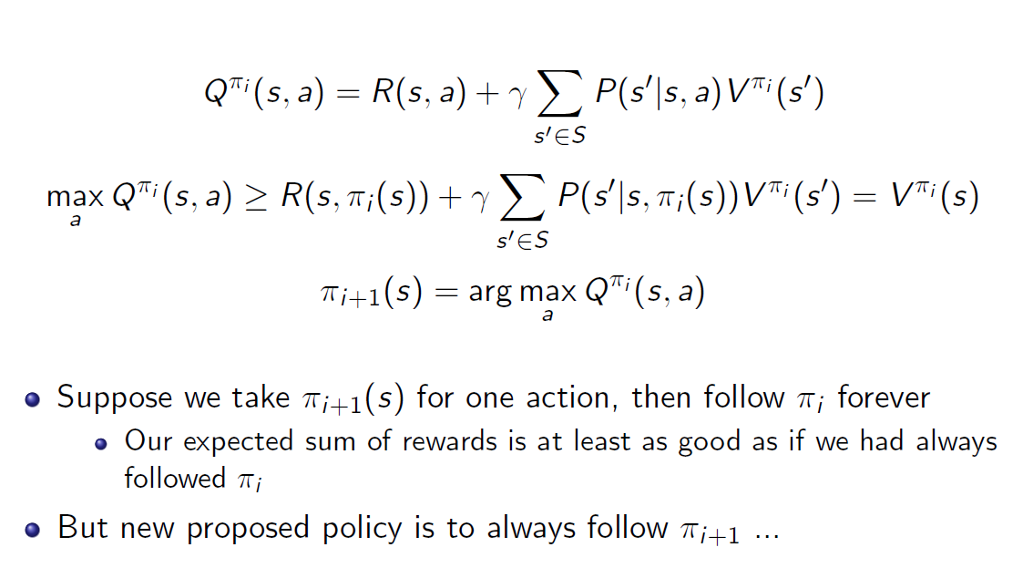
Policy Iteration

Slide 12
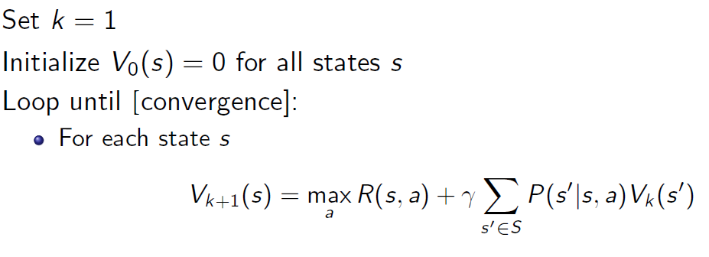
Value Iteration

Slide 13
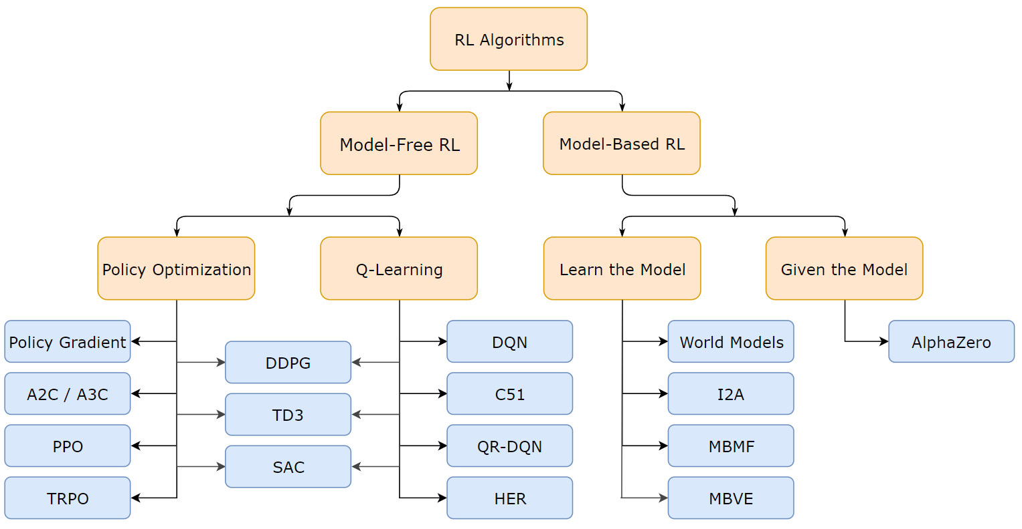
Types of RL

Slide 14
Discussion and fun

Slide 15
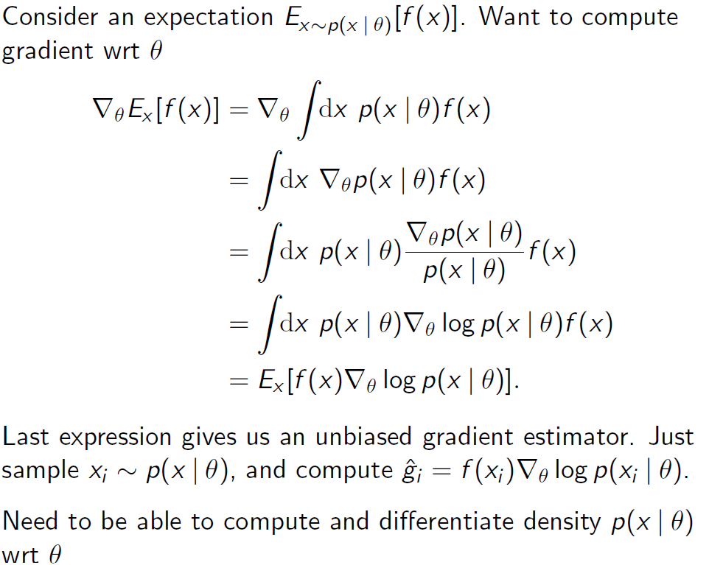
Score function Gradient Estimator

Slide 16

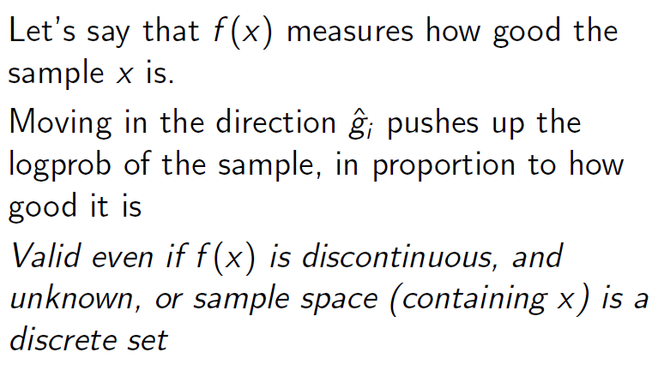
Score function Gradient Estimator

Slide 17
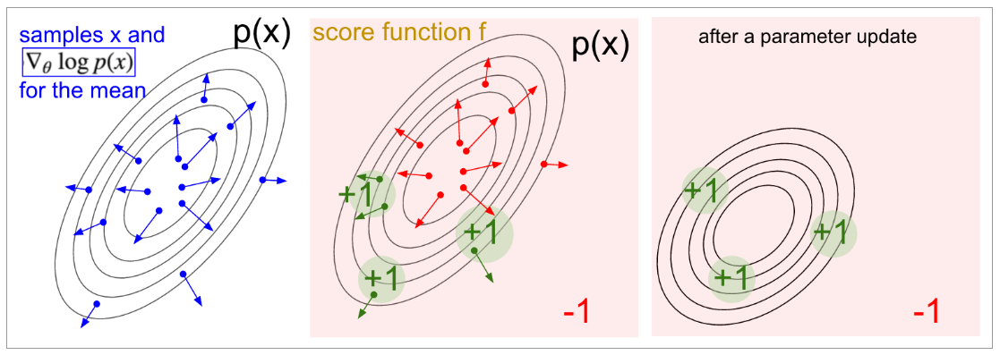
Score function Gradient Estimator

Slide 18
Good sources
Open AI https://spinningup.openai.com/en/latest/user/introduction.html
Go to book - http://incompleteideas.net/book/the-book-2nd.html
http://karpathy.github.io/2016/05/31/rl/

