Slide 1

PhD Summer School
Imbalance Data
Feature Extraction: PCA
Feature Selection: Fiter, Embedded & Wrapper Methods

Slide 2

Dealing with Imbalanced Data
Why?
Undersampling
random sampling
systematic sampling
stratified sampling
other approaches: kNN based, cluster based...
Oversampling
random naive oversampling
stratified over/under sampling
SMOTE, ADASYN
How?
Add weights, Undersampling, Oversampling, Mixed, Change y
100% | PostV+D | PostVoice
PostV+D | 11767 | 1685
PostVoice | 60 | 4373
RAND 25% | PostV+D | PostVoice
PostV+D | 2900 | 418
PostVoice | 13 | 1128
Des.Prc | PostV+D | PostVoice
PostV+D | 10% | 50%
PostVoice | 100% | 20%
STRAT 25% | PostV+D | PostVoice
Px`xostV+D | x`1186 | 848
PostVoice | 60 | 872

Slide 3
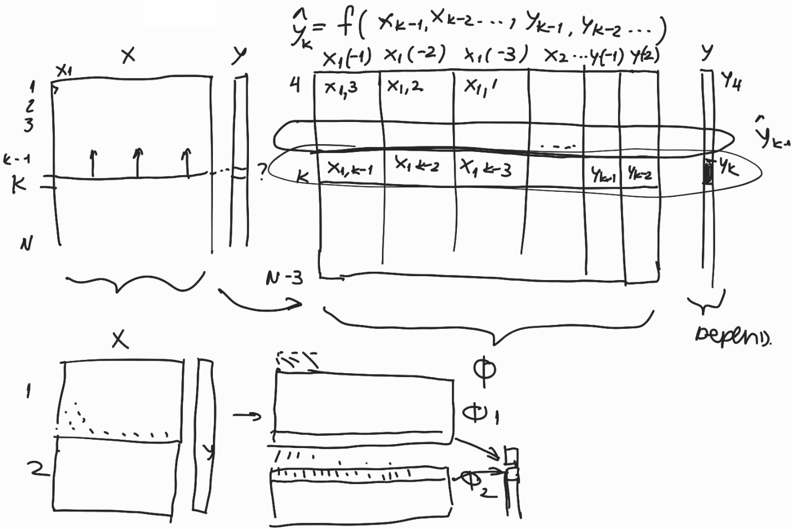
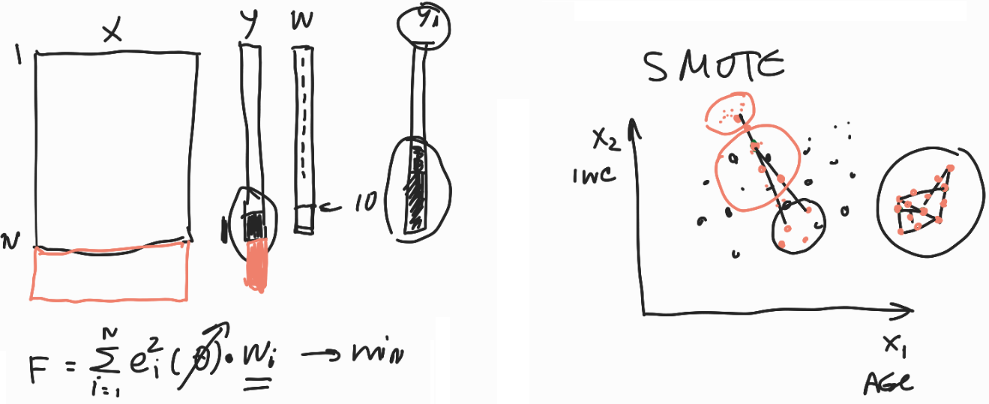
Dealing with Imbalanced Data
Oversampling - Example Merge time-series data sets

Slide 4
FE: PCA – Why, What & Idea
Why Principal Component Analysis (PCA)?
extract features
compress data
visualize data
reduce noise
avoid multicollinearity…
What is PCA?
Feature Extraction (FE) vs Feature Selection (FS)
Feature Extraction vs Feature Engineering
PCA vs Factor Analysis
Idea behind PCA
Generate new features named principal components (PC)
PC-s are linear combination of original features
PC-s are orthogonal (uncorrelated)
Select subset of PC-s & retain max data variability
Transform initial features into selected PC-s

Slide 5
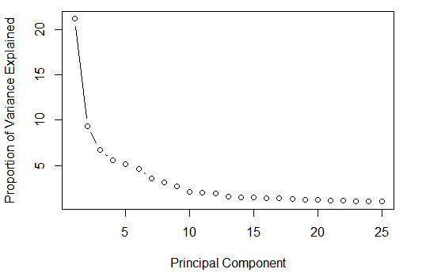
FE: PCA - Steps
Data Preparation
Standardize initial features (X → Xs)
Calculate Xs^{T} Xs, if needed
Calculate PC-s
Apply matrix decomposition to Xs or Xs^{T} Xs
- apply SVD to Xs → singular values & singular vectors
- apply EVD to Xs' Xs → eigenvalues & eigenvectors
Select PC-s
Select subset of PC-s based on singular values / eigenvalues
- Kaiser criterion (Latent Root)
- Scree rule
Apply to new data
Transform initial features into selected PS-s

Slide 6
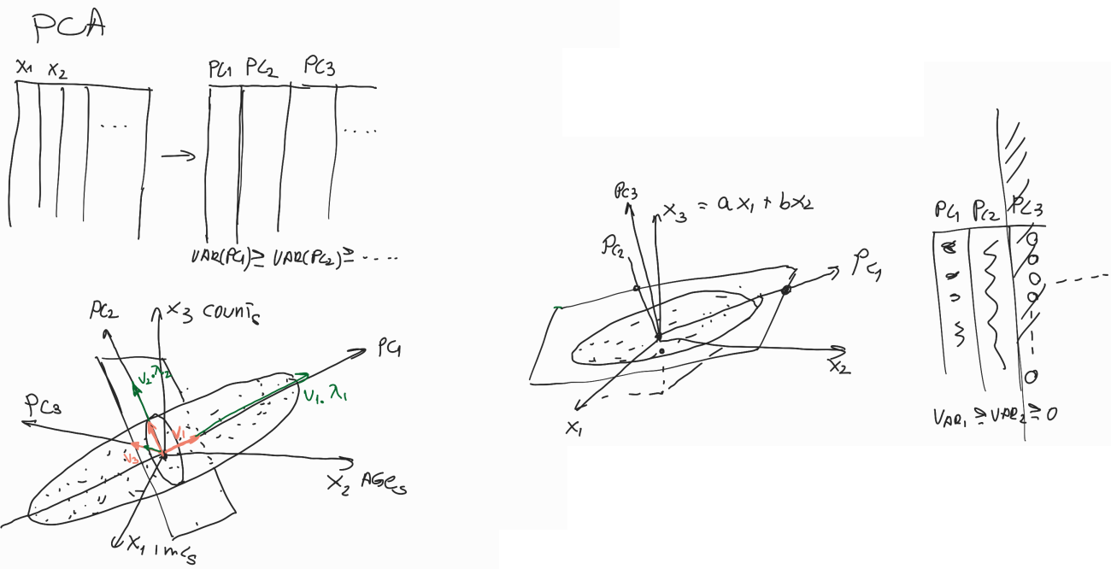
FE: PCA – Geometric Interpretation

Slide 7
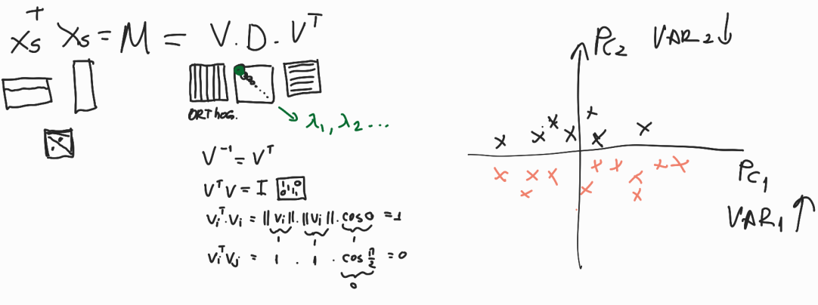
FE: PCA – Math Foundations

Slide 8
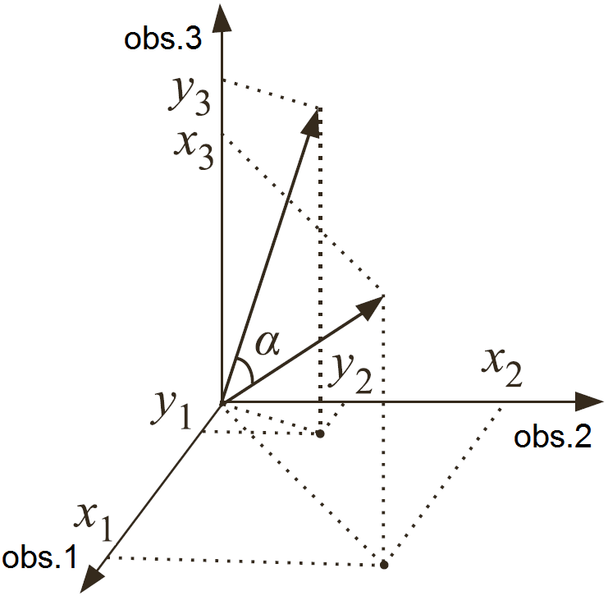
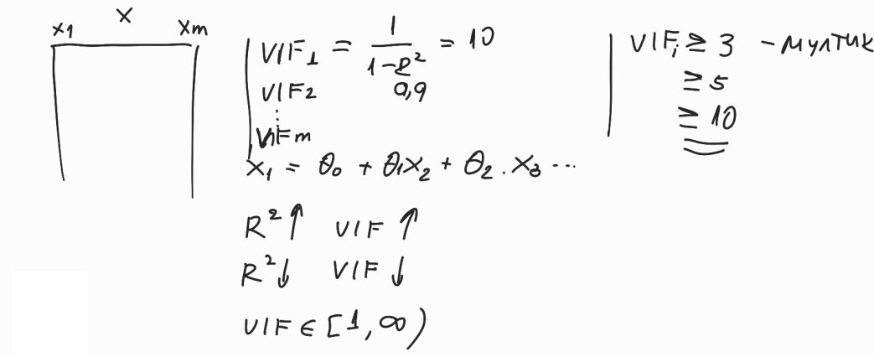
FS: Filter Methods
Approaches for feature selection
filter methods
embedded methods
wrapper methods
Filter Methods
univariate analysis
remove low-variability
too many Missings...
bivariate analysis
Pearson correlation coefficient
ρ_{xy} = x_{c}^{T} y_{c} / (||x_{c}||₂ ||y_{c}||₂) = cosα
Spearman's rank correlation coefficient
Kendall's tau
Pearson contingency coefficient
Tchouproff contingency coefficient
multivariate analysis
multicollinearity & correlation
Variance Inflation Factor (VIF)
 | y1 | y2 | ... | ymy | total
x1 | n11 | n12 | ... | n1my | n1.
x2 | n21 | n22 | ... | n2my | n2.
... | ... | ... | ... | ... | ...
xmx | nmx1 | nmx2 | ... | nmx my | nmx.
total | n.1 | n.2 | ... | n.my | N

Slide 9

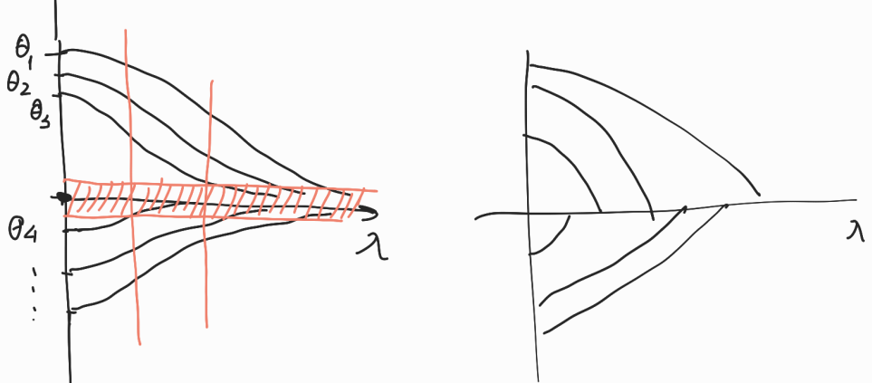
FS: Embedded Methods
Modifications of LS
Ordinary Least Squares
F(θ) = e^{T}e
θ = (Ф^{T}Ф)–1Ф^{T}y
Ridge Regression
F(θ) = e^{T}e + λθ^{T}θ
θ = (Ф^{T}Ф + λI)–1Ф^{T}y
LS & MAP
F(θ) = e^{T}e + λ(θ – θ_{a})^{T}(θ – θ_{a})
θ = (Ф^{T}Ф + λI)–1(Ф^{T}y + λθ_{a})
LASSO Regression
F(θ) = e^{T}e + λ ||θ||₁
Non-linear quadratic constraint optimization
Elastic Net
F(θ) = e^{T}e + λ(α||θ||₁ + (1 – α)||θ||₂)
EN – convex combination of Ridge & LASSO

Slide 10
FS: Wrapper Methods
Approaches for feature selection
filter methods
embedded methods
wrapper methods
Wrapper methods
all combinations of factors
forward regression
backward regression
stepwise regression
All combinations of factors
n – number of potential factors
c – number of models to be examined
c = 2^{n}– 1
Examples:
n = 2, c = 2³ – 1 = 7
{x1}, {x2}, {x3},
{x1, x2}, {x1, x3}, {x2, x3},
{x1, x2, x3}
n = 20, c ≈ 1.0485 x 10⁶
n = 50, c ≈ 1.1259 x 10¹⁵

Slide 11
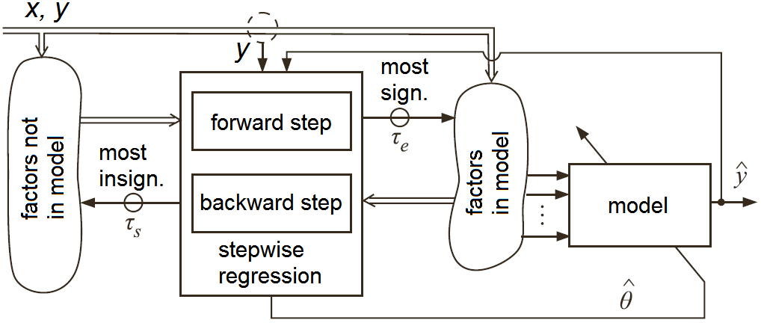
FS: Wrapper Methods
Forward regression
Backward regression
Stepwise regression
Examples:
F/B/SW Linear Regression
F/B/SW Logistic Regression
Efremov, A. Multivariable System Identification. Monograph, second edition, ISBN 978-954-9489-42-2, DAR-RH, Veliko Tarnovo

Slide 12
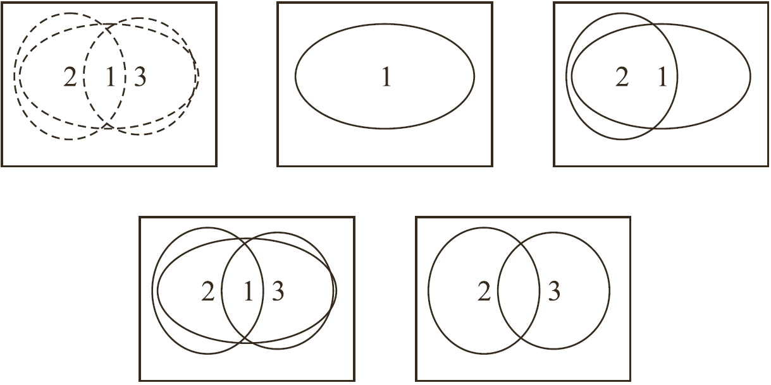
FS: Wrapper Methods
Forward regression
Backward regression
Stepwise regression
Examples:
F/B/SW Linear Regression
F/B/SW Logistic Regression
Efremov, A. Multivariable System Identification. Monograph, second edition, ISBN 978-954-9489-42-2, DAR-RH, Veliko Tarnovo

Slide 13

Thank You
Contacts:
Alexander Efremov, Ph.D., Eng.
aefremov@autegry.com
https://bg.linkedin.com/in/aefremov
Founder & CEO at AUTEGRY Ltd
www.autegry.com
Assoc. Prof. at Technical University of Sofia
www.tu-sofia.bg

